Slide 1
The Cast Operator
The cast operator converts explicitly from one data type of an expression to another. For example, if x is of type int, the value of the expression
  ( float ) x
is the original value of x converted to float. The type and value of x are unchanged.
If x = 3, then (float) x is 3.00000.

Slide 2
Cast, example
#include <stdio.h>
main()
{
int i, j;
float x, y, z;
i = 1;
j = 3;
x = i/j;
y = (float) i / j;
z = (float) i / (float) j;
printf("x=%f,\ny=%f,\n"
"z=%f.\n", x, y, z);
}
prints out:
x=0.000000,
y=0.333333,
z=0.333333.

Slide 3
Real World Applications: Summing a Series
Problem
  Write a program to sum the first n terms of the infinite series
  1/1² + 1/2² + 1/3² + 1/4² + …
Solution
We first prompt the user for the value n. We add the terms starting from the smallest. This improves the accuracy of the sum by ensuring that the values to be added are within the same range, so that we minimize the loss of significant digits due to rounding.

Slide 4
Sum up a series
#include <stdio.h>
main()
{
int i, n, resp;
float sum;
do {
printf(
"\nAgain (1 = yes, 0 = no)? ");
scanf("%d", &resp);
if (resp) {
printf("n = ? ");
scanf("%d", &n);
sum = 0.0;
for(i = n; i > 0; i--)
sum +=
1/((float) i * (float) i);
printf("Sum = %f\n", sum);
}
} while (resp);
}

Slide 5
Run the sum program
Compile with
  cc pg136.c
  a.out
Again (1 = yes, 0 = no)? 1
n = ? 10
Sum = 1.549768
Again (1 = yes, 0 = no)? 1
n = ? 1000
Sum = 1.643934
Again (1 = yes, 0 = no)? 1
n = ? 100000
Sum = 1.644924
Again (1 = yes, 0 = no)? 1
n = ? 1000000
Sum = 1.644933
Again (1 = yes, 0 = no)? 0
Expected answer for the infinite series is π²/6=1.644934067

Slide 6
The sizeof Operator
The sizeof operator gives the amount of storage required by an object. Sizeof is not a function.
Example:
  sizeof(char)
  sizeof('A')

Slide 7
Sizeof example
#include <stdio.h>
main()
{
printf("size of char is %d\n",
sizeof(char));
printf("size of int is %d\n",
sizeof(int));
printf("size of float is %d\n",
sizeof(float));
printf("size of double is %d\n",
sizeof(double));
}
You get the following print out:
size of char is 1
size of int is 4
size of float is 4
size of double is 8

Slide 8
getchar/putchar
The function getchar reads one character from the standard input, and the function putchar writes one charater to the standard output. The function getchar returns the character code or the value EOF when end of file is reached.
Examples:
  c = getchar();
  putchar(d);

Slide 9
getchar and putchar, example
#include <stdio.h>
main()
{
int c;
while( (c=getchar())
!= EOF)
putchar(c);
}
How to use this program?
  Use it to type a file like UNIX cat command by
  a.out < file
  Use it to copy files by
    a.out < file1 > file2

Slide 10
Bitwise Operator
~ Bitwise complement
& Bitwise AND
| Bitwise OR
^ Bitwise exclusive OR
<< Bitwise left shift
>> Bitwise right shift
Bitwise operators work on the binary bits. In particular, bitwise complement, AND, OR, exclusive OR operate on all the bits of a word independently.
0110 first number
1010 second number
Bitwise AND 0010 result of bitwise AND
That is 6 & 10 gets 2.

Slide 11
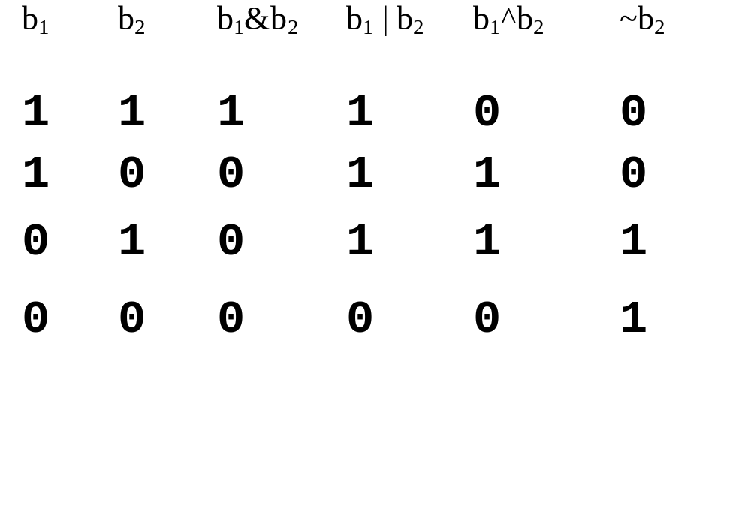
Bitwise Logical Operators
Let b₁ and b₂ be two bits at the same bit position in two words.
b₁
_{Word 1}
b₂
_{Word 2}
The operations are defined by this table:

Slide 12
Bitwise Operator, examples
#include <stdio.h>
main()
{
short int w1, w2;
w1 = 12;
w2 = -35;
printf("w1 = %d\n", w1);
printf("w2 = %d\n", w2);
printf("~w1 = %d\n", ~w1);
printf("~w2 = %d\n", ~w2);
printf("w1 & w2 = %d\n", w1 & w2);
printf("w1 & ~w2 = %d\n", w1 & ~w2);
printf("~w1 & ~w2 = %d\n", ~w1 & ~w2);
printf("w1 | w2 = %d\n", w1 | w2);
printf("~(w1 | w2) = %d\n", ~(w1 | w2));
printf("w1 ^ w2 = %d\n", w1 ^ w2);
}
This output is
w1 = 12
w2 = -35
~w1 = -13
~w2 = 34
w1 & w2 = 12
w1 & ~w2 = 0
~w1 & ~w2 = 34
w1 | w2 = -35
~(w1 | w2) = 34
w1 ^ w2 = -47

Slide 13
Bitwise Operation
w1 = 0000 0000 0000 1100
w2 = 1111 1111 1101 1101
~w2 = 0000 0000 0010 0010
0000 0000 0000 1100
& 1111 1111 1101 1101
0000 0000 0000 1100
| 1111 1111 1101 1101
0000 0000 0000 1100
^ 1111 1111 1101 1101
_{AND}
_{OR}
_{Exclusive OR}

Slide 14
Shift Operators
w << n
shift the bit pattern as a whole to the left n bits. Fill the shift-in bits with 0.
w >> n
shift the bit pattern to the right n bits. Fill with zero for positive number. (0 or 1 for negative number).
if
w = 1111 0001 0000 1111
w << 2 becomes
1100 0100 0011 1100

Slide 15
Bit Operation, Examples
#include <stdio.h>
main()
{
int x = 'A';
int y = 2;
short i, j;
printf("%d\n", x >> y);
i = 0x7A4E;
j = ((i>>8) & 0x00FF) | (i<<8);
printf("%X\n", j);
}
x = 'A' = 65₁₀ = 0…001000001₂
x >>2 = 0…000010000₂=16₁₀
i>>8 = 0x007A
(i>>8) & 0x00FF = 0x007A
i<<8 = 0x4E00
j = 0x007A | 0x4E00 = 0x4E7A

Slide 16
What is printed?
#include <stdio.h>
main()
{
int i, j, k;
i = 1; j = 0; k = 3;
1 printf("%d, ", k<<i);
2 printf("%d, ", !j);
3 printf("%d, ", ~j);
4 printf("%d, ", i & k);
5 printf("%d, ", i && k);
6 printf("%d, ", i ^ j);
7 printf("%d, ", i | k);
8 printf("%d, ", i || k);
printf("\n");
}
6, 1, -1, 1, 1, 1, 3, 1,

Slide 17
Reading/Home Working
Read Chapter 4, page 134 to 148.
Work on Problems
  Section 4.9, page 138, exercise 1, 3, 5.
  Section 4.10, page 142, exercise 1.
  Section 4.1, page 148, exercise 1, 3.
Check your answers in the back of the textbook. Do not hand in.

