Slide 1
An introduction to neural network and machine learning

Slide 2
Machine learning/neural network in physics research
“Identifying quantum phase transitions using artificial neural network on experimental data,” arxiv:1809.05519, B. S. Rem, et al.
“Galaxy Zoo: reproducing galaxy morphologies via machine learning,” M. Banerji, et al, Monthly Notices …, 406, 342, (2010).
“Prediction of thermal boundary resistance by the machine learning method,” T Zhan, et al, Sci Rep 7, 7109 (2017).
“Searching for exotic particles in high-energy physics with deep learning,” P. Baldi, et al, Nature Comm 5, 4308 (2014).

Slide 3
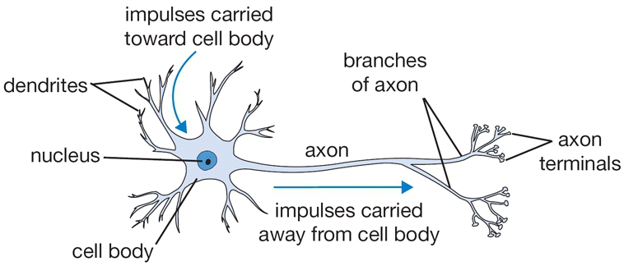
Biological neuron
Notes:
Picture from http://cs231n.github.io/neural-networks-1/

Slide 4
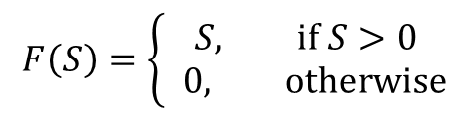
A “mathematical” neuron
x₁
w₁
x₂
w₂
output
input
…
F(.)
y
w_{N}
x_{N}
F (ReLU)
S
Notes:
The function F is called activation, and the particular form F=0 if S < 0 and F=S is called rectified linear unit or reLU.

Slide 5
(feedforward) Neural network
Y₁
X (input layer)
Y₂
x₁
Y (output layer)
x₂
x₃

Slide 6
Supervised “learning”
Determine the W^{(i)} and b^{(i)} with a training set of inputs {x} to minimize the predicted differences.
Least square errors: we minimize (y^{(j)} is the output of j-th sample and d^{(j)} is expected value):

Slide 7

Classification problems
Hand written digits in 28x28 grey-scale pixels
With 10 output neutrons answering the question: is it 0? is it 1? …, is it 9?
60000 for a training set, 10000 examples for testing set.
Notes:
From MNIST dataset.

Slide 8
Network
x₁
y₀
x₂
y₁
The input “2” is a 28x28 bitmap of 0< x_{i} <1 of 784 numbers.
…
…
…
x₇₈₄
y₉
The predicted digit is j such that y_{j} is a maximum, i.e., y gives a score for each of the 10 possibilities. The last step does not apply the F function.

Slide 9
Hinge loss function
Example: Given an image for 2, the 10 outputs (scores), let’s say, are 10, 2, 8, …, 13 for j = 0, 1, .., 9. Clearly, j = 2 should be the correct answer. Let take Δ=1. Then the loss is max(0, 10-8+1) + max(0,2-8+1) + … + max(0,13-8+1) = 3 + 6 = 9. {Incorrect scores get a large penalty}
The learning algorithm tries to minimize total L summed over each sample i with a “regularization” term:
Superscript n denotes the layer number of the network.
Notes:
Lambda is called super-parameter and is not changed.

Slide 10
Softmax or cross-entropy loss
Softmax method for judging the correctness of result is given by the following formula for the i-th sample. We can interpret P_{j} as a probability of having value j.
Notes:
This is essentially the principle of maximum entropy in physics. We recall the Boltzmann distribution function.

Slide 11
Update the network
The steepest descent or (stochastic) gradient descent
Where is the “stochastic” part?
W
Notes:
To evaluate the gradient efficiently we use something called back propagation on the network.

Slide 12
Back Propagation
Suppose we like to compute the derivative of Y with respect to W⁽¹⁾. We do this by the chain rule of calculus. This can be computed efficiently from the output layers down to starting layer.
Notes:
Since Y are vectors, the partial derivatives are Jacobians.

Slide 13
The gradient
Notes:
Here we have assumed one layer only, n=1, and omitted the superscript in.

Slide 14
Preventing under-fit and over-fit by adjust λ
Notes:
From “Deep learning”, Goodfellow, et al, page 119.

Slide 15
Convolutional network
Convolutional networks are simply neural networks that use convolution in place of general matrix multiplication (Wx) in at least one of their layers.
Pooling: replace the results by some static
Notes:
From Figure 9.8 in Goodfellow, et al, page 358.

Slide 16
Convolution
Convolution in math sense
x₁
x₂
x₃
Each neuron is connected to only three inputs based on locality. Three weights w₁, w₂, w₃ are the same on all of the neurons.
…
x₇₈₄

Slide 17
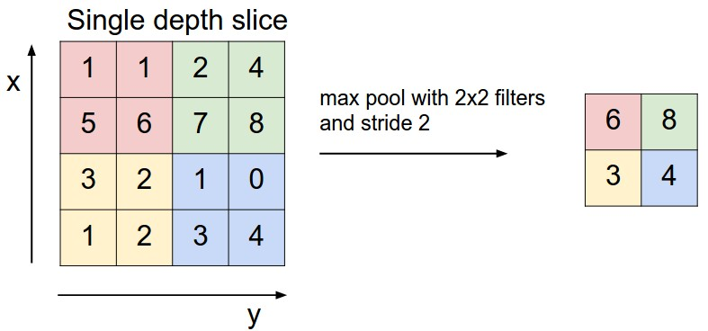
Max Pool
This is very much like the real space RG transform in physics.
Notes:
From http://cs231n.github.io/convolutional-networks/

Slide 18
Other Topics not covered
Recurrent network
Boltzmann Machine/statistical mechanics
etc

Slide 19
Tensorflow
TensorFlow is an open source software library from google for high performance numerical computation.
an open-source machine learning library for research and production.
In Python, C++, javaScript

Slide 20
Example codes
import tensorflow as tf
mnist = tf.keras.datasets.mnist
(x_train, y_train),(x_test, y_test) = mnist.load_data()
x_train, x_test = x_train / 255.0, x_test / 255.0
model = tf.keras.models.Sequential([
tf.keras.layers.Flatten(),
tf.keras.layers.Dense(512, activation=tf.nn.relu),
tf.keras.layers.Dropout(0.2),
tf.keras.layers.Dense(10, activation=tf.nn.softmax)
])
model.compile(optimizer='adam',
loss='sparse_categorical_crossentropy',
metrics=['accuracy'])
model.fit(x_train, y_train, epochs=5)
model.evaluate(x_test, y_test)

Slide 21
Research Project
Can we use a convolutional neutral network to determine the critical temperatureT_{c} accurately? When the network is trained with only low (ferromagnetic phase) and high temperature (paramagnetic phase) spin configurations for the two-dimensional Ising model.

Slide 22
References
Stanford Univ CS231n “Convolutional Neural Networks for Visual Recognition,” http://cs231n.github.io/
“Deep Learning”, Goodfellow, Bengio, and Courville, MIT press (2016).
“Neural Networks”, Haykin, 3rd ed, Pearson (2008).

