Slide 1
GEK1536
Computation & Machine, Ancient to Modern

Slide 2
Computation & Machine: Ancient to Modern
GEK1536
By Prof Wang Jian-Sheng
cscwjs@nus.edu.sg
Department of Physics
Notes:
Email address will change to phywjs.

Slide 3
Course Information
Course Website http://web.cz3.nus.edu.sg/~wangjs/GEM/gem.html (see also IVLE)
Class Schedule
Lectures (LT26): Wed 4:00-6:00pm
Tutorials (S16 #03-03): once every week, slots: Mon 9-10, Tue 9-10, Wed 10-11, 11-12, Thu 2-3, 3-4, Fri 12-1, 1-2.
Download your tutorial problem set at least one week ahead of time.
Notes:
There is also another venue to tutorials.

Slide 4
Assessment
40% final (closed book)
40% tutorial/homework (once every week)
20% Midterm (1 hour on week 8)

Slide 5
Aim, Objective, Syllabus
Numbers and their representations
Historic perspective of computation
Primitive computing tools (abacus, sliding rule, etc)
Development of digital computer and machine language
Future computing machines

Slide 6
Outline of Topics
Oh, So Mysterious Egyptian Mathematics
Mesopotamia Here We Come
These Incredible Greeks
Counting Boards
Quest of π
Babbage and his Computing Engine
Turing Machines
Zeros and Ones
The Digital Age
Machine Instructions & Computer Languages
Quantum Computing

Slide 7
Reference Books
“The Saga of Mathematics, A brief history”, Lewinter & Widulski (Prentice Hall, 2002)
“From One to Zero, a universal history of numbers”, Ifrah (Viking, 1985)
“Computing before Computers”, Aspray (Iowa State, 1990)

Slide 8
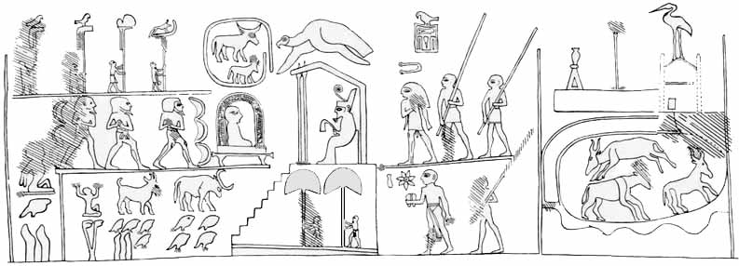
Egyptian Mathematics
The knob of King Narmer’s club, circa 3000 BC.
Notes:
Narmer started first dynasty of Egypt. This picture depicted victory of Narmer’s war over upper Egypt. Knob [nob]
Left: 120,000 slaves. Mid-left: 1,422,000 goats, 400,000 oxen.
The hieroglyphic numbers are also have religious/mythological meaning: The largest numeral on the mace is the hieroglyph for the million, a kneeling “Heh”-god with his sky-supporting arms lifted up. This picture represented the gods involved in the early steps of creation. This sign can therefore be read here as an expression of the new creation that the festival sought to assure for the king and his country, and of the support expected for these from the gods. Next comes the tadpole for the 100,000 quantity. This was the sign for birth, fertility, and proliferation. The four fingers that stood for 10,000 each may allude to the king’s command over the four quarters of the world since the finger was a symbol of command, and four was an expression of totality, as in the four cardinal directions. Moreover, these four fingers were arranged in two upright pairs, with one such pair on either side of the double lotus numeral for 1,000 + 1000 between them. Two upright fingers were in Egyptian hieroglyphics the determinative for “accurate, precise” and so could refer here to the number- juggling in the "booty list", or else to the precise execution of the Heb-Sed rituals. The stems of the two “1000” lotus plants between those protecting finger pairs are here united on the same root, instead of remaining separate as usual. This could illustrate the union of the couple, and also of the “Two Lands” of Upper and Lower Egypt which the king had united under his rule. The lotus was another symbol of rebirth and regeneration, probably because it evoked the image of the sun rising over the inundated Delta where lotus covered the water to the horizon and so seemed to bring forth the sun.
See this site for more information: http://www.recoveredscience.com/const121Narmermacepicture.htm

Slide 9
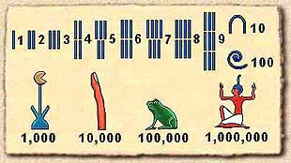
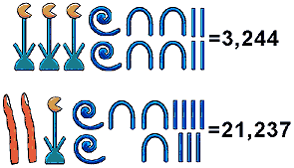
Egyptian Numerals
Egyptian number system is additive.

Slide 10
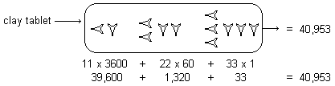
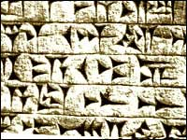
Mesopotamia Civilization
Above: Babylonian sexagesimal (base 60) number. It is the first positional number system.
Left: Oldest cuneiform writing by Sumerian.
Notes:
Cunneiform [‘kjuniifom] Sumerian [sumirean]

Slide 11
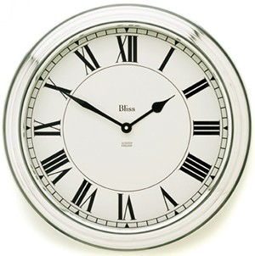
Roman Numerals
I 1
II 2
III 3
IV 4
V 5
VI 6
VII 7
VIII 8
IX 9
X 10
L 50
C 100
D 500
M 1000
MMMDCCCLXXVIII 3878

Slide 12
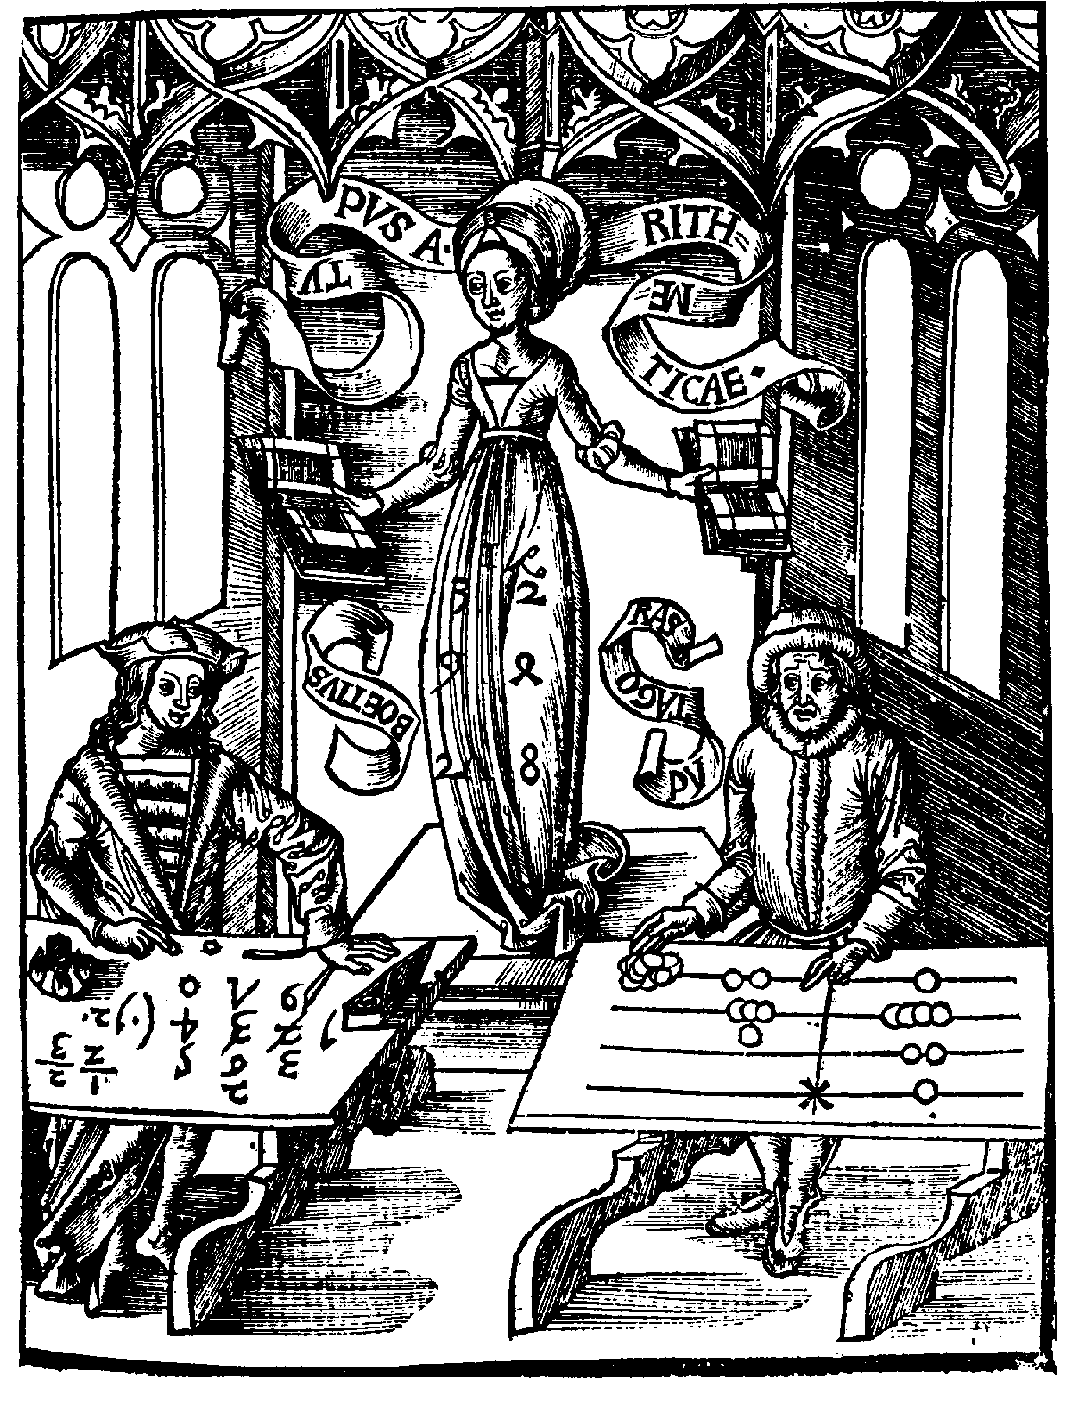
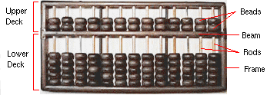
Abaci
Chinese Abacus
Boethius (Hindu-Arabic) vs Pythagoras (counting board)

Slide 13
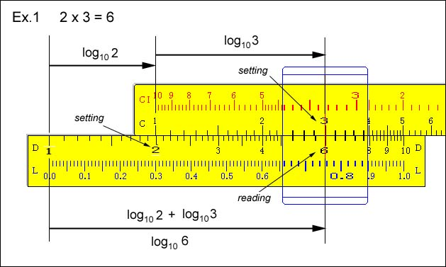
Logarithm and Slide Rule
John Napier of Scotland developed the concept of logarithm around AD 1600.
Slide rule based on the property of logarithm was invented in the late 1700s.
If a^{y}=x, then y = log_{a}x
log (u v) = log (u) + log(v)
Notes:
Slide rule page http://www.ies.co.jp/math/java/misc/slide_rule/slide_rule.html

Slide 14
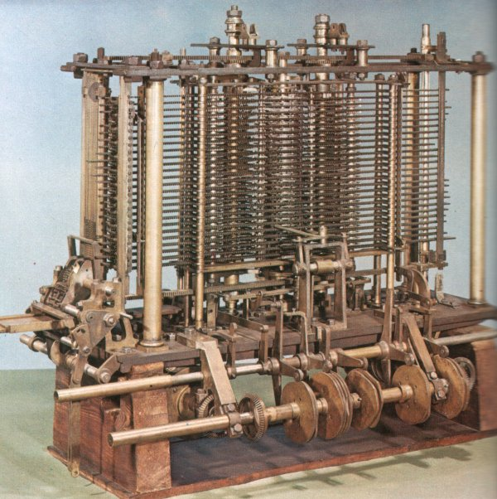
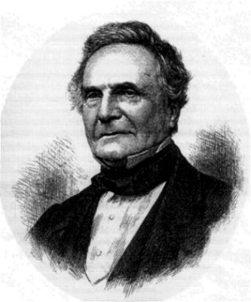
Charles Babbage
Difference Engine, around year 1871. A machine that can calculate a table of quadratic functions such as T(x)=x²+x+41.

Slide 15
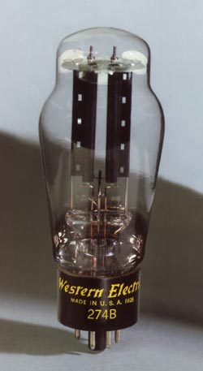
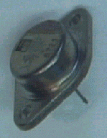
Vacuum Tubes & Transistors
Earliest generation digital computers are made of vacuum tubes. Transistors are invented in the late 1940s.

Slide 16
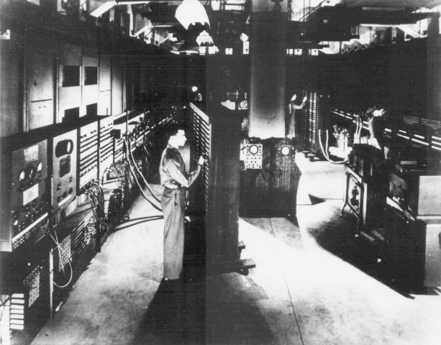
Start of Digital Computer, the ENIAC
Built in 1943-45 at the Moore School of the University of Pennsylvania for the War effort by John Mauchly and J. Presper Eckert, but not delivered to the Army until just after the end of the war, the Electronic Numerical Integrator And Computer (ENIAC) was the first general-purpose electronic digital computer.
Notes:
Physically, ENIAC was a monster—it contained 17,468 vacuum tubes, 7,200 crystal diodes, 1,500 relays, 70,000 resistors, 10,000 capacitors and around 5 million hand-soldered joints. It weighed 30 short tons (27 t), was roughly 2.4 m by 0.9 m by 30 m, took up 167 m² and consumed 160 kW of power. Input was possible from an IBM card reader, while an IBM card punch was used for output. It can add few thousand of numbers in a second, or few hundred multiplications for a 10 digit number.

Slide 17
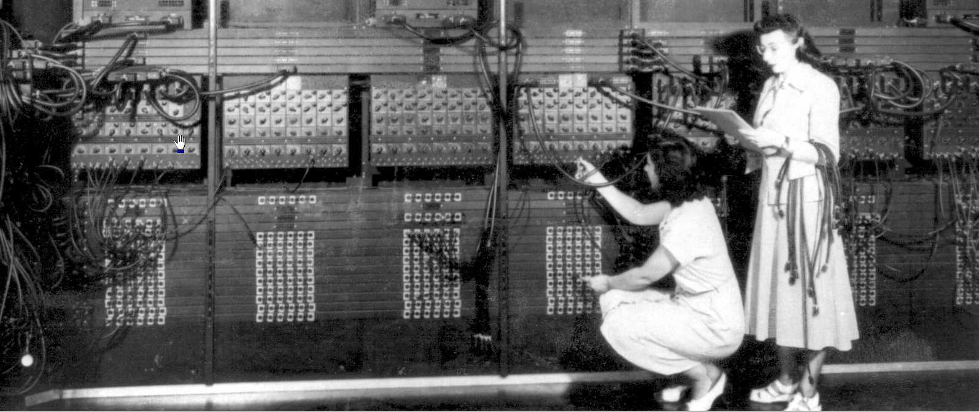
Programming the Computer
Programming the ENIAC is by wiring the cables and flipping the switches.

Slide 18
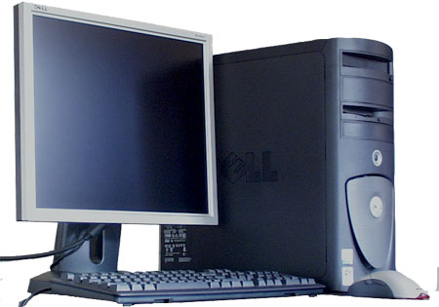
Modern Computer and Programming
#include <stdio.h>
main()
{
int a, b, c;
printf(“Hello\n”);
a=1; b = 2;
c = a + b;
printf(“c=%d”, c);
return;
}
A modern Pentium PC from Dell.

Slide 19
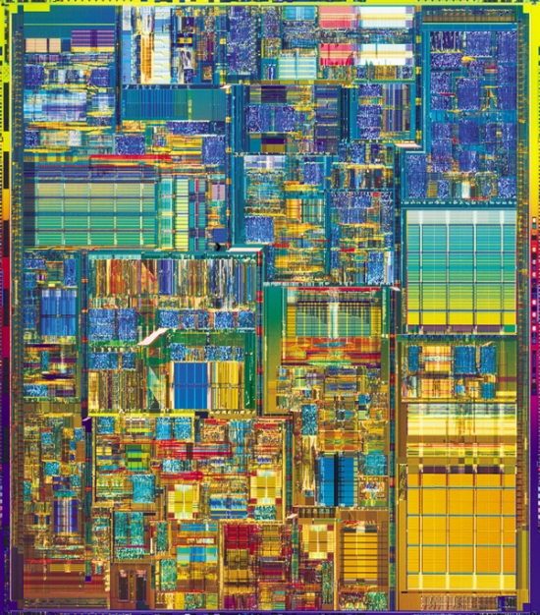
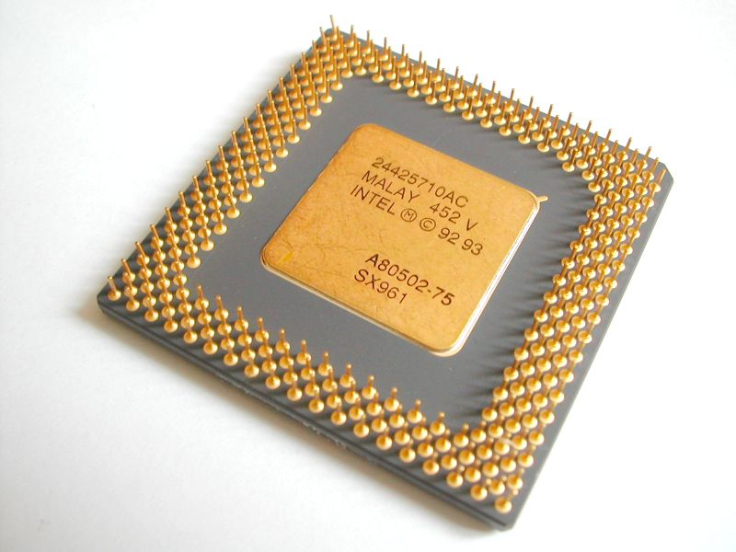
Computer Architecture
A Pentium 4 CPU
add $8, $9, $10

Slide 20
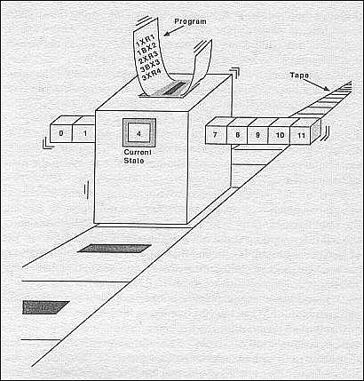
Turing Machine
A Turing Machine includes a head moving on a tape, an internal state, and instructions. Any computer can be made to be equivalent to a Turing machine.
Notes:
Turing machine is a concept, not a real machine. It is used for the theoretical analysis of computation.

Slide 21
Binary Number System for Digital Computer
0000 0000 0 0100 0001 A
0000 0001 1 0100 0010 B
0000 0010 2 0100 0011 C
0000 0011 3 0100 0100 D
0000 0100 4 0100 0101 E
0000 0101 5 0100 0110 F
0000 0110 6 0100 0111 G
0000 0111 7 0100 1000 H
0000 1000 8 0100 1001 I
0011 1110 1000 0000 0000 0000 0000 0000 0.25
character
integer
float-point number

Slide 22
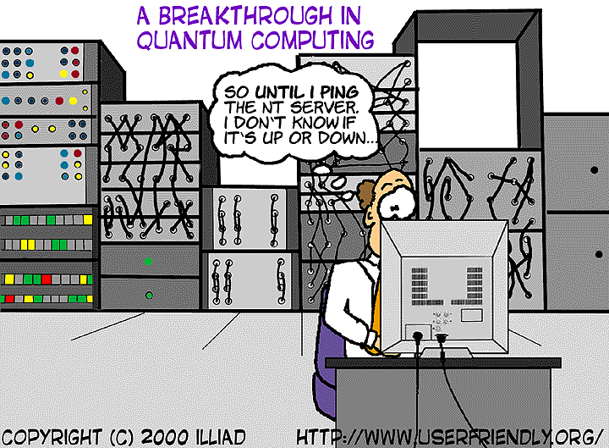
Quantum Computing

Slide 23
Reminder
Load your lecture notes at course website (http://web.cz3.nus.edu.sg/~wangjs/GEM/gem.html)
Sign up for your tutorials (Starting Friday)
Print your tutorial sheets

