Slide 1
Oh, So Mysterious Egyptian Mathematics!
Lecture One

Slide 2
Outline
Where did numbers come from?
Counting
Base of a number system
Egyptian numerals
Calculation with Egyptian numbers
Achievement of Egyptian Mathematics

Slide 3
Timeline of Earth’s History
13 billion years ago
Big Bang
4 billion years ago
Earth form
2 billion years ago
Primitive life
250-65 million years ago
Dinosaur
1.5 million years ago
Homo erectus
0.25 million years ago
Homo sapiens
3000 B.C.
Mesopotamia and Egyptian Civilizations
Notes:
1 million = 1,000,000; 1 billion = 1000 million.

Slide 4
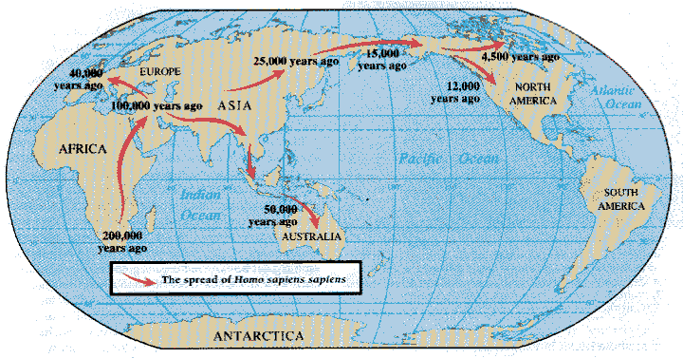
Early Human
Notes:
Homo [houmou] : man, sapien [sæpiən]: wise. Homo sapiens sapiens stands for wise, wise man.

Slide 5
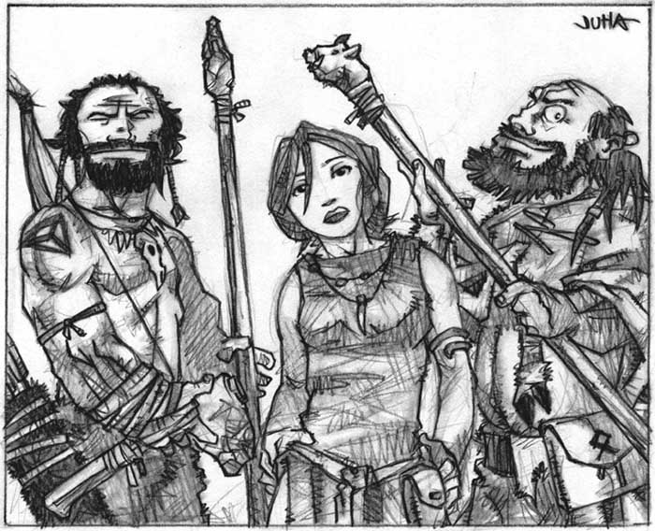
One, Two, Many
It is often said that early primitive people can only count to two – one, two, many.
Notes:
Picture from http://elfwood.lysator.liu.se/loth/j/u/juhaharju/mralothi.jpg.html
Although they may count to two, they still have a very good sense of large or small. There are two aspects to numbers, cardinal (size, one, two, three, four, …) and ordinal (sequence, first, second, third, etc).

Slide 6
Where did numbers come from?
Thimshian language of a group of British Columbia Indians has seven distinct sets of words for numbers: one for use when counting flat objects and animals, one for round objects and time, one for people, one for long objects and trees, one for canoes, one for measures, and one for counting when no particular object is being numerated.
Notes:
De-associate number from concrete objects is the first step in sharp the concept of numbers. See T. Dantzig, “Number, the Language of Science”, The Free Press, New York 1967, p.6.

Slide 7
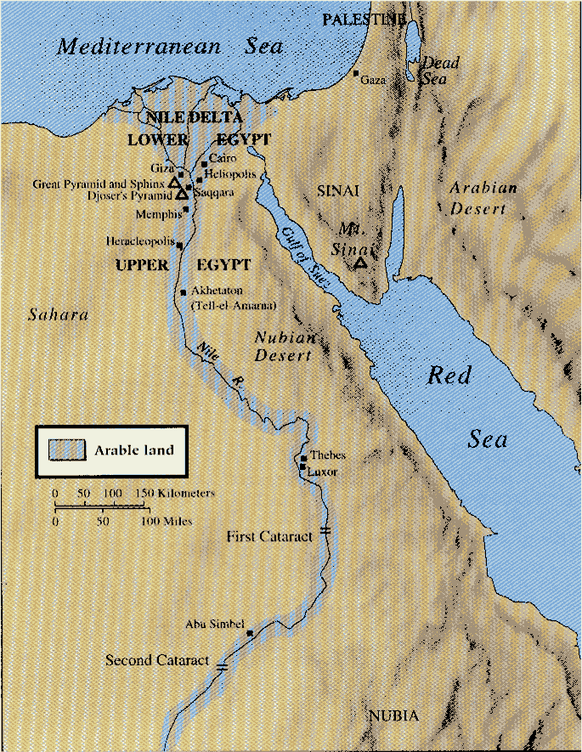
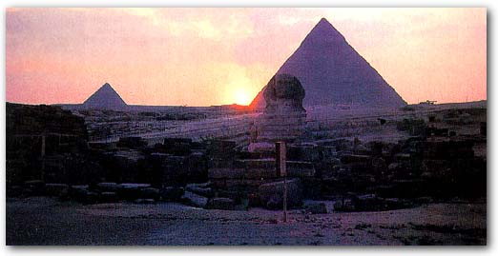
Egypt
Egyptian civilization begins more than 5000 years ago, with their largest pyramids built around 2500 B.C.

Slide 8
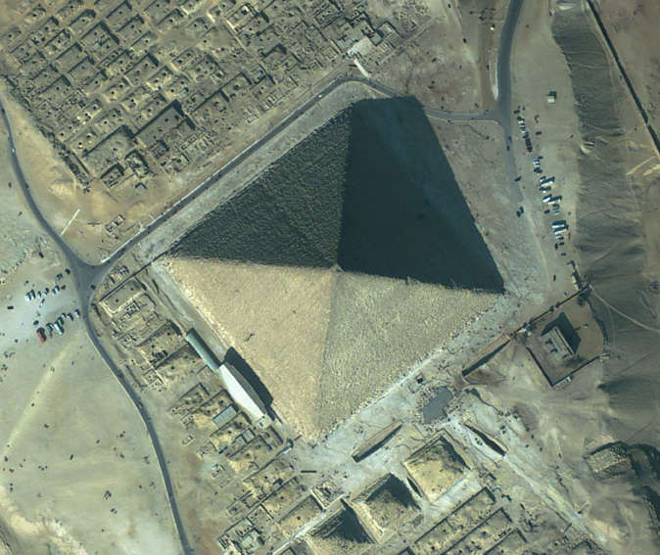
Pyramid from Space
Notes:
The great pyramid is located near Giza. It was built by the Egyptian pharaoh Khufu around 2560 BC over a period of 20 years. When it was built, the Great pyramid was 146m. Over the years, it lost for 10 m off the top. It is the tallest structure on Earth for 4300 years. The base line is 229 m in length. It is a square to within 0.1% accuracy.

Slide 9
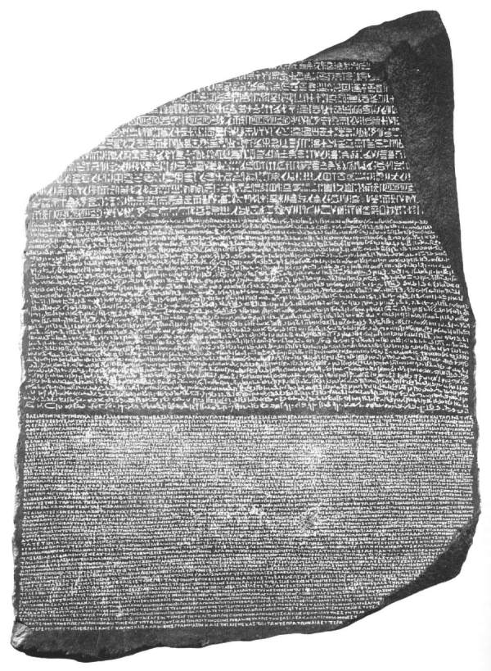
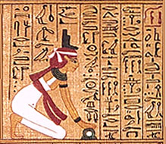
Rosetta Stone & Egyptian Language
Notes:
The name Rosetta refers to the crucial breakthrough in the research regarding Egyptian hieroglyphs. It especially represents the "translation" of "silent" symbols into a living language, which is necessary in order to make the whole content of information of these symbols accessible.
The name Rosetta is attached to the stone of Rosette. This is a compact basalt slab (114x72x28 cm) that was found in July 1799 in the small Egyptian village Rosette (Raschid), which is located in the western delta of the Nile. Today the stone is kept at the British Museum in London. It contains three inscriptions that represent a single text in three different variants of script, a decree of the priests of Memphis in honour of Ptolemaios V. (196 b.c.).
The text appears in form of hieroglyphs (script of the official and religious texts), of Demotic (everyday Egyptian script), and in Greek. The representation of a single text of the three mentioned script variants enabled the French scholar Jean Francois Champollion (1790-1832) in 1822 to basically decipher the hieroglyphs. Furthermore, with the aid of the Coptic language (language of the Christian descendants of the ancient Egyptians), he succeeded to realize the phonetic value of the hieroglyphs. This proved the fact that hieroglyphs do not have only symbolic meaning, but that they also served as a "spoken language".

Slide 10
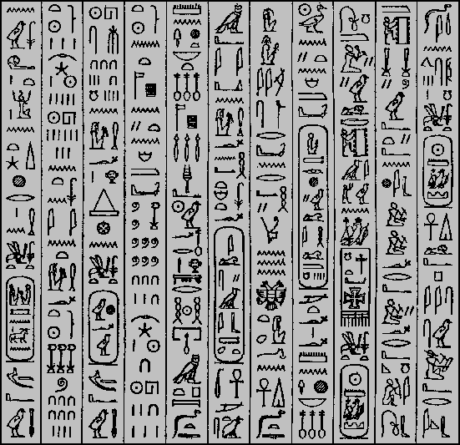
Egyptian Hieroglyphs
Thus speak the servants of the King, whose name is The Sun and Rock of Prussia, Lepsius the scribe, Erbkam the architect, the Brothers Weidenbach the painters, Frey the painter, Franke the molder, Bonomi the sculptor, Wild the architect: All hail to the Eagle, The Protector of the Cross, to the King, The Sun and Rock of Prussia, to the Sun of the Sun, who freed his native country, Friedrich Wilhelm the Fourth, the Loving Father, the Father of his Country, the Gracious One, the Favorite of Wisdom and History, the Guardian of the Rhine, whom Germany has chosen, the Dispenser of Life. May the Most high God grant the King and his wife, the Queen Elizabeth, the Rich in Life, the Loving Mother, the Mother of the Country, the Gracious One, an ever vibrant and long life on earth and a blessed place in heaven for eternity. In the year of our Savior, 1842, in the tenth month, on the fifteenth day, on the forty-seventh birthday of his Majesty, on the Pyramid of King Cheops; in the third year, in the fifth month, on the ninth day of the reign of his Majesty; in the year 3164 from the commencement of the Sothis period under the King Menepthes.
Notes:
This is the hieroglyphic inscription above the Great Pyramid’s entrance. From http://www.catchpenny.org/gpglyph.html
Egyptian written language evolved in three stages, hieroglyphs, hieratic, and coptic (spoken only?).

Slide 11
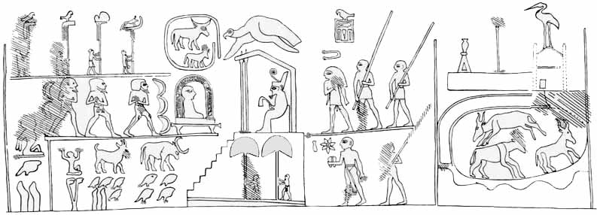
Egyptian Numbers
The knob of King Narmer’s club, circa 3000 BC.
Notes:
The mace head recorded victory of the first King of Egypt. The numerals occupy the center of the lower register. Four tadpoles below the ox, each meaning 100,000, record 400,000 oxen. The sky- lifting Heh- god behind the goat was the hieroglyph for "one million"; together with the four tadpoles and the two "10,000" fingers below the goat, and the double "1,000" lotus- stalk below the god, this makes 1,422,000 goats. To the right of these animal quantities, one tadpole and two fingers below the captive with his arms tied behind his back count 120,000 prisoners. These quantities makes Narmer's mace the earliest surviving document with numbers from Egypt, and the earliest surviving document with such large numbers from anywhere on the planet.

Slide 12
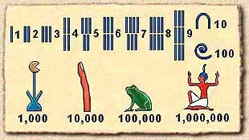
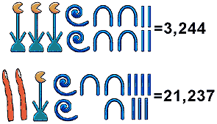
Egyptian Numerals
Egyptian number system is additive.
Notes:
Additive means that the order of these symbols does not matter.

Slide 13
Base of a Number System
Count in group of ten (base 10) is very common in many cultures
Base 20, 6, 12, even 60 are also used
Modern computer system uses base 2

Slide 14
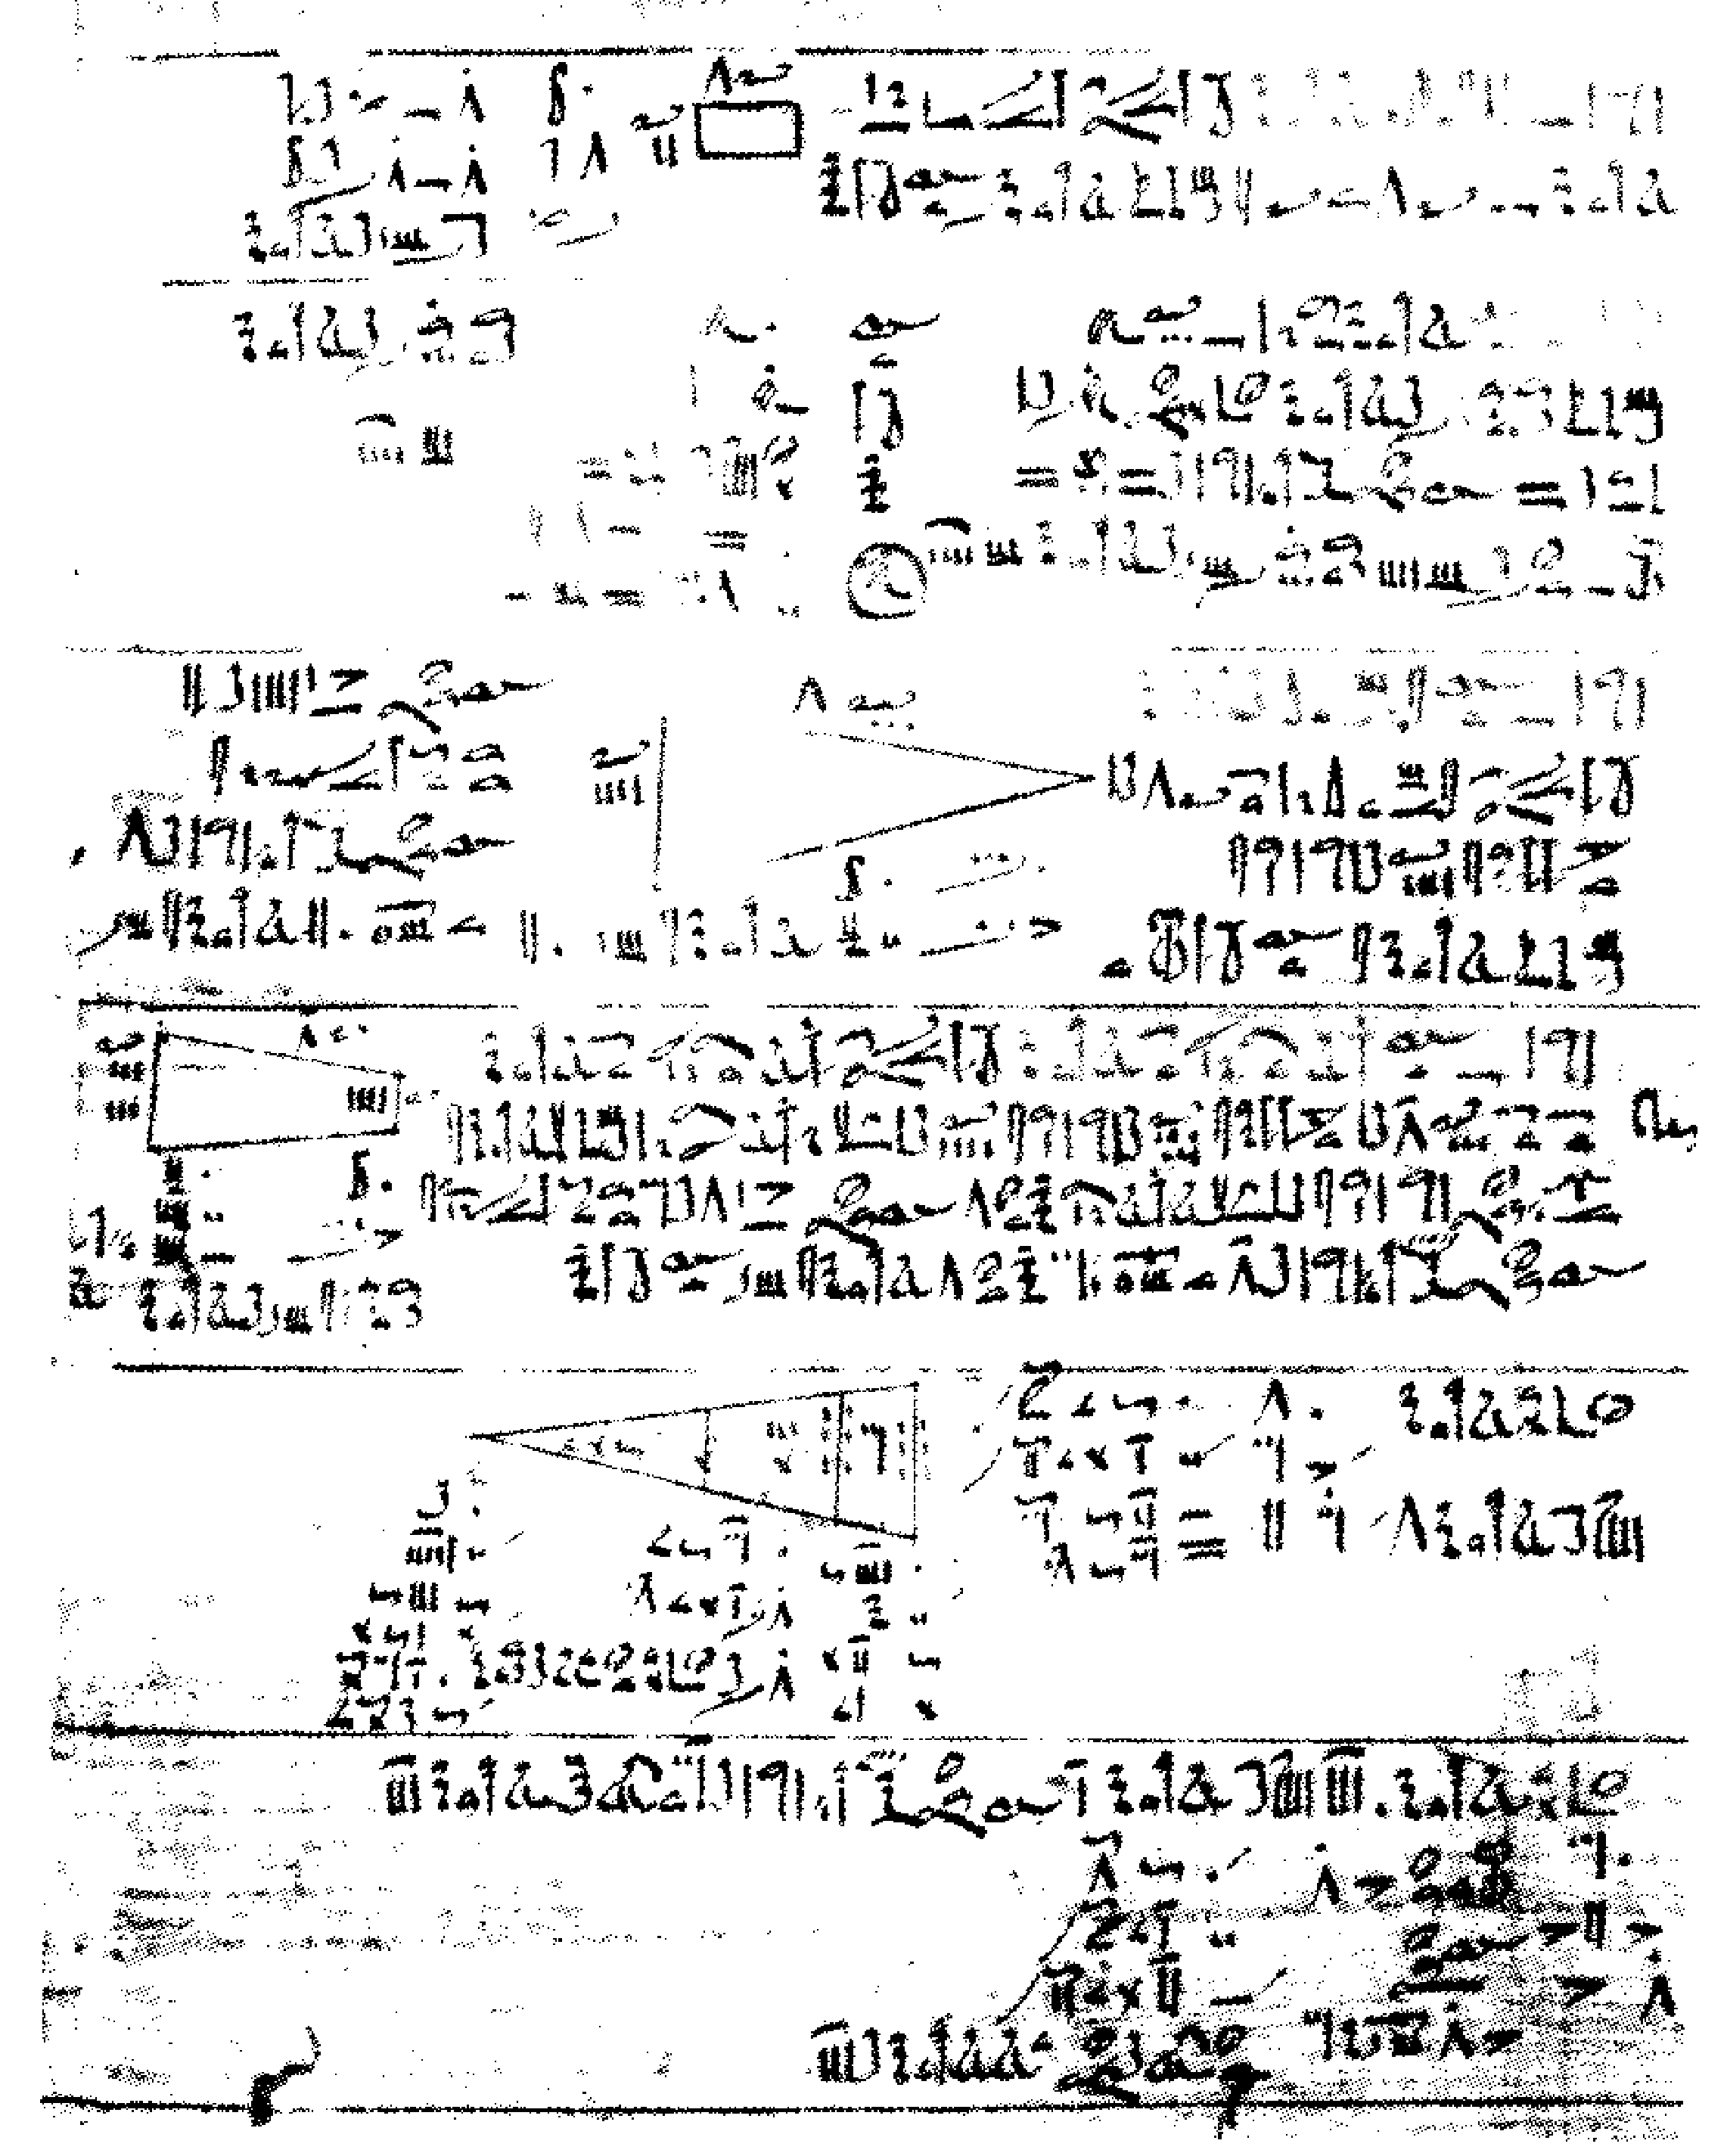
Rhind Papyrus
Part of the Rhind papyrus written in hieratic script about 1650 B.C. It is currently in the British Museum. It started with a premise of “a thorough study of all things, insight into all that exists, knowledge of all obscure secrets.” It turns out that the script contains method of multiply and divide, including handling of fractions, together with 85 problems and their solutions.
Notes:
Papyrus [pə’paiərəs]: paper made from the papyrus plant by cutting it in strips and pressing it flat; used by ancient Egyptians and Greeks and Romans. Tall sedge of the Nile valley yielding fiber that served many purposes in historic times. Rhind Papyrus perhaps is the oldest math text ever existed.

Slide 15
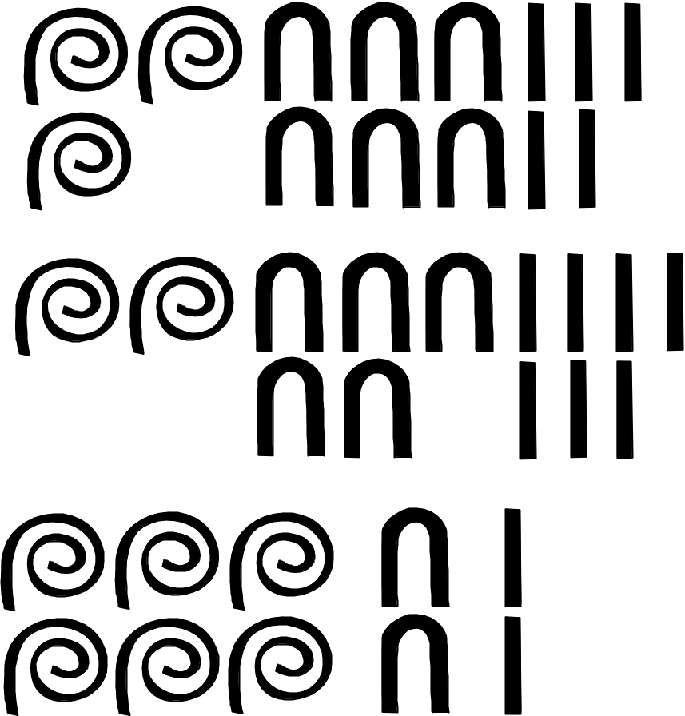
Addition in Egyptian Numerals
365
+ 257
= 622
Notes:
To this day, it is not entirely clear how the Egyptians performed addition and subtractions.

Slide 16
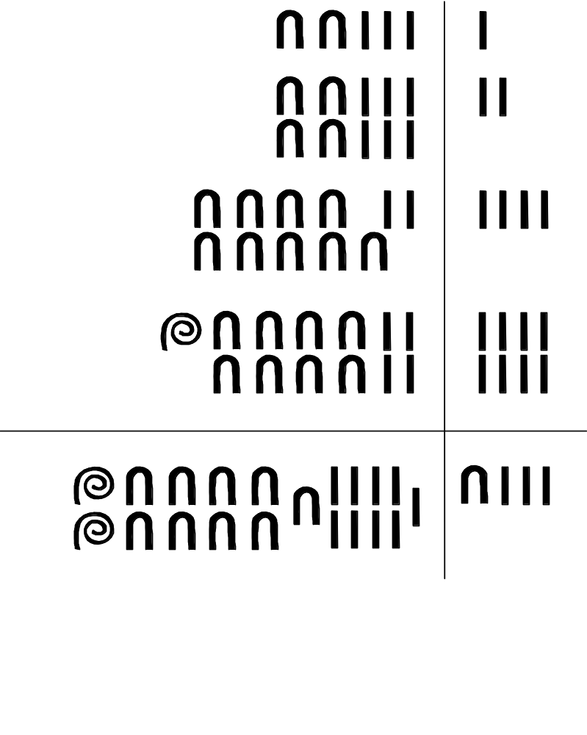
Multiply 23 х 13
multiplicand
23 √
46
92 √
184 √
1 √
2
4 √
8 √
1 + 4 + 8 = 13
23+92+184 = 299
result
multiplier 13
Notes:
A check means that this number will be counted to add up the desired multiplier or results. If we rotate 90 degree of the above figure, and use 1 for the check, and 0 for the non-check, we get a binary number represent of the number 13. “Eureka”, the Egyptians could have discovered binary numbers.

Slide 17
Principles of Egyptian Multiplication
Starting with a doubling of numbers from one, 1, 2, 4, 8, 16, 32, 64, 128, etc, any integer can be written uniquely as a sum of “doubling numbers” (appearing at most one time). E.g.
11 = 1 + 2 + 8
23 = 1 + 2 + 4 + 16
44 = 4 + 8 + 32
Notes:
This is nothing but representing any positive integer as a binary expansion.

Slide 18
Binary Expansion
Any integer N can be written as a sum of powers of 2.
Start with the largest 2^{k} ≤ N, subtract of it, and repeat the process. E.g.:
147 = 128 + 19
19 = 16 + 3, 3 = 2 + 1
So 147 = 128 + 16 + 2 + 1
with k = 7, 4, 1, 0
We denote this as 10010011₂ in binary bits.
Notes:
Power of 2 from k=0 to 8: 1, 2, 4, 8, 16, 32, 64, 128, 256.

Slide 19
Principles of Egyptian Multiplication
Apply distribution law:
a x (b + c) = (a x b) + (a x c)
E.g.,
23 x 13 = 23 x (1 + 4 + 8)
= 23 + 92 + 184
= 299
Notes:
Note that a + b = b + a is called commutative law, and a + ( b + c) = (a + b) + c is called associative law.

Slide 20
Division, 23 х ? = 299
23 √
46
92 √
184 √
1 √
2
4 √
8 √
1 + 4 + 8 = 13
23+92+184 = 299
Notes:
Division and multiplication use the same method, except that the role of multiplier and result are interchanged. Need guess work, or not?

Slide 21
Numbers that cannot divide evenly E.g.: 35 divide by 8
8 1
16 2
√ 32 4
4 1/2
√ 2 1/4
√ 1 1/8
35 4 + 1/4 + 1/8
doubling
half
Do we always half? NO
Notes:
Of course, the result is 4 + 3/8, or 4.375. The Egyptians have not developed the concept of decimal fractions (0.375). They represent the result as 4 + ¼ + 1/8.

Slide 22
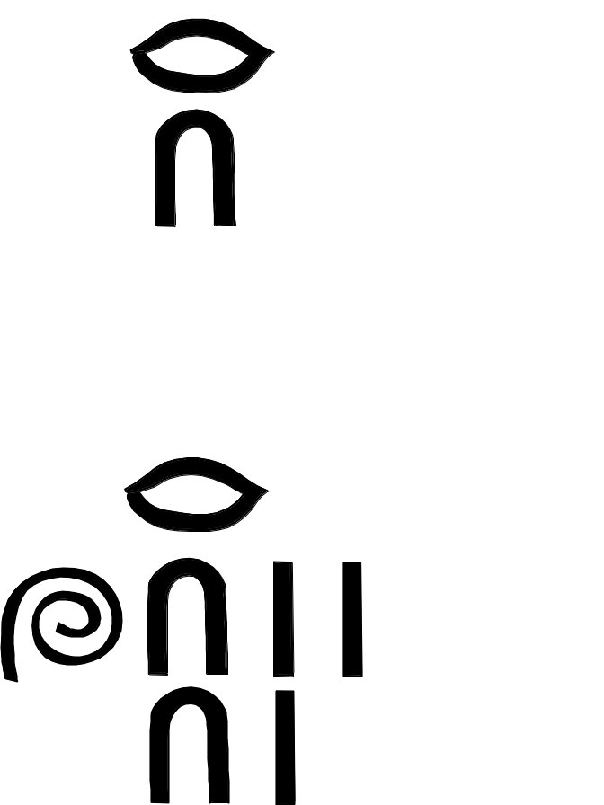
Unit Fractions
One part in 10, i.e., 1/10
One part in 123, i.e.,
1/123
Notes:
A web page on Egyptian fraction: http://www.mcs.surrey.ac.uk/Personal/R.Knott/Fractions/egyptian.html

Slide 23
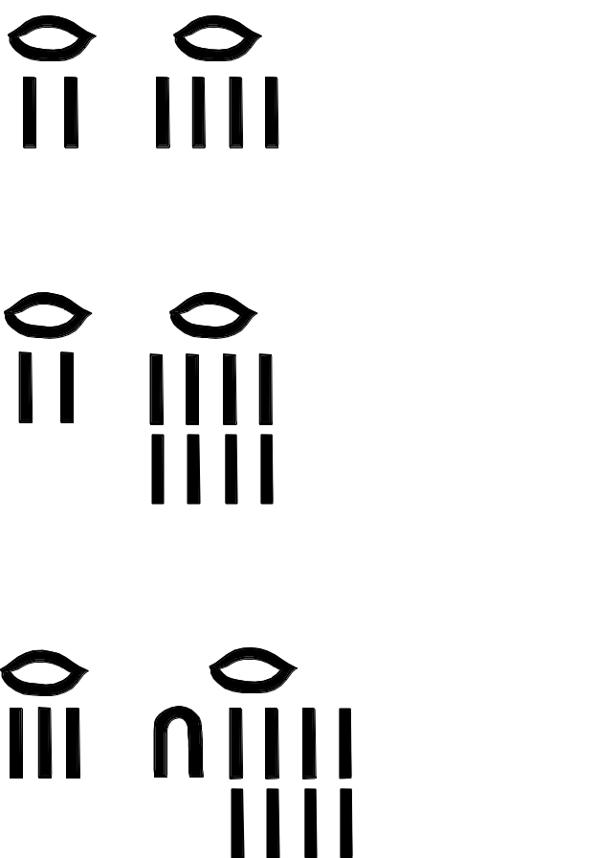
Egyptian Fractions
1/2 + 1/4 = 3/4
1/2 + 1/8 = 5/8
1/3 + 1/18 = 7/18
The Egyptians have no notations for general rational numbers like n/m, and insisted that fractions be written as a sum of non-repeating unit fractions (1/m). Instead of writing ¾ as ¼ three times, they will decompose it as sum of ½ and ¼.

Slide 24
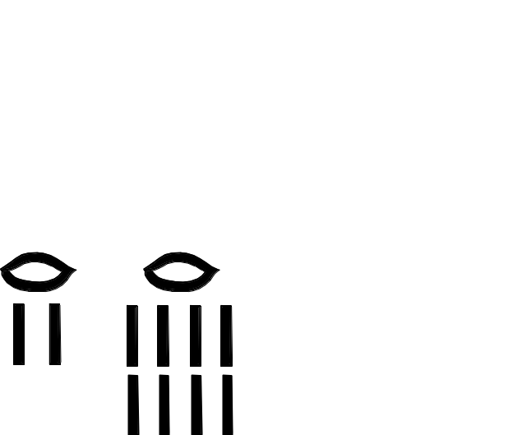
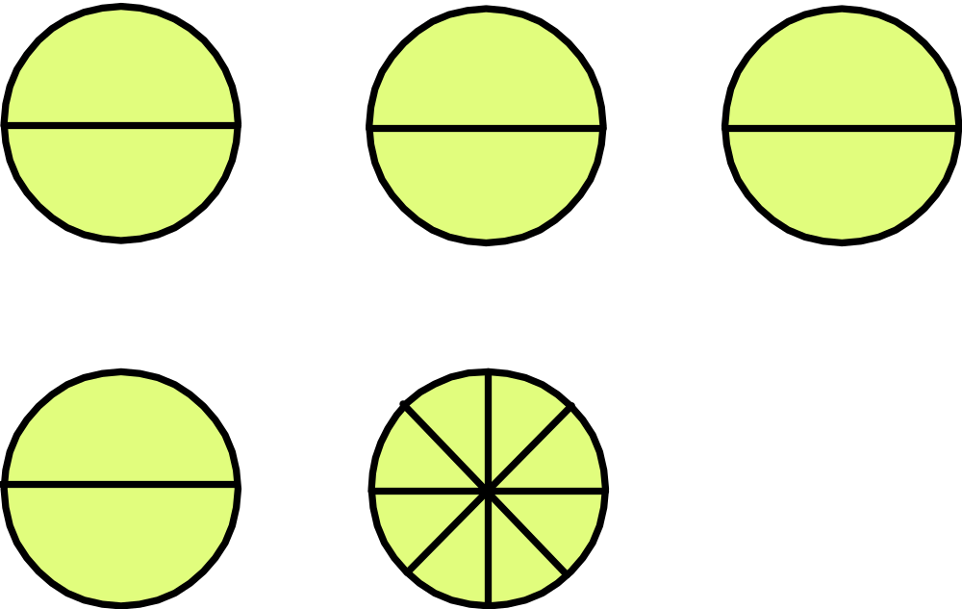
Practical Use of Egyptian Fraction
5/8 = 1/2 + 1/8
Divide 5 pies equally to 8 workers. Each get a half slice plus a 1/8 slice.

Slide 25
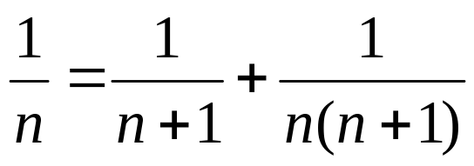
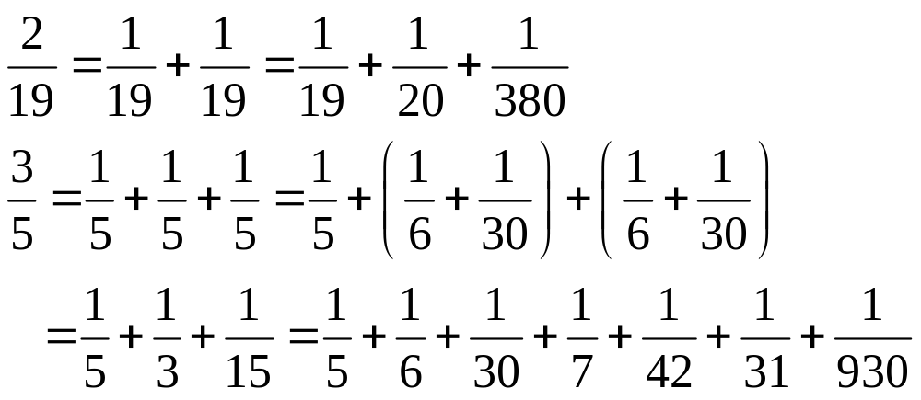
(Modern) Algorithm for Egyptian Fraction
Repeated use of
E.g.:
Notes:
Other formulas are also available, e.g., 2/(3k) = 1/(2k) + 1/(6k), or 2/n = 1/n + 1/(2n) + 1/(3n) + 1/(6n).

Slide 26
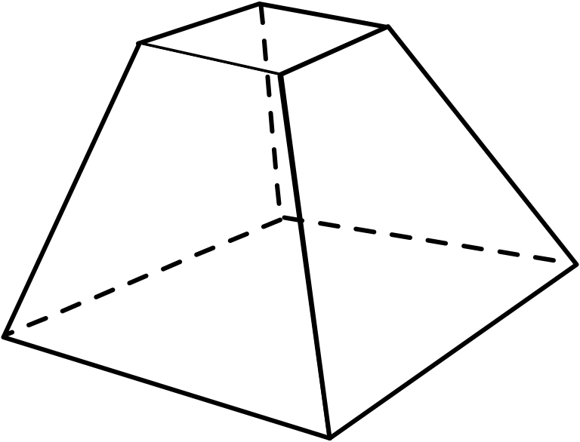
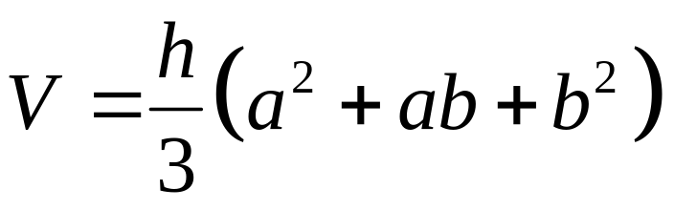
Egyptian Geometry
Volume of the truncated pyramid:
a
a
h
Egyptians’ geometry was empirical – the idea of deduction and proof does not exit.
b
b
Notes:
This solid figure is also known as frustum. This problem was found in Moscow Papyrus. The Egyptians thought that the numbers and their mathematics are given by god; and they does not seem to have the need to justify their methods. Some of the formulas they devise may only be approximate. For example, in the Temple of Horus at Edfu delicatory inscription, area of the 4-sided quadrilateral was given the formula A = (a+c)/(b+d)/4, where a, b, c, d are the lengths of the consecutive sides, which is incorrect.

Slide 27
Summary
Computation begins with counting
Egyptian number system is additive, grouping in units of 10. Multiplication uses a method of doubling. Fraction is complicated because of a rejection of the general notion of n/m, and accepting only unit fractions.
Geometry is at an intuitive stage.

Slide 28
Tutorial Starts Next Week
Choose one of the seven sessions on CORS
The venue is S16 #03-03
Download tutorial sheet from http://web.cz3.nus.edu.sg/GEM/gem.html
Read the web reading materials

