Slide 1
Programming a Computer
Lecture Ten

Slide 2
Outline
A quick introduction to the programming language C
Introduction to software packages:
  Matlab for numerical and matrix computation
  Mathematica for symbolic computation

Slide 3
Why C?
Standard and portable
Simple, concise, and fast
All programming languages are conceptually similar; C is a good example
Other programming languages: Fortran, C++, Java, Pascal, Basic, Lisp, etc

Slide 4
Conceptual Frame of a Program
C program
Memory
main()
{
int i, j, k;
float a, b;
char c;
i = 1;
j = 2;
k = i+j;
}
Data of various types
Declaration of data types and given names
Machine instructions to manipulate the data
Operations on variables

Slide 5
Data Types in C
int : typically 32-bit signed integers from -2³¹ to 2³¹-1
float : 32-bit floating-point numbers
char : a byte for small integers, or for the ASCII character set
Declaration of these variables makes a reservation of memory space in computer

Slide 6
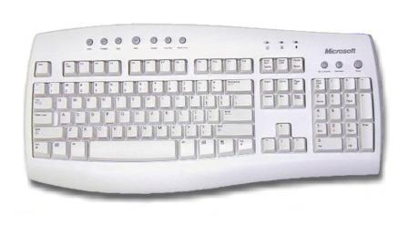
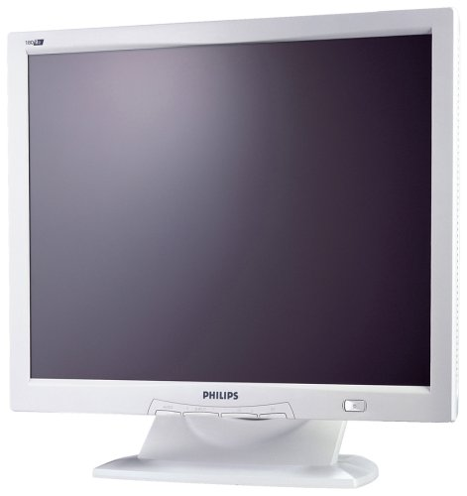
Conceptual Frame of a Program
C program
#include <stdio.h>
main()
{
int i;
scanf(“%d”, &i);
i = i + 1;
printf(“%d”, i);
}
Input or read from key board
Output to screen

Slide 7
I/O in C
printf(….) is used to report results or write a message to the user. E.g.
printf(“Hello\n”); (print Hello & end of line)
printf(“result is %d”, i); (print result is X, where X is the value of i)
printf(“i=%d, f=%f, c=%c\n”, i, f, c); (print respectively the int, float, and char values, in the form i=X, f=Y, x=Z)
The percent sign % followed by d, f, or c is formatting string for integer, float, or char type.

Slide 8
I/O in C
scanf(….) is opposite to printf(). It is used to read (scan) the input from keyboard. E.g.
scanf(“%d”, &i); (read an int)
scanf(“%f”, &a); (read into float variable a)
scanf(“%c”, &c); (read a char or byte into variable c)
The ampersand sign & is called address operator, required for scanf() but not printf().

Slide 9
I/O Example
#include <stdio.h>
main()
{
int i, j, k;
printf(“enter two numbers: ”);
scanf(“%d%d”, &i, &j);
k = i+j;
printf(“the sum equals %d\n”, k);
}
Needed for use I/O
& required for read, but not print

Slide 10
Arithmetic in C
main()
{ int i, j, k;
float a, b, c;
k = i + j; c = a + b;
k = i – j; c = a – b;
k = i * j; c = a * b;
k = i / j; c = a / b;
c = i*j + a/b;
}

Slide 11
Math Functions in C
#include <math.h>
main()
{
double a, b, c, d, f, x;
x = 1.0;
a = sin(x);
b = cos(x);
c = sqrt(x);
d = log(x);
f = pow(x, a);
}
required for using mathematical functions
double type is double precision floating point number, 14-decimal digit accuracy.
square root function
x raised to power a, xª

Slide 12
Equal is not “equal”
In C or another programming languages, the equal sign “=” differs from ordinary math – the equal sign stands for assignment!
a = b+c; (assign the sum to a)
b+c = a; (this is meaningless in C)
To compare whether two numbers are equal or not, one uses “==”, the result is true (1) or false (0). E.g.:
K = (i==j) (K will be 1 if i and j are equal and 0 otherwise)
Notes:
Pascal uses := for assignment.

Slide 13
Control of the Program Execution
Suppose we want to compute the sum from 1 to 100, S=1+2+3+4+…+98+99+100. We could write a program like in the next page:
But much better method is to use the control structure in C.

Slide 14
Sum from 1 to 100
#include <stdio.h>
main()
{ int S;
S = 1 + 2 + 3 + 4 + 5 + 6 + 7 + 8 + 9 + 10 + 11 + 12 + 13 + 14 + 15 + 16 + 17 + 18 + 19 + 20 + 21 + 22 + 23 + 24 + 25 + 26 + 27 + 28 + 29 + 30 + 31 + 32 + 33 + 34 + 35 + 36 + 37 + 38 + 39 + 40 + 41 + 42 + 43 + 44 + 45 + 46 + 47 + 48 + 49 + 50 + 51 + 52 + 53 + 54 + 55 + 56 + 57 + 58 + 59 + 60 + 61 + 62 + 63 + 64 + 65 + 66 + 67 + 68 + 69 + 70 + 71 + 72 + 73 + 74 + 75 + 76 + 77 + 78 + 79 + 80 + 81 + 82 + 83 + 84 + 85 + 86 + 87 + 88 + 89 + 90 + 91 + 92 + 93 + 94 + 95 + 96 + 97 + 98 + 99 + 100;
printf(“sum from 1 to 100 is %d\n”, S);
}

Slide 15
Sum from 1 to 100, using for(…)
Starting with S = 0, run a for-loop, beginning with i equal to 1, increment i in steps of 1 (++i), adding i to S, until adding for the last time when i equals 100. Final S contains the answer.
#include <stdio.h>
main()
{
int i, S;
S = 0;
for(i = 1; i <= 100; ++i) {
S = S + i;
}
printf(“sum from 1 to 100 is %d\n”, S);
}

Slide 16
The For-Loop
for(initialization; condition; increment) {
body;
}
E.g.:
If n = 4; the print-out will be
i=0
i=1
i=2
i=3
for(i = 0; i < n; ++i) {
printf(“i=%d\n”, i);
}
++i means adding one to i.

Slide 17
S = S + i ?
Mathematically, S ≠ S + i, unless i = 0.
Remember that “=” is not equality, by assignment. The meaning of above is to say, take the value of S and add it with i; the new value S + i replaces the old value in variable S.

Slide 18
While-Loop
#include <stdio.h>
main()
{
int i, S;
S = 0;
i = 1;
while (i <= 100) {
S = S + i;
}
printf(“sum from 1 to 100 is %d\n”, S);
}
Keep adding while i is less than or equal to 100 [Stop otherwise].
Notes:
Another example of adding from 1 to 100.

Slide 19
Conditional Execution
We can make choices out of two with if statement:
if (a < b) {
do this;
} else {
do that;
}

Slide 20
Compute π
/* Compute the value of Pi,
using the formula Pi/4 = 1 - 1/3 + 1/5 - 1/7 + ...
*/
#include <stdio.h>
main()
{
int i, N;
double S, pi, term;
printf("enter number of terms N:\n");
scanf("%d", &N);
S = 0;
for(i = 0; i <= N; ++i) {
term = 1.0/(2*i+1);
if((i % 2) == 0) {
S = S + term;
} else {
S = S - term;
}
}
pi = 4.0*S;
printf("pi approx = %f\n", pi);
}
(i % m) means i modulo m, i.e., the remainder of integer division, i/m. (i%2)==0 determines if i is even or odd. In C, an integer divided by an integer results an integer, e.g., 1/3 is 0. Thus we must write 1.0/(2*i+1), for the intended floating point division.
To get 6-digit accuracy for π, one need more than N=10⁶ terms in the summation.

Slide 21
Euclidean Algorithm for Greatest Common Divisor
Let x takes the value of a, d value of b
Compute q and r in x = q*d + r
If r = 0, then gcd = d; stop
Let x takes the current value of d, replacing current value of d with value of r, go to step 2.

Slide 22
A GCD Program
#include <stdio.h>
main()
{
int a, b, r, q, d, x;
printf("enter two integers\n");
scanf("%d%d", &a, &b);
x = a;
d = b;
q = x/d;
r = x - q*d;
while(r != 0) {
x = d;
d = r;
q = x/d;
r = x - q*d;
}
printf("GCD(%d, %d) = %d\n", a, b, d);
}
/* x/d is an integer */
/* “!=” for not equal */

Slide 23
How to Make a Running Program?
You need a computer
You need a compiler (Visual C++, or GCC, or ?)
Exactly what to do depends on your compiler; the compiler produces an executable file (with extension .exe on PCs)
gcc myprogram.c [with GCC]
The name of a C program ends with .c

Slide 24
Demonstration of Matlab and Mathematica Software
Interactive system need much less programming. The user keys in a question or expression, the system gives you answer immediately, like a desk calculator. No compilation process is needed.

Slide 25
MATLAB (MATrix LABoratory)
>>2 + 2
Ans =
4
>>x = 2 + 2
x =
4
>>y = 2^2 + log(pi)*sin(x);
y =
3.1337
Black type: user input
Blue italic: system response
Set value into variable x, and use it later, such as sin(x)

Slide 26
Matrix in MATLAB
>>A=[1 2 3; 4 5 6; 7 8 9]
A =
1 2 3
4 5 6
7 8 9
>>A * A
30 36 42
66 81 96
102 126 150
Matrices are square or rectangular rows of numbers. The concept is useful in solving equations. We can add, multiply, and take inverse of a matrix.
MATLAB is designed for efficient matrix computations.

Slide 27
Mathematica
Black: user input, blue: machine output
In[1]:= 2 + 2
Out[1]= 4
In[2]:= 2^100
Out[2]=1267650600228229401496703205376
In[3]:= N[Pi, 50]
Out[3]=3.1415926535897932384626433832795028841971693993751
In[4]:= 2x + 5x + y
Out[4]= 7x + y
Mathematica’s integers are not limited in sizes
Mathematica can work with symbols

Slide 28
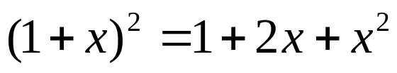
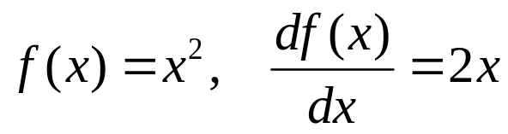
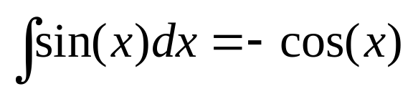
Symbolic Computation
Expand the formula:
In[5]:= Expand[(1+x)^2]
Out[5]= 1 + 2x + x²
In[6]:= D[x^2,x]
Out[6]= 2x
In[7]:= Integrate[Sin[x],x]
Out[6]= –Cos[x]
Compute derivative
Do integral

Slide 29
Summary
We learned data types (int, char, float and double), simple expressions like add, “=” for assignment, not equal, and flow control of programs, such as for, while, and if.
Interactive systems (such as Mathematica) can be more convenient to use. Calculation with formula is possible in symbolic systems.

