Slide 1
Quantum Computing
Lecture Eleven

Slide 2
Outline
Shrinking sizes of electronic devices
Modern physics & quantum world
Principles of quantum computing
Quantum computing algorithms

Slide 3
Shrinking Sizes
10cm
Feature Size
1m = 100 cm (centimeter)
= 10³ mm (millimeter)
= 10⁶ μm (micrometer)
= 10⁹ nm (nanometer)
= 10¹⁰ Å (Angström)
1cm
1mm
10μm
1μm
1nm
1Å
Year
1950
1970
1980
2000

Slide 4
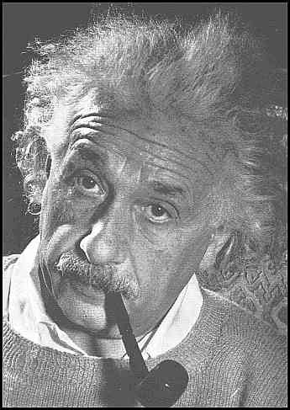

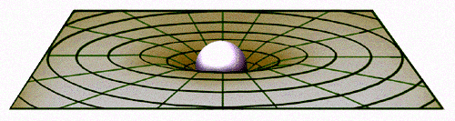
Physics at Large Scale
The beginning of the 20th century has seen remarkable discoveries. Einstein’s theory of (general) relativity describes the geometry of space and time at large scales. He also contributed to the development of the concept of quanta of light.
c=2.99792458 x 10⁸ meter/second
E=mc²

Slide 5
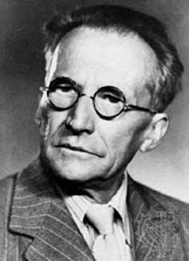
Physics at Small Scale
The classical theory of mechanics developed by Newton does not seem to work for small objects down to size of atoms.
A large number of people contributed to the development of a new theory, “quantum mechanics”, such as Bohr, Planck, Heisenberg, Schrödinger, Dirac, Pauli, etc. Schrödinger’s equation, iħ∂Ψ/∂t=ĤΨ, replaces Newton’s F=ma for the new theory.
Erwin Schrödinger

Slide 6
Classical vs. Quantum
Classical View Quantum View
0.5 Å
–e
–e
–e
An electron experiences a force due to the proton. We describe it by its precise location r and velocity v. The motion is determined by F=m d²r/d²t.
We cannot tell where the electron is, even in principle; it might be here, but it could be there. All that can be said is that it will be somewhere with some probability |Ψ|². The electron behaves like a wave.
+e
+e
–e
The Hydrogen atom
Notes:
We are considering the hydrogen atom.

Slide 7
Classical vs. Quantum
Classical View Quantum View
–e
–e
–e
Physical quantities such as energy, or angular momentum, can take any value in a continuum.
Quantities can take a discrete set of possible values, not arbitrarily any values. In quantum world, the energy is quantized, and angular momentum is always in a multiple of an ħ.
+e
+e
–e
Planck’s constant ħ = 1.05457×10^{–34} Joule∙sec

Slide 8
Spin of an Electron
Classical View Quantum View
The electron spins with a fixed magnitude of angular momentum, ħ/2. It can only point in two directions, up or down, whenever you measure it.
The electron spins, like Earth rotating about its own axis. Any speed and orientation are allowed.

Slide 9
Wave-Particle Duality
λ
–e
The electromagnetic wave, or light, can behave like a stream of particles, with a particle’s energy related to the frequency f of the wave, by E = ħ(2πf)
Particles, on the other hand, can behave like a wave, with the wave length λ related to the velocity of the particle, by
mv = ħ(2π/λ)

Slide 10
Heisenberg Uncertainty Principle
In quantum mechanics, we cannot get accurately and simultaneously certain pair of dynamical variables, such as its position and velocity.
If we know where the electron is, then we don’t know how fast it moves; conversely, if we known how fast it moves, then we don’t know where it is. This is summarized by the formula:
∆x × ∆p ≥ ħ/2
Where ∆x and ∆p are uncertainty (error) in position x and momentum p, p = mv, m is mass, v is velocity.

Slide 11
States and Wave Functions
The quantum system can be in a certain state, or superposition of states. E.g., for an electron, let use |0> to denote the spin-up state, and |1> to denote spin-down state, then in general, the spin is in a state described by:
Ψ=c₀ |0> + c₁ |1>
where c₀ and c₁ are complex numbers.
The notation | > is known as Dirac ket symbol.

Slide 12
Observation or Measurement
If the electron is in state
Ψ = c₀ |0> + c₁ |1>,
a physical measurement destroys the state Ψ, leaving it either in
|0> with probability |c₀|²
or |1> with probability |c₁|²
and cannot stay in the superposition. The total probability is 1=|c₀|²+ |c₁|².
|c₀|²=c₀c₀*
Notes:
This is the Bohr’s or standard interpretation of quantum mechanics. Alternatives interpretations are also possible.

Slide 13
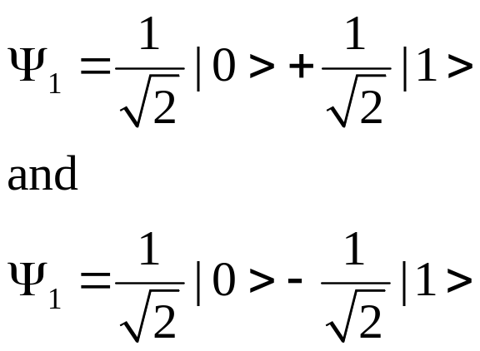
Example of States
The states denoted by
All have ½ probability being in state 0 and ½ probability in 1; but they are different states of the qubit.

Slide 14
Concept of Probability
There are several possibilities of outcome; exactly which one will appear can not be predicted
Each outcome i is assigned a real number 0≤P_{i}≤1, representing the likelihood that i will appear
In quantum mechanics, the standard point view is that we use probability not because we lack knowledge about the system, but because it is the true nature of the system.

Slide 15
Qubit or Quantum Bit
In classical systems, we use any two of the sure states to represent a digit of a binary number, say high voltage/low voltage, or big dot/small dot, or current flow/no current flow, or position of a wheel, etc.
In quantum mechanics at the atomic scale, in general, we cannot be sure which of the two possible states the system is in, not because we cannot measure it (we can, but we irreversibly destroy the state we are measuring), but because it is a true nature of microscopic world.
The wavefunction Ψ=c₀ |0> + c₁ |1> is a qubit. Any measurement yields a value 0 with probability |c₀|², and 1 with probability |c₁|².

Slide 16
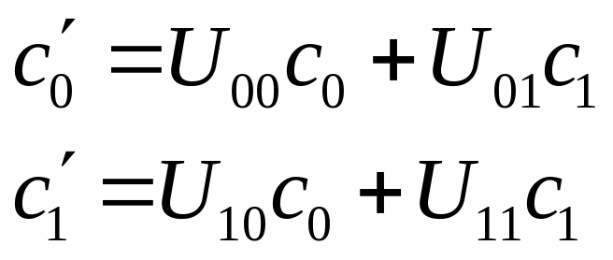
How does state change in quantum mechanics
It follows the Schrödinger equation:
iħ∂Ψ/∂t=ĤΨ. If we have Ψ = c₀ |0> + c₁ |1> at time 0, at a later time, it will be
Ψ’ = c’₀ |0> + c’₁ |1>, with
Where the 4 U’s are some complex numbers

Slide 17
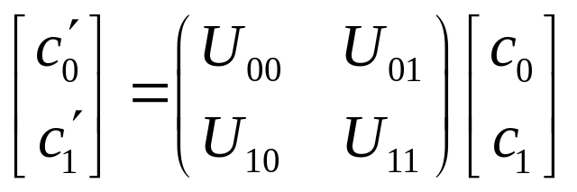
Operators and Transformations
The relation between c and c’ can be written in matrix form:
This is a general feature that in quantum mechanics, states are represented by a column of complex numbers (vectors), and physical quantities (like energy, position, etc) are represented as matrices.
The matrix U must be unitary, UU†=1. But it is too complicated to explain what does that mean.

Slide 18
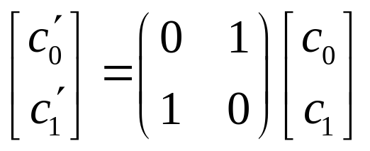
Quantum Logical Gates
The classical computers are built from basic logical gates, such as negation (NOT) (flip between 0 and 1), logical AND, and logical OR.
Something similar can also be built with quantum devices. A quantum NOT gate transform |0> to |1>, or |1> to |0>, by the linear transformation:

Slide 19
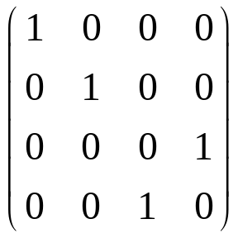
Quantum Control-NOT Gate
The Control-not gate takes a 2-qubits and changes its state in the following way
|00> -> |00>
|01> -> |01>
|10> -> |11>
|11> -> |10>
Its effect on a 2-bit state can be described by the matrix:
gate

Slide 20
Quantum Registers
A qubit stores only “1-bit” of information. A series of qubits can be used to store “n-bits” of information.
Using 3 qubits (e.g., take three electrons or atoms in a row), we can have 8 basis states:
|0>|0>|0>, |0>|0>|1>, |0>|1>|0>, |0>|1>|1>, |1>|0>|0>, |1>|0>|1>, |1>|1>|0>, |1>|1>|1>.
To simplify notation, we can write |000>, |001>, |010>, etc, or simply |n> where n is the corresponding decimal number.

Slide 21
The Meaning of the States
The state |0>|0>|0> =|0,0,0>=|0>
The state |0>|1>|0> =|0,1,0>=|2>

Slide 22
Three-bit Qubits
Using the superposition principle of quantum mechanics, three qubits can generally represent state
Ψ=c₀|0>+c₁|1>+c₂|2>+c₃|3>+c₄|4>+ c₅|5>+c₆|6>+c₇|7>.
A classical register can represent only one of the 8 possibilities for any given time. A quantum 3-bit register can represent all the 8 possibilities, simultaneously.
|c₀|²+ |c₁|²+ |c₂|²+|c₃|²+ |c₄|²+ |c₅|²+|c₆|²+ |c₇|²=1

Slide 23
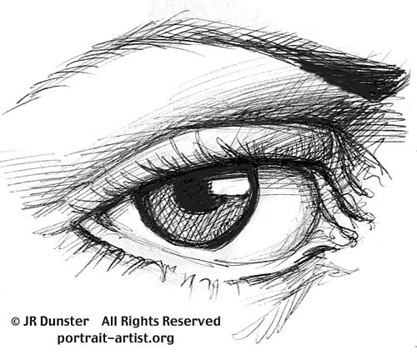
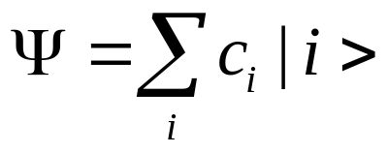
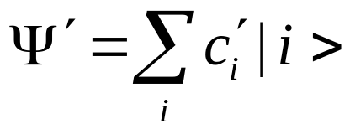
Quantum Computation
Initial state as input
Final state
Strictly no peeking while operating
Quantum logical gates perform unitary transformation on the state, c’=Uc.
A measurement results in a definite state i, with probability |c_{i}|².

Slide 24
Classical vs Quantum
While a classical computer computes an answer one at a time (for each input i), i -> F(i), quantum computer works on all possible inputs of i, and generates all the answers (as a superposition).
However, when you check the answer, you will get only 1 result, F(i), with some probability.

Slide 25
Efficiency of a Quantum Computer
Consider factor a big integer n into product, n = p × q. With a classical computer, we try various possible factors, starting from 2, 3, …, n-1. This takes a number of operations proportional to n.
A quantum computer can factor an integer much faster, proportional to (log(n))³.

Slide 26
Quantum Computer Algorithms
Fast integer factorization due to Shor
Grover’s search algorithm

Slide 27
How far are we away from a real quantum computer?
Still at pioneering stage. Few bit wide qubits are manufactured in labs. Simple quantum logical gates can be made.
Problem of decoherence appears difficult to overcome
An active field of current research

Slide 28
Summary
Quantum computer obeys the law of quantum mechanics. The superposition principle gives new parallelism in quantum computing
It is not certain at all that we’ll see a real quantum computer on your desk in the near or far future.

