Slide 1
GEK1536
Computation & Machine, Ancient to Modern
Review

Slide 2
Aim, Objective, Syllabus
Numbers and their representations
Historic perspective of computation
Primitive computing tools (abacus, sliding rule, etc)
Development of digital computer and programming language
Future computing machines

Slide 3
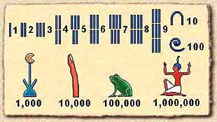
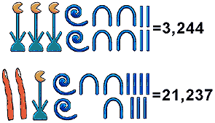
Egyptian Numerals
Egyptian number system is additive.

Slide 4
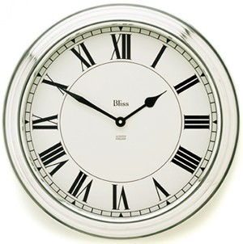
Roman Numerals
I 1
II 2
III 3
IV 4
V 5
VI 6
VII 7
VIII 8
IX 9
X 10
L 50
C 100
D 500
M 1000
MMMDCCCLXXVIII 3878

Slide 5
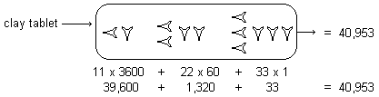
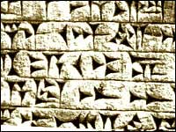
Mesopotamia Civilization
Above: Babylonian sexagesimal (base 60) number. It is the first positional number system.
Left: Oldest cuneiform writing by Sumerian.
Notes:
Cunneiform [‘kjuniifom] Sumerian [sumirean]

Slide 6
Positional Number System
A unique mapping from the digits to the number
Most common bases are b=10 (decimal), b=2 (binary), b=60 (sexagesimal)
Fractions can be represented if we allow for negative powers of b.

Slide 7
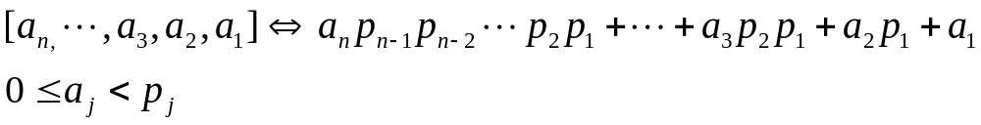
Mixed Radix System
Let p₁ < p₂ < p₃ < … be set of prime numbers
Then we can uniquely represent an integer

Slide 8
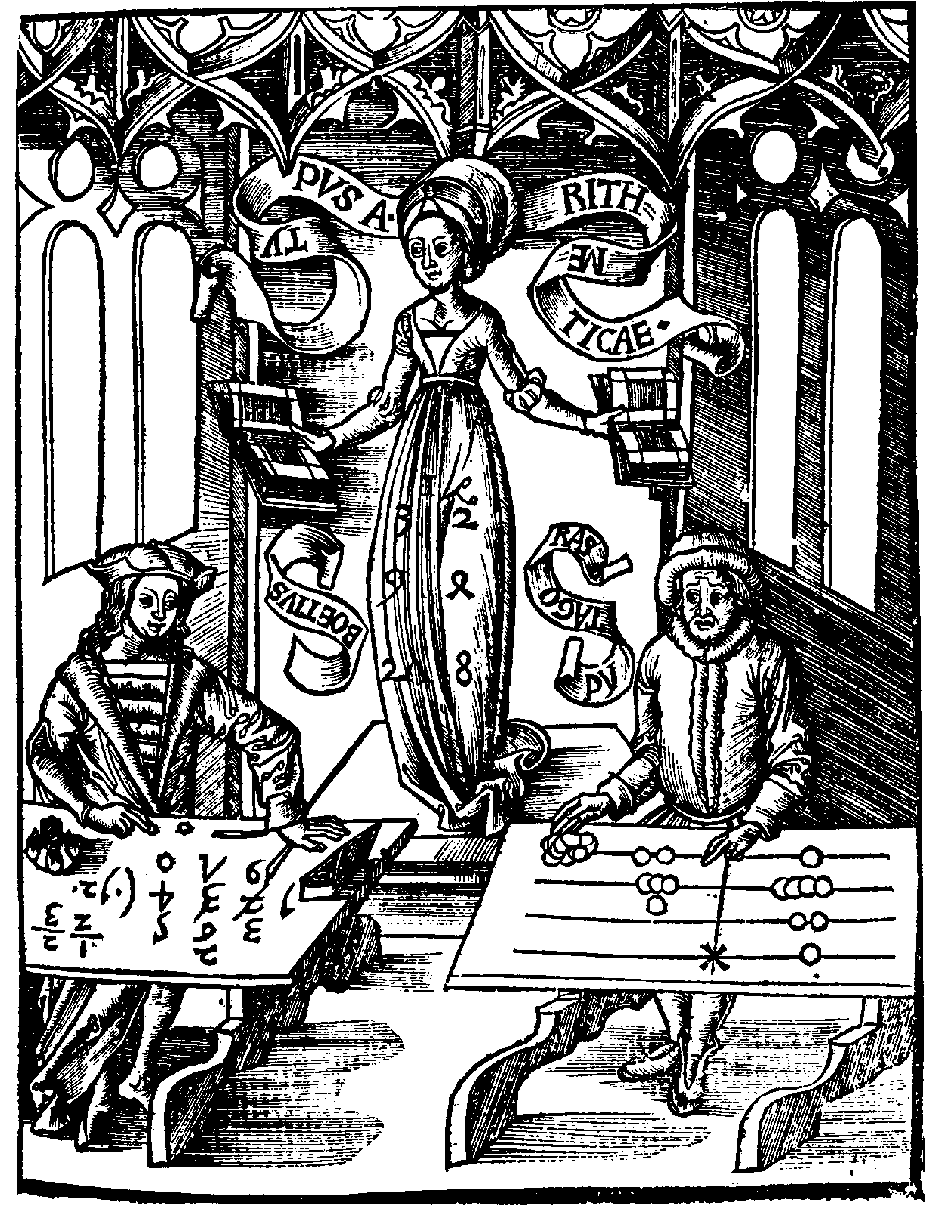
Abaci
Methods of addition, subtraction and multiplication with Roman counting boards. Doubling method for multiplication.
M
C
X
I
Boethius (Hindu-Arabic) vs Pythagoras (counting board)

Slide 9
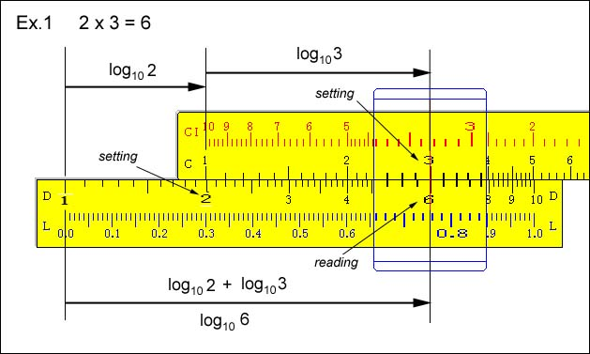
Logarithm and Slide Rule
John Napier of Scotland developed the concept of logarithm around AD 1600. He also invented so-called Napier’s bones.
Slide rule based on the property of logarithm was invented in the late 1700s.
If a^{y}=x, then y = log_{a}x
log (u v) = log (u) + log(v)
Notes:
Slide rule page http://www.ies.co.jp/math/java/misc/slide_rule/slide_rule.html

Slide 10
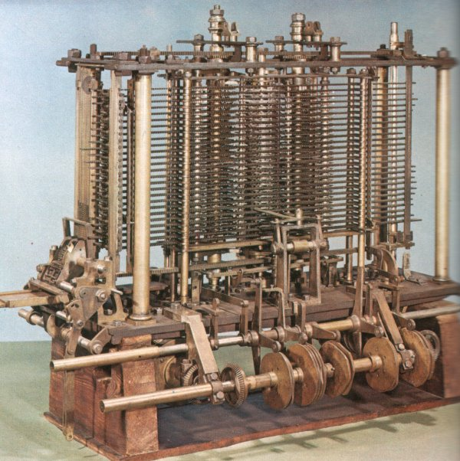
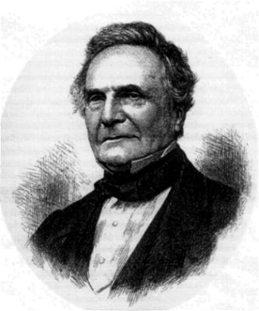
Charles Babbage
Difference Engine is based on finite difference. A machine that can calculate a table of polynomial functions such as T(x)=x²+x+41.
∆f(x) = f(x+h) – f(x)

Slide 11

Modern Computer and Programming
#include <stdio.h>
main()
{
int a, b, c;
printf(“Hello\n”);
a=1; b = 2;
c = a + b;
printf(“c=%d”, c);
return;
}
for( … ), while( … ), if, scanf, printf, etc
int, float, char, double

Slide 12
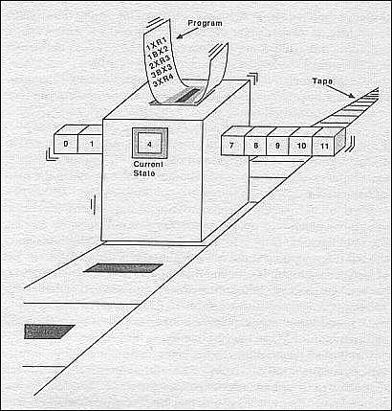
Turing Machine
A Turing Machine includes a head moving on a tape, an internal state, and instructions. Any computer can be made to be equivalent to a Turing machine.
Notes:
Turing machine is a concept, not a real machine. It is used for the theoretical analysis of computation.

Slide 13
Binary Number System for Digital Computer
0000 0000 0 0100 0001 A
0000 0001 1 0100 0010 B
0000 0010 2 0100 0011 C
0000 0011 3 0100 0100 D
0000 0100 4 0100 0101 E
0000 0101 5 0100 0110 F
0000 0110 6 0100 0111 G
0000 0111 7 0100 1000 H
0000 1000 8 0100 1001 I
0011 1110 1000 0000 0000 0000 0000 0000 0.25
character
integer
Biased Exponent
sign
Fractional part
IEEE float-point number
Two’s complement

Slide 14
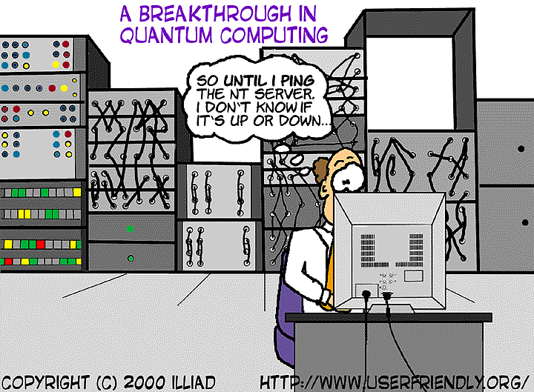
Quantum Computing

Slide 15
Problem 1
For each of the possible alternative statements, choose the one best fit the fact.
(i) Babylonian base-60 number system is first used around
(a) 5000 BC, (b) 2000 BC, (c) 11 AD, (d) 1000 AD.
(ii) The ancient Greeks developed
(a) base-20 system, (b) algebra, (c) geometry, (d) science.
(iii) The Napier’s bones are
(a) toys for dogs, (b) for simplifying addition, (c) aid for multiplication, (d) for computing logarithms.
(iv) Babbage’s difference machine computes value of
(a) differences, (b) sums, (c) polynomials, (d) divisions.
(v) A quantum computer relies on
(a) uncertainty principle, (b) deterministic principle, (c) quantitative principle, (d) superposition principle.
b,c,c,c,d

Slide 16
Problem 2
With one or two sentences, briefly describe the following concepts:
  two’s complement
  positional number system
  register
  overflow
  punched cards

Slide 17
Problem 3
In Euclidean geometry, sum of the three internal angles of a triangle is 180°.
(a) based on this fact, derive the sum of the 4 internal angles of a quadrilateral (a four sided polygon).
(b) Generalize the derivation in part (a), derive a formula for the sum of internal angles for an n-sided polygon, for any n = 3, 4, 5, …

Slide 18
Solution
(a)
Total 360°
180°
180°
A quadrilateral can be viewed as 2 triangles
(b)
To get an n-sided polygon, you can add a triangle to one of side of an (n-1)-sided polygon.
So the sum of the angles is 180°×(n-2).
180°
180°

Slide 19
Problem 4
Design a Turing machine to determine if a binary encoded natural number is even or odd. When the machine halts, it erases the number on the tape and replaces it with the answer 0∆∆∆∆… if the number is even, or 1∆∆∆∆…, if the number is odd. The input number is put on tape with the least significant bit in the first cell [That is, we read the tape backward]. The symbol space will be 0, 1, the space ∆, and an extra dot •. The Turing machine rules will be specified by a diagram.

Slide 20
Solution
(0,0,R)
(0,∆,R)
1
start
(∆,∆,R)
3
halt
2
(1,1,R)
(1,∆,R)

Slide 21
Problem 5
(a) Convert the decimal number +255.125 into IEEE 32-bit single precision floating-point format. Note that the format has the highest bit for the sign, the next 8 bits for a biased exponent (the bias is 127), the rest of the bits for the fractional part of the number.
(b) Interpret the following bit pattern
0011 1111 1111 1111 1111 1111 1111 1111
in three ways (i) unsigned integer, (ii) signed integer, and (iii) floating point number (IEEE format). Find the three values in decimal notation.

Slide 22
Solution
255₁₀=1111 1111₂, 0.125₁₀ = 1/8 = 0.001₂, so 255.125₁₀=11111111.001₂=
1.1111111001×2⁷
f=.11111110010000…0
E=7+127=134=0111 111 + 111 = 1000 0110₂
s = + = 0 (positive)
So the bit pattern is
0 1000 0110 1111111001 0000000000 000
(i) and (ii) +2³⁰-1=1073741823.
(iii) s=0, E=127, so e=0, f = 1.1111….1₂=
2 – 2⁻²³=1.99999988079 = value of the IEEE number.

Slide 23
Problem 6
There are several ways that one can use to convert a decimal integer into binary digits. One possibility is to subtract a power of 2, starting from the largest. In this way, the most significant bit is found first and can be printed out. Implement this idea in a C program. The program first scans (that is, read) a non-negative integer. It then prints out the binary digits from most significant to least significant, one digit a time.

Slide 24
Solution
#include <stdio.h>
main()
{ int i, n;
scanf(“%d”, &n);
i = 1;
while(i<n) { /* find largest power */
i = i*2;
}
while(i > 0) { /* subtract power, from large to small */
if(n-i>=0) {
printf(“1”);
n = n – i;
} else {
printf(“0”);
}
i = i/2;
}
printf(“\n”);
}

Slide 25
Reminder
Final examination on 9:00-11:00, Thursday, 27 April 06

