Slide 1
Mesopotamia Here We Come
Lecture Two
Notes:
Mesopotamia [mesəpə’teimjə]

Slide 2
Outline
Mesopotamia civilization
Cuneiform
The sexagesimal positional system
Arithmetic in Babylonian notation
Mesopotamia algebra
Notes:
Cuneiform [kju:niif o:m]
Babylonian [bæbi`lounjə]
Sexagesimal [seksə`dЗesiməl]

Slide 3
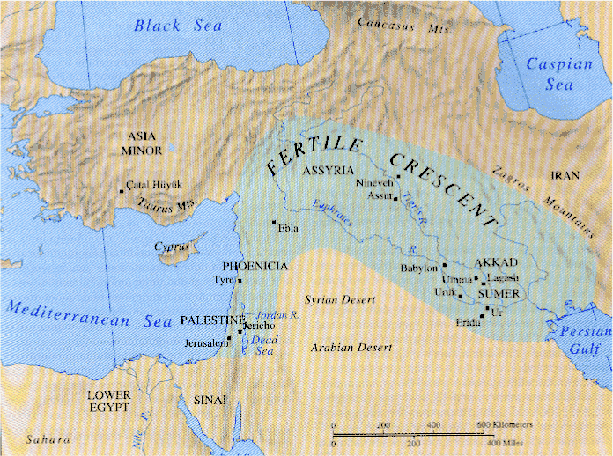
Mesopotamia (the land between the rivers)
One of the earliest civilization appeared around the rivers Euphrates and Tigris, present-day southern Iraq.
Notes:
Euphrates [ju:`freiti:z]
Tigris [`taigris]

Slide 4
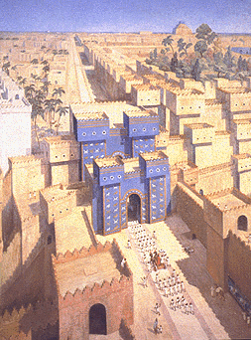
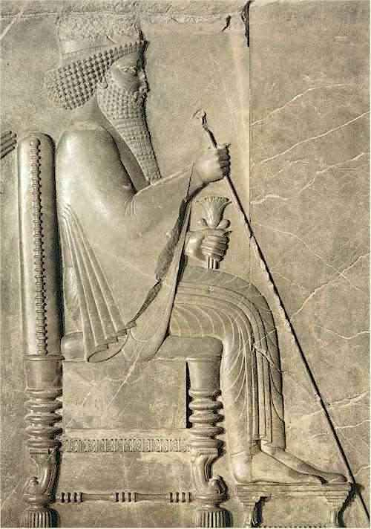
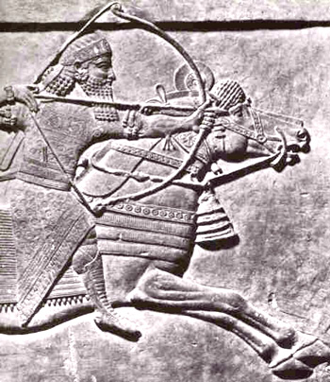
Brief History of the “Fertile Crescent”
3000 – 2000 BC, Sumerians
Around 1800 BC, Hammurabi
2300 – 2100 BC, Akkadian
1600 – 600 BC, Assyrians
600 – 500 BC, Babylonian
600 – 300 BC, Persian Empire
300 BC – 600 AD, Greco-Roman
600 AD - , Islamic
Persian King Darius
Ishtar Gate of Babylon
Assyrian art
Notes:
A reconstructed piece of the Ishtar gate is in Berlin museum. Some of the history is vividly presented in the movie “Alexander”.

Slide 5
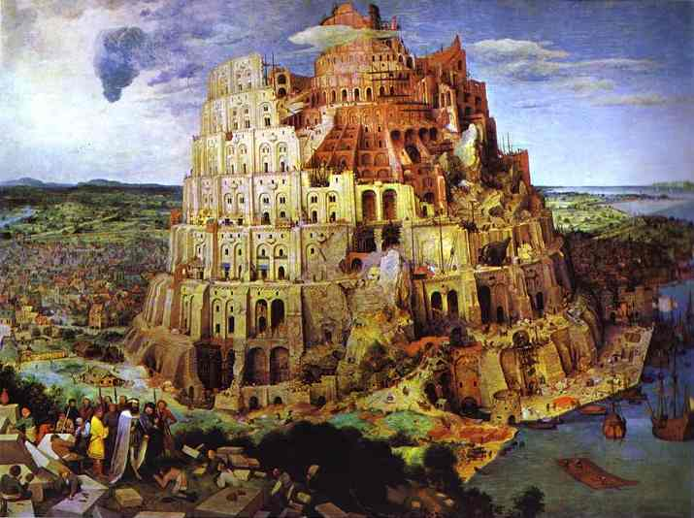
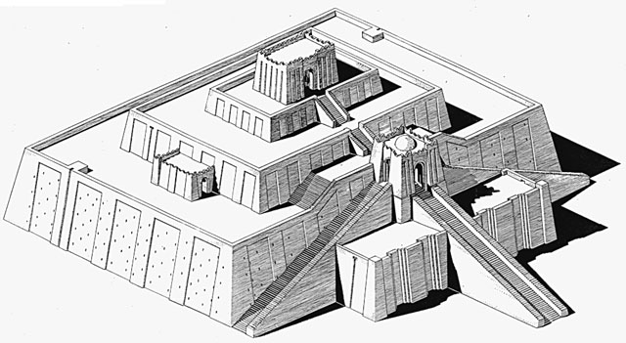
Tower of Babel
Reconstructed Ziggurat made of bricks.
Artistic rendering of “Tower of Babel”
Notes:
Genesis 11:1-9: The Tower of Babel [beibəl, or bæbəl]
Now the whole Earth used the same language and the same words. And it came about as they journeyed east, that they found a plain in the land of Shinar and settled there. And they said to one another, "Come, let us make bricks and burn them thoroughly." And they used brick for stone, and they used tar for mortar. And they said, "Come, let us build for ourselves a city, and a tower whose top will reach into heaven, and let us make for ourselves a name; lest we be scattered abroad over the face of the whole earth.“ And the LORD came down to see the city and the tower which the sons of men had built. And the LORD said, "Behold, they are one people, and they all have the same language. And this is what they began to do, and now nothing which they purpose to do will be impossible for them.“ "Come, let Us go down and there confuse their language, that they may not understand one another's speech.“ So the LORD scattered them abroad from there over the face of the whole earth; and they stopped building the city. Therefore its name was called Babel, because there the LORD confused the language of the whole earth; and from there the LORD scattered them abroad over the face of the whole earth.

Slide 6
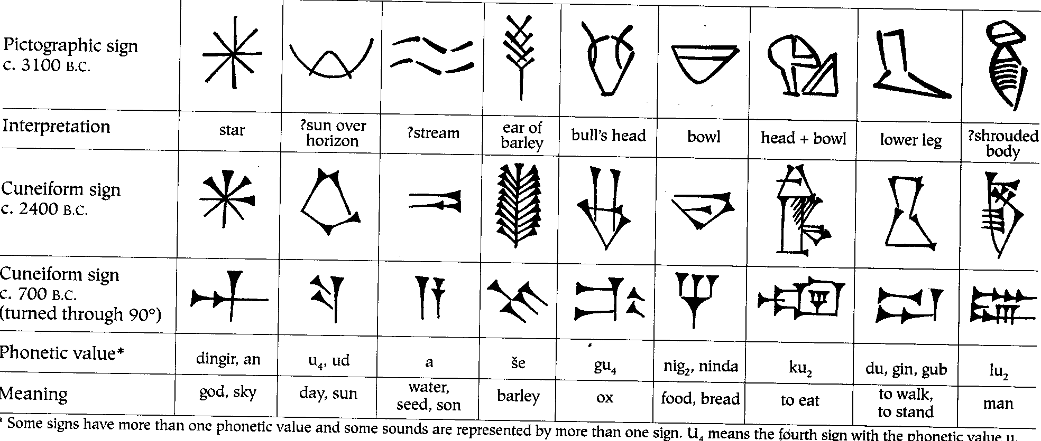
Written System in Mesopotamia

Slide 7
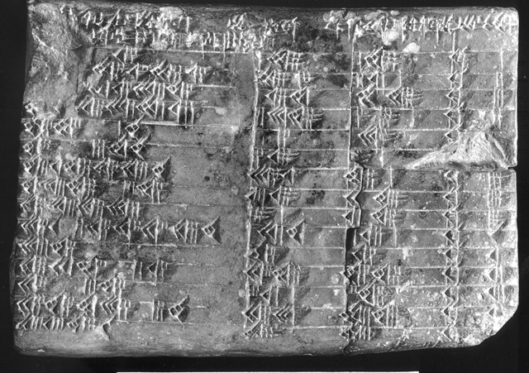
Cuneiform
Cuneiform tablets are made of soft clay by impression with a stylus, and dried for record-keeping.

Slide 8
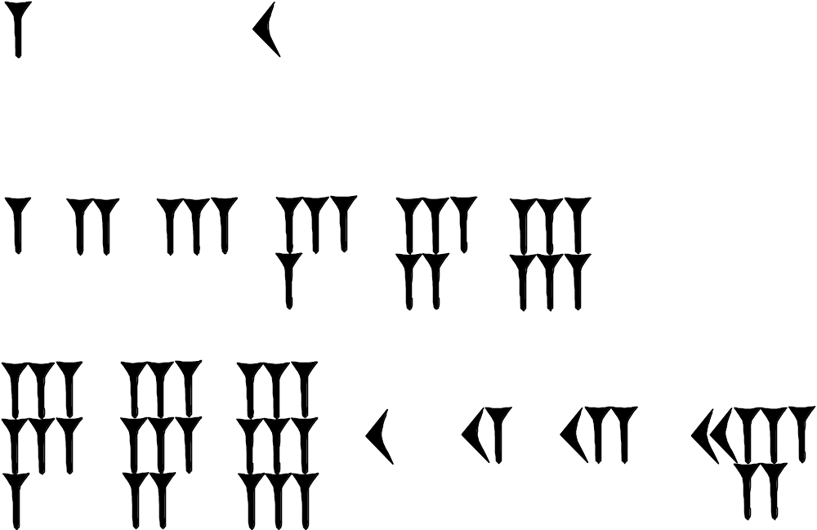
The Basic Symbols
1 (wedge) 10 (chevron)
1 2 3 4 5 6
7 8 9 10 11 12 25

Slide 9
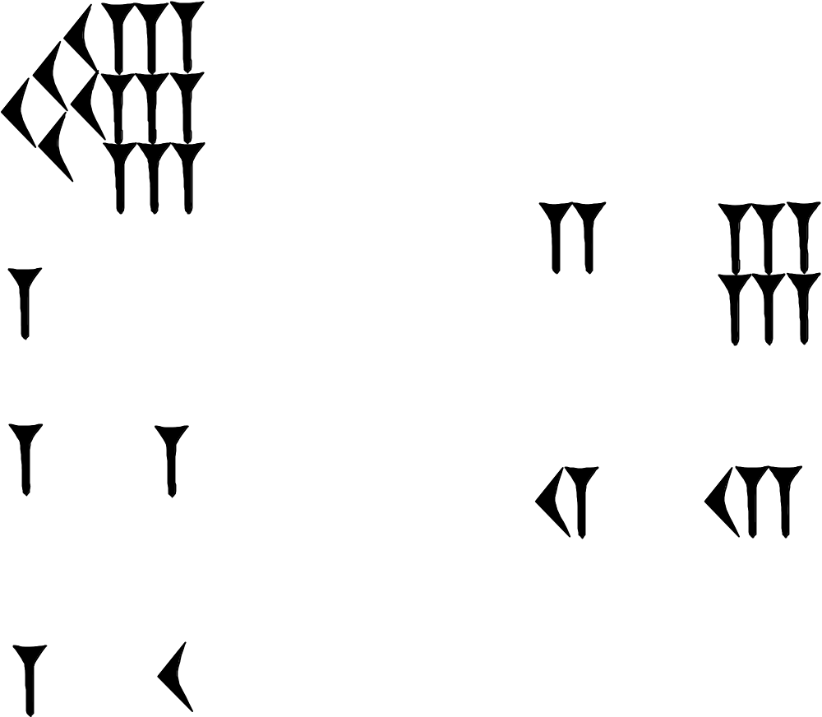
Base 60 (sexagesimal)
59
126=2*60+6
60
61
672=11*60+12
70=60+10
Notes:
This sort of construction goes up to 60, then something different happens. [Babylonian did not have a symbol for 0 or decimal point]

Slide 10
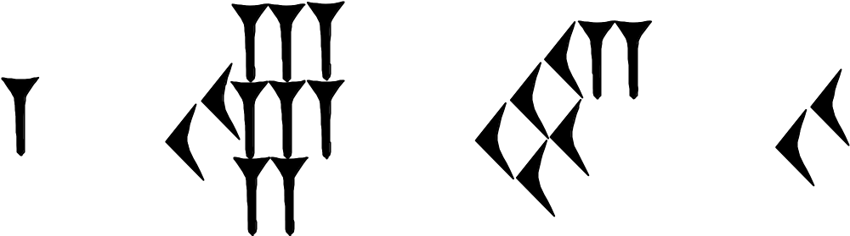
Babylonian Sexagesimal Position System
1*60³ + 28 * 60² + 52 * 60 + 20 = 319940

Slide 11
General Base b Number
A sequence
represents value
Examples: b=10: 2037₁₀ = 2000 + 30 + 7
b=2: 101₂ = 1*2²+0*2¹+1=5
b=60: [1, 28, 52, 20]₆₀ = 1*60³+28*60²+52*60+20=319940

Slide 12
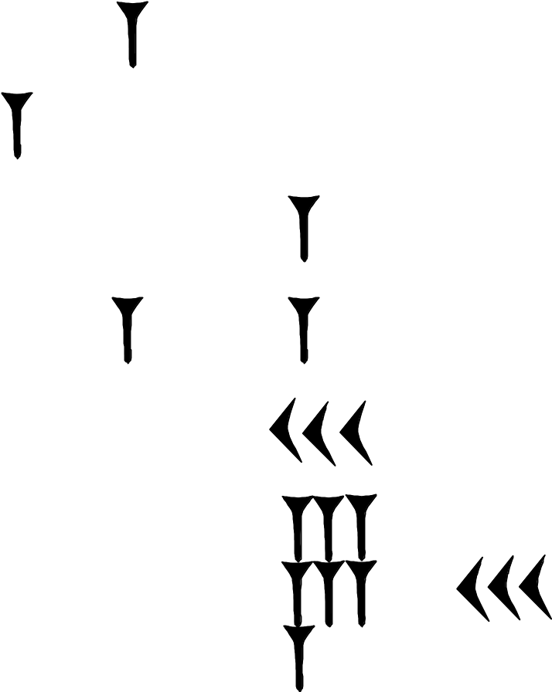
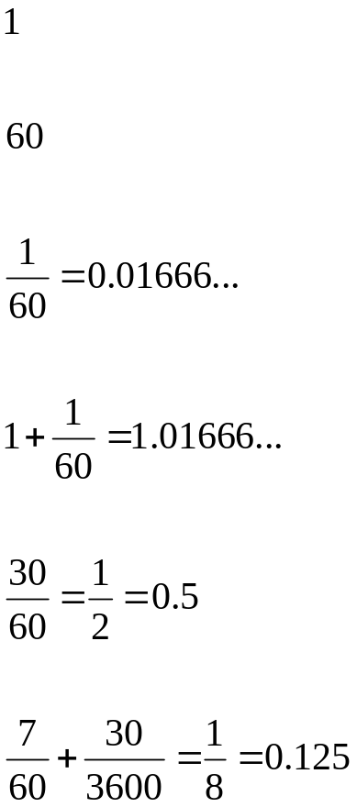
Babylonian Fraction (Sexagesimal Number)
60² 60 1 60⁻¹ 60⁻²
Fractional part

Slide 13
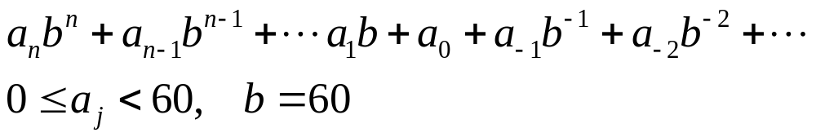
Conversion from Sexagesimal to Decimal
We’ll use the notation, e.g.,
[1 , 0 ; 30, 5] to mean the value
1*60 + 0*1 + 30*60⁻¹+5*60⁻²
= 60+1/2+1/720=60.50138888…
In general we use the formula below to get the decimal equivalent:

Slide 14
Conversion from Decimal to Sexagesmal
Let y = a_{n} 60^{n} + a_{n-1} 60^{n-1} + …, try largest n such that y/60^{n} is a number between 1 and 59, then
y/60^{n} = a_{n} + a_{n-1}/60 + … = a_{n}+ r
The integer part is a_{n} and the fractional part is the rest, r.
Multiple r by 60, then the integer part will be a_{n-1} and fractional part is the rest. Repeat to get all digits.

Slide 15
Conversion Example
Take y = 100.25 = 100+1/4
n=2, y/3600 is too small, so n=1;
y/60 = 1 + (40+1/4)/60 -> a₁ = 1
r₁=(40+1/4)/60, 60*r₁=40+1/4
-> a₀=40, r₀=1/4
60*r₀ = 15, -> a₋₁=15
So 100.25 in base 60 is [1, 40 ; 15]

Slide 16
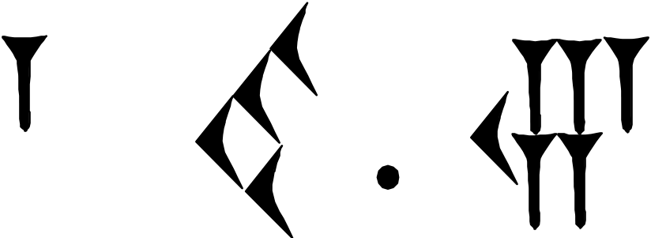
100.25 in base 60
A Better Work Sheet
100.25/60 = 1.6708333333… -> a₁=1
60 x 0.670833333… = 40.25 ->a₀=40
60 x 0.25 = 15.000… ->a₋₁=15
60 x 0.000 = 0 -> a₋₂ = 0
1*60 + 40 + 15/60 = 100.25

Slide 17
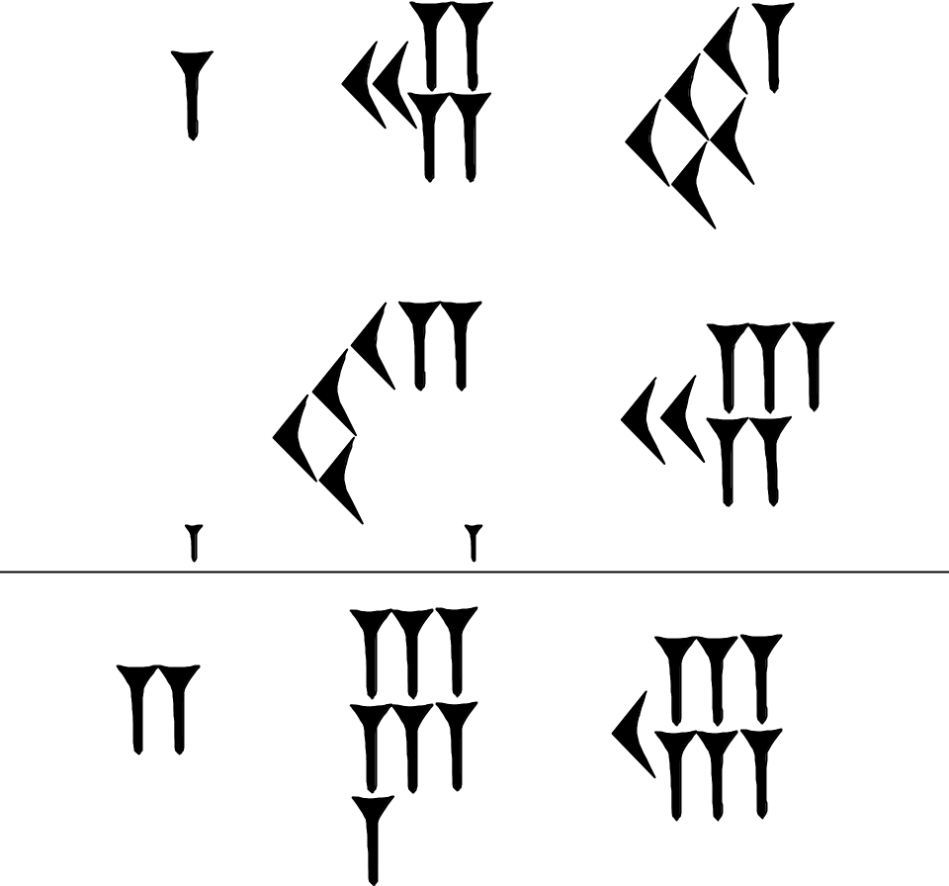
Adding in Babylonian Notation
1 24 51 = 5091₁₀
42 25 = 2545₁₀
+
2 7 16 = 7636₁₀
Every 60 causes a carry!
Notes:
We can interpret this calculation as, 1 hour 24 min 51 sec plus 42 min 25 sec. The answer is 2 hour 7 min 16 sec. To the Babylonian, they don’t have to mean time, they are just numbers.

Slide 18
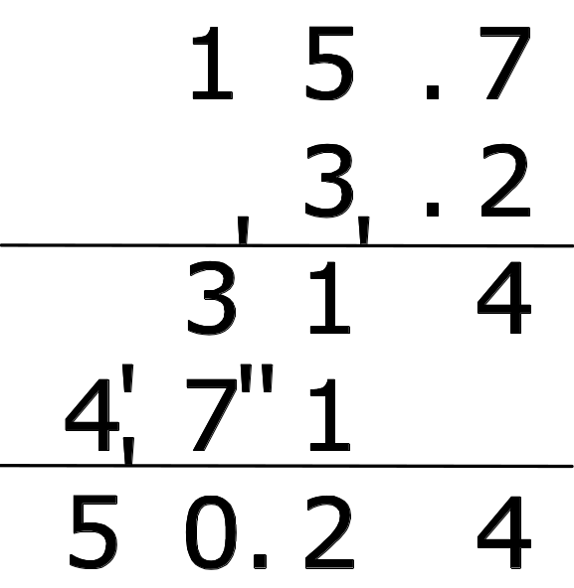
Multiplication in Decimal
1x1=1
1x2=2 2x2=4
1x3=3 2x3=6 3x3=9
1x4=4 2x4=8 3x4=12 4x4=16
1x5=5 2x5=10 3x5=15 4x5=20 5x5=25
1x6=6 2x6=12 3x6=18 4x6=24 5x6=30 6x6=36
1x7=7 2x7=14 3x7=21 4x7=28 5x7=35 6x7=42 7x7=49
1x8=8 2x8=16 3x8=24 4x8=32 5x8=40 6x8=48 7x8=56 8x8=64
1x9=9 2x9=18 3x9=27 4x9=36 5x9=45 6x9=54 7x9=63 8x9=72 9x9=81

Slide 19
Multiplication in Sexagesimal
Instead of a triangle table for multiplication of numbers from 1 to 59, a list of 1, 2, …, 18, 19, 20, 30, 40, 50 was used.
For numbers such as b x 35, we can decompose as b x (30 + 5).

Slide 20
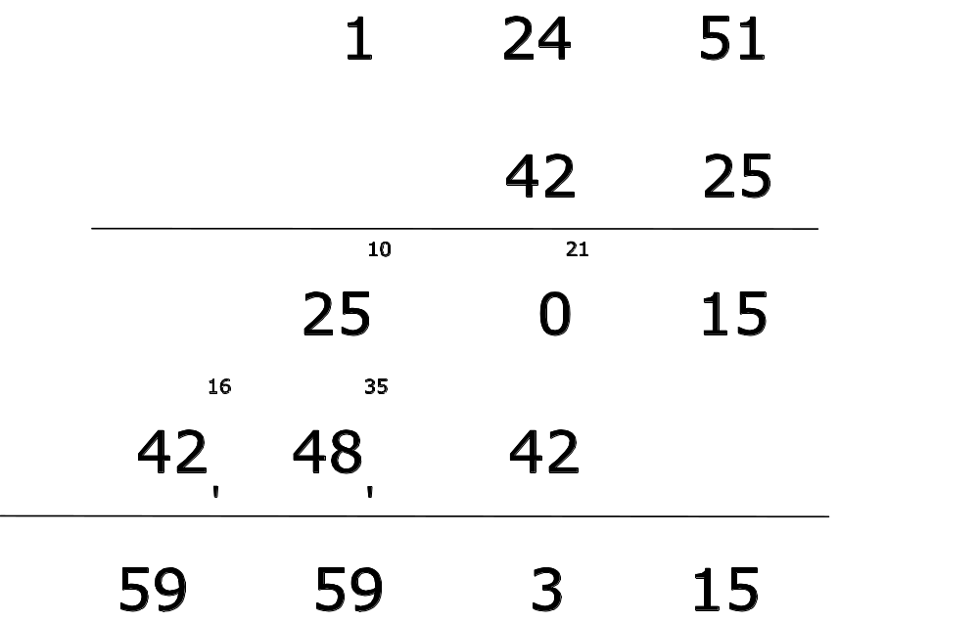
Example of a
Base 60 Multiplication
51 x 25 = (1275)₁₀ = 21x60 + 15
= (21, 15)₆₀
x
+

Slide 21
Division
Division is computed by multiplication of its inverse, thus
a / b = a x b⁻¹
Tables of inverses were prepared.

Slide 22
Table of Reciprocals
a a⁻¹ a a⁻¹ a a⁻¹
2 30 16 3,45 45 1,20
3 20 18 3,20 48 1,15
4 15 20 3 50 1,12
5 12 24 2,30 54 1,6,40
6 10 25 2,24 1 1
8 7,30 27 2,13,20 1,4 56,15
9 6,40 30 2 1,12 50
10 6 32 1,52,30 1,15 48
12 5 36 1,40 1,20 45
15 4 40 1,30 1,21 44,26,40
Notes:
From “The Exact Sciences in Antiquity”, p.32, O Neugebauer, (Brown Univ, 1957). The table has the property that product of the two numbers are powers of 60 (that is, it is 3600, 60, 1, 1/60, depending where we put the decimal point).

Slide 23
An Example for Division
Consider [1, 40] ÷ [0 ; 12]
We do this by multiplying the inverse of [0 ; 12 ]; reading from the table, it is 5.
[1, 40] × [5 ; 0] = [5, 200] = [8, 20]
Notes:
Question: What to do if the number we need to take inverse does not appear on the inverse table?

Slide 24
Sides of Right Triangles
In a clay tablet known as Plimpton 322 dated about 1800 – 1600 BC, a list of numbers showing something like that
a² + b² = c².
This is thousand of years before Pythagoras presumably proved his theorem, now bearing his name.
c
b
90°
a
Notes:
Pythagorean [paiθægəri:ən]

Slide 25
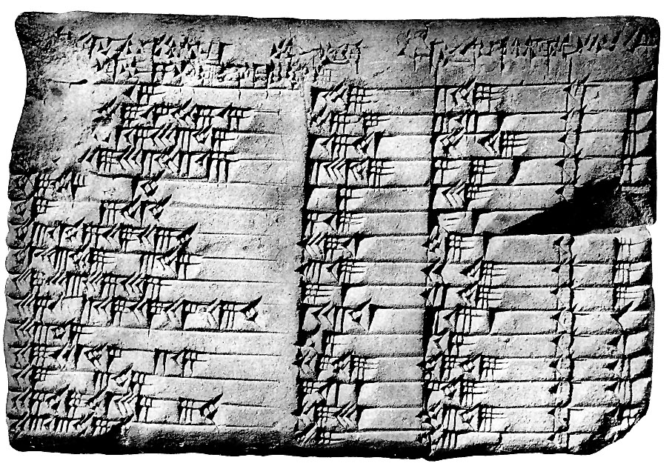
Plimpton 322
line number
(c/a)²
b
c
Line number 11 read (from left to right), [1?; 33, 45], [45], and [1,15]. In decimal notation, we have b = 45, c=75, thus, a = 60, and (c/a)²=1 + 33/60 + 45/3600 = (5/4)²
<- line 11
a² + b² = c², for integers a, b, and c
Notes:
A good explanation at http://www.math.ubc.ca/~cass/courses/m446-03/pl322/pl322.html

Slide 26
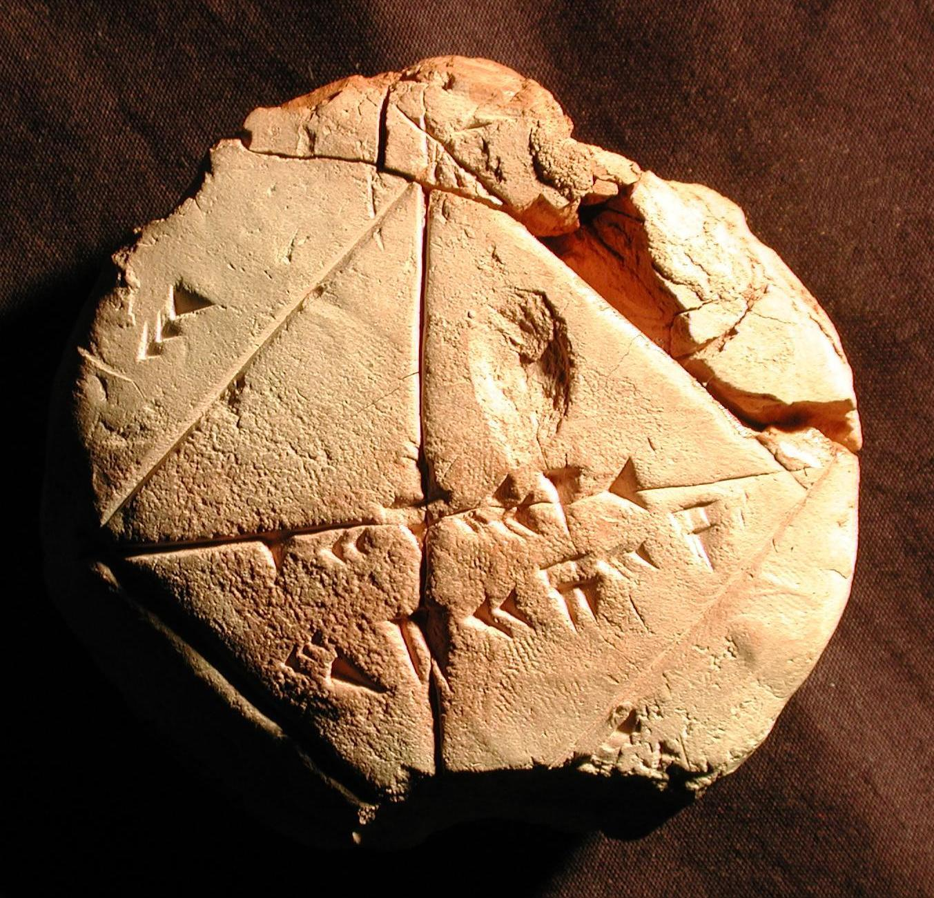
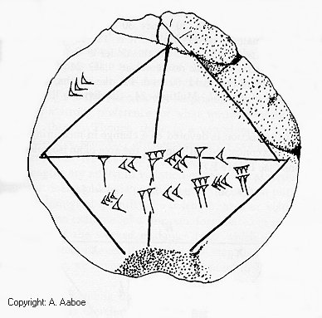
Square Root
The side of the square is labeled 30, the top row on the diagonal is 1, 24, 51, 10; the bottom row is 42, 25, 35.
YBC 7289
Notes:
If the side is 30, the diagonals are exactly the bottom number, 42.4 = 30 * sqrt(2). The top number can be interpreted as 1.4142 … (To be more exact, it is 1.41421296296296, which is accurate to square root of 2 to 6 decimal places). In both cases, we fraction parts start from second digit (from left to right).

Slide 27

Algorithm for Compute
Starting with some value close to the answer, say x =1
x is too small, but 2/x is too large. Replace x with the average (x+2/x)/2 as the new value
Repeat step 2
We obtain, in decimal notation the sequence,
1, 1.5, 1.416666…, 1.41421568.., 1.41421356237…
Notes:
This is nothing but Newton’s method to solve f(x) = x^2 – 2 = 0 Exact value of square root of 2 is sqrt(2) = 1.4142135623730950488… There are infinite numbers of non-repeating digits, as it is an irrational number.

Slide 28
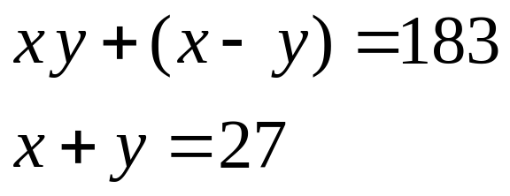
Word Problem (Algebra)
I have multiplied the length and the width, thus obtaining the area. Then I added to the area, the excess of the length over the width: 183 was the result. Moreover, I have added the length and the width: 27. Required length, width, and area?
This amounts to solve the equations, in modern notation:
From Tablet AO8862, see “Science Awakening I” B L van der Waerden
Notes:
Quoted from

Slide 29
The Babylonian Procedure
27 + 183 = 210, 2 + 27 = 29
Take one half of 29 (gives 14 ½)
14 ½ x 14 ½ = 210 ¼
210 ¼ - 210 = ¼
The square root of ¼ is ½.
14 ½ + ½ = 15 -> the length
14 ½ - ½ - 2 = 12 -> the width
15 x 12 = 180 -> the area.

Slide 30
Here is what happens in modern notation
xy+(x-y)=183 (1), x+y=27 (2)
Add (1) & (2), we get xy+x-y+x+y=x(y+2)=210.
Let y’=y+2, we have xy’=210, thus x+y’=x+y+2=29 (3)
So (x+y’)/2 = 14 ½, square it (x²+2xy’+y’²)/4=(14 ½ )² =210 ¼.
Subtract the last equation by xy’=210, we get
(x²-2xy’+y’²)/4 =210 ¼ - 210 = ¼, take square root, so
(x – y’)/2 = ½ , that is x-y’=1 (4)
Do (3)+(4) and (3)-(4), we have 2x= 29+1, or x = 30/2=15
And 2y’ = 29-1 = 28, y’=14, or y = y’-2=14-2 = 12

Slide 31
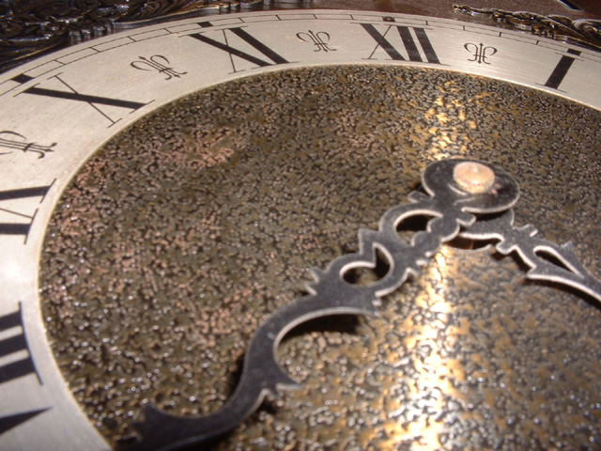
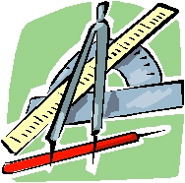
Legacy of Babylonian System
Our measurements of time and angle are inherited from Babylonian civilization. An hour or a degree is divided into 60 minutes, a minute is divided into 60 seconds. They are base 60.

Slide 32
Summary
Babylonians developed a base 60 number system, for both integers and fractions.
We learned methods of conversion between different bases, and arithmetic in base 60.
Babylonians knew Pythagoras theorem, developed method for computing square root, and had sophisticated method for solving algebraic equations.

