Slide 1
Those Incredible Greeks
Lecture Three

Slide 2
Outline
Hellenic and Hellenistic periods
Greek numerals
The rise of “modern” mathematics – axiomatic system and proof
Classic Euclidean geometry
Number theory and Euclidean algorithm

Slide 3
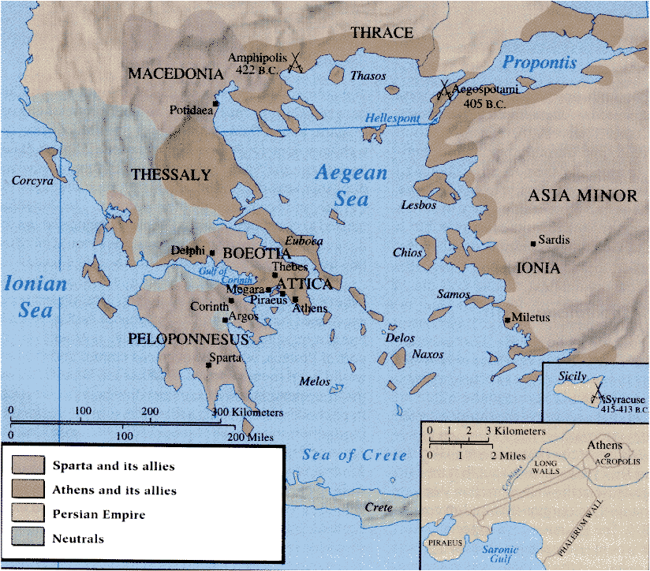
Greek Civilization
The ancient Greece included a large area around the Mediterranean.
Greek city-states appeared about 1000 BC, reaching their high-point around 400 BC.

Slide 4
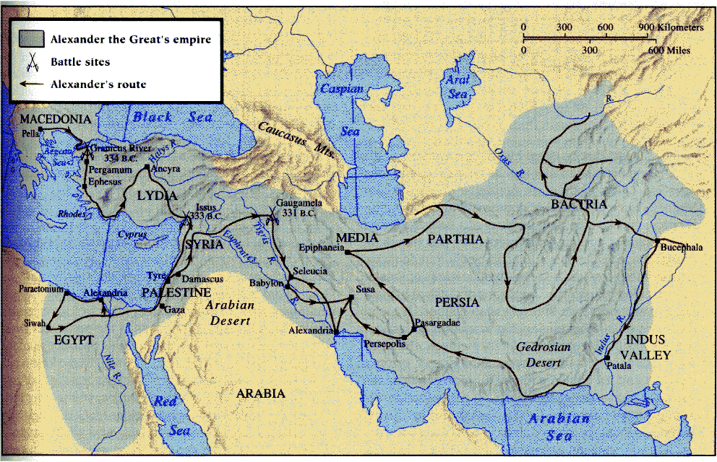
Alexander’s Conquest and Hellenistic Period (320 BC – 30 BC)

Slide 5
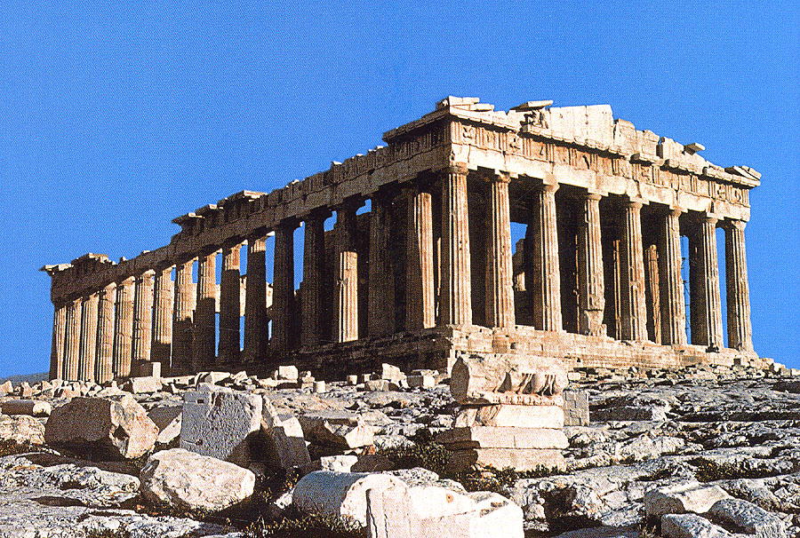
The Parthenon
The arts in classic Greece were designed to express the eternal ideals of reason, moderation, symmetry, balance, and harmony. The Parthenon was built around 440 BC.
Notes:
Parthenon [`pa:θinən]

Slide 6
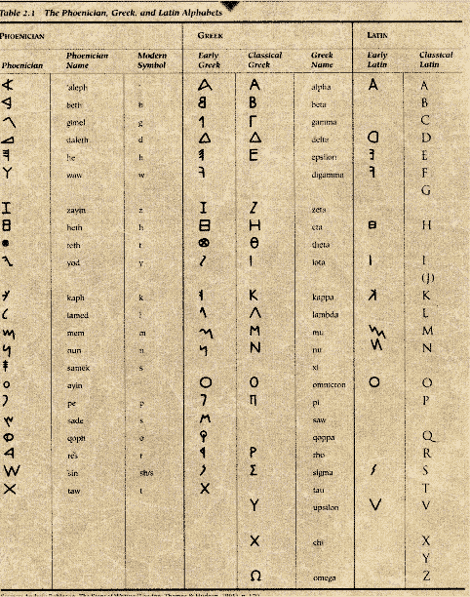
Latin-Family Alphabets
Using symbols to denote sounds of a pronunciation was invented by the Phoenicians, and emulated by many others for their written languages.
Modern English:
A B C D E F G H I J K L M N O P Q R S T U V W X Y Z
a b c d e f g h i j k l m n o p q r s t u v w x y z
Notes:
Ancient Greek and Roman use only capital letters.

Slide 7
The Attic Numerals
I 1
Γ 5
Δ 10
Γ 50
H 100
Γ 500
X 1000
Γ 5000
M 10000
IIII 4
ΓI 6
ΓIIII 9
ΔΔI 21
XXXΓHΔΔΔIII 3633
Δ
H
H
It is an additive system very similar to the Roman numerals.
X
Notes:
The Attic system was used by the Athenians. The sign is derived from Greek name for the numbers: Γ (Γεντε, five), Δ (Δεκα, ten), etc.

Slide 8
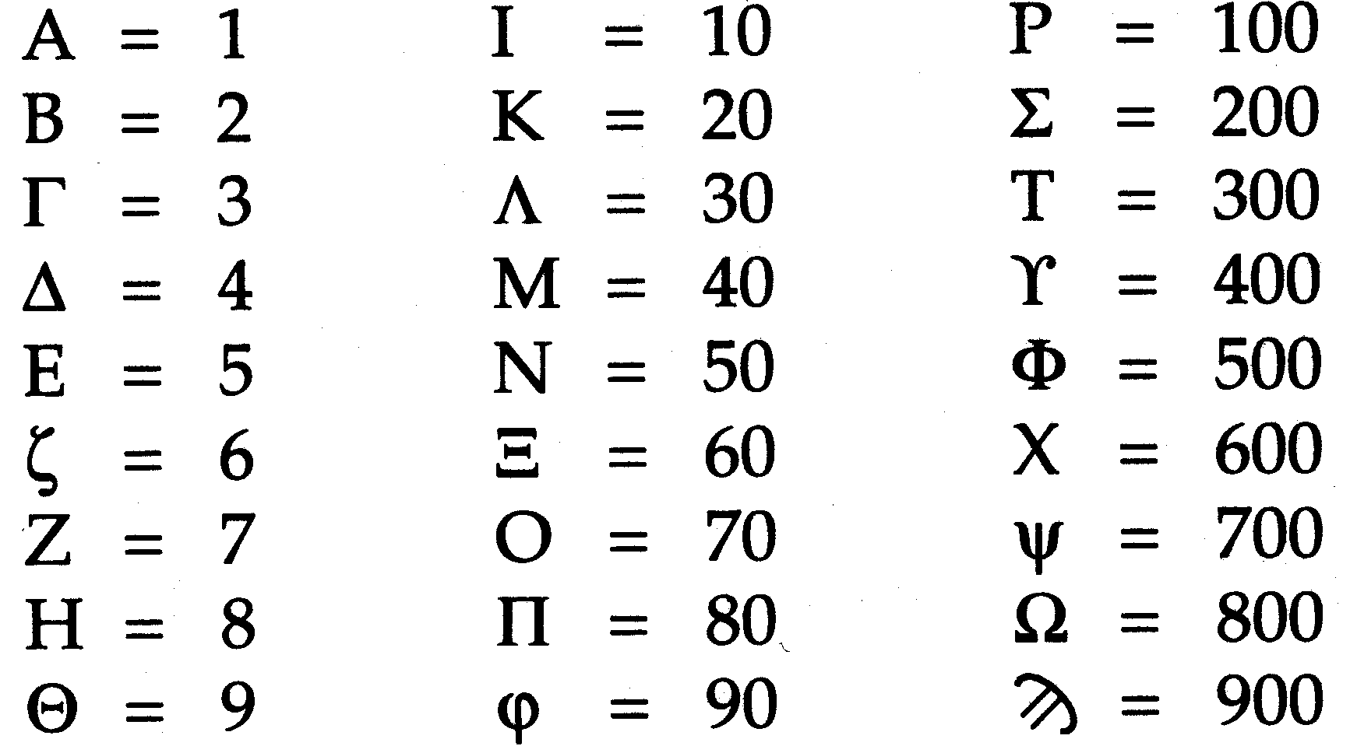
Greek Alphabetic Numerals
E.g., 15 = ΙΕ, 758 =ΨΝΗ
Notes:
Used in Greek part of Asian Minor, started around 200 BC, and displaced the Attic notation after 100 BC. Hebrews used a similar system.

Slide 9
Rise of “Modern” Mathematics
Mathematical “truth” must be proven!
Mathematics builds on itself. It has a structure. One begins with definitions, axiomatic truths, and basic assumptions and then moves on to prove theorems.

Slide 10
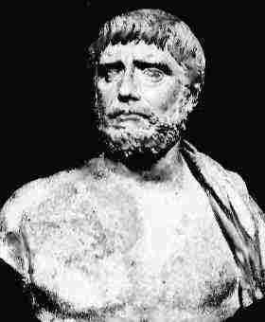
Thales of Miletus (circa 625-547 BC)
Thales is the first to use logic to prove mathematical facts. Many simple geometric theorems are attributed to him, such as the vertical angles theorem, and that the angle inscribed in a semicircle is a right angle.
90◦

Slide 11
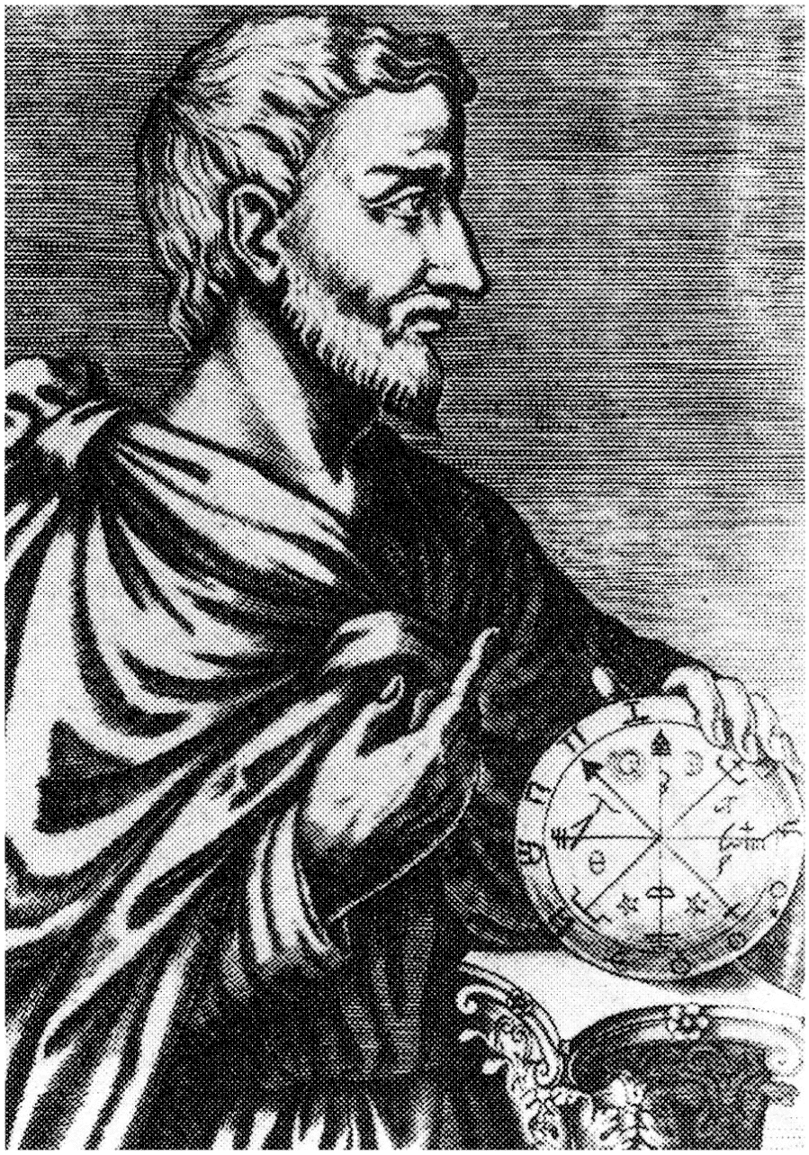
Pythagoras of Samos (circa 580 – 500 BC)
Pythagoras founded a secret society to study mathematics. His doctrine was that “everything is number”. However, when they found out that length of the diagonal of a unit square cannot be expressed as ratio p/q, they got panic, and considered it irrational. He is attributed to have proved a²+b²=c² for a right triangle.
c
a
b
Notes:
Pythagoras [pai`θægərəs].
“everything is a number”, e.g. 1 is reason, 2 stood for man, 3 for woman, and 4 for justice, 5 for marriage. 6 was the number of creation.

Slide 12
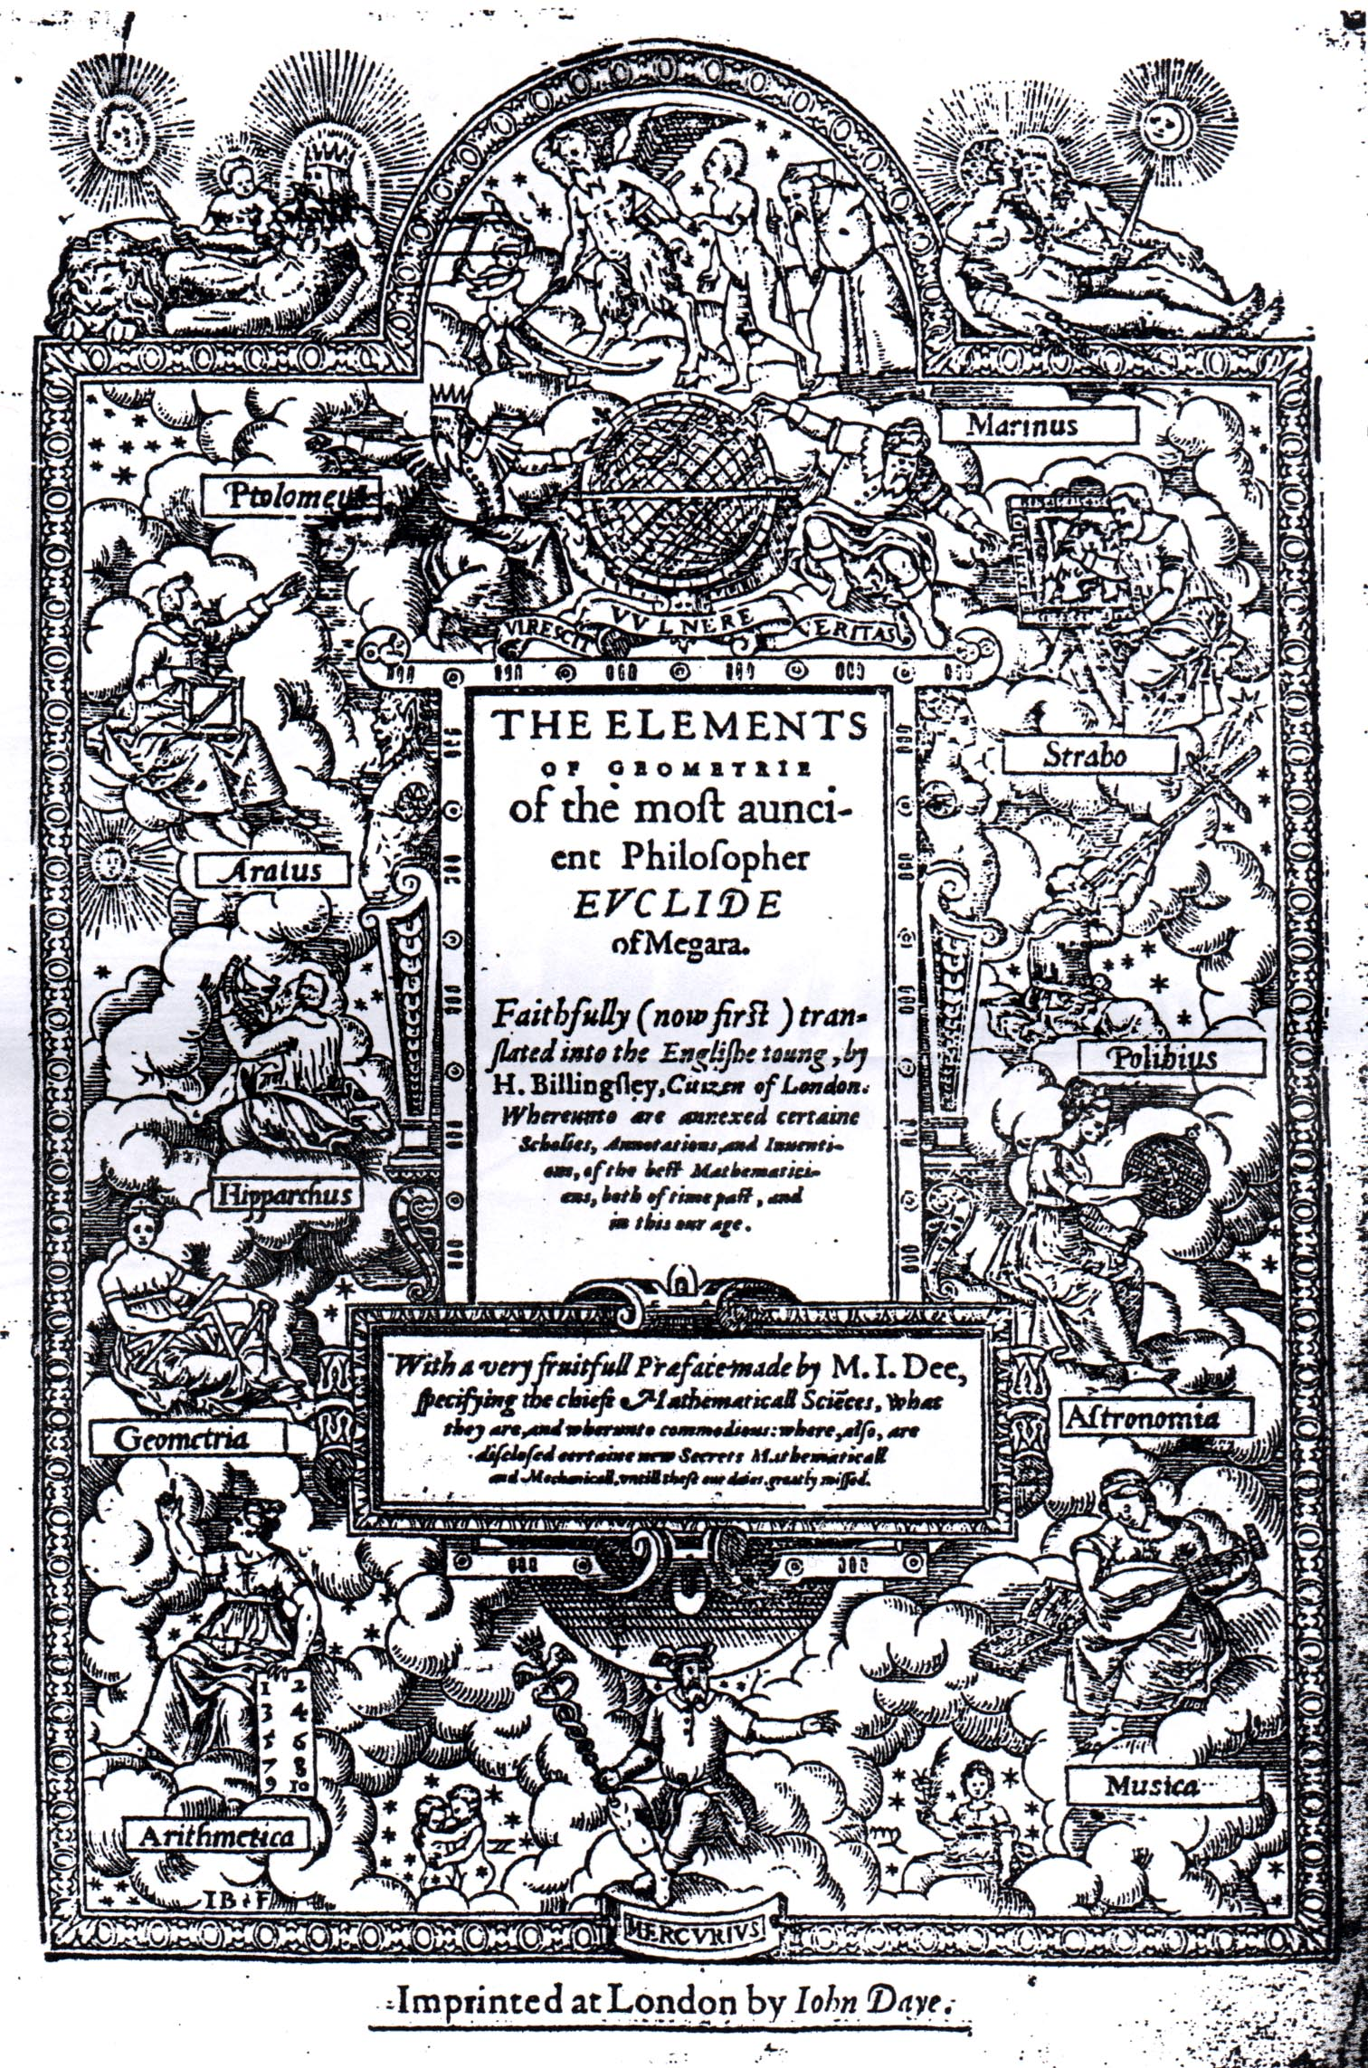
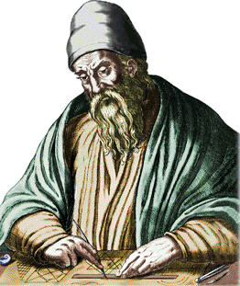
The Euclidean Geometry
Euclid of Alexandria (circa 300 BC).
The book “Elements” by Euclid summarized systematically the mathematical knowledge from antiquity to 300 BC.
Notes:
The 13 volumes consist of I basic definitions, postulates, common notions and the first 48 propositions, II geometric algebra, III circles, IV constructions for inscribed figures. V abstract proportions, VI similar figures, VII, VIII, IX, number theory, X Classification of incommensurables, XI, solid geometry, XII measurement of figures, XIII regular solids.

Slide 13
Definition in Elements
A point is that which has no part.
A line is breadthless length.
A straight line is a line which lies evenly with the points on itself.
When a straight line set up on a straight line makes the adjacent angles equal to one another, each of the equal angles is a right angle.
… …
α
α = 90◦
Notes:
In modern treatment, the point and line are “undefined terms”.

Slide 14
First 4 Postulates in Elements
To draw a straight line from any point to any point.
To produce a finite straight line continuously in a straight line.
To describe a circle with any center and distance.
That all right angles are equal to one another.

Slide 15
The Fifth Postulate
That, if a straight line falling on two straight lines makes the interior angles on the same side less than two right angles, the two straight lines, if produced indefinitely, meet on that side on which are the angles less than the two right angles.
α
β
α + β < 180◦

Slide 16
First Postulate
To draw a straight line from any point to any point.
That is, we can draw one unique straight line through two distinct points:

Slide 17
Second Postulate
To produce a finite straight line continuously in a straight line.
That is, we can extend the line indefinitely.

Slide 18
Third Postulate
To describe a circle with any center and distance.
That is, circle exists.

Slide 19
Fourth Postulate
That all right angles are equal to one another.
90◦
90◦
90◦
90◦

Slide 20
Fifth or Parallel Postulate
The statement of the fifth postulate is complicated. Many attempted to prove the 5th from the first four but failed.
α
α+β < 180◦
β
α+β = 180◦
α
Never intersection
β

Slide 21
Common Notions (Axioms)
Things which are equal to the same thing are also equal to one another. [a=c, b=c => a = b]
If equals be added to equals, the wholes are equal. [a=b => a+c = b+c]
If equals be subtracted from equals, the remainders are equal. [a=b => a-c = b-c]
Things which coincide with one another are equal to one another.
The whole is greater than the part.

Slide 22
Thales’ theorem of “vertical angles are equal”
Straight line spans an angle of 180◦, so
a + c = 180◦, c + b = 180◦
By common notation 1, we have
a + c = c + b
By common notion 3, we subtract c from above, getting
a = b.
c
a
b
Pair of non-adjacent angles a and b are called vertical angles, prove a = b.

Slide 23
Theorem of Transversal Angles
b
From the vertical angle theorem, c = b.
Clearly, c + d = 180◦,
a + d = 180◦ (parallel postulate), so
a = c = b.
c
d
a
The transverse line with two parallel lines makes angles a and b. Show a = b = c.

Slide 24
Angle Sum Theorem
Draw a line through the upper vertex parallel to the base. Two pairs of alternate interior angles are equal, from previous theorem. It follows that
a + b + c = 180◦
a
c
b
a
b
Show the angle sum of a triangle is
a + b + c = 180◦

Slide 25
Side-Angle-Side Theorem
If two triangles have equal lengths for the corresponding side, and equal angle for the included angle, then two triangles are “congruent”. That is, the two triangles can be moved so that they overlap each other.
α
a
b
α
a
b
Notes:
Euclid’s prove is to move the figure so that they coincide. Modern geometry makes this a postulate, rather than a theorem.

Slide 26
Pythagoras Theorem
a
On the sides of a square, draw alternatively length a and b. Clearly, all the triangles are congruent by the side-angle-side theorem. So the four lengths inside the outer square are equal. Since the sum of three angles in a triangle is 180◦, we find that the inner quadrilateral is indeed a square.
Consider two ways of computing the area:
(a+b)² = a² + 2ab + b²,
And c² + 4 ( ½ ab) = c²+2ab.
They are equal, so a²+b² = c².
b
c
Show the sides of a right triangle satisfies
a² + b² = c²
Notes:
Several hundreds of different proofs existed for this theorem.

Slide 27
Non-Euclidean Geometry
5th postulate holds – Euclidean geometry
Parallel lines does not exists (think of great circle on a sphere) – elliptic geometry
Many distinct parallel lines exist – hyperbolic geometry
Notes:
The non-Euclidean geometries was developed by N Lobachevsky (1793-1856), Bolyai (1802-1860), and Gauss (1777-1855).

Slide 28
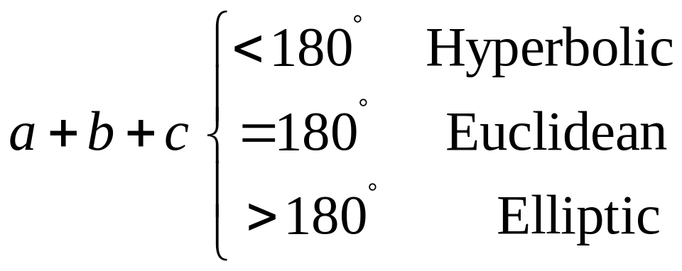
Non-Euclidean Geometry, the angle sum
c
a
b

Slide 29
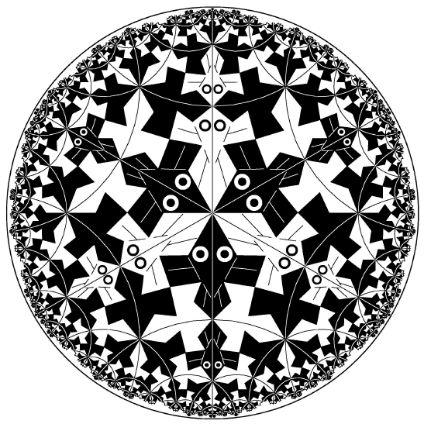
Escher’s Rendering of Hyperbolic Geometry

Slide 30
Euclid’s Number Theory
Definition
An integer a is said to be divisible by an integer d ≠ 0, in symbols d | a, if there exists some integer c such that a = dc.
If a and b are arbitrary integers, then an integer d is said to be a common divisor of a and b if we have both d | a and d | b. The largest one is called greatest common divisor gcd(a,b).
Notes:
Volumes VII, VIII, and IX deals with numebrs.

Slide 31
Example
The positive divisors of 12 are 1, 2, 3, 4, 6, and 12; and that of 30 is 1, 2, 3, 5, 6, 10, 15 and 30. The common divisors are 1, 2, 3, 6.
So gcd(12, 30) = 6.

Slide 32
Division Theorem
For integers a and b, with b > 0, there exists unique integers q and r satisfying
a = q b + r, 0 ≤ r < b.
E.g.: b = 7
1 = 0*7 + 1
−2 = (−1)*7 + 5
28 = 4*7 + 0
−59 = (−9)*7 + 4
a is dividend, b divisor. Integer q is called quotient, integer r is called remainder.

Slide 33
Basis for Euclidean Algorithm
If a = q b + r, 0 ≤ r < b, then
gcd(a,b) = gcd(b, r)
E.g.: a = 30, b = 12, then
30 = 2*12 + 6.
Thus gcd(30, 12) = gcd(12, 6).

Slide 34
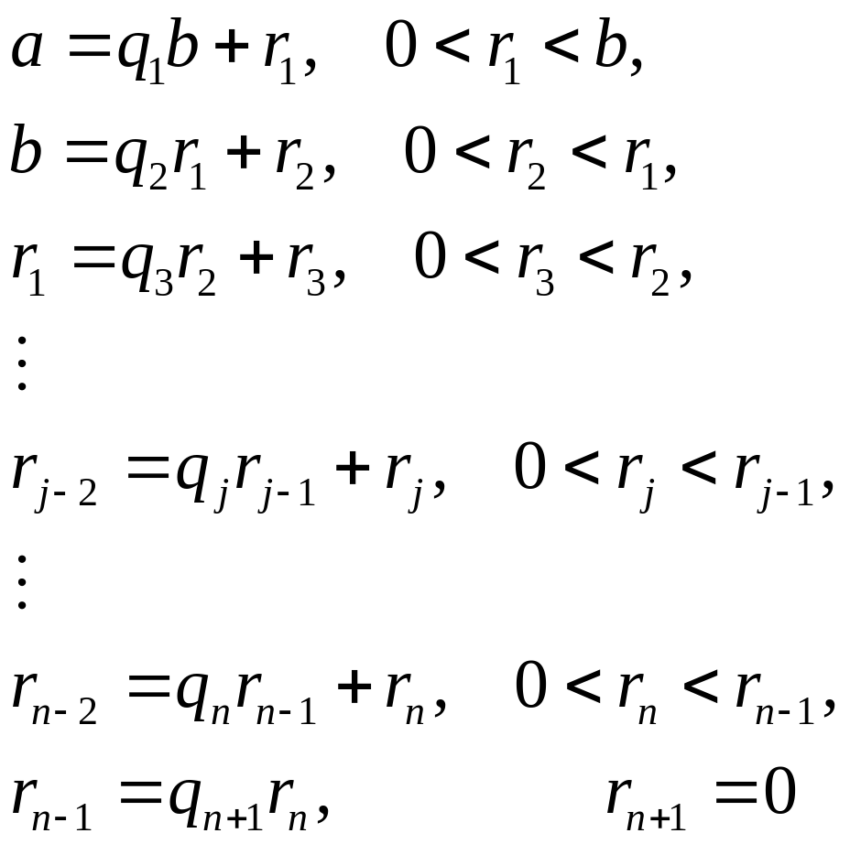
Recursive Application of the Division Theorem
Apply the division theorem using the divisor and remainder of previous step, until the remainder becomes 0, then
gcd(a,b) = r_{n}

Slide 35
Compute gcd(12,30)
12 = 0*30 + 12
30 = 2*12 + 6
12 = 2 * 6 + 0
So, gcd(12,30) = 6.
The last nonzero integer is the greatest common divisor.

Slide 36
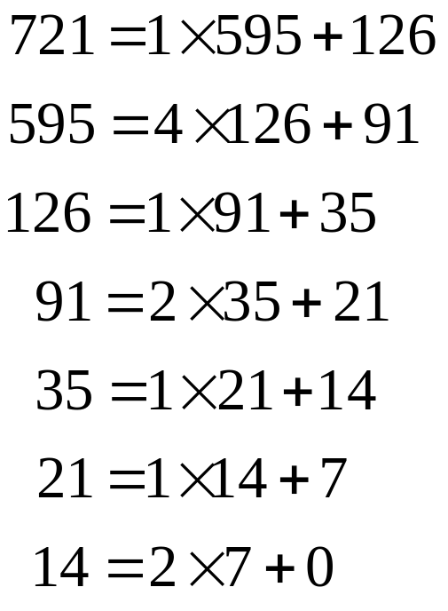
Reduction to Lowest Term
Simplify 595/721
Find the gcd of the two numbers by Euclidean algorithm:
So, gcd(721, 595)=7,
595/721 = (595/7) / (721/7)
= 85/103

Slide 37
Euclidean Algorithm
Let x take the value of a, d value of b
Compute q and r in x = q*d + r
If r = 0, then gcd = d; stop
Let x take the current value of d, replacing current value of d with value of r, go to step 2.
x
d
r
q

Slide 38
Summary
Greek numerals are inconvenient to do computation with
Greek geometry was developed to its highest around 300 BC with the logical deduction as its foundation
Euclidean algorithm for computing greatest common divisor is one of the oldest algorithm suitable for machine execution.

