Slide 1
Counting Boards and Rods
Lecture Four

Slide 2
Outline
Roman empire
Roman numerals and counting board
Chinese counting rods and computation
Chinese/Japanese Abaci
The rise of Hindu-Arabic numerals

Slide 3
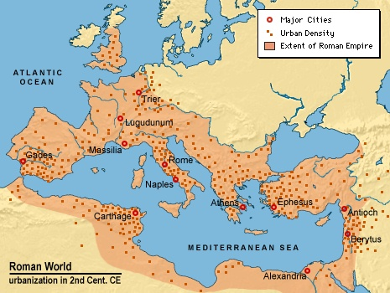
Roman Empire
The Roman world started around 300 BC. It lasted until 300 AD and split into two, western and eastern (Byzantine Empire). Western fell quickly, but the Eastern stayed until 1453.

Slide 4
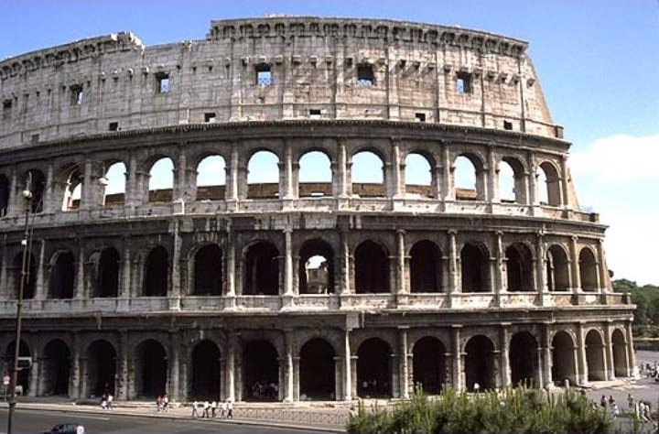
The Colosseum
The Amphitheater was built in 80 AD in Rome. There are complex pass ways and rooms below the arena floor. It can hold 50,000 spectators.
Notes:
Colosseum [kalə`siəm]

Slide 5
Roman Numerals
I 1
V 5
X 10
L 50
C 100
D 500
M 1000
Early Roman numerals are purely additive.
III 3
IIII 4
VII 7
VIIII 9
DCCCCI 901
MMDLXIII 2563

Slide 6
Subtractive Form
IV 4
VI 6
IX 9
XI 11
XC 90
CX 110
More than two letters on the left are not used, e.g., we write VIII, but not IIX for 8.
I (1) II (2) III (3) IV (4)
V (5) VI (6) VII (7) VIII (8)
IX (9) X (10) XI (11) XII (12)
Notes:
The subtractive form becomes popular only much later, around 1600 AD.

Slide 7
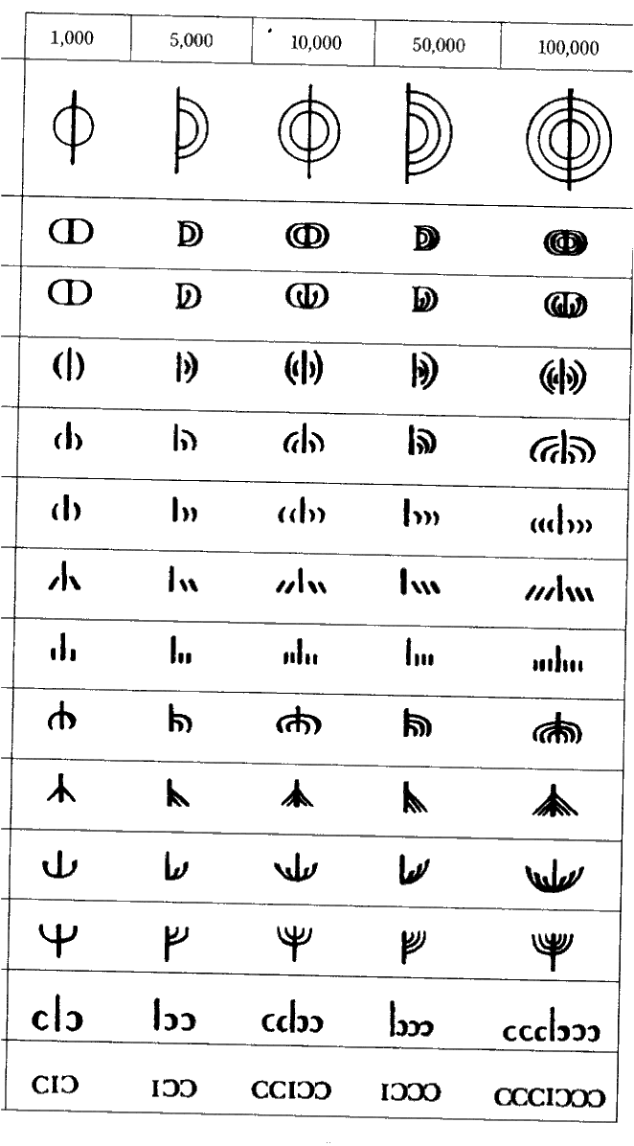
Bigger Numbers
CI
1000, same as M
C
CCI
10,000
CC
CCCCI
CCCC
or M
1,000,000
CCI
CCI
CC
CC
CCI
CI
DXXXVI
26,536
C

Slide 8
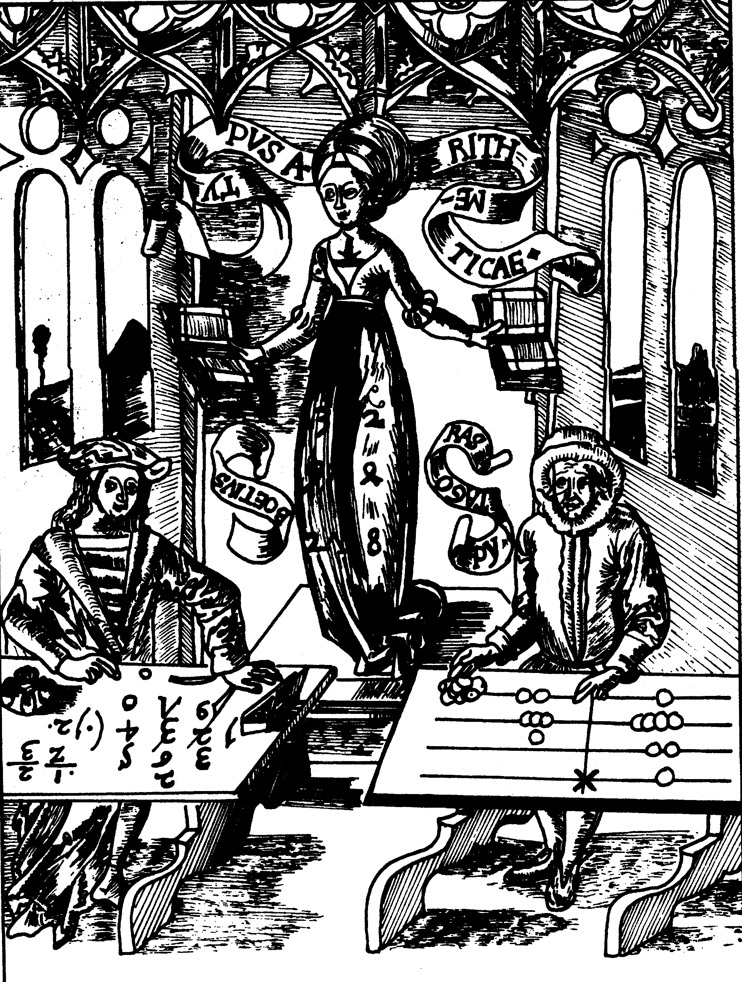
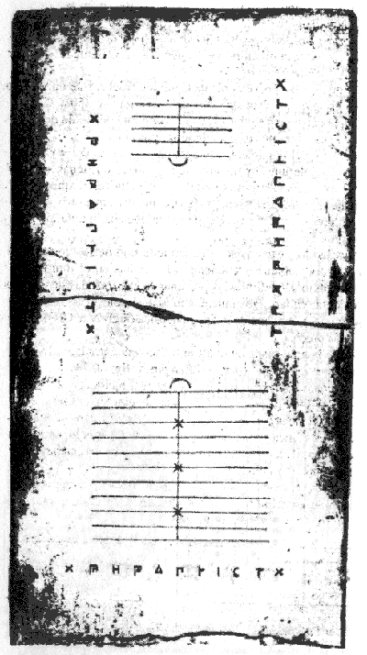
Counting Board
One of the earliest counting board found in Salamis Island, dating about 400 BC. Counting board was used in Europe until about 1500 AD.
Hindu-Arabic vs Counting Board
Notes:
Introduction can be found at http://faculty.ed.umuc.edu/~swalsh/Math%20Articles/MathArt.html in the first section “history”. Other sections are interesting to read.
Left figure: On the left hand of the female figure personifying Arithmetic sits Pythagoras at a line-board on which the numbers 1241 and 82 have been formed; at the right hand of Arithmetic Boëthius faces his computations in Indian numerals. The Middle Ages believed erroneously that these two men were the inventors of the respective forms of computations. The original figure is in “Margarita Philosophica” of Gregor Reisch, 1503. From K Menninger, “Number Words and Number Symbols”, MIT Press, 1969.
Salamis is west of Athens in Greece.

Slide 9
Counting Board
A board with lines indicating 1, 10, 100, and 1000.
In-between lines stand for 5, 50, and 500.
M (1000)
D
C (100)
L
X (10)
V
A pile of pebbles for calculation
I (1)
Notes:
This type of board, known as line board, was most popular in the Middle Age Europe.

Slide 10
Counting Board Number
MMMDCCCLXXIIII (3874)
M
D
C
L
X
V
I

Slide 11
Counting Board MMDCCXXXVII + MMMDCCCLXXIIII
MMDCCXXXVII (2737)
MMMDCCCLXXIIII (3874)
M
D
C
L
X
V
I

Slide 12
Counting Board MMDCCXXXVII + MMMDCCCLXXIIII
MMMMMDDCCCCCLXXXXXVIIIIII
M
D
C
L
X
V
I
Push all the pebbles to the right

Slide 13
Counting Board MMDCCXXXVII + MMMDCCCLXXIIII
Neaten it up by the following rules:
Every 5 pebbles on the line go up in-between the line 1 pebble; every 2 in-between line pebbles go to the above line 1 pebble.
MMMMMDDCCCCCLXXXXXVVI
M
D
C
L
X
V
I
Notes:
This step is also called “purify”.

Slide 14
Counting Board MMDCCXXXVII + MMMDCCCLXXIIII
Neaten it up by the following rules:
Every 5 pebbles on the line go up in-between the line 1 pebble; every 2 in-between line pebbles go to the above line 1 pebble.
MMMMMDDCCCCCLXXXXXXI
M
D
C
L
X
V
I

Slide 15
Counting Board MMDCCXXXVII + MMMDCCCLXXIIII
Neaten up, continued
MMMMMDDCCCCCLLXI
M
D
C
L
X
V
I

Slide 16
Counting Board MMDCCXXXVII + MMMDCCCLXXIIII
Neaten it up by the following rules:
Every 5 pebbles on the line go up in-between the line 1 pebble; every 2 in-between line pebbles go to the above line 1 pebble.
MMMMMDDCCCCCCXI
M
D
C
L
X
V
I

Slide 17
Counting Board MMDCCXXXVII + MMMDCCCLXXIIII
Neaten it up by the following rules:
Every 5 pebbles on the line go up in-between the line 1 pebble; every 2 in-between line pebbles go to the above line 1 pebble.
MMMMMDDDCXI
M
D
C
L
X
V
I

Slide 18
Counting Board MMDCCXXXVII + MMMDCCCLXXIIII
Neaten it up by the following rules:
Every 5 pebbles on the line go up in-between the line 1 pebble; every 2 in-between line pebbles go to the above line 1 pebble.
MMMMMMDCXI
M
D
C
L
X
V
I

Slide 19
Counting Board MMDCCXXXVII + MMMDCCCLXXIIII = I MDCXI
CC
Final answer:
I MDCXI (6611)
CC
M
D
C
L
X
V
I

Slide 20
Counting Board Subtraction
MMMMCCCCXXI (4421) MMDCXXXVIII (2638)
M
D
C
L
X
V
I
Not enough I’s to subtract off

Slide 21
Counting Board Subtraction
MMMMCCCCXXI (4421) MMDCXXXVIII (2638)
M
D
C
L
Not enough X to subtract off
X
V
I
Borrow 1 from X line to get 1 V and 5 I

Slide 22
Counting Board Subtraction
MMMMCCCCXXI (4421) MMDCXXXVIII (2638)
M
Not enough D
D
C
L
X
V
I
Borrow 1 from C line to get 1 L and 5 X

Slide 23
Counting Board Subtraction
MMMMCCCCXXI (4421) MMDCXXXVIII (2638)
M
D
C
L
X
V
I
Borrow 1 from M line to get 2 D

Slide 24
Counting Board Subtraction
Result :MDCCLXXXIII (1783) MMDCXXXVIII (2638)
M
D
C
L
X
V
I
Subtract off

Slide 25
Counting Board Multiply 83x26
XXVI (26)
LXXXIII (83)
M
D
C
L
X
V
I
Consider 26 as 20 + 2 + 4

Slide 26
Counting Board Multiply 83x26
XXVI (26)
LXXXIII × II (83 × 2)
M
D
C
L
X
V
I
Double 83 first

Slide 27
Counting Board Multiply 83x26
XXVI (26)
CLXVI (166)
M
D
C
L
X
V
I
Neaten up the doubling result

Slide 28
Counting Board Multiply 83x26
XXVI (26) LXXXIII × II
LXXXIII × XX (83 × 20)
M
D
C
L
X
V
I
Multiply by 10 by shifting up 1 line
Save a copy of doubled number for later use

Slide 29
Counting Board Multiply 83x26
XXVI (26) LXXXIII × II
LXXXIII × XX (83 × 20)
M
D
C
L
X
V
I
Save 83 × 20, copy 83 × 2

Slide 30
Counting Board Multiply 83x26
XXVI (26) LXXXIII × II
LXXXIII × IIII (83 × 4)
M
D
C
L
X
V
I
Doubling the doubled number, to get 83 × 4

Slide 31
Counting Board Multiply 83x26
XXVI (26) LXXXIII × II
LXXXIII × XX (83 × 20)
M
D
C
L
X
V
I
Neaten up LXXXIII × IIII

Slide 32
Counting Board Multiply 83x26
XXVI (26)
83 × (20+2+4)
M
D
C
L
X
V
I
Push the saved copies over

Slide 33
Counting Board Multiply 83x26
XXVI (26)
The product is MMCLVIII (2158)
M
D
C
L
X
V
I
Clean up the result

Slide 34
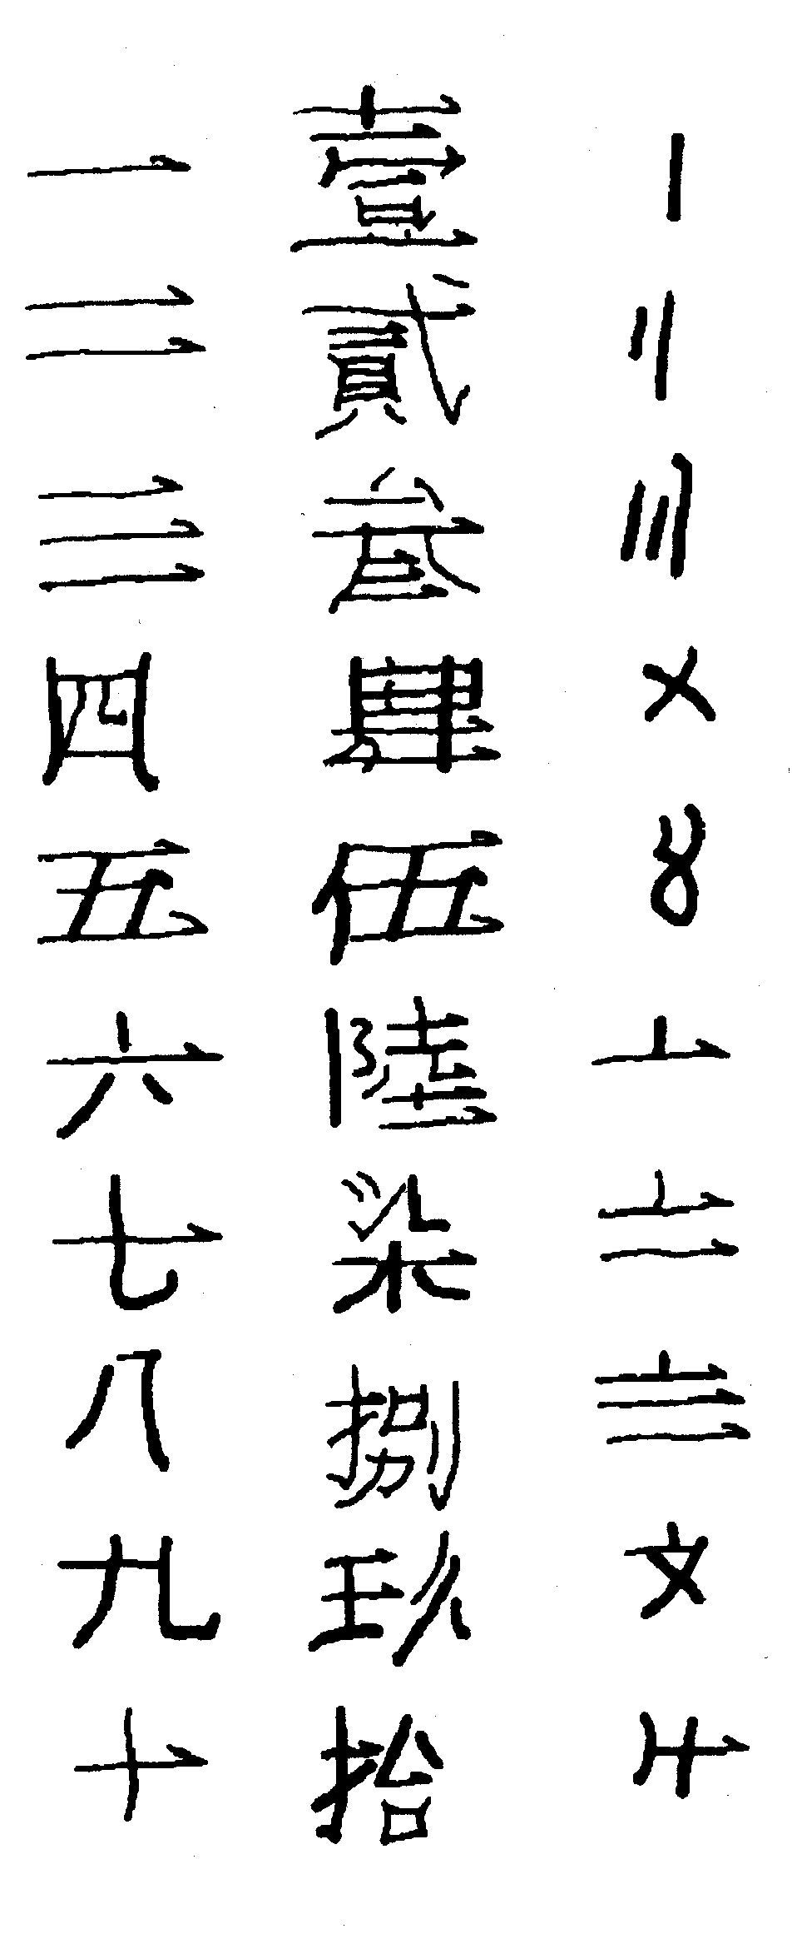
Chinese Numerals
Chinese used a base 10 system from the very beginning. It is nearly a positional system. The earliest important mathematical writing is the “Jiu zhang suanshu” (九章算術, Nine chapters on the mathematical art), representing the mathematical achievement around 1100 BC to 220 AD.
The leftmost numerals for normal use, the center one for very formal situation (such as amount for money), the right one for casual use (e.g., wet market).
1
2
3
4
5
6
7
8
9
10
Notes:
One can see that the casual form of written is derived from the rod representation of numbers.

Slide 35
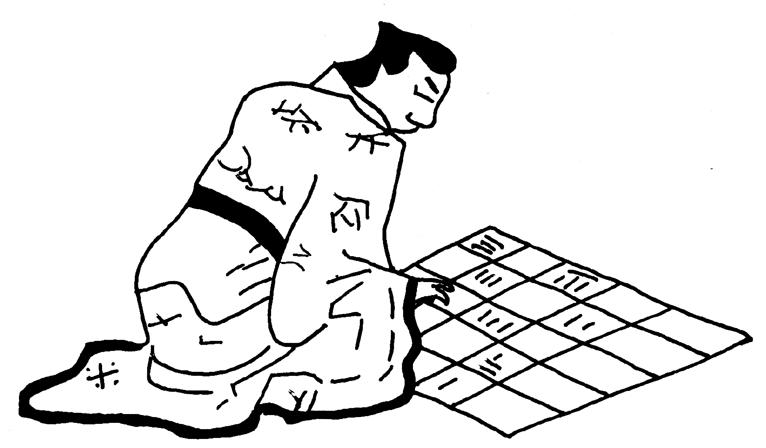
Chinese Rod Number & Board
The Chinese rod numerals were used at least round 400 BC. The square counting board was used until about 1500 AD before abacus replaced it.
1 2 3 4 5 6 7 8 9
Notes:
Art work scanned from M R Williams, “A History of Computing Technology,” p. 30.

Slide 36
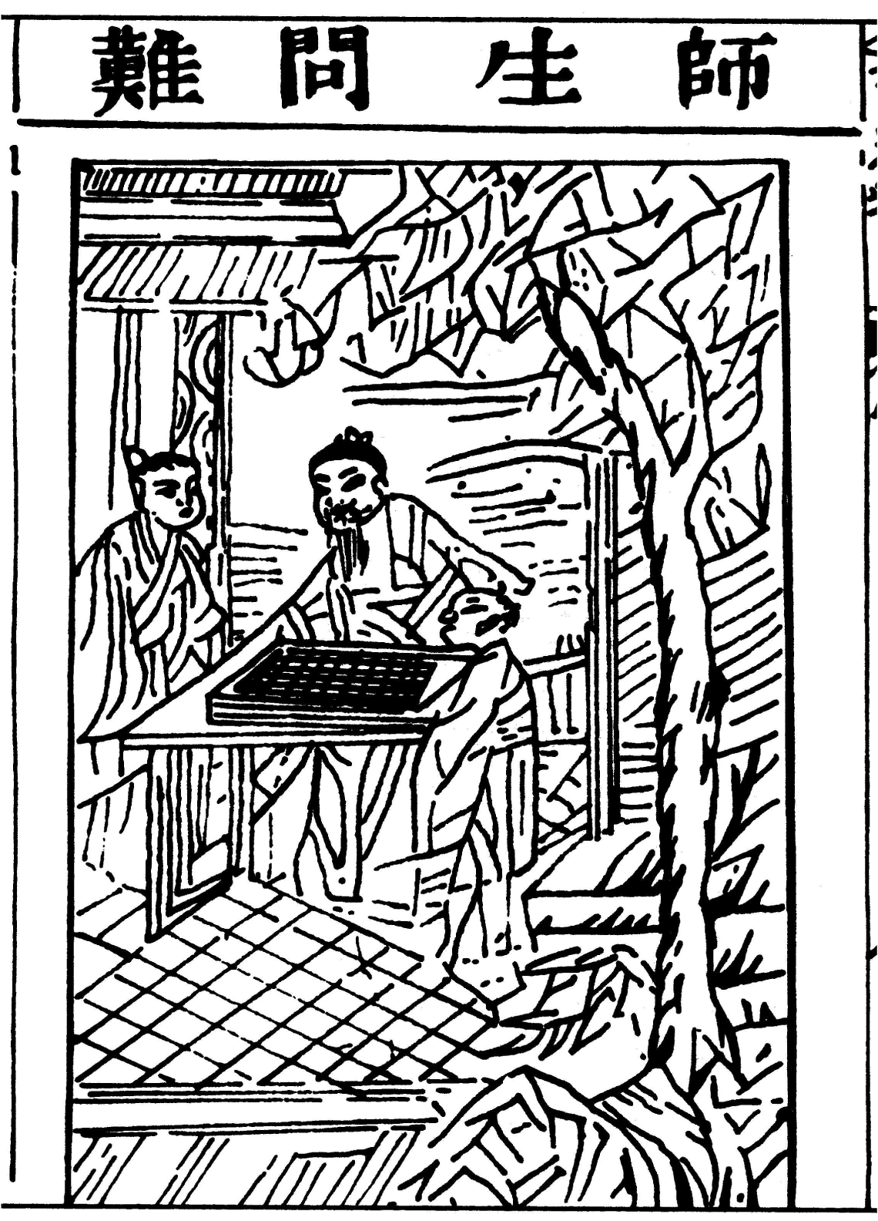
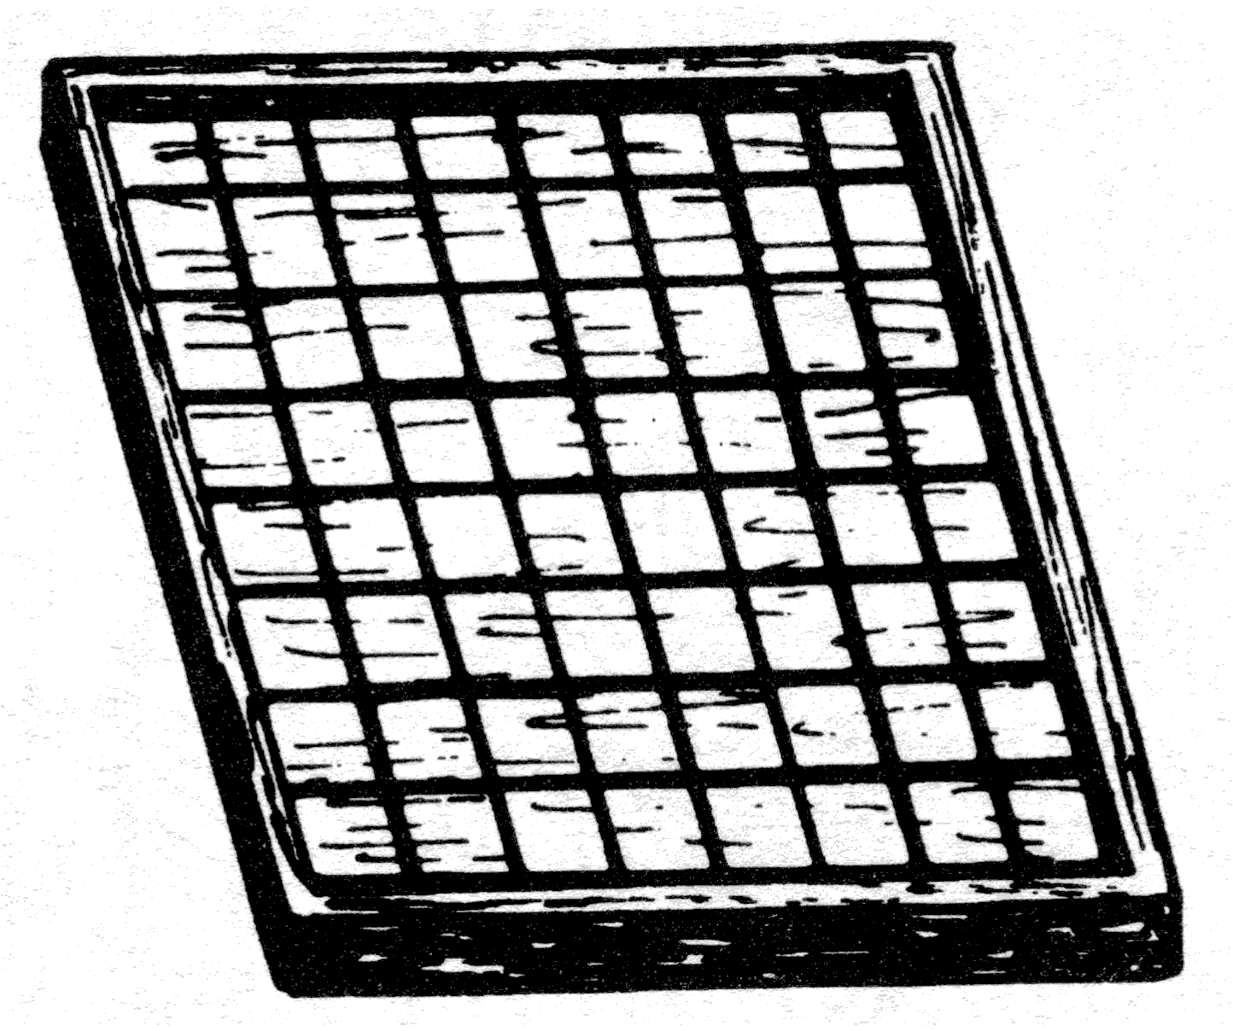
Art of Arithmetic
Model of a Chinese checkerboard use for calculation.
A Chinese Master teaches the arts of calculation to two young pupils, using an abacus with rods. From the Suan Fa Tong Zong (算法統宗, 1593).
Notes:
Figures from G. Ifrah, “the Universal History of numbers”, (Wiley & Sons, 2000) p.283 & 284.

Slide 37
Chinese Numerals
The digits are written with alternating horizontal and vertical versions to void confusion.
Symbol 0 was invented only much later; space was used for 0.
65392
64302

Slide 38
Multiplication with rods, 81 x 81
80x80=6400
80x1=80
8 1
8 1
8 1
6 4
8 1
8 1
6 4 8
8 1
The method appeared in Sun Zi Suanjing (孙子算经) ca. 400 AD.
Notes:
See Lam Lay Yong, Chinese Science 13 (1996) 35-54, for the rod multiplication and division.

Slide 39
Multiplication with rods, 81 x 81
1x80=80
Take away upper 80, shift lower 81 to right
Add 80 into the middle row
8 1
6 4 8
8 1
1
6 4 8
8 1
1
5 6
8 1
Notes:
See Lam Lay Yong, Chinese Science 13 (1996) 35-54, for the rod multiplication and division.

Slide 40
Multiplication with rods, 81 x 81
Take away upper and lower rods
Final result
1 x 1 = 1
1
6 5 6
8 1
1
6 5 6 1
8 1
6 5 6 1
Notes:
See Lam Lay Yong, Chinese Science 13 (1996) 35-54, for the rod multiplication and division.

Slide 41
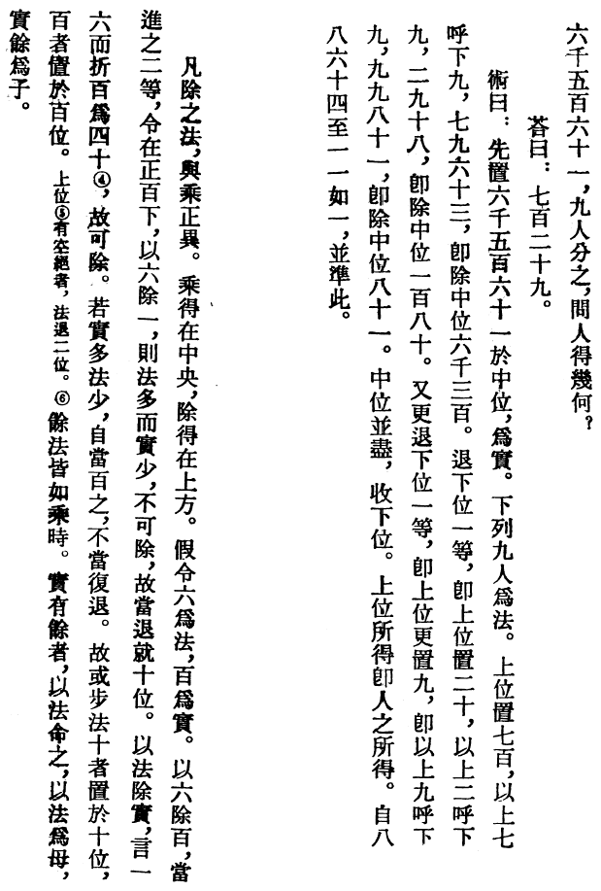
Division
Translation (of the left strip):
In the common method of division, this is the reverse of multiplication. The dividend occupies the middle position and the quotient is placed above it. Suppose 6 is the divisor and 100 is the dividend. When 6 divides 100, it advances two places to the left so that it is directly below the hundreds. This implies the division of 1 by 6. In this case, the divisor is greater than the dividend, so division is not possible. Therefore shift 6 to the right so that it is below tens. Using the divisor to remove the dividend, one six is 6 and 100 is reduced to 40, thus showing that division is possible. If the divisor is less than that part of the dividend above it, it should then stay below the hundreds and should not be shifted. It follows that if the units of the divisor are below the tens of the dividend, the place value of the digits of the quotient is tens; if they are below the hundreds, the place value of the digits of the quotient is hundreds. The rest of the method is the same as multiplication. As for the remainder of the dividend, this is assigned to the divisor such that the divisor is called the denominator and the remaining dividend the numerator.
General method of division, left, and example of 6561÷9, right, in Sun Zi suanjing.

Slide 42
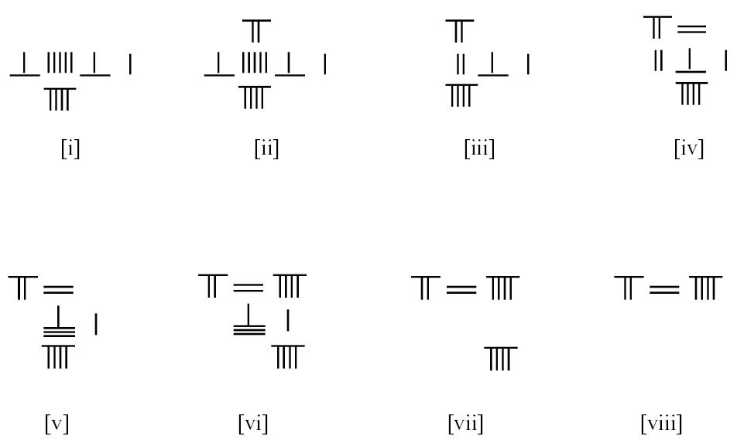
6561 ÷ 9
Ans:
729

Slide 43
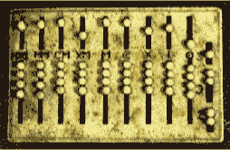
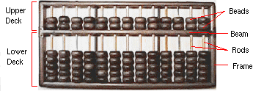
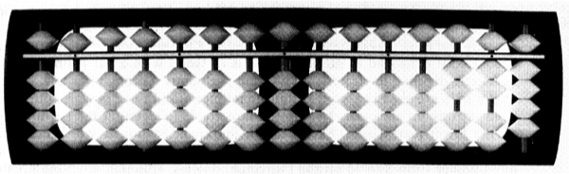
Abacus
Roman Abacus
Abacus is an Latin word, related to Greek “abax”, meaning table. They are probably derived from older Hebrew word “abaq” meaning sand.
The word `calculus’ originally means pebble in Latin, as used in counting board.
Chinese Abacus
Japanese
Soroban
Notes:
The Chinese Abacus appeared around 1100AD, it was introduced to Japan around 1500 AD.

Slide 44
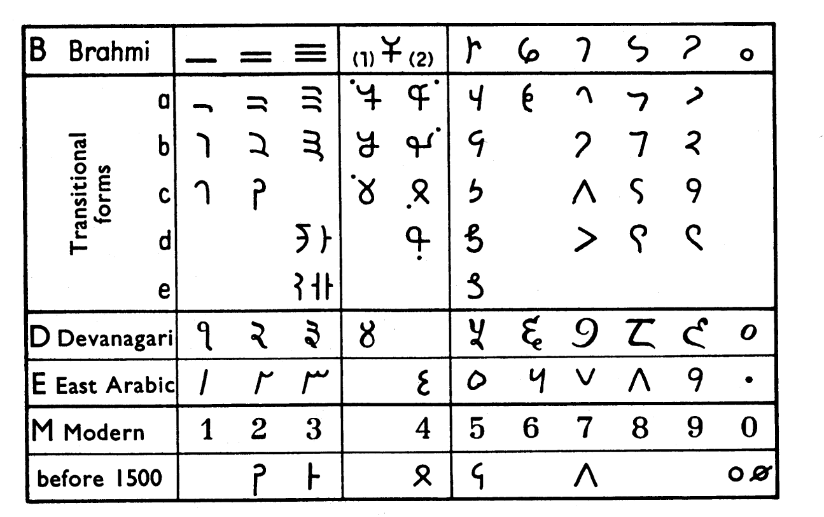
The Hindu-Arabic Numerals
The form of Hindu-Arabic numerals evolved over the centuries. It started from India, and get transmitted to the Arabic world in 700AD. It is known to the European about 1000 AD, but wide-spread use is only after 1400 AD.

Slide 45
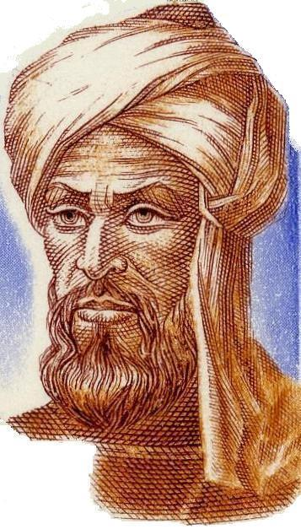
Al-Khowârizmî (circa 780-850)
Mohammad ibn Mûsâ Al-Khowârizmî, Arab mathematician of the court of Mamun in Baghdad. He wrote treatises on arithmetic using Hindu numerals and algebra. Much of the mathematical knowledge of medieval Europe was derived from Latin translations of his works. His systematic and step-by-step way of calculation is known as “algorithmic”, after his name.

Slide 46
Summary
Roman numeral is used throughout the western world until 1400 AD, then Hindu-Arabic numbers replace it.
Chinese numerals (rod-type) are base-10 position system. The operations are essentially the same as Hindu-Arabic arithmetic.
Abacists: use counting board or abacus; algorithmists: use Hindu-Arabic numerals, like what we do today with pencil and paper.

