Slide 1
Napier’s Bones, Logarithm, and Slide Rule
Lecture Six
Notes:
This paper at the side below seems good one for Napier’s bones and slide rule. You can print the pages for the bones and Genaille-Lucas rulers.
http://www.projects.ex.ac.uk/trol/trol/trolha.pdf

Slide 2
Outline
Medieval Mathematics
Napier’s bones for multiplication and Genaille-Lucas Rulers
Logarithm
Slide Rules

Slide 3
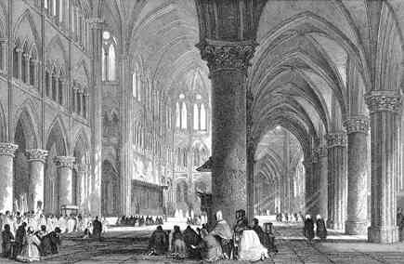
The Dark Age
After the fall of Roman Empire (about 400 AD), Europe went into a stagnation. The Christian churches dominated the scene; mathematical inquiries fell into decline. This lasted until 1300 AD when renaissance picked up speed.

Slide 4
Gelosia Method of Multiplication
7 6 5
Write down the single digit result with higher digit on the up right left and least significant digit on the lower right triangle. Add the numbers along the diagonals with carry. We get
765 × 321 = 245565.
2
1
1
3
2
1
8
5
4
1
1
1
2
4
2
0
0
0
0
1
5
7
6
5
5 6 5
Notes:
The gelosia method probably originated from India. Why it is called Gelosia method?

Slide 5
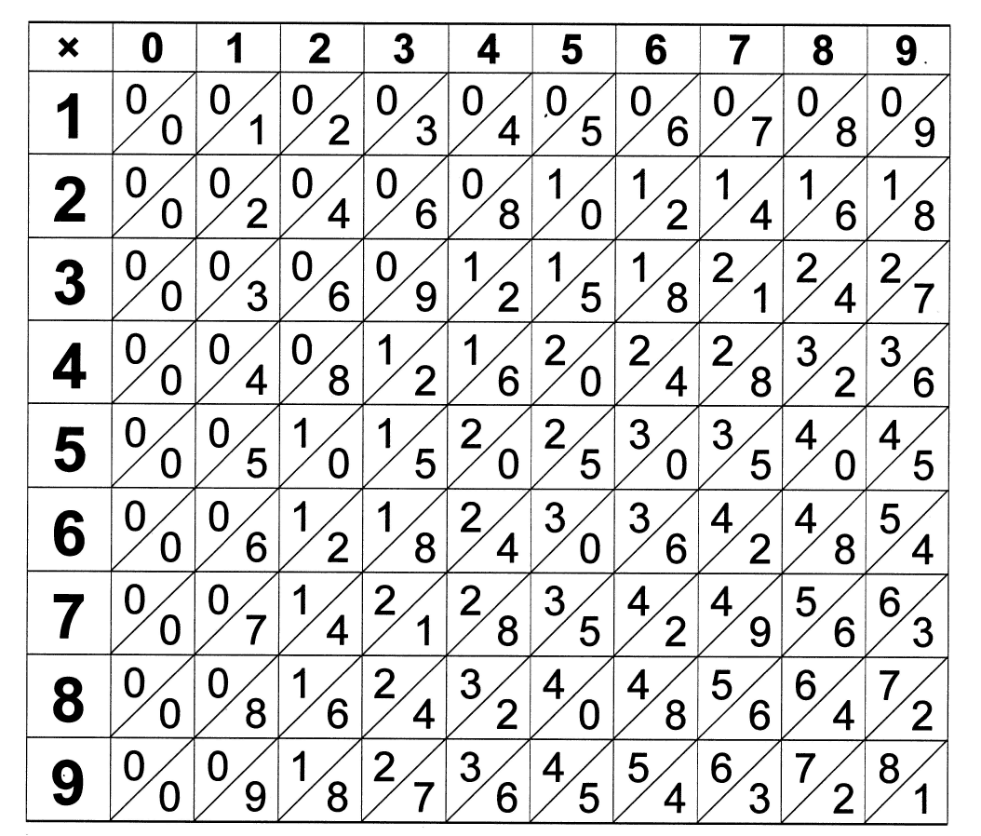
Napier’s Bones
The Napier’s bones consist of vertical strips of the table. Each entry is the product of index number and strip number, e.g., 7 x 8 = 56, with 5 at the upper left half of square and 6 on lower right.
Notes:
Napier called his bones “Rabdologia”, the name “bones” arose from the fact that the better quality sets were constructed from horn, bone, or ivory. Square root can also be calculated with additional strip.

Slide 6
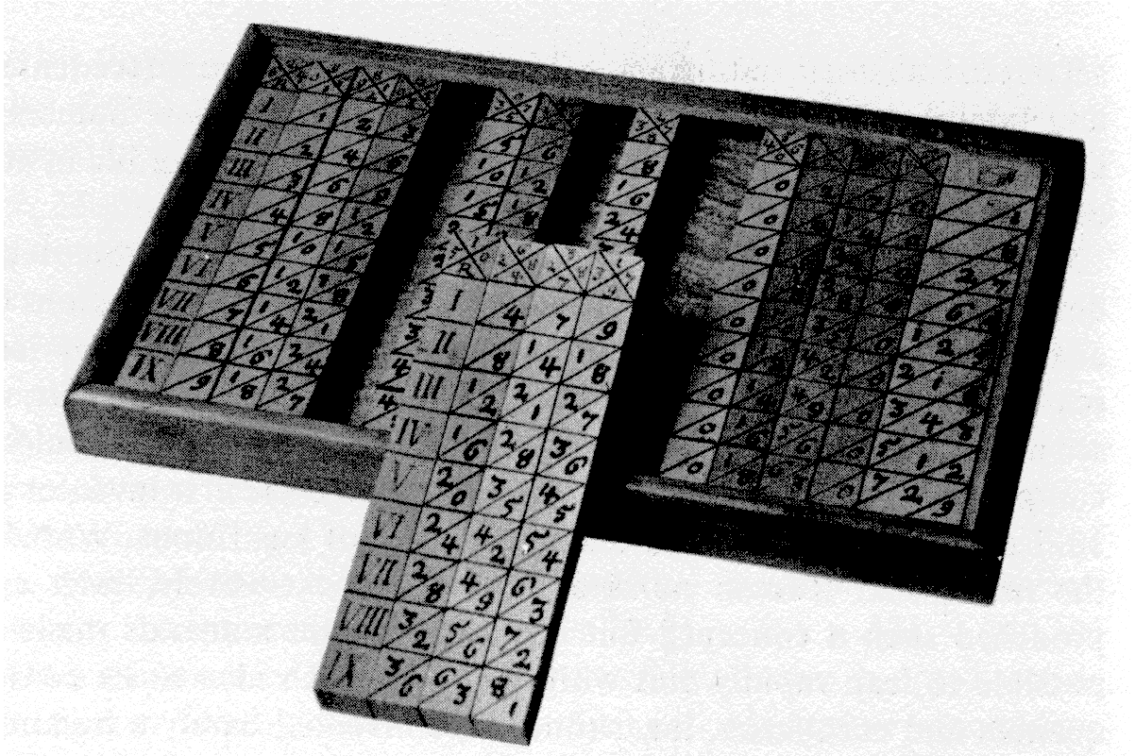
The “Bones”
A box of Napier’s “bones”, one of the oldest calculating “machine” invented by the Scotsman Napier in 1617. The strips with 4, 7, 9 give partial products of any digit from 1 to 9 times 479.

Slide 7
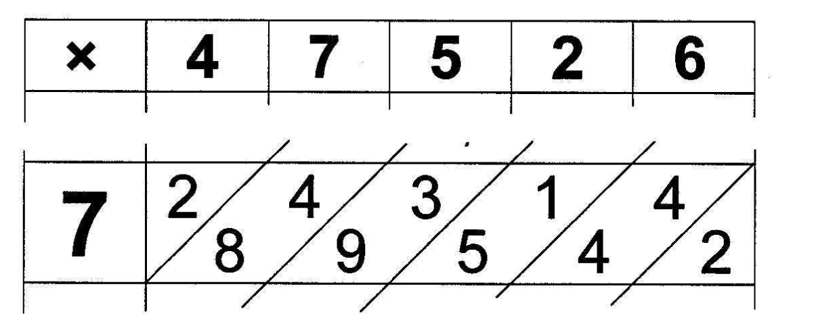
Example of Use of Napier’s Bones
3 3 2 6 8 2
Result for 7 × 47526

Slide 8
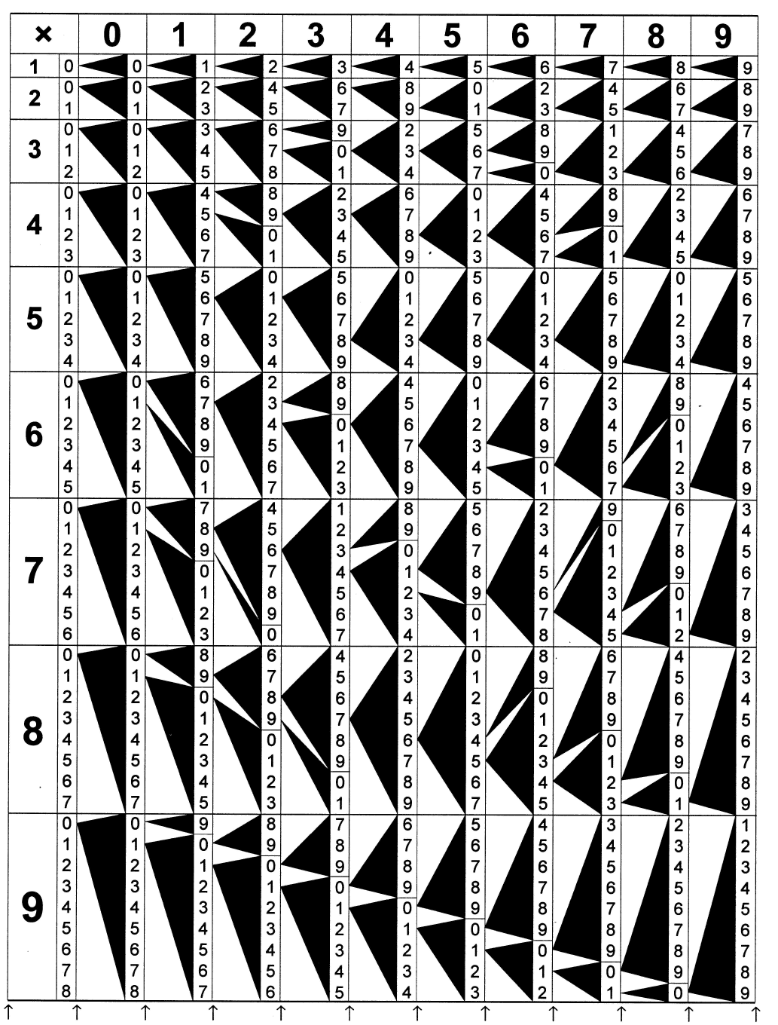
Genaille-Lucas Rulers
Similar to Napier’s bones, but without the need to mentally calculate the partial sum. Just follow the arrows and read off the answer backwards (least significant to most significant digits).
The device was invented by Genaille in 1885.
Notes:
There is a little error in the strip at 4x5 and 5x5.

Slide 9
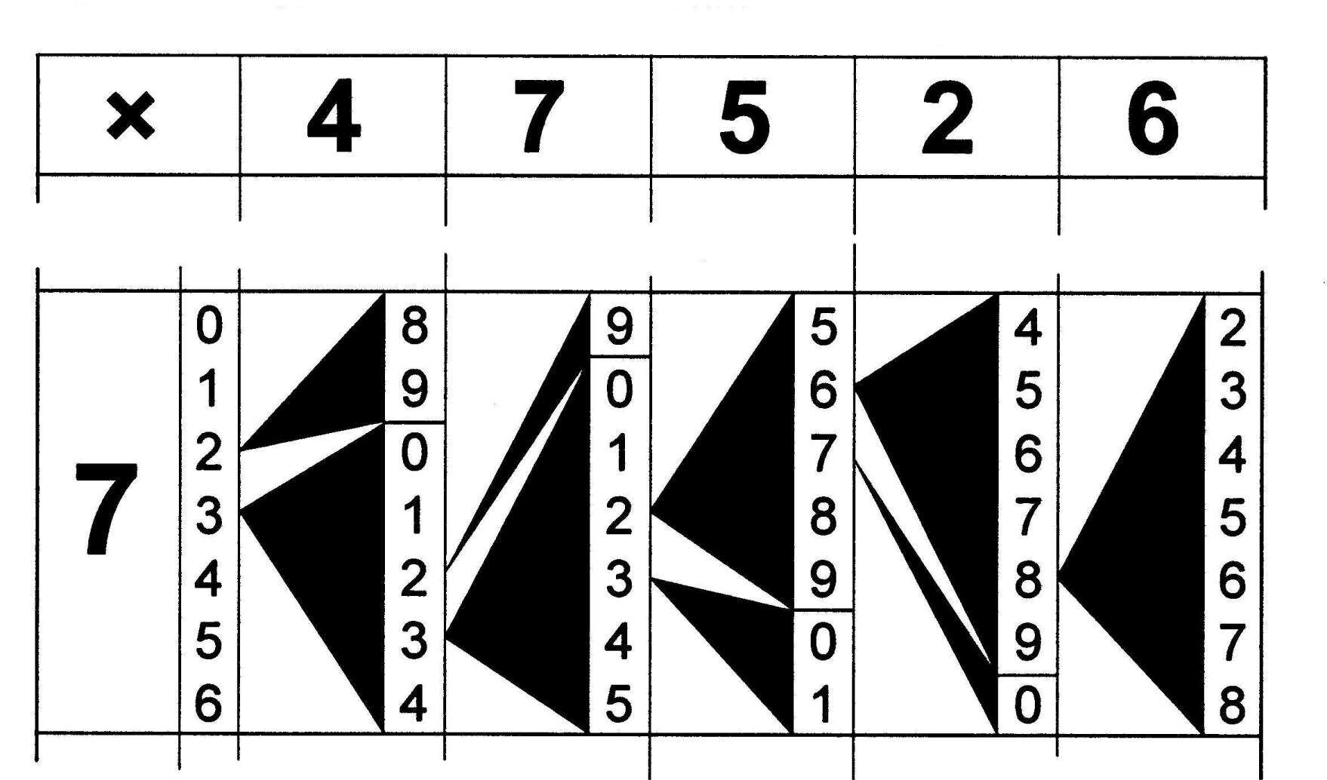
Use of the Genaille Ruler
Must start from the topmost number.
We read 2 -> 8 -> 6 -> 2 -> 3 -> 3
Or
7 × 47526 = 332682.
This is part of the strip.

Slide 10
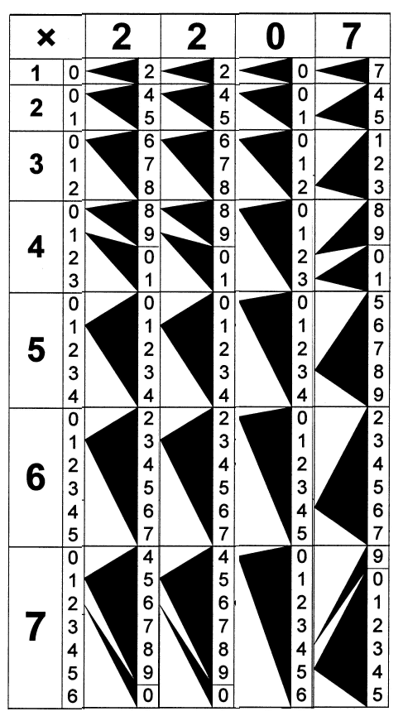
Genaille Ruler, 2207×47
Use the strip 2 twice, strip 0, and 7 to form 2207. Read from the 4th row, we get 08828 (starting from topmost, then following the arrows), and 7th row, 15449. Then add
88280
+ 15449
103729

Slide 11
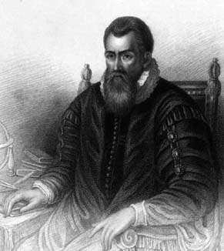
Inventor of Logarithm
“Seeing there is nothing (right well-beloved Students of the Mathematics) that is so troublesome to mathematical practice, nor that doth more molest and hinder calculators, than the multiplications, divisions, square and cubical extractions of great numbers, which besides the tedious expense of time are for the most part subject to many slippery errors, I began therefore to consider in my mind by what certain and ready art I might remove those hindrances. And having thought upon many things to this purpose, I found at length some excellent brief rules to be treated of (perhaps) hereafter. But amongst all, none more profitable than this which together with the hard and tedious multiplications, divisions, and extractions of roots, doth also cast away from the work itself even the very numbers themselves that are to be multiplied, divided and resolved into roots, and putteth other numbers in their place which perform as much as they can do, only by addition and subtraction, division by two or division by three.”
John Napier (1550-1617) on logarithm

Slide 12
Concept of Logarithm
Consider the sequence of power of 2:
0 1 2 3 4 5 6 7 8 9 10
1 2 4 8 16 32 64 128 256 512 1024
In formula, we have
y = 2^{x}
We define
x = log₂y = lg y
x
lg y
y
2^{x}
E.g., 2 to the power 8 is 256, 2⁸ = 256; conversely, the logarithm of 256 base 2 is 8, we write log₂ 256 = 8.
Notes:
X and y need not to be integers.

Slide 13
General Base b
We can use any positive number b as a base, thus we have power
y = b^{x}
and logarithm in base b
x = log_{b} y
The frequently used bases are b = 10 (common logarithm, log), e (natural logarithm, ln), and 2 (lg).
Notes:
e = 2.71828… Base e has nice properties in calculus, such as d e^{x}/dx = e^{x}, d ln x /dx = 1/x. Log base 2 becomes popular only in the computer age (in computer science). How to change the base of logarithm?

Slide 14
A Property of Logarithm
Let U and V be some positive real numbers, let W = U × V
Then Log W = Log U + Log V
E.g.: 8 × 64 = 512
lg 8 = 3, lg 64 = 6, lg 512 = 9
Of course, 3 + 6 = 9, or 2³×2⁶=2⁹
Thus, multiplication can be changed into addition if we use logarithm.

Slide 15
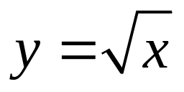
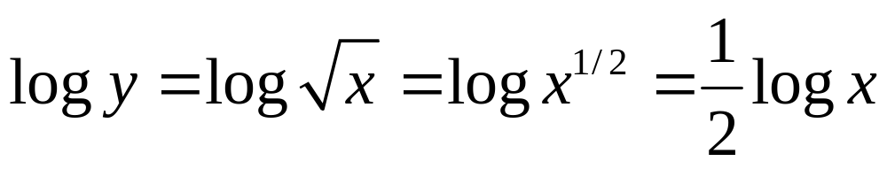
Square Root with Logarithm
To compute
we take
Thus the square root is found by taking the log of x, divide by 2, and taking the inverse of log (that is exponentiation).
Notes:
Such type of calculation requires table of logarithms, which John Napier produced the first one.

Slide 16
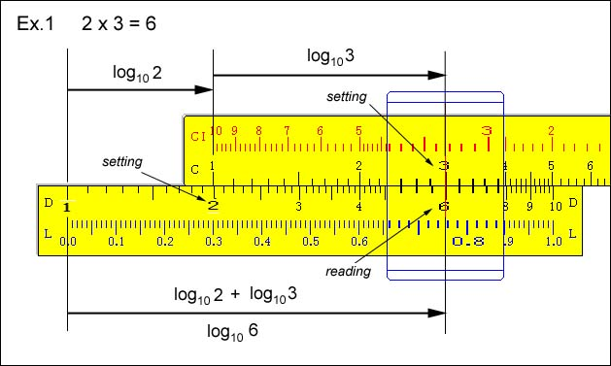
Slide Rule
Notes:
Slide rule at http://www.ies.co.jp/math/java/misc/slide_rule/slide_rule.html can move and use as the real one.

Slide 17
Slide Rule Principle
4×8=32
0
1
2
3
4
5
6
7
1
2
3
4
5
6
7
8
10
16
24
32
64
128
4
0
1
2
3
4
5
6
7
1
2
3
4
5
6
7
8
10
16
24
32
64
128
8
A “base-2” slide rule consists of two identical pieces, marked with a linear scale (upper) and a logarithmic scale (bottom). Multiplication is computed by adding the distances, and read off from the top ruler.
Notes:
Practical slide rule never used base 2, but base 10. Note also that the log-scale is not equally spaced! Of course, you don’t get the exact answer – the slide rule is an analogue computer.

Slide 18
Summary
We use Napier’s bones and Genaille-Lucas rulers to do multiplications without having to remember the multiplication table
Napier also invented logarithm, with which multiplication becomes addition in logarithm.
Slide rule is based on logarithm.

Slide 19
Midterm Test
4:50 – 5:50 Wed, 1 March 2006
Closed book
Calculator may be used
Seated well spaced
Use your own papers for answers

