Slide 1
The Babbage Machines & Modern Computers
Lecture Seven

Slide 2
Outline
Science in the 16 and 17 centuries
The first mechanical calculator by Wilhelm Schickard
Pascal and other mechanical devices
Babbage’s difference machine & analytical engine
The development of modern computers

Slide 3
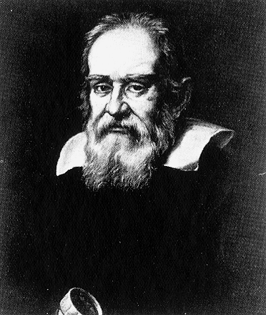
Galileo Galilei (1564-1642)
Galileo pioneered “experimental scientific method” to study motions of objects. He formulated the law of inertia or “first law of motion”, discovered moons of planet Jupiter with his telescope. This and other observations supported Copernicus theory that the Earth revolved around Sun, contrary to the common belief of the day.
Notes:
See http://galileo.rice.edu/

Slide 4
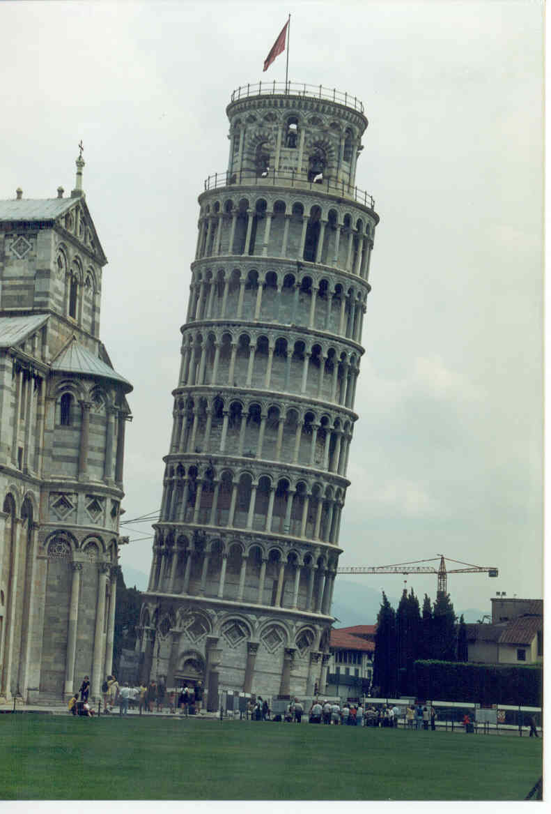
Pisa Tower Experiment
The story has been that Galileo did falling body experiments from the reclined Tower of Pisa. It was found that light and heavy body fall in the same way. The distance s of the body traveled in time t can be described mathematically as
s = ½ g t²
Where t is time in seconds, and g is gravitational acceleration constant, g = 9.8 meter/second². Note that the mass M does not enter the formula.
Notes:
Picture from http://www.eskimo.com/~rwb/images/europe/06-pisa-tower.jpg

Slide 5
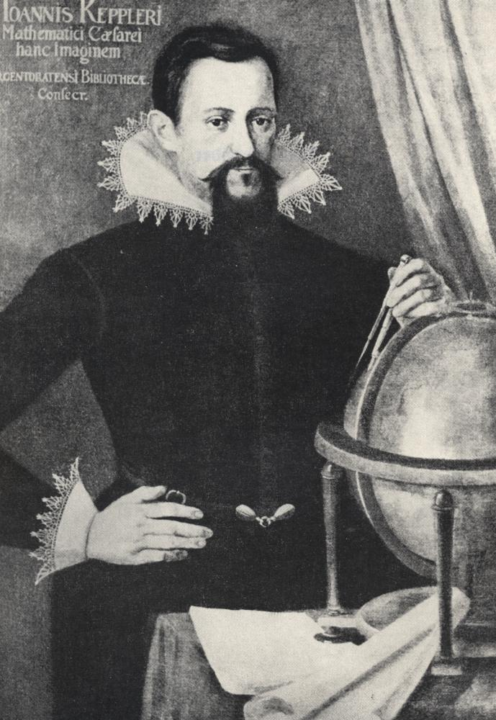
Johannes Kepler (1571-1630)
Kepler is now chiefly remembered for discovering the three laws of planetary motion that bear his name published in 1609 and 1619. He also did important work in optics, discovered two new regular polyhedra, gave the first mathematical treatment of close packing of equal spheres, gave the first proof of how logarithms worked (1624), and devised a method of finding the volumes of solids of revolution that (with hindsight!) can be seen as contributing to the development of calculus. Moreover, he calculated the most exact astronomical tables hitherto known, whose continued accuracy did much to establish the truth of heliocentric astronomy (Rudolphine Tables, Ulm, 1627).
Notes:
Picture from http://www.mathematik.de/mde/information/kalenderblatt/wissenschaftlicheoptik/kepler-1-1000.jpg
Text from http://www-groups.dcs.st-and.ac.uk/~history/Mathematicians/Kepler.html

Slide 6
Kepler’s Laws
Kepler’s 1st law: planet moves in elliptical orbit with Sun at one of the focus point.
2nd Law: The planet weeps equal area in equal time.
3rd Law: The time T it takes for one revolution is proportional to semi-major axis raised to the 3/2 power, T∝ a^{3/2}.
a
Kepler used Tycho Brahe’s accurate observational data of planets (such as Mars) to derive the laws.

Slide 7
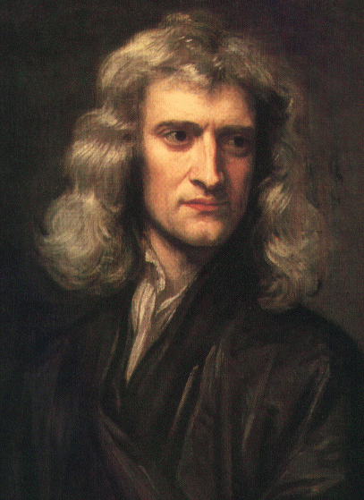

Issac Newton (1643-1727)
One of the very few giants in the whole history of science. Between 1664 and 1666, Newton laid the groundwork of his theory of infinitesimal calculus, binomial expansion, laws of motion, theory of color, and theory of universal gravitation. Newton’s master piece, “Philosophiae Naturalis Principia Mathematica” in 1687 summarized the laws of motion, planetary or in ground. After this, a mechanical world view was firmly established.
Notes:
http://www.hao.ucar.edu/public/education/sp/images/newton.html

Slide 8
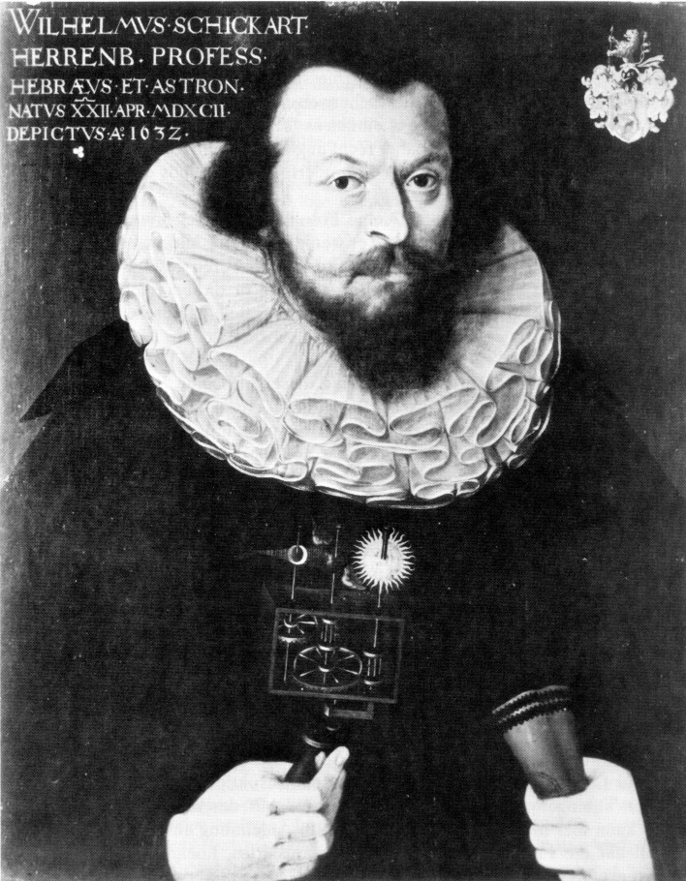
Wilhelm Schickard (1592-1635)
Schickard was born in Tübingen in Germany, the same place as the famous Kepler of planetary motion. He wrote in a letter to Kepler, “What you have done in a logistical way (i.e., by calculation), I have just tried to do by mechanics. I have constructed a machine consisting of eleven complete and six incomplete sprocket wheels which can calculate. You would burst out laughing if you were to see how it carries by itself from one column of tens to the next or borrows from them during subtraction.”
Notes:
From “A history of computing technology” M R Williams, chapter 3 & 4.

Slide 9
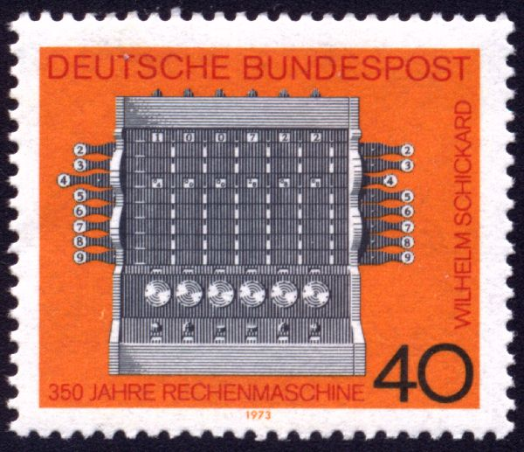
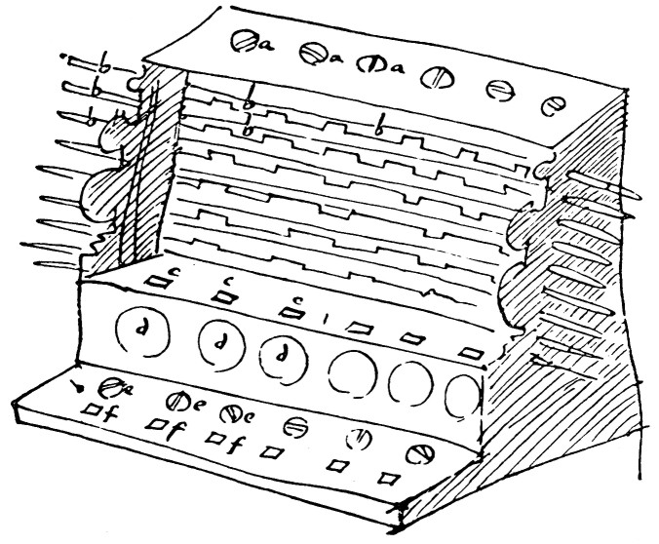
Schickard’s Mechanical Calculator
Rotating the top cylinders to get a set of desired Napier bones, push the horizontal rod to get multiplier entry. To do the addition, we dial the circular dials.
Notes:
Schickard built two, one for Kepler and one for himself, non survived the time. The original drawing were discovered, and its was reconstructed by Prof Bruno Baron von Feytag Loringhoff in the last century.

Slide 10
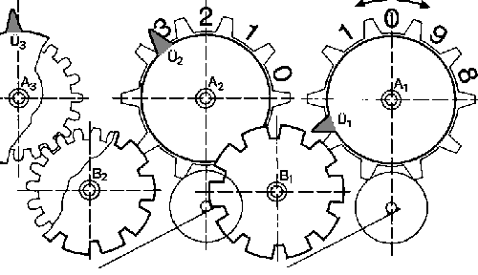
Schickard Carry Mechanism
When the first wheel A₁ pass from 9 to 0, the teeth U₁ causes the intermediate wheel B₁ to rotate, which in turn to make A₂ to rotate by 36 degree, and so on.
A decimal digit is represented by the position of a wheel.
19
+ 1
20

Slide 11
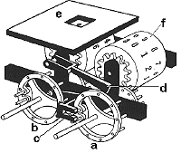
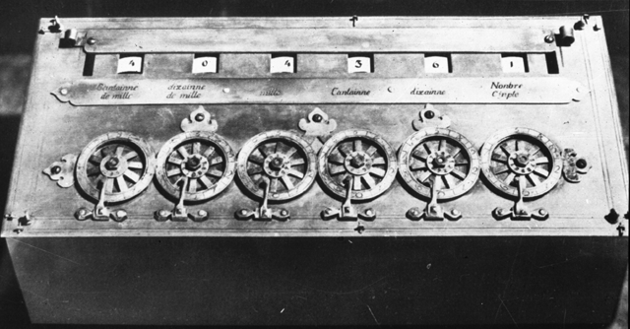
Pascal’s Calculating Machine
Blaise Pascal (1623-1662) invented a different carrying mechanism in his adding machine. To add a number, one dial the wheels like an old-fashioned dial-tone telephone.
Notes:
Before the discovery of Schikard’s machine in the 1950s, it was thought that Pascal had the first mechanical calculator. Pascal’s machine cannot turn backward for subtraction. To subtract, one adds the 9’s complement.

Slide 12
Subtraction with Pascal Machine
Due to its carrying mechanism, the wheels cannot turn backward to do subtraction.
To subtract a number, one adds 10’s complement of a number. A 10’s complement of a number n is 1 plus a number m such that each digit of n+m is 9.
E.g. consider 6-digit numbers (represented by 6 wheels), if n = 000124, its 10’s complement is k=m+1=999875+1=999876, so that k+n=0
000124
+999876
1 000000
Since there are only 6 wheels, the last carry is lost, leaving 0 as the result.
To subtract 000124 from Pascal machine, we add 999876, to get the correct answer.
Notes:
We interpret the 10’s complement of a number as its negative.

Slide 13
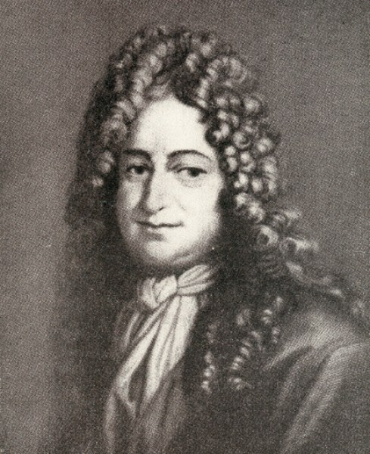
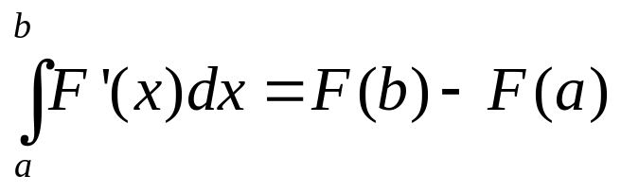
Leibniz (1646-1716)
Leibniz developed, independently from Newton, the differential and integral calculus.
He also developed ideas of mechanical machine for multiplication.

Slide 14
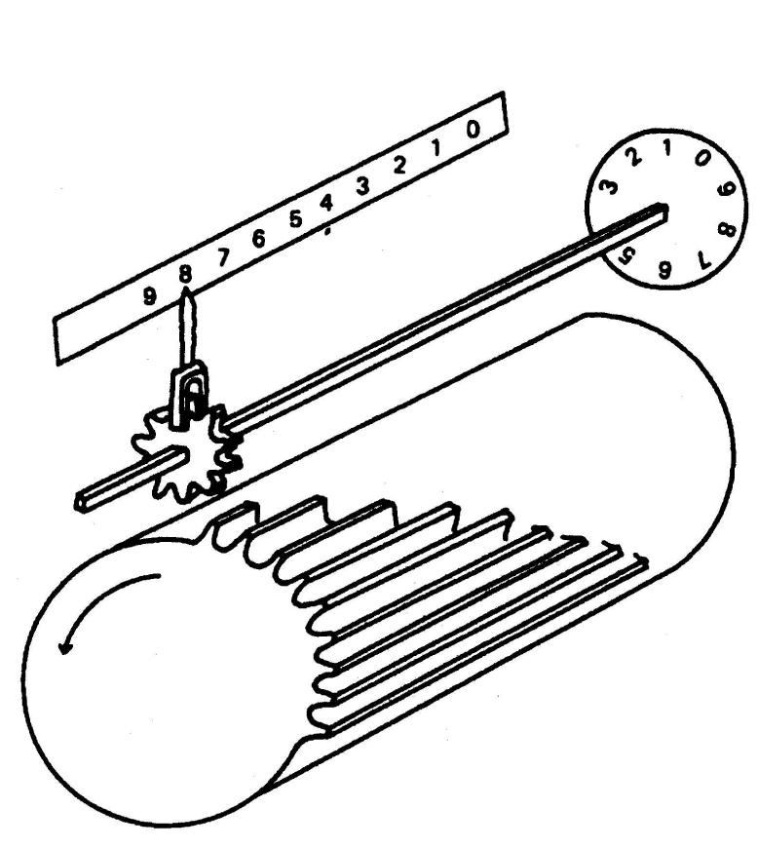
Leibniz Stepped Drum Mechanism
By register a corresponding position of the square shaft, the result wheel can be turned a variable number of positions.

Slide 15
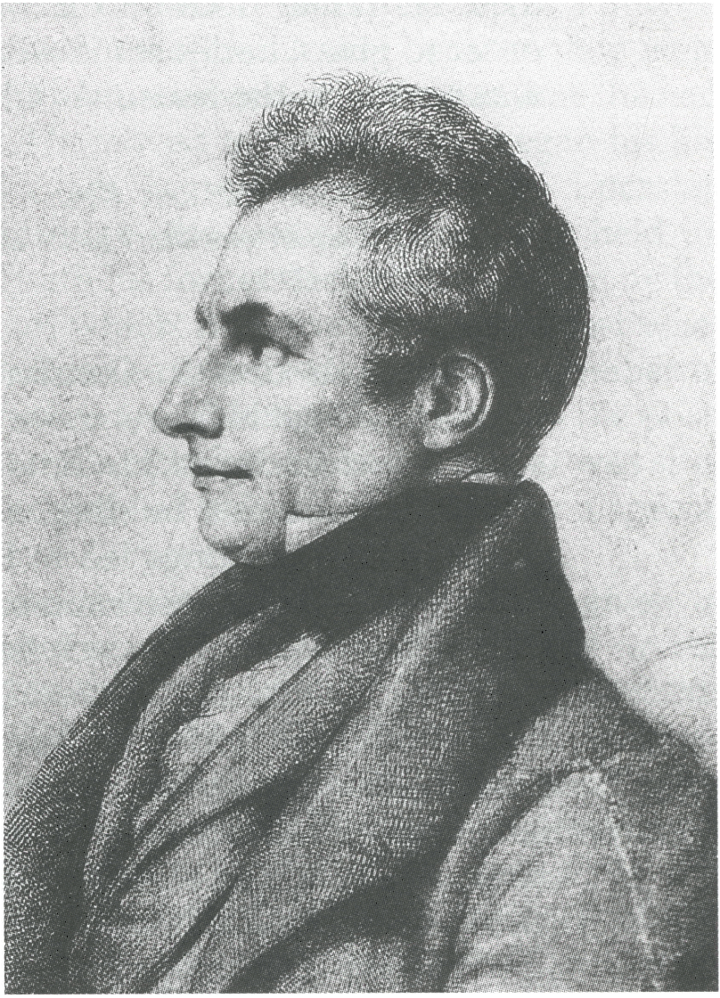
Charles Babbage (1791-1871)
Charles Babbage, perhaps more than any other person, can be considered to be the grandfather of the computer age. He invented the difference machine for the purpose of calculating mathematical tables, and later designed more general machine known as the Analytical Engine. From this, a general concept of programming was considered for the very first time.

Slide 16
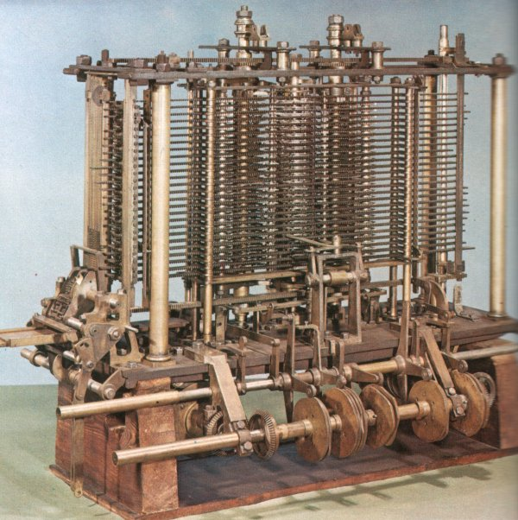
The Difference Machine
Babbage first built a demonstration model asking the British Government to support its construction financially. Due to various reasons, the machine was never finished after spending £17,000 from the Government and £20,000 from his own pocket.
Notes:
A rebuilt working model was done in 1991, a hundred years later.

Slide 17
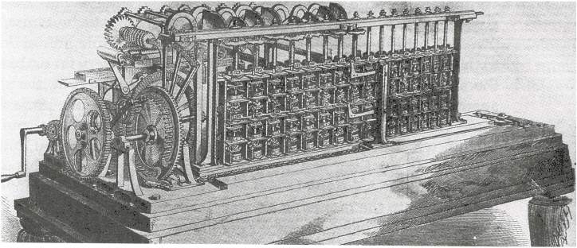
The Scheutz Difference Engine
Around early 1850, Sheutz father-and-son team built the first functional difference machine.

Slide 18
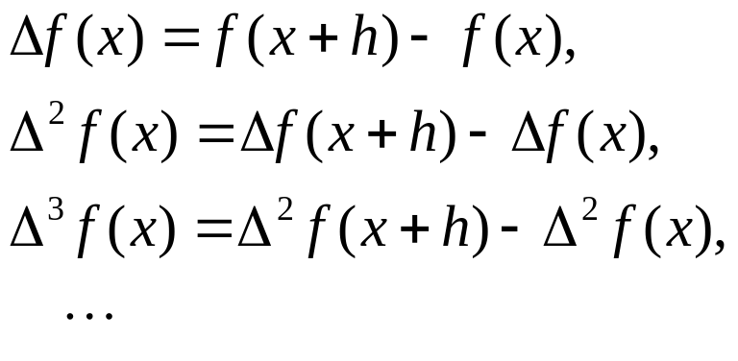
Idea of the Difference Machine
Given a polynomial of degree N
its value at equally spaced points 0, h, 2h, 3h, etc can be evaluated in the following way: The N-th difference is a constant, adding this difference to get N-1 th difference, adding N-1 th difference to get N-2 th difference, and so on until adding first difference to get the function value. The difference is defined to be:
1st difference
2nd difference
3rd difference

Slide 19
Finite Difference Example
Given function F(x)=x²+2x+3, let h = 1
F(0)=3, ΔF(0)=F(1)-F(0)=3, Δ²F(0)=ΔF(1)-ΔF(0)=F(2)-2F(1)+F(0)=2
Thus to get function values at 0, 1, 2, 3, etc, we form:
x 0 1 2 3 4 5 6 7 …
Δ²F 2 2 2 2 2 2 2 2 …
ΔF 3 5 7 9 11 13 15 17 …
F 3 6 11 18 27 38 51 66 …
+
+
+
Known initial values

Slide 20
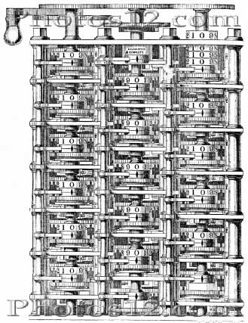
The Difference Machine
Each column of wheels stores the n-th difference. A major operation in the computation is to add the higher order difference to the next lower order difference.
2nd difference
1st difference
F : function value

Slide 21
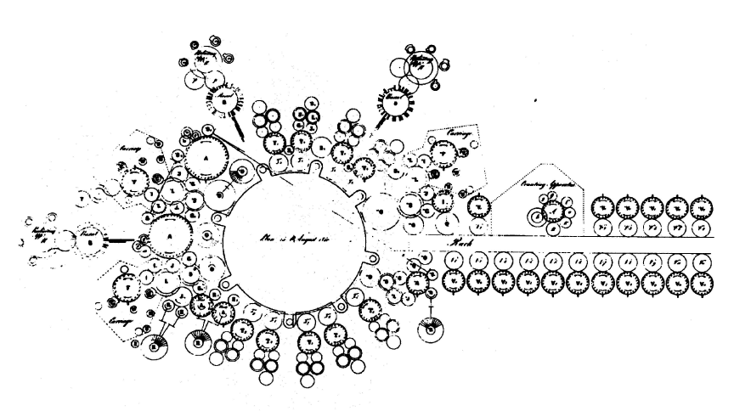
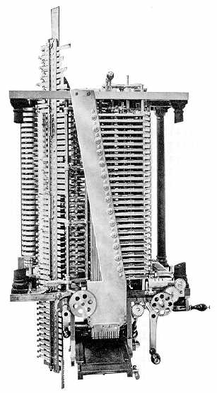
Analytical Engine
The analytical engine was designed to be able to do addition, subtraction, multiplication and division. It consists of store (the memory), mill (the calculating part), and control barrel.
Notes:
The machine was never built in Baggage’s time, but a completed mill was built in 1906 by his son Henry P. Babbage.

Slide 22
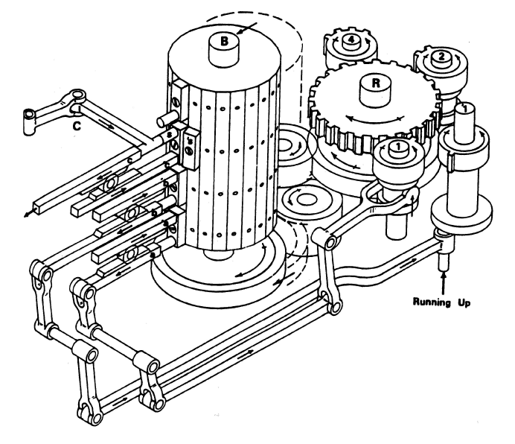
Control Mechanism
Part of control mechanism in Babbage’s analytical engine.

Slide 23
Programming in Analytical Engine
The analytical engine can do calculations with arbitrarily complex expressions, like a(b+c)/(d-e). It was controlled by a series of punched cards. Let V_{n} denote the n-th register in the store, let
a was stored in V₁
b was stored in V₂
c was stored in V₃
d was stored in V₄
e was stored in V₅
store
V₁
V₂
V₃
V₄
V₅
V₆
+–*/
mill

Slide 24
Programming
Then instruction on the cards would have something like
transfer value in V₂ to mill
transfer value in V₃ to mill
add
a b c d e
V₁
V₂
V₃
V₄
V₅
V₆
data transfer
+–*/
b
c
mill

Slide 25
Programming
transfer the sum in mill to V₆
transfer value in V₁ to mill
multiply the mill
transfer the product in mill to V₇
b+c
V₁
V₂
V₃
V₄
V₅
V₆
+–*/
a
b+c
mill

Slide 26
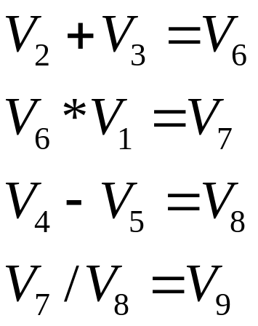
Programming -continued
Transfer value in V₄ to mill
transfer value in V₅ to mill
subtract
transfer the difference to V₈
transfer value in V₇ to mill
transfer value in V₈ to mill
divide
transfer the result in mill to V₉
The final result is in V₉

Slide 27
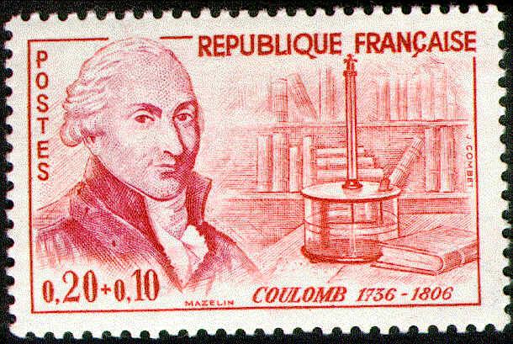
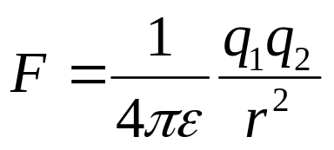
Rise of Electromagnetism
q₂
q₁
Coulomb’s law describes force among charged particles, one of the forms of interactions of matter other than mechanical in origin.

Slide 28
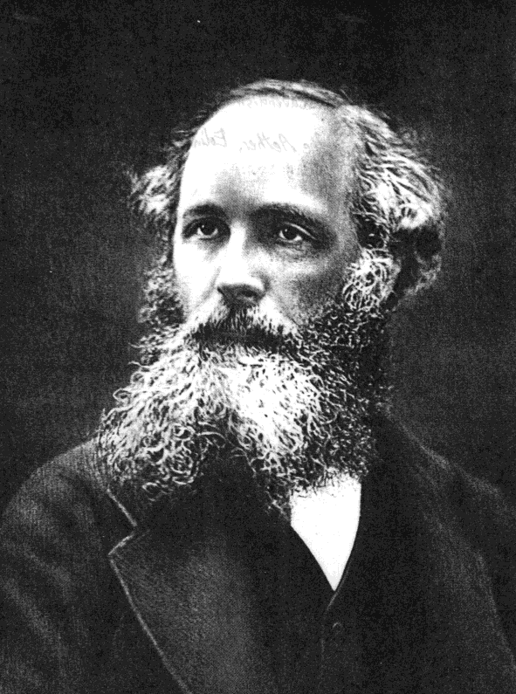
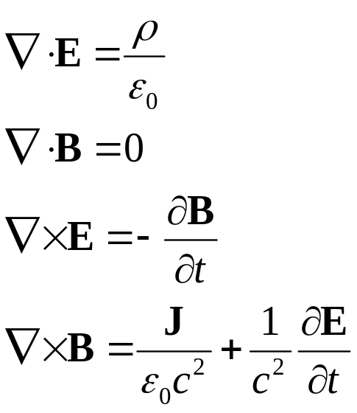
Maxwell Equations
James Clerk Maxwell (1831-1879) unified various descriptions regarding electricity and magnetism, and summarized them with his equations:

Slide 29
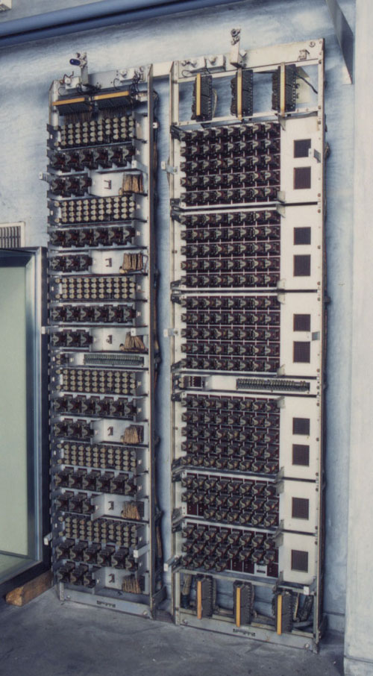
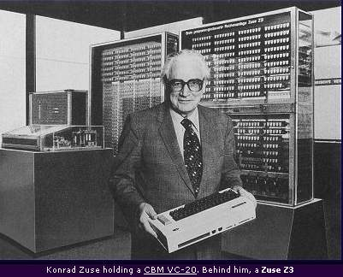
Relay Type of Computer
Mark II computer built in Japan in 1955.
Konrad Zuse in Germany built first relay computer in the 1940s.
Notes:
Zuse’s picture from http://emulazione.multiplayer.it/cbmitapages/pub/zuse.jpg

Slide 30
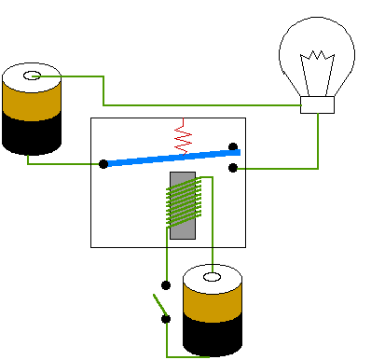
How electromechanical relay works?
The relay technique is standard in the telephone exchange in the 1940s.
Notes:
From http://www.radioelectronicschool.com/downloads/relay.gif

Slide 31
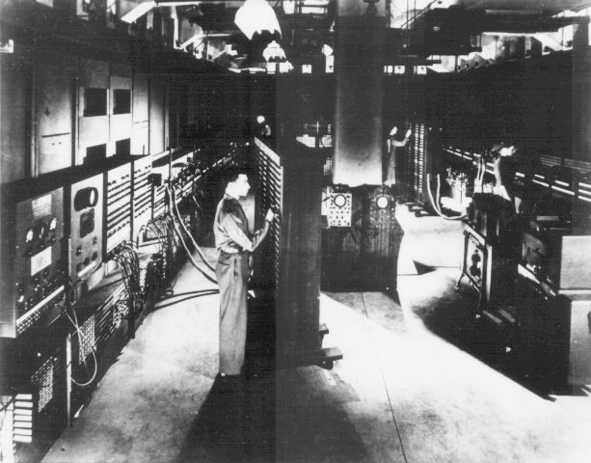
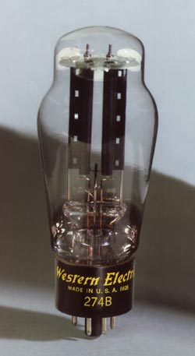
Vacuum Tube Computer
The ENIAC used 18,000 vacuum tubes, 8x3x100 feet³ in size, 30 tones, and used 140 kilowatts of electricity, worthy about 1940s US$ half a million.
Notes:
See also http://plato.stanford.edu/entries/computing-history/ about computer history.

Slide 32
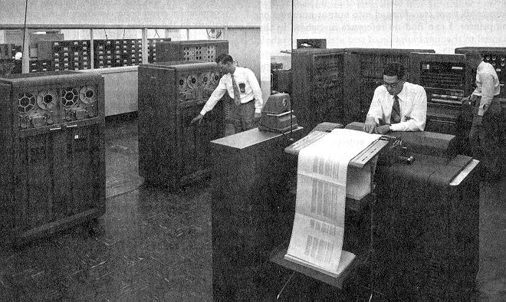
IBM 701 around 1954
Notes:
from the Annuals of the History of Computing, Vol. 5 #2 April 1983, IBM 701 at Douglas Aircraft.

Slide 33
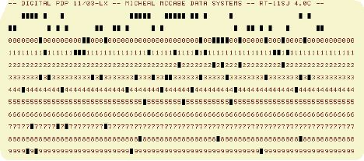
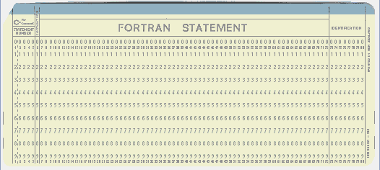
Punched Cards
Programs in the 1950s to 1970s are coded on a piece of paper card with punched holes. They are read by electromechanical or optical reader into the computer. Each card can hole only one line of information. The standard IBM card is 80 characters long.

Slide 34
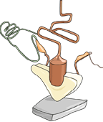

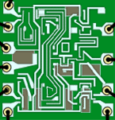
Transistors
Integrated circuits placed all components in one chip, drastically reduce the size.
In 1947, John Bardeen and Walter Brattain invented transistor which quickly replaced the vacuum tube technology. Initially, electronic devices are made of individual components.
Notes:
From http://nobelprize.org/physics/educational/transistor/history/

Slide 35
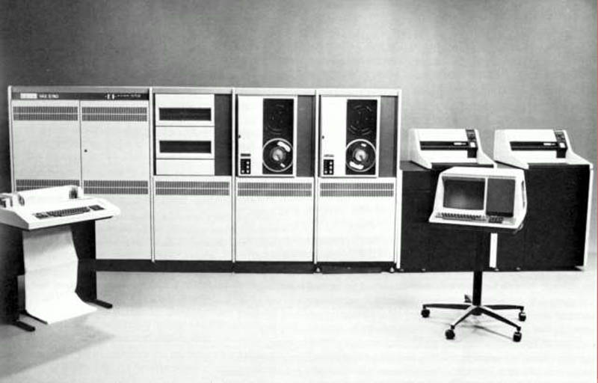
Vax-11 from Digital Equipment
Vax-11 is popular in universities in the early 1980s.

Slide 36
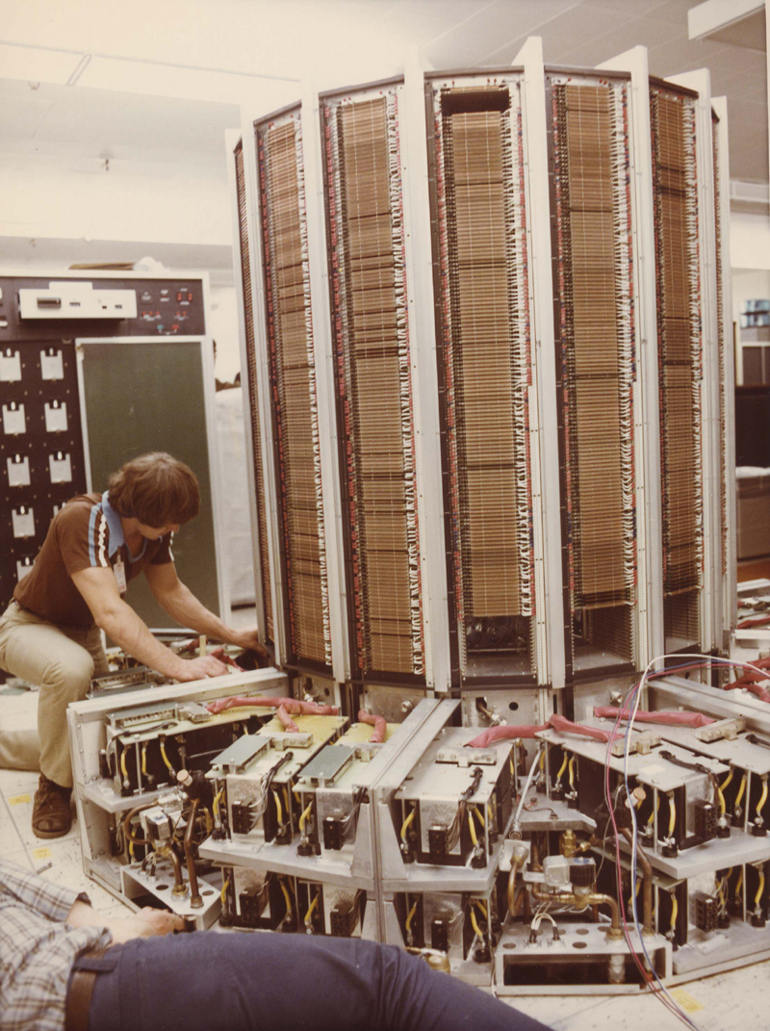
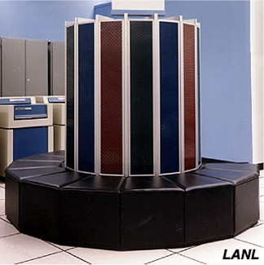
Cray Supercomputer
One of the first so-called supercomputer built around 1976. It was the fastest and also most expensive.
Notes:
Picture from http://www.nersc.gov/~deboni/Computer.history/Aug.2004.Pages/Miscellaneous/images/CRAY.jpg

Slide 37
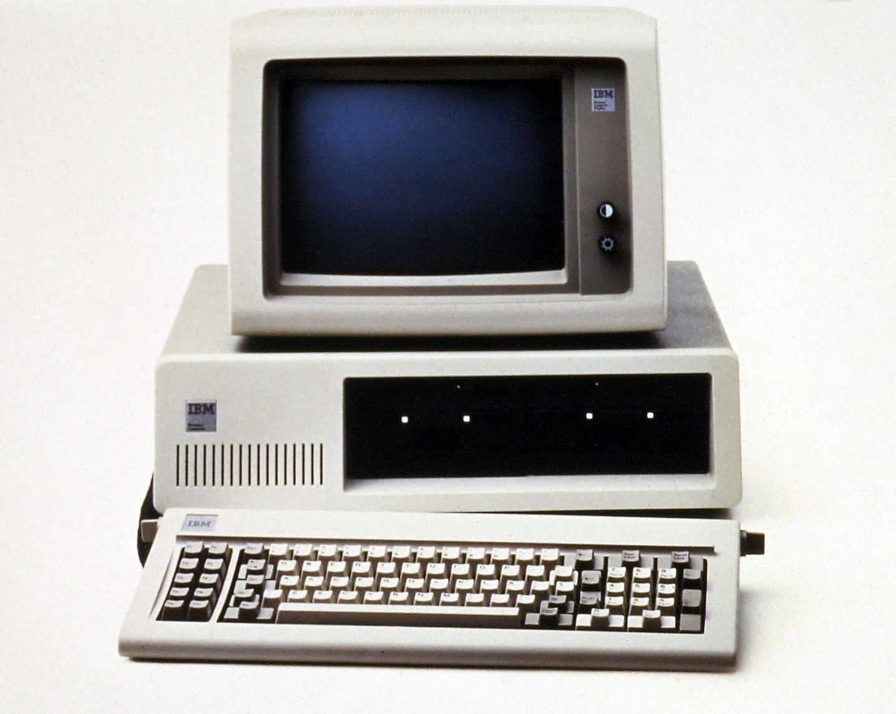
IBM PCs (1981)
The IBM’s Personal Computer started a revolution for computing by the common folks. The “PC” comes with 64kilobyte of memory, 5.25 inch floppy disk drive. It runs at 4.7mega-Hertz. The whole operating system, the Microsoft’s DOS, is on one floppy.
Notes:
The TIME magazine named the computer “man of the year”.

Slide 38
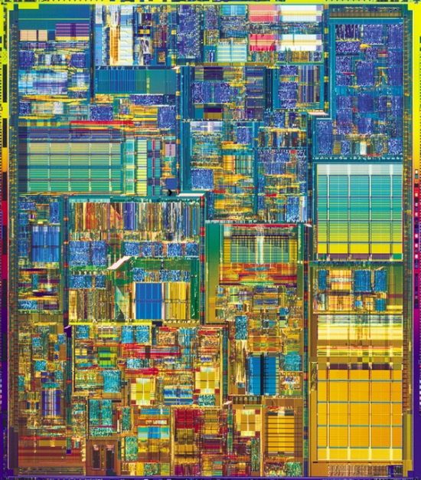
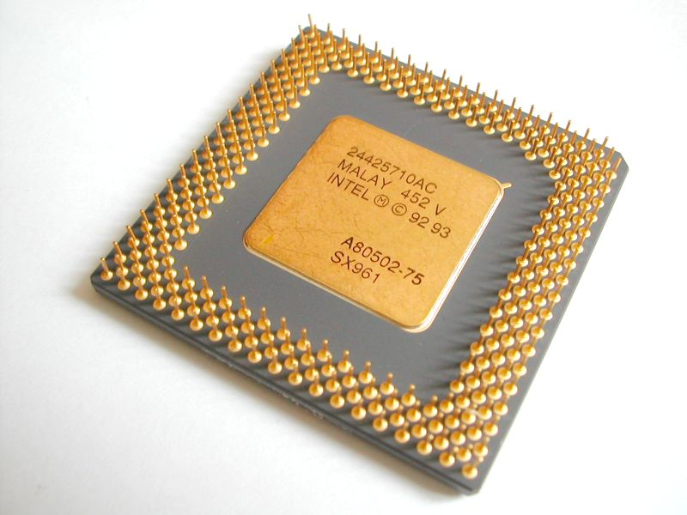
Very Large Scale Integrated Circuit
Modern computers are based on technology of very large number of components on a small silicon chip.

Slide 39
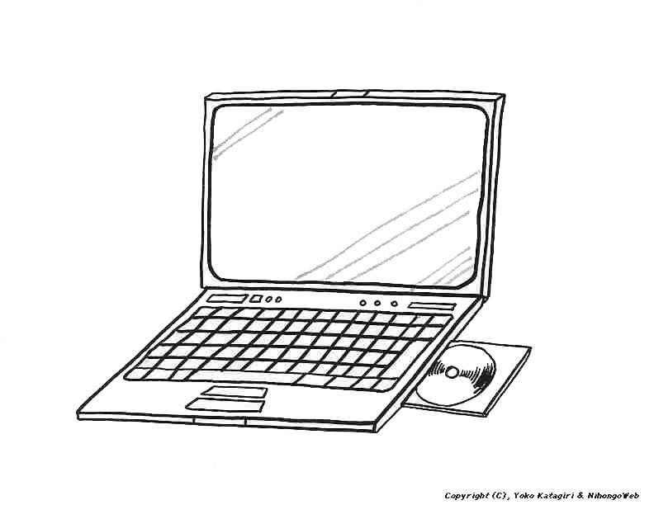
Portable Computing
Nowadays in 2006, laptop of 1.2kg in weight is common place. It runs at 1.8 GegaHertz speed with 512 MegaByte of RAM and 40 Gbyte of internal harddisk, plus DVD drive etc.
Notes:
Figure from http://japanesecentral.com/Siryoo/pictureclips/equipment/laptop.jpg

Slide 40
Characteristics of Commercial Computers
Year | Computer Name | Power (Watts) | Performance (adds/sec) | Memory (kByte) | Price (US dollars)
1951 | UNIVAC I | 124,500 | 1,900 | 48 | $1,000,000
1964 | IBM S360 | 10,000 | 500,000 | 64 | $1,000,000
1965 | PDP-8 | 500 | 330,000 | 4 | $16,000
1976 | Cray-1 | 60,000 | 166,000,000 | 32,768 | $4,000,000
1981 | IBM PC | 150 | 240,000 | 256 | $3,000
1991 | HP 9000 | 500 | 50,000,000 | 16,384 | $7,400
2006 | ThinkPad T43 notebook | 20 | 1,000,000,000 | 512,000 | $1,900
Notes:
From D A Patterson & J L Hennessy, “Computer Organization & Design, the hardware/software interface”, page 40.

Slide 41
Summary
Babbage’s difference machine is a ingenious way of evaluating a polynomial; his analytic engine laid the seed for modern digital computer
It has been a long way from first mechanical calculator to electromechanical devices to fully electronic computers

