Slide 1
Computer Organization and Turing Machines
Lecture Eight

Slide 2
Outline
Components in a modern computer
Von Neumann architecture
Computer instructions
Turing machines

Slide 3

Computer Components (outside)
CPU box
Monitor (output device)
CD/DVD/floppy drives (I/O devices)
Mouse (input device)
Keyboard (input device)

Slide 4
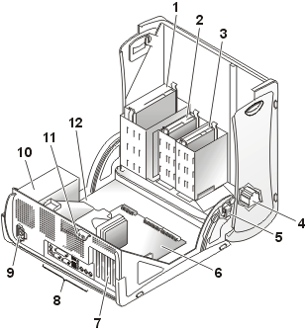
Computer Components (inside)
Optical drive
Diskette drive
Hard drive
Internal speaker
Chassis intrusion switch
System board
Expansion-card slots
I/O ports and connectors
AC power connector
Power supply
Padlock ring
Microprocessor and heat sink shroud
Notes:
Picture from support.ap.dell.com.

Slide 5
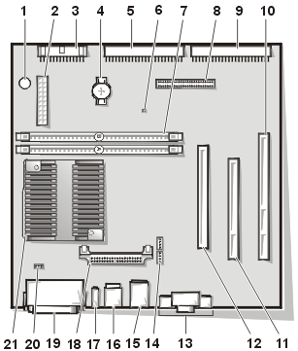
Computer Components (system board)
1. PC speaker 2. DC power connector 3. Diskette drive connector 4. Battery 5. EIDE2 connector 6. Auxiliary power indicator 7. Memory module (DIMM) connectors (2) 8. Front-panel cable connector 9. EIDE1 connector 10. PCI 2 riser connector 11. PCI 1 connector 12. AGP/GPA (AIMM) connector 13. Video connector (upper) and audio connectors (lower) 14. CD audio and telephony connectors 15. NIC connector (upper) and USB connectors (2) (lower) 16. Keyboard (lower) and mouse (upper) connectors 17. Diagnostic LEDs 18. Voltage regulator module 19. Parallel port (upper) and serial port (2) (lower) connectors 20. Microprocessor fan connector 21. Microprocessor and heat sink assembly
CPU
Notes:
This is system board from Dell.

Slide 6
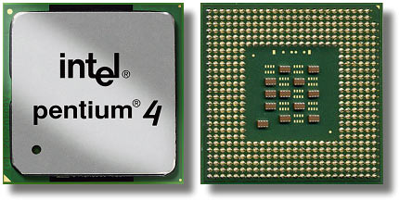
Central Processing Unit (CPU)
The heart of the computer is the central processing unit which has the raw computing power to do arithmetic and logical operations on data.
A 3.0 GHertz computer means roughly it can perform a basic step 3.0x10⁹ times per second.

Slide 7
Computer Organization
CPU
Both the data and program are stored in memory as “numbers”.
Memory
Control
Input
Data Path
Output
Notes:
The stored program concept is also called von Neumann architecture. For further details on computer organization, number representation in computer, and programming, see “Computer Organization & Design, the hardware/software interface”, by D. A. Patterson, J. L. Hennessy, (Morgan Kaufmann).

Slide 8
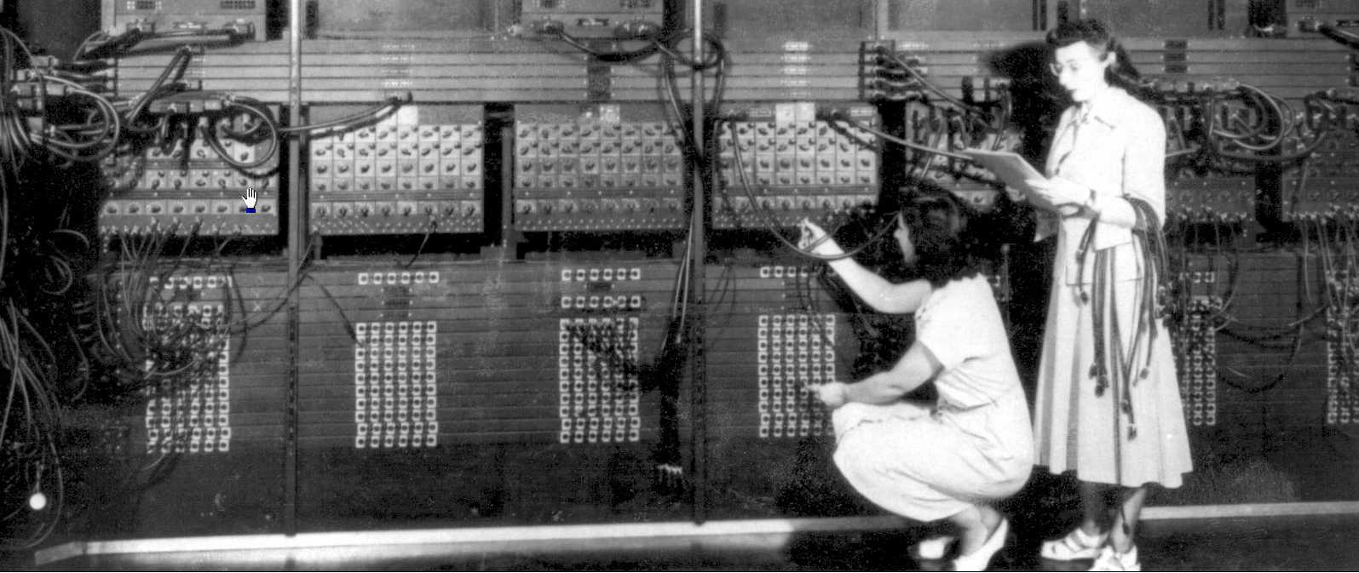
Programming a Computer (in old days)
Programming in the early days meant to plug or unplug, or connection cables in certain way.

Slide 9
Programming a Modern Computer
swap(int v[], int k)
{ int temp;
temp = v[k];
v[k] = v[k+1];
v[k+1] = temp;
}
swap:
mul $2, $5, 4
add $2, $4, $2
lw $15, 0($2)
lw $16, 4($2)
sw $16, 0($2)
sw $15, 4($2)
j $31
Use an editor, a programmer writes C code. A compiler translates the C program into assembly language.
00000000101000010000000000011000 00000000100011100001100000100001 10001100011000100000000000000000 10001100111100100000000000000100 10101100111100100000000000000000 10101100011000100000000000000100 00000011111000000000000000001000
Another translation makes it ready for computer to use.
MIPS machine code

Slide 10
A closer look at machine instructions
Transfer data in register to/from memory
Do arithmetic on the values of registers, and put result in other register.
Control certain line of codes executed repeatedly or conditionally.
Memory
CPU
Registers
$1
$2
$3
$4
Notes:
The registers are like the columns in Babbage’s difference machine.

Slide 11

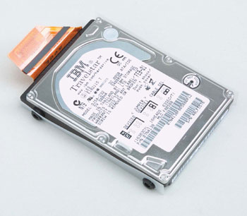
Computer Memory
Location 1
01000011
Memory consists of cells each of which can store 8-bits of information. Each cell has a unique address to it. Contents are stored in internal memory temporarily, and stored in external harddisk or other media permanently. Both programs and data are stored in memory as sequence of 0’s and 1’s.
Location 2
01001001
Location 3
11010001
Internal SIMM
Location 4
01011111
11000010
… …
. . .
Location 1048575
01101011
Harddisk
00000010
Location 1048576
Address
Notes:
SIMM: Acronym for single in-line memory module, a small circuit board that can hold a group of memory chips. Typically, SIMMs hold up 8 (on Macintoshes) or 9 (on PCs) RAM chips. On PCs, the ninth chip is often used for parity error checking. Unlike memory chips, SIMMs are measured in bytes rather than bits. SIMMs are easier to install than individual memory chips.

Slide 12
Examples of Instructions
Memory
CPU
program
The first instruction lw $4, 0($2) says load the value stored at location given by the value of register 2 into register number 4.
The second instruction asks to add the values in registers 4 and 2, and put the result back in register 3.
The last instruction asks the program to jump to a location in memory stored in register 31. To read the instruction from there.
The bottom part stores data (in binary, of course) used and altered by the program.
lw $4, 0($2)
add $3, $4, $2
j $31
Control
$1
$2
$3
$4
0101101010001111
Registers
data
Notes:
The instructions are from the MIPS machine. PC instructions from Intel are much more complex.

Slide 13
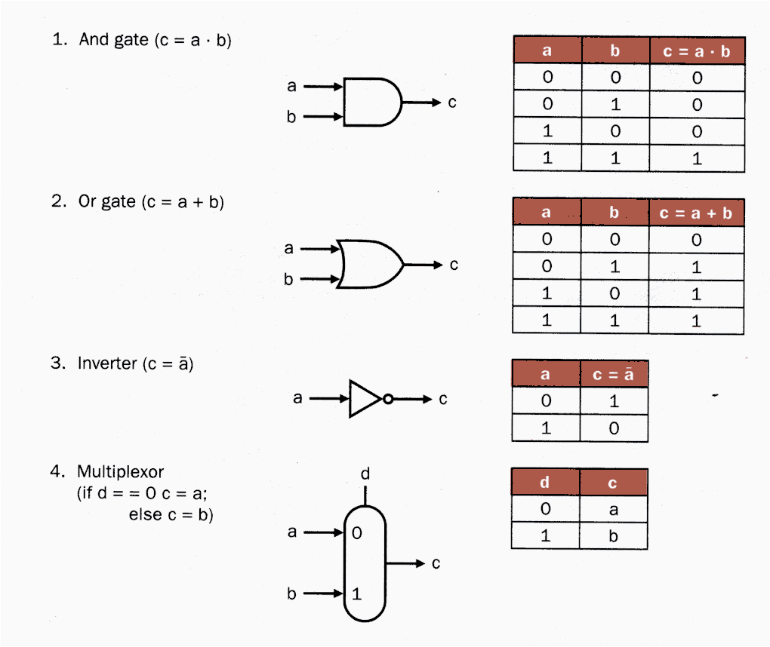
Building Block of CPU Circuit – Logical Gates
A logical value is TRUE or FALSE, or in computer science 1 or 0. 1 and 0 can be represented by low or high voltage. From basic electronic circuit, one can build simple devices like logical AND, OR, Negation, or simple choices.

Slide 14
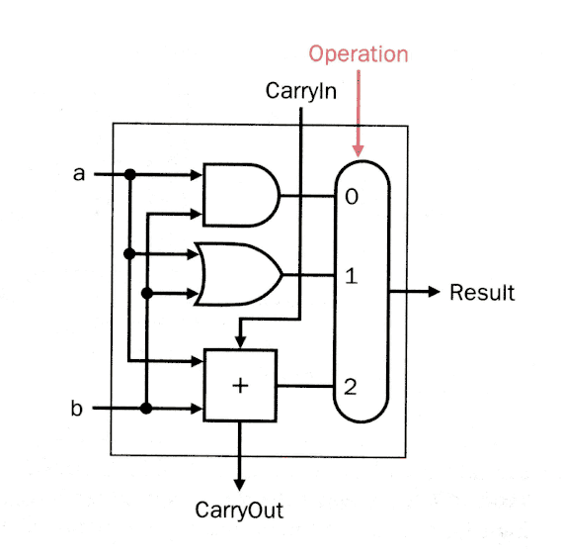
1-bit Logical AND, OR, and Add
This 1-bit device takes two inputs (a and b, both take values 0 or 1), a “Carry in” and mode of operations, 0 for AND, 1 for OR, and 2 for Add (sum), produces 1-bit result and a carry bit. E.g., for add
1 1 0 0
+ 1 + 0 +1 +0
1 1 0 1 0 1 0 0
Carry
Result

Slide 15
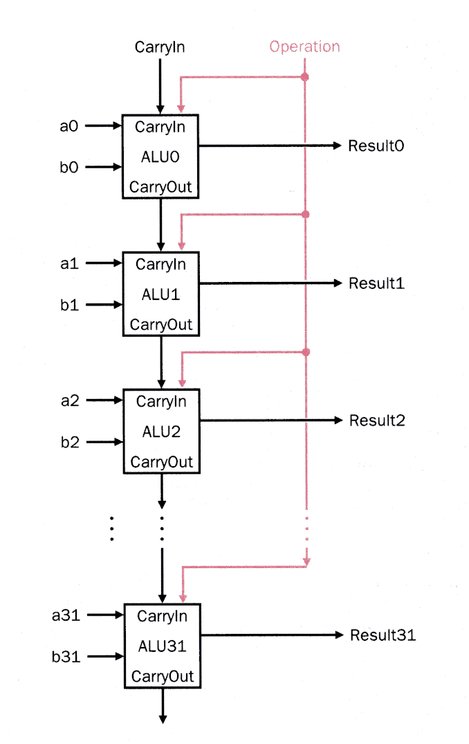
32-bit Arithmetic and Logical Unit
By combining 32 simple units of 1-bit device, we can construct useful 32-bit adder, as well as bit-wise logical AND and OR.
There is no need to build a separate unit for subtraction if we represent negative integer by 2’s complement.

Slide 16
2’s Complement for Negative Integers (4-bit numbers)
0000
0001
0010
0011
0100
0101
0110
0111
0
1
2
3
4
5
6
7
1000
1001
1010
1011
1100
1101
1110
1111
8 -8
9 -7
10 -6
11 -5
12 -4
13 -3
14 -2
15 -1
To get 2’s complement representation of a negative number –n, write out positive n in binary, complement all the bits, then add one.
Positive values
Unsigned
Or negative
Notes:
To use the unsigned 15 or negative value -1, say, for 1111, is a matter of interpretation. That is, the user decide what it means.

Slide 17
2’s Complement, example
To write –1 in 2’s component binary, we write (e.g., 4-bit pattern)
0001,
complementing all bits, to get
1110
After adding 1 to it, we get
1111
1111 represents –1.
bit-pattern decimal value
0001
+ 1111
1 0000
1
-1
0
Overflow bit discarded

Slide 18
Turing Machine, Introduction
How powerful a computer can be? Can it replace intelligence? It came as a surprise in 1930s before the advent of digital electronic computer that Alan Turing argued that any computer, present and the ones ever will exist, is as power as the simple “Turing Machine”. Certain problems cannot be solved by computer, no matter how powerful the computer is.
Notes:
See this article on Turing machine. http://www.alanturing.net/turing_archive/pages/Reference%20Articles/What%20is%20a%20Turing%20Machine.html
Another is http://plato.stanford.edu/entries/turing-machine/

Slide 19
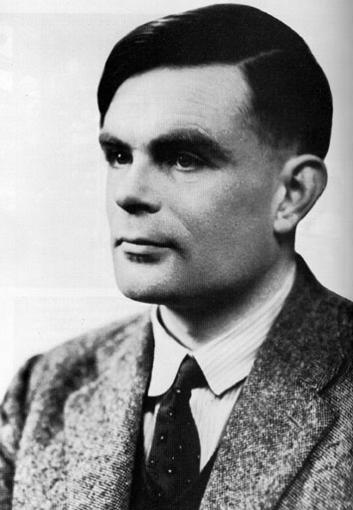
Alan Turing
Alan Turing was a British mathematician who had a great deal to do with the construction of the first computer in Britain. Turing studied mathematics at King’s College in Cambridge, UK in the 1930s. His paper “On computable numbers with an application to entscheidungs-problem” showed for the first time that there exist classes of problems having no algorithmic solution.

Slide 20
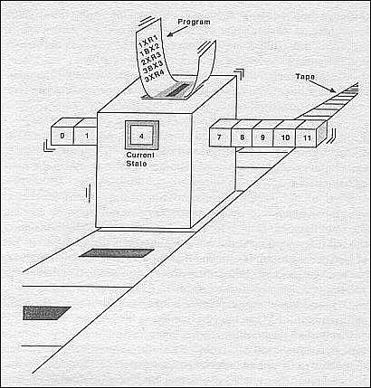
The Turing Machine
The Turing machine consists of a tape, a moving head which can read and print a set of symbols, an internal state of the machine, and a “program”. A program is a list of rules what to do next given the current reading and internal state. It can move to the left or right, change internal state and print a symbol on the tape.

Slide 21
Turing Machine Details
A set of alphabet or characters, including blank, serves as input and output symbols on the tape. E.g. {a,b,c, … }
A tape divided into a sequence of numbered cells each containing one character or a blank. The tape starts from cell 1, and extends to the right indefinitely.
Notes:
Follow the definition in “Introduction to Computer Theory”, D A Cohen, (John Wiley & Sons, 1991).

Slide 22
Turing Machine Details – cont’d
A tape head that can in one step read the contents of a cell on the tape, replace it with some other character, and reposition itself to the next cell to the right or left of the one it has just read. At the start of the process, tape head always begins by reading the input in cell 1.
A finite set of internal states of the machine, including START, HALT, and other named states such as 1, 2, 3, …

Slide 23
Turing Machine Details
A program, which is a set of rules that tell us, on the basis of the letter the tape head just read, how to change states, what to print, and where to move the tape head. We use five symbols
(state, letter read, new state, letter write, direction)
to indicate such a rule.

Slide 24
Notes on Turing Machine
The character set will be finite, but the number and symbols are unspecified. Same for the states.
The machine begins from the START state and stops at the HALT state. Illegal action causes the machine to crash (such as move to left when it is on cell 1, or moved to state q but no instruction found for that state).

Slide 25
Turing machine to recognize a symbol b in the second cell.
The symbols will be [a, b, space=Δ]
States: 1=START, 2, 3, 4=HALT
Program: (1,a,2,a,R)
(1,b,2,b,R)
(2,b,3,b,R)
(3,a,3,a,R),(3,b,3,b,R)
(3,Δ,4,Δ,R)
Starting tape is
a
b
a
Δ
Δ
Δ
Δ
…
cell 1
cell 2
cell 3
… …

Slide 26
Execution of the Turing Machine Example
1
Program: (1,a,2,a,R)
(1,b,2,b,R)
(2,b,3,b,R)
(3,a,3,a,R)
(3,b,3,b,R)
(3,Δ,4,Δ,R)
1=start,
4=halt.
Start machine by position the head in cell 1, in state 1.
First rule says change state to 2, move to right
3rd rule says change state to 3, move to right
4th rule says, move to right
Last rule says change to state 4. Since we are in state 4, we must halt. Program executed successfully.
a
b
a
Δ
Δ
Δ
Δ
…
2
a
b
a
Δ
Δ
Δ
Δ
…
3
a
b
a
Δ
Δ
Δ
Δ
…
3
a
b
a
Δ
Δ
Δ
Δ
…
4
a
b
a
Δ
Δ
Δ
Δ
…

Slide 27
Execution of the Turing Machine Example (different input)
1
Program: (1,a,2,a,R)
(1,b,2,b,R)
(2,b,3,b,R)
(3,a,3,a,R)
(3,b,3,b,R)
(3,Δ,4,Δ,R)
1=start,
4=halt.
Start machine by position the head in cell 1, in state 1.
Second rule says change state to 2, move to right.
When in state 2 and reading a, there is no instruction as what to do, the machine crashes (given you the answer that there is no b in cell 2).
b
a
a
Δ
Δ
Δ
Δ
…
2
b
a
a
Δ
Δ
Δ
Δ
…

Slide 28
Turing machine to add 1 to a binary number
The states are [1=START, 2, 3=HALT]
Characters on tape are [0,1,space=Δ]
The program is
(1,0,3,1,R)
(1,1,2,0,R)
(2,0,3,1,R)
(2,1,2,0,R)
Meaning of the “program”: When start (state 1) if the digit under head is 0, change it to 1, and halt (e.g., 1100 + 1 = 1101). If it is 1, change it to 0 and remember the carry by putting it in state 2. In state 2, we need to add the carry, just like it is in state 1.

Slide 29
Running of the adding-1-program, add 1 to 1011.
1
(1,0,3,1,R)
(1,1,2,0,R)
(2,0,3,1,R)
(2,1,2,0,R)
First pair of numbers are current state and reading, second pair new state and writing, last symbol (R or L) is moving direction.
We set up the input tape with the binary number 1011, least significant digit at the leftmost.
By 2nd rule, change tape to 0, change state to 2, move to right.
By 4th rule, change tape to 0, move to right.
By 3rd rule, change 0 to 1, and halt. The result is 1100.
1
1
0
1
Δ
Δ
Δ
…
2
0
1
0
1
Δ
Δ
Δ
…
2
0
0
0
1
Δ
Δ
Δ
…
3
0
0
1
1
Δ
Δ
Δ
…
Notes:
Reading the binary number backwards is for computational convenience.

Slide 30
Another Way to Represent Turing Machine Programs (Rules)
A list of 5 Items:
(1,0,3,1,R)
(1,1,2,0,R)
(2,0,3,1,R)
(2,1,2,0,R)
(0,1,R)
(1,0,R)
(0,1,R)
1
2
3
start
halt
(1,0,R)
The number in square or circle represents the current state of the machine. The arrow points to next state in a move. The triplet of symbols means (read, write, direction). Where to move is determined by what is read currently.

Slide 31
What does this program do?
States [1=START,2,3,4,5,6,7,8=HALT]
Characters [a,b,Δ]
Program:
(1,a,2,Δ,R), (1,b,5,Δ,R), (1,Δ,8,Δ,R), (2,a,2,a,R), (2,b,2,b,R), (2,Δ,3,Δ,L), (3,a,4,Δ,L), (3,Δ,8,Δ,R), (4,a,4,a,L), (4,b,4,b,L), (4,Δ,1,Δ,R), (5,a,5,a,R), (5,b,5,b,R), (5,Δ,6,Δ,L), (6,Δ,8,Δ,R), (6,b,7,Δ,L), (7,a,7,a,L), (7,b,7,b,L), (7,Δ,1,Δ,R).
The program determines if the strings formed by a’s and b’s are palindrome. It halts if yes, crashes if no.
Notes:
Palindrome is a string which is the same when read forward and backward.

Slide 32
What problems cannot be answered by Turing machine?
Halting problem: Given an arbitrary Turing machine T and an input tape, decide if T halts on input data.
This means build another (in a sense more powerful) Turing machine, take T and the input data as input, run over it. Leave a yes/no answer on the tape and halt in a finite number of steps.
Such a machine is impossible, theoretically.

Slide 33
Computable Numbers
Turing's original paper concerned computable numbers. A number is Turing-computable if there exists a Turing machine which starting from a blank tape computes an arbitrarily precise approximation to that number. All of the algebraic numbers (roots of polynomials with algebraic coefficients) and many transcendental mathematical constants, such as e and π are Turing-computable. [But almost all the reals are uncomputable]
Notes:
This implies there are numbers which is not computable. In fact, Turing proved that almost all numbers are uncomputable.

Slide 34
Universal Turing Machine
It is possible to build (the most powerful) Turing machine that can simulate the behavior of any other Turing machine (including itself). A Turing machine exists that take an encoded Turing machine T and its input data as input on its tape. The result is the same as if executing the lesser Turing machine T.

Slide 35
Summary
Computers consist of various components. The most basic components to build a computer are the logical gates. Data, machine instructions, and memory are important concepts.
Any real computer is as powerful as a Turing machine. If a problem cannot be solved by Turing machine, it cannot be solved by any real computer either.

