Slide 1
MATLAB
Lecture One
Monday 4 July 2005

Slide 2
Matlab
Melvyn Sim
Department of Decision Sciences
NUS Business School
Email: dscsimm@nus.edu.sg

Slide 3
References
“Getting Started with Matlab,” by Rudra Pratap
“Matlab manual” by the MathWorks Inc.

Slide 4
Chapter 1

Slide 5
What is MATLAB
An interactive numerical computing environment
Matrix computations
Graphics
Programming (M-files)
Toolboxes (signal processing, statistics, optimization, symbolic math)

Slide 6
Advantage of MATLAB
Easy, interactive environment
Fast numerical algorithms
Inexpensive software
Fun and easy environment for learning Linear Algebra!!

Slide 7
Think Linear Algebra!!
More important and calculus!!
Background Knowledge
  Given two matrices, A and B,
  is AB = BA?
  A and B are symmetric Matrices, is AB symmetric?
  What is positive definite matrix?
  What is Eigenvalue decomposition?

Slide 8
Windows Environment
MATLAB is essentially operating system independent

Slide 9
Input/Output
MATLAB handles double, char and logical data types
Array need not dimensioned
Variables are case sensitive
Output format can be controlled
Command history remembered

Slide 10
Files MATLAB Handle
M-files (*.m) are script and function files
Mat-files (*.mat) are created by MATLAB with save, and read with load
Mex-files (*.mex) MATLAB callable codes compiled from other languages

Slide 11
General Commands
On-line helps (help, helpwin, helpdesk, lookfor, demo)
Workspace (who, whos, what, clear, clc, clf)
Directory (pwd, cd, dir, ls, path)
General (computer, clock, date, more, ver)
Termination (^c, quit, exit)

Slide 12
Chapter 2

Slide 13
Tutorial Lessons

Slide 14
Lesson 1
Assign values to variables
Basic arithmetic (+,-, *, /, ^)
Suppress screen output by ;
Float-point number appearance
Function sin, cos, log
Quit

Slide 15
Lesson 2
Create row and column vectors
Linearly spaced vectors
Arithmetic on vectors
Array operations with .*, ./, .^
Math functions on vectors

Slide 16
Lesson 3: Creating and Printing Plot
Create points
2D plots
Printing

Slide 17
Lesson 4: Script file
Create, write, save a script file
How to execute the script file
path, and addpath command
pwd and cd command

Slide 18
Lesson 5: Creating a function
Function file
Executing a function

Slide 19
Exercises
Lesson 3, exercise 3.
  An exponentially decaying sine plot: Plot y = exp(-0.4x) sin x, 0<x<4π

Slide 20
Exercises
Lesson 5, exercise 2.
  Convert temperature: write a function that outputs a conversion table from Celsius and Fahrenheit temperatures. The two temperatures are related as F = (9/5) C + 32

Slide 21
Exercises
Best way to skin a cat!!
Given a vector x
  Find the sum
  Find the sum of squares

Slide 22
Exercise
Monte Carlo Sampling
  Generate N samples of the sum of M independent uniformly distributed random variables.

Slide 23
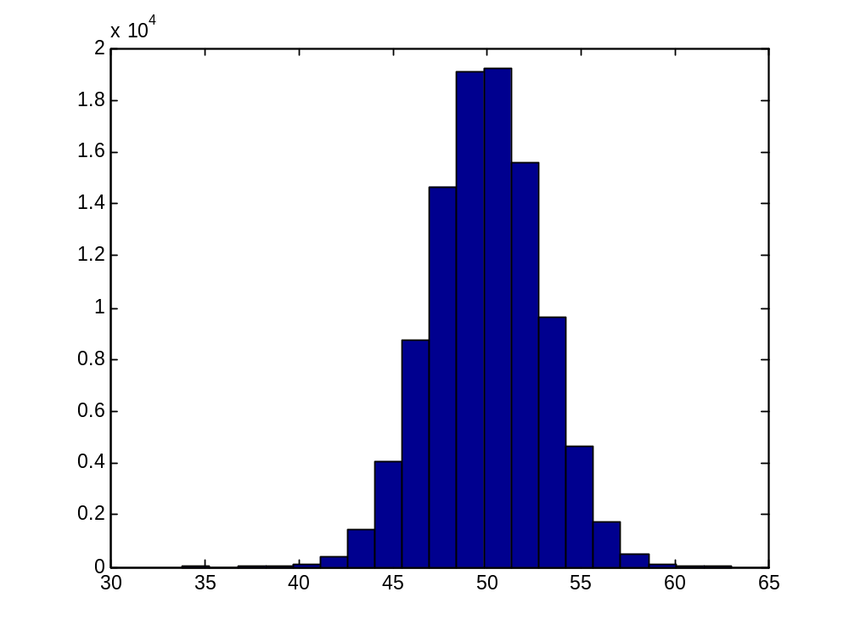
Histogram Plot

