Slide 1

Dissipative Particle Dynamics

Slide 2
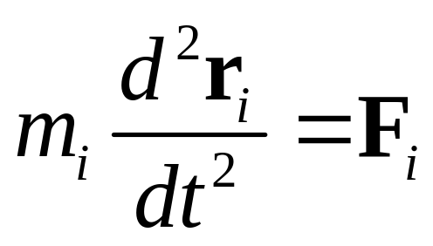
Molecular Dynamics, why slow?
MD solves Newton’s equations of motion for atoms/molecules:
Why MD is slow?

Slide 3
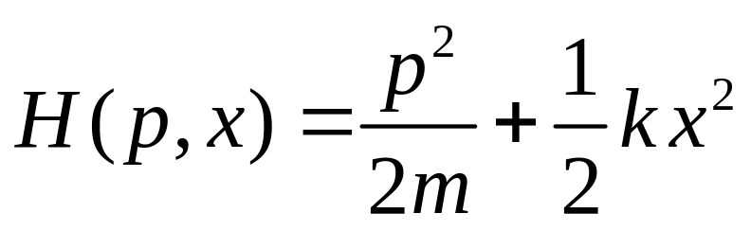
Length, Time, & Energy Scales
Look at typical scales of carbon-based molecules: length 1 Å, mass 12 amu, spring constant k = 20 eV/Å² with a Hamiltonian
What is the associated equation of motion and time scale?

Slide 4
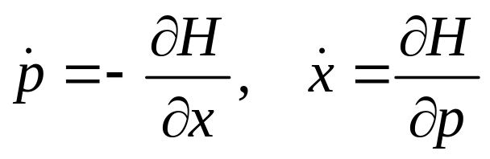
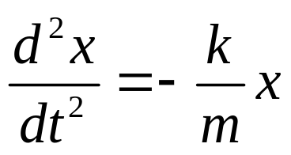
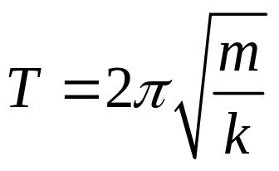
Hamilton’s Equations
From
We get dp/dt = - k x, dx/dt = p/m
Or
The solution is a harmonic oscillation x(t)=Acos[ (2πt+δ)/T ] with time period

Slide 5
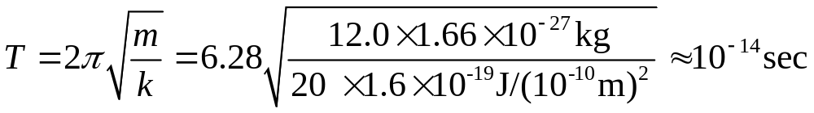

Time Scale
We use the units conversion factors:
1 eV = 1.6 x 10⁻¹⁹ joule
1 amu = 1.66 x 10⁻²⁷ kg
1 Å = 10⁻¹⁰ meter
1 milli sec = 10⁻³ sec
1 μs = 10⁻⁶ sec
1 nano sec = 10⁻⁹ sec
1 pico sec =10⁻¹² sec
1 femto sec = 10⁻¹⁵ sec

Slide 6
How to increase the time scale of MD?
Increase mass m, instead of simulating a single atom, we simulate a lump of them.
Decrease the interaction strength k, we make the interaction softer.

Slide 7
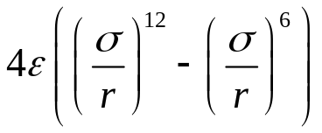
Lennard-Jones vs Soft Pair Potential
V(r)
LJ
Linear soft repulsion
r

Slide 8
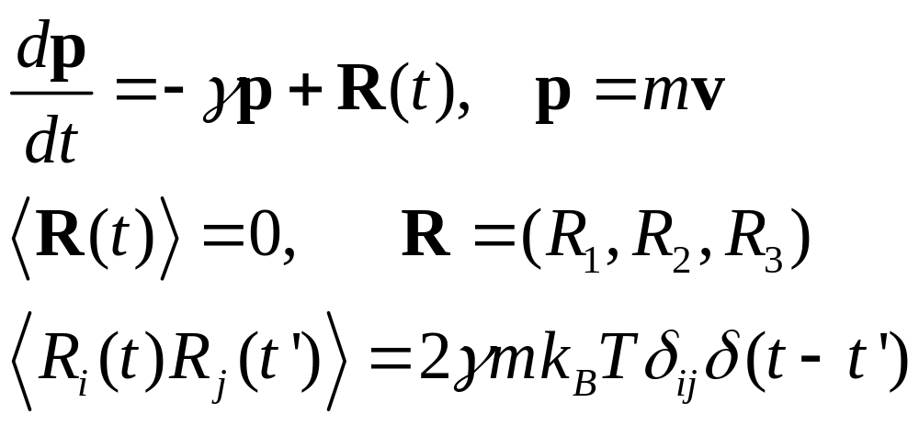
Brownian/Langevin Dynamics
-γp is a dissipative (frictional) force, R(t) is random force with zero average and δ-function correlated in time (white noise). Bold face for vectors.

Slide 9
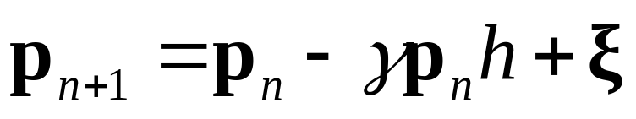
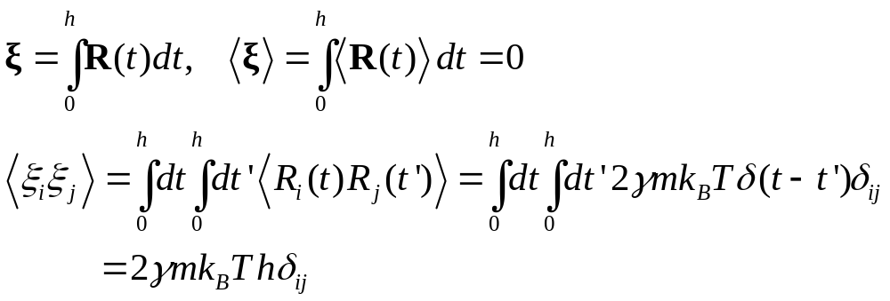
How to solve an equation with random forces?
Where ξ is independent Gaussian random variable with zero mean and variance 2γmk_{B}T h. (Why?)
Notes:
Note that ξ is proportional to square root of h.

Slide 10
Statistical Ensembles
Micro-canonical ensemble: fixed particle number, volume, and energy (N, V, E)
Canonical ensemble: fixed particle number, volume, and temperature (N, V, T). Langevin dynamics implements a canonical ensemble.

Slide 11
Dissipative Particle Method
The dissipative particle dynamics was first proposed by Hoogerbrugge and Koelman (1992) for simulating hydrodynamic behavior. It was further improved by Groot and Warren (1997). It is a molecular dynamics with pair forces of three types.
Notes:
P J Hoogerbrugge and J M V A Koelman, Europhys Lett 19, 155 (1992); J M V A Koelman and P J Hoogerbrugge, Europhys Lett 21, 363 (1993).
R D Groot and P B Warren, J Chem Phys 107, 4423 (1997).

Slide 12
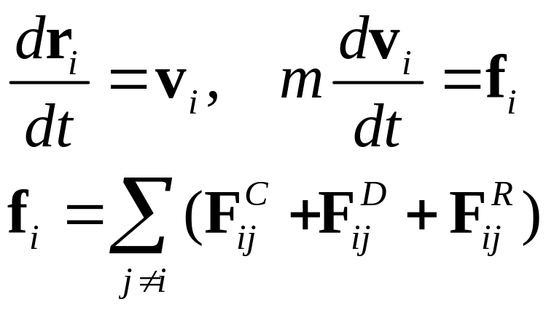
DPD equations
The forces are pair-wise additive, with conservative force F^{C}, dissipative force F^{D}, and stochastic force F^{R}.

Slide 13
Conservative Force
V(r) = (1/2) a (r –r_{c})², r < r_{c}
= 0, r ≥ r_{c}
Where r is distance between two given particles. What is the form of the force acting on particle i from particle j ?
Notes:
F = - dV/dr, what about the direction of the force?

Slide 14
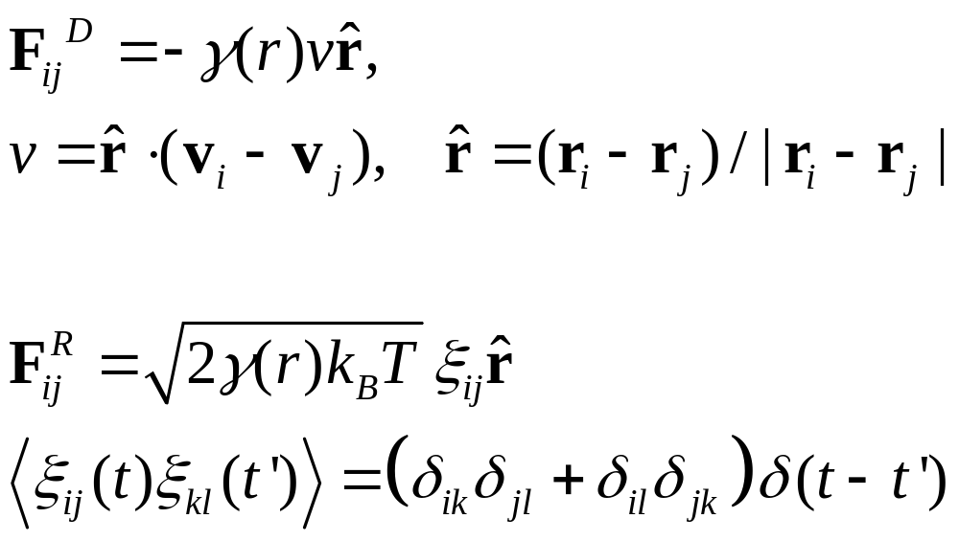
Dissipative Force and Random Force

Slide 15
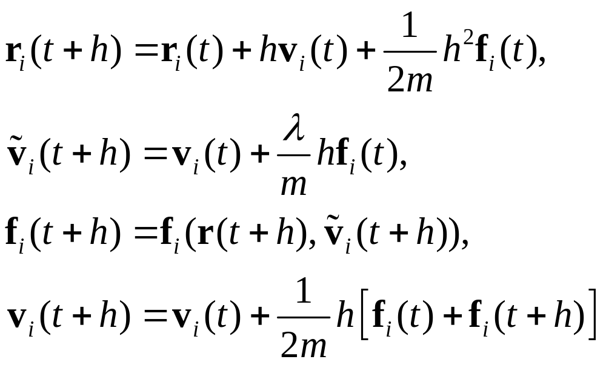
Velocity-Verlet Algorithm
What λ value to take? Order of accuracy?

Slide 16
Application of DPD method
Coarse-grained description for solutions (e.g., water), simulating polymers (e.g., DNAs) in solution.
Complex fluids at hydrodynamic time scales.
Suspension of hard objects (spheres, rods, etc) in fluids.

Slide 17
Smoothed Particle Hydrodynamics
A typical class of methods where continuum field equations (such as hydrodynamic equations) are simulated using the concept of particles.
The traditional methods was to solve the partial differential equations on a regular grids (in space and time).
Notes:
See book by G.-R. Liu and M. B. Liu, “Smoothed Particle hydrodynamics, a meshfree particle method” (World Scientific).

