Slide 1
Nearfield Heat Transfer
Between Metal Surfaces
Xplorer Symposia - thermal transport and energy conversion, Guilin, 6-11 August 2025
Jian-Sheng Wang
Department of Physics, National University of Singapore

Slide 2
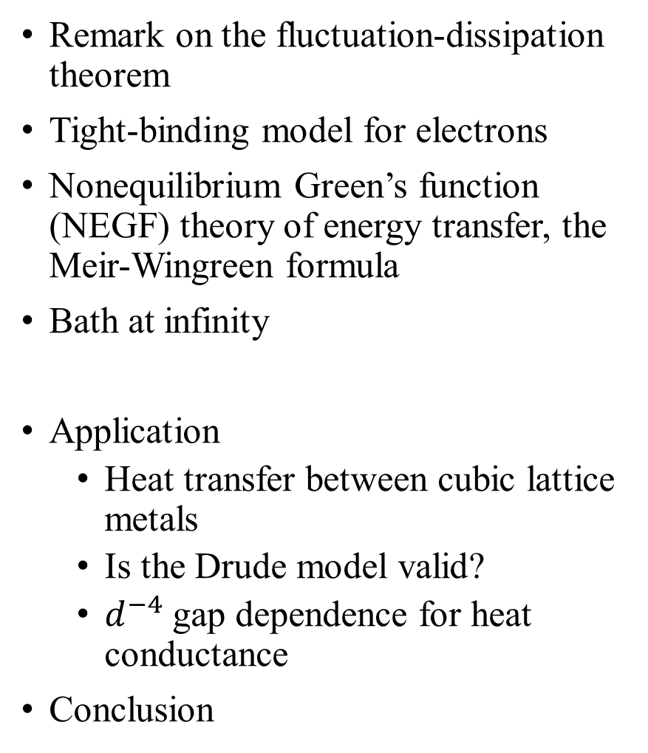
Outline
Remark on the fluctuation-dissipation theorem
Tight-binding model for electrons
Nonequilibrium Green’s function (NEGF) theory of energy transfer, the Meir-Wingreen formula
Bath at infinity
Application
  Heat transfer between cubic lattice metals
  Is the Drude model valid?
  $d^{−4}$ gap dependence for heat conductance
Conclusion

Slide 3

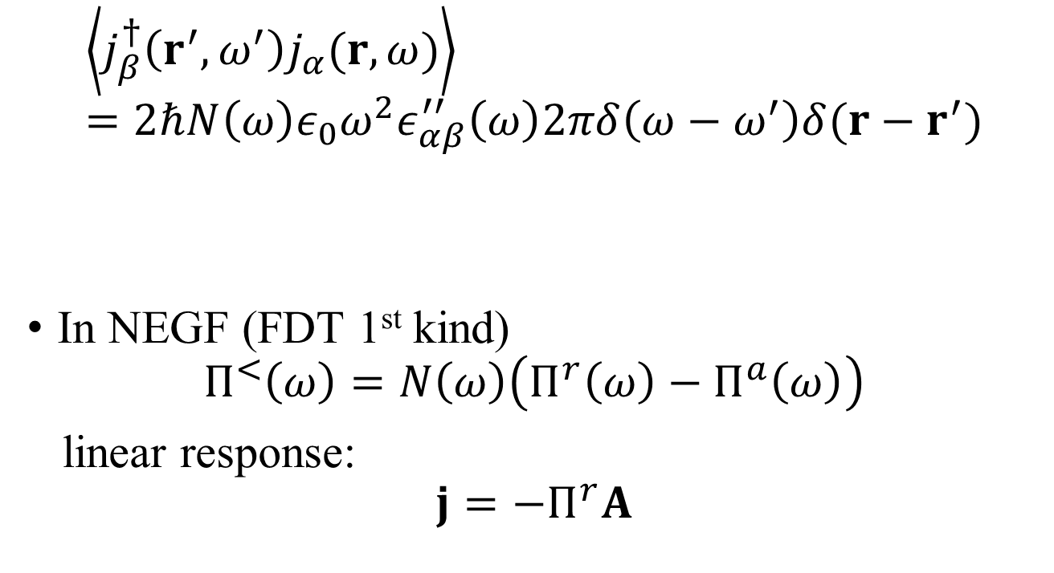
Fluctuation-dissipation theorem (2nd kind)
$$\left\langle j_{β}^{†}\left(r^{′},ω^{′}\right)j_{α}(r,ω)\right\rangle =2ℏN\left(ω\right)ε_{0}ω^{2}ε_{αβ}^{′′}\left(ω\right)2πδ\left(ω−ω^{′}\right)δ(r−r^{′})$$
In NEGF (FDT 1st kind)
$$Π^{<}\left(ω\right)=N\left(ω\right)\left(Π^{r}\left(ω\right)−Π^{a}\left(ω\right)\right)$$
linear response:
$$j=−Π^{r}A$$
Callen and Welton 1951,
Kubo 1966,
Eckhardt 1984
permittivity
$$Π^{r}=ω^{2}ε_{0}\left(1−ε\right)=−iωσ$$
conductivity

Slide 4
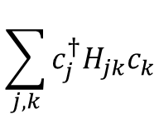

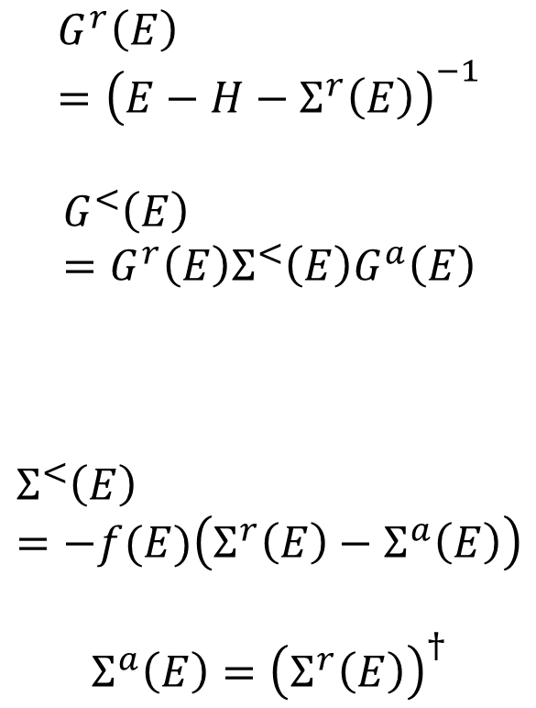
Electron tight-binding model with baths
$$G^{r}\left(E\right)={\left(E−H−Σ^{r}\left(E\right)\right)}^{−1}$$
$$G^{<}\left(E\right)=G^{r}\left(E\right)Σ^{<}\left(E\right)G^{a}\left(E\right)$$
$$Σ^{<}\left(E\right)=−f(E)\left(Σ^{r}\left(E\right)−Σ^{a}\left(E\right)\right)$$
$$Σ^{a}\left(E\right)={\left(Σ^{r}\left(E\right)\right)}^{†}$$
system
bath $Σ$
$$\sum_{j,k}{c_{j}^{†}H_{jk}c_{k}}$$

Slide 5
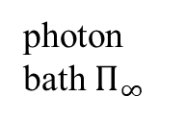
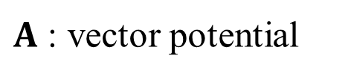
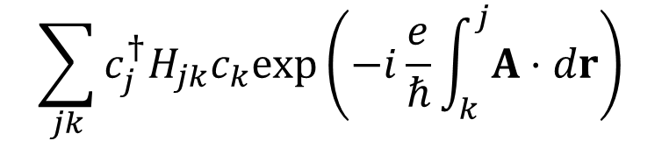

Electron-field interaction, Peierls substitution
system
photon bath $Π_{∞}$
$$\sum_{jk}{c_{j}^{†}H_{jk}c_{k}exp\left(−i\frac{e}{ℏ}\int_{k}^{j}{A⋅dr}\right)}$$
electron bath
$A$ : vector potential
$$B=∇×A$$

Slide 6

NEGF, definitions
See AGD chapter 6
Henneberger 2008
$φ=0$ gauge
Heisenberg-Pauli 1930;
B. S. Kay 2021.
Notes:
Abrikosov, Gorkov, Dzyaloshinski

Slide 7
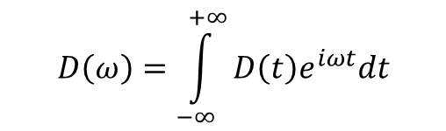

Fluctuation-dissipation theorem in thermal equilibrium
Eckhardt 1984
Agarwal 1975
Bose function
$$D\left(ω\right)=\int_{−∞}^{+∞}{D\left(t\right)e^{iωt}dt}$$
$$β=\frac{1}{k_{B}T}$$

Slide 8





Dyson equation
Haug & Jauho
$$τ$$
contour ordered
contour time $τ$
real time $t$
$$\underset{v^{−1}}{\underbrace{ }}$$
Two-linear responses:
$$A=−D^{r}j_{ex}$$

Slide 9
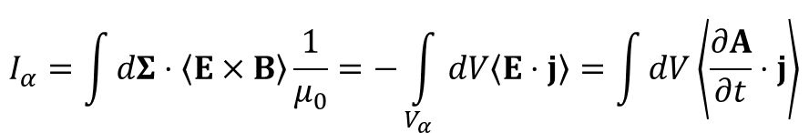
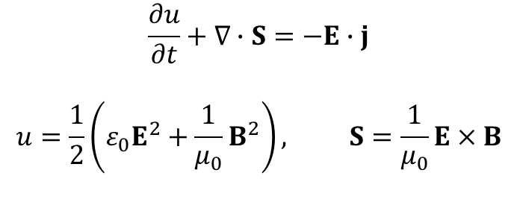
Poynting theorem and heat transfer
$$\frac{∂u}{∂t}+∇∙S=−E∙j$$
$$u=\frac{1}{2}\left(ε_{0}E^{2}+\frac{1}{μ_{0}}B^{2}\right), S=\frac{1}{μ_{0}}E×B$$
α
$$I_{α}=\int{dΣ⋅\left\langle E×B\right\rangle \frac{1}{μ_{0}}=−\int_{V_{α}}{dV\left\langle E⋅j\right\rangle }}=\int{dV\left\langle \frac{∂A}{∂t}⋅j\right\rangle }$$

Slide 10
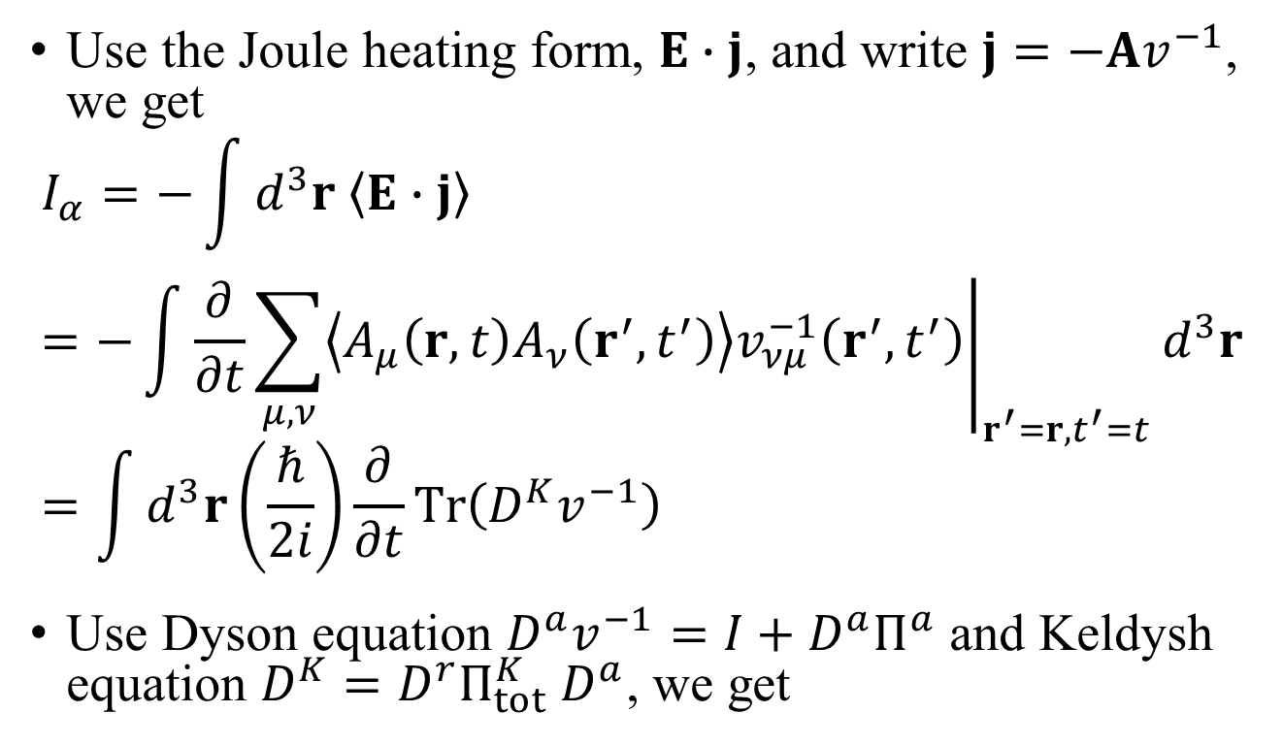
Deriving a Meir-Wingreen formula
Use the Joule heating form, $E∙j$, and write $j=−Av^{−1}$, we get
$$I_{α}=−\int{d^{3}r \left\langle E∙j\right\rangle }=−\int{{\left.\frac{∂}{∂t}\sum_{μ,ν}{\left\langle A_{μ}\left(r,t\right)A_{ν}\left(r^{′},t^{′}\right)\right\rangle v_{νμ}^{−1}\left(r^{′},t^{′}\right)}\right|}_{r^{′}=r,t^{′}=t}}d^{3}r=\int{d^{3}r\left(\frac{ℏ}{2i}\right)\frac{∂}{∂t}Tr\left(D^{K}v^{−1}\right)}$$
Use Dyson equation $D^{a}v^{−1}=I+D^{a}Π^{a}$ and Keldysh equation $D^{K}=D^{r}Π_{tot}^{K}{ D}^{a}$, we get

Slide 11
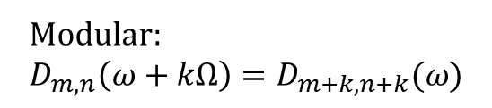
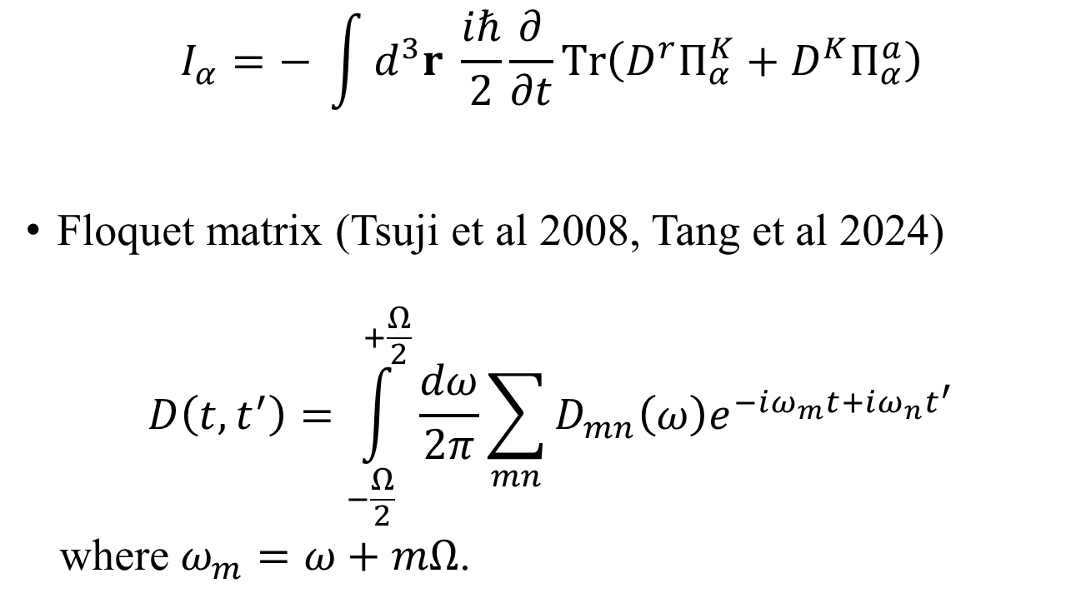
Meir-Wingreen formula
$$I_{α}=− \int{d^{3}r \frac{iℏ}{2}}\frac{∂}{∂t}Tr\left(D^{r}Π_{α}^{K}+D^{K}Π_{α}^{a}\right)$$
Floquet matrix (Tsuji et al 2008, Tang et al 2024)
$$D\left(t,t^{′}\right)=\int_{−\frac{Ω}{2}}^{+\frac{Ω}{2}}{\frac{dω}{2π}\sum_{mn}{D_{mn}\left(ω\right)e^{−iω_{m}t+iω_{n}t^{′}}}}$$
where $ω_{m}=ω+mΩ$.
Modular:
$$D_{m,n}\left(ω+kΩ\right)=D_{m+k,n+k}(ω)$$

Slide 12
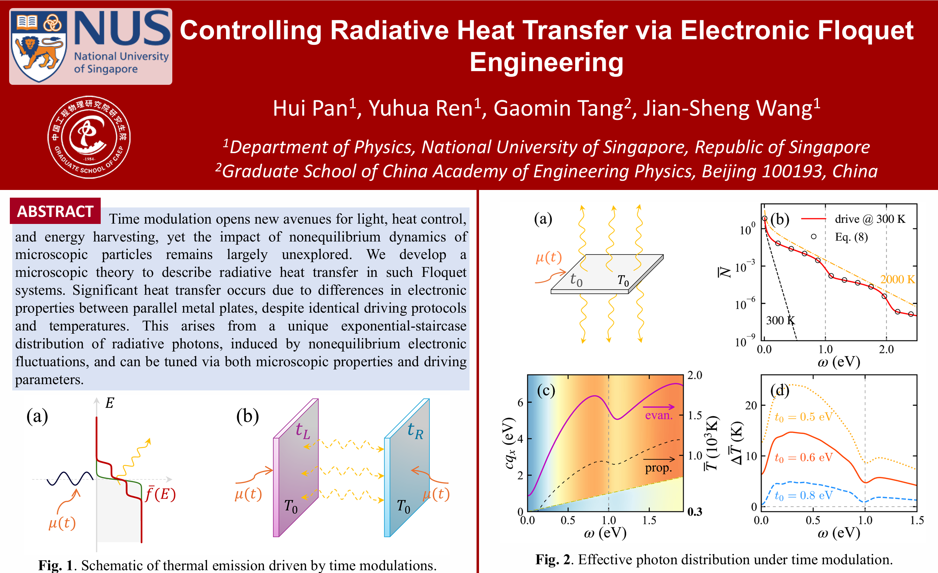
Floquet drive, see Hui Pan poster
From Phys. Rev. B 112, L041401 (2025).

Slide 13
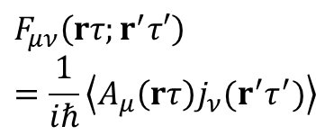
Steady-state Meir-Wingreen formula
Krüger, et al (2012); Strekha, et al (2022);
Wang, et al, Front. Phys. (2023).
$$F_{μν}\left(rτ;r^{′}τ′\right)=\frac{1}{iℏ}\left\langle A_{μ}\left(rτ\right)j_{ν}(r^{′}τ^{′})\right\rangle$$
Notes:
Levi Civita symbol

Slide 14
From Meir-Wingreen to Landauer
local equilibrium
No Landauer form for force and torque!

Slide 15
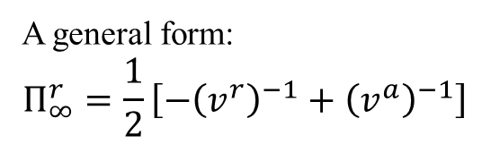

Bath at infinity
Eckhardt, PRA 29, 1991 (1984)
Krüger, et al, PRB 86, 115423 (2012)
$$∞$$
A general form:
$$Π_{∞}^{r}=\frac{1}{2}\left[−{\left(v^{r}\right)}^{−1}+{\left(v^{a}\right)}^{−1}\right]$$

Slide 16
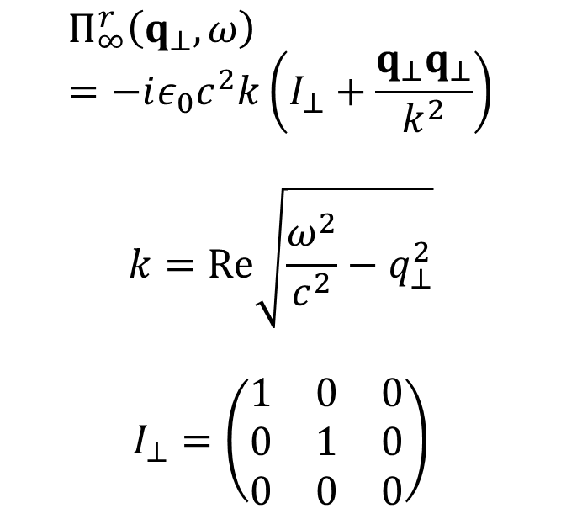


Bath at $∞, p$lanar geometry
$$Π_{∞}^{r}\left(q_{⊥},ω\right)=−iε_{0}c^{2}k\left(I_{⊥}+\frac{q_{⊥}q_{⊥}}{k^{2}}\right)$$
$$k=Re\sqrt{\frac{ω^{2}}{c^{2}}−q_{⊥}^{2}}$$
$$I_{⊥}=\left(\begin{matrix}1 & 0 & 0 \\ 0 & 1 & 0 \\ 0 & 0 & 0\end{matrix}\right)$$
z
$$Π_{∞}$$

Slide 17

Recover Planck result
$$T$$
R
0

Slide 18
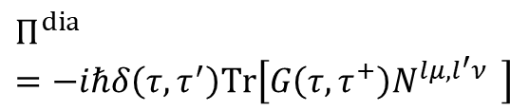

Self-energy $Π$
$$Π^{dia}=−iℏδ\left(τ, τ^{′}\right)Tr\left[G\left(τ,τ^{+}\right)N^{lμ,l^{′}ν } \right]$$
diamagnetic
RPA

Slide 19
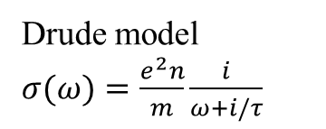




Radiative heat transfer between metal blocks
Drude model $σ(ω)=\frac{e^{2}n}{m}\frac{i}{ω+i/τ}$
$$q_{⊥}=(q_{x},q_{y})$$
z
$$T_{1}$$
$$T_{2}$$
gap $d$

Slide 20

Polder & von Hove 1971
$$1/d^{2}$$
Drude model conductance for chromium at a temperature of 315 K.
s polarization
See also Wise & Basko, PRB 103, 165423 (2021).
p polarization

Slide 21
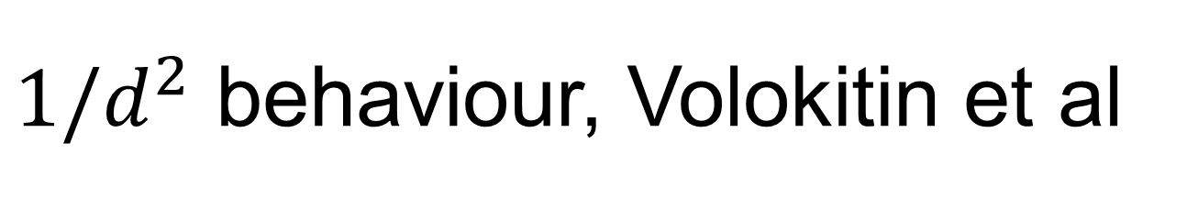


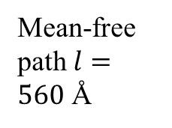
$1/d^{2}$ behaviour, Volokitin et al
Mean-free path $l=560$ Å
$l=20$ Å
$l=3.4$ Å
From Volokitin & Persson, RMP 2007

Slide 22

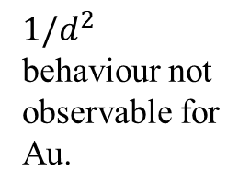
Saturation at $d→0$
$1/d^{2}$ behaviour not observable for Au.
local even p
nonlocal even s
local evan s
nonlocal evan p
From P.-O. Chapuis, et al, PRB 77, 035431 (2008).

Slide 23
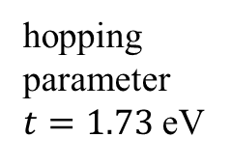
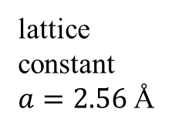

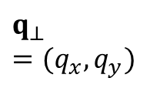

Semi-infinite cubic lattice
J.-S. Wang, Phys. Rev. B 111, 245404 (2025)
half filling
lattice constant $a=2.56$ Å
hopping parameter $t=1.73$ eV
$$q_{⊥}=(q_{x},q_{y})$$
Au surface
$$aj$$
$$j$$

Slide 24
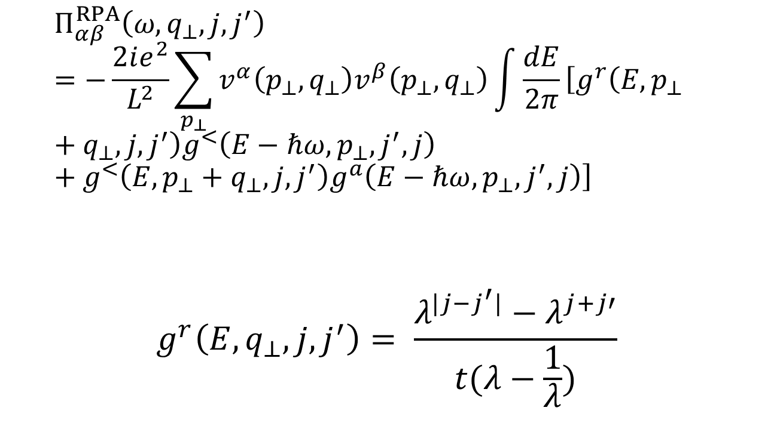
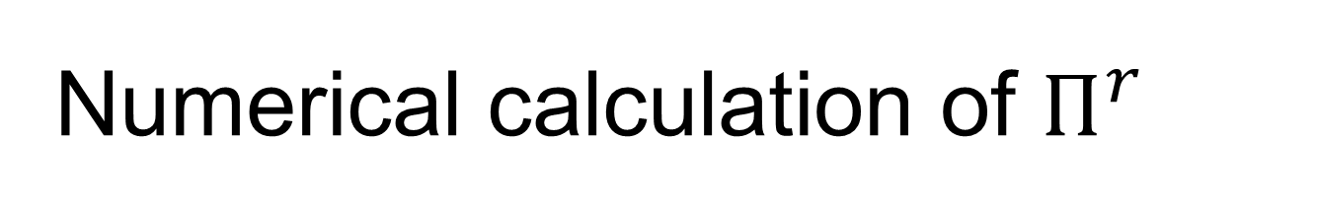

Numerical calculation of $Π^{r}$
  $$Π_{αβ}^{RPA}\left(ω,q_{⊥},j,j^{′}\right)=−\frac{2ie^{2}}{L^{2}}\sum_{p_{⊥}}{v^{α}\left(p_{⊥}, q_{⊥}\right)v^{β}\left(p_{⊥},q_{⊥}\right)\int{\frac{dE}{2π}}\left[g^{r}\left(E,p_{⊥}+q_{⊥},j,j^{′}\right)g^{<}\left(E−ℏω,p_{⊥},j^{′},j\right)+g^{<}\left(E,p_{⊥}+q_{⊥},j,j^{′}\right)g^{a}\left(E−ℏω,p_{⊥},j^{′},j\right)\right]}$$
$$g^{r}\left(E,q_{⊥},j,j^{′}\right)= \frac{λ^{|j−j^{′}|}−λ^{j+j′}}{t(λ−\frac{1}{λ})}$$
surface Green’s function:
$$\frac{t}{λ}+E+iη−ε_{q_{⊥}}+tλ=0$$

Slide 25
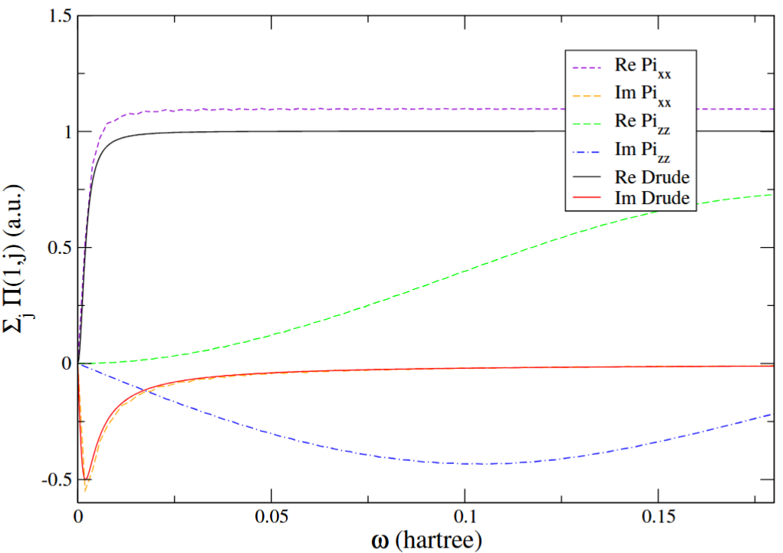

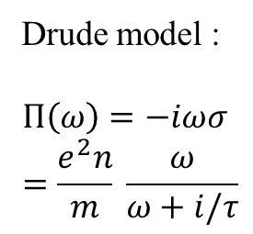
Drude model $Π$?
x
z
x: parallel to plate, z: normal to plate
Re Pi, x
Drude model :
$$Π\left(ω\right)=−iωσ=\frac{e^{2}n}{m} \frac{ω}{ω+i/τ}$$
Re Pi_{zz}
Im Pi_{zz}

Slide 26
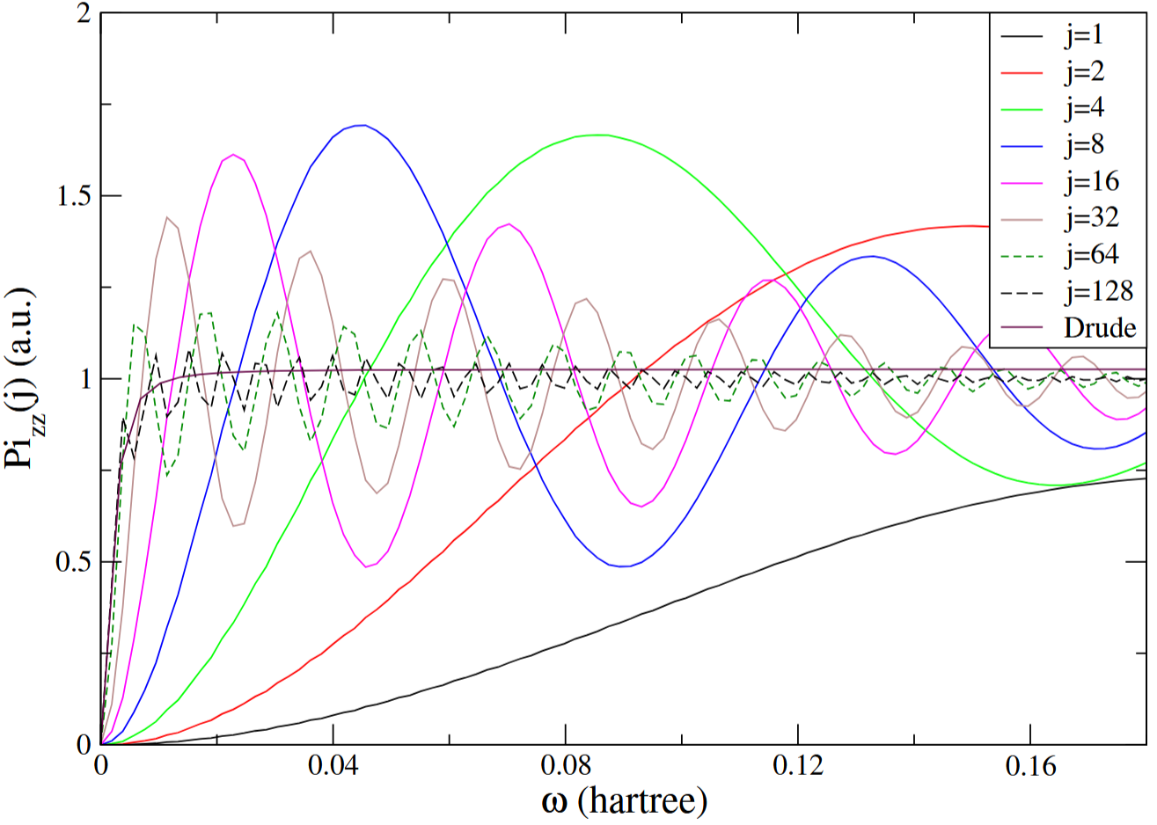
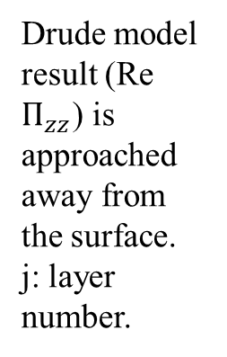
Surface vs bulk
Drude model result (Re $Π_{zz}$) is approached away from the surface. j: layer number.

Slide 27
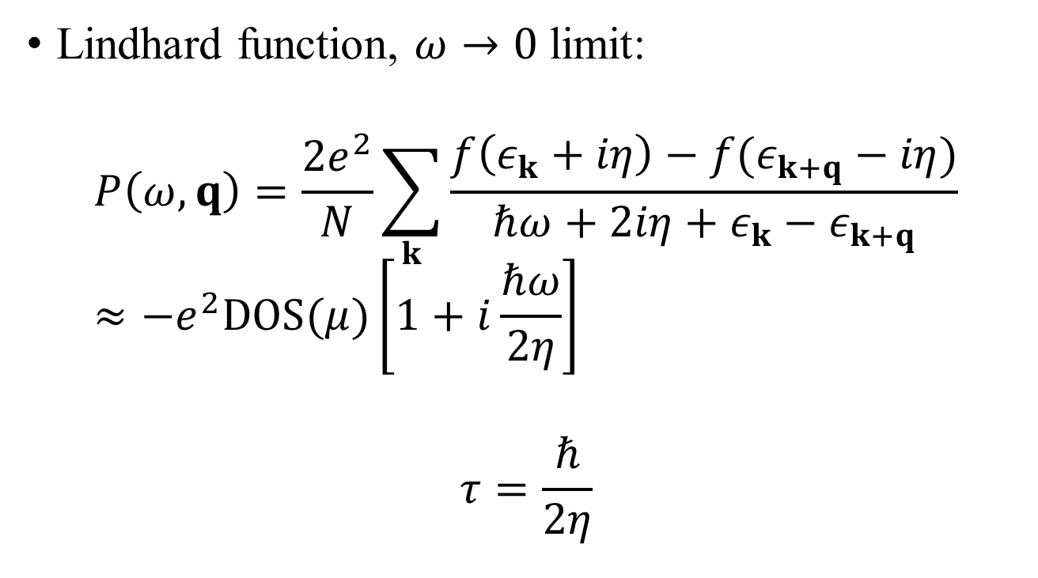
Scalar potential, charge-charge correlation
Lindhard function, $ω→0$ limit:
$$P\left(ω,q\right)=\frac{2e^{2}}{N}\sum_{k}{\frac{f\left(ε_{k}+iη\right)−f(ε_{k+q}−iη)}{ℏω+2iη+ε_{k}−ε_{k+q}}}≈−e^{2}DOS(μ)\left[1+i\frac{ℏω}{2η}\right]$$
$$τ=\frac{ℏ}{2η}$$

Slide 28
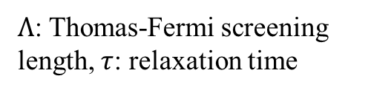
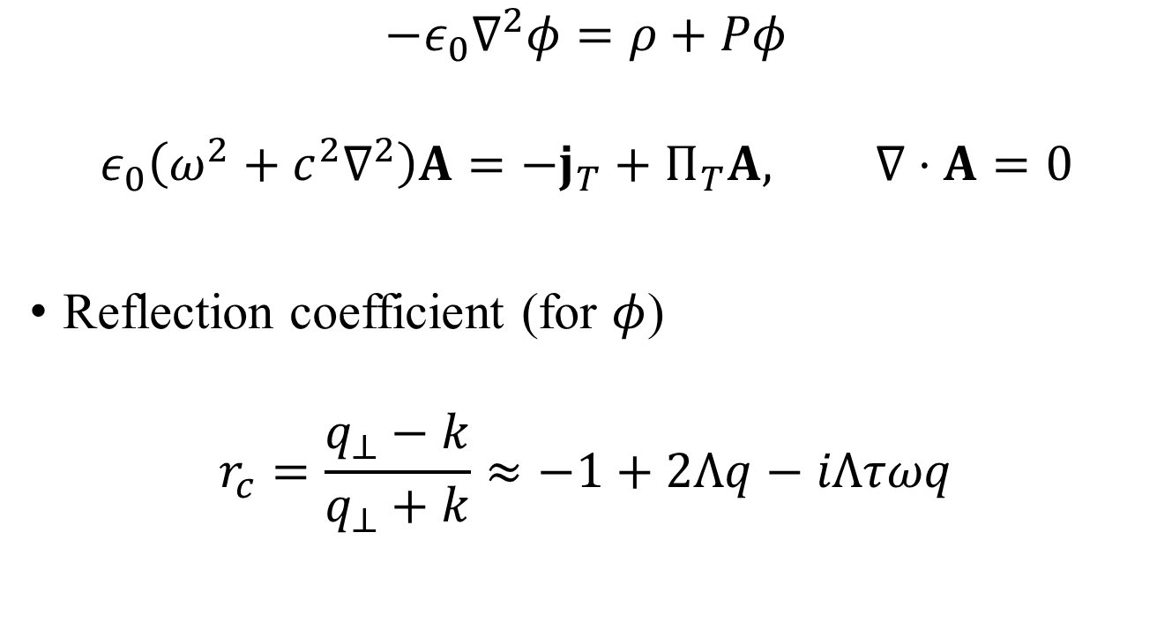
Scattering problem in Coulomb gauge
$$−ε_{0}∇^{2}φ=ρ+Pφ$$
$$ε_{0}\left(ω^{2}+c^{2}∇^{2}\right)A=−j_{T}+Π_{T}A, ∇⋅A=0$$
Reflection coefficient (for $φ$)
$$r_{c}=\frac{q_{⊥}−k}{q_{⊥}+k}≈−1+2Λq−iΛτωq$$
$Λ$: Thomas-Fermi screening length, $τ$: relaxation time

Slide 29


Drude model $r_{p}$, $c→∞$ limit
$$r_{p}=\frac{k_{z}^{′}−εk_{z}}{k_{z}^{′}+εk_{z}}≈\frac{1−ε}{1+ε}$$
$$k_{z}=\sqrt{\frac{ω^{2}}{c^{2}}−q_{⊥}^{2}}, { k}_{z}^{′}=\sqrt{ε\frac{ω^{2}}{c^{2}}−q_{⊥}^{2}}$$
$$ε=1−\frac{e^{2}n}{ε_{0}m} \frac{1}{ω\left(ω+i/τ\right)}$$

Slide 30
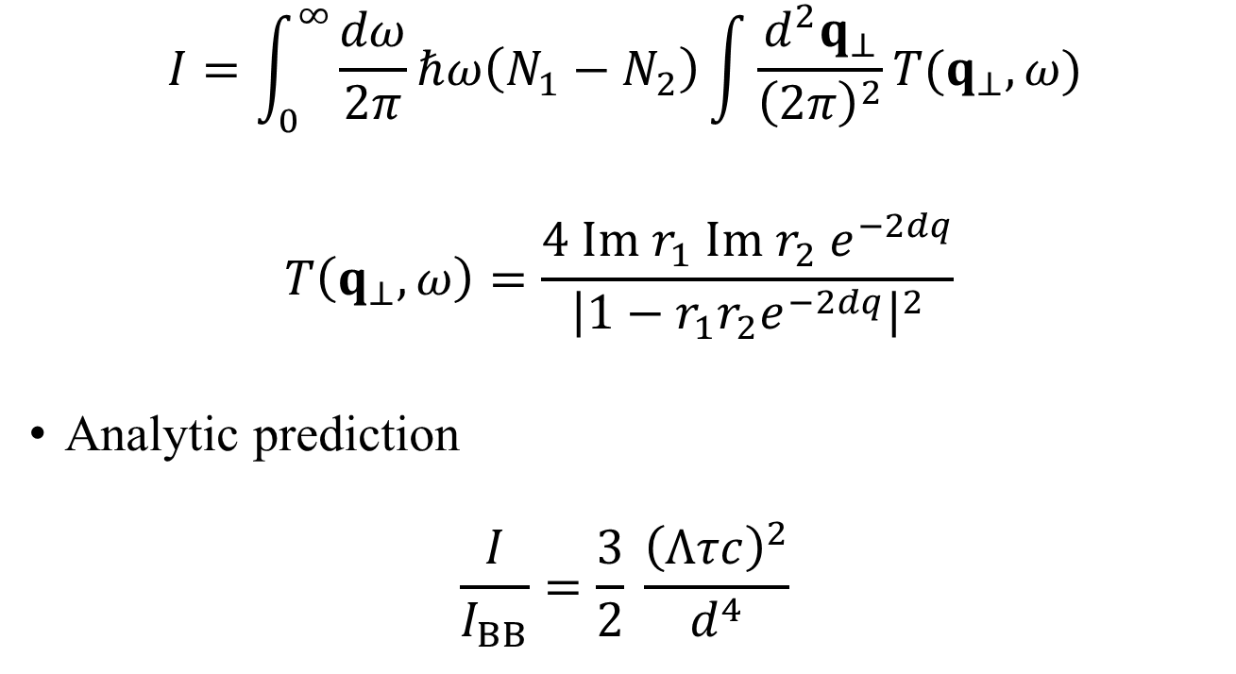
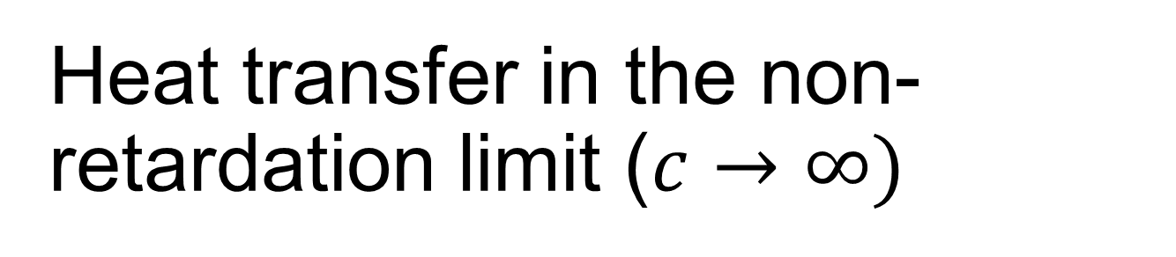


Heat transfer in the non-retardation limit ($c→∞)$
$$I=\int_{0}^{∞}{\frac{dω}{2π}ℏω\left(N_{1}−N_{2}\right)\int{\frac{d^{2}q_{⊥}}{{\left(2π\right)}^{2}}T(q_{⊥},ω)}}$$
$$T\left(q_{⊥},ω\right)=\frac{4 Im r_{1} Im r_{2} e^{−2dq}}{{\left|1−r_{1}r_{2}e^{−2dq}\right|}^{2}}$$
Analytic prediction
$$\frac{I}{I_{BB}}=\frac{3}{2} \frac{{\left(Λτc\right)}^{2}}{d^{4}}$$
Thomas-Fermi screening length:
$$Λ=\sqrt{\frac{a^{3}ε_{0}}{e^{2}DOS(μ) }}$$
$I_{BB}$ blackbody power

Slide 31
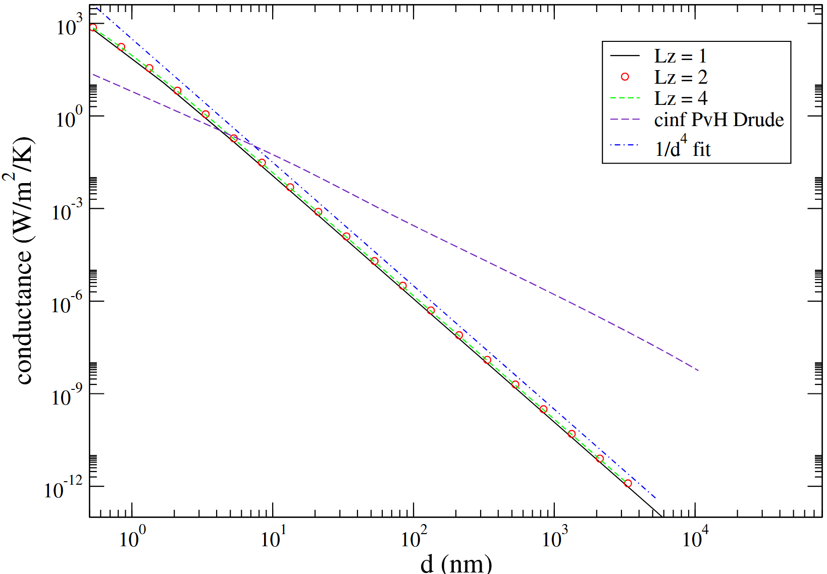

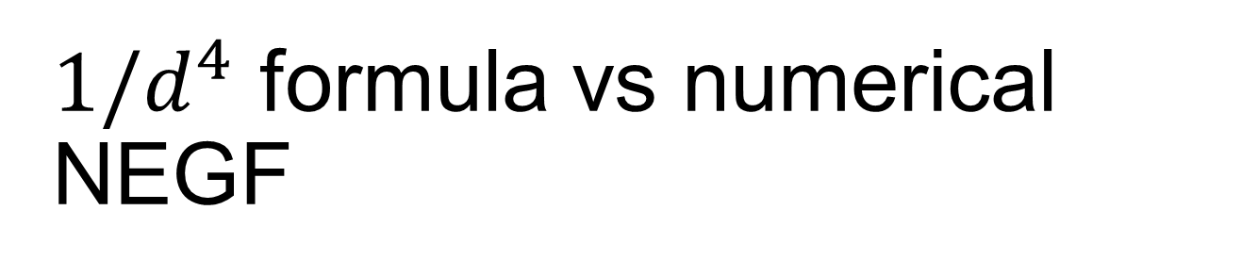

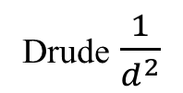
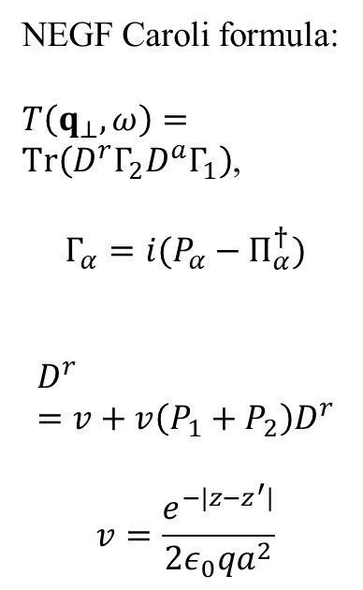

$1/d^{4}$ formula vs numerical NEGF
$$d$$
$$L_{z}$$
NEGF Caroli formula:
$T\left(q_{⊥},ω\right)=Tr\left(D^{r}Γ_{2}D^{a}Γ_{1}\right)$,
$$Γ_{α}=i(P_{α}−Π_{α}^{†})$$
$$D^{r}=v+v\left(P_{1}+P_{2}\right)D^{r}$$
$$v=\frac{e^{−|z−z^{′}|}}{2ε_{0}qa^{2}}$$
Drude $\frac{1}{d^{2}}$
$$\frac{1}{d^{4}}$$
From Wang 2025; see also Zhang, Lü, Wang PRB 2018

Slide 32
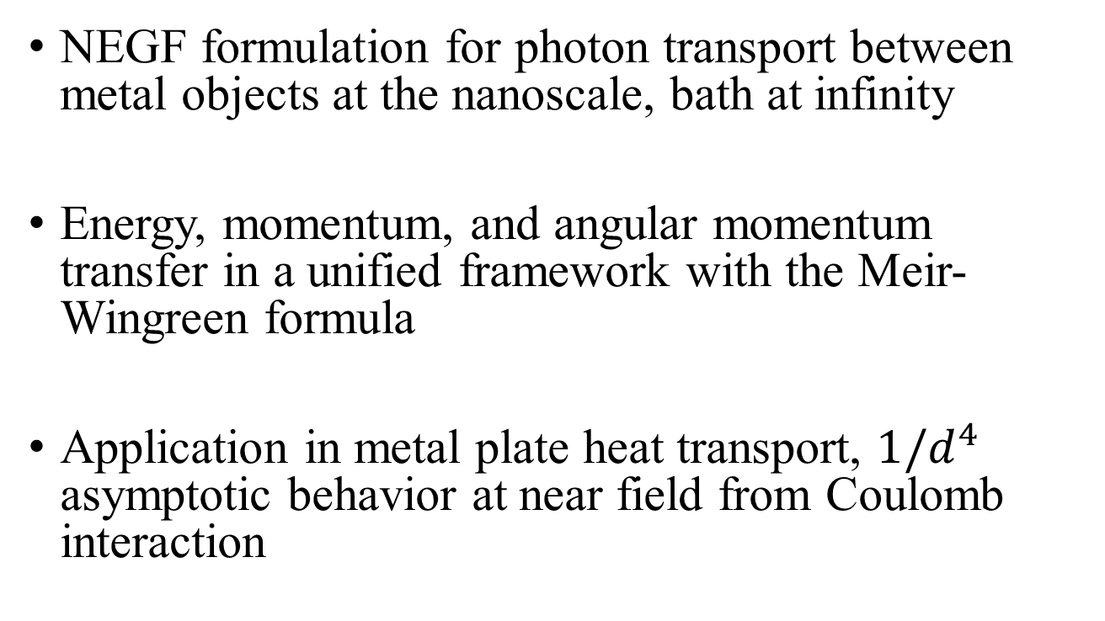
Conclusion
NEGF formulation for photon transport between metal objects at the nanoscale, bath at infinity
Energy, momentum, and angular momentum transfer in a unified framework with the Meir-Wingreen formula
Application in metal plate heat transport, $1/d^{4}$ asymptotic behavior at near field from Coulomb interaction

Slide 33
Single electron quantum mechanics
Notes:
In a particular representation, since H is 2x2 matrix, Psi a column vector, so the Green’s function G is also 2x2 matrix.

Slide 34
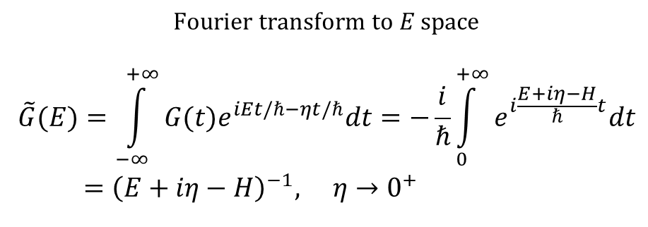
Green’s function in energy space
$$\text{Fourier} \text{transform} \text{to} E \text{space}$$
$$\tilde{G}(E)=\int_{−∞}^{+∞}{G(t)e^{iEt/ℏ−ηt/ℏ}dt=−\frac{i}{ℏ}}\int_{0}^{+∞}{e^{i\frac{E+iη−H}{ℏ}t}dt} \\ ={\left(E+iη−H\right)}^{−1}, η→0^{+}$$
${\left(z−H\right)}^{−1}$ is called resolvent of the operator $H$.
Notes:
Here z or E or i*eta really means the constant type the identity matrix I. The small eta 1) makes the integral converge, 2) makes the inverse Fourier transform well defined (which produce the theta(t) in the retarded Green’s function).

Slide 35
Perturbation theory, single electron

Slide 36
Annihilation/creation operators
defining property of fermion

Slide 37
Many-electron Hamiltonian and Green’s functions
Annihilation operator c is a column vector, H is N by N matrix. {A, B} =AB+BA
Notes:
Various other Green’s functions (G<, G>, G^r, G^a, G^t, G^tbar) will be defined later for phonon. The form and relation among Greens are such so that phonon and electrons are the same. See slide 54, 55.

Slide 38
Contour-ordered Green’s function
Contour order: the operators earlier on the contour are to the right. See, e.g., H. Haug & A.-P. Jauho.
τ’
τ
t₀
Notes:
A B in the second line is in Schrodinger picture.
38

Slide 39
Convolution, Langreth rule
Keldysh rotation
Notes:
The last two equations are known as Keldysh equations.

Slide 40
From electron to photon (scalar field theory)

Slide 41
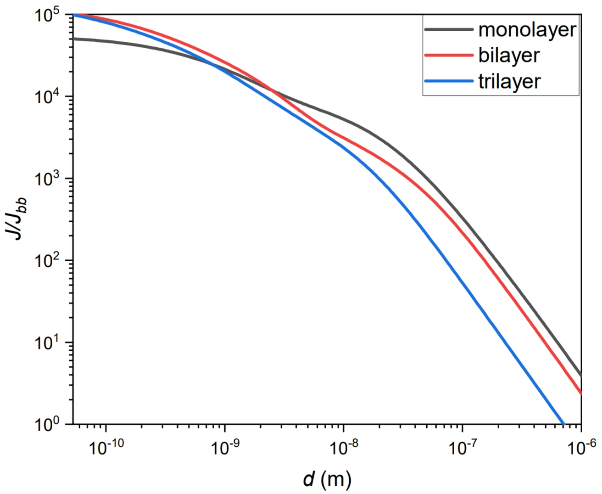
Heat transfer between two graphene sheets
↓ First principles QE/BerkeleyGW calculation for the ratio of energy transfer to blackbody value between two multilayer graphene sheets at temperatures 300 K and 1000 K. Wang, et al, Frontiers of Physics, 18, 43602 (2023).
↑ Heat transfer ratio based on electron tight-binding model with nearest neighbor hopping t = 2.8 eV, between 300 K and 1000 K sheets at chemical potential μ = 0.1 eV. Jiang & Wang, PRB 96, 155437 (2017).

Slide 42


Heat transfer between zigzag nanotubes or triangles
Heat transfer from 400K to 300K objects. (a), (b) zigzag carbon nanotubes. (c), (d) nano-triangles. d: gap distance, M: nanotube circumference, L: triangle length. ε: dielectric constant. From Tang, et al, Phys. Rev. Appl. 11, 031004 (2019).

Slide 43
Emission to infinity

Slide 44
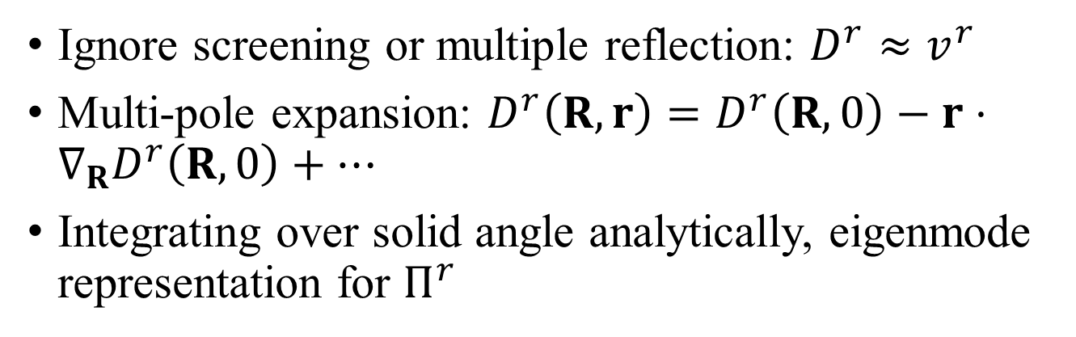
Far field approximations
Ignore screening or multiple reflection: $D^{r}≈v^{r}$
Multi-pole expansion: $D^{r}\left(R,r\right)=D^{r}\left(R,0\right)−r⋅∇_{R}D^{r}\left(R,0\right)+⋯$
Integrating over solid angle analytically, eigenmode representation for $Π^{r}$
Fermi golden rule

Slide 45
Torque and force on object
Force is zero if system is reciprocal, i.e., if ${\left(Π^{<}\right)}^{T}=Π^{<}$

Slide 46
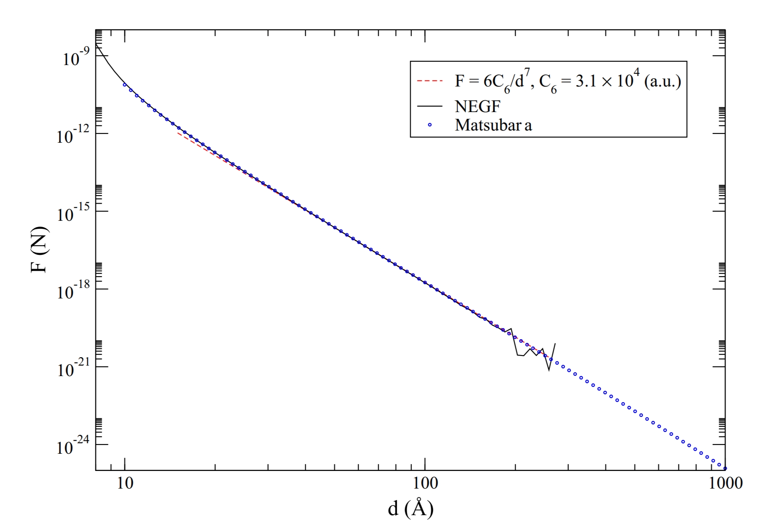
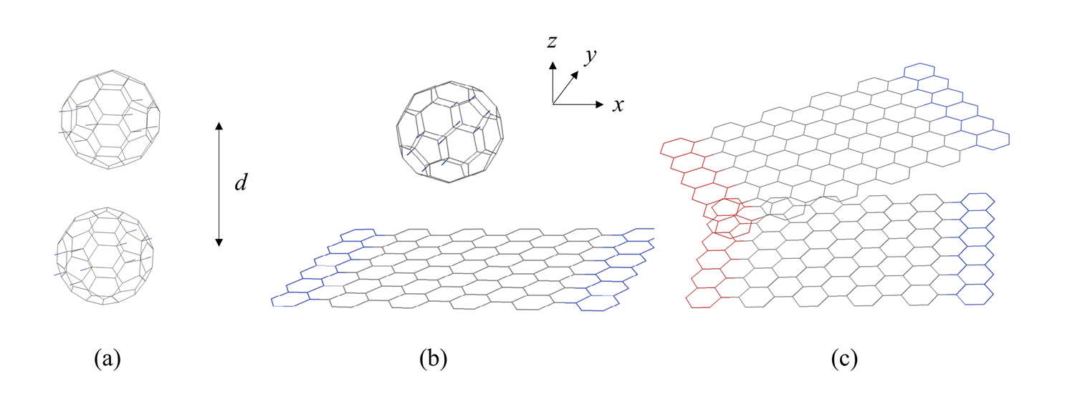
C₆₀ and graphene
Wang and Antezza, Phys. Rev. B 109, 125105 (2024)

Slide 47



Results
↑ two strips with a rotation angle. Black: both unbiased, red: biased on top, green: both biased.
↑ power and force between the arm-chair strip and C60, symmetric bias.
→ Total emission to infinity.

Slide 48

Heat transfer driven by current
Partial integrand for the total current with different driven velocities (blue dash 0, red 5, black 9, units 10⁵ m/s). From Peng arXiv:1805.09493.

Slide 49

Boltzmann equation for nonequilibrium distribution
$G_{k}^{<}\left(E\right)=f_{k}(G_{k}^{r}\left(E\right)−G_{k}^{a}\left(E\right))$
$f_{k}=f_{k}^{0}−\frac{df^{0}}{dε_{k}}Φ_{k}=f^{0}(ε_{k}−Φ_{k})$
$Φ_{k}=ℏk_{x}v_{1}$
More general case $Φ_{k}=−eEτ_{k}\frac{∂ε_{k}}{∂(ℏk_{x})}$
Graphene taking into lattice symmetry: $Φ_{k}=v_{1}Re\left[ z^{∗}\frac{∂z}{∂k_{x}} \right](ℏv_{F}^{2})$, $z=−t(e^{−ik_{x}a}+e^{i\left(\frac{k_{x}a}{2}+\frac{k_{y}a\sqrt{3}}{2}\right)}+e^{i\left(\frac{k_{x}a}{2}−\frac{k_{y}a\sqrt{3}}{2}\right)})$

Slide 50
Current-induced heat transfer
: T₁=T₂=300 K. (a) and (c) infinite system (fluctuational electrodynamics), (b) and (d) 4×4 cell finite system with four leads (NEGF).
: Double-layer graphene. T₁=300K, varying T₂ at distance d = 10 nm, chemical potential at 0.1 eV.
From Peng & Wang, arXiv:1805.09493.

Slide 51


Emission from graphene edge
(a) Emission power as a function of temperature, (b) P, N, F as a function of $μ_{L}$ fixing $\frac{μ_{R}}{t}=−0.8$. Y.-M. Zhang, etc.

Slide 52

Au, PvH vs NEGF full E&M

