Slide 1

Cluster Monte Carlo Algorithms:
Jian-Sheng Wang
National University of Singapore

Slide 2
Outline
Introduction to Monte Carlo and statistical mechanical models
Cluster algorithms
Replica Monte Carlo

Slide 3

1. Introduction to MC and Statistical Mechanical Models

Slide 4
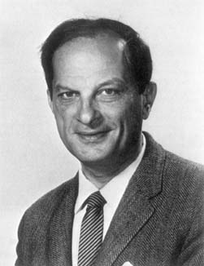
Stanislaw Ulam (1909-1984)
S. Ulam is credited as the inventor of Monte Carlo method in 1940s, which solves mathematical problems using statistical sampling.
Notes:
Stanislaw Ulam, a Polish born mathematician who worked for John von Neumann on the United States’ Manhattan Project during World War II. Ulam is primarily known for designing the hydrogen bomb with Edward Teller in 1951. He invented the Monte Carlo method in 1946 while pondering the probabilities of winning a card game of solitaire.

Slide 5
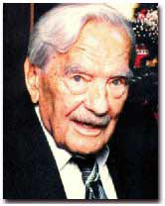
Nicholas Metropolis (1915-1999)
The algorithm by Metropolis (and A Rosenbluth, M Rosenbluth, A Teller and E Teller, 1953) has been cited as among the top 10 algorithms having the "greatest influence on the development and practice of science and engineering in the 20th century."
Notes:
“The code that was to become the famous Monte Carlo method of calculation originated from a synthesis of insights that Metropolis brought to more general applications in collaboration with Stanislaw Ulam in 1949. A team headed by Metropolis, which included Anthony Turkevich from Chicago, carried out the first actual Monte Carlo calculations on the ENIAC in 1948. Metropolis attributes the germ of this statistical method to Enrico Fermi, who had used such ideas some 15 years earlier. The Monte Carlo method, with its seemingly limitless potential for development to all areas of science and economic activities, continues to find new applications.”
From “Physics Today” Oct 2000, Vol 53, No. 10., see also http://www.aip.org/pt/vol-53/iss-10/p100.html.

Slide 6
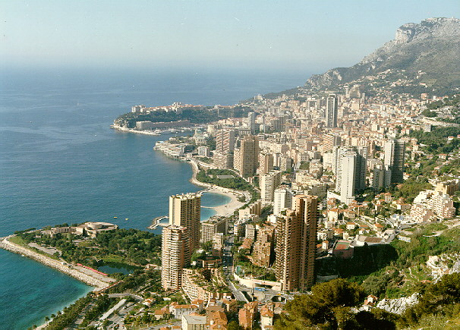
The Name of the Game
Metropolis coined the name “Monte Carlo”, from its gambling Casino.
Monte-Carlo, Monaco
Notes:
“Monte Carlo, in the principality of Monaco, is a favorite port of call for many cruise visitors to the Mediterranean. It is tiny (only three kilometers long - less than two miles) and sits on a large rock named Mont Des Mules overlooking the sea. A road separates Monaco from France, and you hardly realize it when you are moving between the two countries. There are about 30,000 residents of Monaco, of which the citizens, called Monegasques, make up about 25 per cent of the total populace. ”
From http://cruises.about.com/library/weekly/aa021101a.htm

Slide 7
Use of Monte Carlo Methods
Solving mathematical problems (numerical integration, numerical partial differential equation, integral equation, etc) by random sampling
Using random numbers in an essential way
Simulation of stochastic processes

Slide 8
Markov Chain
Monte Carlo
Generate a sequence of states X₀, X₁, …, X_{n}, such that the limiting distribution is given P(X)
Move X by the transition probability
W(X -> X’)
Starting from arbitrary P₀(X), we have
P_{n+1}(X) = ∑_{X’} P_{n}(X’) W(X’ -> X)
P_{n}(X) approaches P(X) as n go to ∞

Slide 9
Necessary and sufficient conditions for convergence
Ergodicity
  [W^{n}](X - > X’) > 0
  For all n > n_{max}, all X and X’
Detailed Balance
P(X) W(X -> X’) = P(X’) W(X’ -> X)

Slide 10
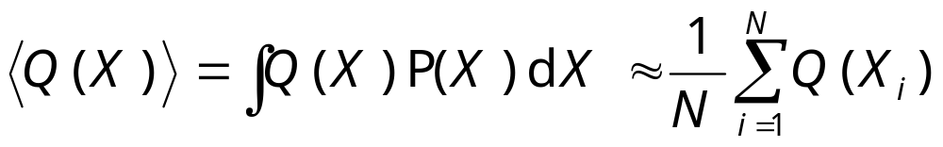
Taking Statistics
After equilibration, we estimate:
It is necessary that we take data for each sample or at uniform interval. It is an error to omit samples (condition on things).

Slide 11
Choice of Transition Matrix W
The choice of W determines a algorithm. The equation
P = PW
or
P(X)W(X->X’)=P(X’)W(X’->X)
has (infinitely) many solutions given P.
Any one of them can be used for Monte Carlo simulation.
Notes:
However, the efficiency depends on the choice of W.

Slide 12
Metropolis Algorithm (1953)
Metropolis algorithm takes
W(X->X’) = T(X->X’) min(1, P(X’)/P(X))
where X ≠ X’, and T is a symmetric stochastic matrix
T(X -> X’) = T(X’ -> X)
Notes:
T is not fixed and is usually zero unless X’ is in a “neighborhood” of X.
Show that detailed balance equation is satisfied.
Peskun has a theorem which says, in some sense, Metropolis rate min(1, …) is most efficient. P Peskun, Biometrika, 60 (1973) 607.

Slide 13
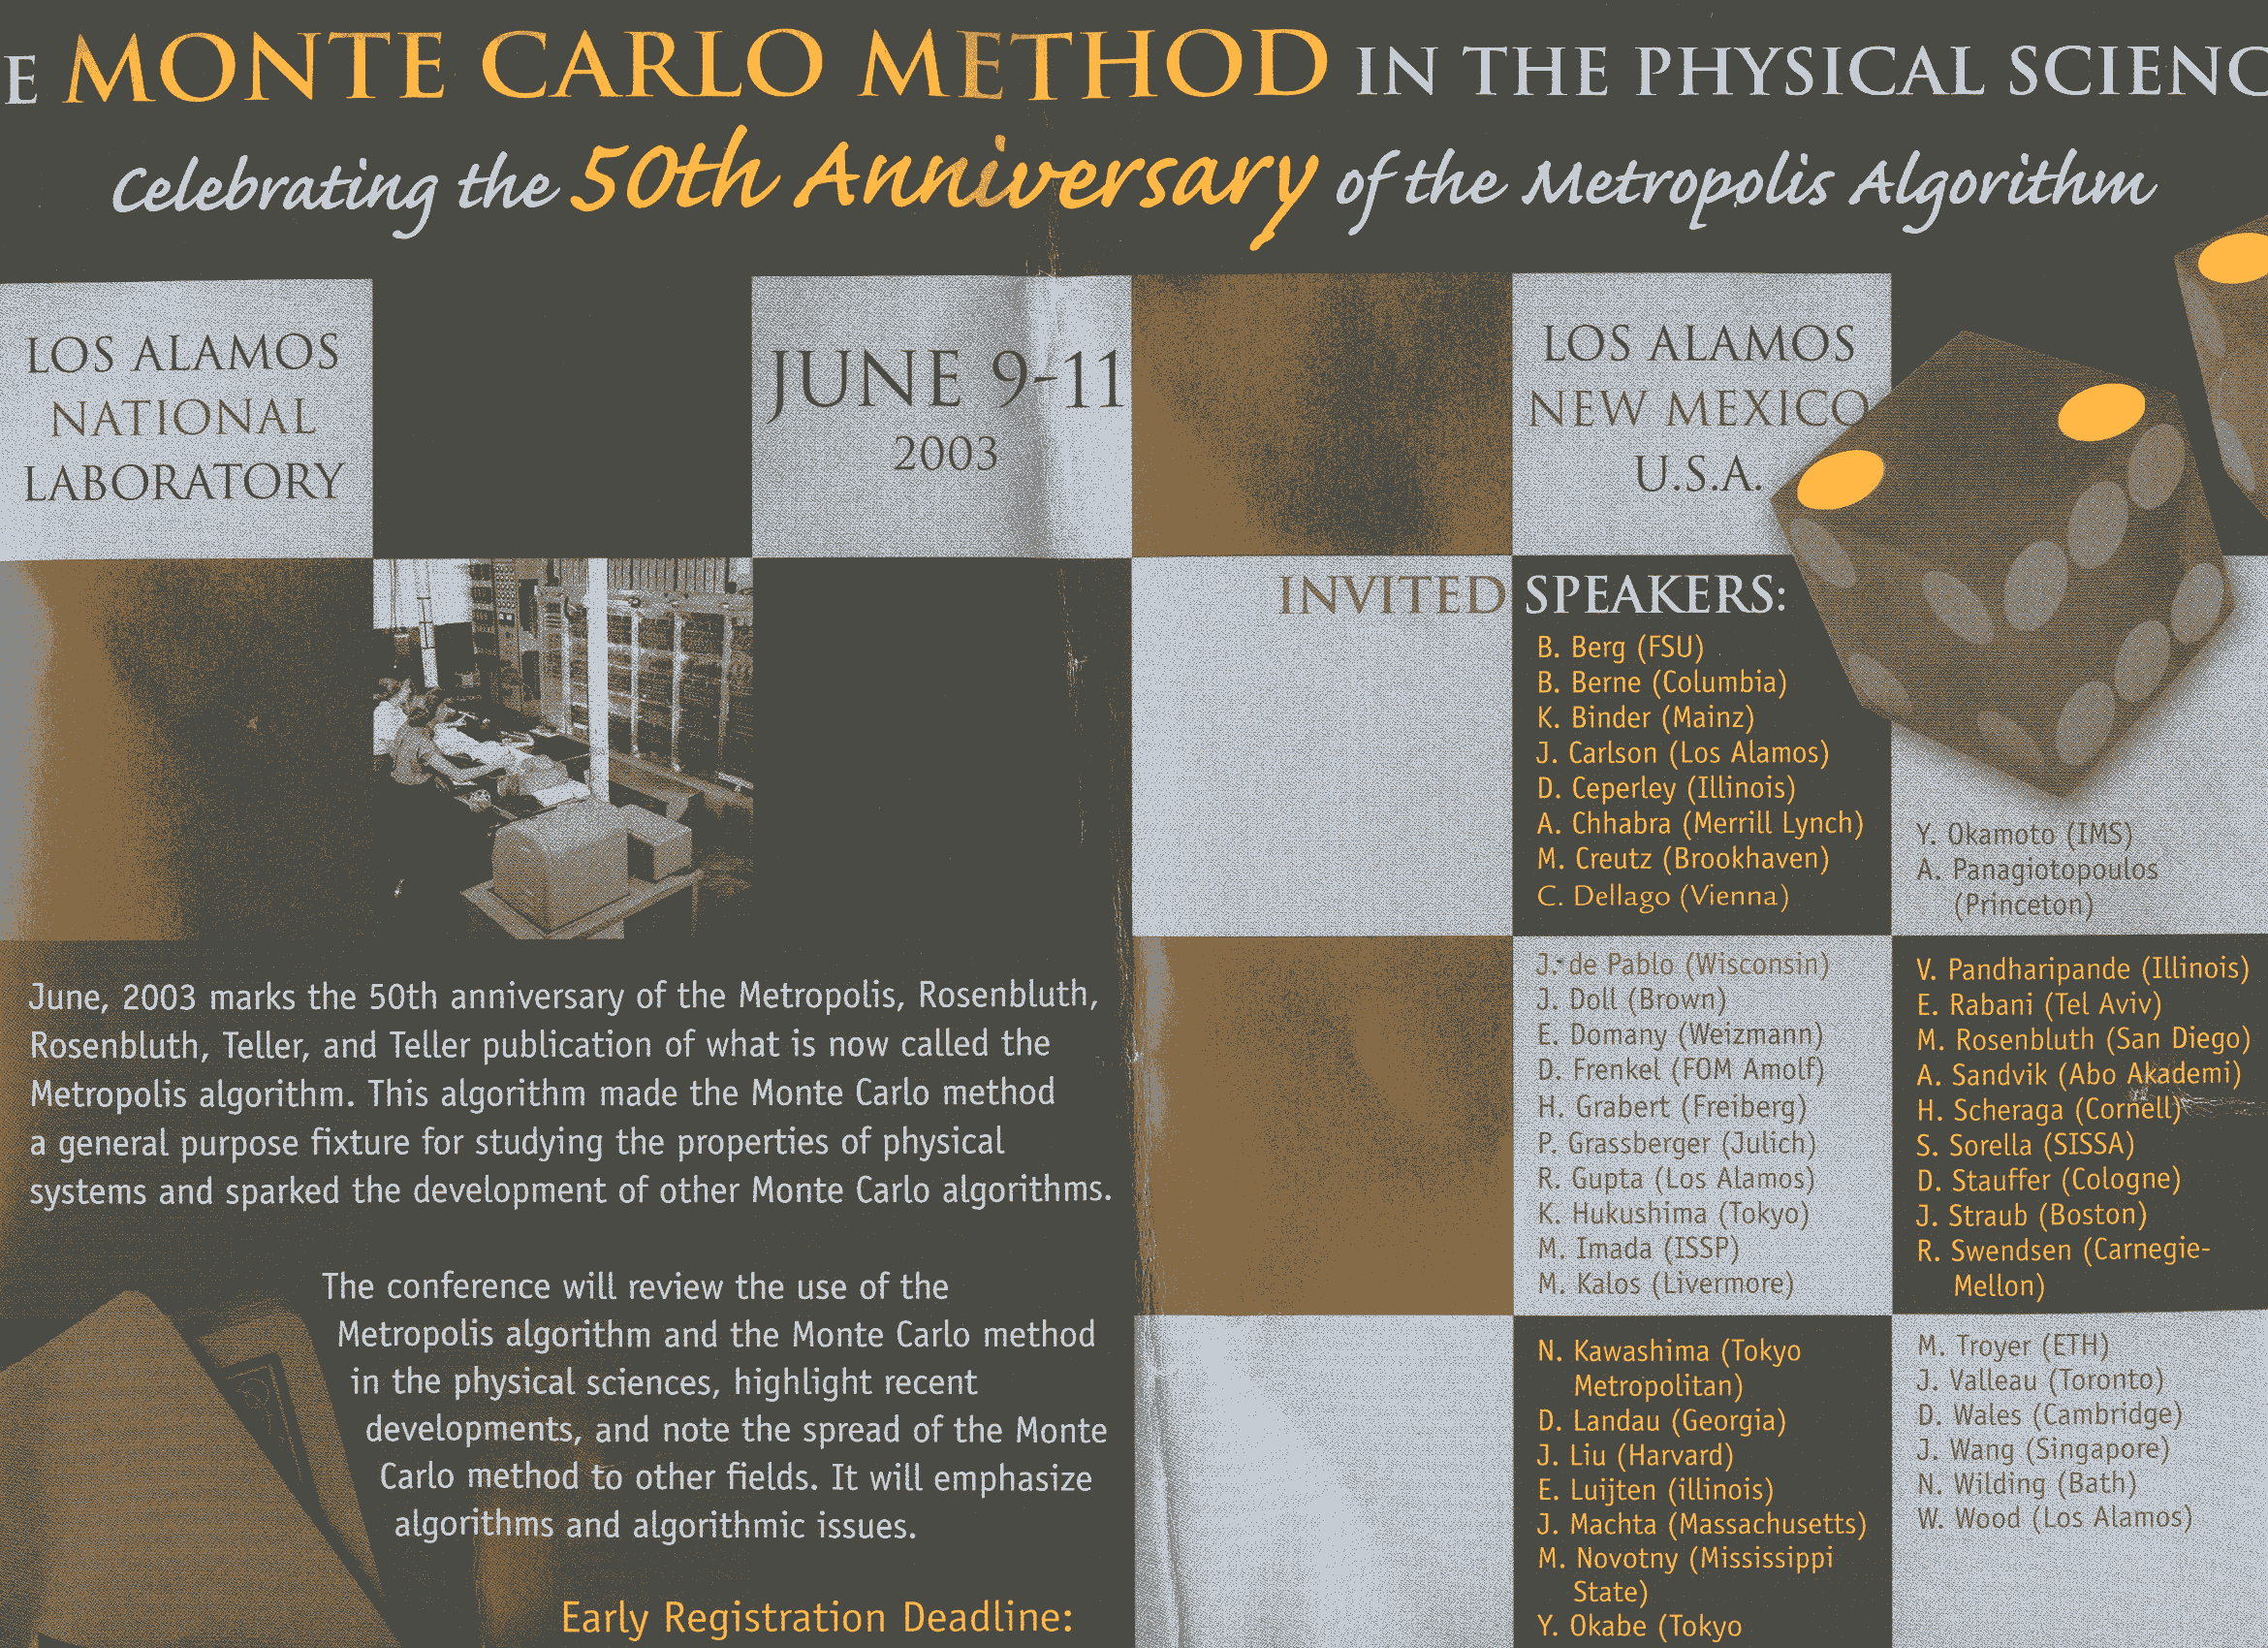

Slide 14
Model Gas/Fluid
A collection of molecules interact through some potential (hard core is treated), compute the equation of state: pressure p as function of particle density ρ=N/V.
(Note the ideal gas law) PV = N k_{B}T
Notes:
P is pressure, V is volume, N is number of molecules or atoms, T is temperature, and k_{B} is Boltzmann constant.

Slide 15
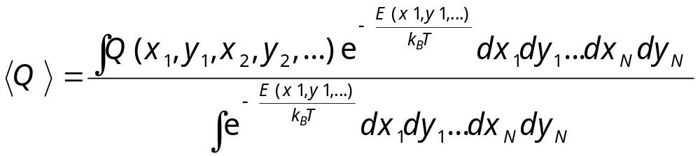
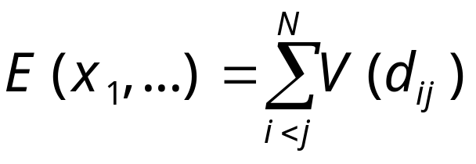
The Statistical Mechanics of Classical Gas/(complex) Fluids/Solids
Compute multi-dimensional integral
where potential energy
Notes:
Using 2D disks as an example.

Slide 16
The Ising Model
-
-
+
-
+
-
The energy of configuration σ is
E(σ) = - J ∑_{<ij>} σ_{i} σ_{j}
where i and j run over a lattice, <ij> denotes nearest neighbors, σ = ±1
-
-
-
+
+
-
+
+
-
-
-
+
+
-
+
+
+
-
+
+
-
-
-
-
+
+
-
-
+
-
σ = {σ₁, σ₂, …, σ_{i}, … }
Notes:
In 1925, physicist W. Lenz asked his student E. Ising to solve a statistical mechanics problem relevant to the magnetic properties of matter. Ising was able to solve it on a one-dimensional lattice. Almost twenty years were passed before L. Onsager found analytic solution to the two-dimensional version of the problem. The three-dimensional Ising model which is most relevant in the physical world has denied any serious attempt. Thus, any information we have is from approximations and numerical simulations.
Ising model and its generalizations are extremely important in our understanding of the properties of matter, especially the phenomena of phase transitions. Ising model is still actively used in various ways to model systems in condensed matter physics.

Slide 17
The Potts Model
1
1
2
2
3
3
The energy of configuration σ is
E(σ) = - J ∑_{<ij>} δ(σ_{i},σ_{j})
σ_{i} = 1,2,…,q
1
1
1
2
2
3
3
1
2
3
3
2
3
2
1
1
2
2
2
2
2
2
3
1
1
2
1
1
2
3
See F. Y. Wu, Rev Mod Phys, 54 (1982) 238 for a review.
Notes:
In 1925, physicist W. Lenz asked his student E. Ising to solve a statistical mechanics problem relevant to the magnetic properties of matter. Ising was able to solve it on a one-dimensional lattice. Almost twenty years were passed before L. Onsager found analytic solution to the two-dimensional version of the problem. The three-dimensional Ising model which is most relevant in the physical world has denied any serious attempt. Thus, any information we have is from approximations and numerical simulations.
Ising model and its generalizations are extremely important in our understanding of the properties of matter, especially the phenomena of phase transitions. Ising model is still actively used in various ways to model systems in condensed matter physics.

Slide 18
Metropolis Algorithm Applied to Ising Model (Single-Spin Flip)
Pick a site I at random
Compute ΔE=E(σ’)-E(σ), where σ’ is a new configuration with the spin at site I flipped, σ’_{I}=-σ_{Ι}
Perform the move if ξ < exp(-ΔE/kT), 0<ξ<1 is a random number

Slide 19
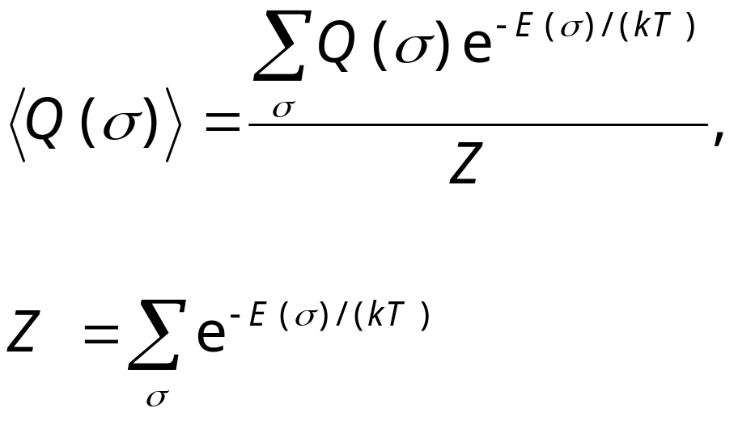
Boltzmann Distribution
In statistical mechanics, thermal dynamic results are obtained by expectation value (average) over the Boltzmann (Gibbs) distribution
Z is called partition function
Notes:
What is remarkable is that, instead of following the actually dynamics of a system, we can do phase space average through Boltzmann distribution.

Slide 20
2. Swendsen-Wang algorithm

Slide 21
Percolation Model
Each pair of nearest neighbor sites is occupied by a bond with probability p. The probability of the configuration X is
p^{b} (1-p)^{M-b}.
b is number of occupied bonds, M is total number of bonds
Notes:
See D Stauffer, “Introduction to Percolation Theory”, for more information.

Slide 22
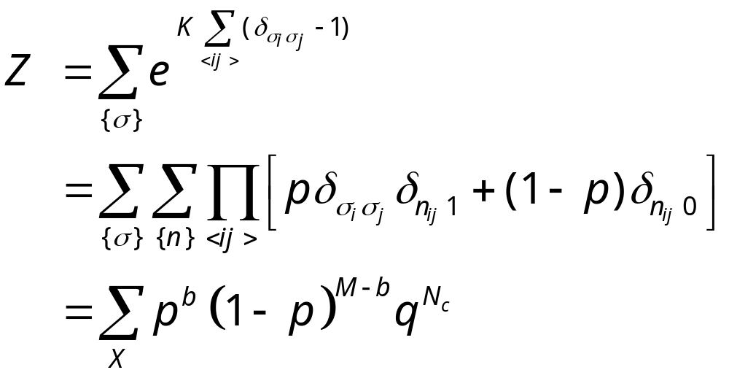
Fortuin-Kasteleyn Mapping (1969)
where K = J/(k_{B}T), p =1-e^{-K}, and q is number of Potts states, N_{c} is number of clusters.
Notes:
For Potts models, see F. Wu, Rev. Mod. Phys. 54 (1982) 235. The difference from bond percolation is the extra faction q^Nc. Physical quantities, such as energy, and magnetization can be mapped from Potts representation to bond representation.

Slide 23
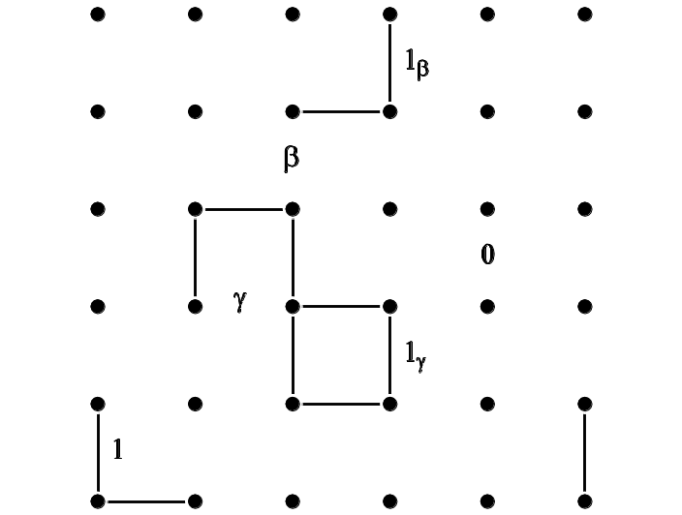
Sweeny Algorithm (1983)
Heat-bath rates:
w(· ->1_{γ}) = p
w(· -> γ) = 1 – p
w(· -> 1_{β}) = p/( (1-p)q +p )
w(· -> β) = (1-p)q/( (1-p)q + p )
P(X) ∝ ( p/(1-p) )^{b} q^{Nc}
Notes:
Sweeny algorithm is a heat-bath algorithm in the bond percolation representation of the Potts model.
F Gliozzi, Phys Rev E 66 (2002) 016115, proposed a similar rates.
Different type of “bond states” and computational complexity.

Slide 24
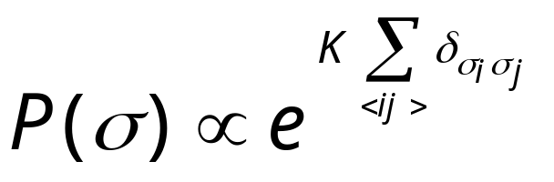
Swendsen-Wang Algorithm (1987)
+
-
-
+
-
+
-
-
-
-
-
An arbitrary Ising configuration according to
+
+
+
+
+
+
+
-
+
-
-
+
-
+
+
-
+
+
-
-
+
-
-
-
-
+
+
-
-
+
+
+
+
-
+
-
-
-
K = J/(kT)
Notes:
For a review, see R. H. Swendsen, J.-S. Wang and A. M. Ferrenberg, in “The Monte Carlo Method in Condensed Matter Physics”, K Binder, ed, Springer 1992. For a complete working program on Swenden-Wang, as well as Sweeny and Gliozzi, see the C program sw-oner-gg.c. The Fortran program sw2d.f was used mainly for timing computers.

Slide 25
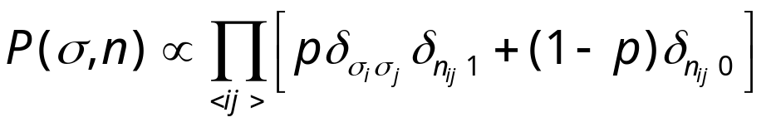
Swendsen-Wang Algorithm
+
-
-
+
-
+
-
-
-
-
-
Put a bond with probability p = 1-e^{-K}, if σ_{i} = σ_{j}
+
+
+
+
+
+
+
-
+
-
-
+
-
+
+
-
+
+
-
-
+
-
-
-
-
+
+
-
-
+
+
+
+
-
+
-
-
-
Notes:
Note that there is a factor of 2 difference between Ising Hamiltonian –JΣσ_{i}σ_{j} and Potts Hamiltonian –JΣδ(σ_{i},σ_{j}). Thus p = 1 –exp(-2J/(kT)) in standard Ising model, but p = 1 – exp(-K) for Potts model.

Slide 26
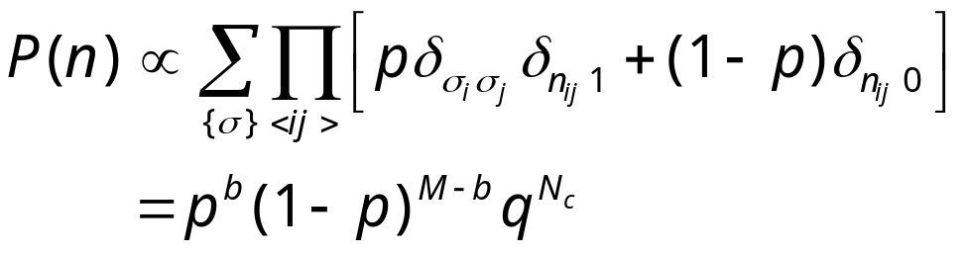
Swendsen-Wang Algorithm
Erase the spins

Slide 27
Swendsen-Wang Algorithm
-
+
-
-
-
-
+
Assign new spin for each cluster at random. Isolated single site is considered a cluster.
-
+
-
-
+
+
+
+
-
-
+
-
-
+
+
+
-
+
+
-
+
+
-
-
-
+
-
-
-
+
+
-
+
-
-
+
+
-
+
+
-
-
Go back to P(σ,n) again.
Notes:
If a magnetic field is present, the probability of new spins will be based on the field energy.

Slide 28
Swendsen-Wang Algorithm
-
+
-
-
-
-
+
Erase bonds to finish one sweep.
-
+
-
-
+
+
+
+
-
-
+
-
-
+
+
+
-
+
+
-
+
+
-
-
-
+
-
-
-
+
+
-
+
-
-
+
+
-
+
+
-
-
Go back to P(σ) again.

Slide 29
Identifying the Clusters
Hoshen-Kompelman algorithm (1976) can be used.
Each sweep takes O(N).

Slide 30
Measuring Error
Let Q_{t} be some quantity of interest at time step t, then sample average is
Q_{N} = (1/N) ∑_{t} Q_{t}
We treat Q_{N} as a random variable. By central limit theorem, Q_{N} is normal distributed with a mean <Q_{N}>=<Q> and variance σ_{N}² = <Q_{N}²>-<Q_{N}>².
<…> standards for average over the exact distribution.
Notes:
Normal distributed: i.e., Gaussian distribution with mean <Q> and variance. <Q> is the exact mean, and < … > can also be interpreted as average over infinite number of independent (equilibrated) Monte Carlo runs of length N each. Also note, Q_{N} is an unbiased estimator of
<Q>, that is <Q_{N}> = <Q>, but <Q_{N}²>-<Q_{N}>² is not an unbiased estimator of the true variance of Q_{N}. (But this point is unimportant when N is large). σ_{N} is the standard deviation.

Slide 31
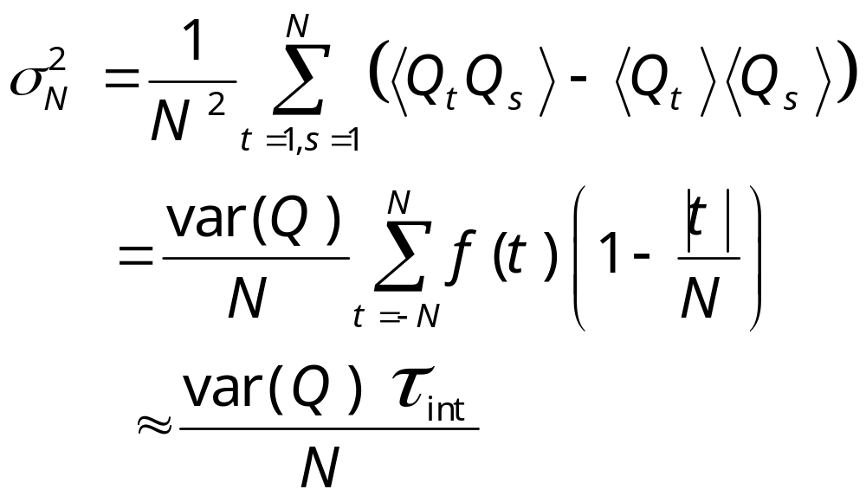
Estimating Variance
H. Műller-Krumbhaar and K. Binder, J Stat Phys 8 (1973) 1.
Notes:
As long as τ_{int} << N. In deriving the equality, we used the fact that the Markov chain is already in equilibrium, so that the time-translational invariance is used, i.e., <Q_{t}Q_{s}> is a function of the difference |t-s| only. This formula was derived first by H Müler-Krumbhaar and K Binder, J Stat Phys 8 (1973) 1. The approximate sign ≈ is due to the fact that we omitted the |t|/N term and letting N goes to infinity in the definition of integrated correlation time τ_{int}, which is justified for τ_{int} << N.

Slide 32
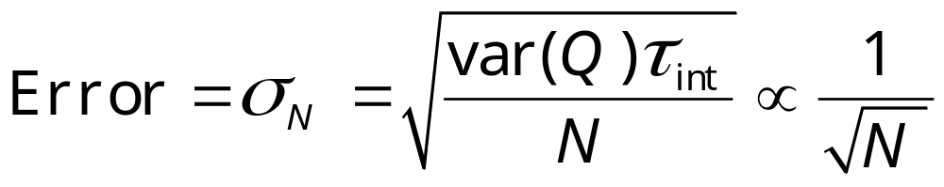
Error Formula
The above derivation gives the well-known error estimate in Monte Carlo as:
where var(Q) = <Q²>-<Q>² can be estimated by sample variance of Q_{t}.
Notes:
I.e. var(Q) ≈ (1/N) ∑_{t}Q_{t}² - Q_{N}², that is, square average minus the average sqared.

Slide 33
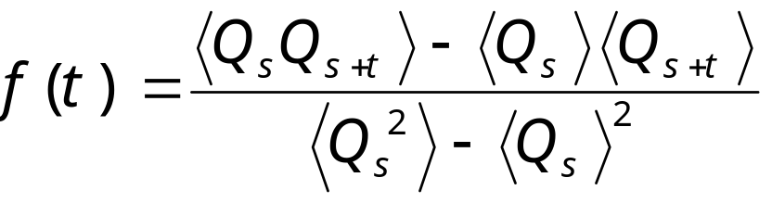
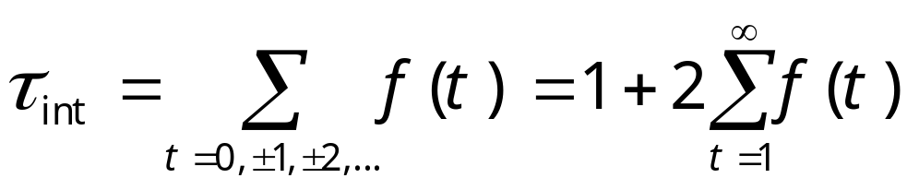
Time-Dependent Correlation Function and Integrated Correlation Time
We define
and
Notes:
Some people define the second term, ∑_{t=1}∞ f(t) as the integrated correlation time. We can call τ_{int} de-correlation time, as it is the number of steps needed to generate effectively independent sample. We can interpret the average < … > as over the history of a Markov chain (which requires the joint distribution of the chain from time s to s+t), or can be estimated from a simulation as average over time, i.e.,
<Q_{s}Q_{s+t}> ≈ (1/N) ∑_{s=1}^{N} Q_{s}Q_{s+t}.
What is τ_{int} for completely uncorrelated sample?

Slide 34
Critical Slowing Down
τ
The correlation time becomes large near T_{c}. For a finite system τ(T_{c}) ∝ L^{z}, with dynamical critical exponent z ≈ 2 for local moves
T_{c}
T
Notes:
The figure is only schematic. z is about 2 for order parameter non-conserving dynamics and 4 for order parameter conserving dynamics. For first-order phase, τ diverges exponentially with size L.

Slide 35
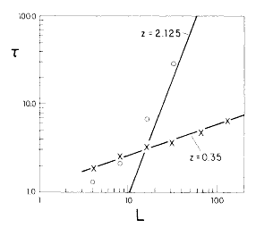
Much Reduced Critical Slowing Down
Comparison of exponential correlation times of Swendsen-Wang with single-spin flip Metropolis at T_{c} for 2D Ising model
From R H Swendsen and J S Wang, Phys Rev Lett 58 (1987) 86.
τ ∝ L^{z}

Slide 36
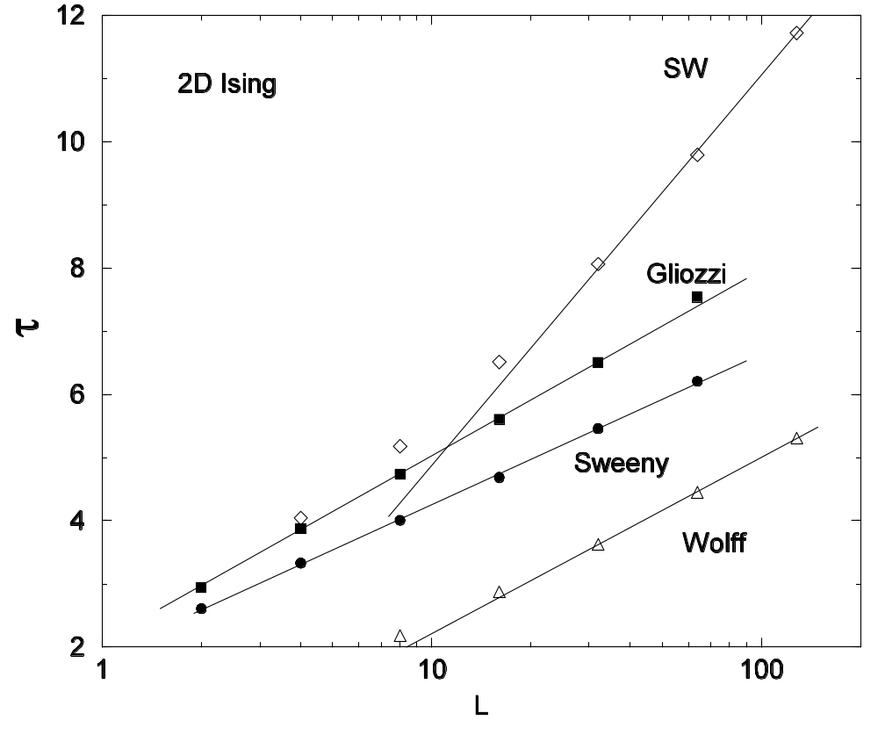
Comparison of integrated autocorrelation times at T_{c} for 2D Ising model.
J.-S. Wang, O. Kozan, and R. H. Swendsen, Phys Rev E 66 (2002) 057101.

Slide 37
Wolff Single-Cluster Algorithm
void flip(int i, int s0)
{
int j, nn[Z];
s[i] = - s0;
neighbor(i,nn);
for(j = 0; j < Z; ++j) {
if(s0 == s[nn[j]] && drand48() < p)
flip(nn[j], s0);
}
Notes:
Wolff cluster algorithm grows a cluster on the spins of same sign with probability p. Wolff also generalizes to the case of continuum symmetry, e.g., for XY (classical rotor) model. See, Phys Rev Lett, 62 (1989) 361. A complete program is in the file Wolff.c.

Slide 38
Replica Monte Carlo
Notes:
For a review of extended ensemble methods, see Y. Iba, Internal J Mod Phys C 12 (2001) 623.

Slide 39
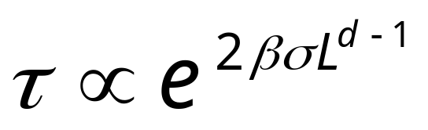
Slowing Down at First-Order Phase Transition
At first-order phase transition, the longest time scale is controlled by the interface barrier
where β=1/(k_{B}T), σ is interface free energy, d is dimension, L is linear size
Notes:
The multi-canonical ensemble simulation due to Berg et al overcomes this problem.

Slide 40
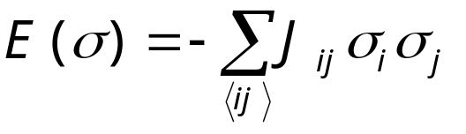
Spin Glass Model
+
-
-
+
-
+
-
-
+
-
+
+
-
-
+
+
+
+
-
+
-
A random interaction Ising model - two types of random, but fixed coupling constants (ferro J_{ij} > 0) and (anti-ferro J_{ij} < 0)
-
+
-
+
+
-
+
+
-
-
+
-
-
-
-
+
+
-
-
+
+
+
+
-
+
-
-
-
Notes:
See K. Binder and A. P. Young, Rev Mod Phys 58 (1986) 801, for a review.

Slide 41
Replica Monte Carlo
A collection of M systems at different temperatures is simulated in parallel, allowing exchange of information among the systems.
β₁
β₂
β₃
. . .
β_{M}
Notes:
Replica Monte Carlo [R. H. Swendsen and J.-S. Wang, Phys Rev Lett 57 (1986) 2607] is one of the earliest idea that simulates many systems in parallel for efficiency.

Slide 42
Moves between Replicas
Consider two neighboring systems, σ¹ and σ², the joint distribution is
P(σ¹,σ²) ∝ exp[-β₁E(σ¹) –β₂E(σ²)]
= exp[-H_{pair}(σ¹, σ²)]
Any valid Monte Carlo move should preserve this distribution

Slide 43
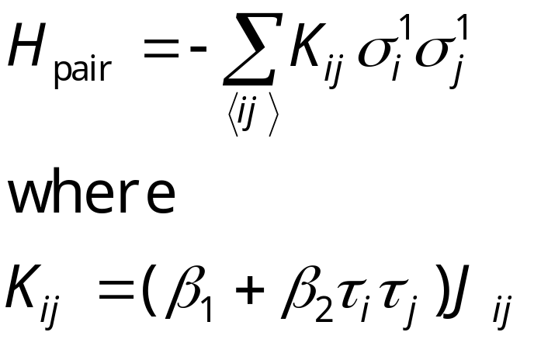
Pair Hamiltonian in Replica Monte Carlo
We define τ_{i}=σ_{i}¹σ_{i}², then H_{pair} can be rewritten as
The H_{pair} again is a spin glass. If β₁≈β₂, and two systems have consistent signs, the interaction is twice as strong; if they have opposite sign, the interaction is 0.

Slide 44
Cluster Flip in Replica Monte Carlo
Clusters are defined by the values of τ_{i} of same sign, The effective Hamiltonian for clusters is
H_{cl} = - Σ k_{bc} s_{b}s_{c}
Where k_{bc} is the interaction strength between cluster b and c, k_{bc}= sum over boundary of cluster b and c of K_{ij}.
τ = +1
τ = -1
^{b}
^{c}
Metropolis algorithm is used to flip the clusters, i.e., σ_{i}¹ -> -σ_{i}¹, σ_{i}² -> -σ_{i}² fixing τ for all i in a given cluster.
Notes:
Before the cluster move, s_{b} = +1, for all clusters b. To ensure ergodicity, other single spin flips within a single system has to be used. Swendsen-Wang mapping can be used inside each tau cluster to produce non-interacting clusters as well.

Slide 45
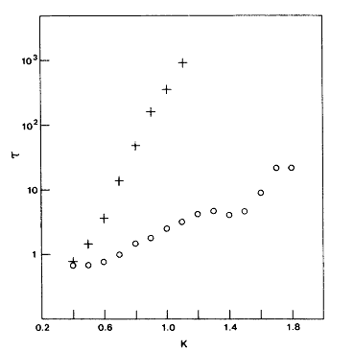
Comparing Correlation Times
Single spin flip
Correlation times as a function of inverse temperature β on 2D, ±J Ising spin glass of 32x32 lattice.
From R H Swendsen and J S Wang, Phys Rev Lett 57 (1986) 2607.
Replica MC
Notes:
The replica Monte Carlo program used for this research is in glassibm.for. It is really a legacy code specially for the IBM 3083 computer that may not compile on modern computers.

Slide 46
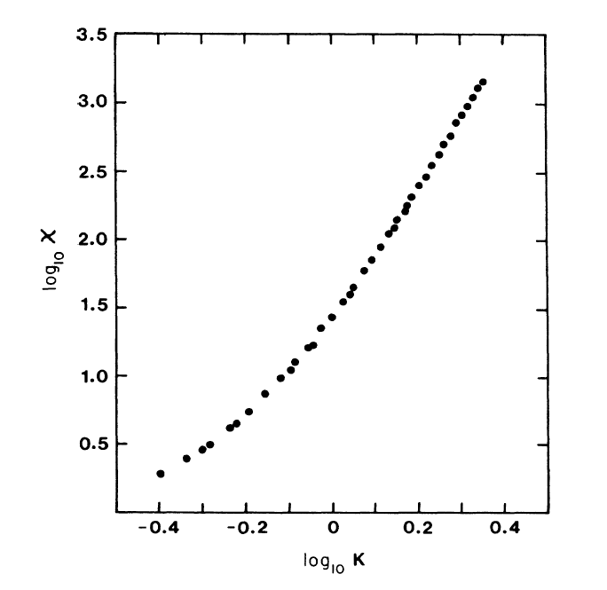
2D Spin Glass Susceptibility
2D +/-J spin glass susceptibility on 128x128 lattice, 1.8x10⁴ MC steps.
From J S Wang and R H Swendsen, PRB 38 (1988) 4840.
χ ∝ K^{5.11} was concluded.

Slide 47
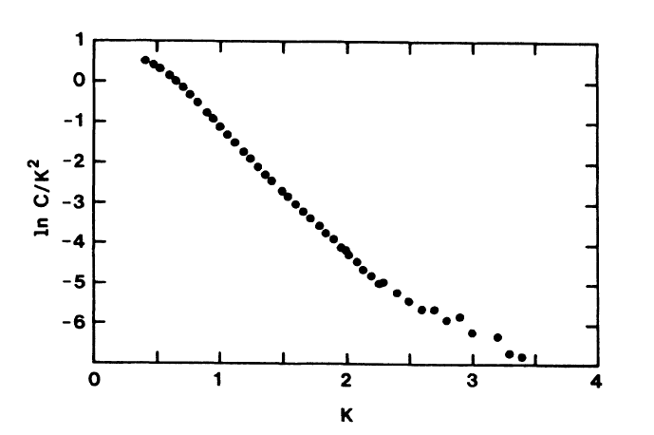
Heat Capacity at Low T
c ∝ T ²exp(-2J/T)
This result is confirmed recently by Lukic et al, PRL 92 (2004) 117202.
slope = -2

Slide 48
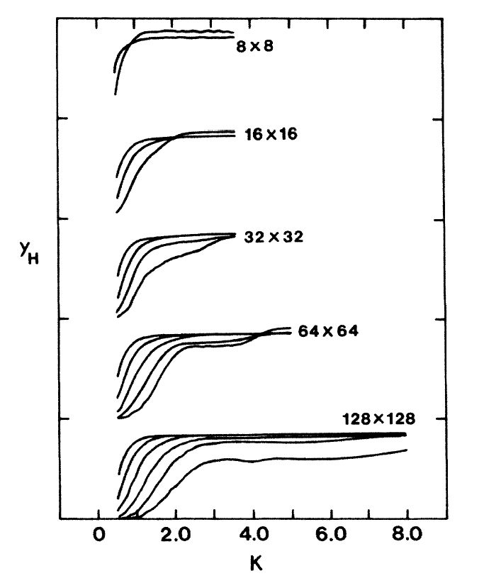
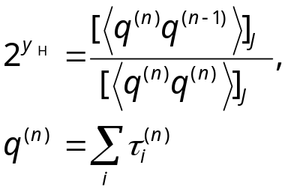
Monte Carlo Renormalization Group
Y_{H} defined by
with RG iterations for difference sizes in 2D.
From J S Wang and R H Swendsen, PRB 37 (1988) 7745.

Slide 49
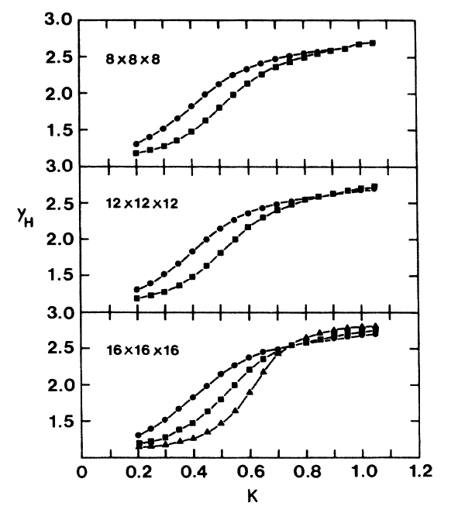
MCRG in 3D
3D result of Y_{H}.
MCS is 10⁴ to 10⁵, with 23 samples for L= 8, 8 samples for L= 12, and 5 samples for L= 16.

Slide 50
Conclusion
Monte Carlo methods have broad applications
Cluster algorithms eliminate the difficulty of critical slowing down
Replica Monte Carlo works on frustrated and disordered systems

