Slide 1

Modern Monte Carlo Methods:
(2) Histogram Reweighting
(3) Transition Matrix Monte Carlo
Jian-Sheng Wang
National University of Singapore

Slide 2
Outline
Histogram reweighting
Transition matrix Monte Carlo
Binary-tree summation Monte Carlo

Slide 3
Methods for Computing Density of States
Reweighting methods (Salsburg et al, 1959, Ferrenberg-Swendsen, 1988)
Multi-canonical simulation (Berg et al, 1992)
Broad Histogram (de Oliveira et al, 1996)
TMMC and flat-histogram (Wang, Swendsen, et al, 1999)
F.Wang-Landau method (2001)
Micheletti, Laio, and Parrinello, Phys Rev Lett, Apr (2004)

Slide 4
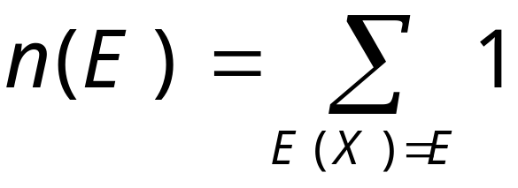
Density of States
The density of states n(E) is the count of the number of (microscopic) states with energy E, assuming discrete energy levels.

Slide 5
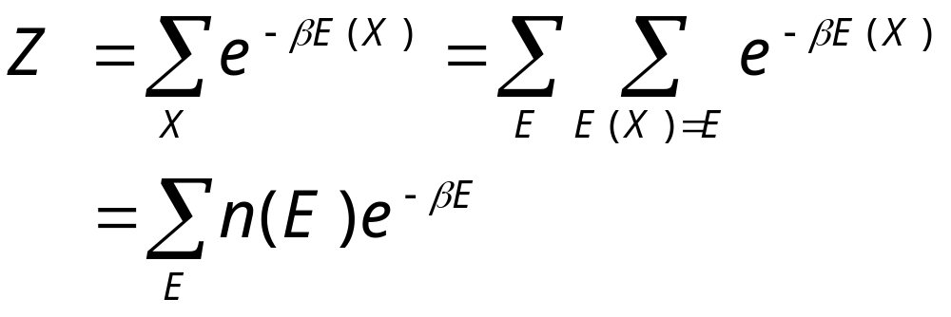
Partition Function in n(E)
We can express partition function in terms of density of states:
Thus, if n(E) is calculated, we effectively solved the statistical-mechanics problem.

Slide 6

4. Reweighting Methods

Slide 7
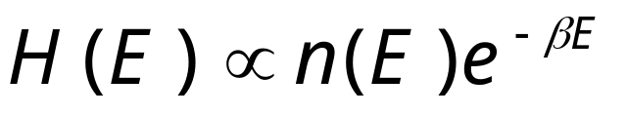
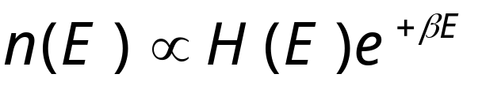
Ferrenberg-Swendsen Histogram Reweighting
Do a canonical ensemble simulation at temperature T=1/(k_{B}β), and collect energy histogram, i.e., the counts of occurrence of energy E.
Thus, density of states can be determined up to a constant:
Notes:
What is the proportionality constant? If the Hamiltonian is the form S + hM, we can also consider joint histogram H(S,M) and reweight both in T and h.

Slide 8
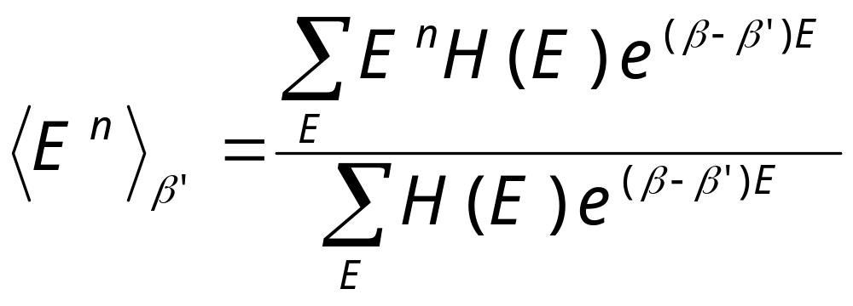
Calculate Moments of Energy
From the density of states, we can calculate moments of energy at any other temperature,
Notes:
The unknown constant (M/Z) is not needed, as it cancels from numerator and denominator in the above formula. Any other quantities Q(X) can also be calculated, if we take histogram of Q as a function of E as well.

Slide 9
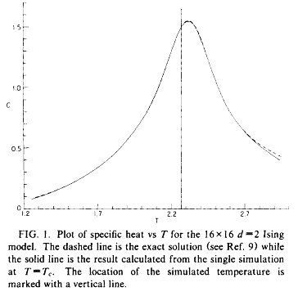
Reweighting Result
Result from a single simulation of 2D Ising model at T_{c}, extrapolated to other temperatures by reweighting
From Ferrenberg and Swendsen, Phys Rev Lett 61 (1988) 2635.

Slide 10
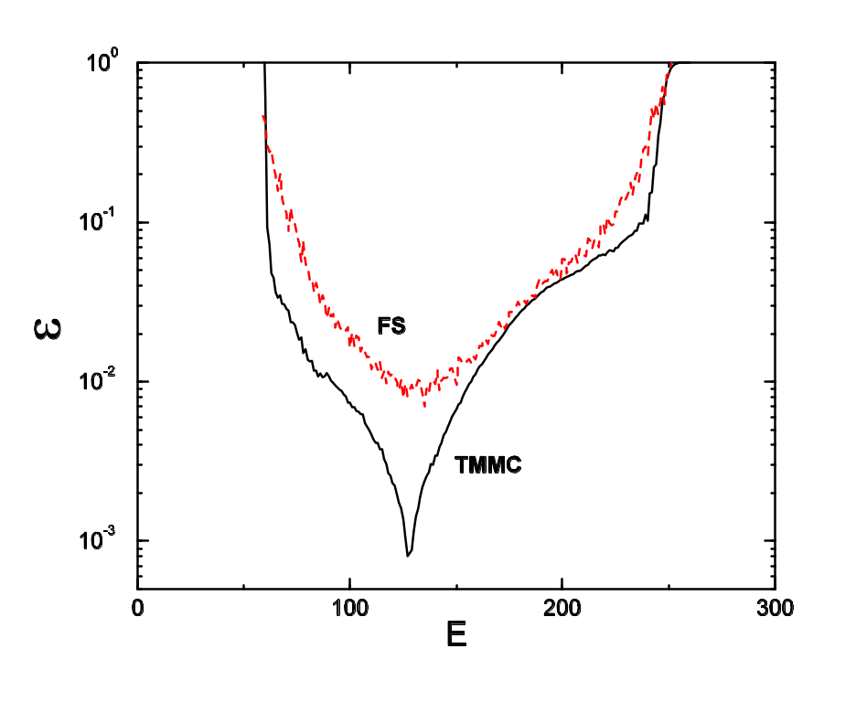
Range of Validity of n(E)
Relative error of density of states |n_{MC}/n_{exact}-1| from Ferrenberg-Swendsen method and transition matrix Monte Carlo, 32×32 Ising at T_{c}.
From J S Wang and R H Swendsen, J Stat Phys 106 (2002) 245.
Red curve marked FS is from Ferrenberg-Swendsen method

Slide 11
Multiple Histogram Method
Conduct several simulations at different temperatures T_{i}
How to combine histogram results H_{i}(E) properly at different temperatures?
Notes:
See A. M. Ferrenberg and R. H. Swendsen, Phy Rev Lett 63 (1989) 1195.

Slide 12
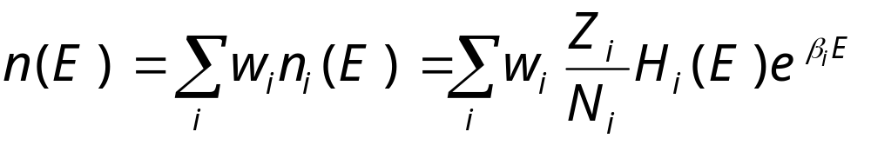
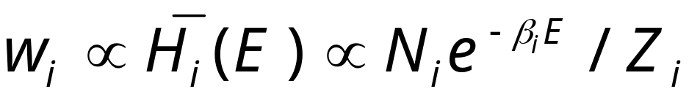
Minimize error at each E
We do a weighted average from M simulations
The optimal weight is
Where the proportionality constant is fixed by normalization Σw_{i} = 1, and Z_{i}= Σ_{E} n(E) exp(-β_{i}E)
Notes:
N_{i} is the length (number of histogram samples) of i-th run, and Z_{i} is the partition function at temperature T_{i}. H_{i} with bar denotes the average of histogram of fixed length N_{i} over (infinitely) many runs. See M. E. J. Newman & G. T. Barkema, “Monte Carlo Methods in Statical Physics”, sec.8.2, for a derivation.

Slide 13
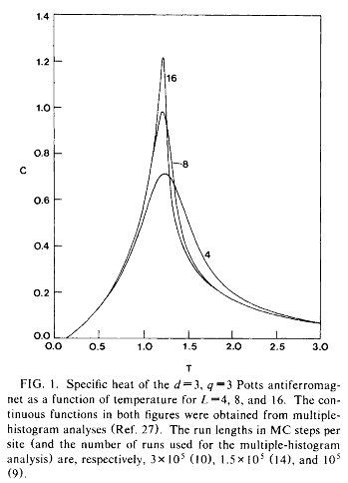
Multiple Histogram Example
Multiple histogram calculation of the specific heat of the 3D three-state anti-ferromagnetic Potts model, using a cluster algorithm
From J S Wang, R H Swendsen, and R Kotecký, Phys Rev Lett 63 (1989) 109.

Slide 14
5. Transition Matrix Monte Carlo (TMMC)

Slide 15
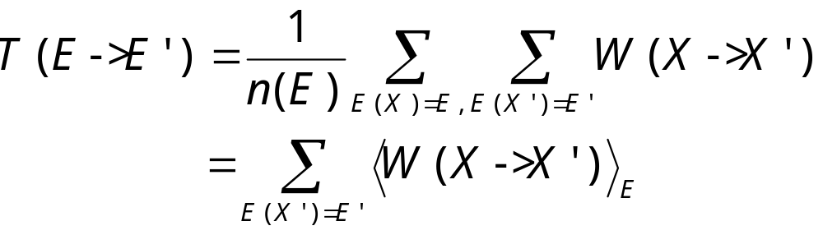
Transition Matrix
(in energy)
We define transition matrix
which has the property
h(E) T(E->E ’) = h(E ’) T(E ’->E)
h(E) = n(E) e^{-E/(kT)} is energy distribution or exact energy histogram.

Slide 16
Transition Matrix
Monte Carlo
Compute T(E->E ’) with any valid MC algorithms that have micro-canonical property
Obtain h(E), or equivalently n(E) from energy detailed balance equation
See J.-S. Wang and R. H. Swendsen, J Stat Phys 106 (2002) 245.
Notes:
The transition matrix Monte Carlo was proposed in J.-S. Wang, T. K. Tay, and R. H. Swendsen, Phys Rev Lett 82 (1999) 476. See also, J.-S. Wang and R. H. Swendsen, J Stat Phys 106 (2002) 245.

Slide 17
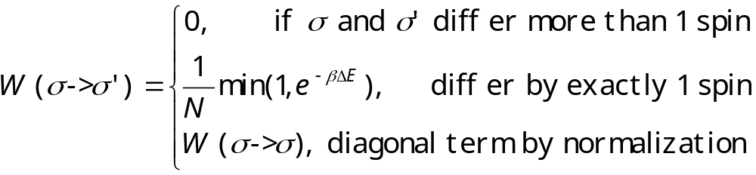
Example for Ising Model
Using single-spin-flip dynamics, the transition matrix W in spin configuration space is
N = L^{d} is the number of sites.
Notes:
The diagonal term is from Σ_{σ’} W(σ->σ’) = 1. The factor 1/N means we pick a site at random.

Slide 18
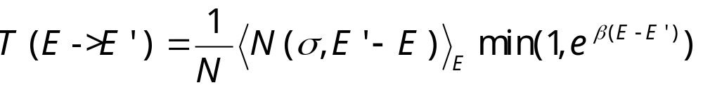
Transition Matrix for Ising model
where <N (σ,E ’-E )>_{E} is micro-canonical average of number of ways that the system goes to a state with energy E ’, given the current energy is E.

Slide 19
The Ising Model
ΔE=0
-
-
+
-
+
-
Total energy is
E(σ) = - J ∑_{<ij>} σ_{i} σ_{j}
sum over nearest neighbors, σ = ±1
N(σ,ΔE) is the number of sites, such that flip spin costs energy ΔE.
-
-
-
+
+
-
+
+
-
-
-
+
+
-
+
+
+
-
+
+
-
-
-
-
ΔE=-8J
+
+
-
-
+
-
σ = {σ₁, σ₂, …, σ_{i}, … }
Notes:
In 1925, physicist W. Lenz asked his student E. Ising to solve a statistical mechanics problem relevant to the magnetic properties of matter. Ising was able to solve it on a one-dimensional lattice. Almost twenty years were passed before L. Onsager found analytic solution to the two-dimensional version of the problem. The three-dimensional Ising model which is most relevant in the physical world has denied any serious attempt. Thus, any information we have is from approximations and numerical simulations.
Ising model and its generalizations are extremely important in our understanding of the properties of matter, especially the phenomena of phase transitions. Ising model is still actively used in various ways to model systems in condensed matter physics.

Slide 20
Broad Histogram Equation (Oliveira)
n(E)<N(σ,E ’-E)>_{E} = n(E ’)<N(σ’,E-E ’)>_{E ’}
This equation is used to determine density of states as well as to construct a “flat-histogram” algorithm
Notes:
This equation was first proposed by P. M. C de Oliveira et al, Braz J Phys 26 (1996) 677.

Slide 21
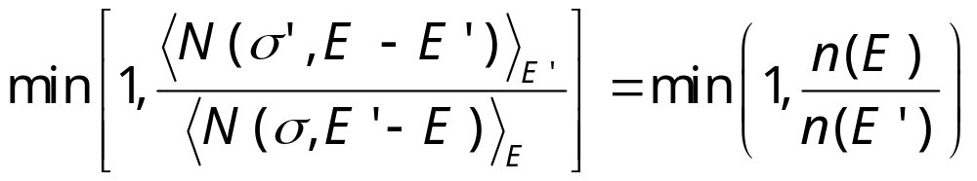
Flat Histogram Algorithm
Pick a site at random
Flip the spin with probability
Where E is current and E ’ is new energy
Accumulate statistics for <N(σ,E ’-E)>_{E}
Notes:
See J-S Wang, Eur Phys J B 8 (1999) 287. Since <N(σ, E’-E)>_{E} is both the quantity that we are going to collect statistics and input to the algorithm, we can not do it without approximation. In real simulation, we replace the exact micro-canonical average by running average.

Slide 22
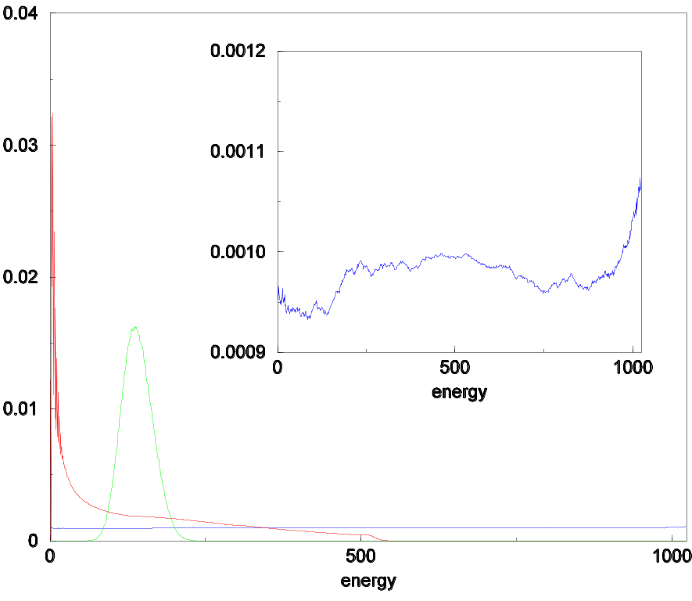
Histograms
Histograms for 2D Ising 32x32 with 10⁷ Monte Carlo steps. Insert is a blow-up of the flat-histogram.
From J-S Wang and L W Lee, Computer Phys Comm 127 (2000) 131.
Broad histogram
Flat-histogram
Canonical
Notes:
The program tmmc_n_conv.c was used to calculate and compare density of states n(E).

Slide 23
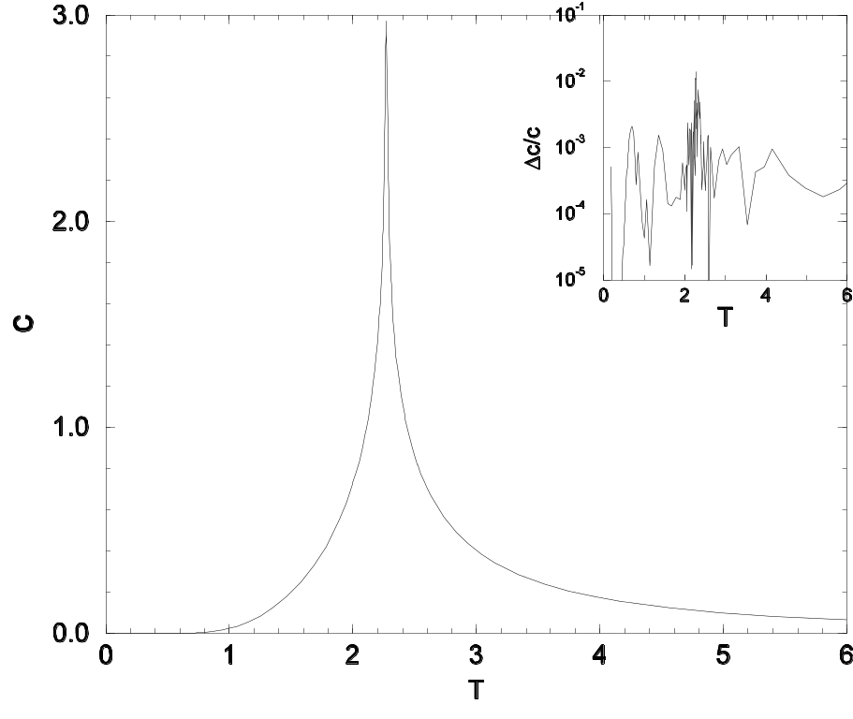
2D Ising Result
Specific heat of a 256x256 Ising model, using flat-histogram/multi-canonical method. Insert shows relative error. 3 x 10⁷ Monte Carlo sweeps are used.
From J-S Wang, “Monte Carlo and Quasi-Monte Carlo Methods 2000,” K-T Fang et al, eds.
Notes:
The Wang-Landau method was able to do similar calculations.

Slide 24
5. Binary Tree Summation Monte Carlo

Slide 25
Newman-Ziff Method for Percolation
Start with an empty lattice, compute Q(Γ₀)
Notes:
See D Stauffer, “Introduction to Percolation Theory”, for more information.

Slide 26
Newman-Ziff Method
Randomly occupy a bond, compute Q(Γ₁)
Notes:
See D Stauffer, “Introduction to Percolation Theory”, for more information.

Slide 27
Newman-Ziff Method
Randomly occupy an unoccupied bond, compute Q(Γ₂)
Notes:
See D Stauffer, “Introduction to Percolation Theory”, for more information.

Slide 28
Newman-Ziff Method
And so on and compute Q(Γ_{b}) with b number of bonds
Notes:
See D Stauffer, “Introduction to Percolation Theory”, for more information.

Slide 29
Newman-Ziff Method
Until all bonds are occupied, compute Q(Γ_{M})
Notes:
See D Stauffer, “Introduction to Percolation Theory”, for more information.

Slide 30
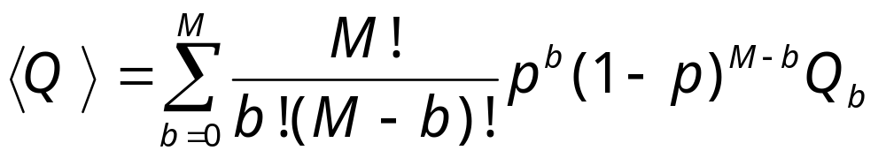
Newman-Ziff Method
Any quantity as a function of p is computed as (for percolation, q = 1)
Each sweep takes time of O(N)

Slide 31
Binary Tree Summation
Work in the Fortuin-Kasteleyn representation, P(Γ) ∝ p^{b}(1-p)^{M-b}q^{Nc}
Putting bonds of β-type only (i.e. always merge two clusters into one)
The steps that do no merge cluster are not explicitly simulated
Compute weights w(b,i)
See J.-S. Wang, O. Kozan, and R. Swendsen, `Computer Simulation Studies in Condensed Matter Physics XV', p.189, Eds. D. P. Landau, et al (Springer-Verlag, Heidelberg, 2002).

Slide 32
BTS algorithm
Start with an empty lattice, n₀=0, n₁=M, i=0, compute Q(0)
Pick a type-β bond at random, merge the clusters A and B
n₀ ← n₀+ n_{AB} – 1, n₁ ←n₁-n_{AB}, i ← i+1
Compute Q(i), goto 2 if i < N-1
Compute weight w(b,i)
Where M is total number of bonds, N is number of sites, n₀ is number of γ-type bonds and n₁ is number of β-type bonds. n_{AB} is number of unoccupied bonds connecting clusters A and B.

Slide 33
Compute Weight
w(0,i) = δ_{i,0}
w(b+1,i) = w(b,i) (n₀(i)-b+i) +
w(b,i-1)n₁(i-1)/q

Slide 34
Simulated and Re-constructed Configurations
i (merge sequence)
N-1
fully occupied lattice
simulated path
reconstructed path
2
2
n₁/q
n₀
1
b (bonds)
0
1
1
1
2
N-1
N
M

Slide 35
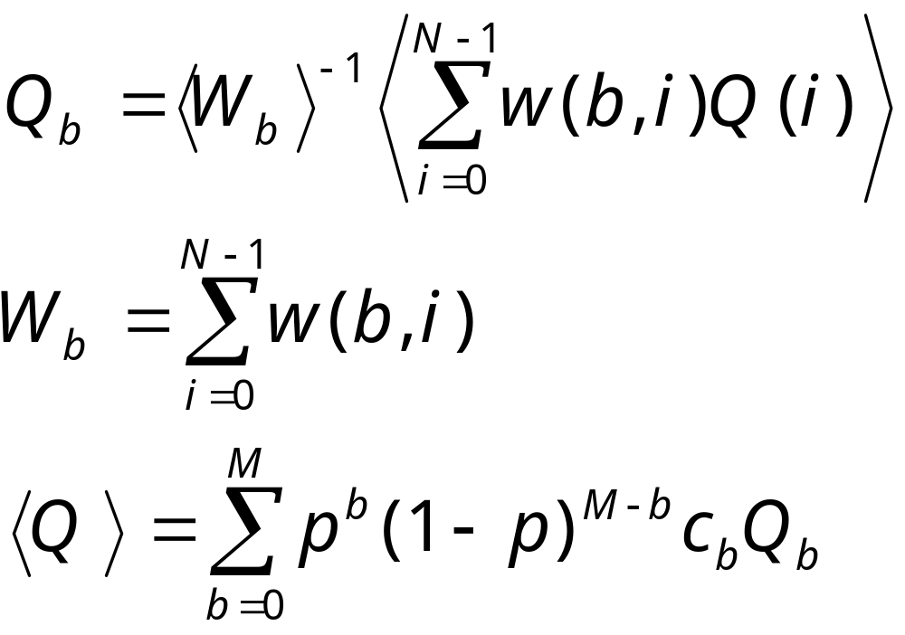
Statistical Average at Fixed p

Slide 36
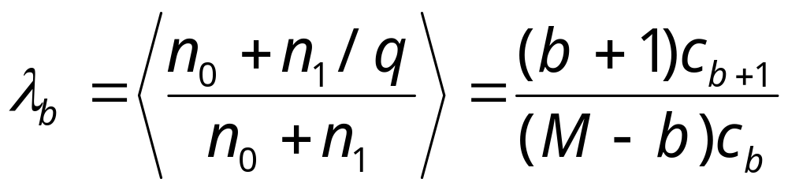
c_{b} play the rule of density of states
We compute c_{b} from

Slide 37
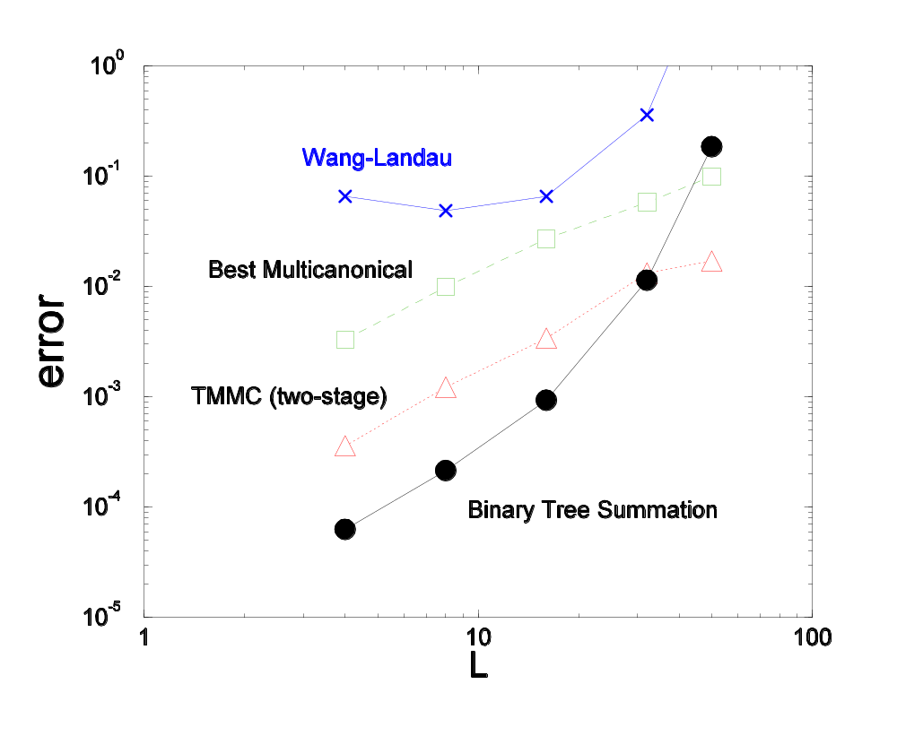
Comparison
Relative error for density of states (or c_{b} for BTS) after 10⁶ Monte Carlo steps.
Note: |n(E)/n_{ex}(E)-1| ≈ |S(E) – S_{ex}(E)| ] where S(E) = ln n(E).

Slide 38
Some features of BTS
Independent sample in each sweep
Any real values of p can be used (including negative p)
It is not an importance sampling method (similar to Sequential MC)
Each sweep takes O(N²)

Slide 39
Summary
Cluster algorithms are best at T_{c}
TMMC produces n(E) and uses more information from the samples
BTS is an interesting variation

