Slide 1
Heat Conduction in One-Dimensional Systems: molecular dynamics and mode-coupling theory
Jian-Sheng Wang
National University of Singapore

Slide 2
Outline
Brief review of 1D heat conduction
Introducing a chain model
Nonequilibrium molecular dynamics results
Projection formulism and mode-coupling theory
Conclusion

Slide 3
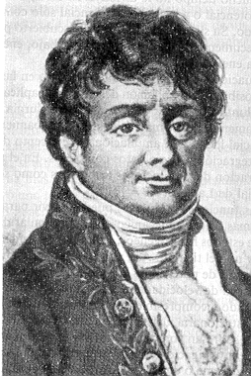
Fourier Law of Heat Conduction
Fourier proposed the law of heat conduction in materials as
J = − κ ∇T
where J is heat current density, κ is thermal conductivity, and T is temperature.
Fourier, Jean Baptiste Joseph, Baron (1768 – 1830)

Slide 4
Normal & Anomalous Heat Transport
3D bulk systems obey Fourier law (insulating crystal: Peierls’ theory of Umklapp scattering process of phonons; gas: kinetic theory, κ = ⅓cvl )
In 1D systems, variety of results are obtained and still controversial. See S Lepri et al, Phys Rep 377 (2003) 1, for a review.
T_{L}
T_{H}
J

Slide 5
Heat Conduction in
One-Dimensional Systems
1D harmonic chain, κ ∝ Ν (Rieder, Lebowitz & Lieb, 1967)
κ diverges if momentum is conserved (Prosen & Campbell, 2000)
Fermi-Pasta-Ulam model, κ ∝ Ν ^{2/5} (Lepri et al, 1998)
Fluctuating hydrodynamics + Renormalization group, κ ∝ Ν ^{1/3} (Narayan & Ramaswamy 2002)

Slide 6
Approaches to Heat Transport
Equilibrium molecular dynamics using linear response theory (Green-Kubo formula)
Nonequilibrium steady state (computer) experiment
Laudauer formula in quantum regime

Slide 7
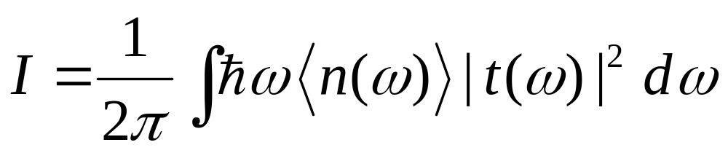
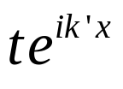
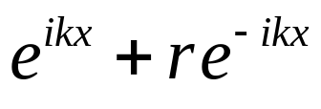
Ballistic Heat Transport at Low Temperature
Laudauer formula for heat current
scatter

Slide 8
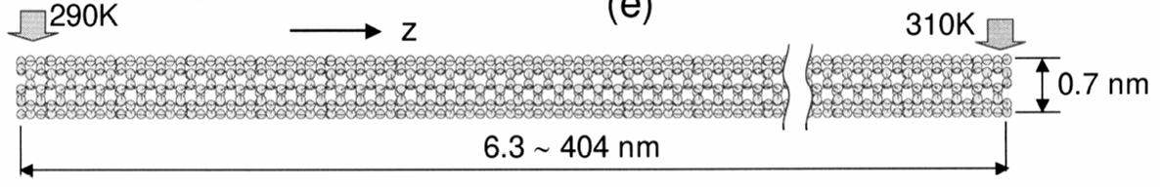
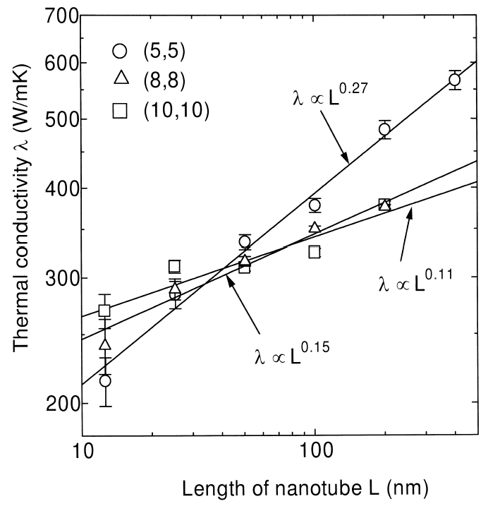
Carbon Nanotube
Heat conductivity of Carbon nanotubes at T = 300K by nonequilibrium molecular dynamics.
From S Maruyama, “Microscale Thermophysics Engineering”, 7 (2003) 41. See also G Zhang and B Li, cond-mat/0403393.

Slide 9
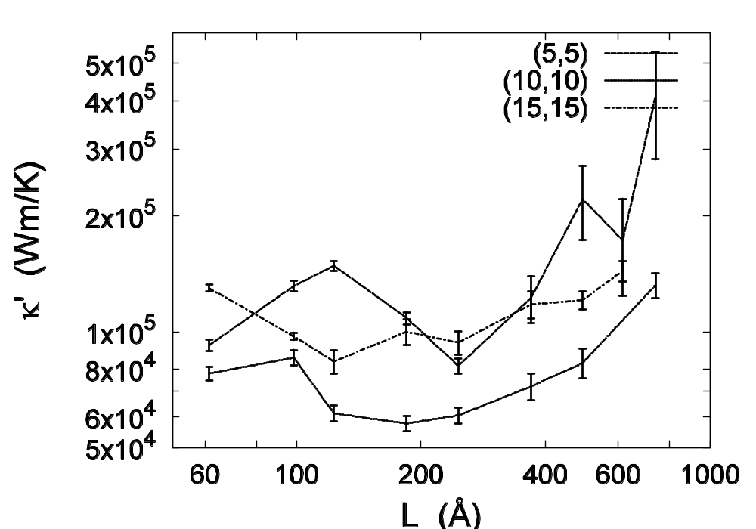
Carbon Nanotubes
Thermal conductance κA of carbon nanotube of length L, determined from equilibrium molecular dynamics with Green-Kubo formula, periodic boundary conditions, Tersoff potential. Z Yao, J-S Wang, B Li, and G-R Liu, cond-mat/0402616.

Slide 10
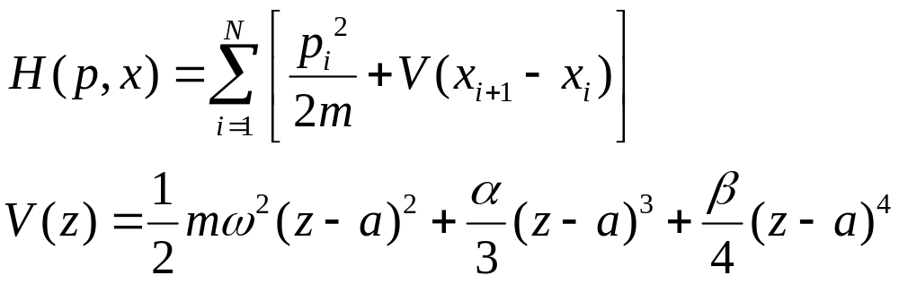
Fermi-Pasta-Ulam model
A Hamiltonian system with
A strictly one-dimensional model.

Slide 11
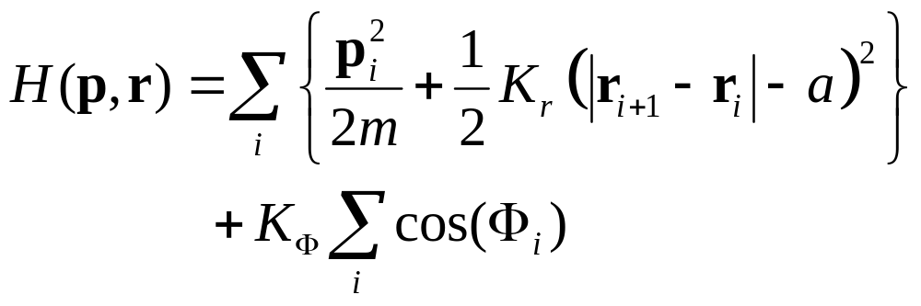
A Chain Model for Heat Conduction
r_{i} = (x_{i},y_{i})
T_{H}
T_{L}
m
Φ_{i}
Transverse degrees of freedom introduced

Slide 12
Nonequilibrium Molecular Dynamics
Nosé-Hoover thermostats at the ends at temperature T_{L} and T_{H}
Compute steady-state heat current: j =(1/N)Σ_{i} d (ε_{i} r_{i})/dt, where ε_{i} is local energy associated with particle i
Define thermal conductance κ by <j> = κ (T_{H}-T_{L})/(Na)
N is number of particles, a is lattice spacing.

Slide 13
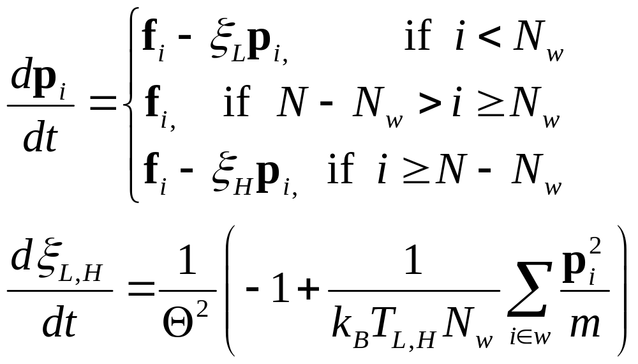
Nosé-Hoover Dynamics

Slide 14
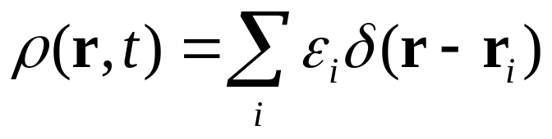
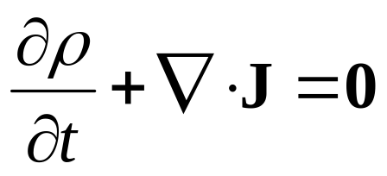
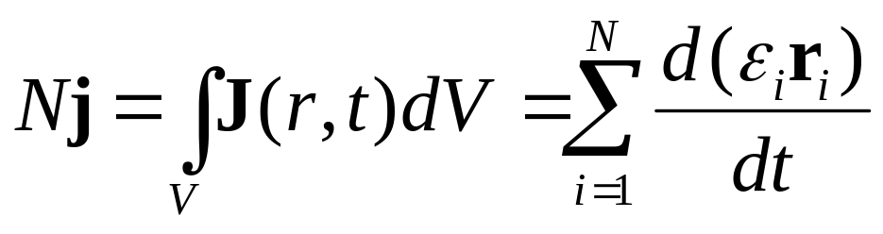
Defining Microscopic Heat Current
Let the energy density be
then J satisfies
A possible choice for total current is

Slide 15
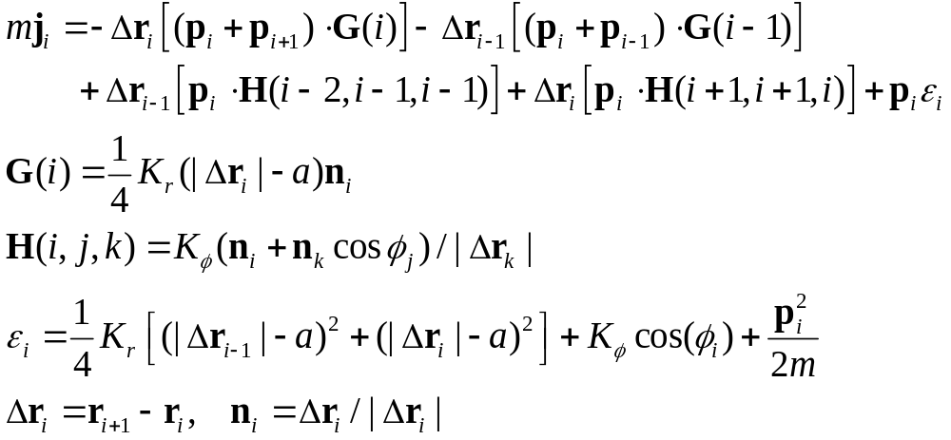
Expression of j for the chain model

Slide 16
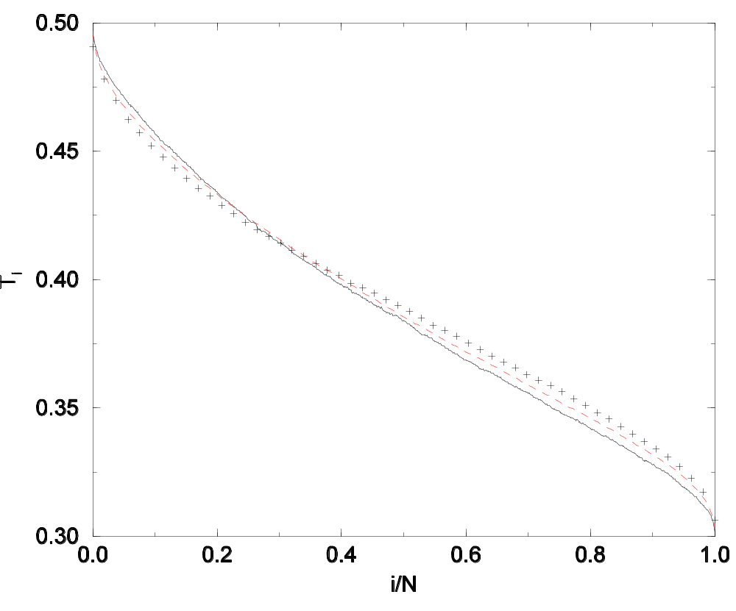
Temperature Profile
Temperature of i-th particle computed from k_{B}T_{i}=<½mv_{i}² > for parameter set E with N =64 (plus), 256 (dash), 1024 (line).

Slide 17
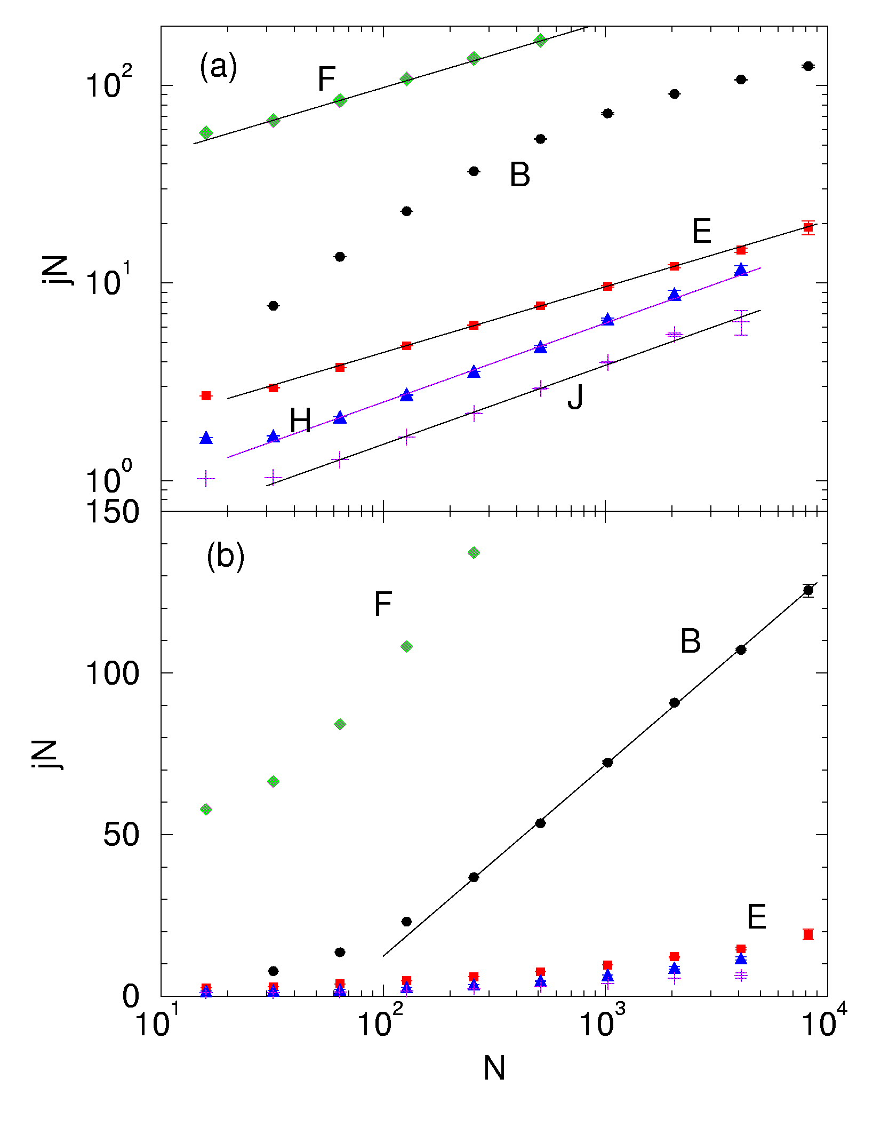
Conductance vs Size N
Model parameters (K_{Φ}, T_{L}, T_{H}):
Set F (1, 5, 7), B (1, 0.2, 0.4), E (0.3, 0.3, 0.5), H (0, 0.3, 0.5), J (0.05, 0.1, 0.2) ,
m=1, a=2, K_{r}=1.
From J-S Wang & B Li, Phys Rev Lett 92 (2004) 074302.
slope=1/3
slope=2/5
ln N

Slide 18
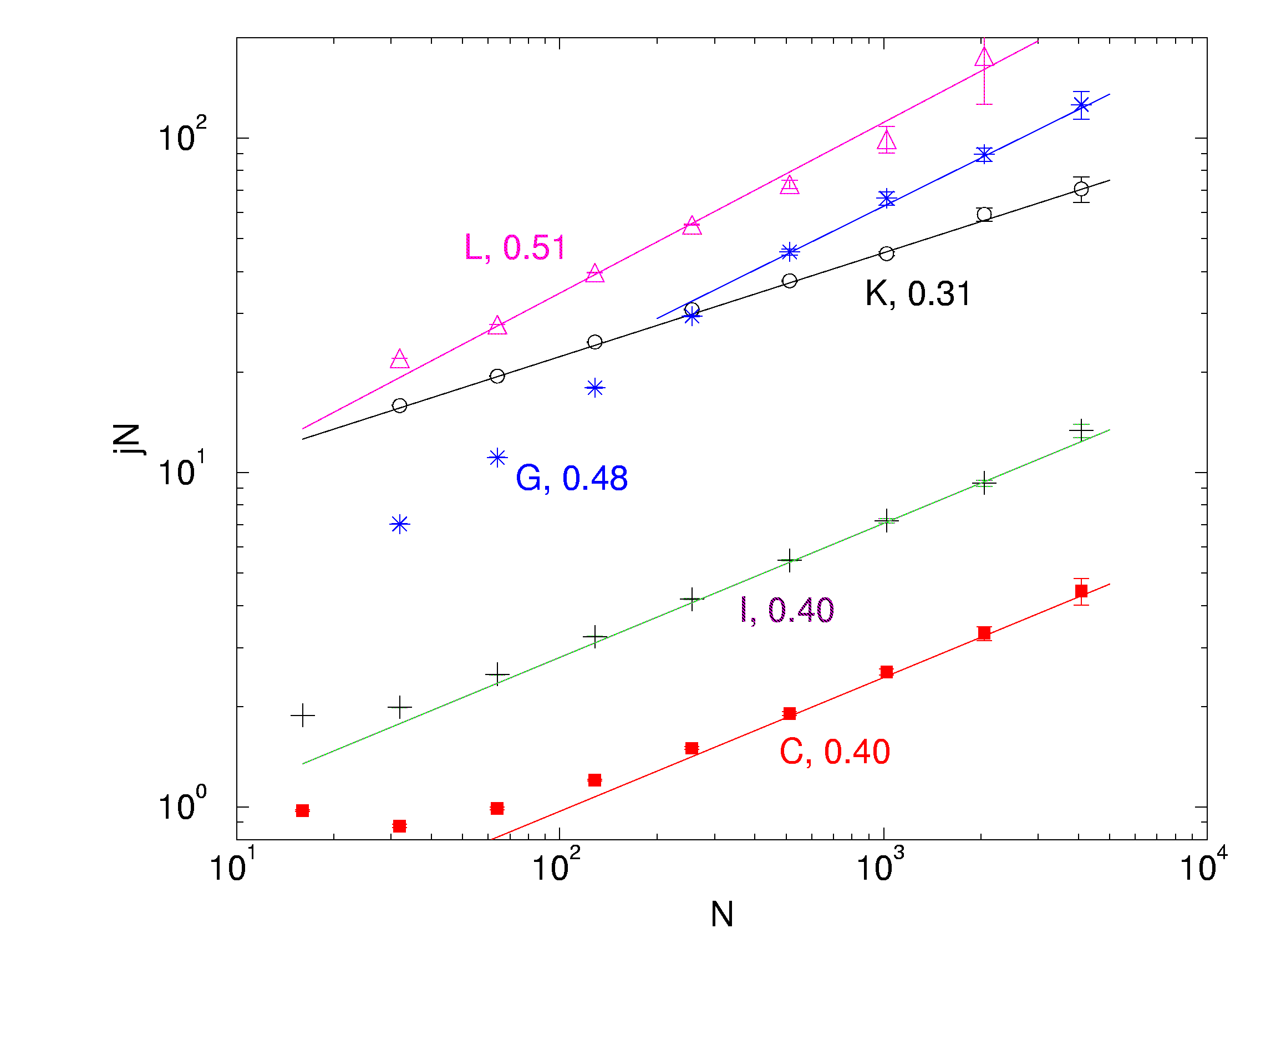
Additional MD data
Parameters (K_{Φ}, T_{L}, T_{H}, ε), set L(25,1,1.5,0.2) G(10,0.2,0.4,0) K(0.5,1.2,2,0.4) I(0.1,0.3,0.5,0.2) C(0.1,0.2,0.4,0)
From J-S Wang and B Li, PRE, 70, 021204 (2004).

Slide 19
Mode-Coupling Theory for Heat Conduction
Use Fourier components as basic variables
Derive equations relating the correlation functions of the variables with the damping of the modes, and the damping of the modes to the square of the correlation functions
Evoke Green-Kubo formula to relate correlation function with thermal conductivity

Slide 20
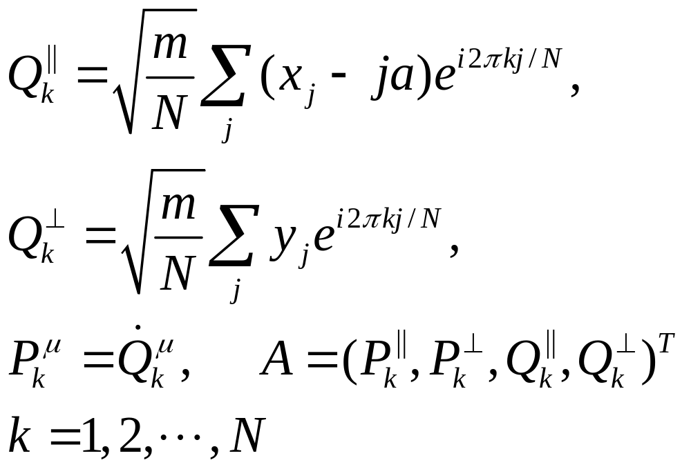
Basic Variables (work in Fourier space)

Slide 21
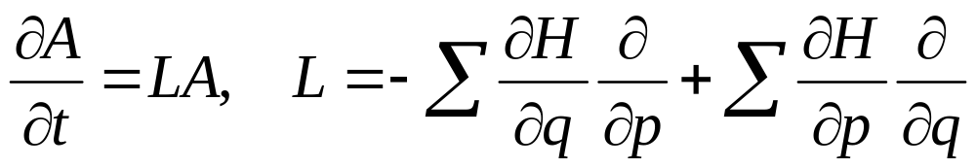
Equation of Motion for A
Formal solution:

Slide 22
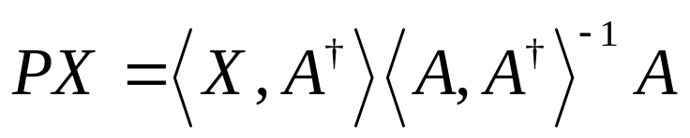

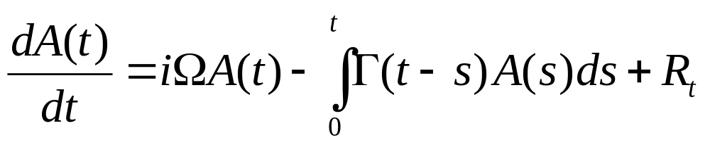
Projection Operator & Equation
Define
We have
Apply P and 1−P to the equation of motion, we get two coupled equations. Solving them, we get

Slide 23
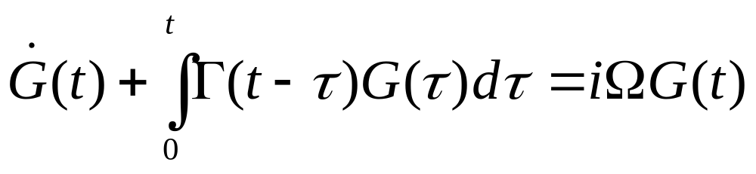
Projection Method (Zwanzig and Mori)
Equation for dynamical correlation function:
where G(t) is correlation matrix of normal-mode Canonical coordinates (P_{k},Q_{k}). Γ is related to the correlation of “random” force.

Slide 24
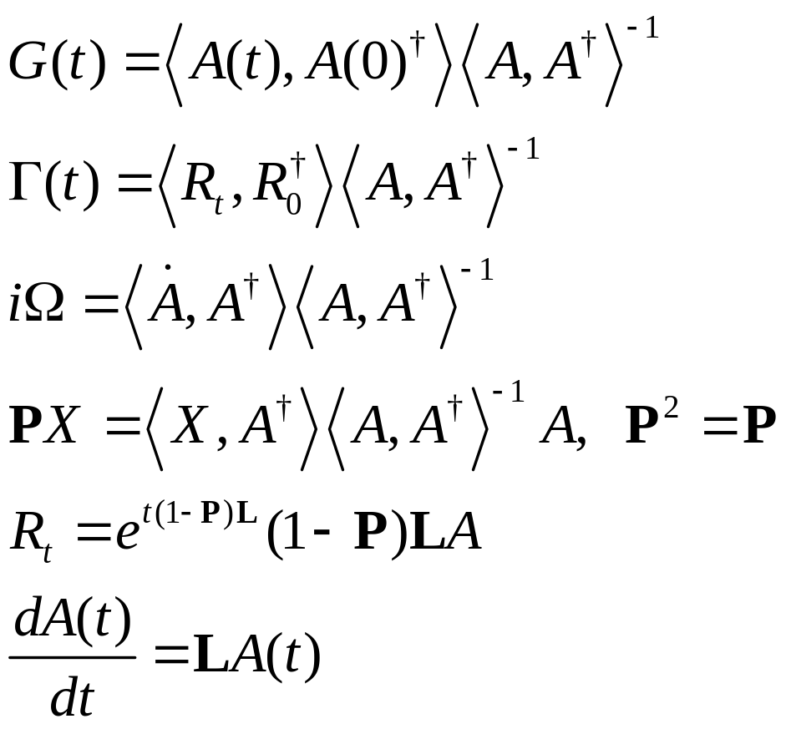
Definitions
L is Liouville operator

Slide 25
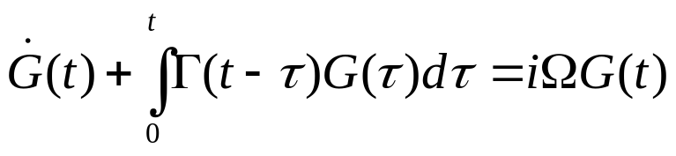
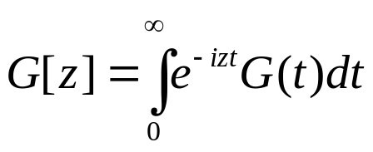
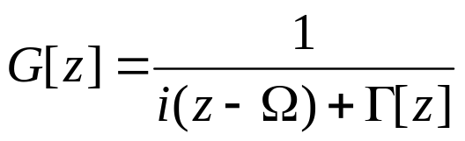
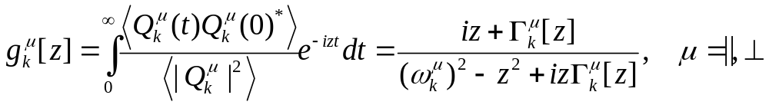
Correlation function equation and its solution (in Fourier-Laplace space)
Define
the equation can be solved as
in particular

Slide 26
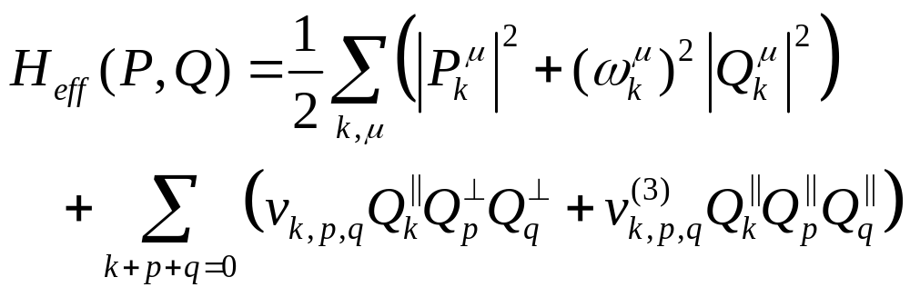
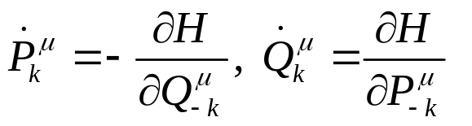
Small Oscillation Effective Hamiltonian
Equations of motion

Slide 27
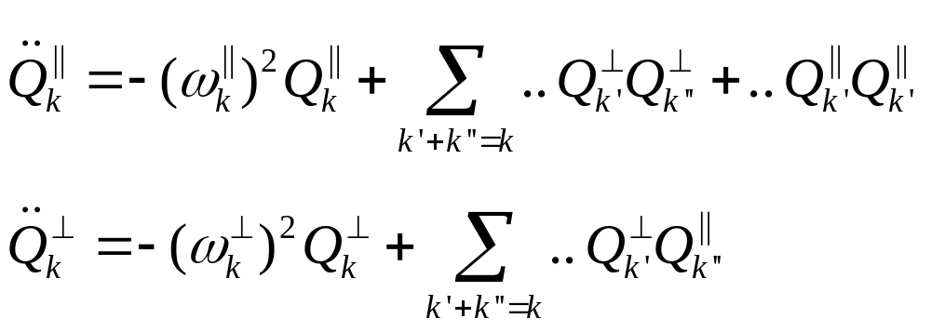
Equation of Motion of Modes

Slide 28
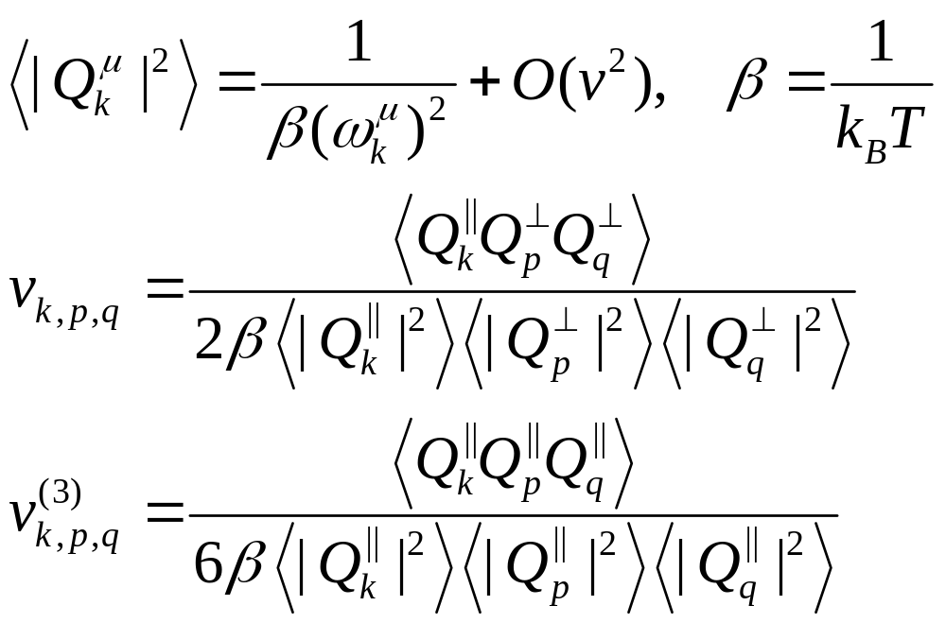
Determine Effective Hamiltonian Model Parameters from MD

Slide 29
Mode-Coupling Approximation
Γ(t) = β <R(t) R(0)>
R ∝ Q Q
Γ(t) ∝ <Q(t)Q(t)Q(0)Q(0)>
≈ <Q(t)Q(0)><Q(t)Q(0)>
= g(t)g(t) [mean-field type]

Slide 30
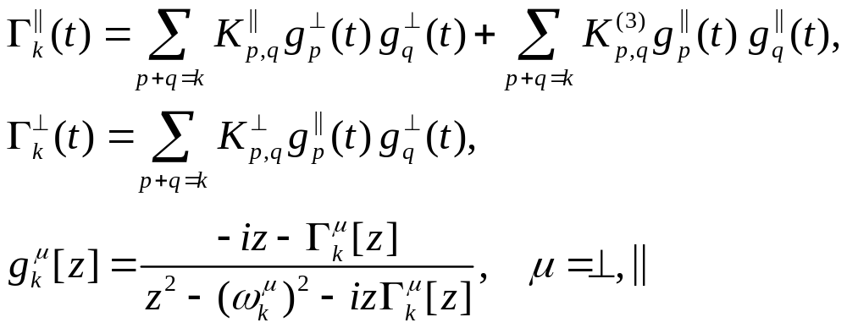


Full Mode-Coupling Equations
is Fourier-Laplace transform of

Slide 31
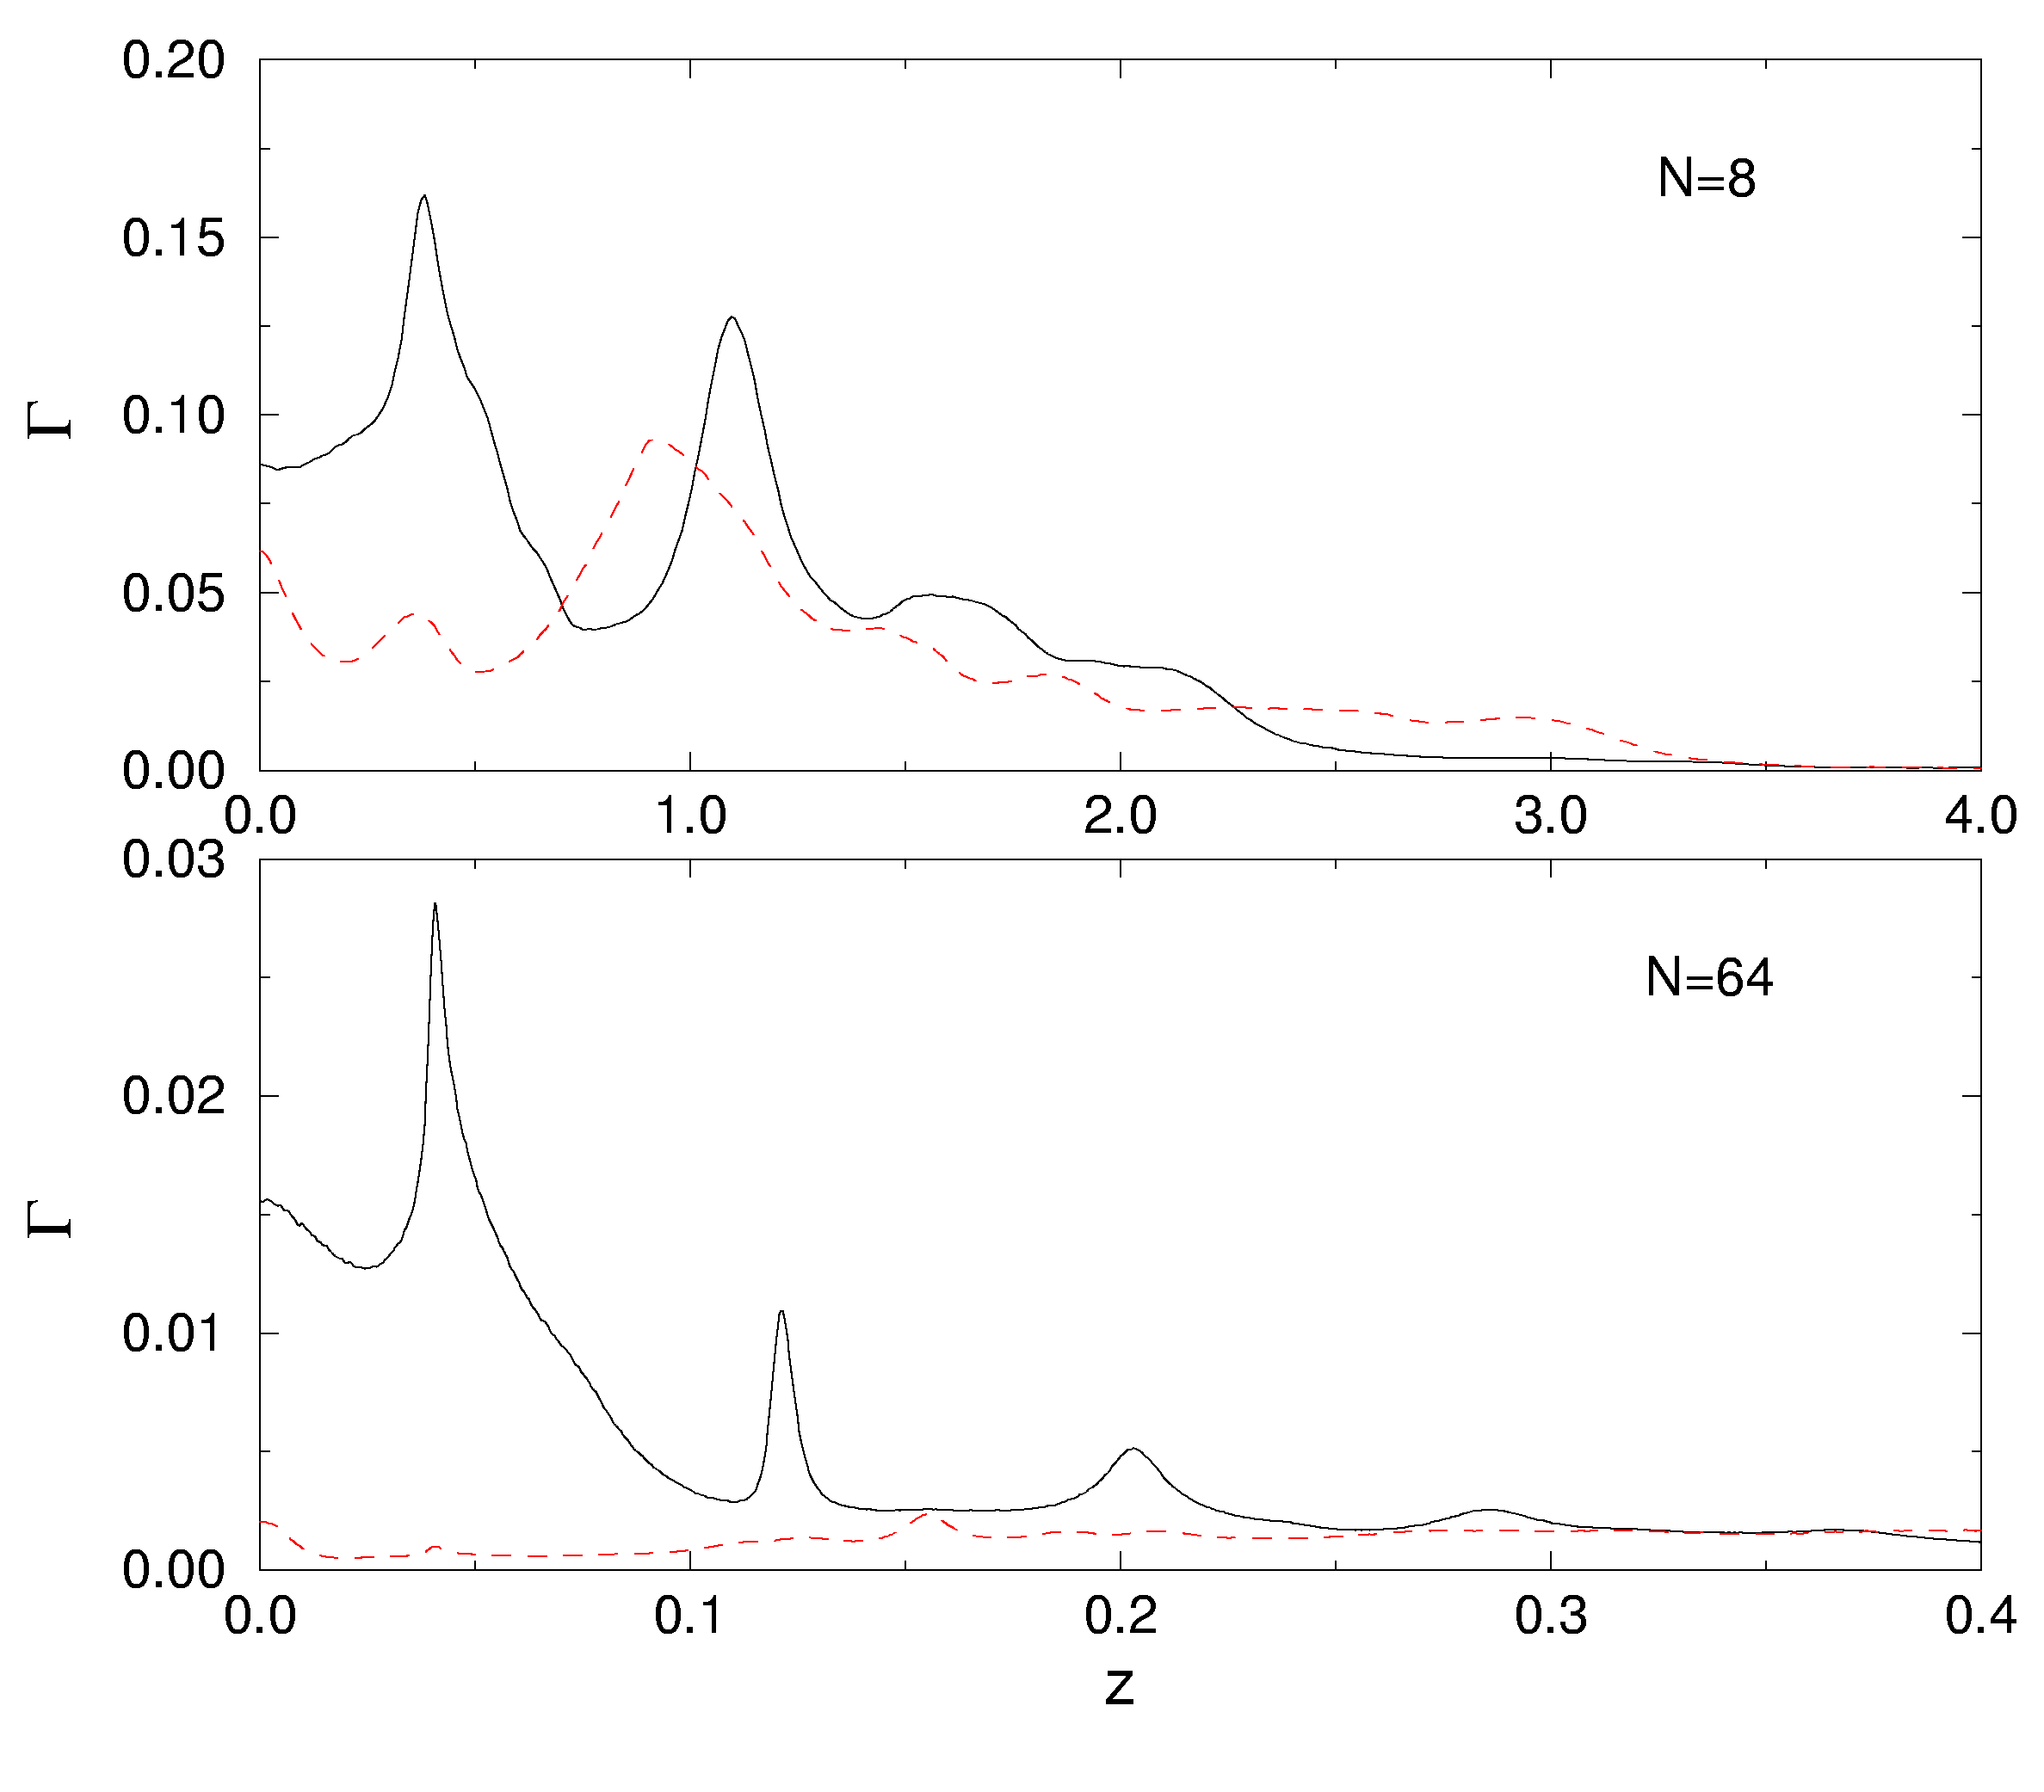
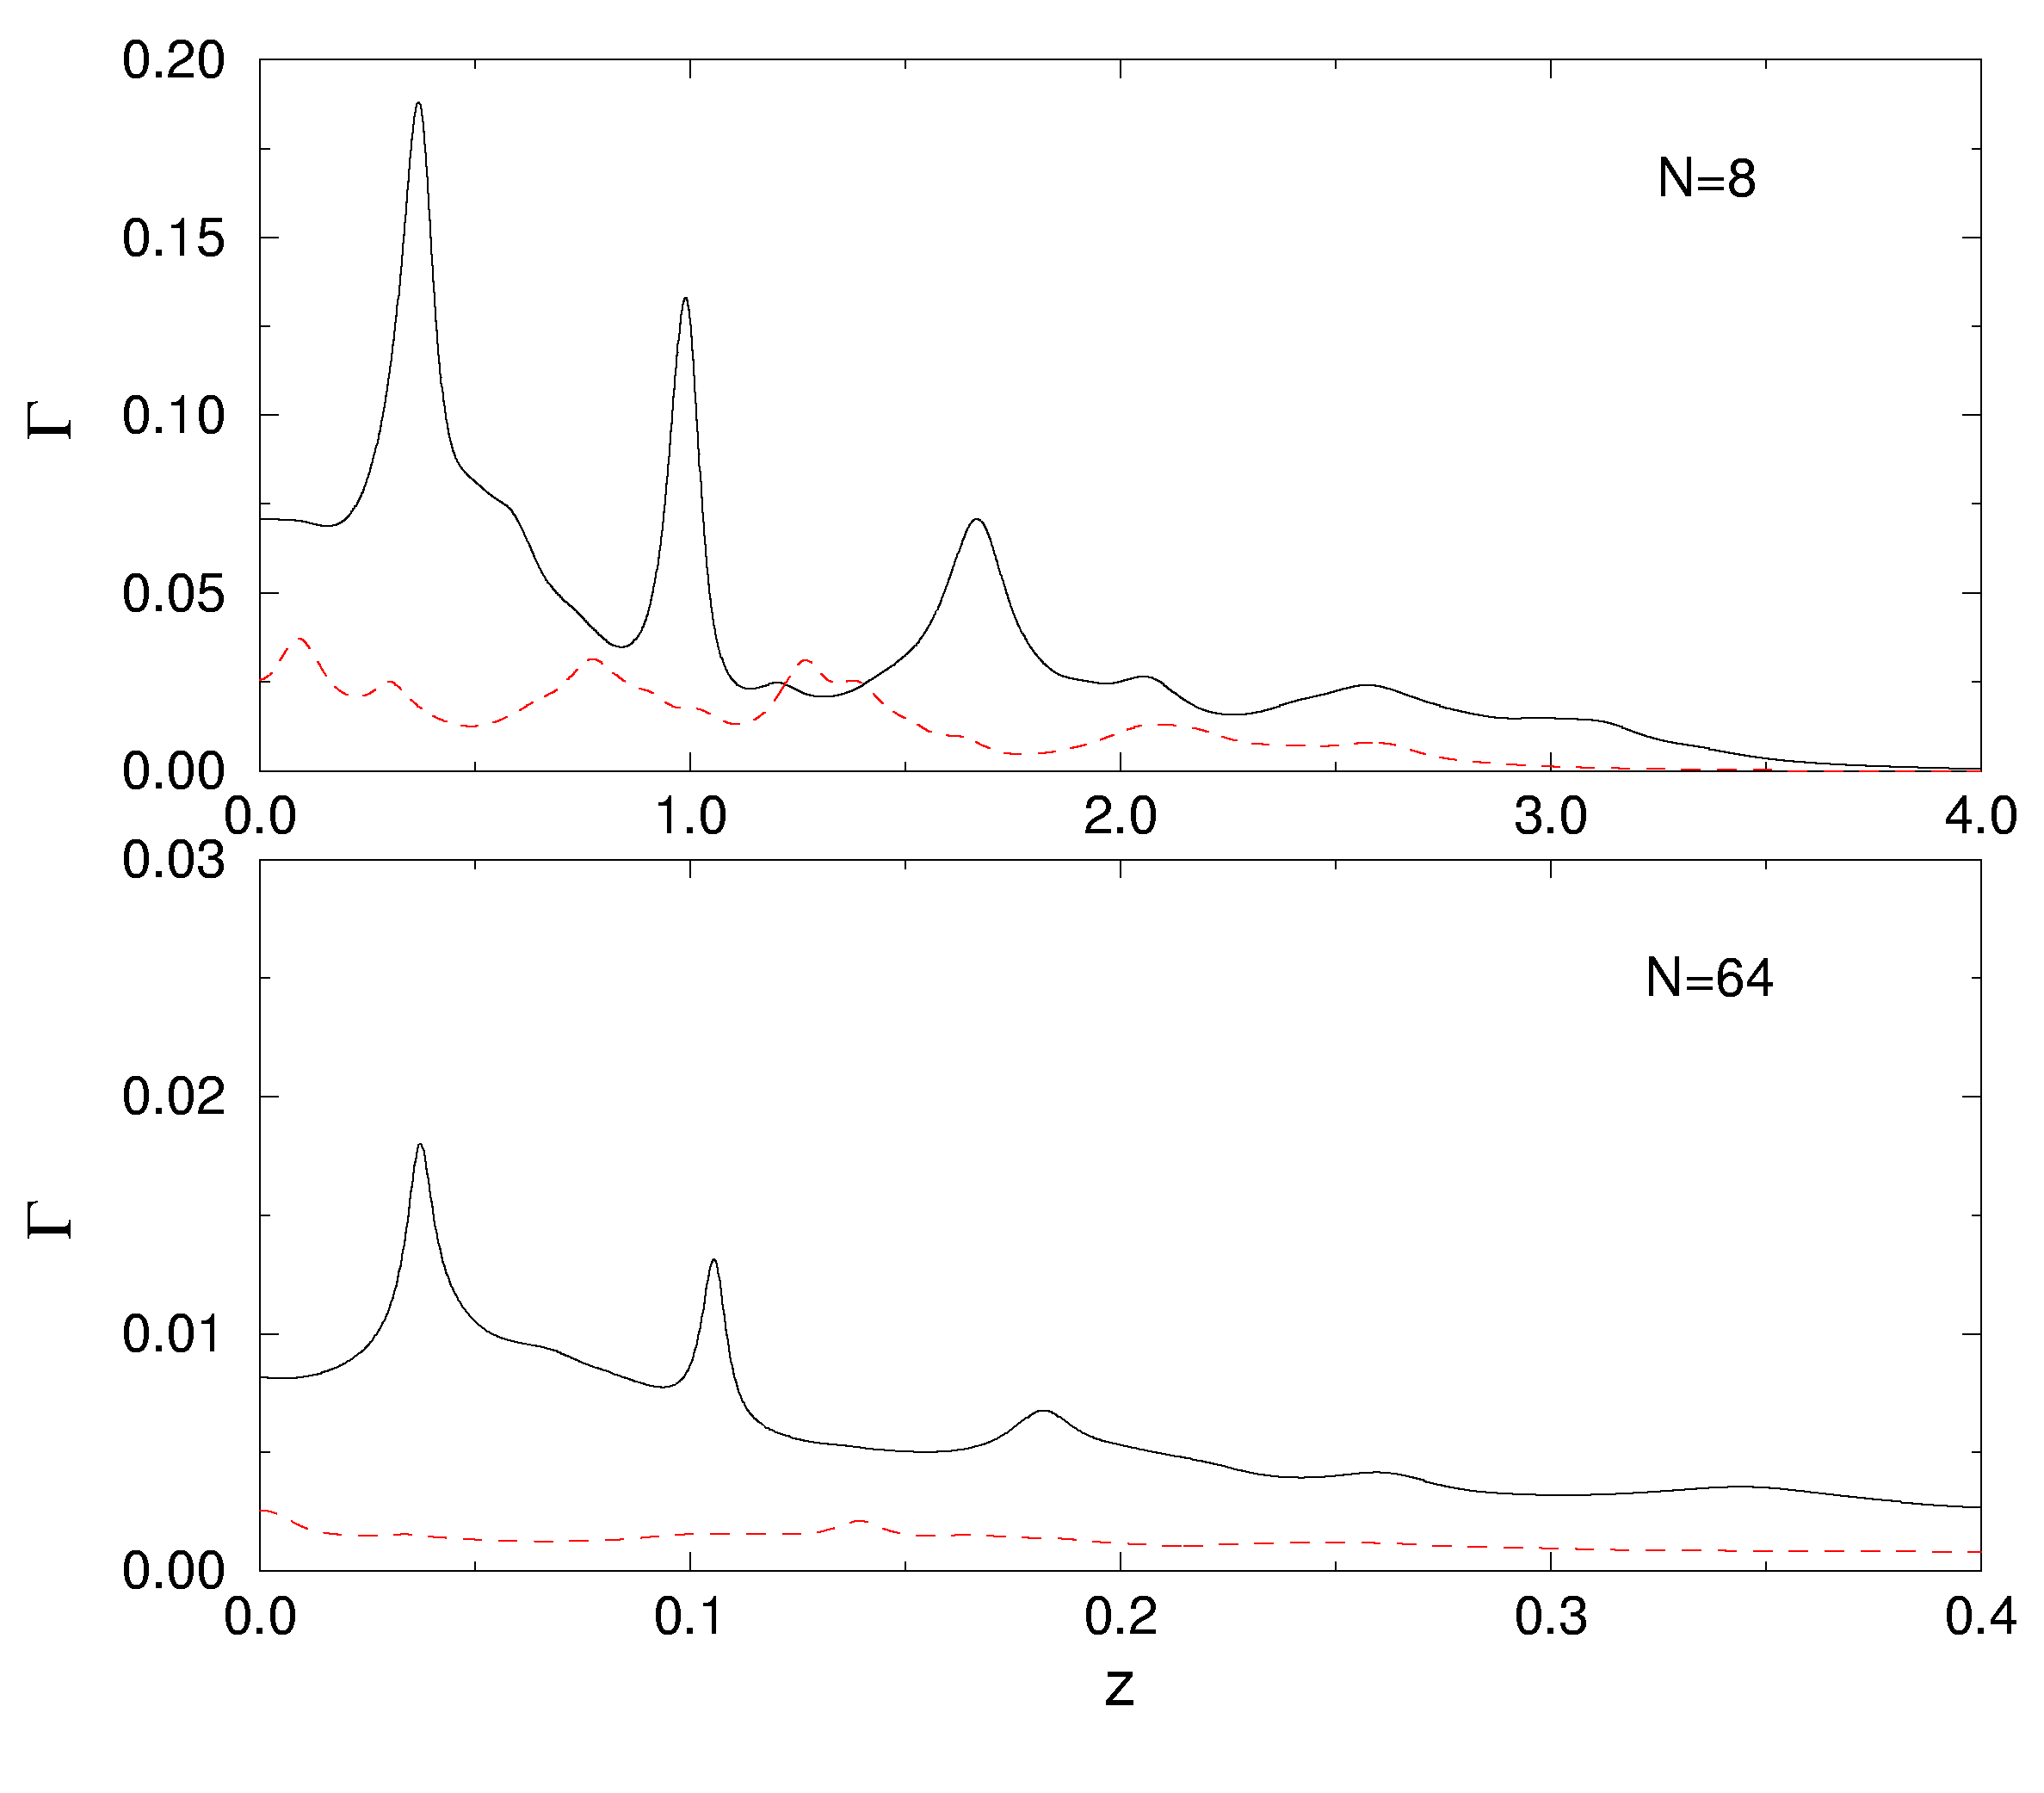
Damping Function Γ₁[z]
Molecular Dynamics
Mode-Coupling Theory
From J-S Wang & B Li, PRE 70, 021204 (2004).

Slide 32
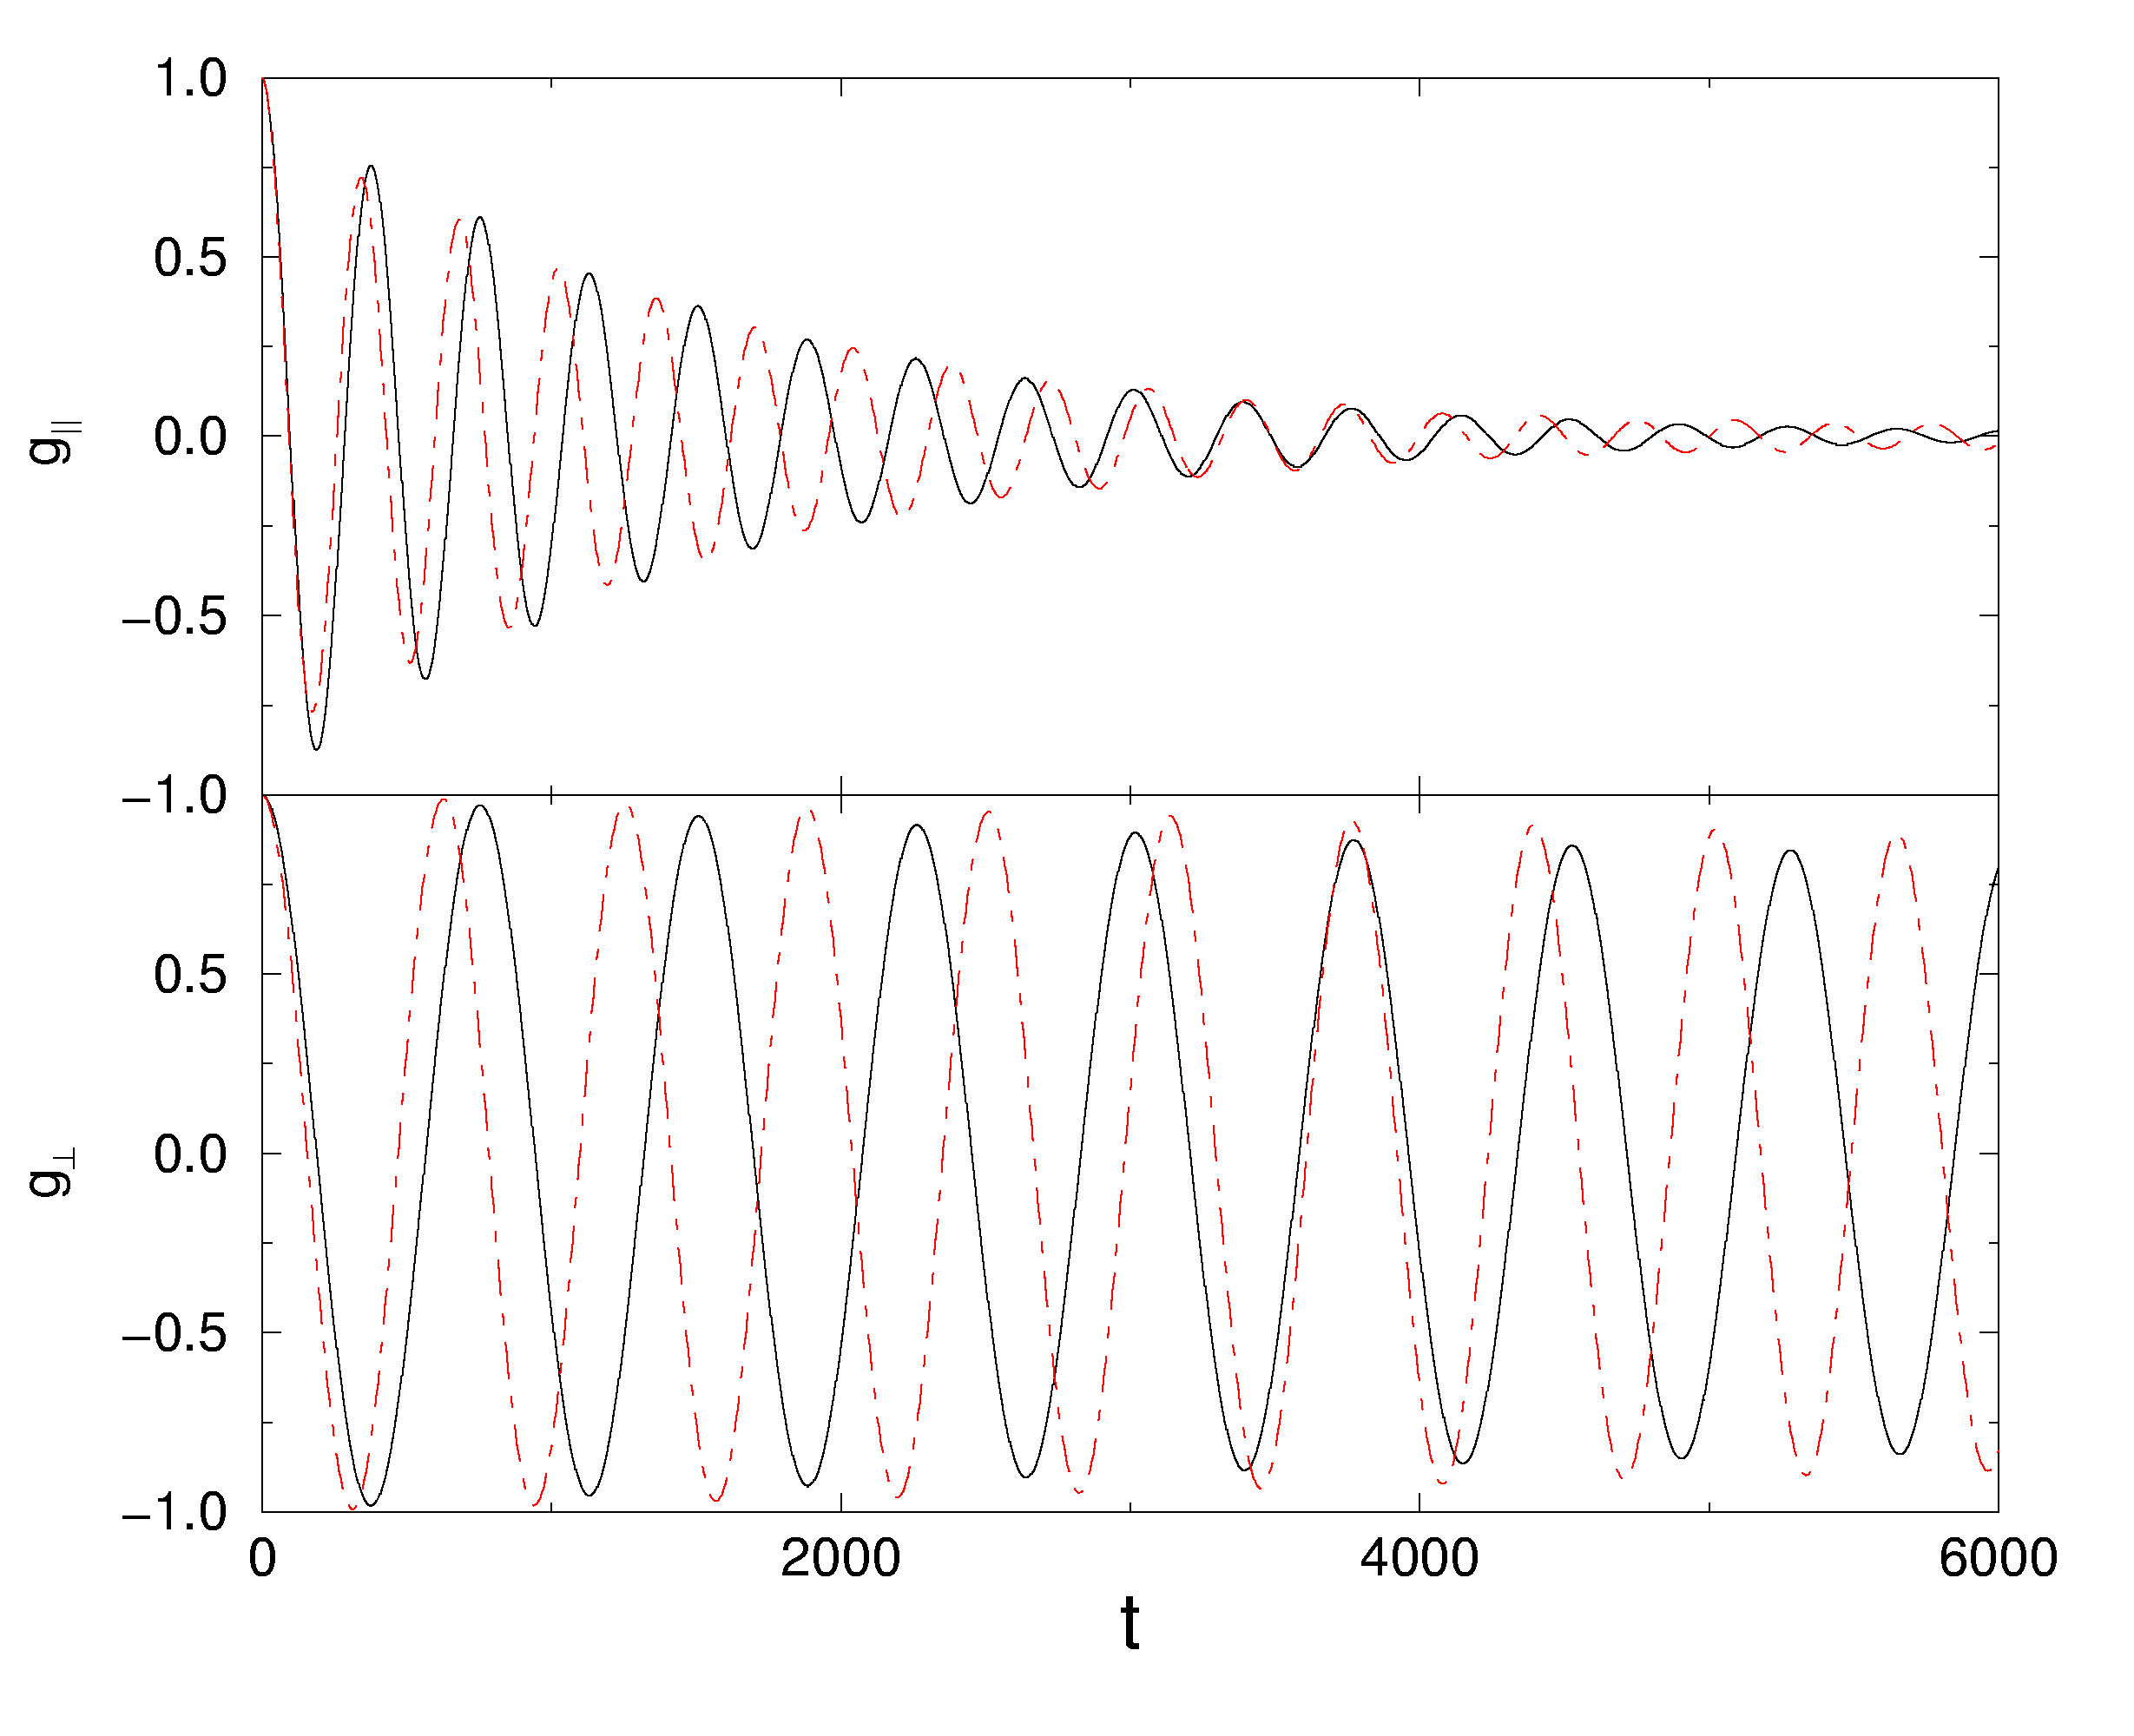
Correlation Functions
Correlation function g(t) for the slowest longitudinal and transverse modes. Black line: mode-coupling, red dash: MD. N = 256.
g(t) ≈ e^{-γt}cos(ωt)

Slide 33
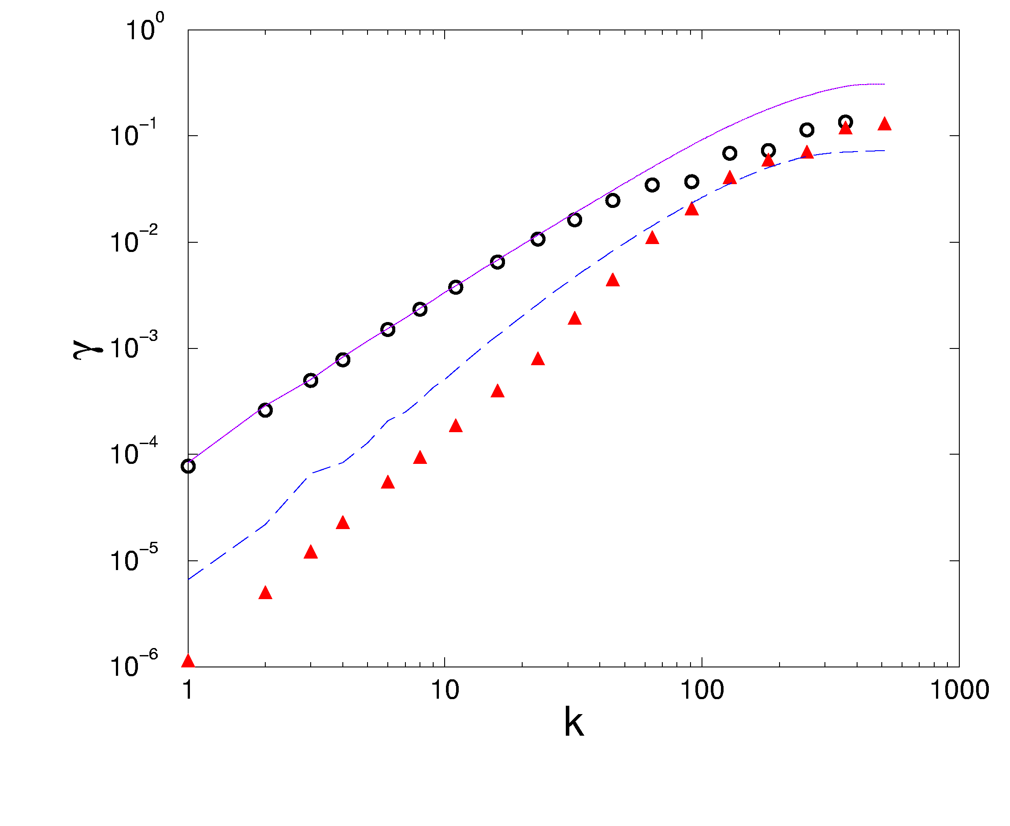
Decay or Damping Rate
Decay rate of the mode vs mode index k. p = 2πk/(Na) is lattice momentum. N = 1024.
Symbols are from MD, lines from mode-coupling theory. Straight lines have slopes 3/2 and 2, respectively.
slope=3/2
longitudinal
slope=2
transverse

Slide 34
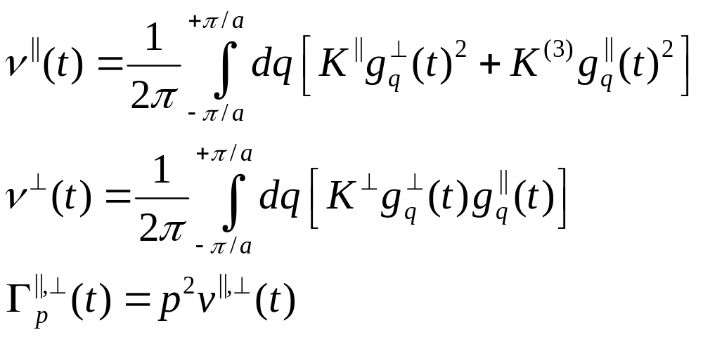
Mode-Coupling Theory in the Continuum Limit

Slide 35
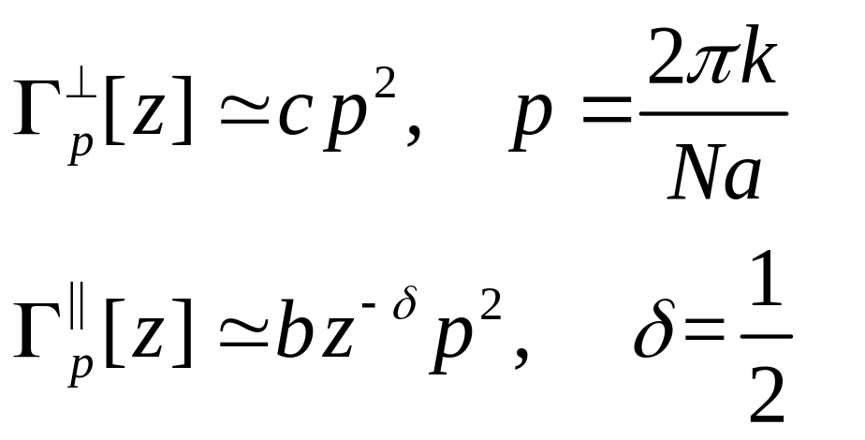
Asymptotic Solution
The mode-coupling equations predict, for large system size N, and small z :
If there is no transverse coupling, Γ = z^{(-1/3)}p² (Result of Lepri).

Slide 36
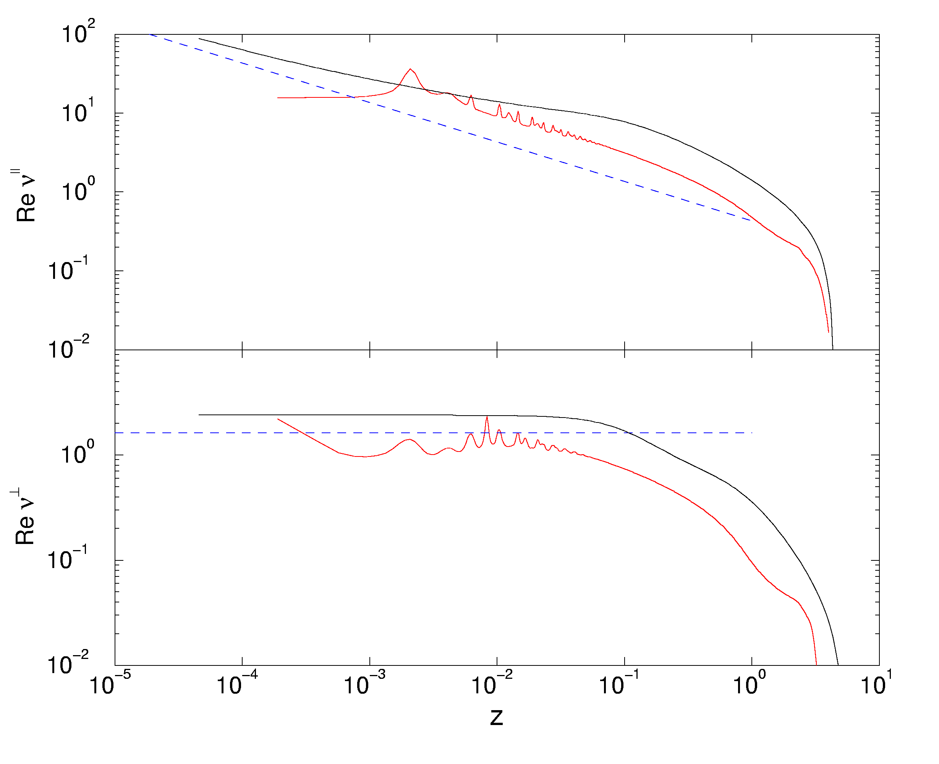
Mode-Coupling Γ[z]/p²
At parameter set B. Blue dash : asymptotic analytical result, red line : Full theory on N =1024, solid line : N → ∞ limit theory
|| slope = −1/2
⊥ slope = 0

Slide 37
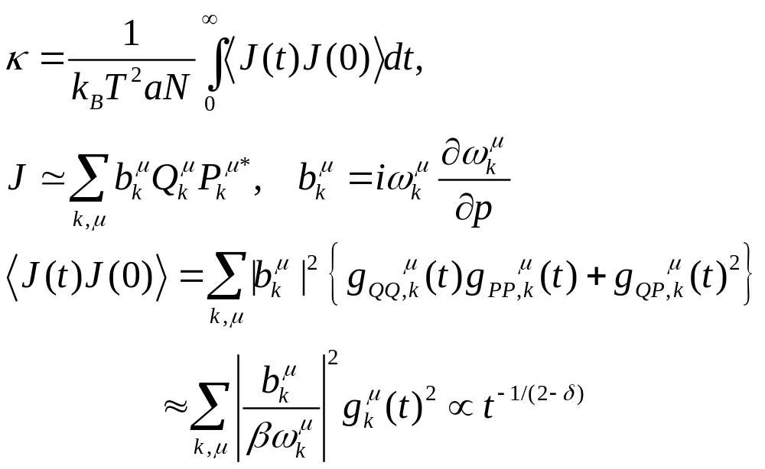
Green-Kubo Formula

Slide 38
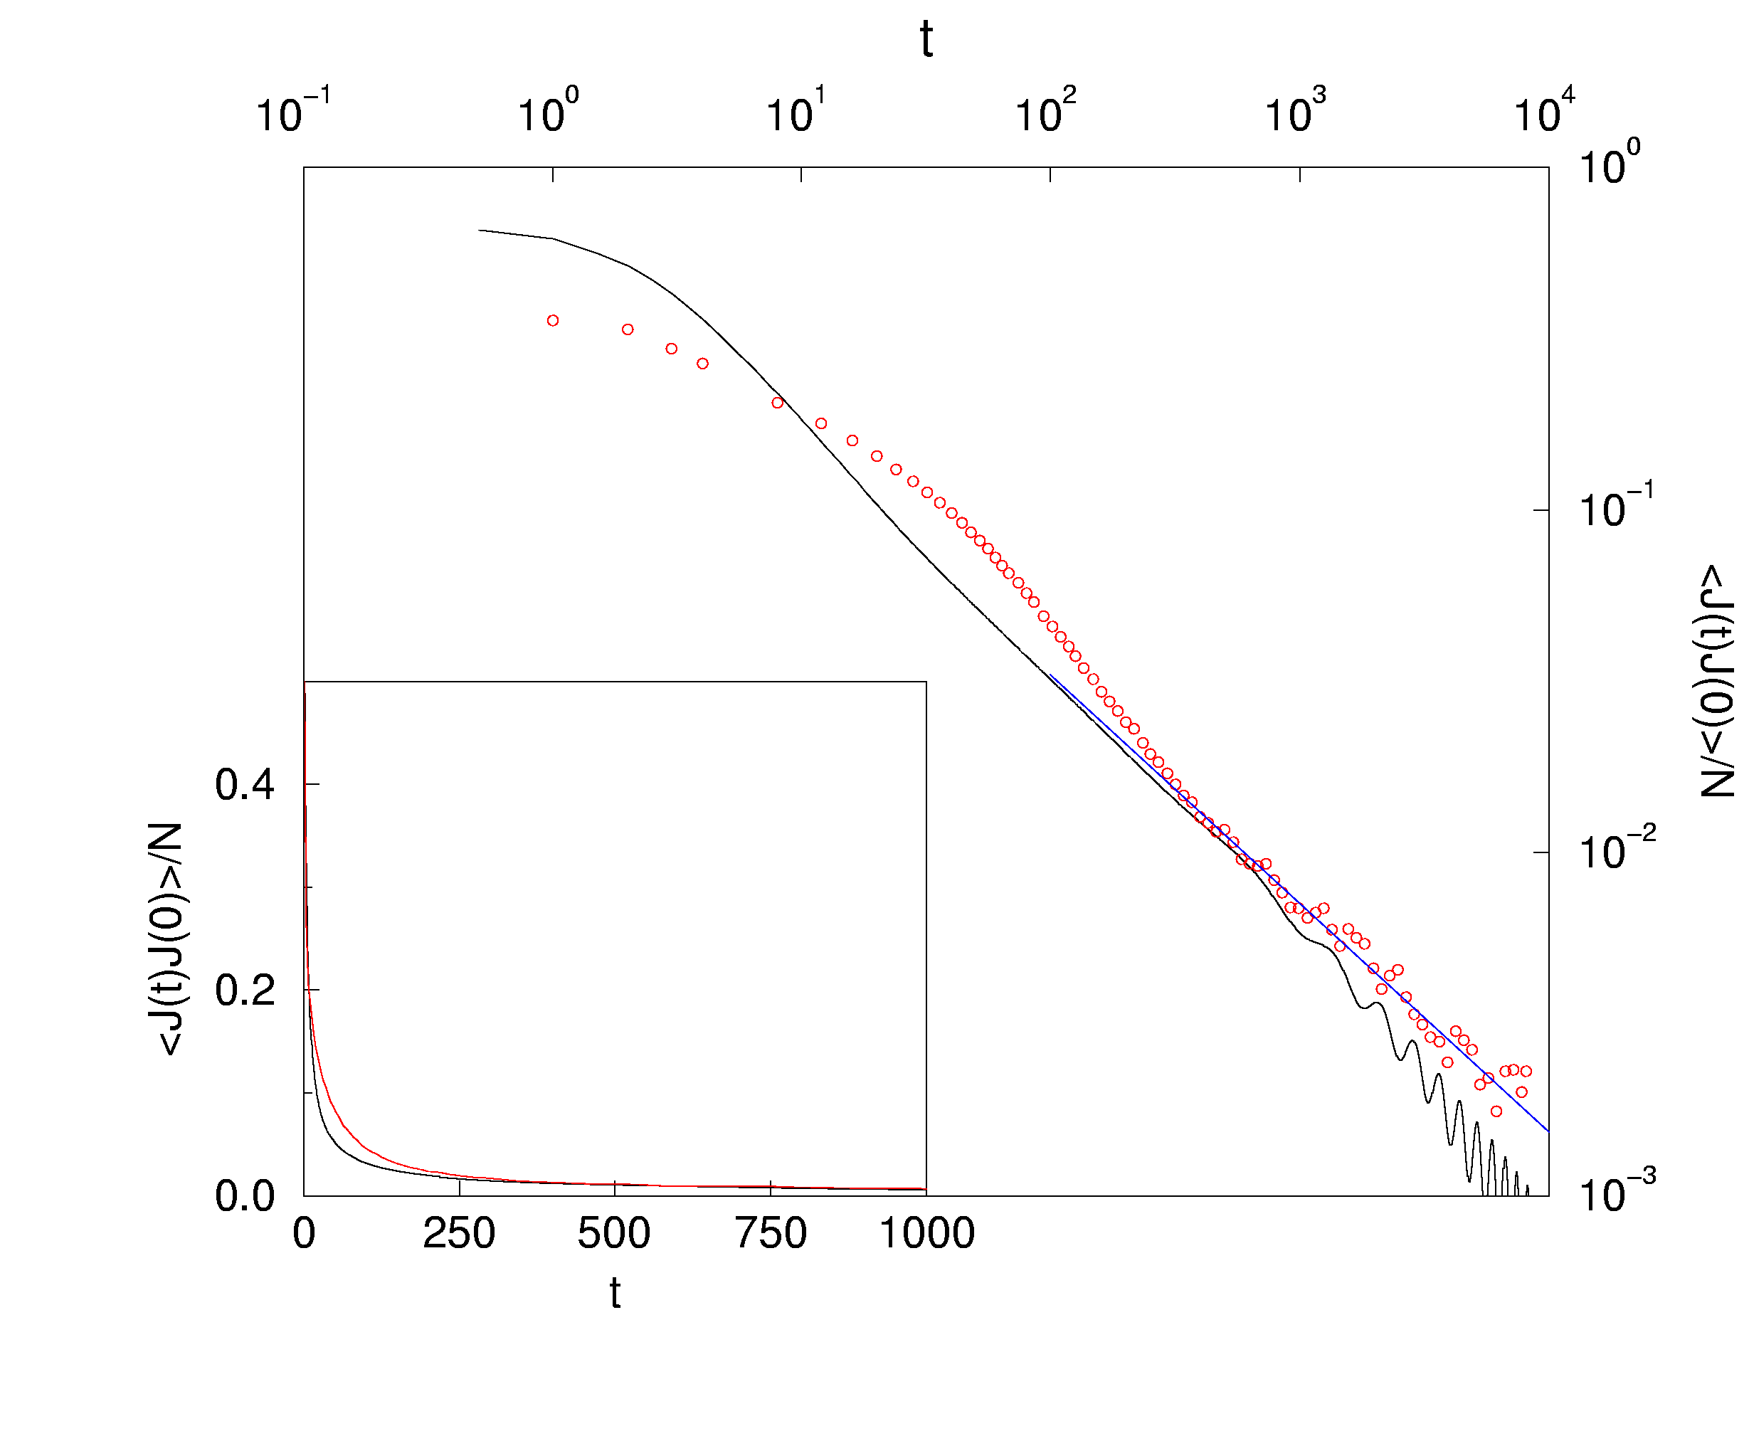
Green-Kubo Integrand
Parameter set B. Red circle: molecular dynamics, solid line: mode-coupling theory (N = 1024), blue line: asymptotic slope of 2/3.

Slide 39
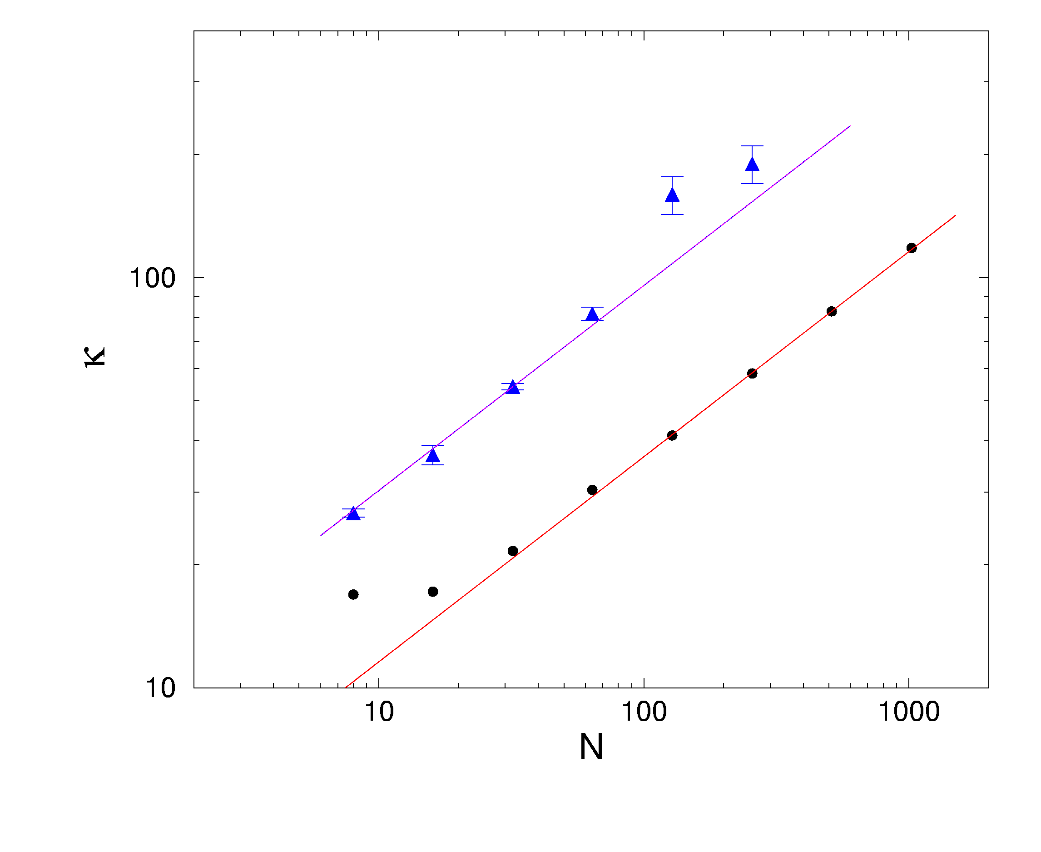
κ_{N} with Periodic Boundary Condition
κ from Green-Kubo formula on finite systems with periodic boundary conditions, for parameter set B (K_{r}=1, K_{Φ}=1, T=0.3)
slope=1/2
Molecular dynamics
Mode-coupling

Slide 40
Relation between Exponent in Γ and κ
If mode decay with Γ≈z^{-δ}p², then
With periodic B.C. thermal conductance κ ≈ N ^{1-δ}
With open B.C. κ ≈ N ^{1-1/(2-δ)}
Mode coupling theory gives δ=1/2 with transverse motion, and δ=1/3 for strictly 1D system.

Slide 41
Conclusion
Quantitative agreement between mode-coupling theory and molecular dynamics is achieved
Molecular dynamics and mode-coupling theory support 1/3 power-law divergence for thermal conduction in 1D models with transverse motion, 2/5 law if there are no transverse degrees of freedom.

