Slide 1
Energy, momentum, and angular momentum transfers mediated by photons
Jian-Sheng Wang
Department of Physics,
National University of Singapore

Slide 2
Outline
Radiative (heat & momentum) transfer, experimental background
NEGF theory of energy, momentum, and angular momentum transfer
  N + 1 objects, bath at infinity
  Meir-Wingreen/Landauer formula
  Zero-point motion, when it contributes?
Applications
  Near-field heat transfer between graphene objects
  Angular momentum emission from current-driven benzene molecule
  Graphene edge effect

Slide 3
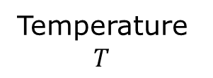
Blackbody radiation
Temperature $T$

Slide 4
Why a hole is the same as a blackbody for radiation?
Schroeder, “intro to thermal physics”

Slide 5
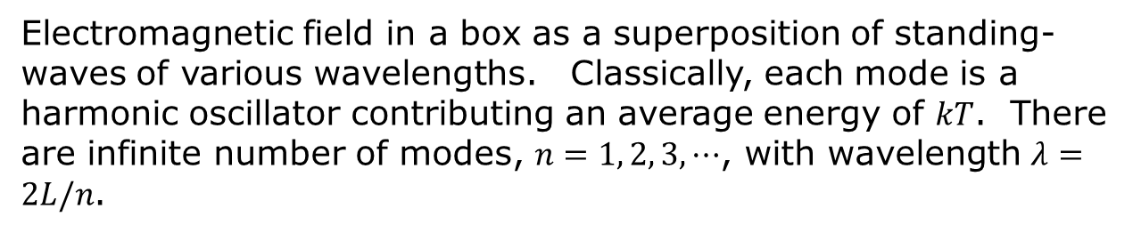
The ultraviolet catastrophe
Classical physics – equipartition theorem
Electromagnetic field in a box as a superposition of standing-waves of various wavelengths. Classically, each mode is a harmonic oscillator contributing an average energy of $kT$. There are infinite number of modes, $n=1, 2, 3, ⋯$, with wavelength $λ=2L/n$.

Slide 6
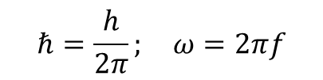
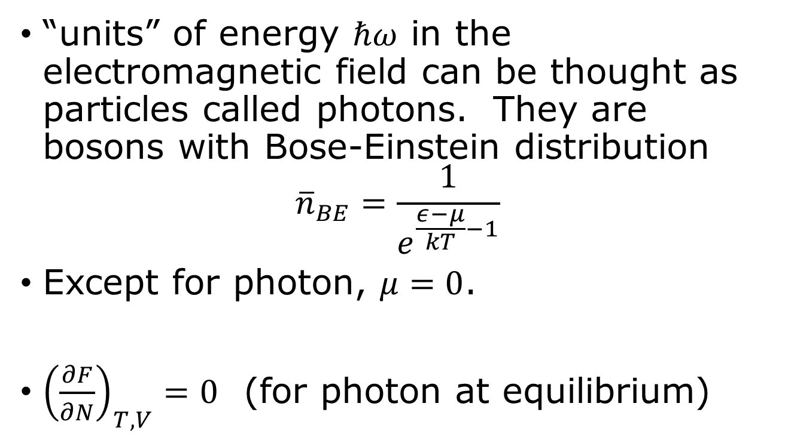
Photons
$$ℏ=\frac{h}{2π}; ω=2πf$$
“units” of energy $ℏω$ in the electromagnetic field can be thought as particles called photons. They are bosons with Bose-Einstein distribution
$${\overline{n}}_{BE}=\frac{1}{e^{\frac{ε−μ}{kT}−1}}$$
Except for photon, $μ=0$.
${\left(\frac{∂F}{∂N}\right)}_{T,V}=0$ (for photon at equilibrium)

Slide 7

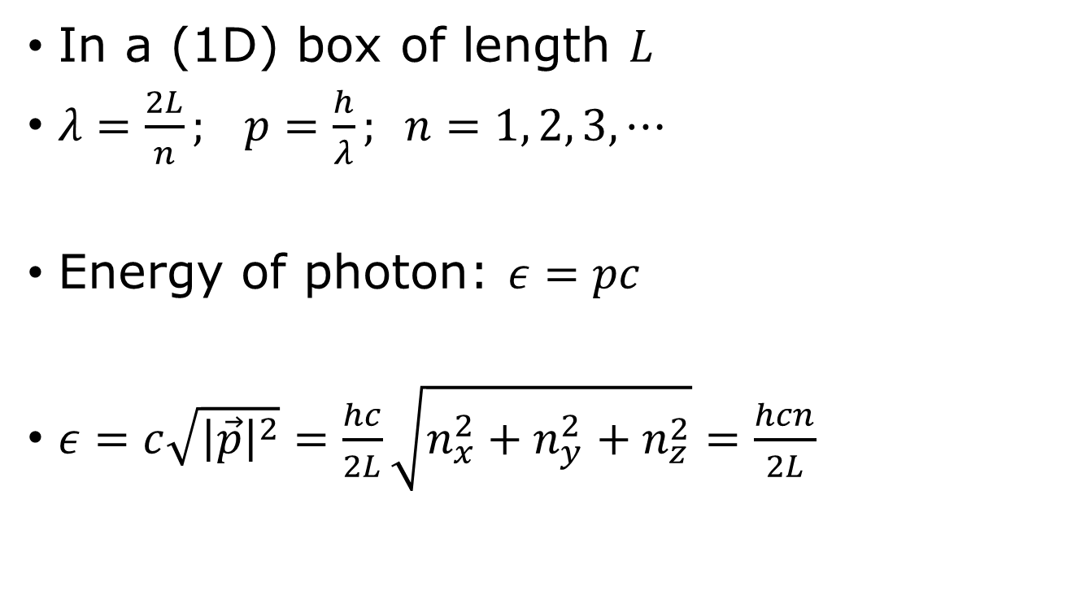

Photon dispersion relation
$$ε=c|p|$$
In a (1D) box of length $L$
$λ=\frac{2L}{n}; p=\frac{h}{λ}; n=1, 2, 3, ⋯$
Energy of photon: $ε=pc$
$ε=c\sqrt{{\left|\vec{p}\right|}^{2}}=\frac{hc}{2L}\sqrt{n_{x}^{2}+n_{y}^{2}+n_{z}^{2}}=\frac{hcn}{2L}$
0
$$p$$

Slide 8
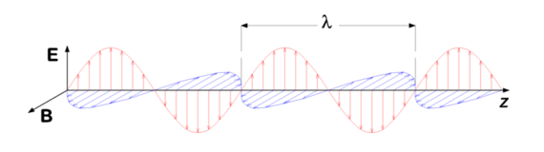
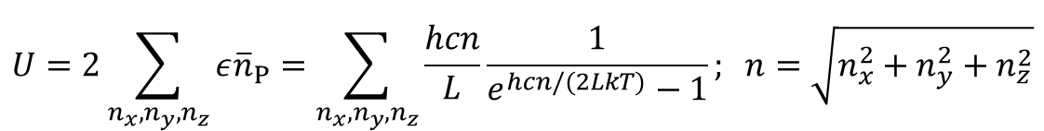
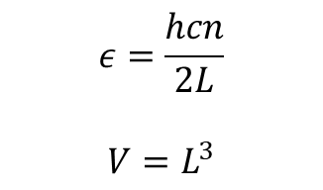
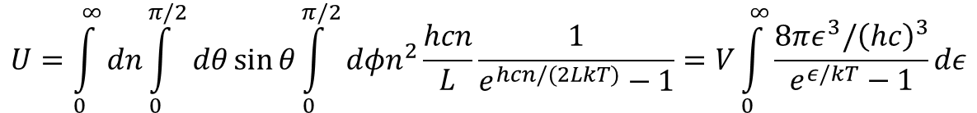
Summing over modes
$$ε=\frac{hcn}{2L}$$
$$V=L^{3}$$
$$U=2\sum_{n_{x}, n_{y},n_{z}}{ε{\overline{n}}_{P}}=\sum_{n_{x},n_{y},n_{z}}{\frac{hcn}{L}\frac{1}{e^{hcn/(2LkT)}−1}}; n=\sqrt{n_{x}^{2}+n_{y}^{2}+n_{z}^{2}}$$
$$U=\int_{0}^{∞}{dn}\int_{0}^{π/2}{dθ}\sin{θ}\int_{0}^{π/2}{dφn^{2}\frac{hcn}{L}\frac{1}{e^{hcn/(2LkT)}−1}}=V\int_{0}^{∞}{\frac{8πε^{3}/{\left(hc\right)}^{3}}{e^{ε/kT}−1}dε}$$

Slide 9
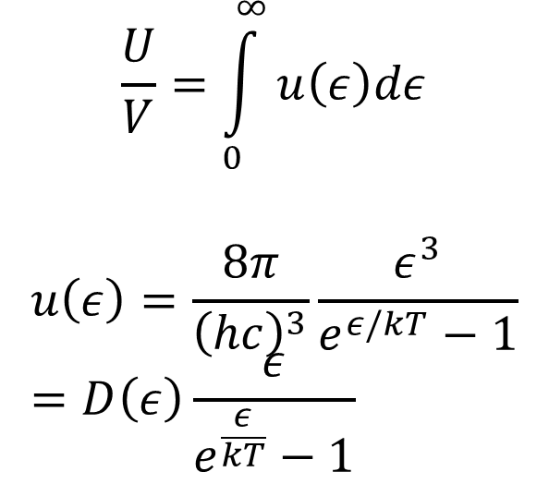
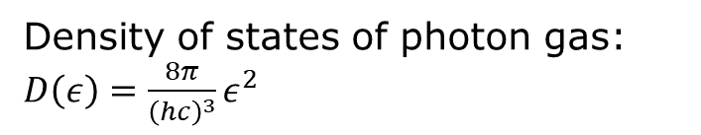
Planck spectrum
$$\frac{U}{V}=\int_{0}^{∞}{u\left(ε\right)dε}$$
$$u\left(ε\right)=\frac{8π}{{\left(hc\right)}^{3}}\frac{ε^{3}}{e^{ε/kT}−1}=D\left(ε\right)\frac{ε}{e^{\frac{ε}{kT}}−1}$$
Density of states of photon gas: $D\left(ε\right)=\frac{8π}{{\left(hc\right)}^{3}}ε^{2}$

Slide 10

Experimental background, blackbody radiation
Poynting vector
Notes:
u is S per unit wavelength.

Slide 11
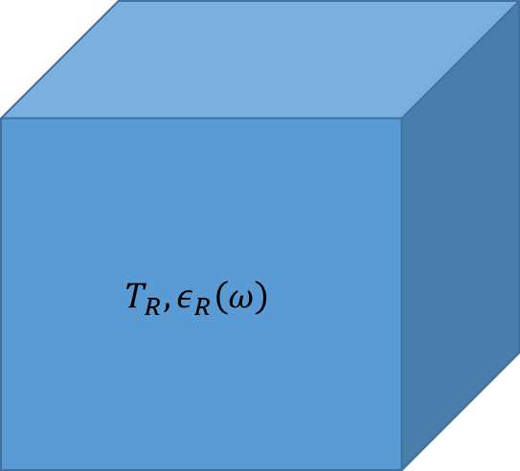
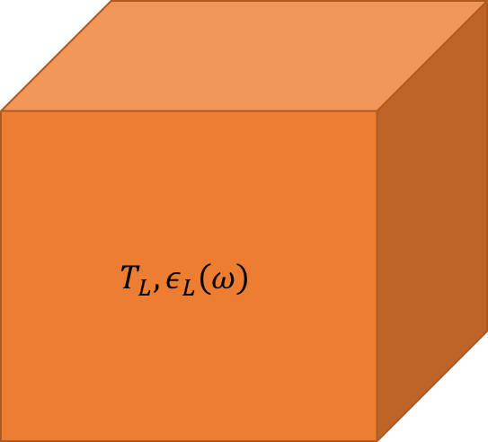

Heat transfer between (grey) bodies
$$T_{L}, ε_{L}\left(ω\right)$$
$$T_{R}, ε_{R}\left(ω\right)$$
Polder & van Hove problem (1971)

Slide 12
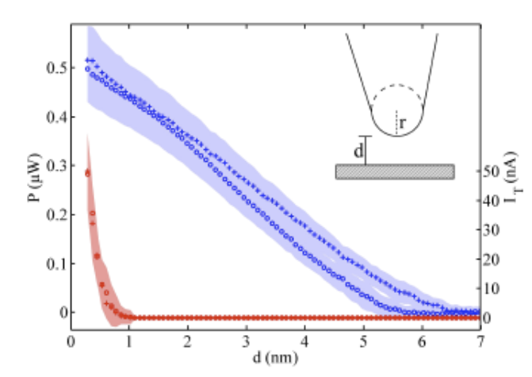
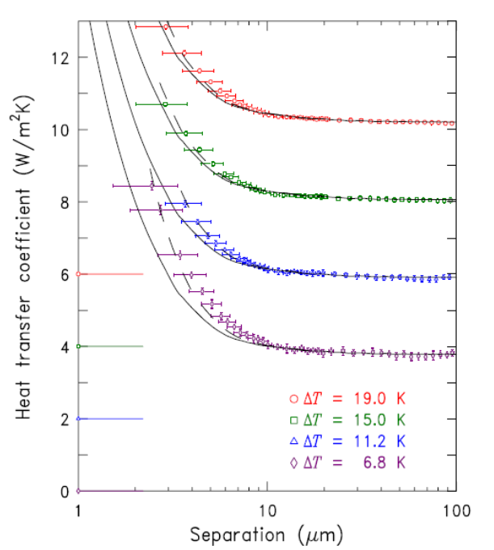
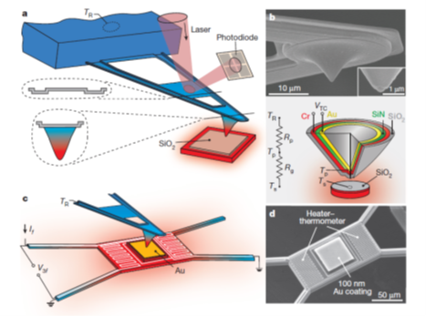
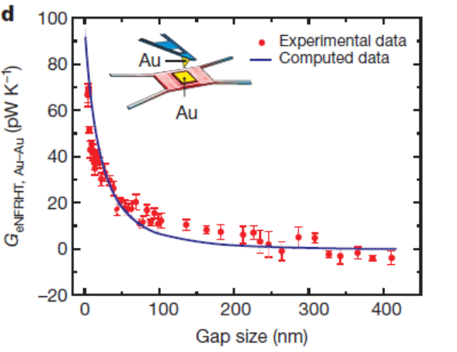
Near-field heat transfer
↑ Kloppstech, et al, Nature Comm (2017).
Ottens, et al PRL (2011).
→ Kim et al, Nature (2015).

Slide 13
(Casimir) force
Casimir force in plate-sphere geometry, from Mohideen and Roy, PRL (1998).

Slide 14
Angular momentum emission
2D semiconductor junction made of WSe₂ that can emit polarized light. From Y. J. Zhang, et al., Science 344, 725 (2014).
Notes:
W: Tungsten, Se: Sellenium. Chalcogen [kaekegen]

Slide 15
Nonequilibrium Green’s function (NEGF) theory

Slide 16

System setup
N+1 or infinity
$$R→∞$$
…
1
Question: what is the energy emitted, force and torque applied to, for each of the object 1 to N+1.
N
2

Slide 17


NEGF preliminaries
+
−
$$−∞$$
$$t$$

Slide 18
NEGF preliminaries

Slide 19
Fluctuation-dissipation theorem in thermal equilibrium

Slide 20
Dyson equations

Slide 21
Keldysh equation

Slide 22
ϕ = 0 gauge, fundamental equation for vector potential A

Slide 23
Poynting theorem, steady state average

Slide 24
From surface integral to volume integral
α

Slide 25
A-j correlation function

Slide 26
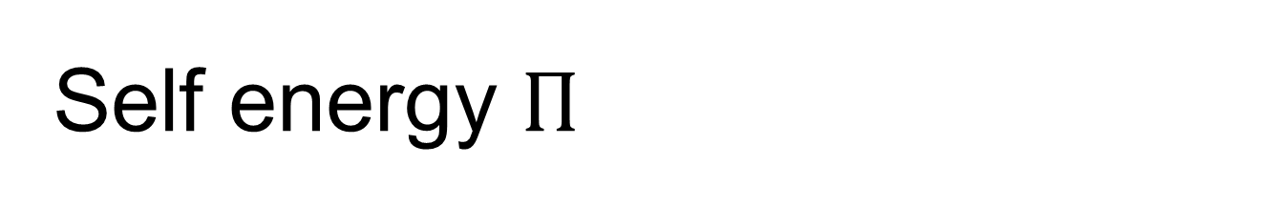
Self energy $Π$
RPA
Aslamazov-Larkin diagram

Slide 27
Operator order: normal or symmetric order?

Slide 28
Meir-Wingreen formula
Notes:
Levi Civita symbol

Slide 29
Bath at infinity
Eckhardt, PRA 29, 1991 (1984)
Krüger, et al, PRB 86, 115423 (2012)

Slide 30
Recover blackbody Planck result
R
0

Slide 31
From Meir-Wingreen to Landauer: local equilibrium approximation
No Landauer form for force and torque!

Slide 32
When zero-point-motion contribution is cancelled?

Slide 33
Emission to infinity

Slide 34
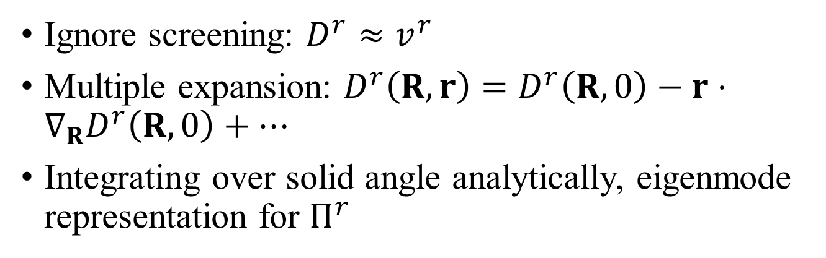
Far field approximations
Ignore screening: $D^{r}≈v^{r}$
Multiple expansion: $D^{r}\left(R,r\right)=D^{r}\left(R,0\right)−r⋅∇_{R}D^{r}\left(R,0\right)+⋯$
Integrating over solid angle analytically, eigenmode representation for $Π^{r}$

Slide 35
Applications

Slide 36
Heat transfer between two graphene sheets
↓ First principles QE/BerkeleyGW calculation for the ratio of energy transfer to blackbody value between two graphene sheets at temperatures 300 K and 1000 K, η = 0.05 eV, electron chemical potential at Dirac point. Zhu & Wang, PRB 104, L121409 (2021).
↑ Heat transfer ratio based on electron tight-binding model with nearest neighbor hopping t = 2.8 eV, between 300 K and 1000 K sheets at chemical potential μ = 0.1 eV. Slope ≈ 2.2. Jiang & Wang, PRB 96, 155437 (2017).

Slide 37


Heat transfer between zigzag nanotubes
Heat transfer from 400K to 300K objects. (a), (b) zigzag carbon nanotubes. (c), (d) nano-triangles. d: gap distance, M: nanotube circumference, L: triangle length. ε: dielectric constant. From Tang, Yap, Ren, and Wang, Phys. Rev. Appl. 11, 031004 (2019).

Slide 38

Angular momentum emission from a benzene molecule
Far field monopole approximation (all atoms are at the origin), ignore screening/multiple scatterings.

Slide 39



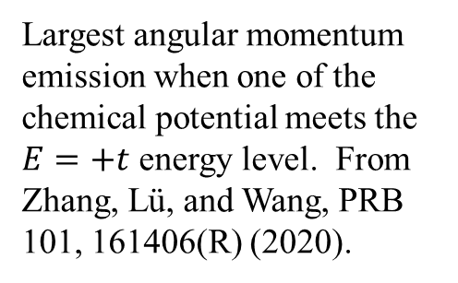
Angular momentum emission resonance effect
E
$E=t$, $\left|l\right|=2$
$$E=−2t, l=0$$
Largest angular momentum emission when one of the chemical potential meets the $E=+t$ energy level. From Zhang, Lü, and Wang, PRB 101, 161406(R) (2020).

Slide 40






Force and torque from the nonequilibrium edge
$$J$$
$$p$$
$$μ_{L}$$
$$μ_{R}$$

Slide 41

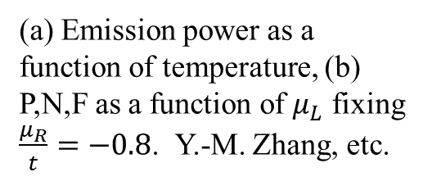
Emission from graphene edge
(a) Emission power as a function of temperature, (b) P,N,F as a function of $μ_{L}$ fixing $\frac{μ_{R}}{t}=−0.8$. Y.-M. Zhang, etc.

Slide 42
I, N, F scan $μ_{R}$vs $μ_{L}$. System size width 700 unit cells, k-point 401. From Zhang, et al, PRB (2022).

Slide 43
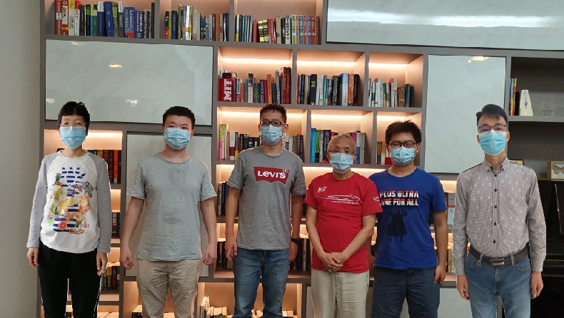
Acknowledgements
left to right: Dr. Zhang Yong-Mei, Dr. Zhu Tao, Dr. Gao Zhibin, Prof. Wang Jian-Sheng, Mr. Sun Kangtai, and Dr. Zhang Zuquan.

