Slide 1

Nonequilibrium Green’s Function (NEGF) and Quantum Thermal Transport
Workshop on Thermal Transport 2016 (WTT2016)
Wang Jian-Sheng
Notes:
This is a set of four lectures for the Nanjing Normal university workshop on thermal transport, 17-22 May 2016.

Slide 2
Lecture 1: Basics of thermal transport.
Lecture 2: NEGF – a brief history, definition of Green’s functions, properties, interpretation.
Lecture 3: NEGF “technologies” – rules of calculus, equation of motion method, currents.
Lecture 4: Feynman diagrammatics, Hedin equation.
Lecture 5: Applications.
Notes:
This set of lectures is on basic concepts and fundamental techniques. The formulas are well-known. However, as a (theoretical) physicist, one is not satisfied with a given formula and how to use it, but one want to know now it is derived, and what it’s limitations are. So that one can apply the technique to new situations. Many-body physics theories are fundamental to understand the lectures fully, such are discussed in books as such Fetter-Walecka, Mahan, etc. Although the title is on thermal transport, my aim is on general non-equilibrium transport, not necessarily thermal.

Slide 3
References
J.-S. Wang, J. Wang, and J. T. Lü, “Quantum thermal transport in nanostructures,” Eur. Phys. J. B 62, 381 (2008).
J.-S. Wang, B. K. Agarwalla, H. Li, and J. Thingna, “Nonequilibrium Green’s function method for quantum thermal transport,” Front. Phys. 9, 673 (2014).
See also http://staff.science.nus.edu.sg/~phywjs/NEGF/negf.html
Notes:
See also http://staff.science.nus.edu.sg/~phywjs/NEGF/negf.html for the links to the arxiv version of the review papers.

Slide 4
Lecture One
Basics of thermal transport or transport in general
Notes:
Lecture one is mostly phenomenological. Lecture two and two will start from ground up.

Slide 5
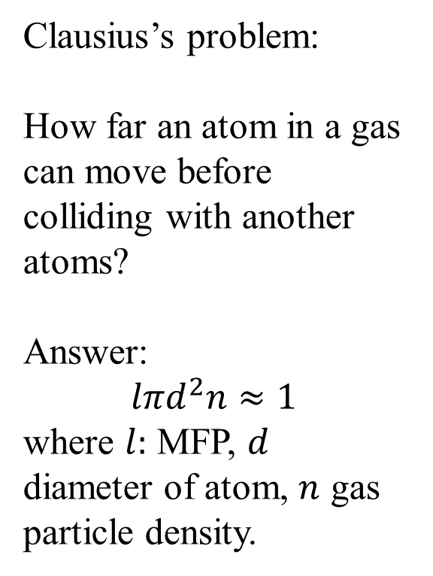
Mean free path (MFP)
Clausius’s problem:
How far an atom in a gas can move before colliding with another atoms?
Answer:
$$lπd^{2}n≈1$$
where $l:$ MFP, $d$ diameter of atom, $n$ gas particle density.
Diffusive vs ballistic regime
Notes:
MFP is a fundamental concept distinguish diffusive over ballistic transport. For a quantum dot with no size/length, we can hardly talk about diffusive transport.

Slide 6
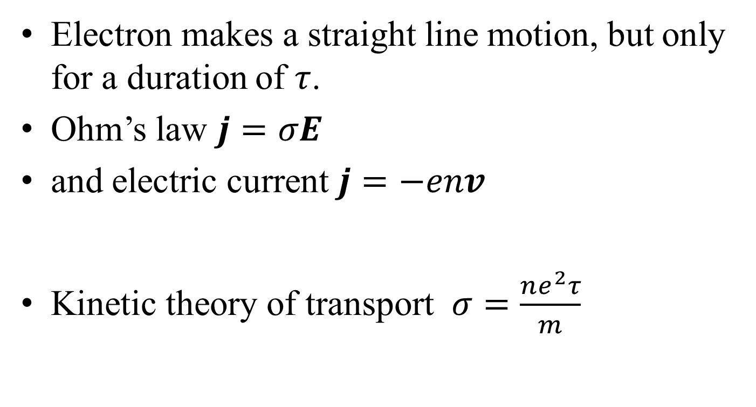
Relaxation time (electrons)
Electron makes a straight line motion, but only for a duration of $τ$.
Ohm’s law $j=σE$
and electric current $j=−env$
Kinetic theory of transport $σ=\frac{ne^{2}τ}{m}$
See: Ashcroft/Mermin, Solid State Physics.
Notes:
Electron has charge (-e). This is obviously in the diffusive transport regime.

Slide 7
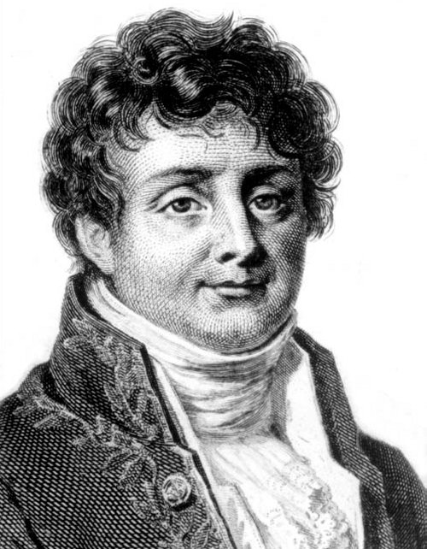
Fourier’s law for heat conduction
Fourier, Jean Baptiste Joseph, Baron (1768-1830)

Slide 8
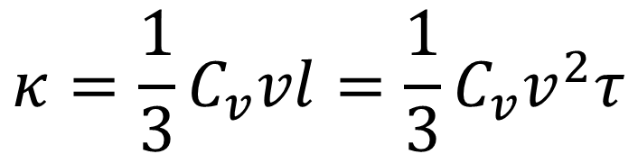
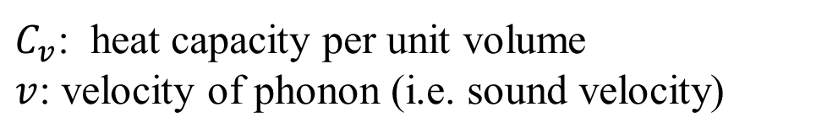
Kinetic theory formula for thermal conductivity
$$κ=\frac{1}{3}C_{v}vl=\frac{1}{3}C_{v}v^{2}τ$$
$C_{v}$: heat capacity per unit volume
$v$: velocity of phonon (i.e. sound velocity)
Notes:
MPF: l = vτ.

Slide 9
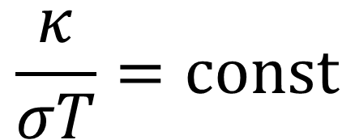
Wiedemann-Franz law (for electrons)
$$\frac{κ}{σT}=const$$

Slide 10
Some features of electron transport in metal

Slide 11
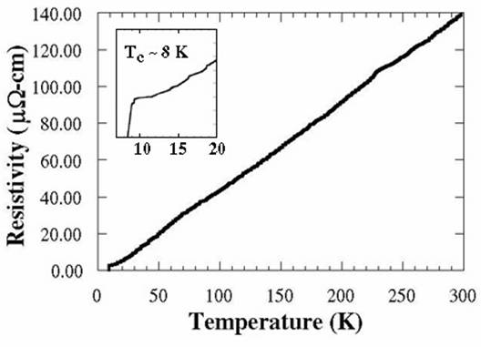
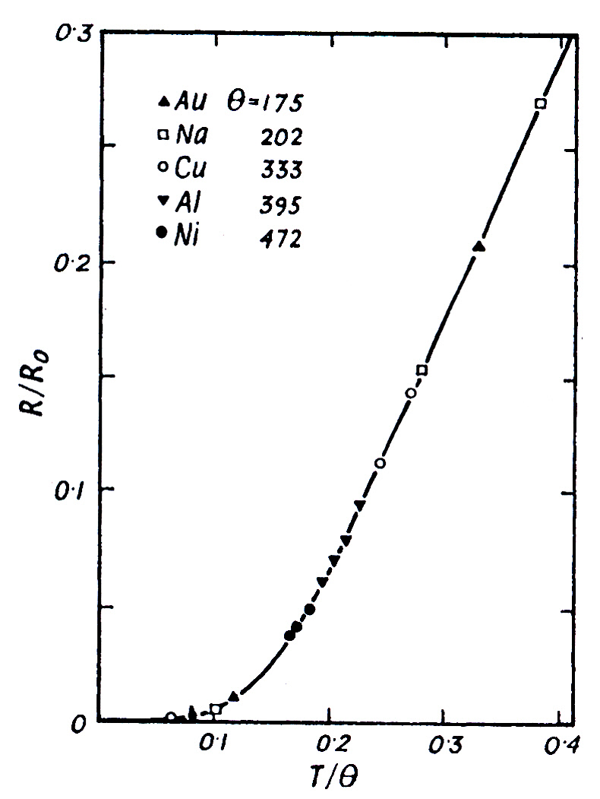
ρ ∝ T⁵ at low temperature
ρ vs T for lead (Pb), ρ ∝ T almost in the entire temperature range and becomes superconducting at T_{c} = 7.2 K.
Simple kinetic theory gives ρ = 1/σ = m/(ne²τ). Electron-phonon scattering can explain this linear dependence as self-energy (-Im Σ^{r} ∝1/τ) due to phonon is proportional to <uu> ∝ T in the classical limit. The best conductor near room temperature is Cu with resistivity around 1.6 μΩ·cm.
Fig. 115 of Ziman. Two-parameter fit to Grüneisen-Bloch theory to experimental data. The theory is based on Boltzmann transport equation and Debye model for phonons. The typical value of good metal resistivity is of the order of μΩ·cm (or 10 nΩ·m).
Notes:
Lead rho vs T is from http://www.bpc.edu/mathscience/faculty/jones/chapter_1_01.html
The Debye temperature of Pb is 88 K; this explains why the linear region is so large.

Slide 12
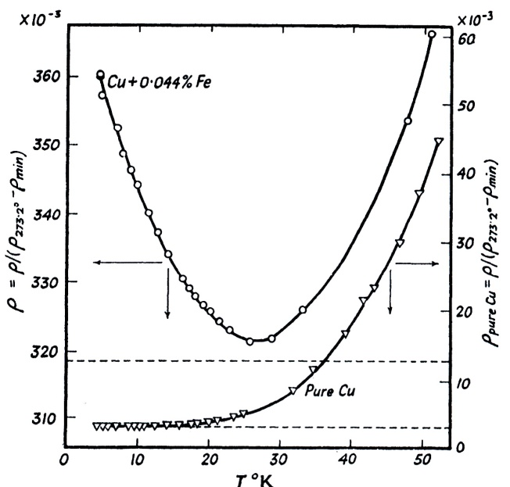
J. M. Ziman, “Electrons and Phonons,” Oxford Univ Press, 1960
Left top: Fig. 107. Due to impurity scattering, the resistance saturates to a constant. But with small amount of magnetic atoms, the resistance can go up, now known as Kondo effect.
Left bottom: Fig. 103. The disordered alloy follows Δρ ∝ (1-x) x. This is known as Nordheim’s rule (1931).
Top right, Fig. 109. bottom right, Fig. 129. Thermal power S (also known as Seebeck coefficient). The Boltzmann approach gives S = - π²k_{B}²T/(3e)· ∂ln σ(ε)/∂ε|_{ε=εF}.
-S
Notes:
Kondo problem has rich physics and is a big topic in traditional condensed matter physics.

Slide 13
Top left: Fig. 157. magneto-resistance of Mg. Bottom: Fig. 158. Δρ = ρ(H)-ρ(0), ρ₀ = ρ(0). The magneto-effect can be surprisingly large, e.g. Bi. The scale seems wrong, can the magneto-effect so large? Note they are all positive (i.e. magnetic field increases resistance). Top right: Fig. 159. Anisotropic effect with respect to crystalline direction.
Kohler’s rule (1938): Δρ/ρ₀=F(H/ρ₀). The data fall on the same curve independent of T (top left). This can be explained by Boltzmann equation under Lorentz force. Δρ ∝ H² is typical.
Notes:
Mg: Magnesium (Ne)3s², Mn: Manganese (Ar)3d⁵4s².
A. A. Abrikosov, Europhys. Lett. 49 789 (2000): this paper gives theory that magneto-resistance can be linear in H, not quadratic for some systems. Seems to be a hot topic related to topological insulator.

Slide 14
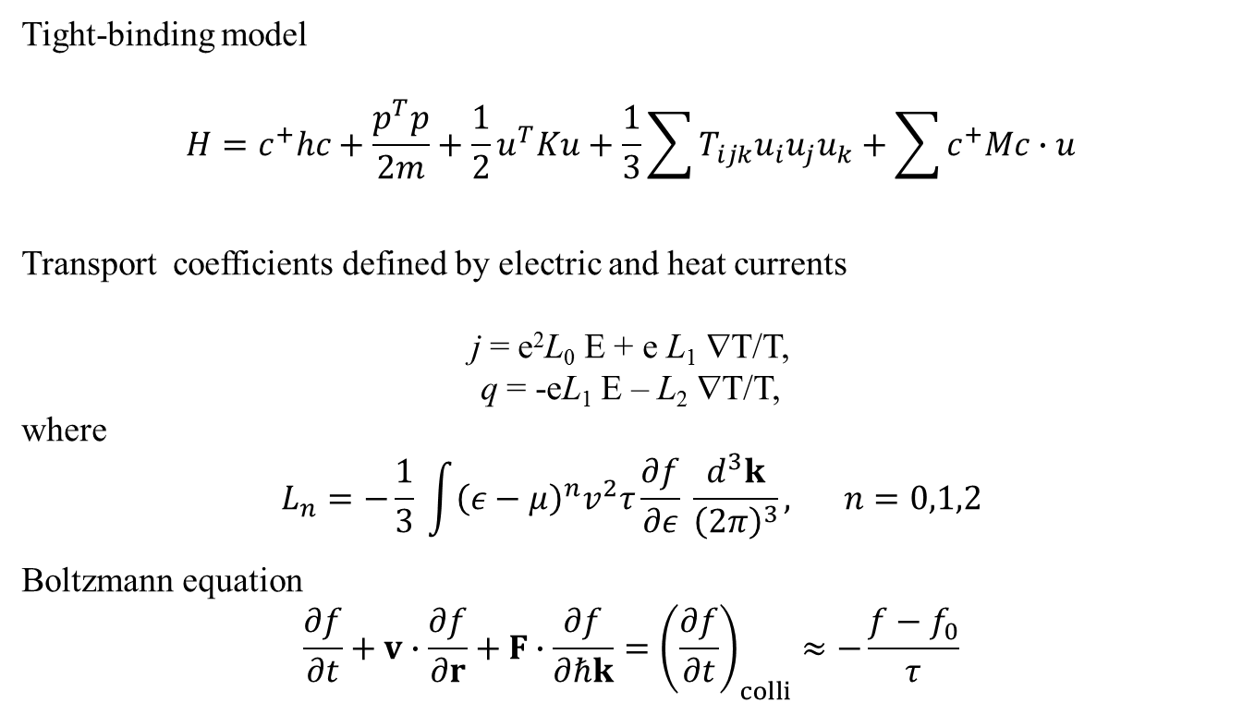
Boltzmann approach to transport
Tight-binding model
$$H=c^{+}hc+\frac{p^{T}p}{2m}+\frac{1}{2}u^{T}Ku+\frac{1}{3}\sum{T_{ijk}u_{i}u_{j}u_{k}}+\sum{c^{+}Mc∙u}$$
Transport coefficients defined by electric and heat currents
j = e²L₀ E + e L₁ ∇T/T,
q = -eL₁ E – L₂ ∇T/T,
where
$$L_{n}=−\frac{1}{3} \int{{\left(ε−μ\right)}^{n}v^{2}τ\frac{∂f}{∂ε} \frac{d^{3}k}{{\left(2π\right)}^{3}}, } n=0,1,2$$
Boltzmann equation
$$\frac{∂f}{∂t}+v∙\frac{∂f}{∂r}+F∙\frac{∂f}{∂ℏk}={\left(\frac{∂f}{∂t}\right)}_{colli}≈−\frac{f−f_{0}}{τ}$$

Slide 15
Green-Kubo & Kubo-Greenwood formulas
Notes:
Green-Kubo approach, see R. Kubo, M. Toda, N. Hashitsume, “Statistical Physics II.” See my own handwritten notes on the derivation of Kubo-Greenwood formula.s

Slide 16
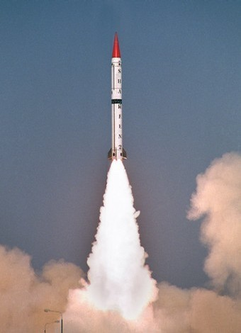
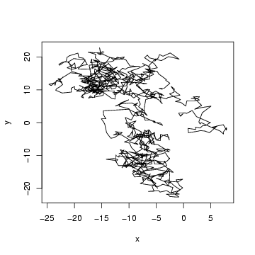
Diffusive transport vs ballistic transport
t
Notes:
We recall Brownian motion, Langevin equation and Fokker-Planck equations, Einstein formula, etc. See book by, e.g., N Pottier, “Nonequilibrium statistical physics.”

Slide 17
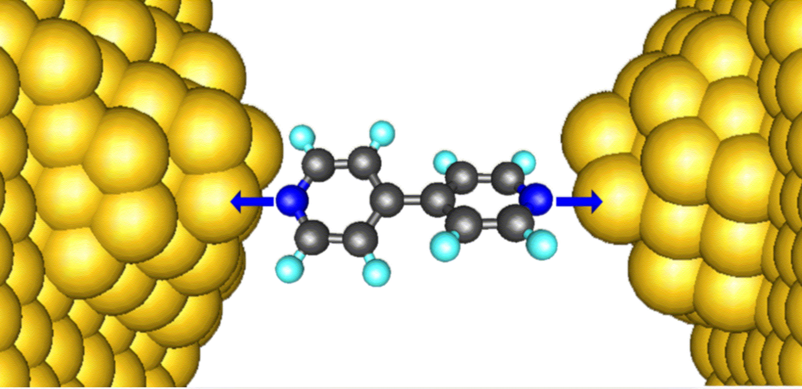
Thermal conductance
Notes:
For near zero-dimensional systems like this, we need a different perspective of physical quantities, like thermal conductance G.

Slide 18
Experimental report of Z Wang et al (2007)
The experimentally measured thermal conductance is 50pW/K for alkane chains at 1000K, From Z Wang et al, Science 317, 787 (2007).

Slide 19
“Universal” thermal conductance
Rego & Kirczenow, PRL 81, 232 (1998).
M = 1

Slide 20
Landauer formula
Scatter-ing center
Left lead/bath TL
Right lead/bath TR
See: S Datta, “Electronic transport in mesoscopic systems”
Notes:
By convention, I_L is the current out of the left bath. Why we need to divide by 2π, not pi or other factor? Since the temperature of the left and right can be any value in the Bose function f, this is a nonlinear response current. We give a derivation in late lectures from NEGF. Another approach is scattering picture approach, see my first review in EPJB.

Slide 21
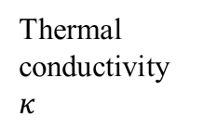

From ballistic to diffusive
Thermal conductivity $κ$
?
System linear dimension L
MFP $l$
Notes:
This is a research topic of current interests, see many of contributions from Prof. Li Baowen’s group.

Slide 22
Phonon Hall effect
B
Experiments by C Strohm et al, PRL (2005), also confirmed by AV Inyushkin et al, JETP Lett (2007). Effect is small |T₄ –T₃| ~ 10⁻⁴ kelvin in a strong magnetic field of few tesla, performed at low temperature of 5.45 K.
T₄
T₃
Tb₃Ga₅O₁₂
∇T
5 mm

Slide 23
Ballistic model of phonon Hall effect
H is not positive-definite
Notes:
See Lifa Zhang’s papers, e.g., New J. Phys. 11, 113038 (2009).

Slide 24
Revised positive-definite Hamiltonian
H is formally the same as ionic crystal in a magnetic field

Slide 25
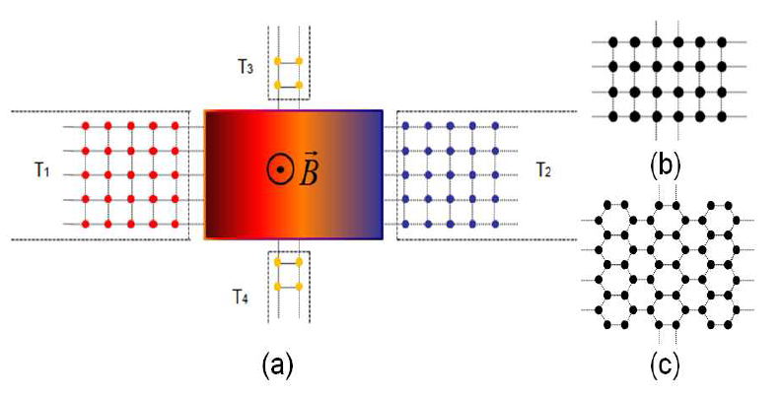
Four-terminal junction structure, NEGF
R=(T₃ -T₄)/(T₁ –T₂).

Slide 26
Hamiltonian for the four-terminal junction

Slide 27
The energy current

Slide 28
Linear response regime

Slide 29
Problems for lecture one
Derive the electron conductivity σ formula (slide 6) following Ashcroft/Mermin.
Give a hand-waving derivation of the kinetic theory formula for thermal conductivity κ (slide 8).
Give a derivation of the thermal conductivity (generalized to sum over the phonon modes) based on Boltzmann equation (slides 14) with single mode relaxation approximation.
Notes:
These are more or less trivial.

Slide 30
Derive the “universal” conductance formula (slide 19) from the Landauer formula, assuming a unit transmission T [ω]=1.
Generalize Landauer formula so that it smoothly interpolates between ballistic regime and diffusive regime [hint: J Wang, J-S Wang APL (2006)].
Derive the Kubo-Greenwood formula (slide 15) .
Notes:
Answer to problem 6 is in my handwritten notes. It is long.

Slide 31
end of lecture one

Slide 32
Lecture Two
History, definitions, properties of NEGF

Slide 33
A Brief History of NEGF
Schwinger 1961
Kadanoff and Baym 1962
Keldysh 1965
Caroli, Combescot, Nozieres, and Saint-James 1971
Meir and Wingreen 1992
Notes:
Schwinger introduced earliest g<, g>, g^t, g^t_bar. Kadanoff and Baym had their famous book “quantum statistical mechanics”, Keldysh emphasized the contour order and its usefulness for diagrammatic expansion, Caroli perhaps first apply to transport, and we now have the Meir-Wingreen formula for current when the center is interactive.

Slide 34
Equilibrium Green’s functions using a harmonic oscillator as an example
Single mode harmonic oscillator is a very important example to illustrate the concept of Green’s functions as any phononic system (vibrational degrees of freedom in a collection of atoms) at ballistic (linear) level can be thought of as a collection of independent oscillators in eigenmodes. Equilibrium means that system is distributed according to the Gibbs canonical distribution.

Slide 35
Harmonic Oscillator
k
m
Notes:
du/dt = sqrt(hbar/(2Omega)) ( - a + a\dagger) (i Omega). The harmonic oscillator is also fundamental in the quantum field of photon, e.g.

Slide 36
Eigenstates, Quantum Mech/Stat Mech

Slide 37
Heisenberg Operator/Equation
O: Schrödinger operator
O(t): Heisenberg operator

Slide 38
Defining >, <, t, Green’s Functions
Notes:
Derive the last equation from the top definition.

Slide 39
Notes:
T, Ť are called super-operator, as it act on the operator, not in the vector of Hilbert space. What to define for theta(0) is a bit arbitrary/controversy.

Slide 40
Retarded and Advanced Green’s functions

Slide 41
Fourier Transform
Notes:
We use the convention that planewave is exp(ik.r – i ωt).

Slide 42
Plemelj formula, fluctuation-dissipation, Kubo-Martin-Schwinger condition
P for Cauchy principle value
Valid only in thermal equilibrium

Slide 43
Matsubara Green’s Function
Notes:
What periodicity/boundary do we have for fermion?

Slide 44
Nonequilibrium Green’s Functions
By “nonequilibrium”, we mean, either the Hamiltonian is explicitly time-dependent after t₀, or the initial density matrix ρ is not a canonical distribution.
We’ll show how to build nonequilibrium Green’s function from the equilibrium ones through product initial state or through the Dyson equation.

Slide 45
Definitions of General Green’s functions (phonon/displacement)
Notes:
Other types such as Matsubara Green’s function or canonical (Kubo) correlation are also used. i = sqrt(-1). The average < … > can be equilibrium or with respect to arbitrary density matrix. For classical systems, G< = G>.
45

Slide 46
Relations among Green’s functions
Notes:
The relation implies two (three?) linearly independent ones, and one independent one only if nonlinear dependence is considered. Does self-energy has similar relations?
46

Slide 47
Steady state, Fourier transform
Notes:
The inverse Fourier transform has a factor of 2 . We use square brackets [ ] to denote Fourier transformed function. For more general relation of Gr and Ga, see my handwritten notes on NEGF for electrons.
47

Slide 48
Equilibrium Green’s Function, Lehmann Representation
Notes:
Lehmann representation is to expand everything in the eigenstates.

Slide 49
Kramers-Kronig Relation
Notes:
G^a is when z -> w – I eta.

Slide 50
Eigen-mode Decomposition
Notes:
Only for finite system, in equilibrium? See a nice summary in appendix of Phys Rev B. 80 205429 (2009).

Slide 51
Pictures in Quantum Mechanics
Schrödinger picture: O, (t) =U(t,t₀)(t₀)
Heisenberg picture: O(t) = U(t₀,t)OU(t,t₀) , ρ₀, where the evolution operator U satisfies
See, e.g., Fetter & Walecka, “Quantum Theory of Many-Particle Systems.”
Notes:
< . > = Tr(ρ . ). T here denotes time order, assuming t > t’. Anti-time order if t < t’.
51

Slide 52
Calculating correlation
B
A
t₀
t’
t
Notes:
t₀ is the synchronization time where the Schrödinger picture and Heisenberg picture are the same.
52

Slide 53
Evolution Operator on Contour

Slide 54
Contour-ordered Green’s function
Contour order: the operators earlier on the contour are to the right. See, e.g., H. Haug & A.-P. Jauho.
τ’
τ
t₀
Notes:
54

Slide 55
Relation to other Green’s function
τ’
τ
t₀
Notes:
σ = + for the upper branch, and – for the returning lower branch.
55

Slide 56
An Interpretation
G is defined with respect to Hamiltonian H and density matrix ρ and assuming Wick’s theorem.
Notes:
This is originally due to Schwinger.

Slide 57
Definition of Green’s function for electrons
We refer to the NEGF electron handwritten notes for this part

Slide 58
Green’s function for photons
A: vector potential (component A^{α}),
V: volume,
e: polarization vector.
Notes:
Epsilon_0 is dielectric constant of the vacuum.

Slide 59
Problems for lecture two
Express the annihilation operator a and creation operator a⁺ by the position operator x and momentum operator p (slide 35). Why they have to be that form?
Compute the thermal average values <aa>, <a⁺a⁺>, <aa⁺>, and <a⁺a> for the simple harmonic oscillator (slide 36).
For the harmonic oscillator, work out the expressions for various Green’s functions defined in terms of a, a⁺, instead of u (slide 38 - 40). Discuss the advantage and disadvantage of both. [Hint: Piet Brower’s lecture notes, “Theory of many-particle systems”.]
Notes:
http://www.physics.udel.edu/~bnikolic/QTTG/shared/reviews/brouwer_notes.pdf

Slide 60
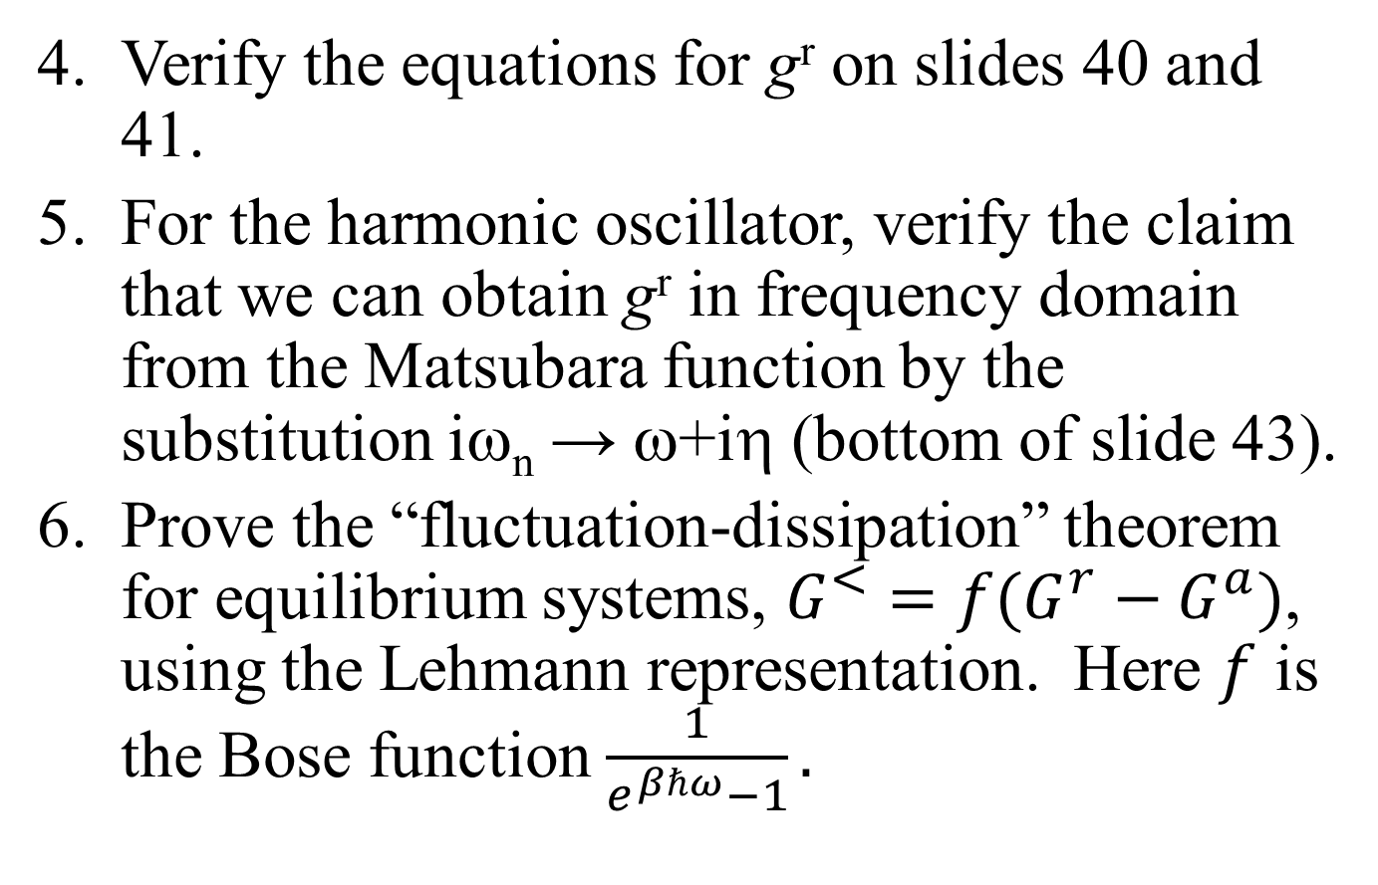
Verify the equations for g^{r} on slides 40 and 41.
For the harmonic oscillator, verify the claim that we can obtain g^{r} in frequency domain from the Matsubara function by the substitution iω_{n} → ω+iη (bottom of slide 43).
Prove the “fluctuation-dissipation” theorem for equilibrium systems, $G^{<}=f(G^{r}−G^{a})$, using the Lehmann representation. Here $f$ is the Bose function $\frac{1}{e^{βℏω}−1}.$

Slide 61
Prove the Kramers-Kronig relation and state the condition needed for its validity (slide 49).
Explain the meaning of slide 54 from first line to the second line.
Derive the retarded Green’s function of photon for a free field (no interaction) and discuss how it differs from the time-ordered one (at zero temperature) [Hint. Mahan, “Many-particle physics”,3rd ed, Chap.2.10]

Slide 62
end of lecture two

Slide 63
Lecture three
Calculus on contour, equation of motion method, current, etc
Notes:
This lecture is the real meat of NEGF.

Slide 64
Calculus on the contour
Integration on (Keldysh) contour
Differentiation on contour
Notes:
dτ is σdt for integration, but just dt in differentiation. σ is either just the sign + or -, or +1, -1.
64

Slide 65
Theta function and delta function
Theta function
Delta function on contour
where θ(t) and δ(t) are the ordinary Heaviside theta and Dirac delta functions
Notes:
65

Slide 66
Transformation/Keldysh Rotation
Notes:
Also properly known as Larkin-Ovchinikov transform, JETP 41, 960 (1975).

Slide 67
Convolution, Langreth Rule
Notes:
The last two equations are known as Keldysh equations.

Slide 68
Equation of Motion Method
The advantage of equation of motion method is that we don’t need to know or pay attention to the distribution (density operator) ρ. The equations can be derived quickly.
The disadvantage is that we have a hard time justified the initial/boundary condition in solving the equations.

Slide 69
Heisenberg Equation on Contour
Notes:
The integral on the exponential is from a point tau_1 specified on the contour to tau_2 at a later point on the contour. The integral is along the contour.

Slide 70
Express contour order using theta function
Operator A(τ) is the same as A(t) as far as commutation relation or effect on wavefunction is concerned
Notes:
u u^{T} is a square matrix, and [u, v^{T}] is a matrix formed by (j,k) element [u_{j}, v_{k}].
70

Slide 71
Equation of motion for contour ordered Green’s function
Notes:
We use the equation of motion d²u/dt² = -Ku.
71

Slide 72
Equations for Green’s functions
Notes:
72

Slide 73
Solution for Green’s functions
c and d can be fixed by initial/boundary condition.
Notes:
Note that if ax = b, x = b/a, but not if a = 0, in that case, x = infinity, thus, the Dirac delta function.
73

Slide 74
Junction system, adiabatic switch-on
  g_{α} for isolated systems when leads and centre are decoupled
  G0 for ballistic system
  G for full nonlinear system
H_{L}+H_{C}+H_{R} +V +H_{n}
H_{L}+H_{C}+H_{R} +V
G
H_{L}+H_{C}+H_{R}
G₀
g_{α}
t = − ∞
Equilibrium at T_{α}
t = 0
Nonequilibrium steady state established
74
Notes:
Two adiabatic switch-on’s.
74

Slide 75
Sudden Switch-on
H_{L}+H_{C}+H_{R} +V +H_{n}
Green’s function G
H_{L}+H_{C}+H_{R}
g_{α}
t = − ∞
Equilibrium at T_{α}
t = ∞
t =t₀
Nonequilibrium steady state established
75
Notes:
Two adiabatic switch-on’s.
75

Slide 76
Three regions
76
Notes:
76

Slide 77
Heisenberg equations of motion in three regions
77
Notes:
77

Slide 78
Force Constant Matrix

Slide 79
Relation between g and G0
Equation of motion for GLC
Notes:
In obtaining G_{LC}, an arbitrary function satisfying (d/dtau^2 + K^{L}) f = 0 is omitted. Absence of this term is consistent with adiabatic switch-on from Feynman diagrammatic expansion.
79

Slide 80
Dyson equation for GCC
Notes:
In this derivation, we assume H_{n} = 0.
80

Slide 81
Equation of Motion Way (ballistic system)

Slide 82
The Langreth theorem
Notes:
Need to use the relation between G⁺⁺, G⁻ ⁻, G⁺⁻, and G⁺⁻ with G^{r} and G<. See Haug & Jauho, page 66.
82

Slide 83
Dyson equations and solution
Notes:
In deriving the last line, we use the fact (g^{r})⁻¹ g< = 0.
83

Slide 84
Energy current
Notes:
I_{L} is energy flowing out of the left lead into the center. This expression can be proving to be real, no need to take Re. Above equation works for general nonlinear case.
84

Slide 85
Meir-Wingreen formula, symmetric form
Notes:
What is the electronic current analogue of this equation?

Slide 86
Landauer/Caroli formula
Notes:
The symmetrization appears necessary to get the Caroli formula. Caroli formula is valid only for ballistic case where H_{n} = 0.
86

Slide 87
1D calculation
In the following we give a complete calculation for a simple 1D chain (the baths and the center are identical) with on-site coupling and nearest neighbor couplings. This example shows the steps needed for more general junction systems, such as the need to calculate the “surface” Green’s functions.

Slide 88
Ballistic transport in a 1D chain
Force constants
Equation of motion
Notes:
The matrix K is infinite in both directions.
88

Slide 89
Solution of g
Notes:
K^{R} is semi-finite, V is nonzero only at the corner.
89

Slide 90
Lead self energy and transmission
T[ω]
1
ω
Notes:
Σ_{R} is nonzero only for the lower right corner.
90

Slide 91
Heat current and conductance
Notes:
The last formula σ is called universal conductance.
91

Slide 92
General recursive algorithm for g
Notes:
The algorithm is due to Lopez Sancho et al (1985). Typically, 10 to 20 iterations should be already converged. For real fortran codes, see http://staff.science.nus.edu.sg/~phywjs/NEGF/balli.tar.gz
92

Slide 93
Problems for lecture three
Work out the detail of Keldysh rotation and Langreth rules (slide 66,67).
On slide 69, what is the meaning of t₀⁺? And why we need to define Heisenberg operator starting at the same point?
Derive the integral form of equation from the differential form for G_{LC} (slide 79) and state clearly the implicit assumption made for the validity of the integral form.

Slide 94
On slide 73, how to fix the constants c and d for the retarded, advanced, and time-ordered Green’s functions?
Derive the contour ordered Dyson equation, slides 78-80.
Derive the two different forms of Keldysh equations on bottom of slide 83.
Derive the Meir-Wingreen formula and the Caroli formula (slide 84 - 86).
Verify the results on slide 89-90 for 1D chain. In particular, show that the transmission function T[ω]=1.

Slide 95
end of lecture three

Slide 96
Lecture four
Feynman diagrammatic expansion, Hedin equations
Notes:
The last set of lecture slides are sketchy due to lack of preparation time.

Slide 97
Diagrammatic representation of expansion results, e.g., Meyer expansion for equation of states
Grant potential:
Ξ = 1 + x [ o ] + ½! x² [ o o + o---o] + 1/3! x³ [ …. ]
ln Ξ = x [ o ] + ½! x² [ o---o] + 1/3! x³ [ …. ]
Equation of state
o o---o
pV/(k_{B}T) = N – 1/2 [ o---o] – 1/3 [ o---o] – 1/8 [ 3 o---o + …]

Slide 98
Diagrammatics in higher order quantum master equations
Diagrams representing the terms for current `V or [X ^{T},V]. Open circle has time t=0, solid dots have dummy times. Arrows indicate ordering and pointing from time -∞ to 0. Note that (4) is cancelled by (c); (7) by (d).
From Wang, Agarwalla, Li, and Thingna, Front. Phys. (2013), DOI: 10.1007/s11467-013-0340-x.

Slide 99
Feynman diagrammatic method
The Wick theorem
Cluster decomposition theorem, factor theorem
Dyson equation
Vertex function
Vacuum diagrams and Green’s function
Notes:
What is the basis of the validity of Wick theorem?

Slide 100
Handling interaction
Transform to interaction picture, H = H₀ + H_{n}
Notes:
For the concept of pictures and relations among them, see A. L. Fetter and J. D. Walecka, “Quantum theory of many-body systems”, McGraw-Hill, 1971. The meaning of t₀ and t’ is quite different. t₀ is such that three pictures are equivalent, t’ is an arbitrary time. Note that ρ behaves like |><|.
100

Slide 101
Scattering operator S
Notes:
A(t) and B(t’) are in interaction picture (i.e. A_{I}(t) etc).
101

Slide 102
Contour-ordered Green’s function
τ’
τ
t₀
Notes:
Another possible representation of the result is using Feynman path integral formulation.
102

Slide 103
Perturbative expansion of contour ordered Green’s function
Notes:
Every operator is in interaction picture, dropped superscript I for simplicity. The Wick theorem is valid if the expectation < … > is with respect to a quadratic weight. For a proof, see Rammer.
103

Slide 104
General expansion rule
Single line
3-line vertex
n-double line vertex

Slide 105
Diagrammatic representation of the expansion
=
+ 2iħ
+ 2iħ
+ 2iħ
=
+
Notes:
Due to the last term, G should be read as connected part G_c only in the Dyson equation. The Dyson equation here is wrong – one need to subtract the disconnected part, which is not zero.
105

Slide 106
Self -energy expansion
Σ_{n} =
Notes:
The self-energy diagrams are obtained by including all doubly or more connected diagrams removing the two external legs from the Green’s function diagrams. For a more systematic exposition of the Feynman-diagrammatic expansion, see Fetter and Welecka. hbar was set to 1 in the diagrams.
106

Slide 107
Explicit expression for self-energy
Notes:
See also figure 3 in J.-S. Wang, X. Ni, and J.-W. Jiang, Phys. Rev. B 80, 224302 (2009).
107

Slide 108
One-Point Green’s Function
Notes:
From Jingwu Jiang’s PRB.

Slide 109
Average displacement, thermal expansion
One-point Green’s function
Notes:
The idea of calculating the thermal expansion coefficient this way due to Jiang Jinwu.
109

Slide 110
“Partition Function”

Slide 111
Diagrammatic Way
Feynman diagrams for the nonequilibrium transport problem with quartic nonlinearity. (a) Building blocks of the diagrams. The solid line is for g_{C}, wavy line for g_{L}, and dash line for g_{R}; (b) first few diagrams for ln Z; (c) Green’s function G⁰_{CC}; (d) Full Green’s function G_{CC}; and (e) re-sumed ln Z where the ballistic result is ln Z₀ = (1/2) Tr ln (1 –g_{C}Σ). The number in front of the diagrams represents extra combinatorial factor.

Slide 112
Electron phonon interaction
Free electrons + free phonons + ep interactions
G₀
Vertex M
D₀

Slide 113
Hedin equations
Notes:
The idea of Hedin is that use functional derivatives, the complete diagrammatic expansion with infinite many different diagrams can be encapsulated with few lines of algebraic/integral equations, as if they are close set of equations. These functions involved the Green’s functions, self-energies, and vertex functions. The famous WG method the first term in the expansion for coulomb interaction. We need read Hedin’s original PRB paper and other newer papers to understand Hedin equations.

Slide 114
Functional Derivative

Slide 115
Problems for lecture four
Give a proof of the expansion rule on slide 104, using the equation of motion method.
Work out the first few terms of Feynman-Dyson expansion for the (contour ordered) electron Green’s function G and phonon Green’s function D and identify the lowest order self-energies (the Hartree, Fock, and polarization diagrams). Give the explicit expressions in energy/frequency space.

Slide 116
Verify the “one-point” Green’s function result for the T_{ijk} interaction for phonons on slide 109.
Derive the Hedin equations for the electron-phonon system.
Notes:
I have not understood the derivation or have not spend time try. A smart student in the audience should try and give a presentation.

Slide 117
end of lecture four

Slide 118
The end of lectures
These powerpoint slides can be found at http://staff.science.nus.edu.sg/~phywjs
Under the heading of talks (Nanjing-talks.pptx)

