Slide 1
Nonequilibrium Green’s Function Approach to Thermal Transport in Nanostructures
Jian-Sheng Wang
National University of Singapore

Slide 2
Outline
Brief review of theories and computational methods for thermal transport
Report of some of our recent results (MD, ballistic/diffusive transport in nano-tubes)
Nonequilibrium Green’s function method and some results
Conclusion

Slide 3
Thermal Conduction at a Junction
Left Lead, T_{L}
Right Lead, T_{R}
semi-infinite
Junction Part

Slide 4
Approaches to Heat Transport
Molecular dynamics√ /Mode-coupling | Strong nonlinearity | Classical, break down at low temperatures
Green-Kubo formula | Both quantum and classical | Linear response regime, apply to junction?
Boltzmann-Peierls equation | Diffusive transport | Concept of distribution f(t,x,k) valid?
Landauer formula√ | Ballistic transport | T→0, no nonlinear effect
Nonequilibrium Green’s function √ | A first-principle method | Perturbative. A theory valid for all T?

Slide 5
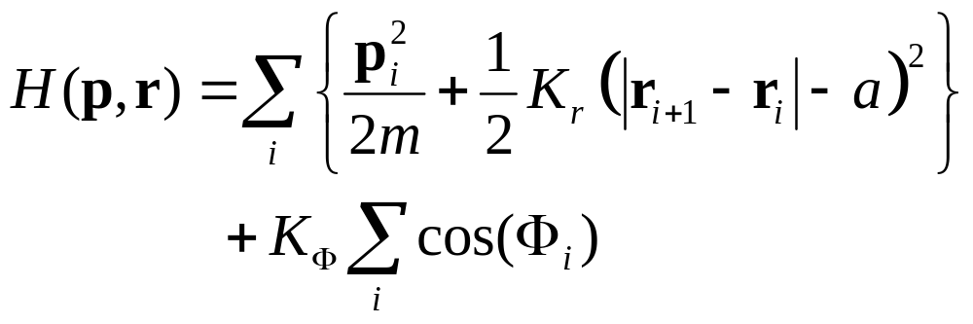
A Chain Model for Heat Conduction
r_{i} = (x_{i},y_{i})
T_{R}
T_{L}
m
Φ_{i}
Transverse degrees of freedom introduced

Slide 6
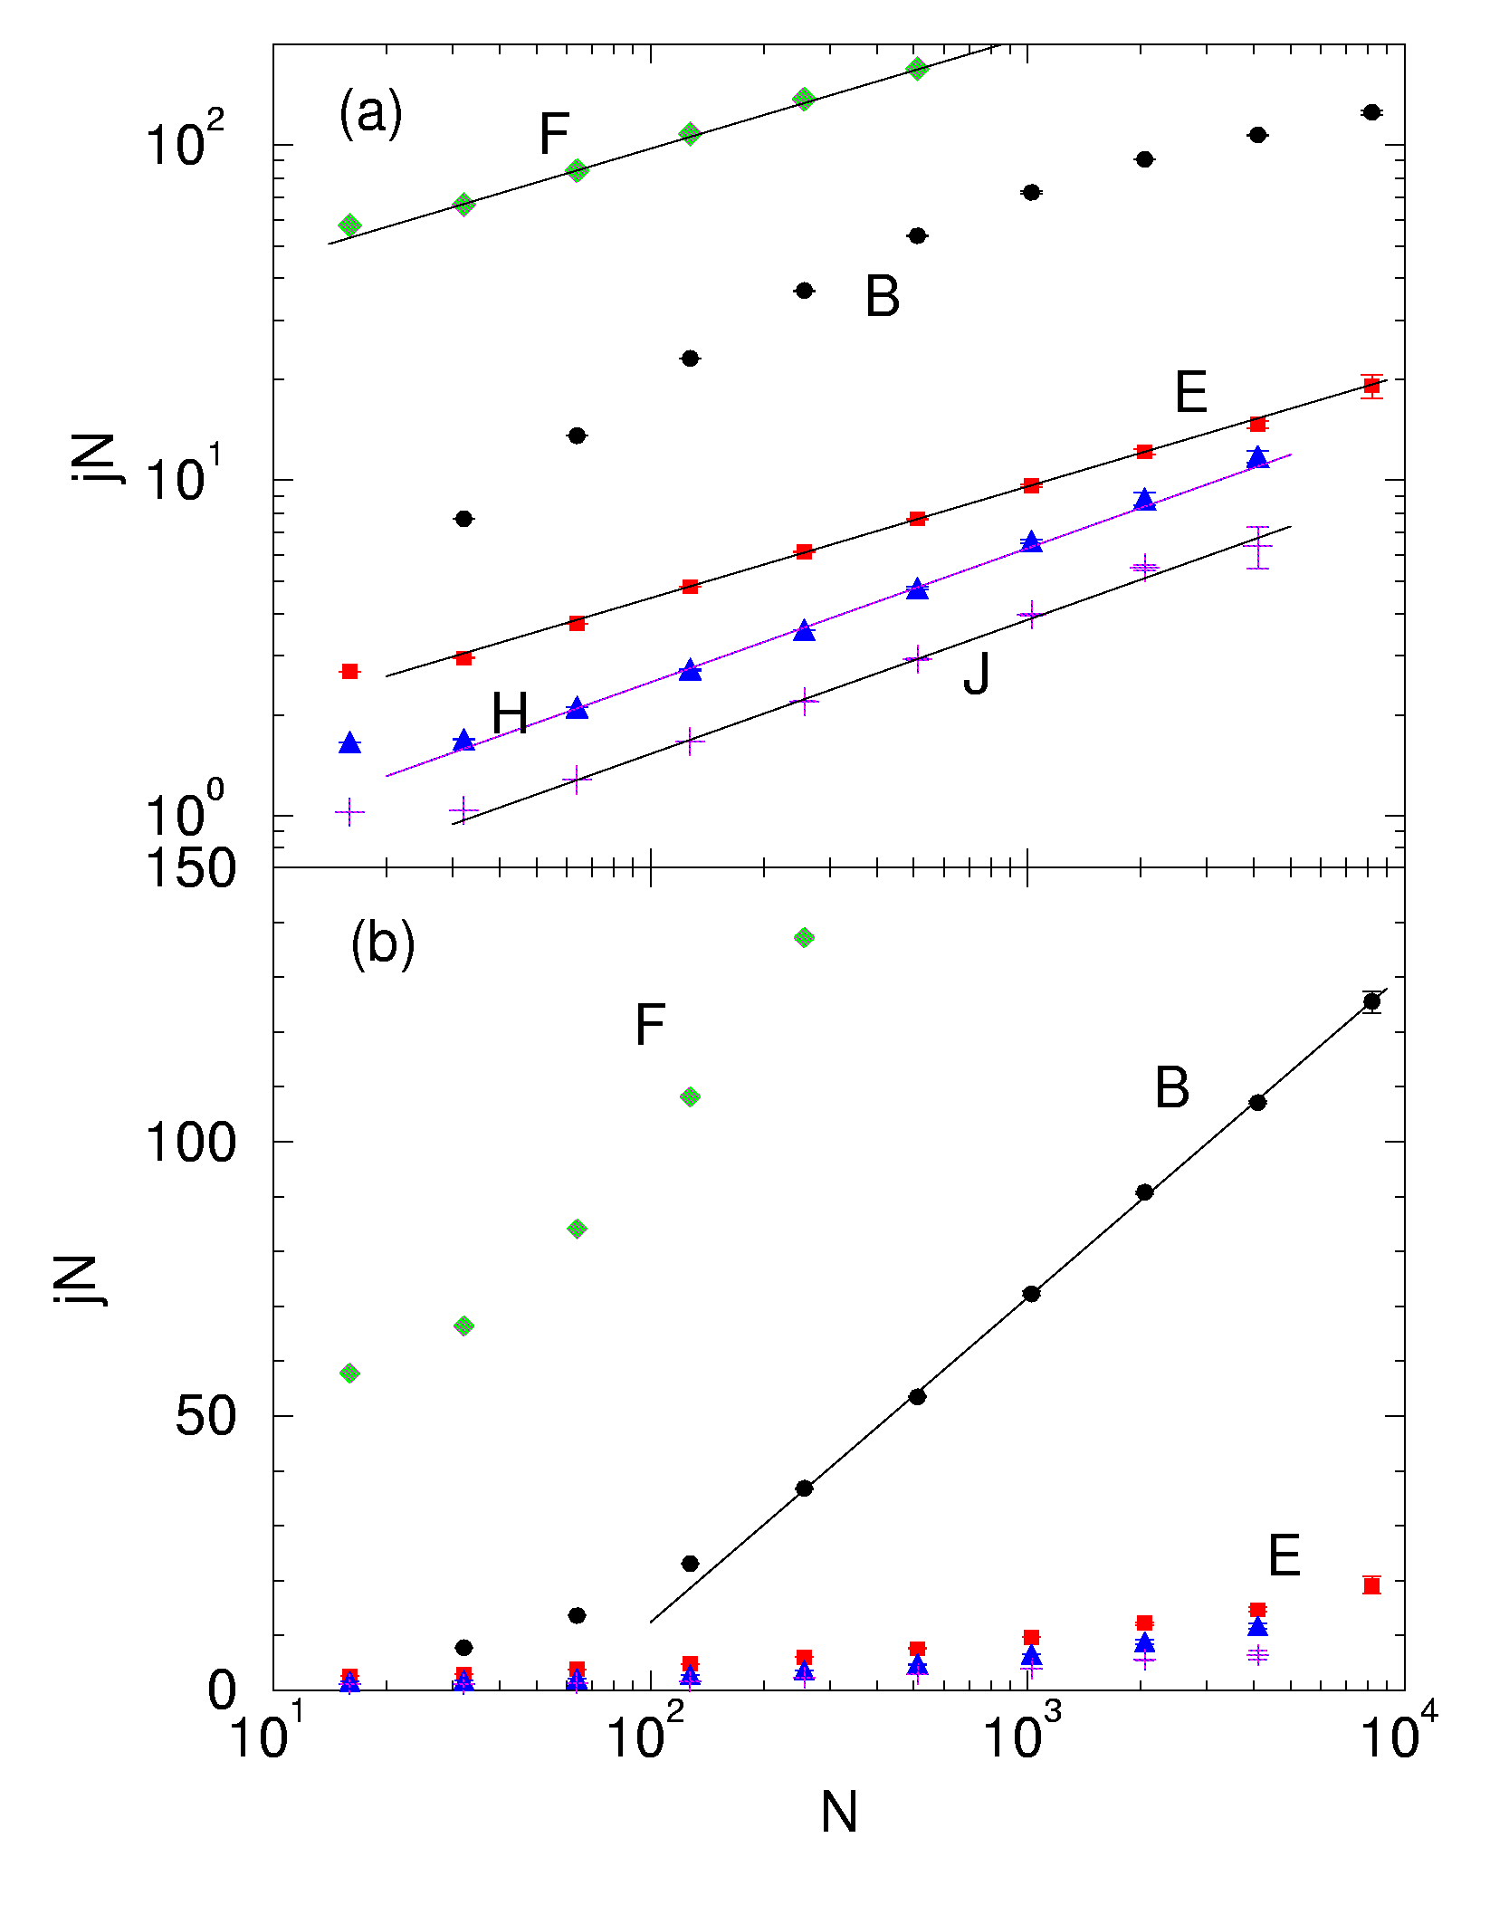
Conductivity vs Size N
Model parameters (K_{Φ}, T_{L}, T_{R}):
Set F (1, 5, 7), B (1, 0.2, 0.4), E (0.3, 0.3, 0.5), H (0, 0.3, 0.5), J (0.05, 0.1, 0.2) ,
m=1, a=2, K_{r}=1.
From J-S Wang & B Li, Phys Rev Lett 92 (2004) 074302; see also PRE 70 (2004) 021204.
slope=1/3
slope=2/5
ln N

Slide 7
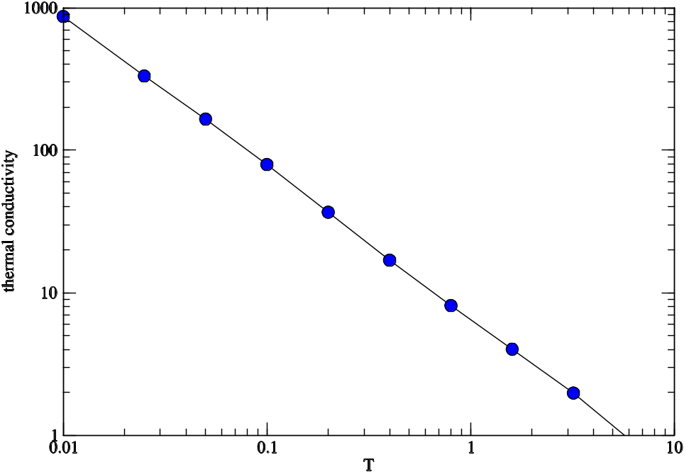
Temperature Dependence of Conductivity in Mode-Coupling Theory
Mode-coupling theory gives a κ ∝ 1/T behavior for a very broad temperature range. Parameters are for model E with size L=8, periodic boundary condition.
J-S Wang, unpublished.

Slide 8
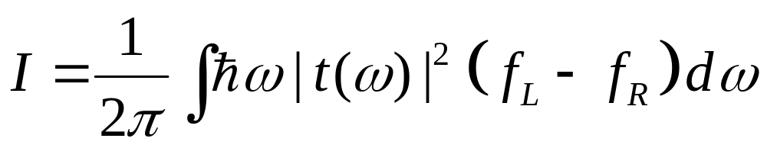
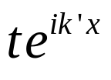
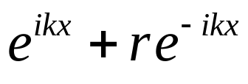
Ballistic Heat Transport at Low Temperature
Laudauer formula for heat current
scatter

Slide 9
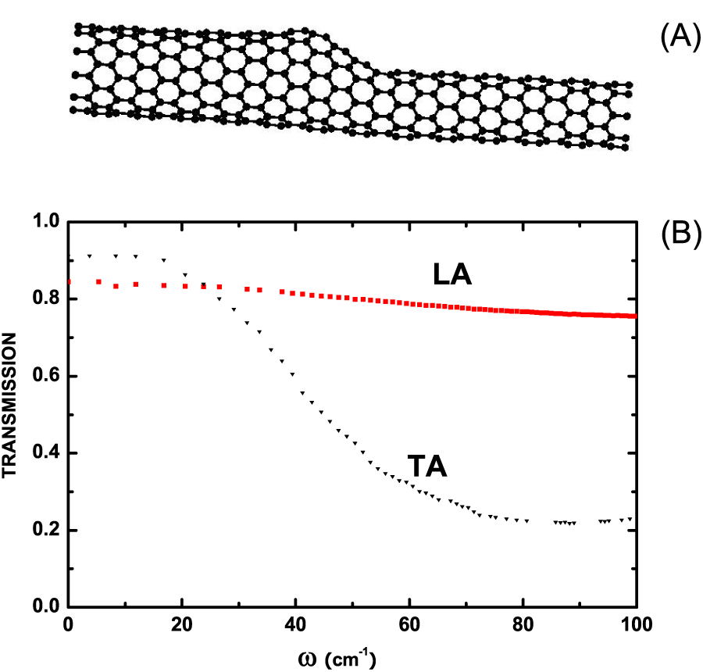
Carbon Nanotube Junction
(A) Structure of (11,0) and (8,0) nanotube junction optimized using Brenner potential.
(B) The energy transition coefficient as a function of angular frequency, calculated using a mode-match/singular value-decomposition.
J Wang and J-S Wang, Phys Rev B, to appear; see also cond-mat/0509092.

Slide 10
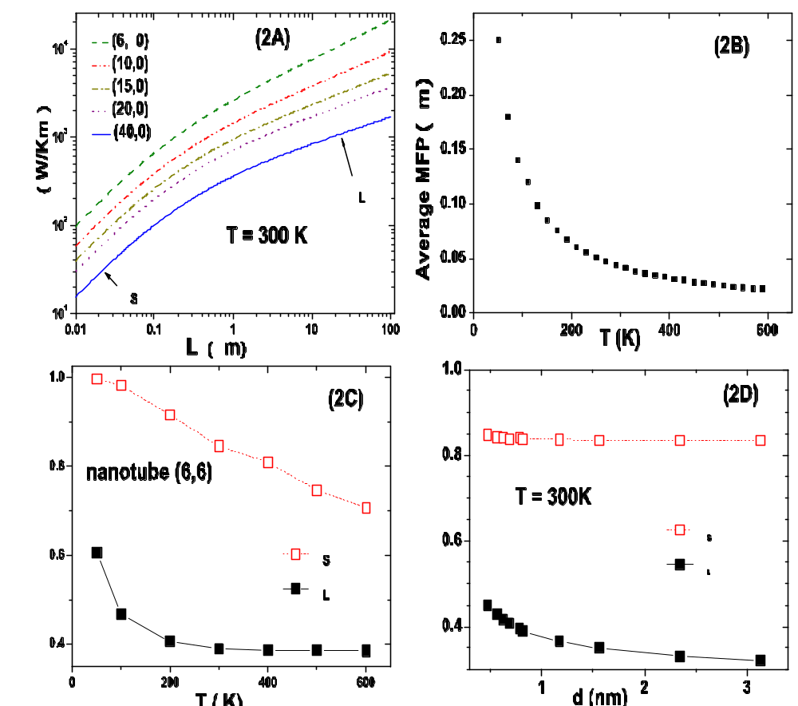
A Phenomenological Theory for Nonlinear Effect
Assuming T[ω] = ℓ₀/(ℓ₀+L), where ℓ₀ is mean-free path, L is system size. Use Umklapp phonon scattering result ℓ₀ ≈ A/(ω²T).
From J Wang and J-S Wang, Appl Phys Lett 88 (2006) 111909.

Slide 11
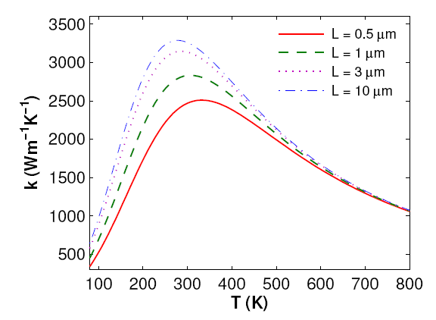
Experimental Results on Carbon nanotubes
From E Pop, D Mann, Q Wang, K Goodson, H Dai, Nano Letters, 6 (2006) 96.

Slide 12
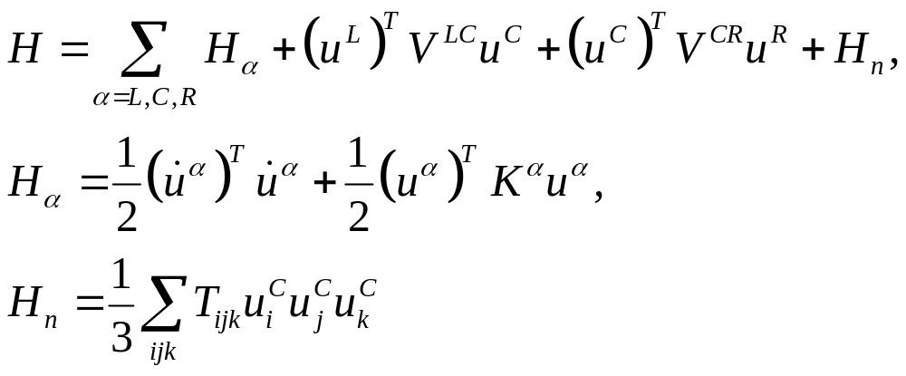
Nonequilibrium Green’s Function Approach
Quantum Hamiltonian:
^{T} for matrix transpose
mass m = 1,
ħ = 1
Left Lead, T_{L}
Right Lead, T_{R}
Junction Part

Slide 13
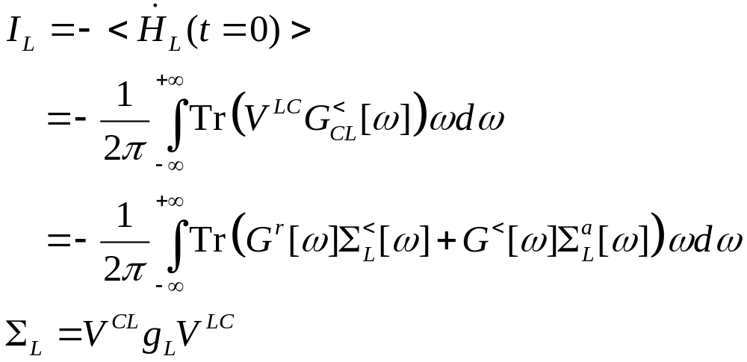
Heat Current
Where G is the Green’s function for the junction part, Σ_{L} is self-energy due to the left lead, and g_{L} is the (surface) green function of the left lead.

Slide 14
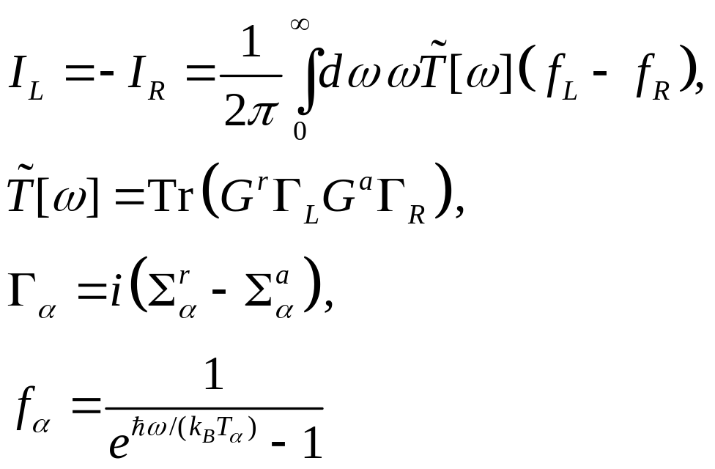
Landauer/Caroli Formula
In elastic systems without nonlinear interaction the heat current formula reduces to that of Laudauer formula:
See, e.g., Mingo & Yang, PRB 68 (2003) 245406.

Slide 15
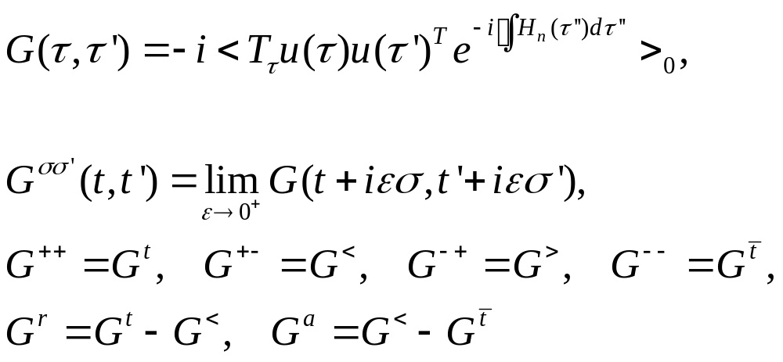
Contour-Ordered Green’s Functions
τ complex plane
See Keldysh, Meir & Wingreen, or Haug & Jauho

Slide 16
Adiabatic Switch-on of Interactions
Governing Hamiltonians
H_{L}+H_{C}+H_{R} +V +H_{n}
H_{L}+H_{C}+H_{R} +V
G
H_{L}+H_{C}+H_{R}
Green’s functions
G₀
g
t = − ∞
Equilibrium at T_{α}
t = 0
Nonequilibrium steady state established

Slide 17
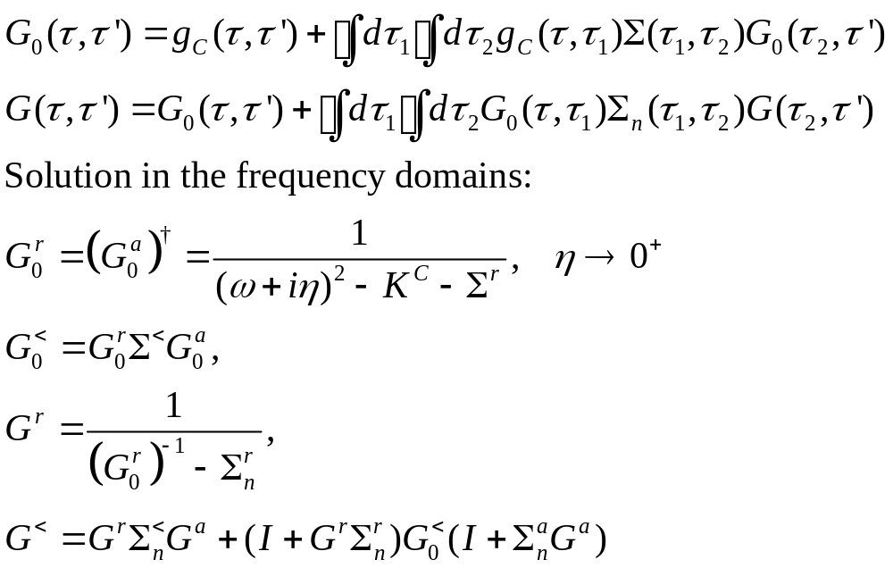
Contour-Ordered Dyson Equations

Slide 18
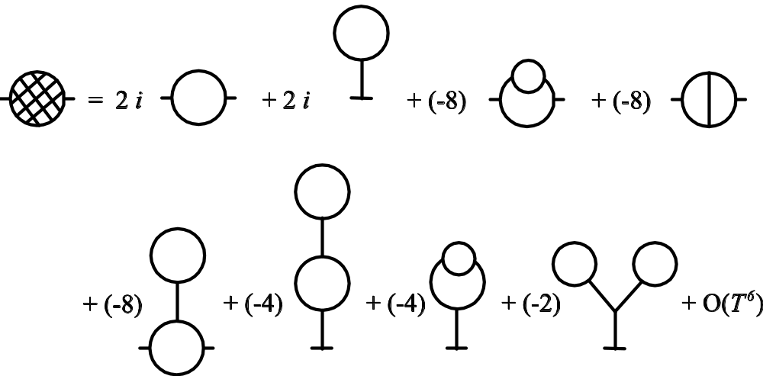
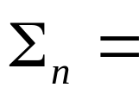
Feynman Diagrams
Each long line corresponds to a propagator G₀; each vertex is associated with the interaction strength T_{ijk}.

Slide 19
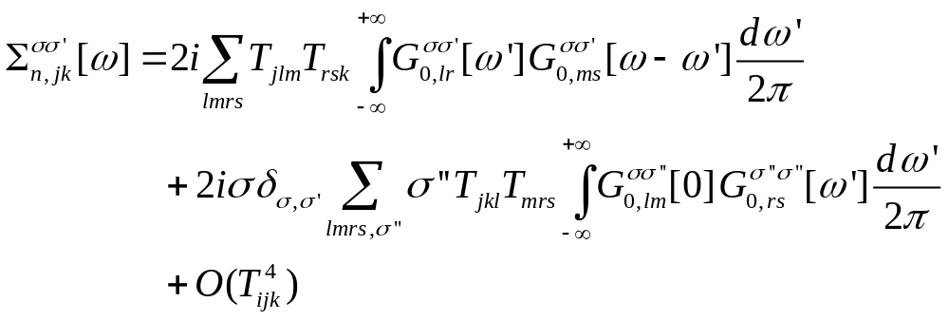
Leading Order Nonlinear Self-Energy
σ = ±1, indices j, k, l, … run over the atom labels

Slide 20
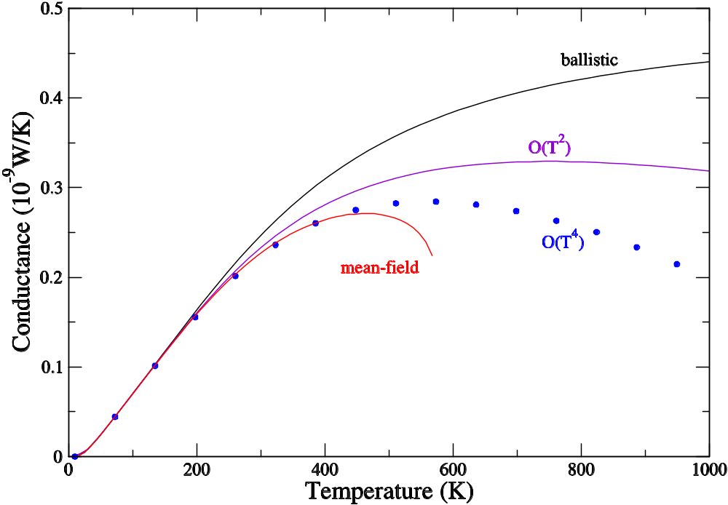
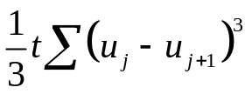
Three-Atom 1D Junction
Thermal conductance
κ = I/(T_{L} –T_{R})
From J-S Wang, J Wang, & N Zeng, Phys Rev B 74, 033408 (2006).
Nonlinear term:
k_{L}=1.56 k_{C}=1.38, t=1.8 k_{R}=1.44

Slide 21
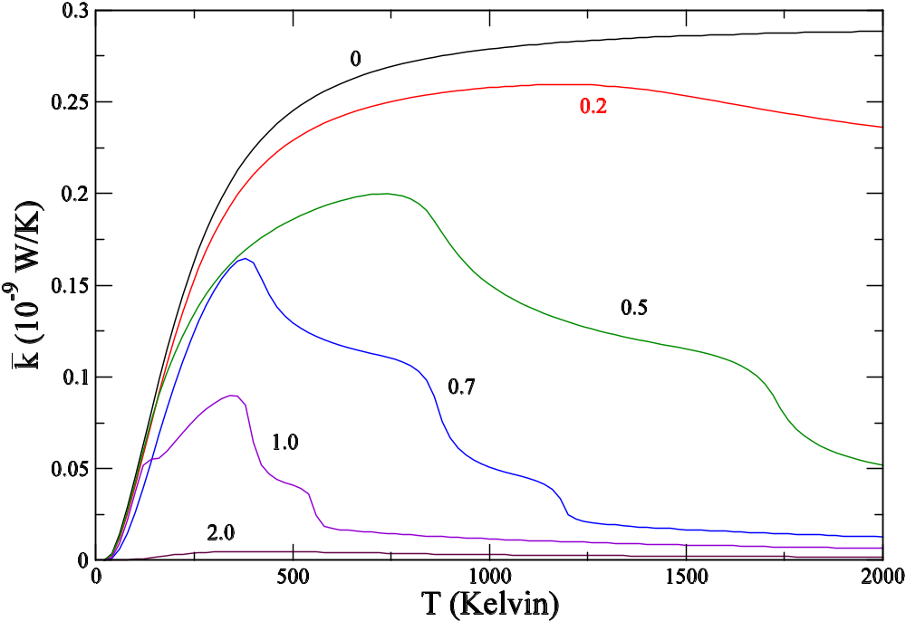
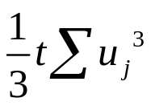
1D Cubic On-Site Model
Thermal conductance as a function of temperature for several nonlinear on-site strength t. N=5. Lowest order perturbation result. J-S Wang, Unpublished.
Nonlinear term:
k_{L}=1.00 k_{C}=1.00 k_{R}=1.00

Slide 22
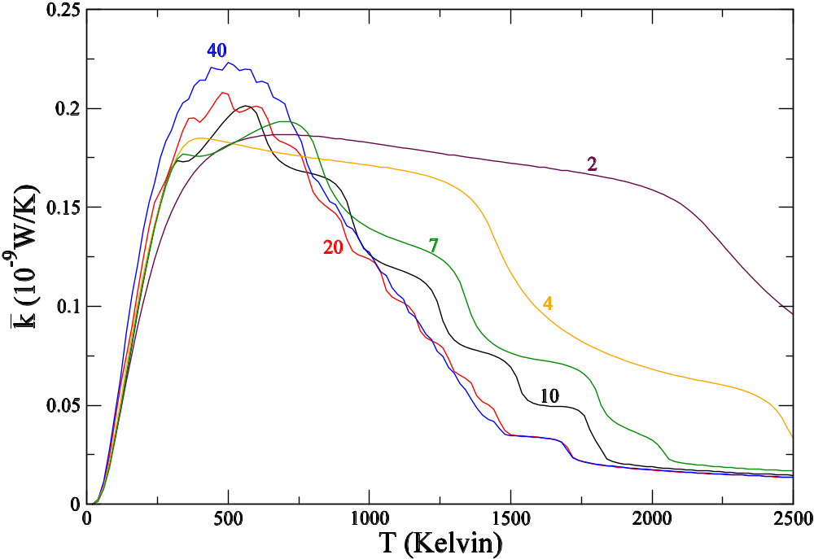
1D Cubic On-Site Model
Thermal conductance dependence on chain length N. Nonlinear on-site strength t= 0.5 [eV/(Å³(amu)^{3/2)}].
J-S Wang, Unpublished.
Nonlinear term:
k_{L}=1.00 k_{C}=1.00 k_{R}=1.00

Slide 23
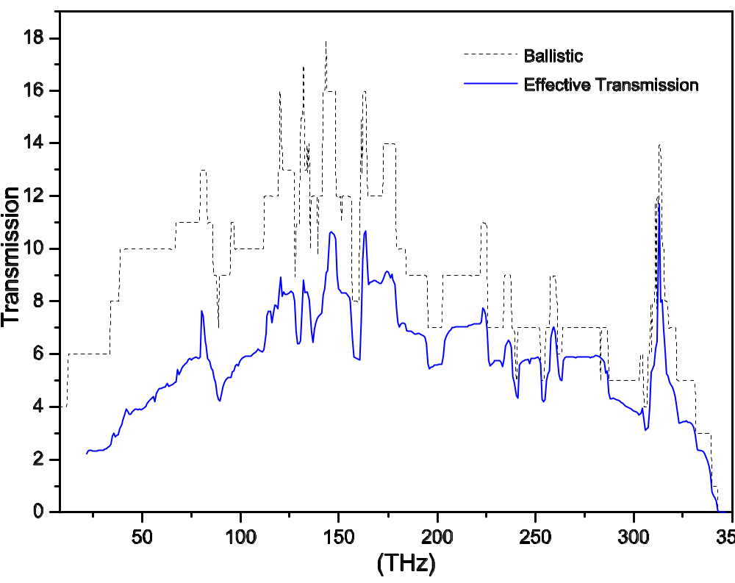
Energy Transmissions
The transmissions in a one-unit-cell carbon nanotube junction of (8,0) at 300 Kelvin.
Phys Rev B 74, 033408 (2006).

Slide 24
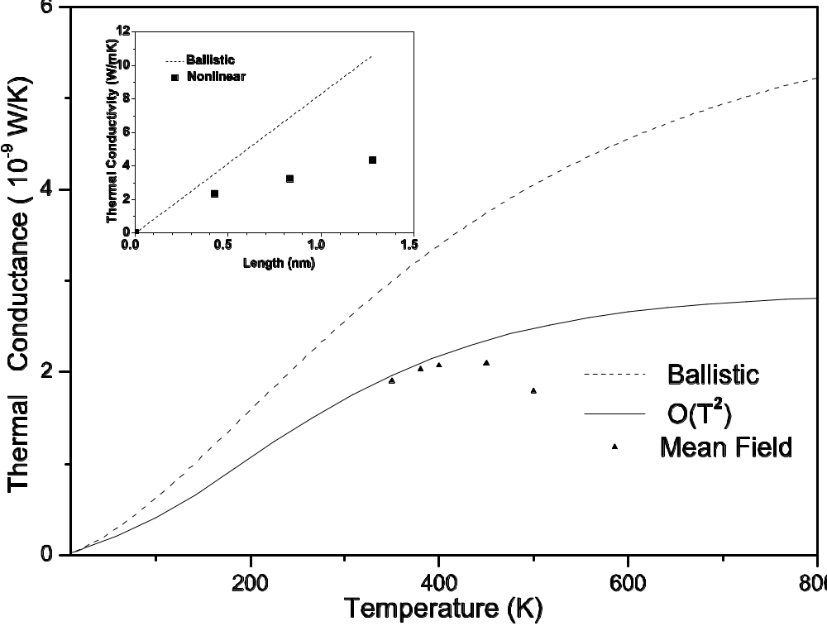
Thermal Conductance of Nanotube Junction
Phys Rev B 74, 033408 (2006).

Slide 25
Conclusion
The nonequilibrium Green’s function method is promising for a truly first-principle approach. Appears to give excellent results up to room temperatures.
Still too slow for large systems.
Need a better approximation for self-energy.

