Slide 1
The phonon Hall effect – NEGF and Green-Kubo treatments
Jian-Sheng Wang,
National University of Singapore

Slide 2
Overview
The phonon Hall effect
NEGF formulism
Green-Kubo formula
Conclusion

Slide 3
Phonon Hall effect
B
Experiments by C Strohm et al, PRL (2005), also confirmed by AV Inyushkin et al, JETP Lett (2007). Effect is small |T₄ –T₃| ~ 10⁻⁴ Kelvin in a strong magnetic field of few Tesla, performed at low temperature of 5.45 K.
T₄
T₃
Tb₃Ga₅O₁₂
∇T
5 mm

Slide 4
Previous theories
L. Sheng, D. N. Sheng, & C. S. Ting, PRL 2006, give a perturbative treatment
Y. Kagan & L. A. Maksimov, PRL 2008, appears to say nonlinearity is required

Slide 5
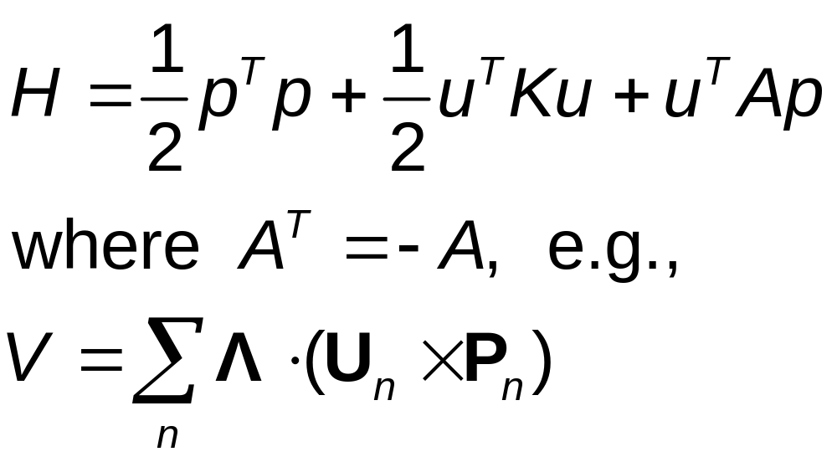
Ballistic model of phonon Hall effect

Slide 6
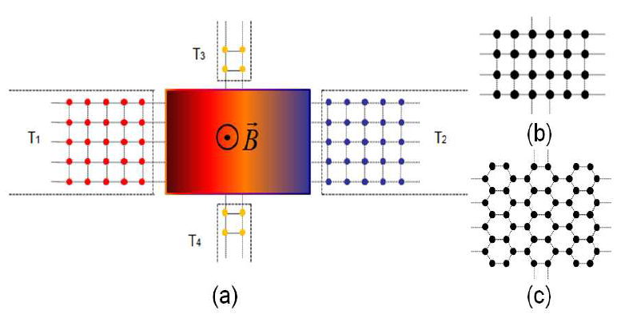
Four-terminal junction structure, NEGF
R=(T₃ -T₄)/(T₁ –T₂).

Slide 7
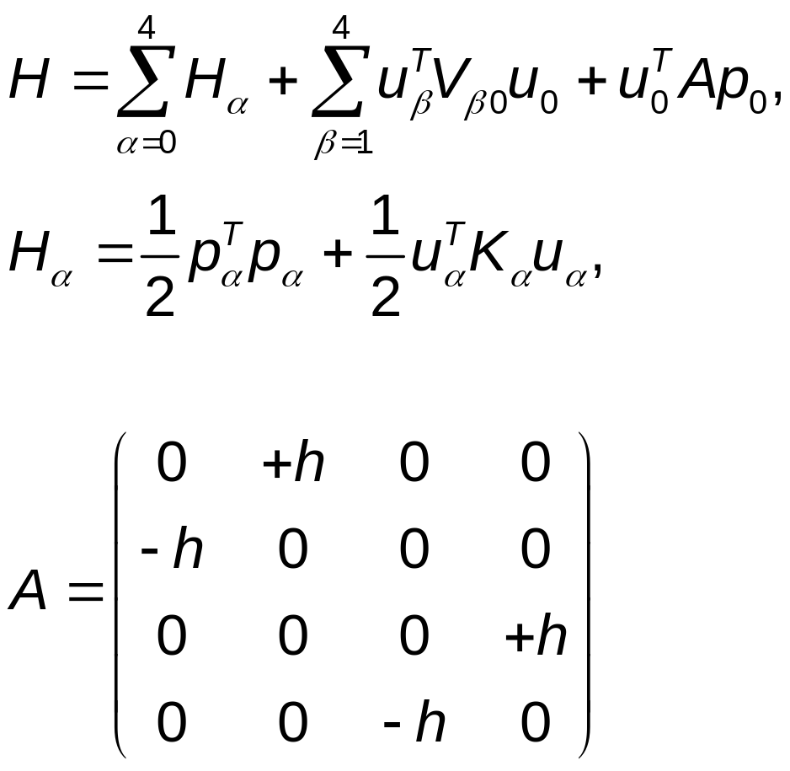
Hamiltonian for the four-terminal junction

Slide 8
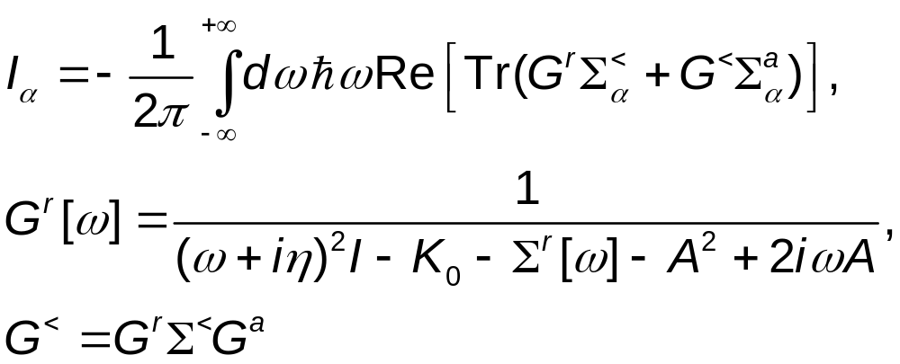
The energy current

Slide 9
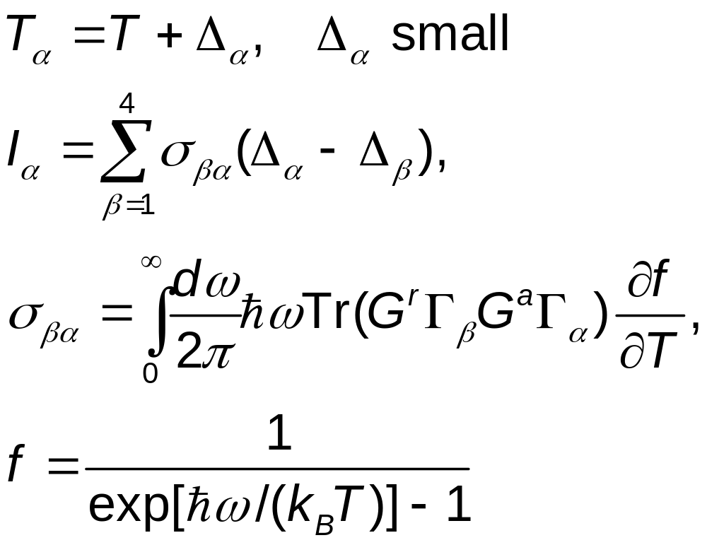
Linear response regime

Slide 10
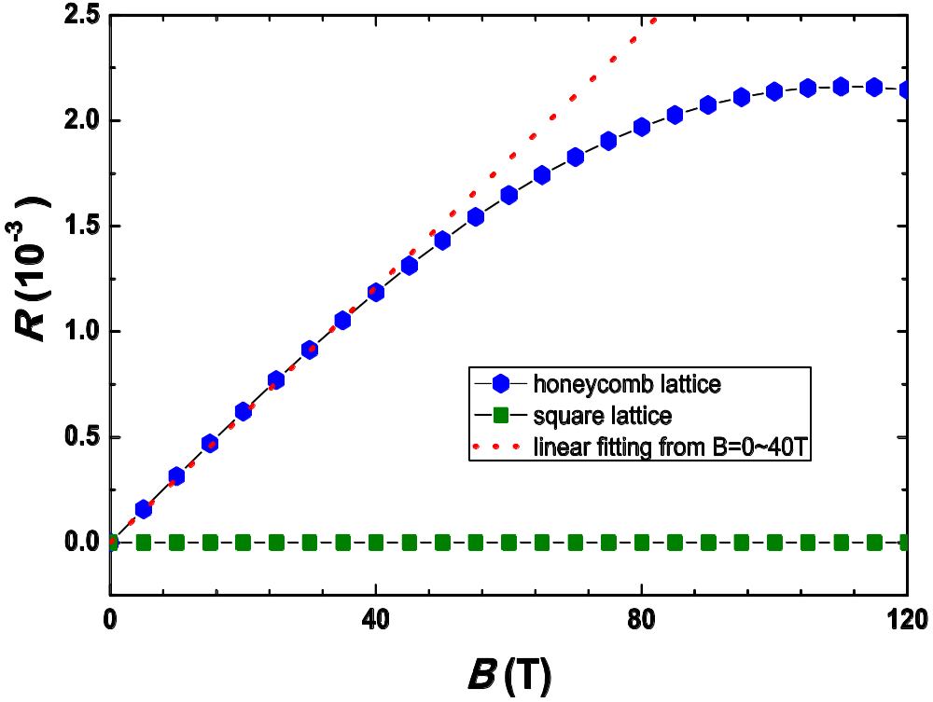
Ratios of transverse to longitudinal temperature difference
R=(T₃ -T₄)/(T₁ –T₂).
From L Zhang, J-S Wang, and B Li, arXiv:0902.4839.
No Hall effect on square lattice with nearest neighbor couplings.

Slide 11
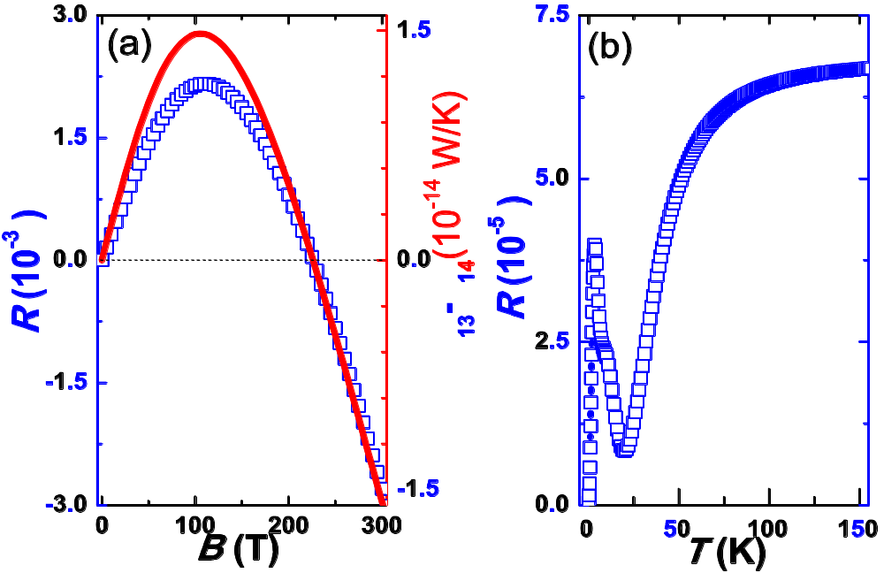
R vs B or T
The relative Hall temperature difference R vs (a) magnetic field B, (b) vs temperature T at B = 1 Tesla.
Red line is σ₁₃ – σ₁₄

Slide 12
Green-Kubo method
Work on periodic lattices
Find the phonon eigenmodes (turns out not othonormal)
Derive the energy density current
Compute equilibrium correlation function of the energy density current

Slide 13
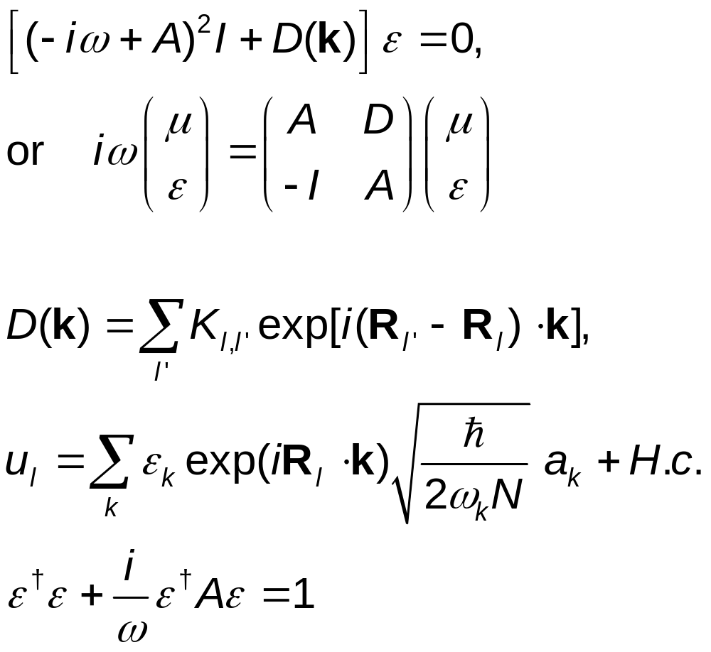
Eigenmodes

Slide 14
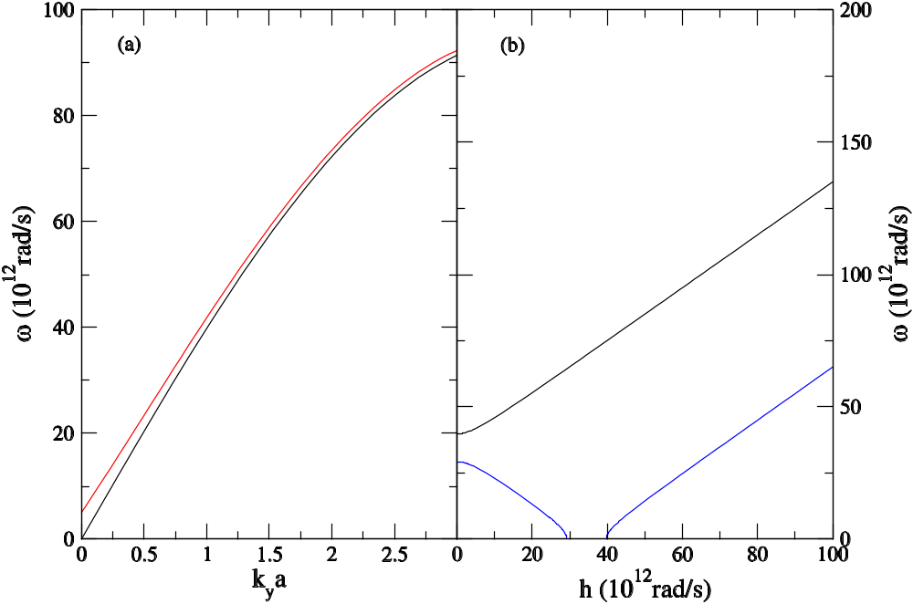
Effect of A to phonon dispersion
Phonon-dispersion relation of a triangular lattice. (a) longitudinal mode as a function of k_{y}a with k_{x} = 0. black (h=0), red (h=5x10¹² rad s⁻¹.) (b) as a function of h at ka=(0,1).

Slide 15
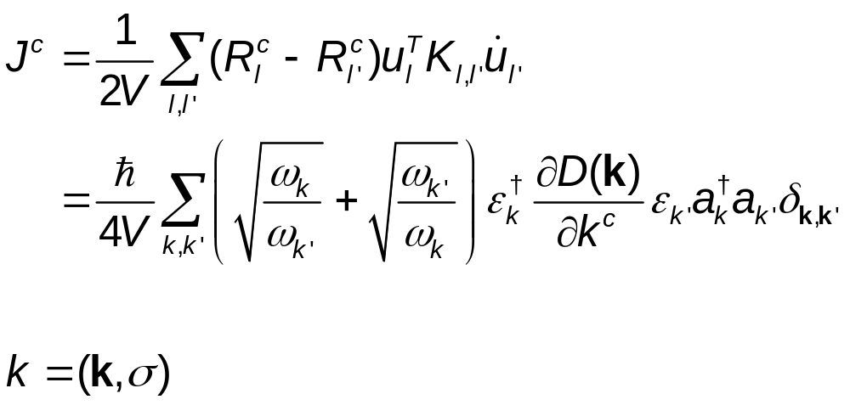
Current density vector (Hardy 1963)

Slide 16
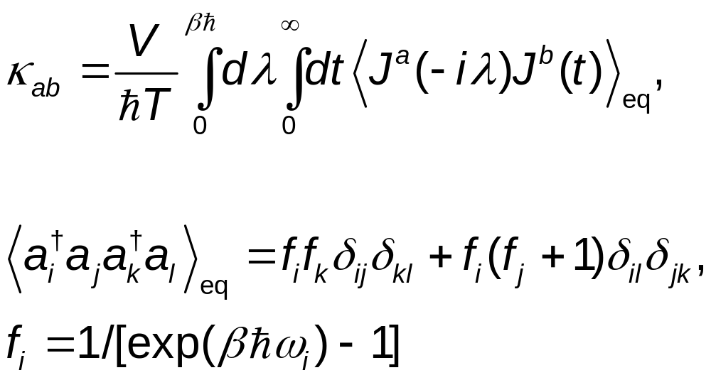
Green-Kubo formula

Slide 17
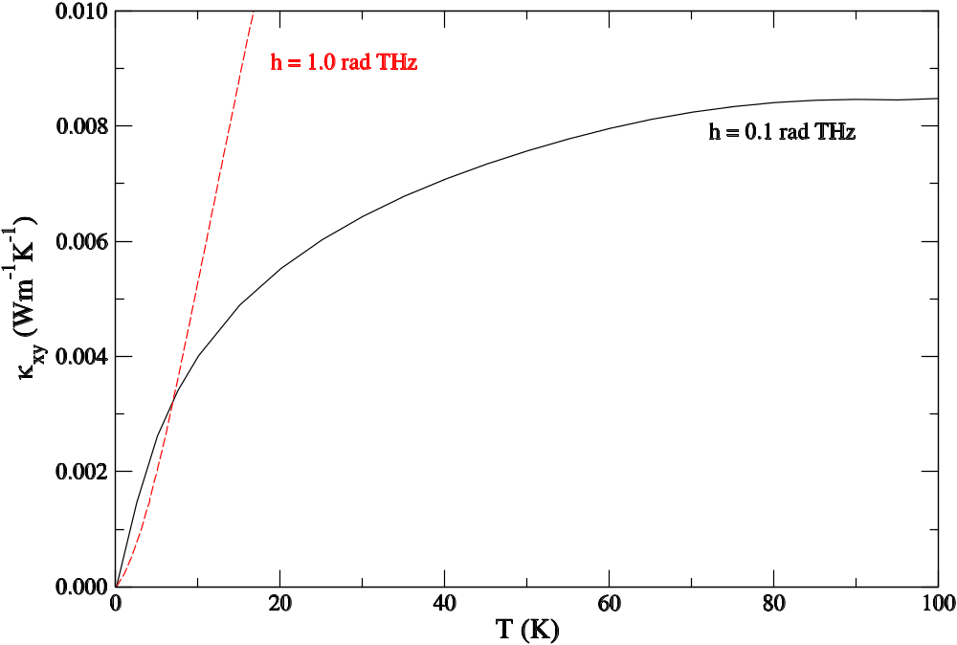
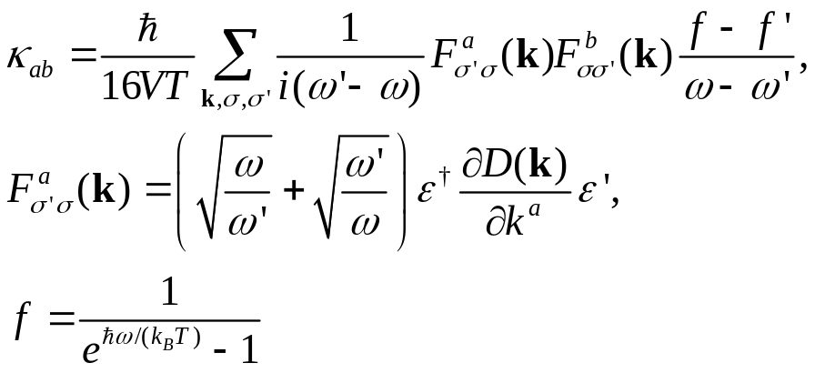
Thermal Hall conductivity, Green-Kubo formula
J S Wang and L Zhang, PRB 80, 012301 (2009).

Slide 18
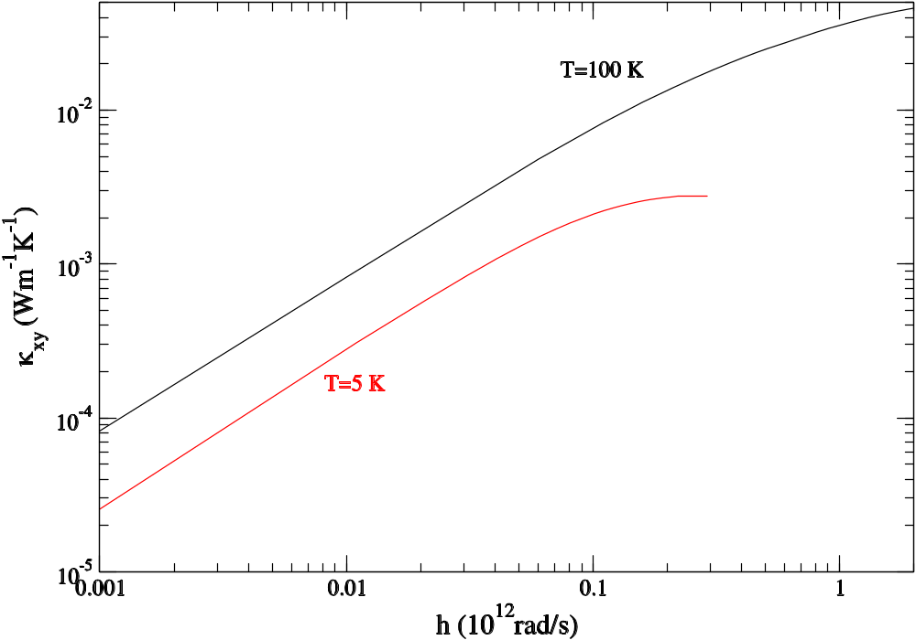
Hall conductivity vs h

Slide 19
A symmetry principle
If there is a symmetry transformation S, such that
SDS^{T} =D, SAS^{T}=-A,
then the off-diagonal elements of the thermal conductivity tensor κ_{ab} = 0

Slide 20
Mirror reflection symmetry
y
J=-κ ∇T
x, -∇T
J(D,A)=J(D,-A)

Slide 21
Conclusion
Both NEGF and Green-Kubo approaches give phonon Hall effect in the ballistic models, provided that a symmetry is not fulfilled.

Slide 22
Acknowledgements
This work is in collaboration with Lifa Zhang and Baowen Li
Support by NUS faculty research grants

