Slide 1
Quantum thermal transport from classical molecular dynamics
Jian-Sheng Wang
Department of Physics, National University of Singapore

Slide 2
Outline
Thermal transport problems
Classical molecular dynamics (MD) for thermal transport – advantages and disadvantages
Quantum “correction” after MD simulations
QMD – classical MD with quantum baths
  Derivation & results
QMD to electron transport and electron-phonon interactions
Outlook and conclusion

Slide 3
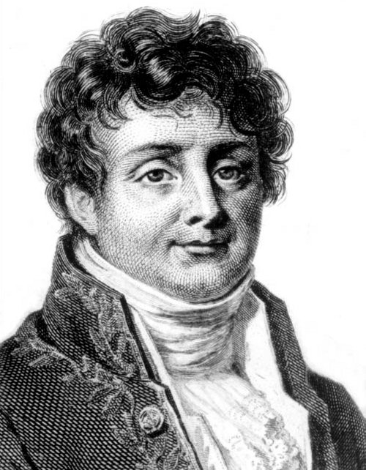
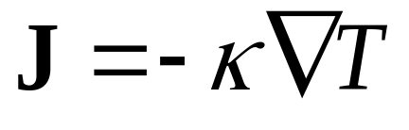
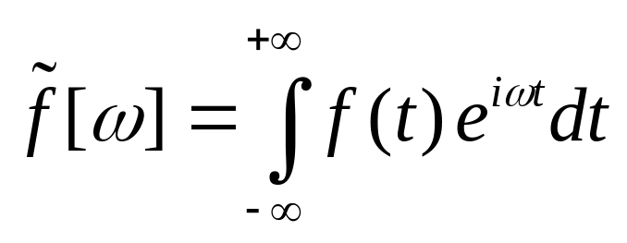
Fourier’s law for heat conduction
Fourier, Jean Baptiste Joseph, Baron (1768-1830)

Slide 4
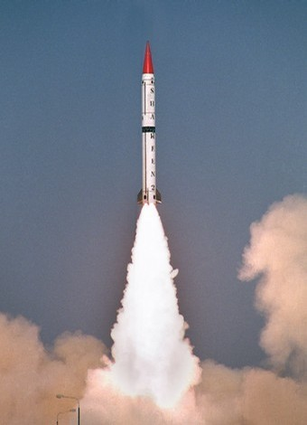
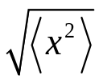

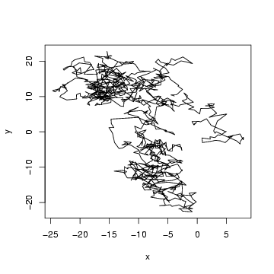

Diffusive transport vs ballistic transport
t

Slide 5
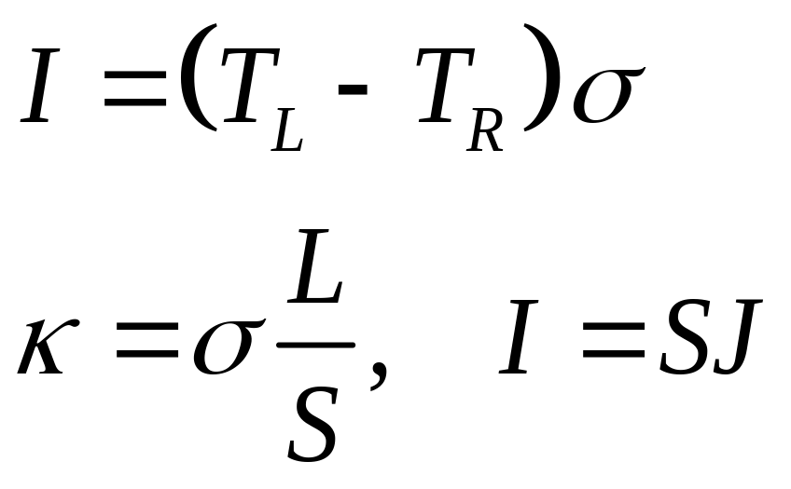
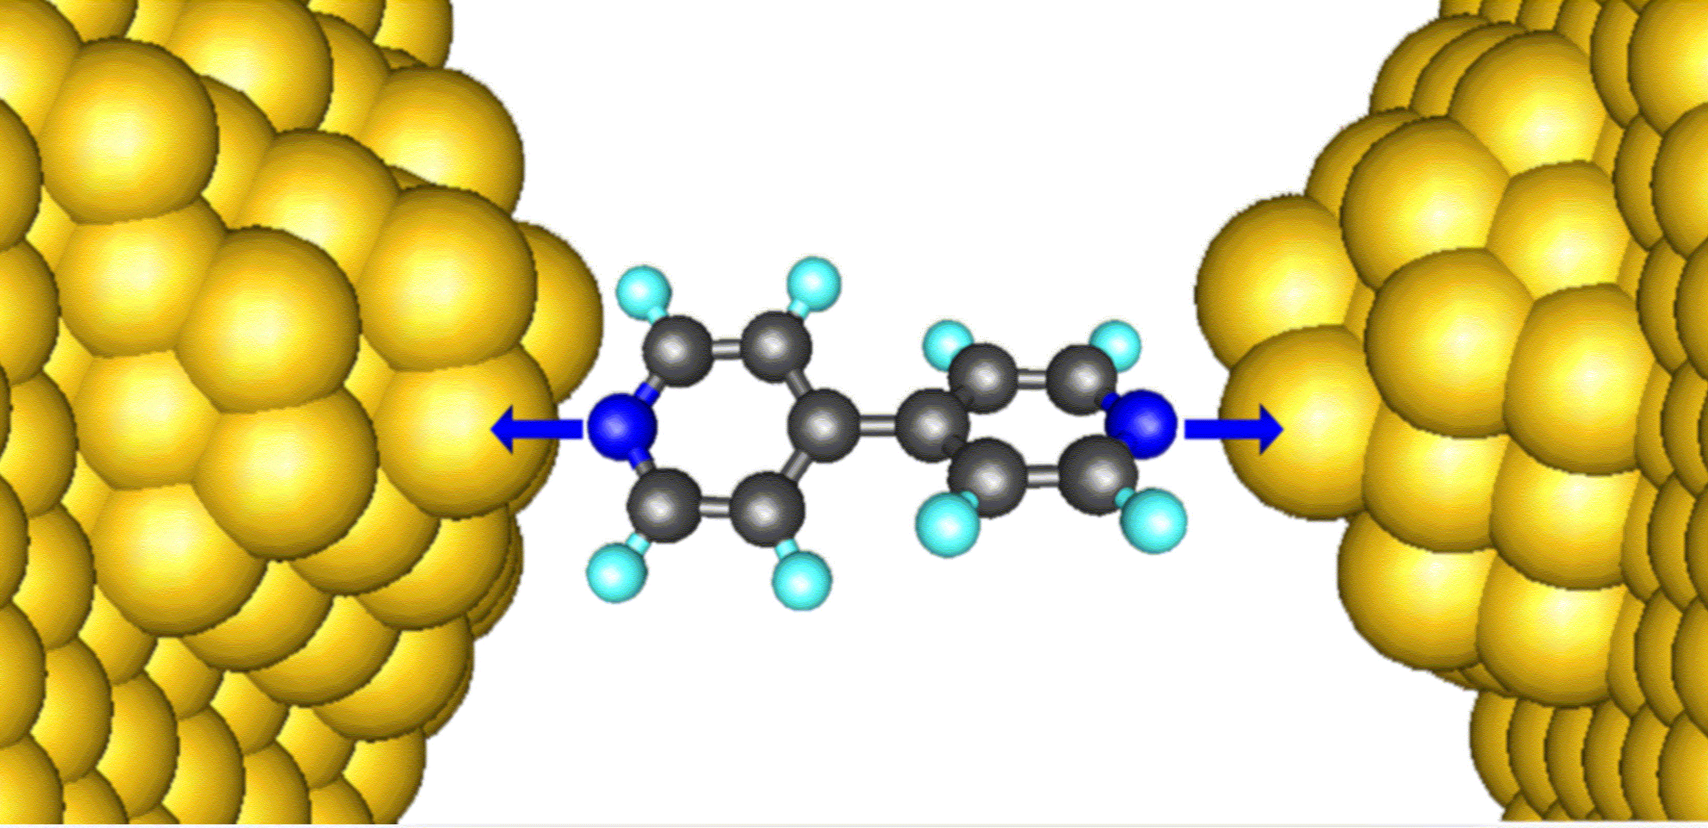
Thermal conductance

Slide 6
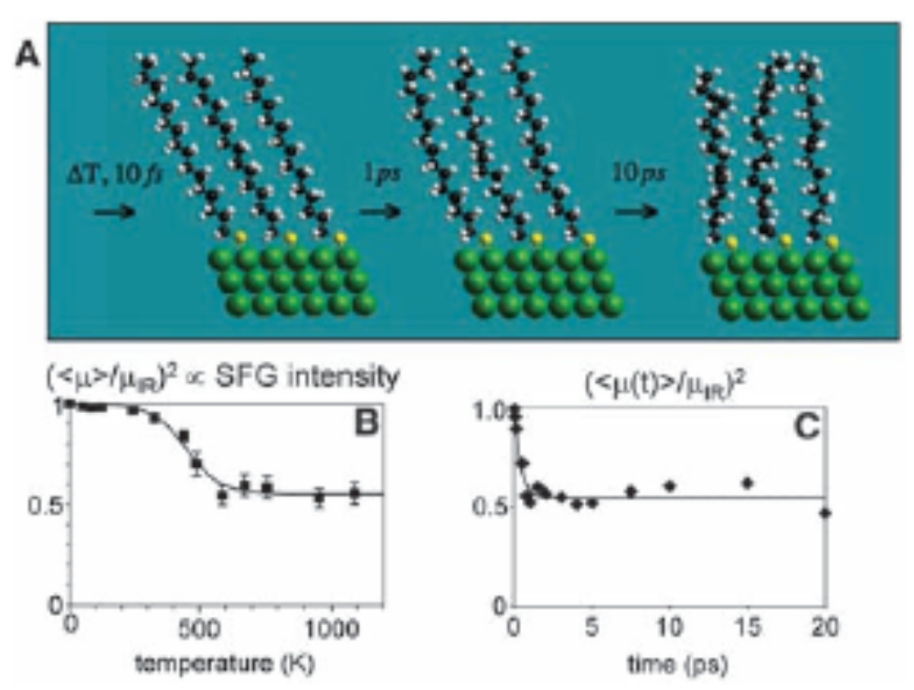
Experimental report of Z Wang et al (2007)
The experimentally measured thermal conductance is 50pW/K for alkane chains at 1000K. From Z Wang et al, Science 317, 787 (2007).

Slide 7
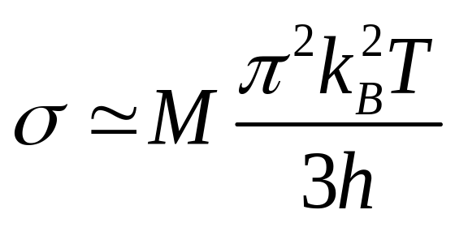
“Universal” thermal conductance in the low temperature limit
Rego & Kirczenow, PRL 81, 232 (1998).
M = 1

Slide 8
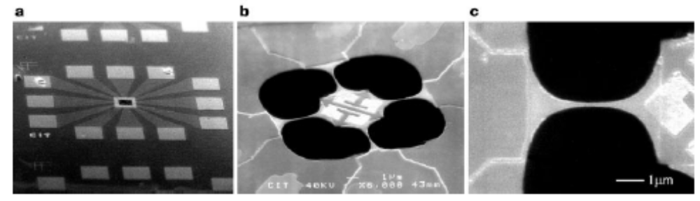
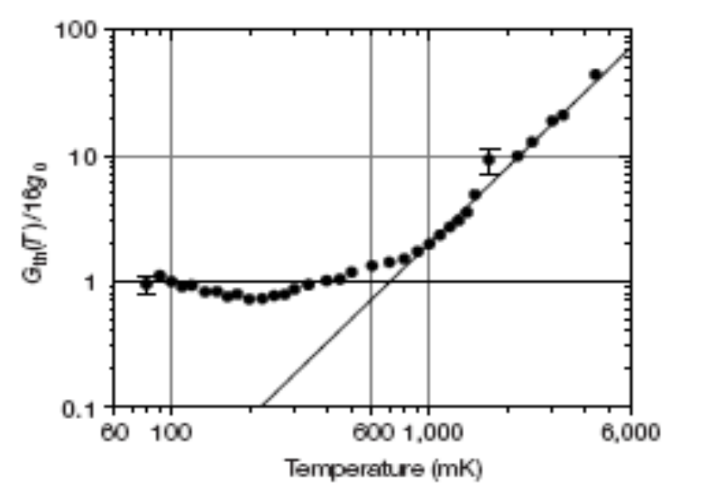
Schwab et al experiments
From K Schwab, E A Henriksen, J M Worlock and M L Roukes, Nature, 404, 974 (2000).

Slide 9
Classical molecular dynamics
Molecular dynamics (MD) for thermal transport
  Equilibrium ensemble, using Green-Kubo formula
  Non-equilibrium simulation
    Nosé-Hoover heat-bath
    Langevin heat-bath
    Velocity scaling heat source/sink
Disadvantage of classical MD
  Purely classical statistics
    Heat capacity is quantum below Debye temperature
    Ballistic transport for small systems is quantum

Slide 10
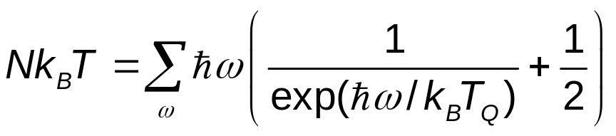
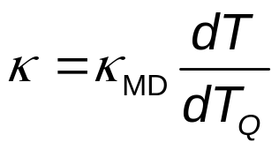
Quantum corrections
Methods due to Wang, Chan, & Ho, PRB 42, 11276 (1990); Lee, Biswas, Soukoulis, et al, PRB 43, 6573 (1991).
Compute an equivalent “quantum” temperature by
Scale the thermal conductivity by
But we have a criticism to this method
(1)
(2)

Slide 11
Thermal conduction at a junction
Left Lead, T_{L}
Right Lead, T_{R}
semi-infinite
Junction Part

Slide 12
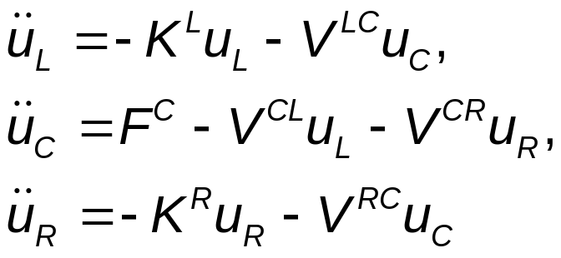
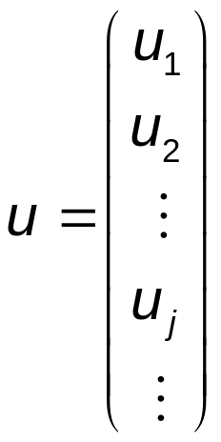
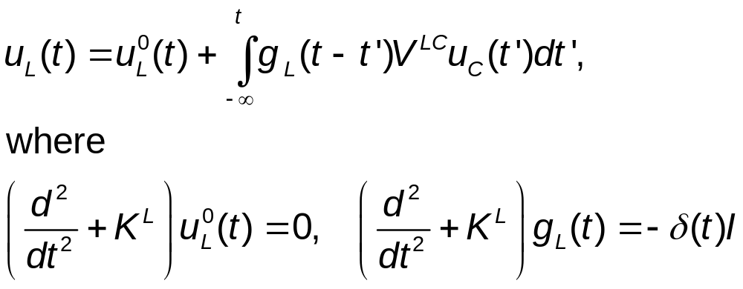
Quantum heat-bath & MD
Consider a junction system with left and right harmonic leads at equilibrium temperatures T_{L} & T_{R}, the Heisenberg equations of motion are
The equations for leads can be solved, given
(3)
(4)

Slide 13
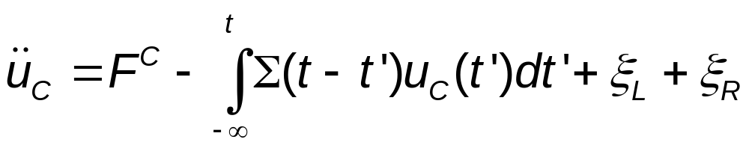
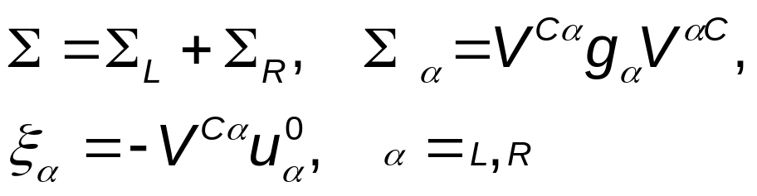
Quantum Langevin equation for center
Eliminating the lead variables, we get
where retarded self-energy and “random noise” terms are given as
(5)
(6)

Slide 14
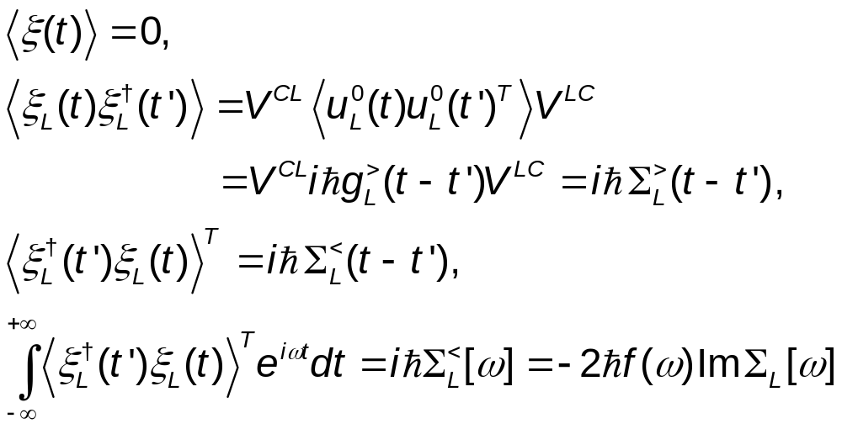
Properties of the quantum noise
(7)
(8)
(9)
For NEGF notations, see JSW, Wang, & Lü, Eur. Phys. J. B, 62, 381 (2008).

Slide 15
Quasi-classical approximation, Schmid (1982)
Replace operators u_{C} & ξ by ordinary numbers
Using the symmetrized quantum correlation, iħ(∑> +∑<)/2 for the correlation matrix of ξ.
For linear systems, quasi-classical approximation turns out exact! See, e.g., Dhar & Roy, J. Stat. Phys. 125, 805 (2006).

Slide 16
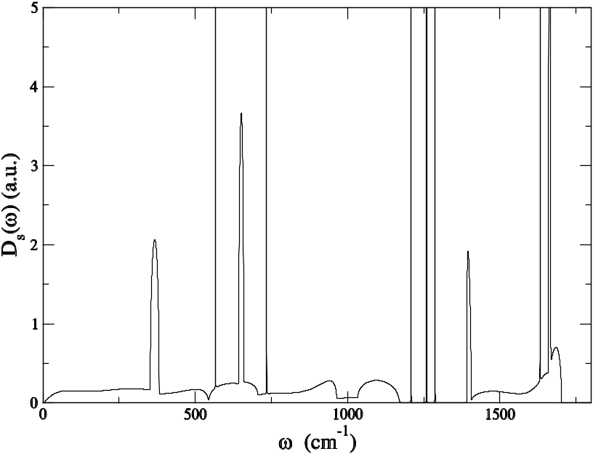
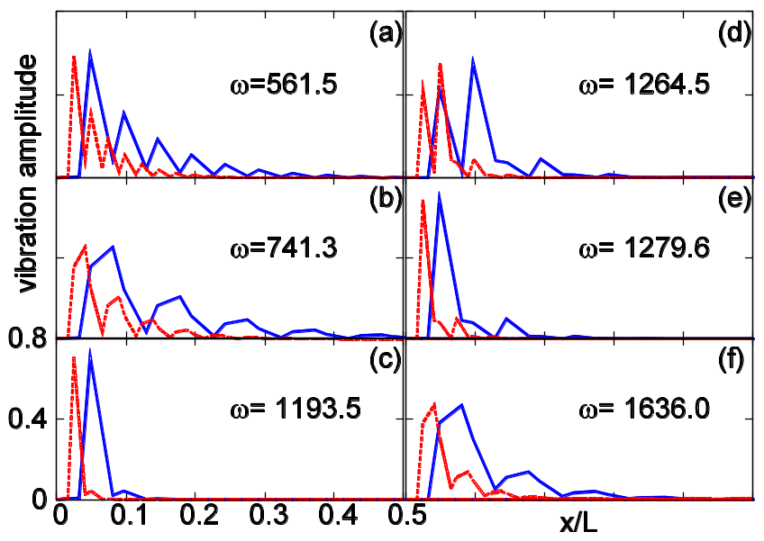
Delta singularities in self-energy
The surface density of states vs frequency for a 2 unit cell (8 atoms) wide zigzag graphene strip. The delta peaks are consistent with the localized edge modes shown on the left. JSW, Ni, Jiang, unpublished.

Slide 17
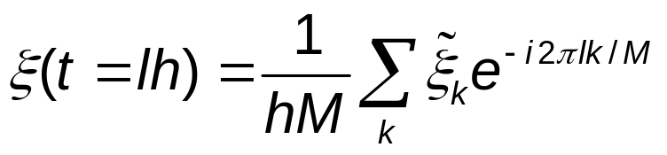
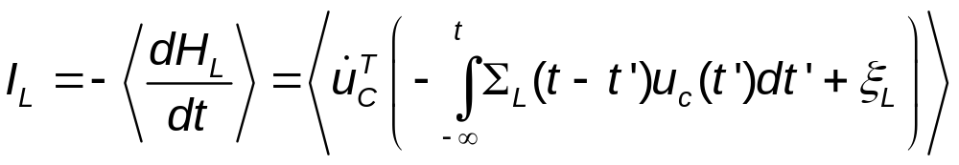
Implementation
Generate noise using fast Fourier transform
Solve the differential equation using velocity Verlet
Perform the integration using a simple rectangular rule
Compute energy current by
(10)
(11)

Slide 18
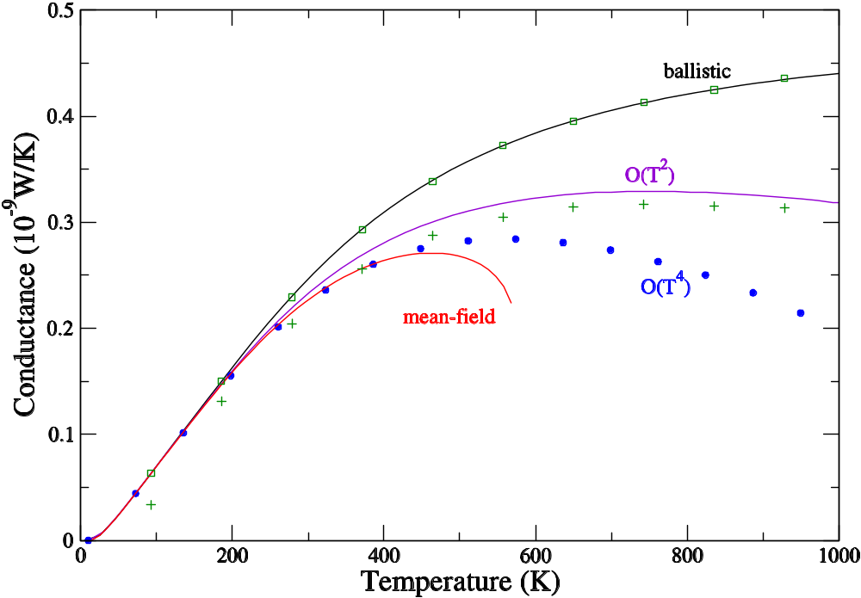
Comparison of QMD with NEGF
Three-atom junction with cubic nonlinearity (FPU-α). From JSW, Wang, Zeng, PRB 74, 033408 (2006) & JSW, Wang, Lü, Eur. Phys. J. B, 62, 381 (2008).
QMD ballistic
QMD nonlinear
k_{L}=1.56 k_{C}=1.38, t=1.8 k_{R}=1.44

Slide 19
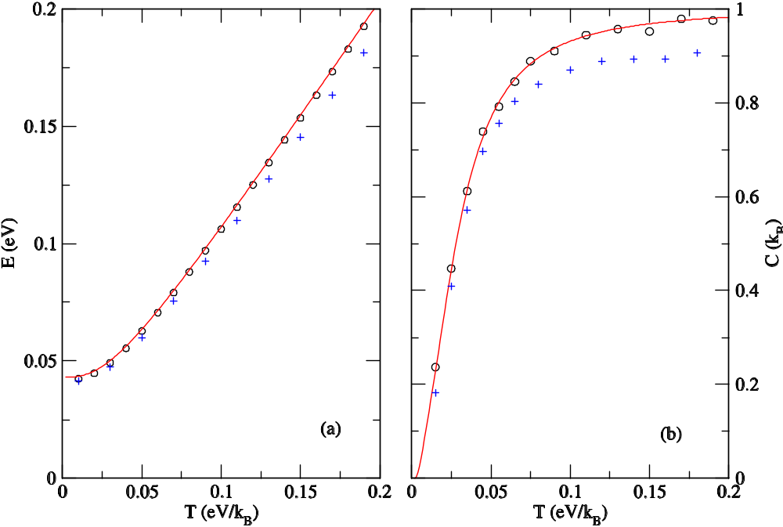
Equilibrium simulation
1D linear chain (red lines exact, open circles QMD) and nonlinear quartic onsite (crosses, QMD) of 128 atoms. From Eur. Phys. J. B, 62, 381 (2008).

Slide 20
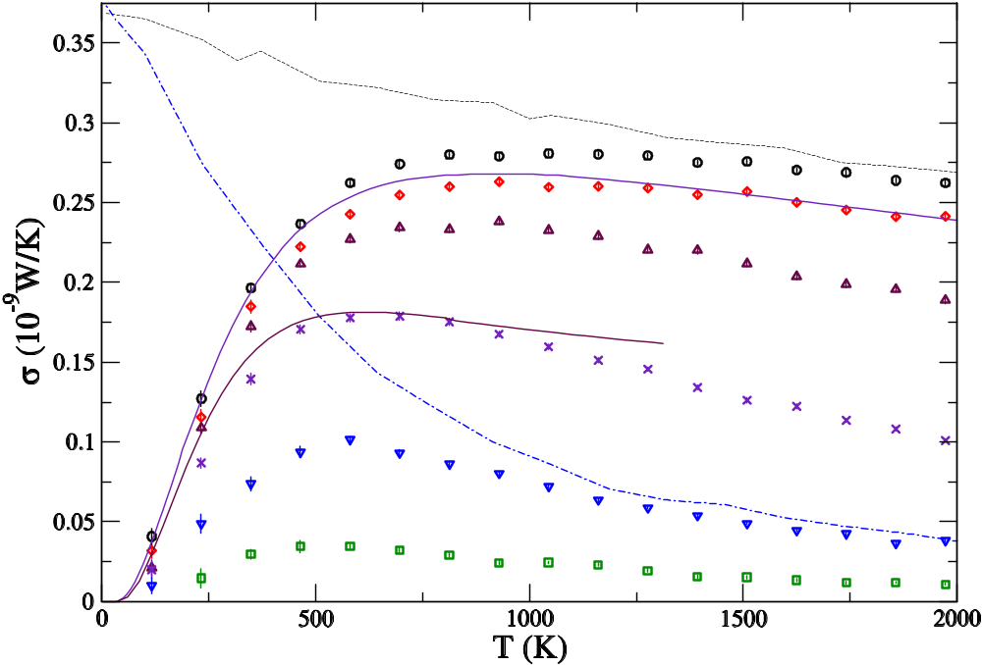
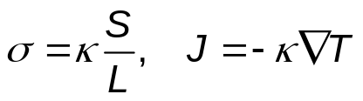
From ballistic to diffusive transport
1D chain with quartic onsite nonlinearity (Φ⁴ model). The numbers indicate the length of the chains. From JSW, PRL 99, 160601 (2007).
Classical, ħ → 0
4
16
NEGF, N=4 & 32
64
256
1024
4096

Slide 21
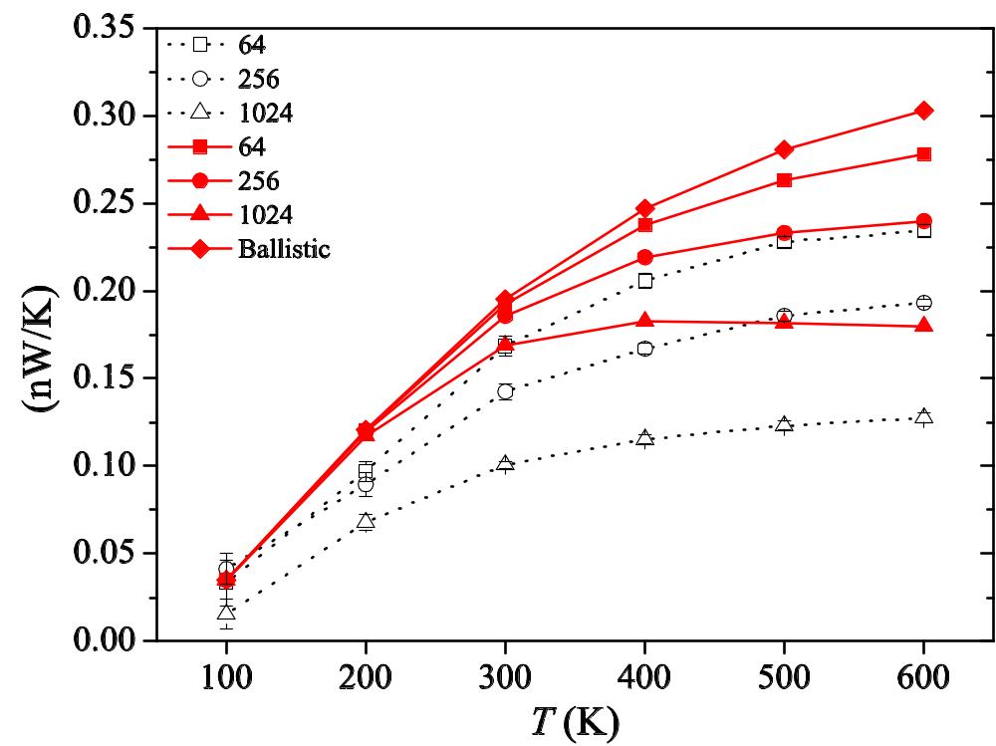
FPU-β model
It is not clear whether QMD over or under estimates the nonlinear effect. From Xu, JSW, Duan, Gu, & Li, PRB 78, 224303 (2008).
} relaxing rate NEGF

Slide 22
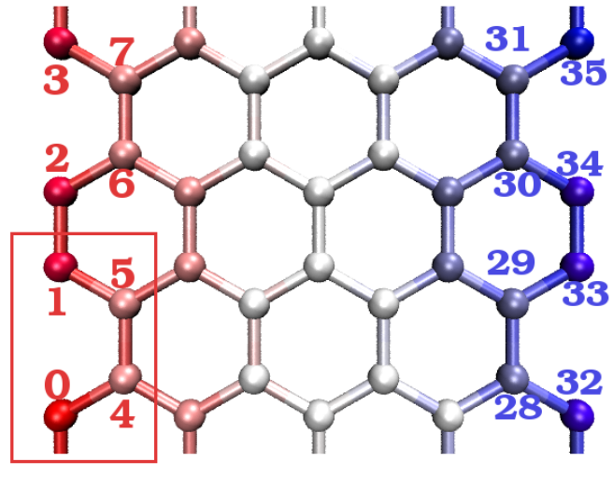
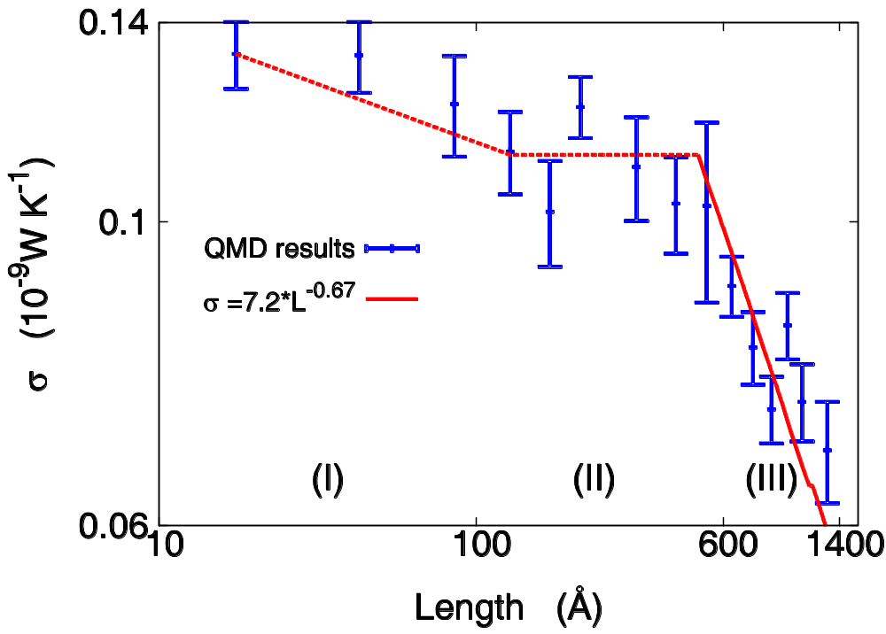
Conductance of graphene strips
Sites 0 to 7 are fixed left lead and sites 28 to 35 are fixed right lead. Heat bath is applied to sites 8 to 15 at temperature T_{L} and site 20 27 at T_{R}. JSW, Ni, & Jiang, unpublished.

Slide 23
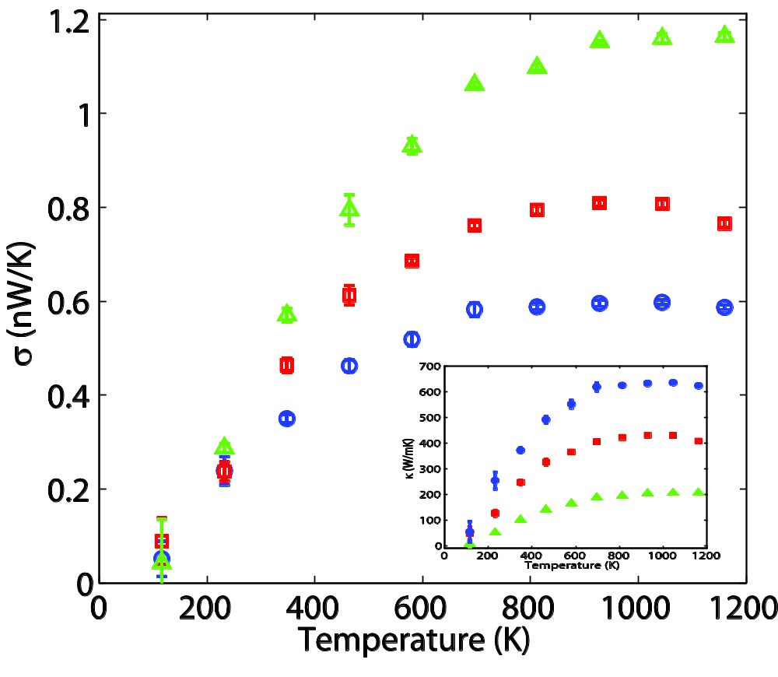
Zigzag (5,0) carbon nanotubes
Temperature dependence of the thermal conductance (and conductivity) for lengths 4.26 (green), 12.8 (red) and 25.6 (blue) nm, respectively. JSW, Ni and Jiang, unpublished.

Slide 24
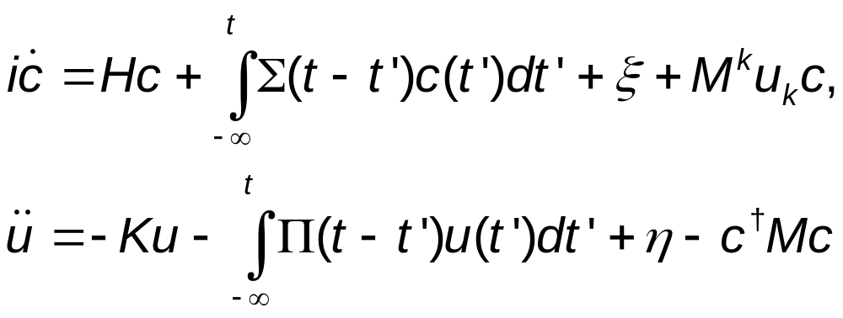
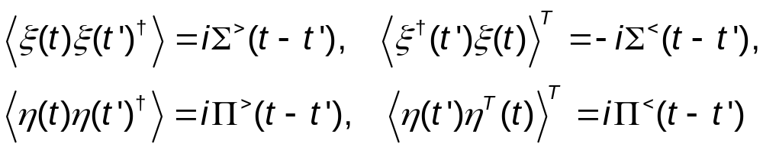
Electron transport & phonons
For electrons in the tight-binding form interacting with phonons, the quantum Langevin equations are (set ħ = 1)
(12)
(13)
(14)
(15)

Slide 25
Quasi-classical approximation & NEGF
D<
∑<_{n} = i
G<
G<
∑^{r}_{n} = i {
D<
D^{r}
D^{r}
}
+
−
G^{r}
G>
Χ
G<
To lowest order in coupling M, quasi-classical approximation is to replace all G> by −G<.
Π<_{n} = −i
Χ
G>
Π^{r}_{n} = −i {
G^{r}
G<
}
+
G<
Gª

Slide 26
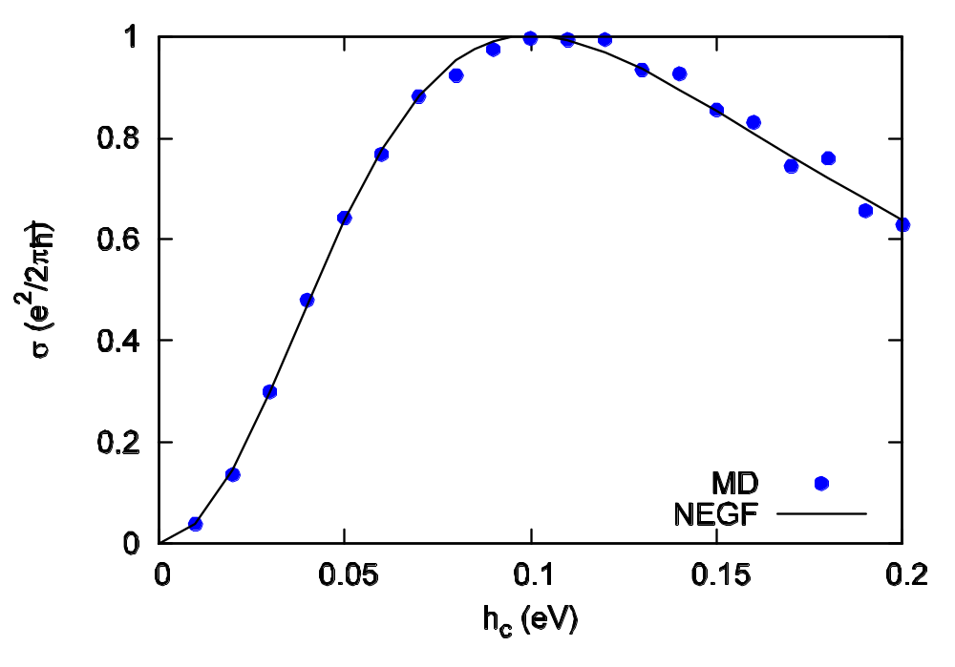
Ballistic electron transport, NEGF vs QMD
Nearest neighbor hopping model with two sites in the center, lead hopping -h_{l} = 0.1 eV, varying the center part hopping term. From Lü & JSW, arXiv:0803.0368. For NEGF method of electron-phonon interaction, see Lü & JSW, PRB 76, 165418 (2007).

Slide 27
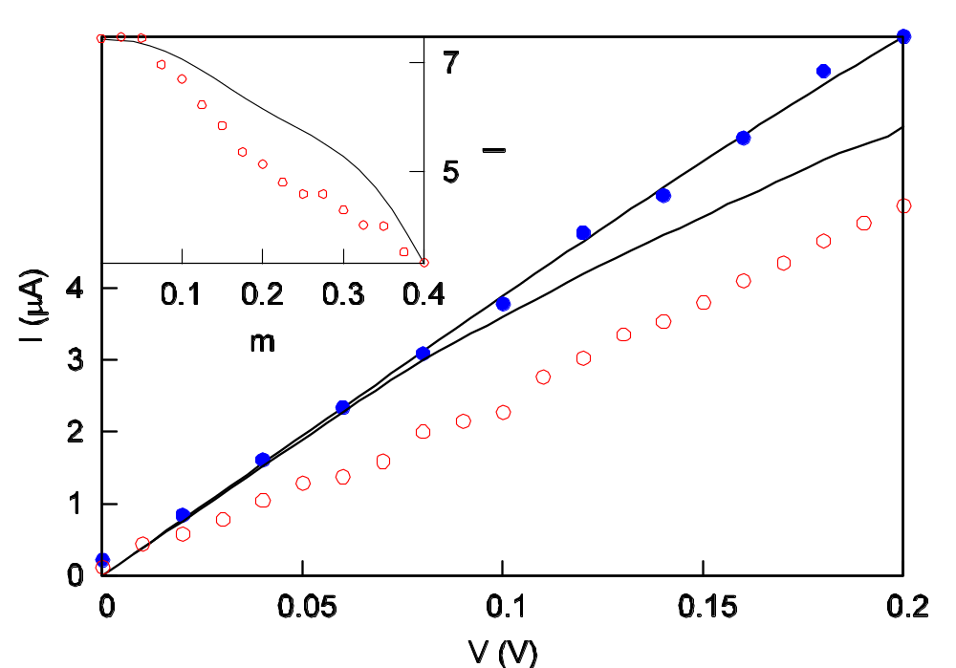
Strong electron-phonon interactions
Two-center-atom model with Su, Schrieffer & Heeger electron-phonon interaction. Lines are NEGF, dots are QMD. From Lü & JSW, J. Phys.: Condens. Matter, 21, 025503 (2009).
ballistic

Slide 28
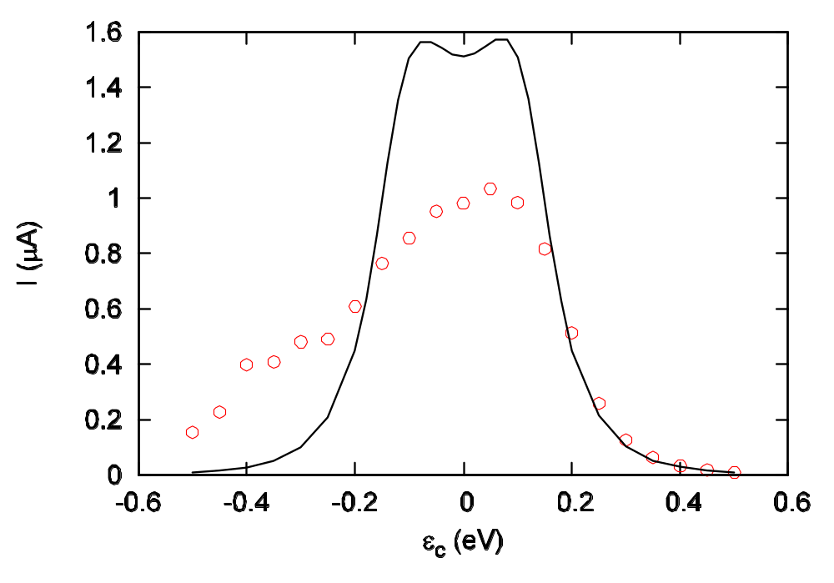
QMD is exact in low electron density limit
Self-consistent Born approximation NEGF
QMD
Low electron density

Slide 29
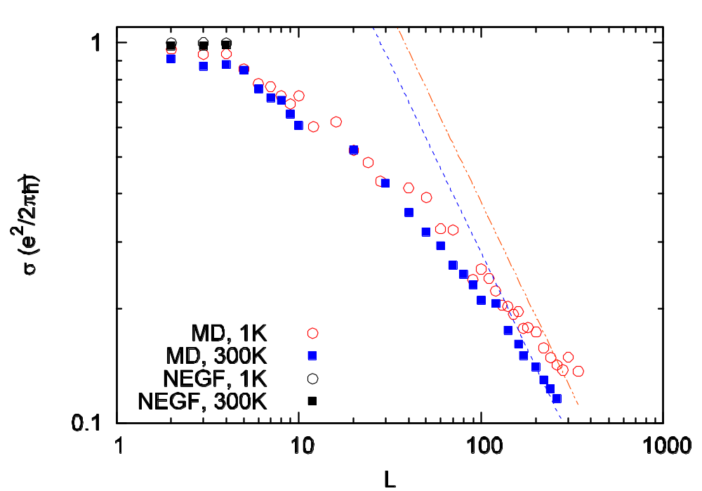
Ballistic to diffusive
Electronic conductance vs center junction size L. Electron-phonon interaction strength is m=0.1 eV. From Lü & JSW, arXiv:0803.0368.

Slide 30
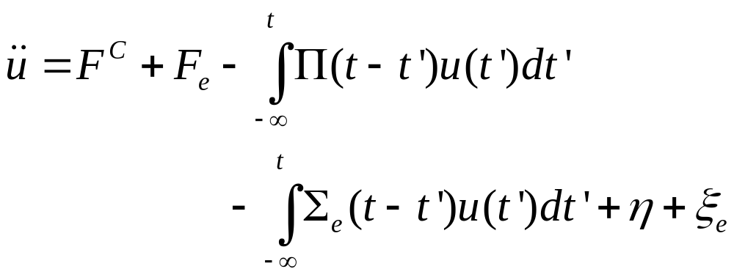
Electrons as a heat bath (Lü, Brandbyge, et al, based on path-integral formulism)

Slide 31
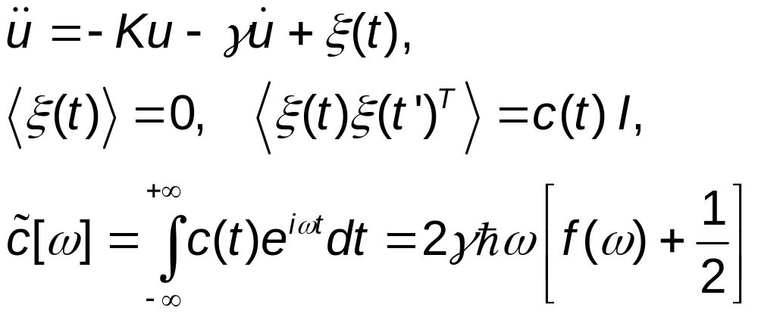
A simplified QMD?
Consider the following Langevin equation for lattice vibration [Keblinski & JSW, unpublished; see also Buyukdagli, et al, PRE 78, 066702 (2008) ]:
then in the limit of small damping (γ → 0), the energy of the vibrational modes is given exactly as that of the corresponding quantum system.
(16)
(17)
(18)

Slide 32
Conclusion & outlook
QMD for phonon is correct in the ballistic limit and high-temperature classical limit
Much large systems can be simulated (comparing to NEGF)
Quantum corrections in dynamics?
  Solve a hierarchical set of Heisenberg equations (Prezhdo et al, JCP)
  Two-time dynamics (e.g., Koch et al, PRL 2008)?
  Can we treat the noises ξ & η as operators (i.e. matrices) thus restore ∑> ≠∑<?

Slide 33
Collaborators
Baowen Li
Pawel Keblinski
Jian Wang
Jingtao Lü
Jin-Wu Jiang
Eduardo Cuansing
Nan Zeng
Lifa Zhang
Xiaoxi Ni
Saikong Chin
Chee Kwan Gan
Jinghua Lan
Yong Xu

Slide 34
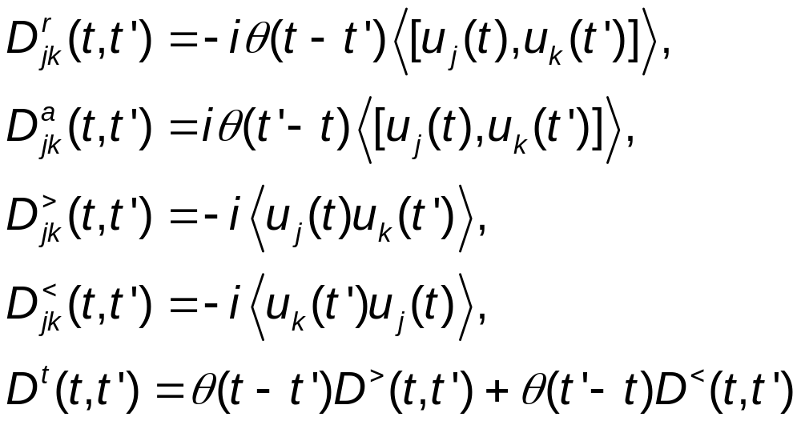
Definitions of Phonon Green’s functions

Slide 35
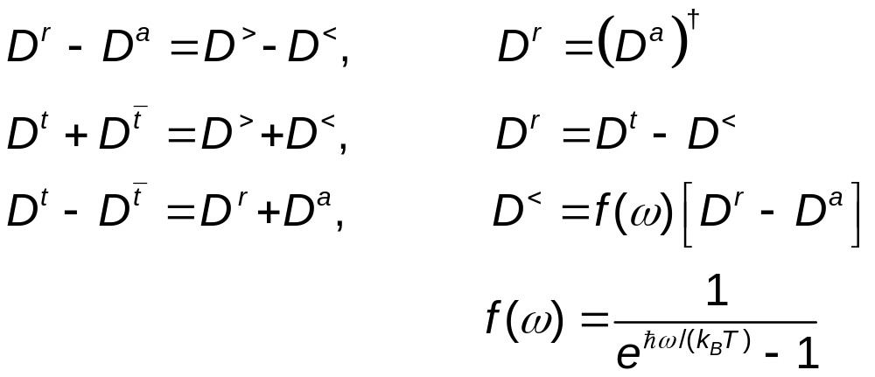
Relation among Green’s functions

Slide 36
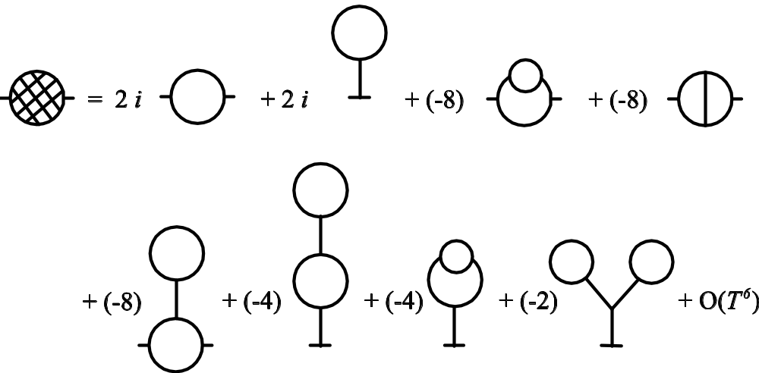
Self-energy Feynman diagrams

Slide 37
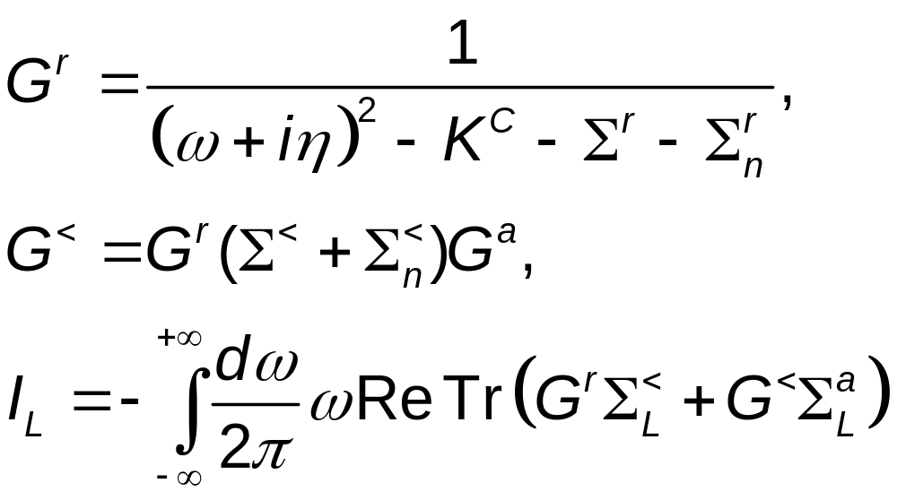
From self-energy to Green’s functions, to heat current

