Slide 1

Replica Monte Carlo Simulation
Jian-Sheng Wang
National University of Singapore

Slide 2
Outline
Review of extended ensemble methods (multi-canonical, Wang-Landau, flat-histogram, simulated tempering)
Replica MC
Connection to parallel tempering and cluster algorithm of Houdayer
Early and new results

Slide 3
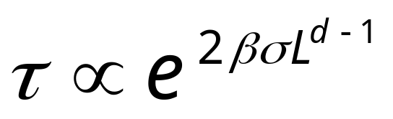
Slowing Down at First-Order Phase Transition
At first-order phase transition, the longest time scale is controlled by the interface barrier
where β=1/(k_{B}T), σ is interface free energy, d is dimension, L is linear size
Notes:
The multi-canonical ensemble simulation due to Berg et al overcomes this problem.

Slide 4
Multi-Canonical Ensemble
We define multi-canonical ensemble as such that the (exact) energy histogram is a constant
h(E) = n(E) f(E) = const
This implies that the probability of configuration is
P(X) ∝ f(E(X)) ∝ 1/n(E(X))
Notes:
This concept was first introduced by B. Berg. Such ensemble do not correspond to real physical systems. It is used as a simulation device to reconstruct the original canonical ensemble. Compare, micro-canonical, P(X) = const for all states with fixed E(X)=E, canonical P(X) = exp(-E(X)/(k_{B}T))/Z.

Slide 5
Multi-Canonical Simulation (Berg et al)
Do simulation with probability weight f_{n}(E), using Metropolis acceptance rate min[1, f_{n}(E’)/f_{n}(E) ]
Collection histogram H(E)
Re-compute weight by
f_{n+1}(E) = f_{n}(E)/H(E)
Iterate until H(E) is flat
Notes:
This method is due to B. A. Berg and T. Neuhaus, Phys Rev Lett 68 (1992) 9. For a review, see B. A. Berg, Field Institute Communication 26 (2000) 1. Determine new weight f_{n+1} from the simulation data and old weight f_{n} can be complicated for a stable algorithm. The problem is that what to do if there is no sample, H(E) = 0 for some E. The above is an over-simplification.

Slide 6
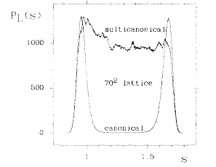
Multi-Canonical Simulation and Reweighting
Multicanonical histogram and reweighted canonical distribution for 2D 10-state Potts model
From A B Berg and T Neuhaus, Phys Rev Lett 68 (1992) 9.
Notes:
Interfacial free energy can be determined very accurately by this method.

Slide 7
Wang-Landau Method
Work directly with n(E), starting with some initial guess, n(E) ≈ const, f = f₀ > 1 (say 2.7)
Flip a spin according to acceptance rate min[1, n(E)/n(E ’)]
And also update n(E) by
n(E) <- n(E) f
Reduce f by f <-f ^{1/2} after certain number of MC steps, when the histogram H(E) is “flat”.
Notes:
See F. Wang and D. P. Landau, Phys Rev Lett 86 (2001) 2050.

Slide 8
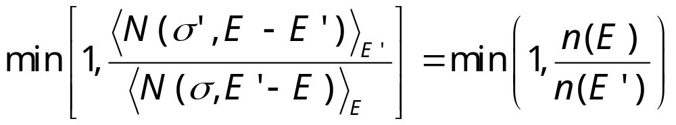
Flat Histogram Algorithm
Pick a site at random
Flip the spin with probability
where E is current and E ’ is new energy
3. Accumulate statistics for <N(σ,E ’-E)>_{E}
Notes:
See J-S Wang, Eur Phys J B 8 (1999) 287. Since <N(σ, E’-E)>_{E} is both the quantity that we are going to collect statistics and input to the algorithm, we can not do it without approximation. In real simulation, we replace the exact micro-canonical average by running average.

Slide 9
The Ising Model
ΔE=0
-
-
+
-
+
-
Total energy is
E(σ) = - J ∑_{<ij>} σ_{i} σ_{j}
sum over nearest neighbors, σ_{i} = ±1
N(σ,ΔE) is the number of sites, such that flip spin costs energy ΔE.
-
-
-
+
+
-
+
+
-
-
-
+
+
-
+
+
+
-
+
+
-
-
-
-
ΔE=-8J
+
+
-
-
+
-
σ = {σ₁, σ₂, …, σ_{i}, … }
Notes:
In 1925, physicist W. Lenz asked his student E. Ising to solve a statistical mechanics problem relevant to the magnetic properties of matter. Ising was able to solve it on a one-dimensional lattice. Almost twenty years were passed before L. Onsager found analytic solution to the two-dimensional version of the problem. The three-dimensional Ising model which is most relevant in the physical world has denied any serious attempt. Thus, any information we have is from approximations and numerical simulations.
Ising model and its generalizations are extremely important in our understanding of the properties of matter, especially the phenomena of phase transitions. Ising model is still actively used in various ways to model systems in condensed matter physics.

Slide 10
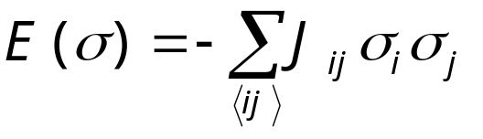
Spin Glass Model
+
-
-
+
-
+
-
-
+
-
+
+
-
-
+
+
+
+
-
+
-
A random interaction Ising model - two types of random, but fixed coupling constants (ferro J_{ij} > 0) and (anti-ferro J_{ij} < 0)
-
+
-
+
+
-
+
+
-
-
+
-
-
-
-
+
+
-
-
+
+
+
+
-
+
-
-
-
Notes:
See K. Binder and A. P. Young, Rev Mod Phys 58 (1986) 801, for a review.

Slide 11
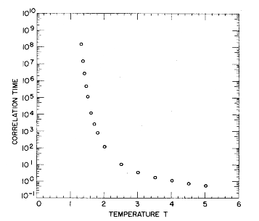
Slow Dynamics in
Spin Glass
Correlation time in single spin flip dynamics for 3D spin glass. τ ∝ |T-T_{c}|⁶.
From Ogielski, Phys Rev B 32 (1985) 7384.

Slide 12
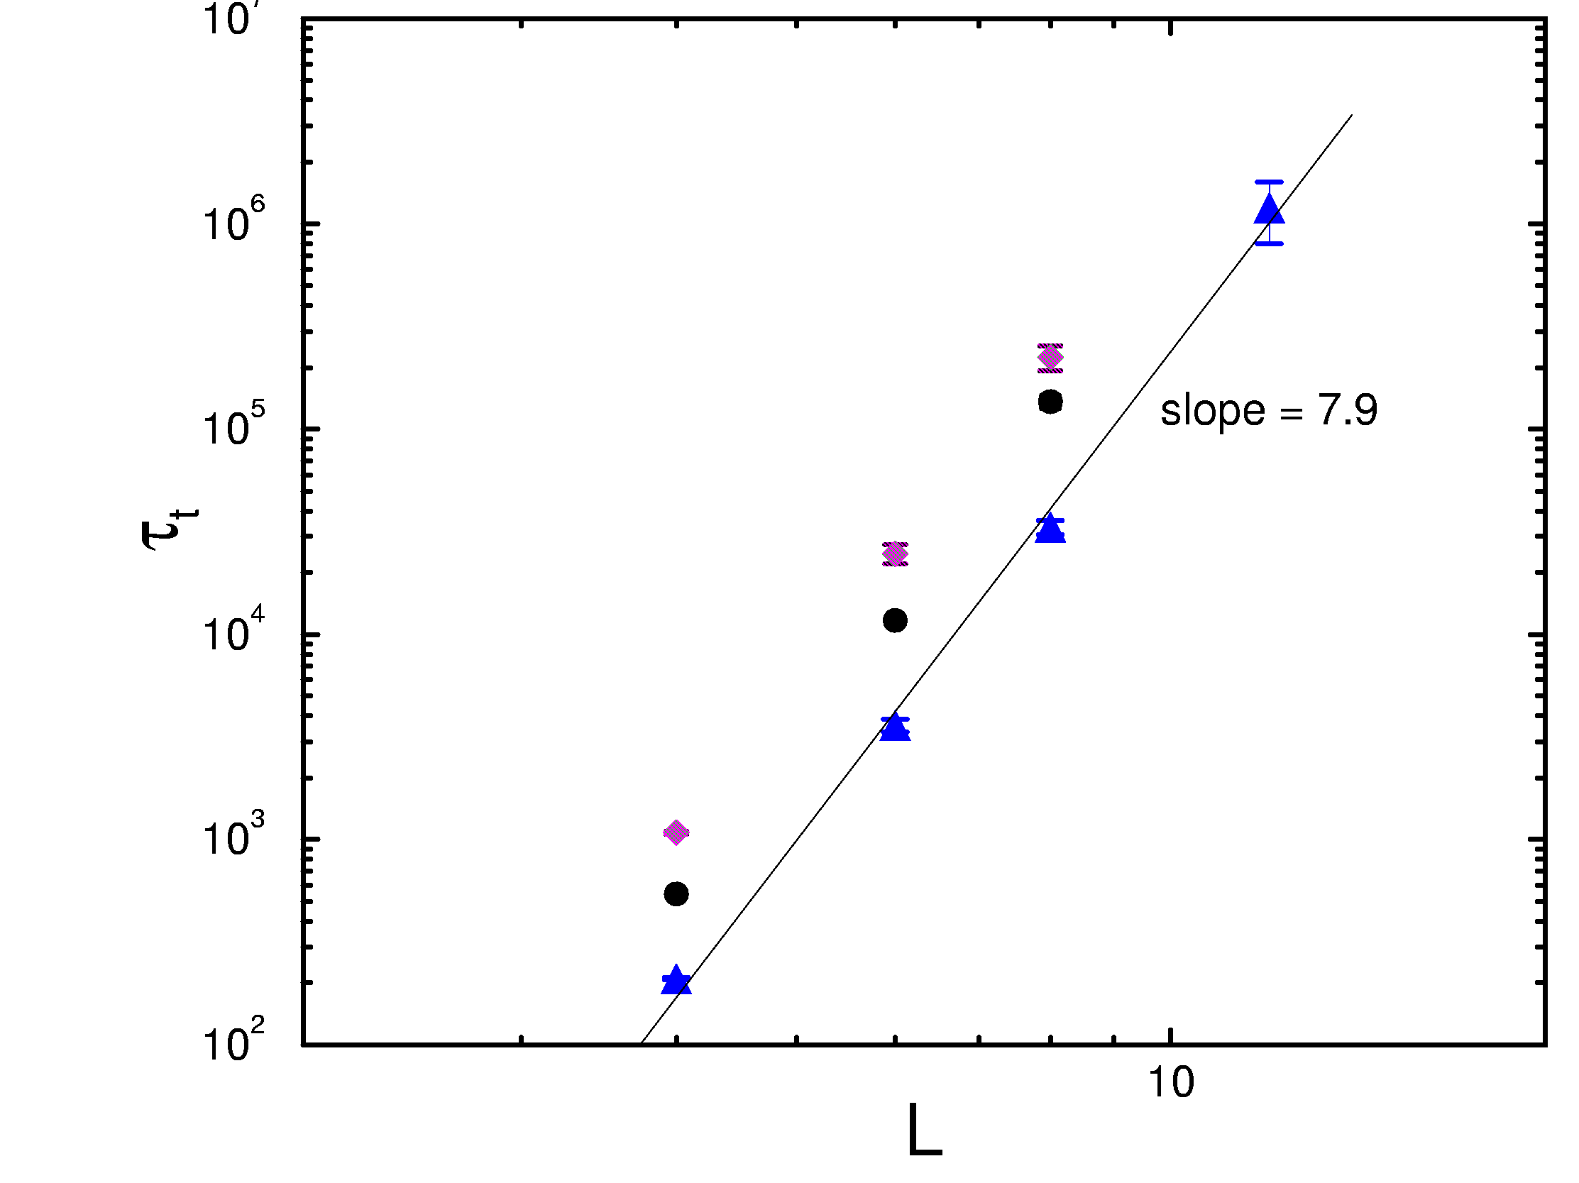
Tunneling Time for 3D Spin Glass
Diamond: standard flat histogram algorithm; dot: with N-fold way; triangle: equal-hit algorithm.
From J S Wang & R H Swendsen, J Stat Phys, 106 (2002) 245.

Slide 13
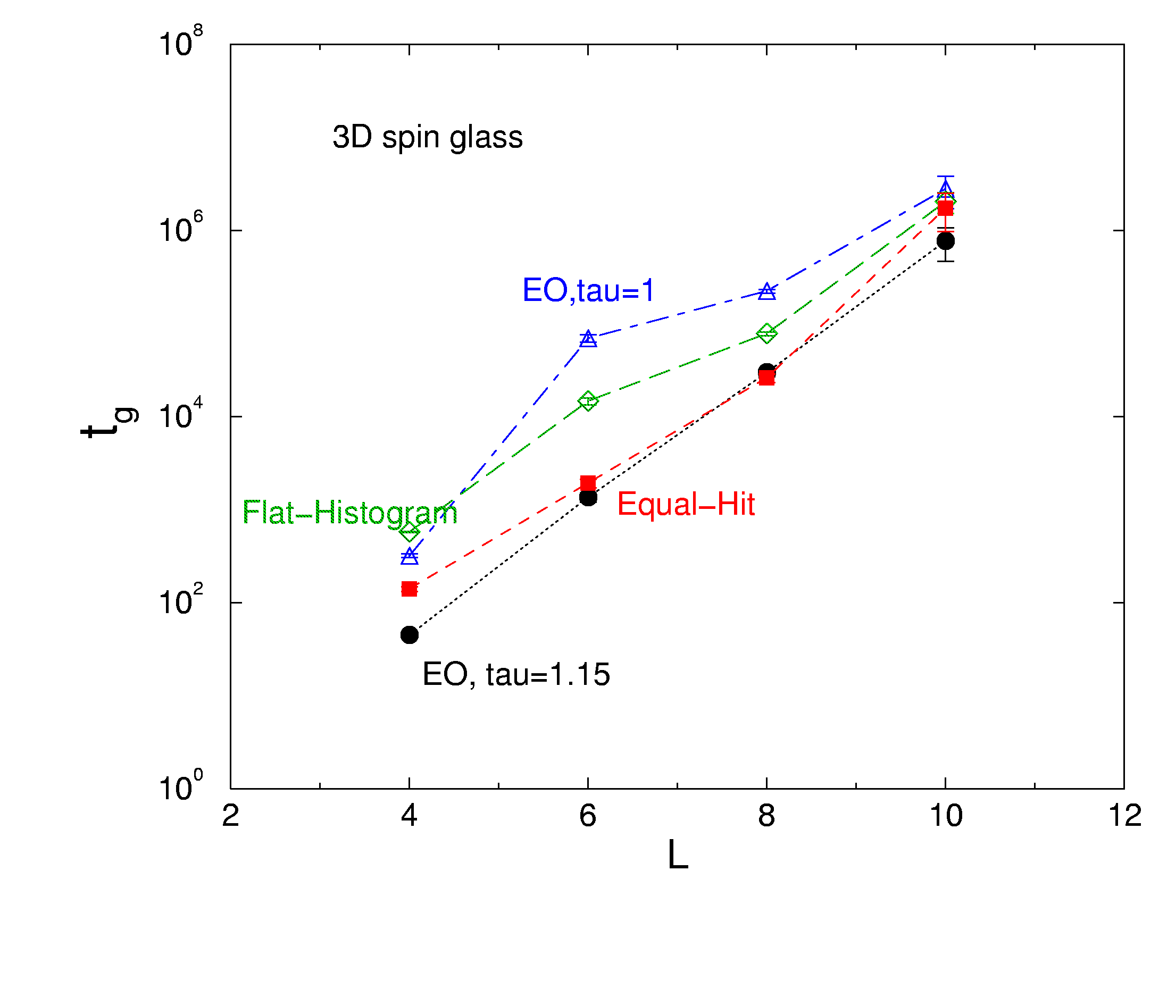
First-Passage Time to Ground States
Number of sweeps needed to discover a ground state for the first time. Extremal Optimization (EO) is an optimization algorithm.
From J S Wang and Y Okabe, J Phys Soc Jpn, 72 (2003) 1380.

Slide 14
Simulated Tempering (Marinari & Parisi, 1992)
Simulated tempering treats parameters as dynamical variables, e.g., β jumps among a set of values β_{i.} We enlarge sample space as {X, β_{i}}, and make move {X,β_{i}} -> {X’,β’_{i}} according to the usual Metropolis rate.
Notes:
See E. Marinari and G. Parisi Europhys Lett 19 (1992) 451.

Slide 15
Replica Monte Carlo
A collection of M systems at different temperatures is simulated in parallel, allowing exchange of information among the systems.
β₁
β₂
β₃
. . .
β_{M}
Notes:
Replica Monte Carlo [R. H. Swendsen and J.-S. Wang, Phys Rev Lett 57 (1986) 2607] is one of the earliest idea that simulates many systems in parallel for efficiency.

Slide 16
Moves between Replicas
Consider two neighboring systems, σ¹ and σ², the joint distribution is
P(σ¹,σ²) ∝ exp[-β₁E(σ¹) –β₂E(σ²)]
= exp[-H_{pair}(σ¹, σ²)]
Any valid Monte Carlo move should preserve this distribution

Slide 17
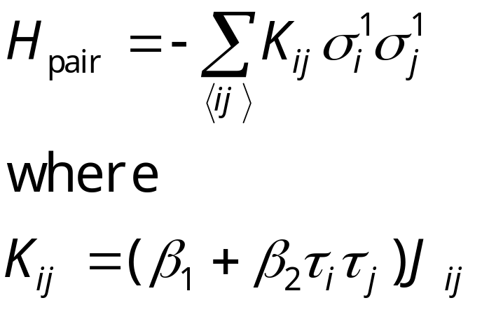
Pair Hamiltonian in Replica Monte Carlo
We define τ_{i}=σ_{i}¹σ_{i}², then H_{pair} can be rewritten as
The H_{pair} again is a spin glass. If β₁≈β₂, and two systems have consistent signs, the interaction is twice as strong; if they have opposite sign, the interaction is 0.

Slide 18
Cluster Flip in Replica Monte Carlo
Clusters are defined by the values of τ_{i} of same sign, The effective Hamiltonian for clusters is
H_{cl} = - Σ k_{bc} s_{b}s_{c}
Where k_{bc} is the interaction strength between cluster b and c, k_{bc}= sum over boundary of cluster b and c of K_{ij}.
τ = +1
τ = -1
^{b}
^{c}
Metropolis algorithm is used to flip the clusters, i.e., σ_{i}¹ -> -σ_{i}¹, σ_{i}² -> -σ_{i}² fixing τ for all i in a given cluster.
Notes:
Before the cluster move, s_{b} = +1, for all clusters b. To ensure ergodicity, other single spin flips within a single system has to be used. Swendsen-Wang mapping can be used inside each tau cluster to produce non-interacting clusters as well.

Slide 19
Apply Swendsen-Wang in Replica MC
The τ-cluster can be further broken down. Within a τ-cluster, a bond is set with probability P = 1 – exp(-2 (β₁+β₂)|J_{ij}|) if interaction is satisfied J_{ij}σ_{ι}σ_{j} > 0; no bond otherwise.
No interaction between clusters broken this way.
τ = +1
τ = -1
^{b}
^{c}

Slide 20
Implementation Issues
Use Hoshen-Kompelman algorithm to identify clusters
Based on cluster size and total number of clusters, pre-allocate memory to store effective cluster coupling k_{ab}
Order O(N) algorithm for each sweep

Slide 21
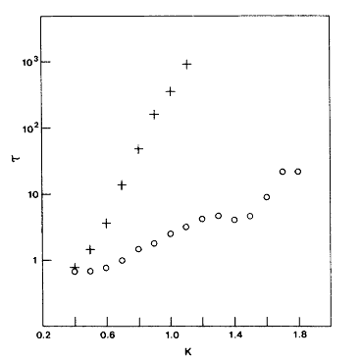
Comparing Correlation Times
Single spin flip
Correlation times as a function of inverse temperature K=βJ on 2D, ±J Ising spin glass of 32x32 lattice.
From R H Swendsen and J-S Wang, Phys Rev Lett 57 (1986) 2607.
Replica MC
Notes:
The replica Monte Carlo program used for this research is in glassibm.for. It is really a legacy code specially for the IBM 3083 computer that may not compile on modern computers.

Slide 22
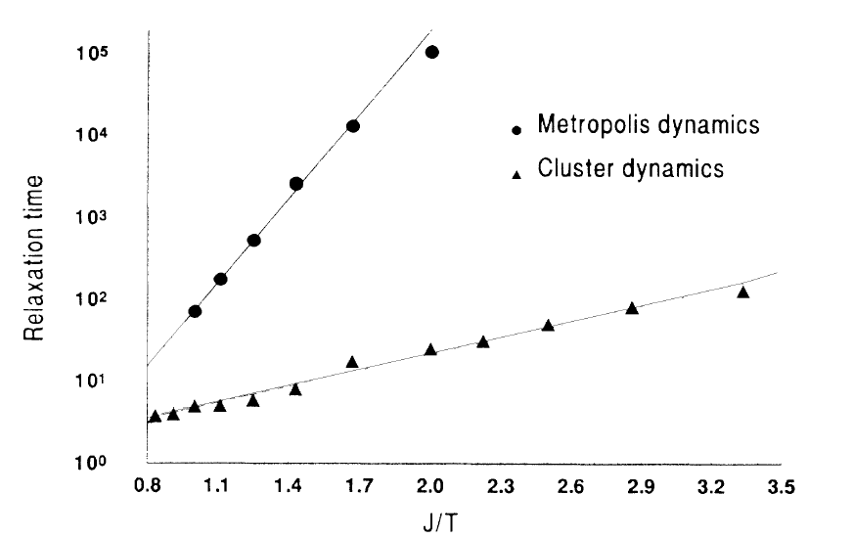
Cluster Algorithm of
S Liang
2D Gaussian spin glass on 16x16 lattice, using a generalization due to F Niedermayer.
From S Liang, PRL 69 (1992) 2145.

Slide 23
Replica Exchange (Hukushima & Nemoto, 1996)
A simple move of exchange configurations, σ¹ <-> σ², with Metropolis acceptance rate
min{ 1, exp[(β₂-β₁)(E(σ²)-E(σ¹))] }
This is equivalent to flip all the τ_{i} =-1 clusters in replica Monte Carlo.
Also known as parallel tempering
Notes:
The replica exchange algorithm is due to K. Hukushima and Y. Nemoto, J Phys Soc Jpn 65 (1996) 1604. Replica exchange is equivalent a replica Monte Carlo move where all the tau=-1 clusters are flipped.

Slide 24
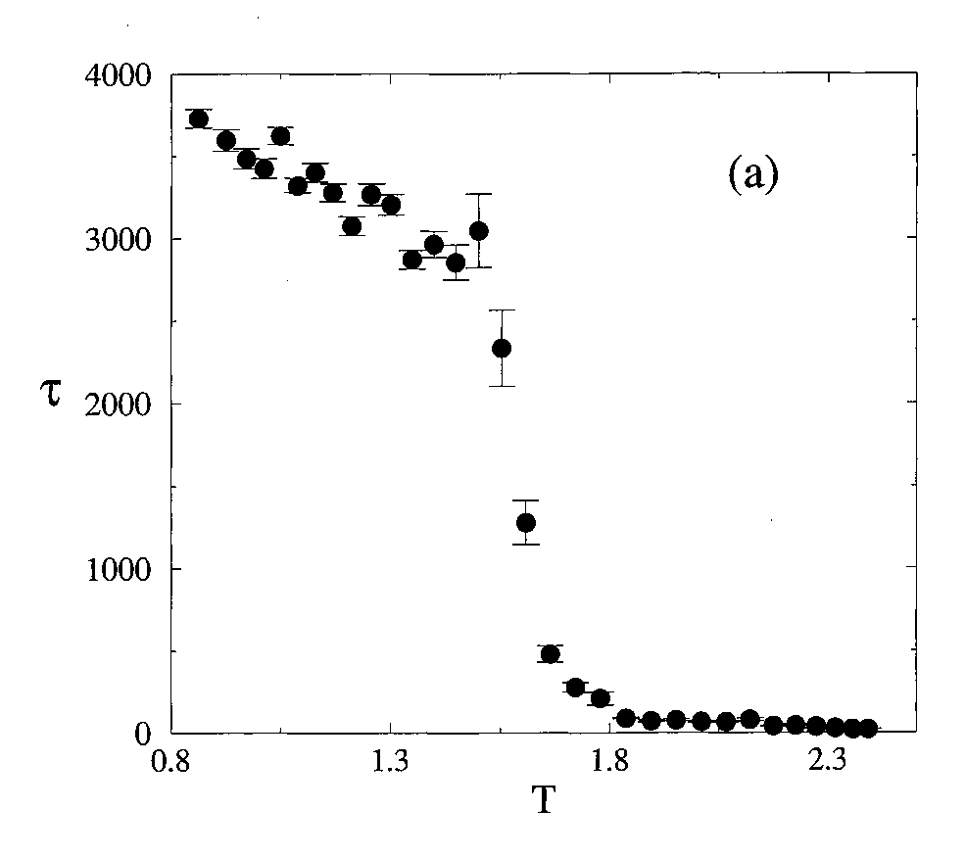
Replica Exchange
Spin-spin exponential relaxation time for replica exchange on 12³ lattice.
From K Hukushima and K Nemoto, J Phys Soc Jpn, 65 (1996) 1604.

Slide 25
Houdayer’s Cluster Algorithm
β₁
β₂
β₃
. . .
β_{M}
set N
Single τ-cluster flip between same temperature
. . .
β₁
β₂
β₃
. . .
β_{M}
set 2
β₁
β₂
β₃
. . .
β_{M}
set 1
Replica exchange between different temperatures
Simulate simultaneously M by N systems.

Slide 26
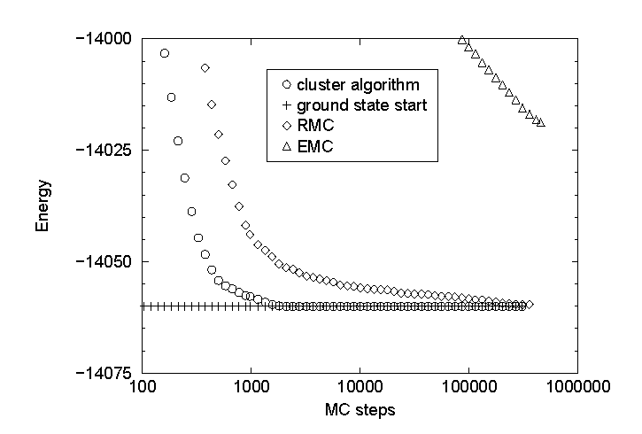
Relaxation towards Equilibrium at LowT
Relaxation of energy for 100x100 +/-J Ising spin glass at T = 0.1 [32 set of 26 replicas for cluster algorithm].
From J Houdayer, Eur Phys J B 22 (2001) 479.

Slide 27
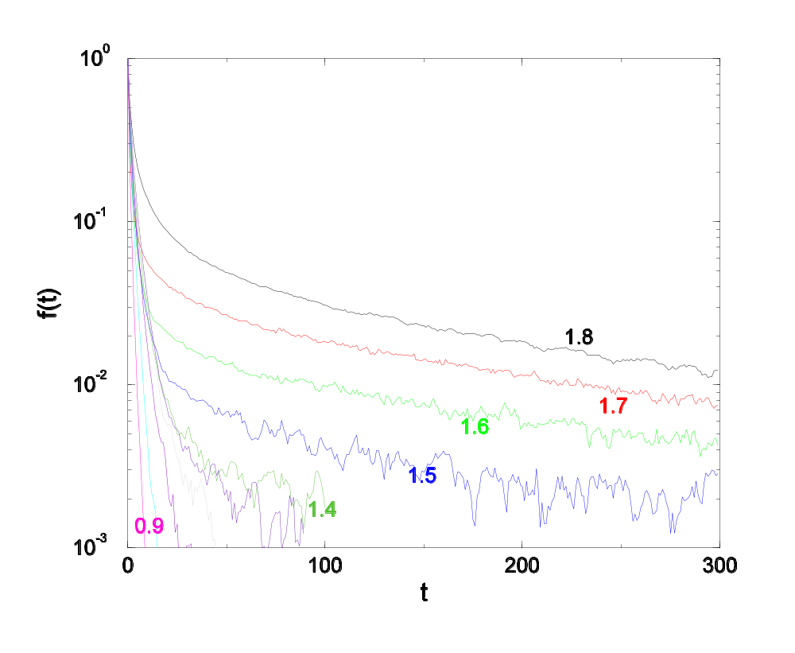
Correlation Functions in Replica MC
Time correlation function for order parameter q on 128x128 ±J Ising spin glass. 10⁶ MCS used. Labels are K=1/T.
q=|∑_{i}τ_{i}|
From J-S Wang and R H Swendsen, cond-mat/0407273.

Slide 28
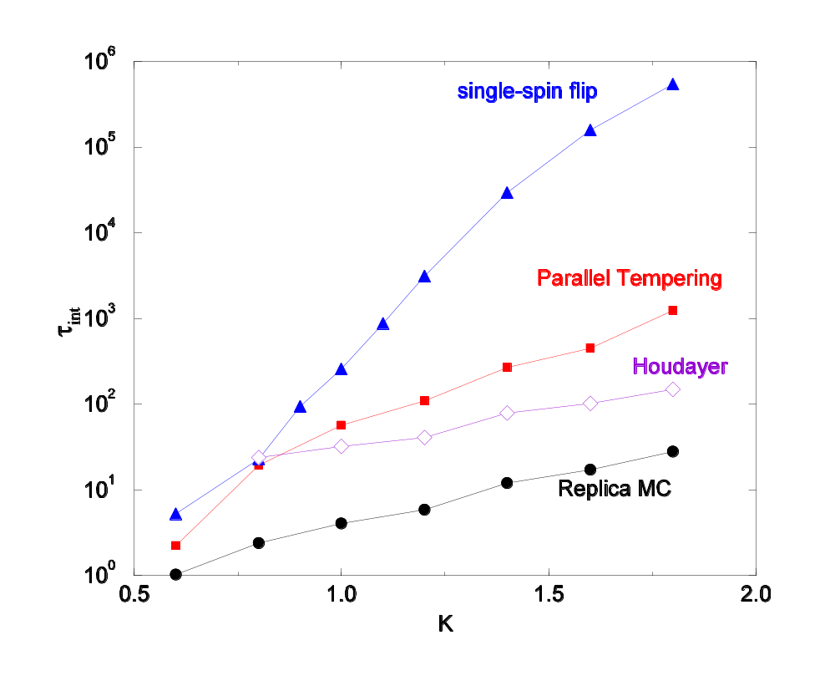
Comparison of Single-spin-flip, Parallel Tempering, Houdayer, and Replica MC
2D ±J Ising spin glass integrated correlation time on a 32x32 lattice.
From cond-mat/0407273, to appear (2005) Prog Theor Phys Suppl.

Slide 29
Integrated Correlation Times, 128x128 system
1/T | Replica MC | Parallel Tempering | Single Spin Flip
5.0 | 71
3.0 | 367
1.8 | 13.5 | 39000 | 5.2x10⁶
1.6 | 5.1 | 2700 | 2.4x10⁶
1.4 | 2.3 | 2076 | 48000
1.3 | 2.4 | 998
1.0 | 1.3 | 163 | 162.1

Slide 30
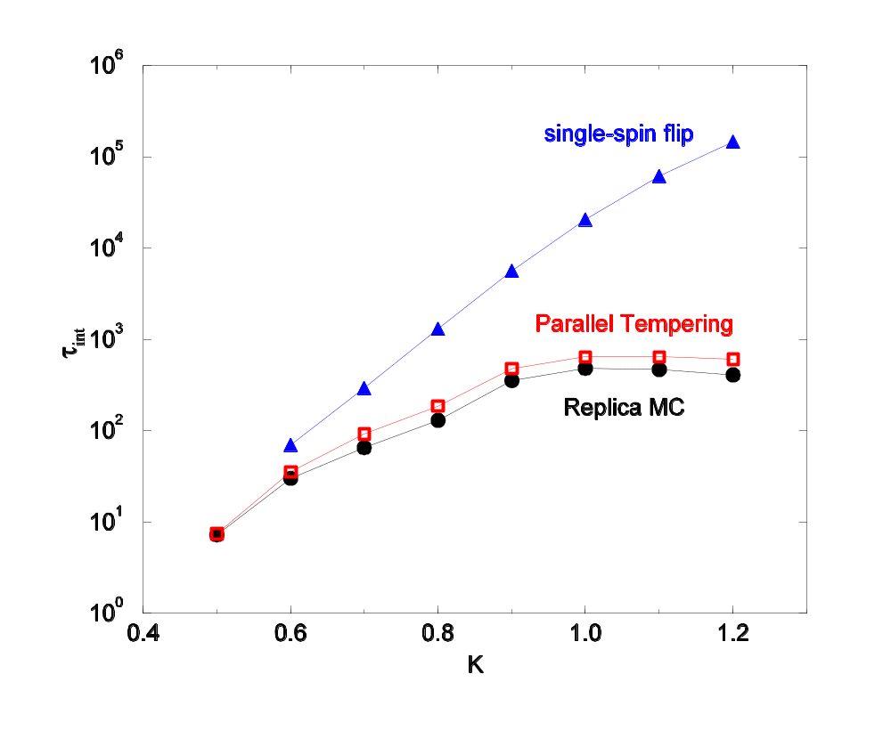
Comparison in 3D
Integrated correlation times for ±J Ising spin glass on 12x12x12 lattice.

Slide 31
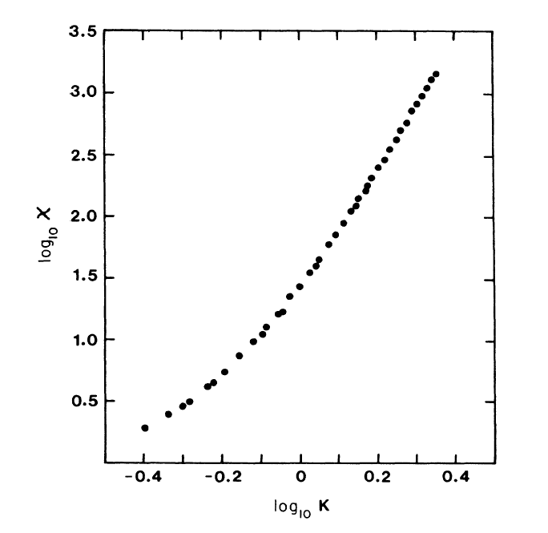
2D Spin Glass Susceptibility
2D ±J spin glass susceptibility on 128x128 lattice, 1.8x10⁴ MC steps.
From J S Wang and R H Swendsen, PRB 38 (1988) 4840.
χ ∝ K^{5.11} was concluded.

Slide 32
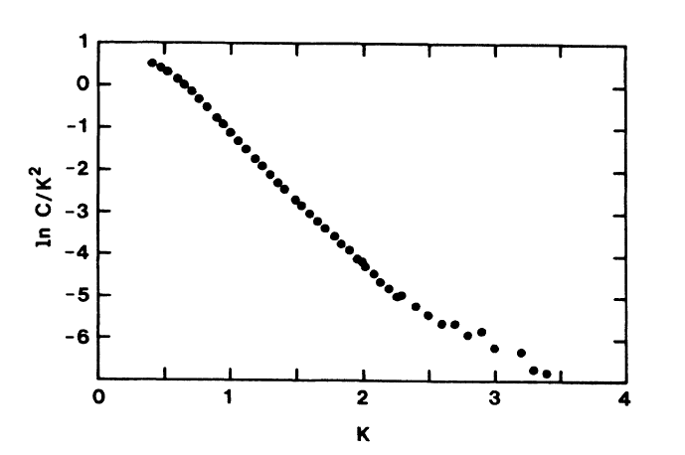
Heat Capacity at Low T
c ∝ T ⁻²exp(-2J/T)
This result is confirmed recently by Lukic et al, PRL 92 (2004) 117202.
slope = -2

Slide 33
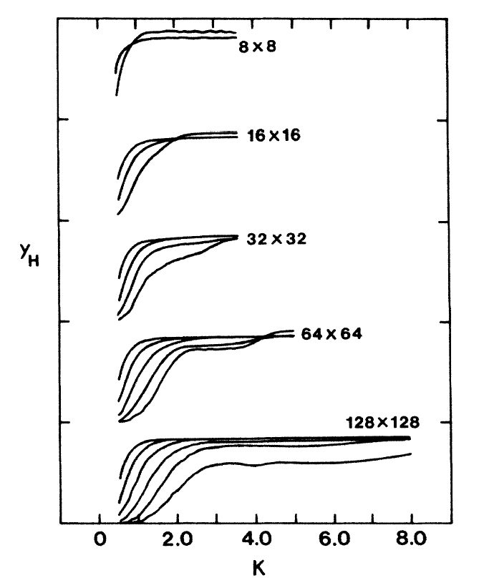
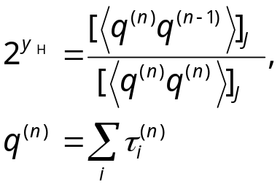
Monte Carlo Renormalization Group
Y_{H} defined by
with RG iterations for difference sizes in 2D.
From J S Wang and R H Swendsen, PRB 37 (1988) 7745.

Slide 34
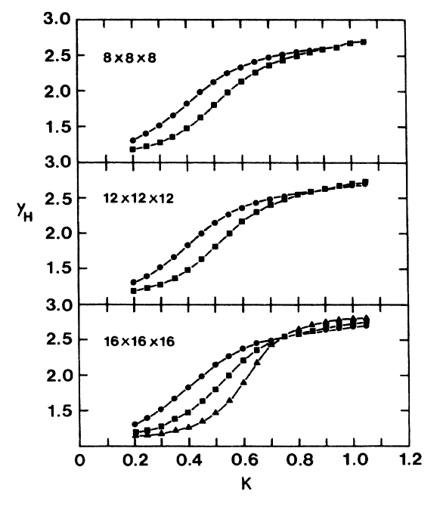
MCRG in 3D
3D result of Y_{H}.
MCS is 10⁴ to 10⁵, with 23 samples for L= 8, 8 samples for L= 12, and 5 samples for L= 16.

Slide 35
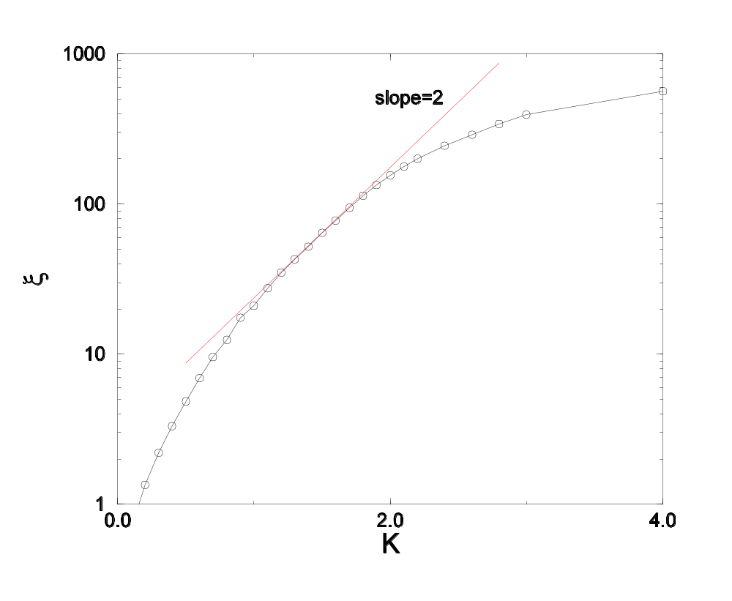
Correlation Length
Correlation length (defined by ratio of wavenumber dependent susceptibilities) on 128x128 lattice, averaged of 96 random coupling samples.
Unpublished.

Slide 36
Summary
Replica MC is very efficient in 2D, and becomes equivalent to Parallel Tempering in 3D
Replica MC has been used for equilibrium simulations (heat capacity, MCRG, etc)

