Slide 1
Series Expansion in Nonequilibrium Statistical Mechanics
Jian-Sheng Wang
Dept of Computational Science, National University of Singapore

Slide 2
Outline
Introduction to Random Sequential Adsorption (RSA) and series expansion
Ising relaxation dynamics and series expansion
Padé analysis

Slide 3
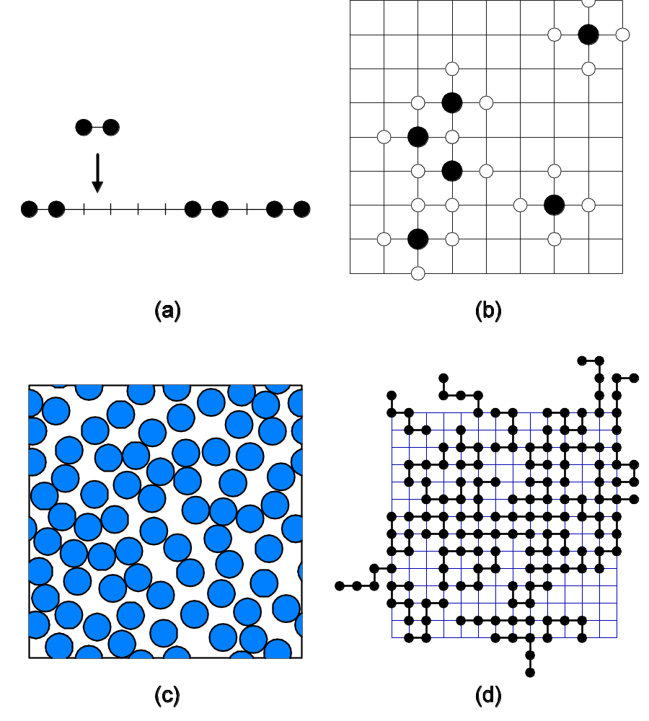
Random Sequential Adsorption
For review, see J S Wang, Colloids and Surfaces, 165 (2000) 325.
Notes:
For a review in random sequential adsorption, including Monte Carlo simulations, see J S Wang, “Colloids and Surfaces”, 165 (2000) 325.

Slide 4
The Coverage
Disk in d-dimension:
θ(t) = θ(∞) – a t^{-1/d}
Lattice models
θ(t) = θ(∞) – a exp(-b t)
Problems: (1) determine accurately the function θ(t), in particular the jamming coverage θ(∞); (2) determine t -> ∞ asymptotic law

Slide 5
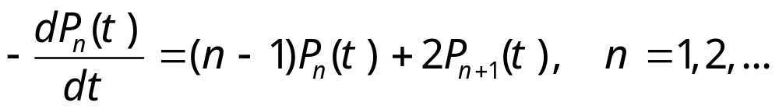
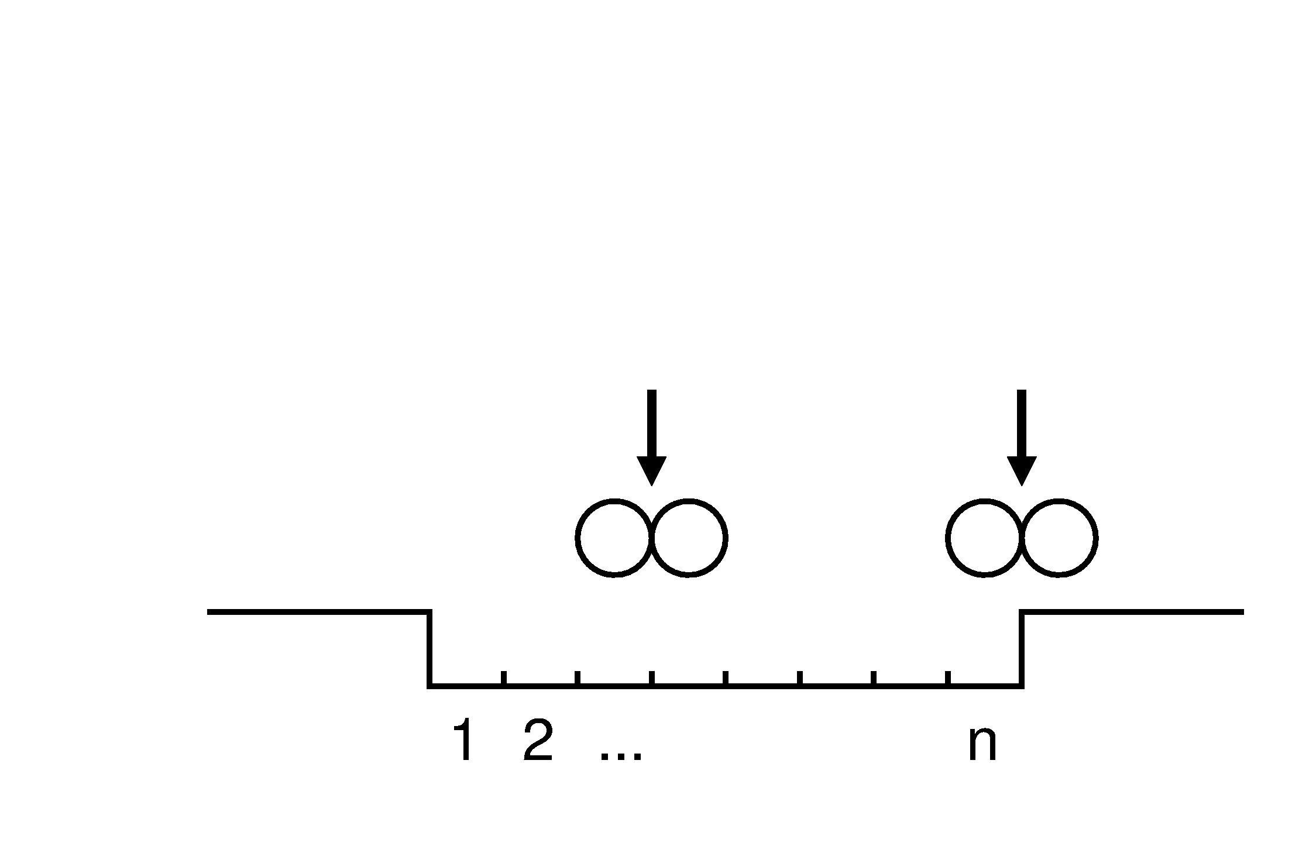
1D Dimer Model
P_{n}(t) is the probability that n consecutive sites are empty.
Notes:
Exact result is known for this equation.

Slide 6
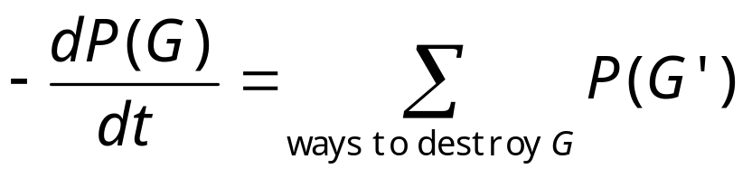
Rate Equations
Where G is some graph formed by a set of empty sites.

Slide 7
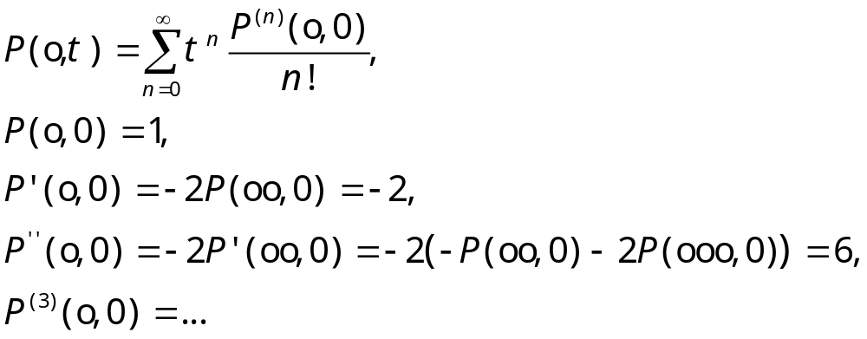
Series Expansion,
1D Dimer

Slide 8
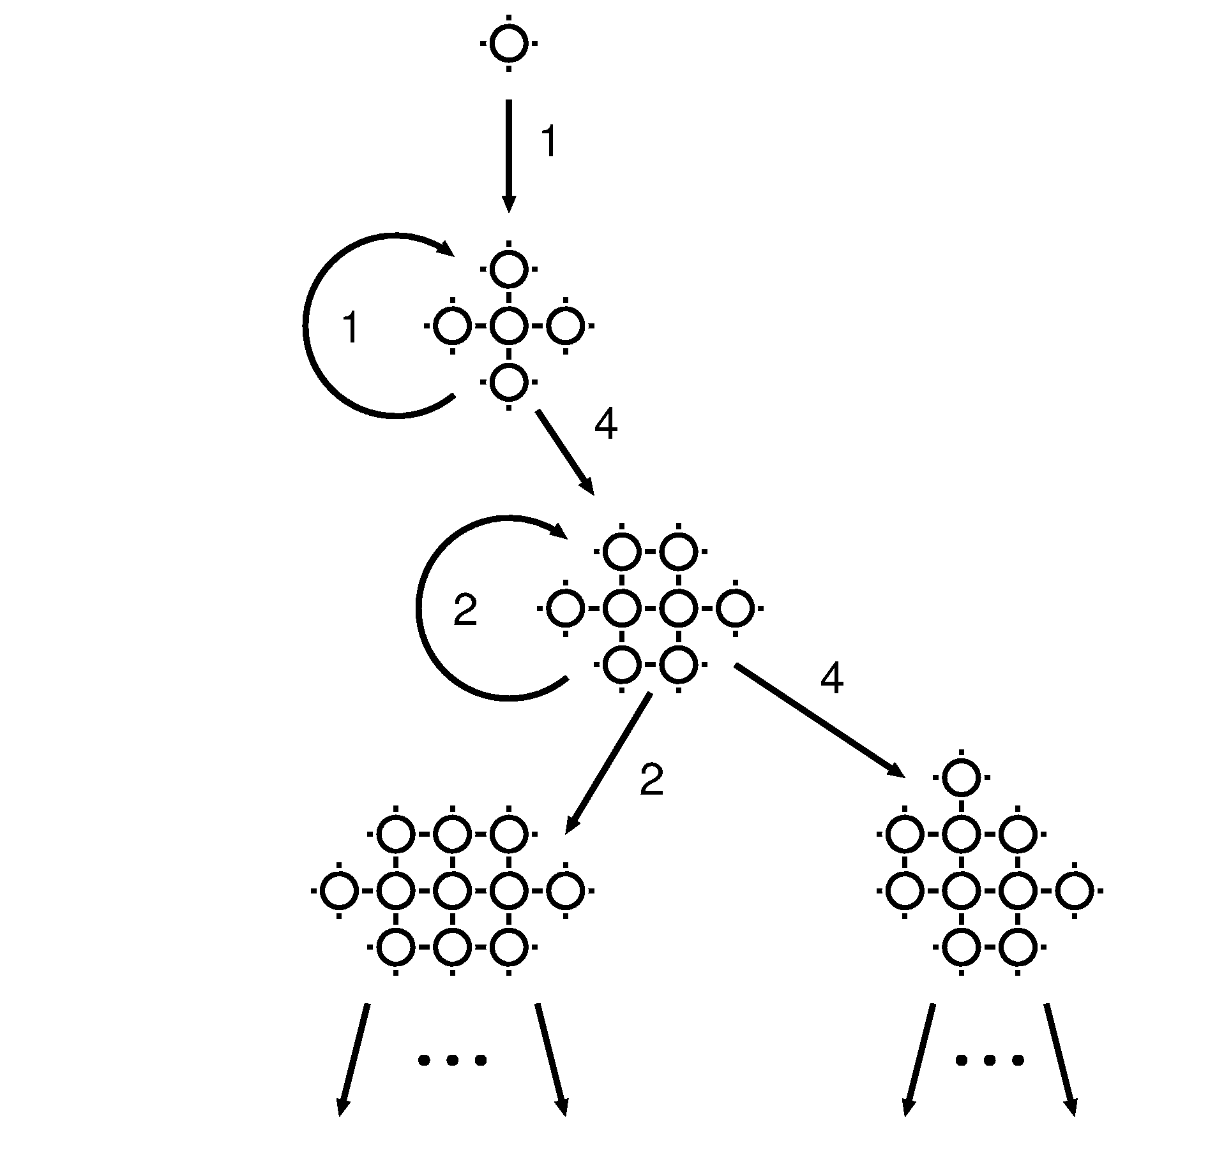
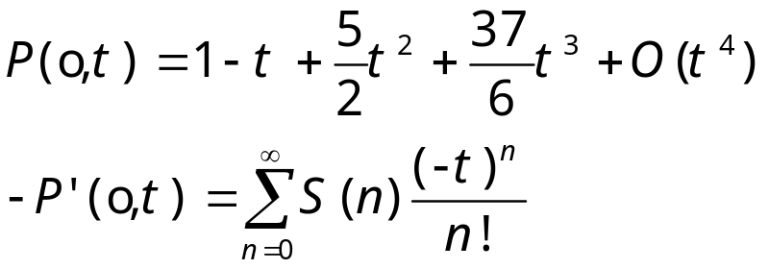
Nearest Neighbor Exclusion Model

Slide 9
Computerized Series Expansion
RSA(G,n)
{
S(n) += |G|;
if(n > N_{max}) return;
for each (x in G) {
RSA(G U D(x), n +1);
}
}
// G is a set of sites,
// x is an element in G,
// D(x) is a set consisting
// of x and 4 neighbor
// sites. |…| stands for
// cardinality, U for
// union.

Slide 10
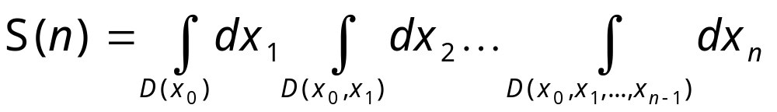
RSA of disk
For continuum disk, the results can be generalized for the coefficients of a series expansion:
where D(x₀) is a unit circle centered at (0,0), D(x₀,x₁) is the union of circles centered at x₀ and x₁, etc.
Notes:
See the original paper by R Dickman, J S Wang, and I Jensen, “J Chem Phys”, 94 (1991) 8252.
Note that x_{i} = (a,b) is two-dimensional.

Slide 11
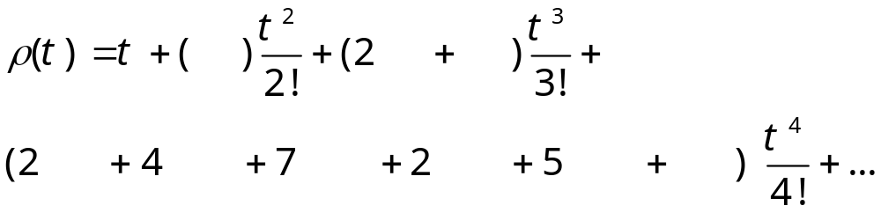
Diagrammatic Rule for RSA of disk
A sum of all n-point connected graphs. Each graph represents an integral, in which each node (point) represents an integral variable, each link (line) represents f(x,y)=-1 if |x-y|<1, and 0 otherwise. This is similar to Mayer expansion.

Slide 12
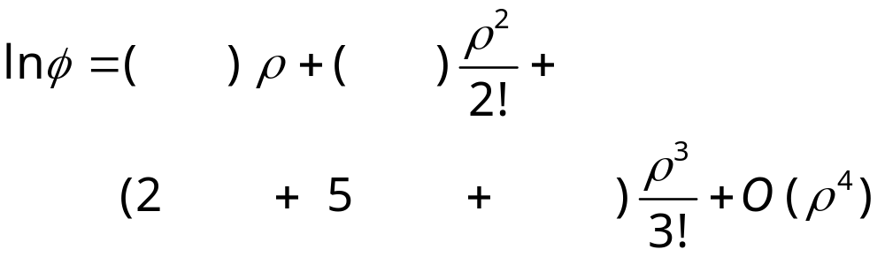
Density Expansion
Where φ = dρ/dt is rate of adsorption. The graphs involve only star graphs. From J A Given, Phys Rev A, 45 (1992) 816.

Slide 13
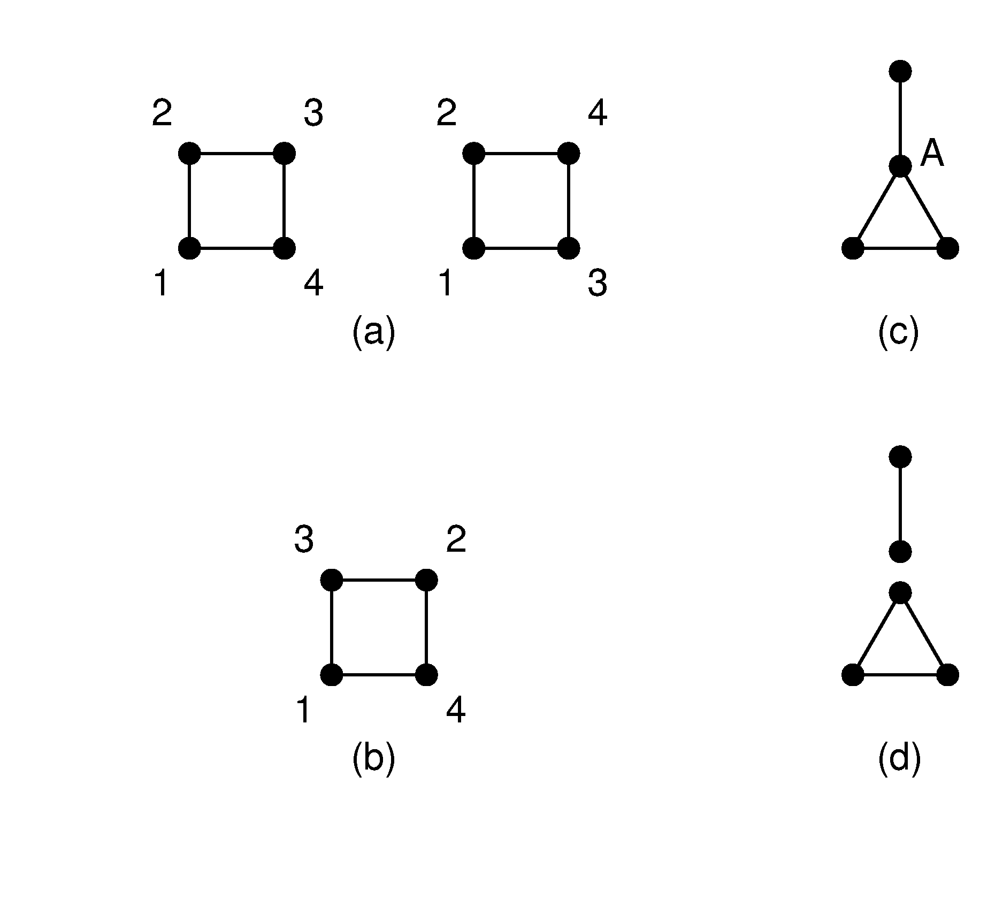
Symmetry Number and Star Graph
A is called an articulation point. Removal of point A breaks the graph into two subgraphs.
A star graph (doubly connected graph) does not have articulation point.
A point must connect to a point with label smaller than itself.

Slide 14
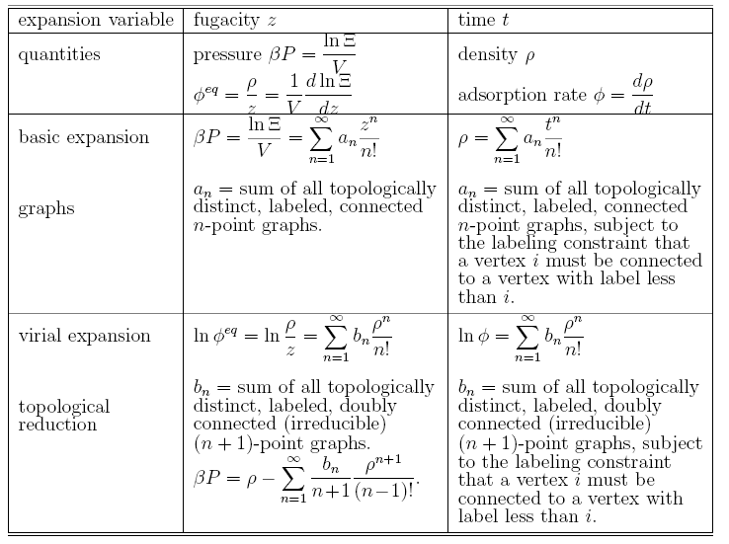
Mayer Expansion vs RSA

Slide 15
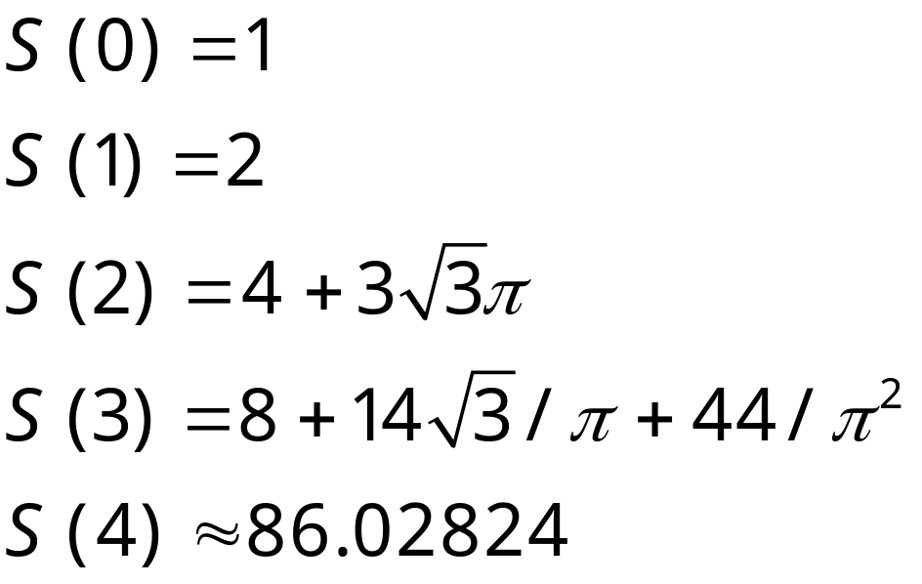
Series Results, 2D disk

Slide 16
Series Analysis
Transform variable t into a form that reflects better the asymptotic behavior: e.g:
y=1-exp(-b(1-e^{-t})) for lattice models
y=1-(1+bt)^{-1/2} for 2D disk
Form Padé approximants in y.

Slide 17
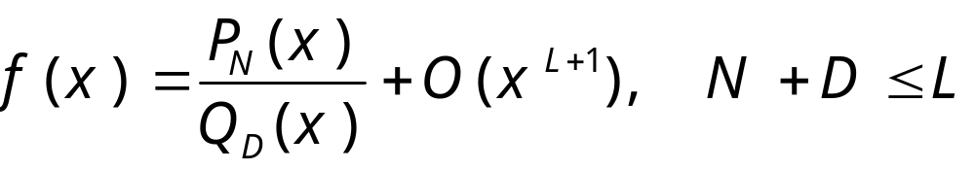
Padé Approximation
Where P_{N} and Q_{D} are polynomials of order N and D, respectively.

Slide 18
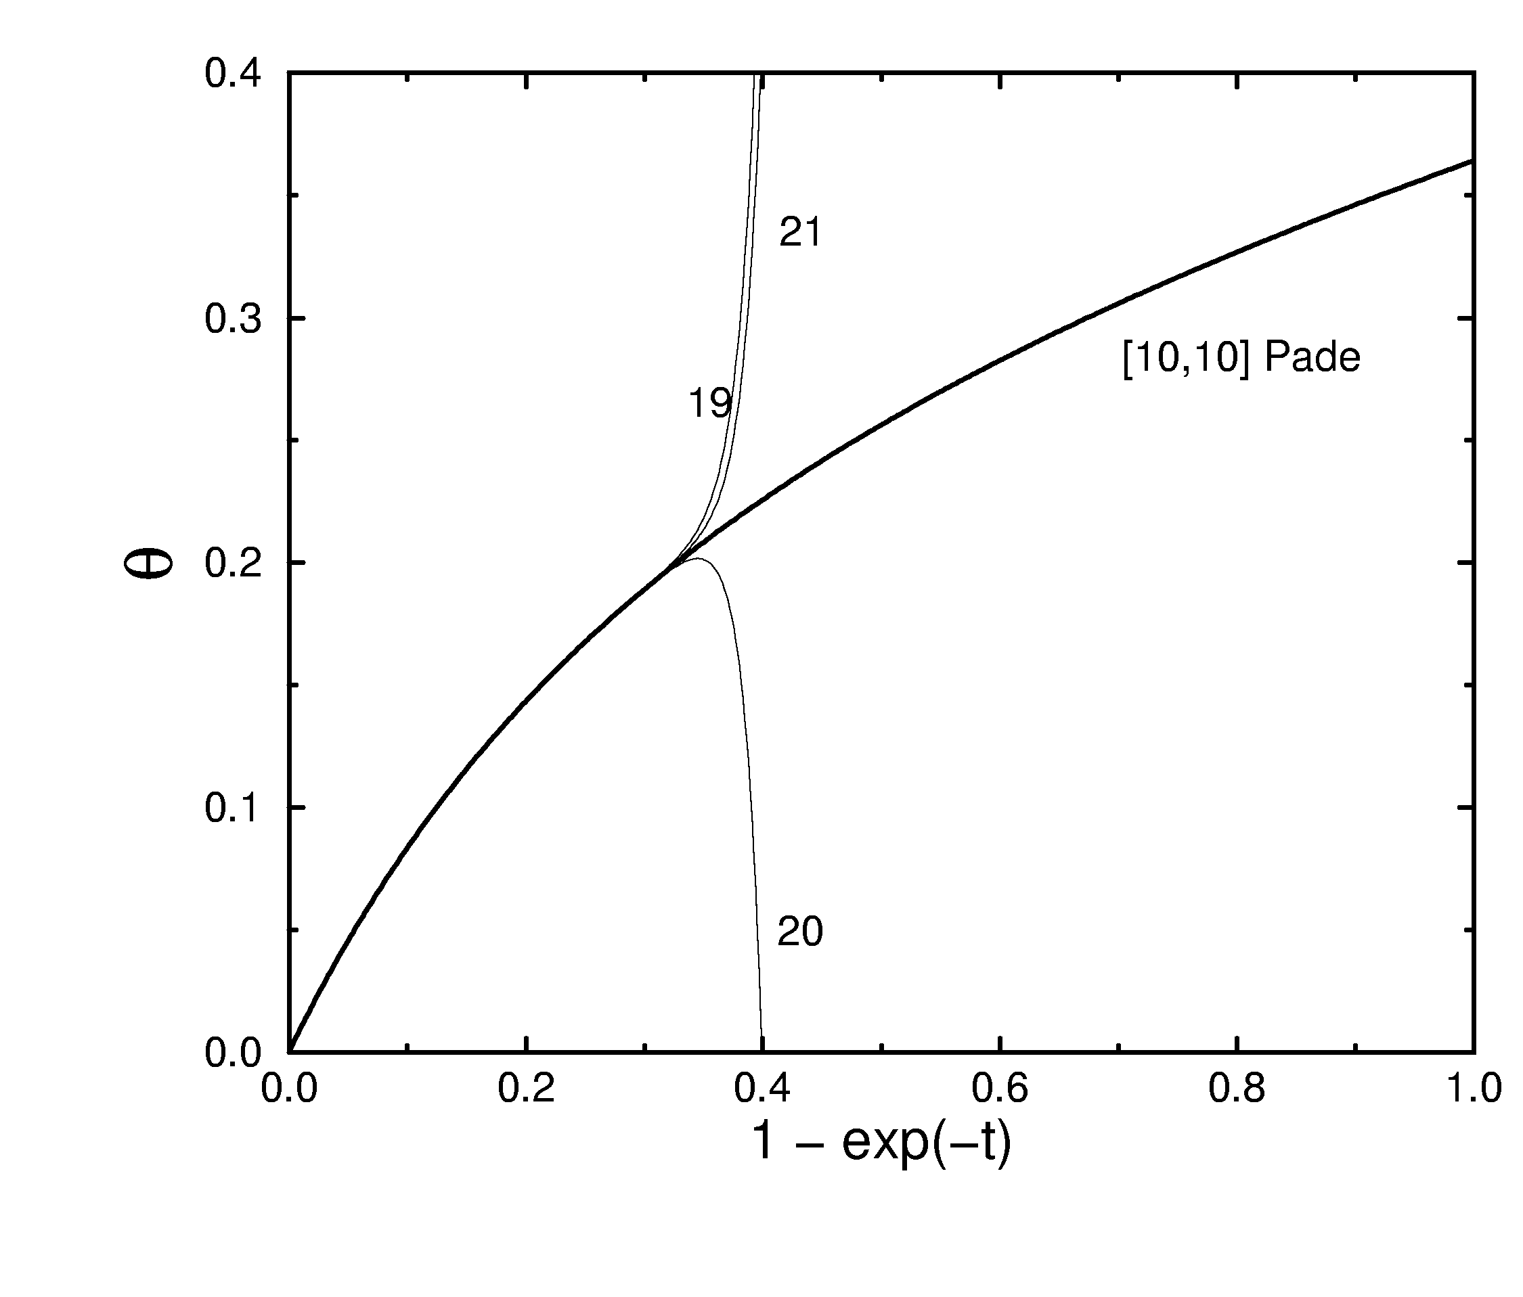
RSA nearest neighbor exclusion model
Direct time series to 19, 20, and 21 order, and Padé approximant in variable y with b=1.05. θ(∞) from Padé analysis is 0.3641323(1), from Monte Carlo is 0.36413(1).
θ(∞)

Slide 19
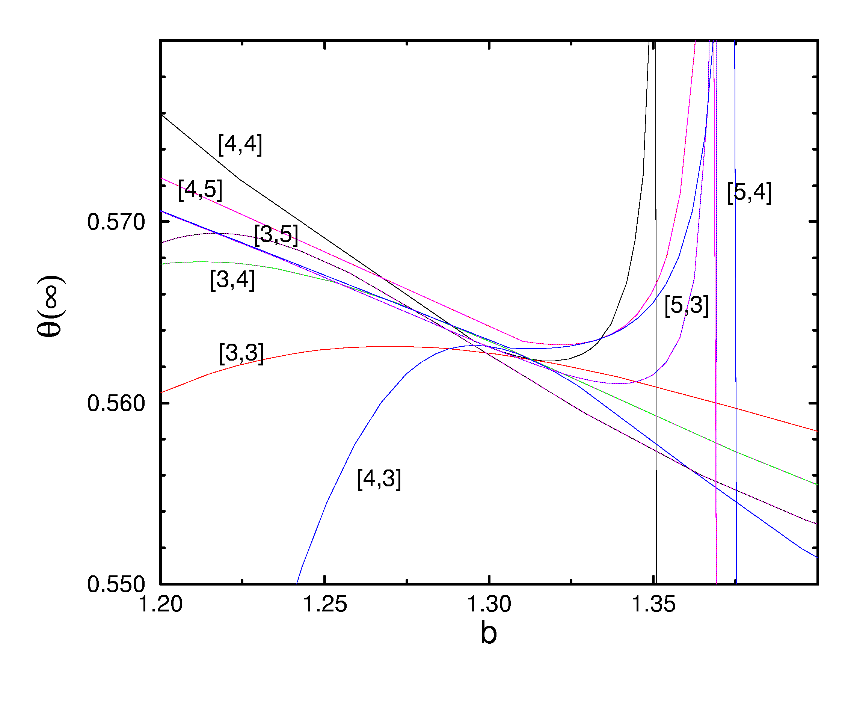
Padé Analysis of Oriented Squares
The [N,D] Padé results of θ(∞) vs the adjustable parameter b. Best estimate is b=1.3 when most Padé approximants converge to the same value 0.563.

Slide 20
Estimates of the Jamming Coverage
Model | n_{max} | Series | MC
NN | 21 | 0.3641323(1)^{A} | 0.36413(1)^{E}
Dimer | 18 | 0.906823(2)^{A} | 0.906820(2)^{F}
NN (honeycomb) | 24 | 0.37913944(1)^{A} | 0.38(1)^{G}
Dimer (honeycomb) | 22 | 0.8789329(1)^{A} | 0.87889^{H}
NNN | 14 | 0.186985(2)^{B} | 0.186983(3)^{I}
Hard disk | 5 | 0.5479^{C} | 0.5470690(7)^{J}
Oriented squares | 9 | 0.5623(4)^{D} | 0.562009(4)^{K}
A: Gan & Wang, JCP 108 (1998) 3010. B: Baram & Fixman, JCP, 103 (1995) 1929. C: Dickman, Wang, Jensen, JCP 94 (1991) 8252. D: Wang, Col & Surf 165 (2000) 325. E: Meakin, et al, JCP 86 (1987) 2380. F: Wang & Pandey, PRL 77 (1996) 1773. G: Widom, JCP, 44 (1966) 3888. H: Nord & Evans, JCP, 82 (1985) 2795. I: Privman, Wang, Nielaba, PRB 43 (1991) 3366. J: Wang, IJMP C5 (1994) 707. K: Brosilow, Ziff, Vigil, PRA 43 (1991) 631.

Slide 21
Ising Relaxation towards Equilibrium
Magnetization m
Schematic curves of relaxation of the total magnetization as a function of time. At T_{c} relaxation is slow, described by power law:
m ∝ t ^{-β/(zν)}
T < T_{c}
T = T_{c}
T > T_{c}
Time t
Notes:
See, e.g., N. Ito et al, J Phys Soc. Jpn, 69 (2000) 1931. See also B Zheng, Int. J. Mod. Phys B12 (1998) 1419 for short-time dynamics.
Figure is schematic. β is the magnetization exponent, ν is correlation length exponent, and z is dynamical critical exponent.

Slide 22
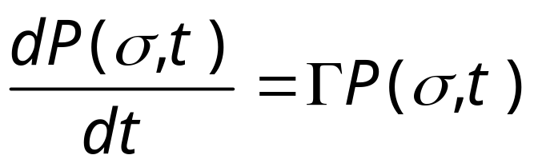
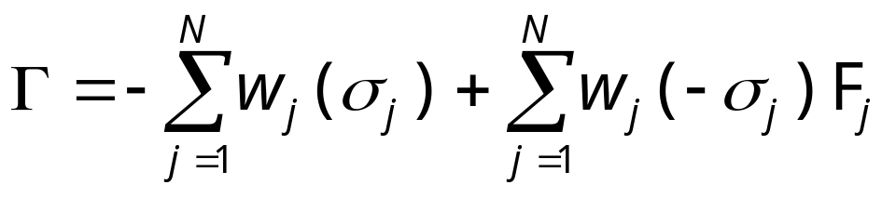
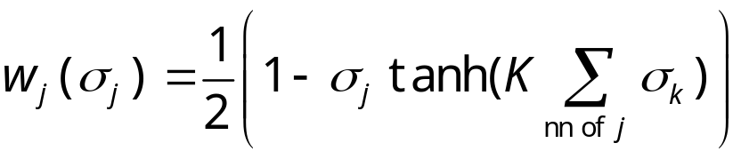
Basic Equation for Ising Dynamics (continuous time)
where Γ is a linear operator in configuration space σ. For Glauber flip rate, we can write

Slide 23
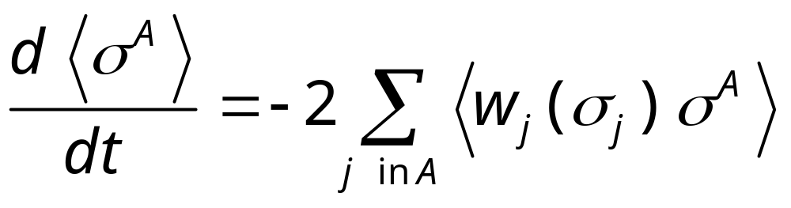
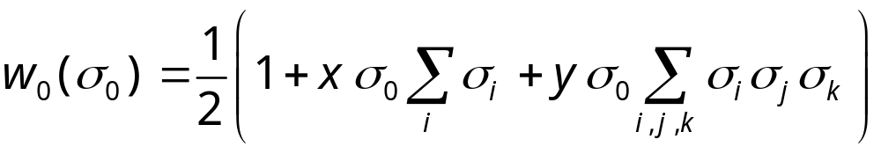
General Rate Equation in Ising Dynamics

Slide 24
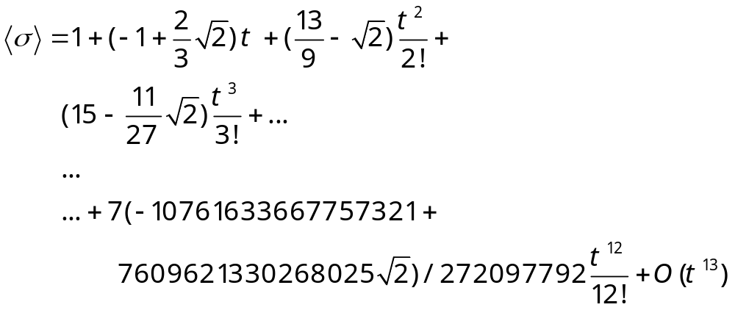
The Magnetization Series at T_{c}
Energy series <σ₀σ₁> is also obtained.

Slide 25
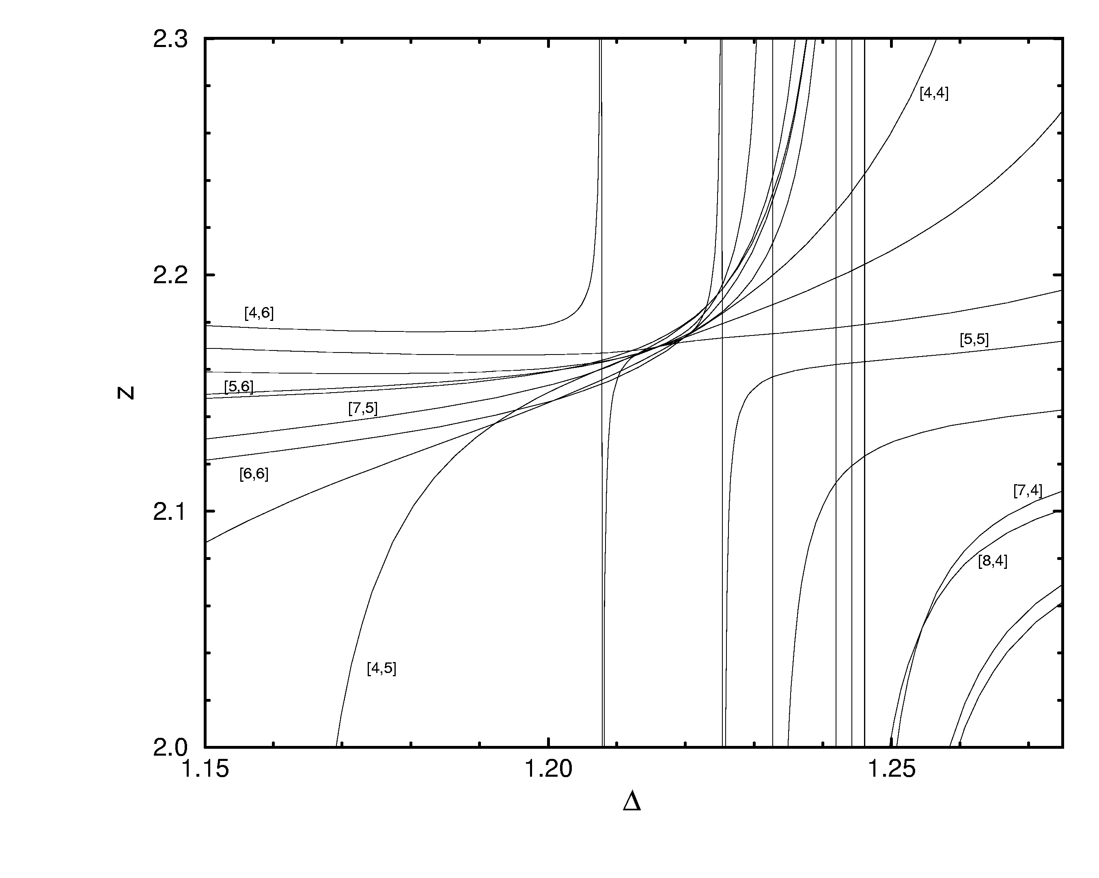
Ising Dynamics Padé Plot
Best z estimate is from Δ where most curves intersect.
From J-S Wang & Gan, PRE, 57 (1998) 6548.

Slide 26
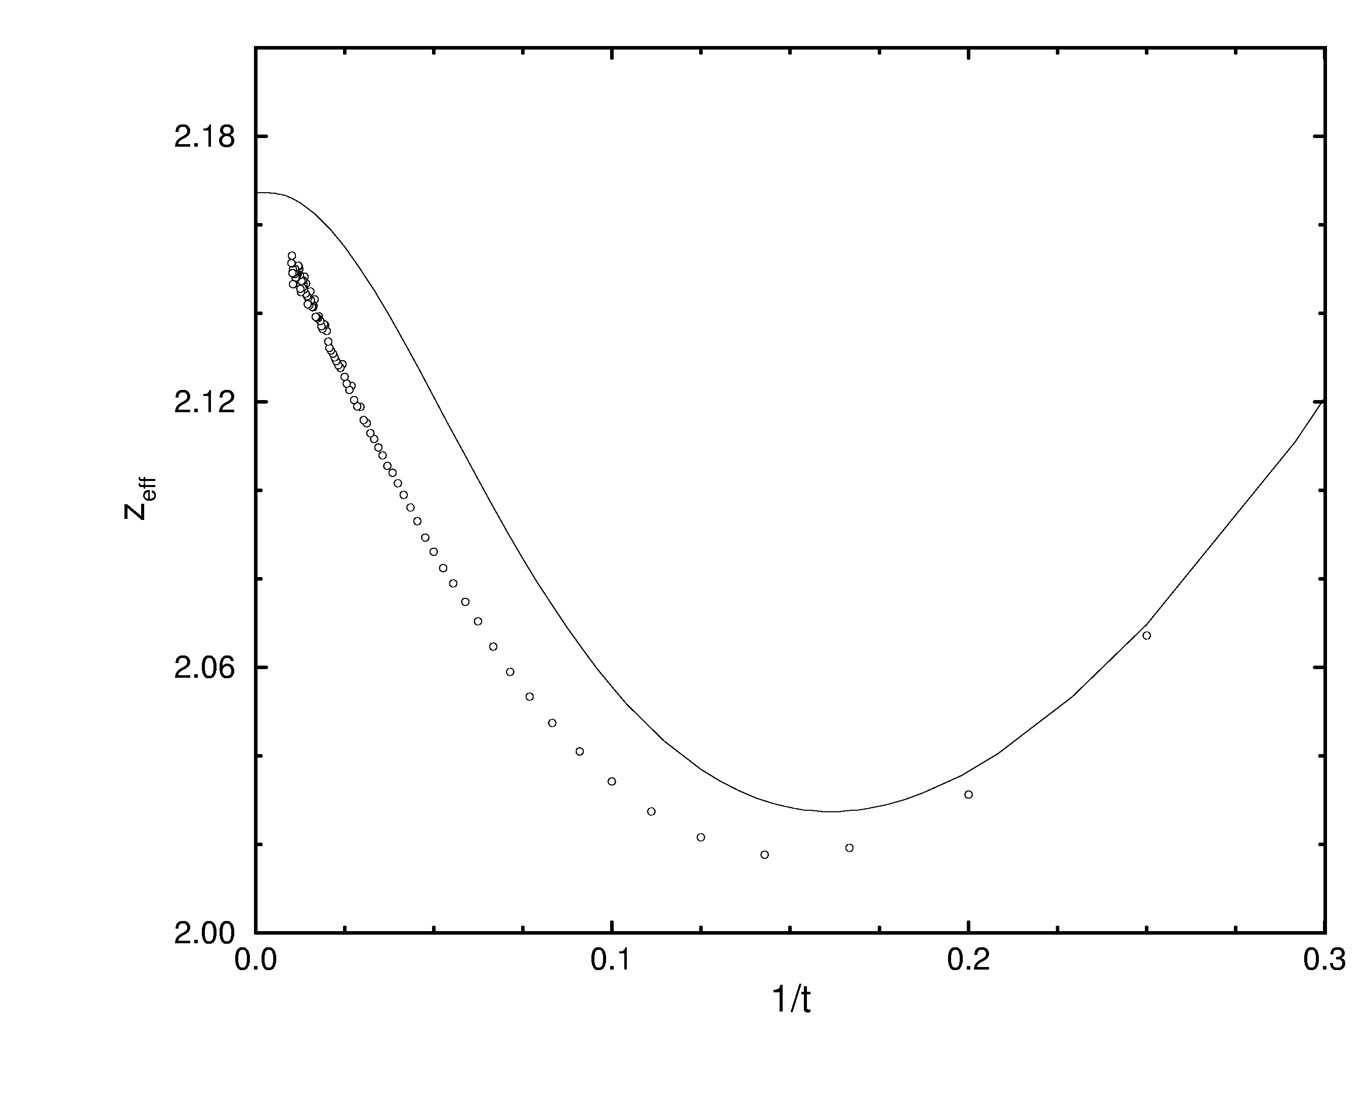
Effective Dynamical Exponent z
Extrapolating to t -> ∞, we found z = 2.169±0.003, consistent with Padé result.
[6,6] Padé
MC

Slide 27
Summary
Series for Random Sequential Adsorption and Ising dynamics are obtained. Using Padé analysis, the results are typically more accurate than Monte Carlo results.

