Slide 1
Nonequilibrium Green’s Function Method for Thermal Transport
Jian-Sheng Wang
Notes:
Slides for TIENCS 2010 Singapore, lecture by Jian-Sheng Wang, a soft ppt copy is available under the page http://staff.science.nus.edu.sg/~phywjs/Talks/talks.html

Slide 2
Outline of the lecture
Models
Definition of Green’s functions
Contour-ordered Green’s function
Calculus on the contour
Feynman diagrammatic expansion
Relation to transport (heat current)
Applications

Slide 3
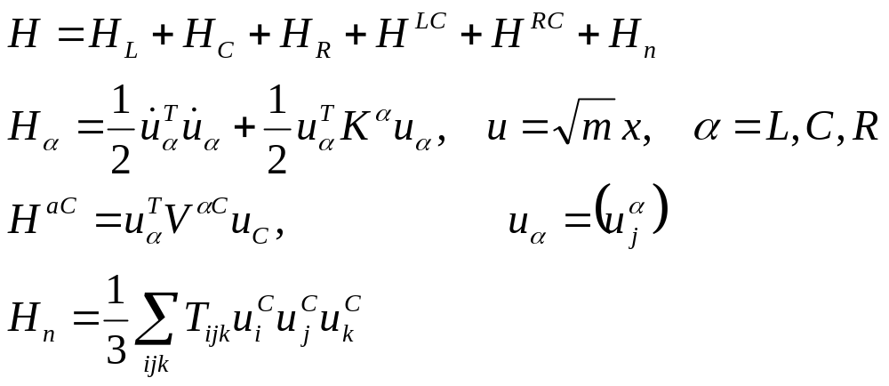
Models
Junction
Left Lead, T_{L}
Right Lead, T_{R}
Notes:
The model in this form is fairly general. Note that x has the dimension of length. Superscript T is for matrix or column vector transpose.

Slide 4
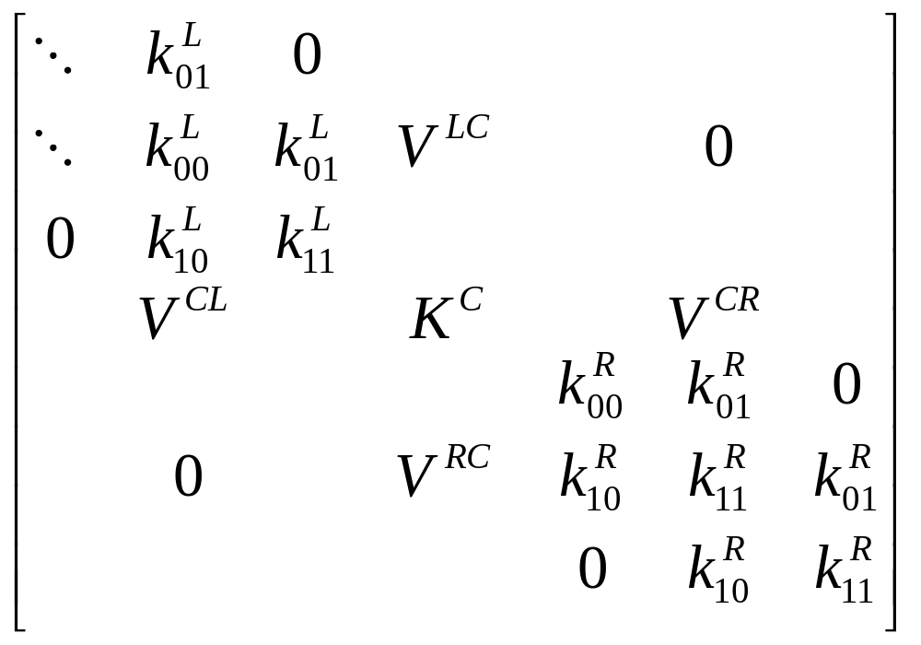
Force constant matrix
K^{R}
Notes:
K is divided into three regions, left, center, right. The force constants K can be computed from a first principles package by taking the second derivatives of the total potential.

Slide 5
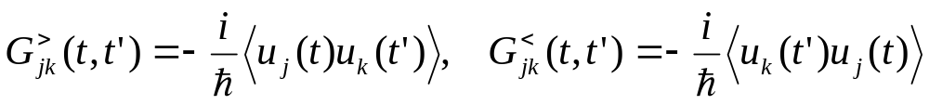
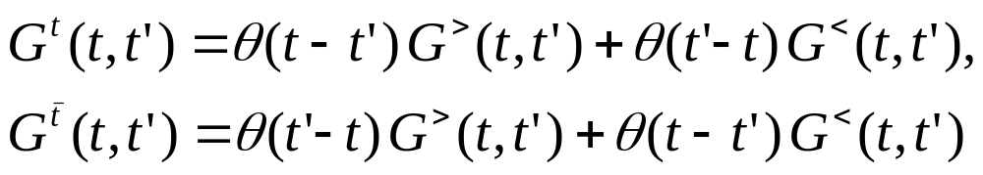
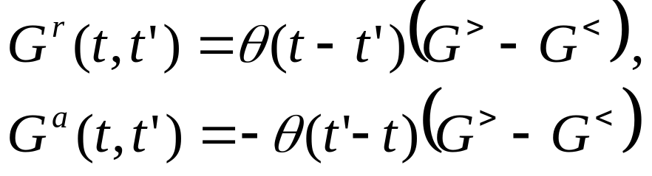
Definitions of Green’s functions
Greater/lesser Green’s function
Time-ordered/anti-time ordered Green’s function
Retarded/advanced Green’s function
Notes:
Other types such as Matsubara Green’s function or canonical (Kubo) correlation are also used. i = sqrt(-1). The average < … > can be equilibrium or with respect to arbitrary density matrix. For classical systems, G< = G>.

Slide 6
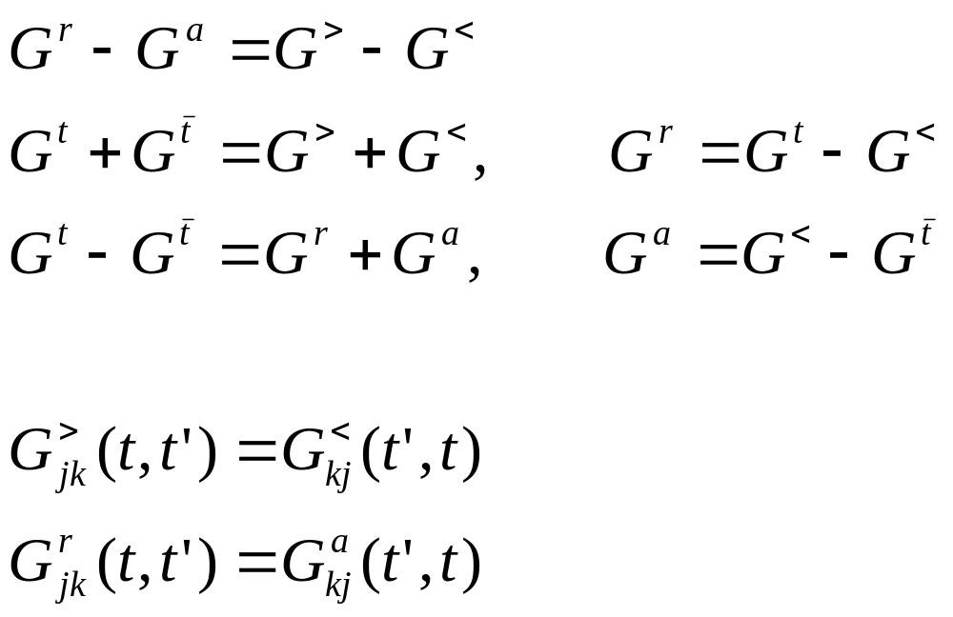
Relations among Green’s functions
Notes:
The relation implies two (three?) linearly independent ones, and one independent one only if nonlinear dependence is considered.

Slide 7
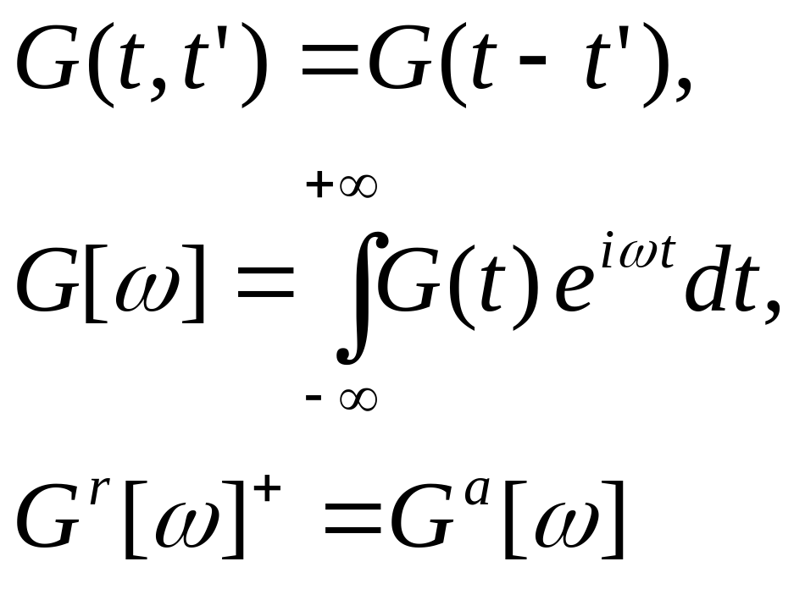
Steady state, Fourier transform
Notes:
The inverse Fourier transform has a factor of 2 . We use square brackets [ ] to denote Fourier transformed function.

Slide 8
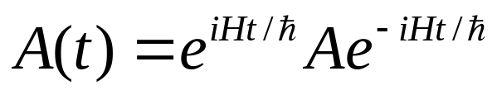
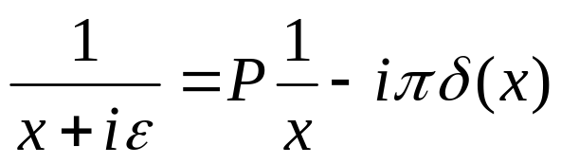
Equilibrium systems, Lehmann representation
The average is with respect to the density operator exp(-β H)/Z
Heisenberg operator
Write the various Green’s functions in terms of energy eigenstate H |n> = E_{n} |n>
Use the formula
Notes:
For Lehmann representation, see, e.g., H Bruus and K. Flensberg, “Many-Body Quantum …”, page 128. Electron Green’s function was used there, but it’s easy to adapt for phonons.

Slide 9
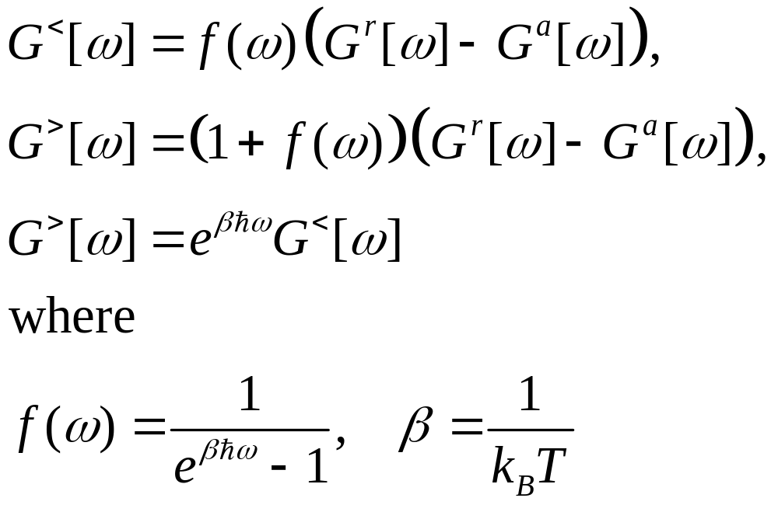
Fluctuation dissipation theorem
Notes:
The fluctuation dissipation theorem applies only for equilibrium systems.

Slide 10
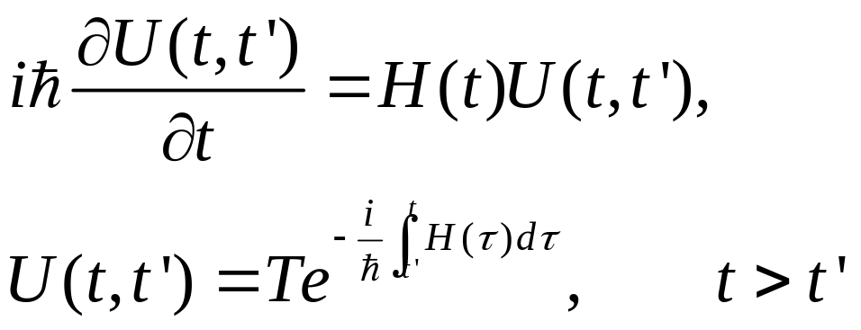
Computing average (nonequilibrium)
Average < ... > over an arbitrary density matrix ρ
ρ = exp(-βH)/Z in equilibrium
Schrödinger picture: A, (t)
Heisenberg picture: A_{H}(t) = U(t₀,t)AU(t,t₀) , ρ₀ , where operator U satisfies
Notes:
< . > = Tr(ρ . ). T here denotes time order, assuming t > t’. Anti-time order if t < t’.

Slide 11
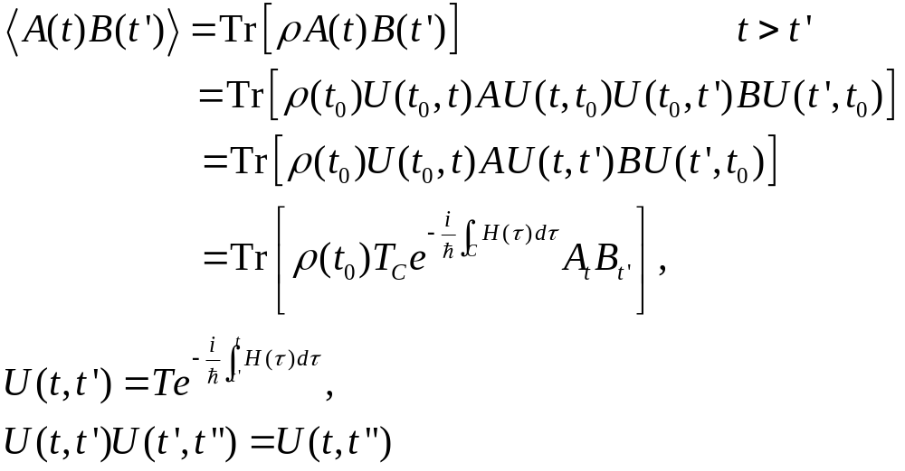
Calculating correlations
B
A
t₀
t’
t
Notes:
t₀ is the synchronization time where the Schrödinger picture and Heisenberg picture are the same.

Slide 12
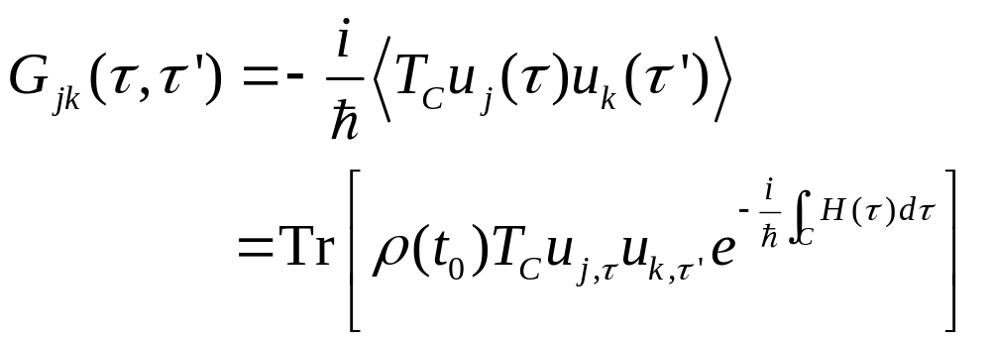
Contour-ordered Green’s function
Contour order: the operators earlier on the contour are to the right.
τ’
τ
t₀

Slide 13
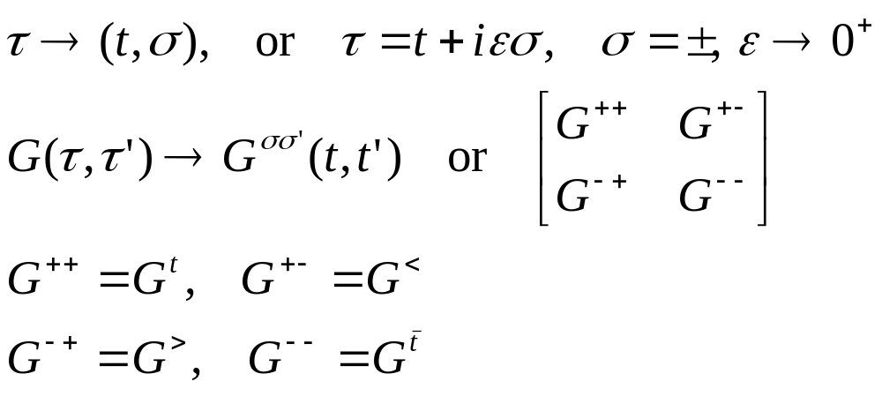
Relation to other Green’s function
τ’
τ
t₀
Notes:
σ = + for the upper branch, and – for the returning lower branch.

Slide 14
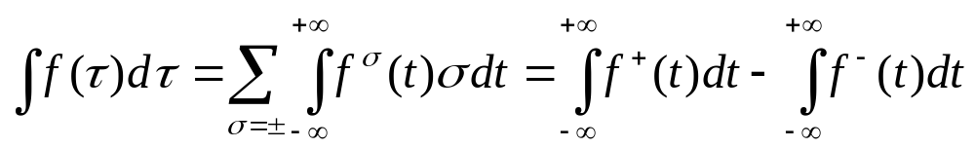
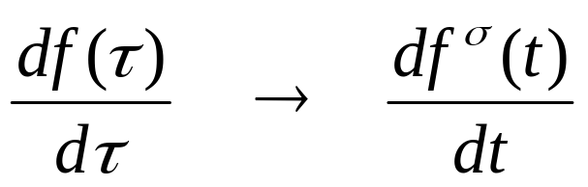
Calculus on the contour
Integration on (Keldysh) contour
Differentiation on contour
Notes:
dτ is σdt for integration, but just dt in differentiation. σ is either just the sign + or -, or +1, -1.

Slide 15
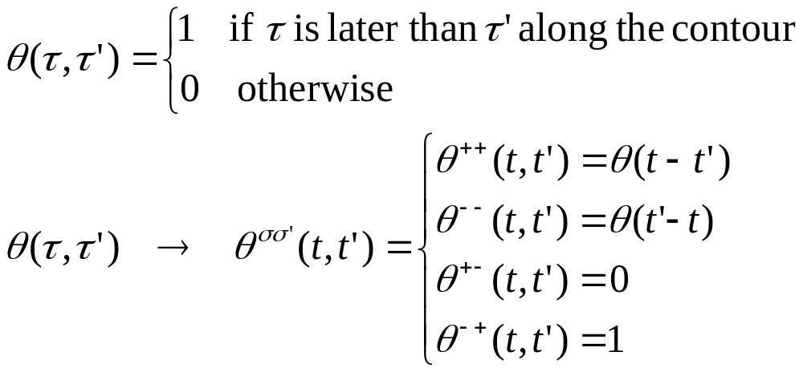
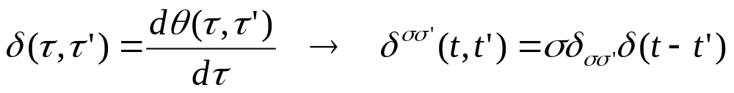
Theta function and delta function
Theta function
Delta function on contour
where θ(t) and δ(t) are the ordinary theta and Dirac delta functions

Slide 16
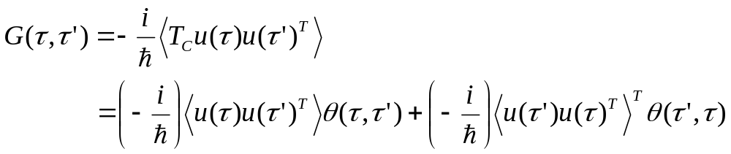
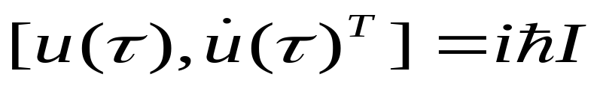
Express contour order using theta function
Operator A(τ) is the same as A(t) as far as commutation relation or effect on wavefunction is concerned
Notes:
u u^{T} is a square matrix, and [u, v^{T}] is a matrix formed by (j,k) element [u_{j}, v_{k}].

Slide 17
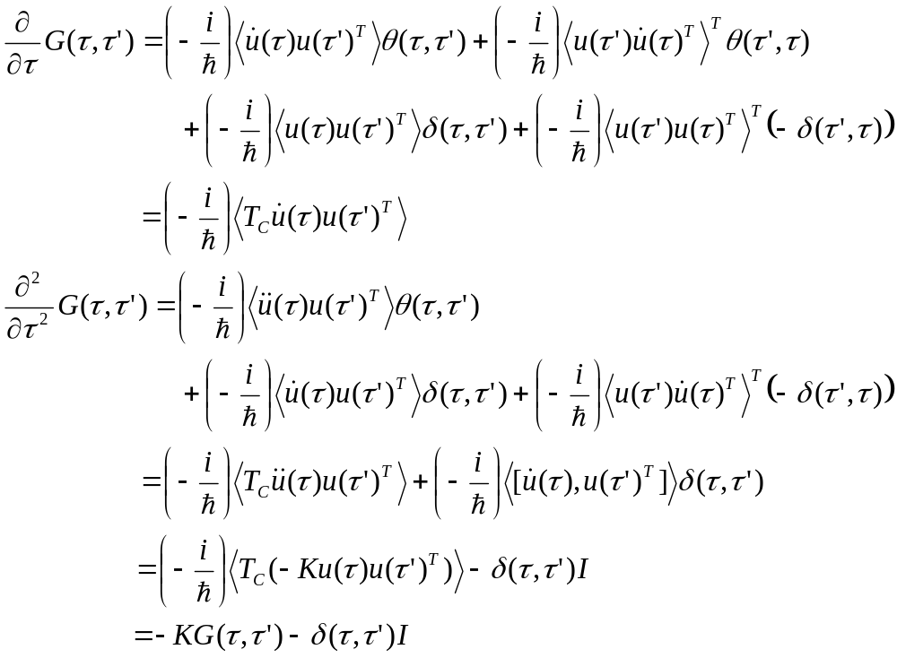
Equation of motion for contour ordered Green’s function
Consider a harmonic system with force constant K
Notes:
We use the equation of motion d²u/dt² = -Ku.

Slide 18
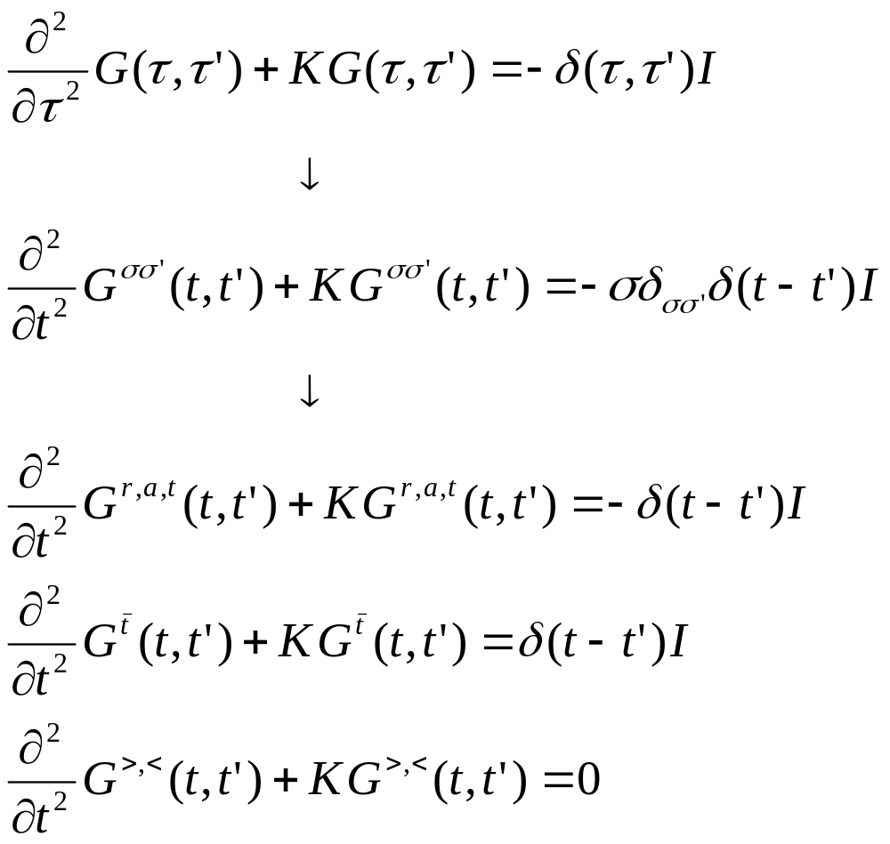
Equations for Green’s functions

Slide 19
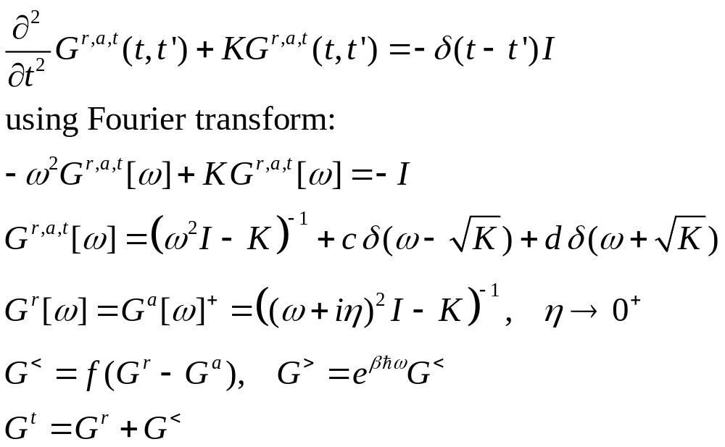
Solution for Green’s functions
c and d can be fixed by initial/boundary condition.
Notes:
Note that if ax = b, x = b/a, but not if a = 0, in that case, x = infinity, thus, the Dirac delta function.

Slide 20
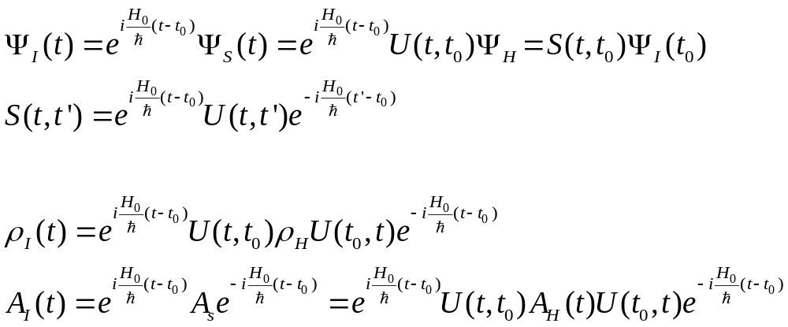
Handling interactions
Transform to interaction picture, H = H₀ + H_{n}
Notes:
For the concept of pictures and relations among them, see A. L. Fetter and J. D. Walecka, “Quantum theory of many-body systems”, McGraw-Hill, 1971. The meaning of t0 and t’ is quite different. t0 is such that three pictures are equivalent, t’ is an arbitrary time. Note that ρ behaves like |><|.

Slide 21
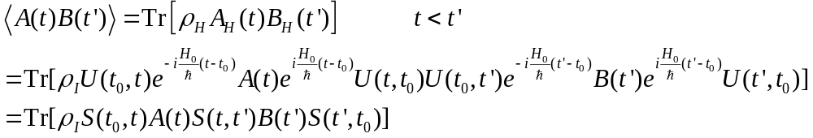
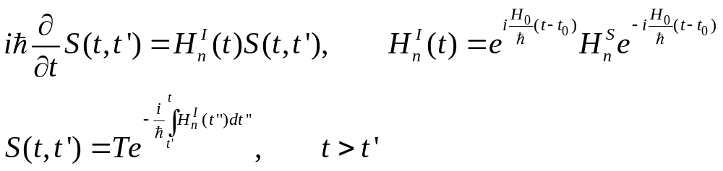
Scattering operator S
Transform to interaction picture
The scattering operator satisfies:
Notes:
A(t) and B(t’) are in interaction picture (i.e. A_{I}(t) etc).

Slide 22
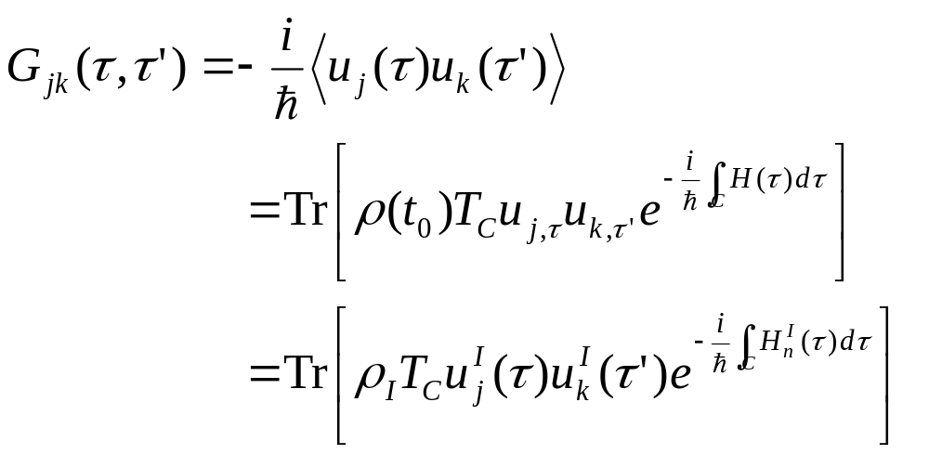
Contour-ordered Green’s function
τ’
τ
t₀
Notes:
Another possible representation of the result is using Feynman path integral formulation.

Slide 23
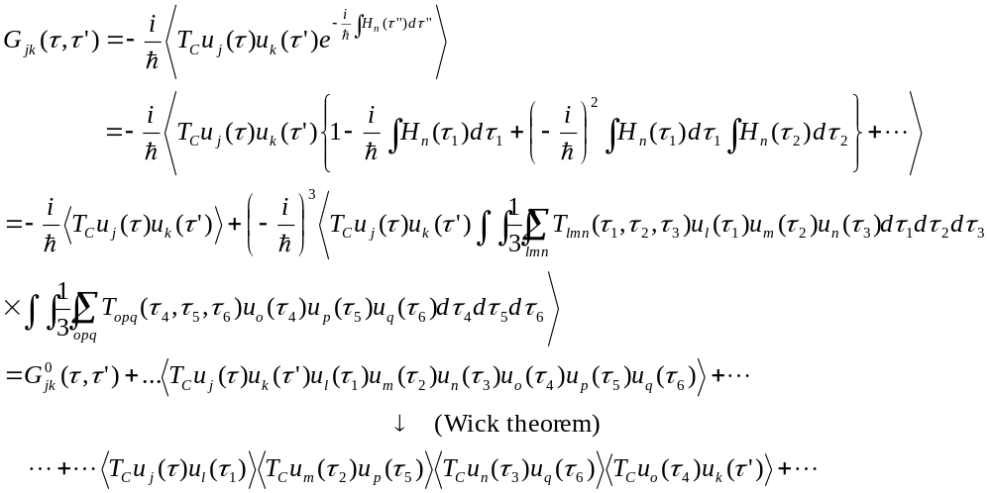
Perturbative expansion of contour ordered Green’s function
Notes:
Every operator is in interaction picture, dropped superscript I for simplicity. The Wick theorem is valid if the expectation < … > is with respect to a quadratic weight. For a proof, see Rammer.

Slide 24
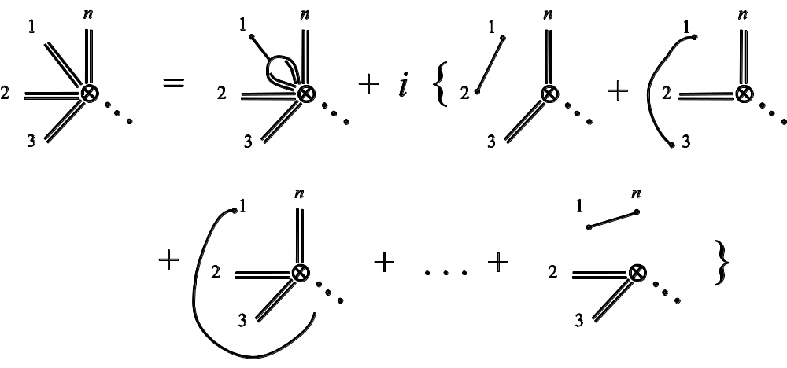
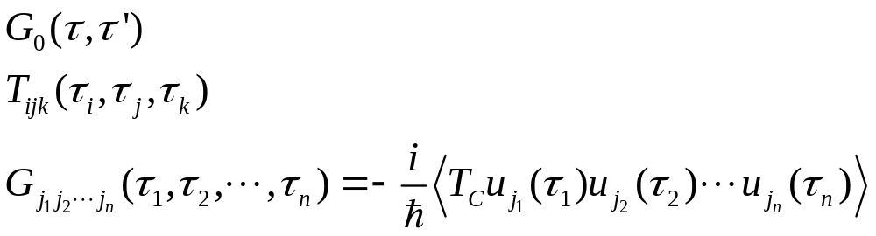
General expansion rule
Single line
3-line vertex
n-double line vertex
Notes:
See our review article or Rammer’s book.

Slide 25
Diagrammatic representation of the expansion
=
+ 2i
+ 2i
+ 2i
=
+

Slide 26
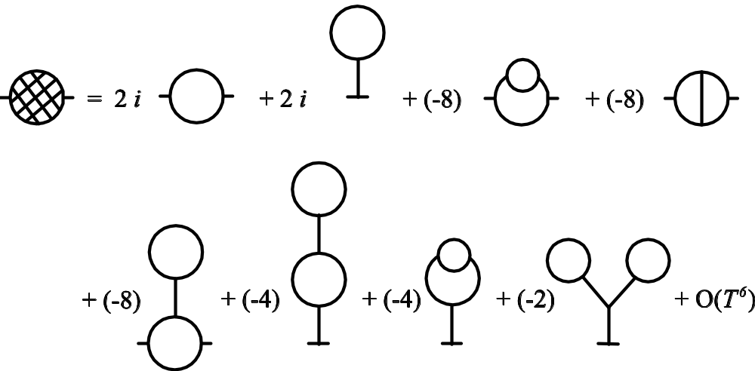
Self -energy expansion
Σ_{n}
Notes:
The self-energy diagrams are obtained by including all doubly or more connected diagrams removing the two external legs from the Green’s function diagrams. For a more systematic exposition of the Feynman-diagrammatic expansion, see Fetter and Welecka.

Slide 27
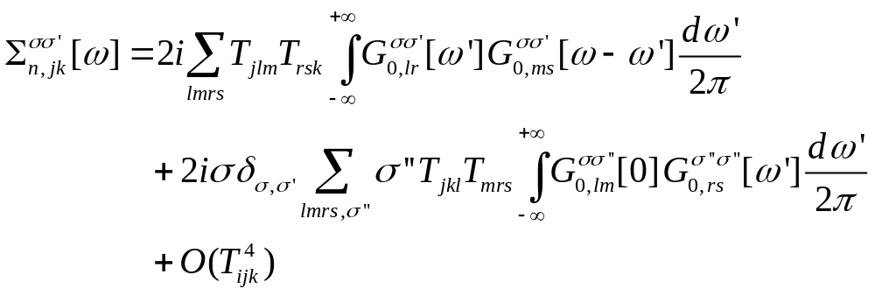
Explicit expression for self-energy
Notes:
See also figure 3 in J.-S. Wang, X. Ni, and J.-W. Jiang, Phys. Rev. B 80, 224302 (2009).

Slide 28
Junction system
Three types of Green’s functions:
  g for isolated systems when leads and centre are decoupled
  G0 for ballistic system
  G for full nonlinear system
Governing Hamiltonians
H_{L}+H_{C}+H_{R} +V +H_{n}
H_{L}+H_{C}+H_{R} +V
G
H_{L}+H_{C}+H_{R}
G₀
Green’s function
g_{α}
t = − ∞
Equilibrium at T_{α}
t = 0
Nonequilibrium steady state established
Notes:
Two adiabatic switch-on’s.

Slide 29
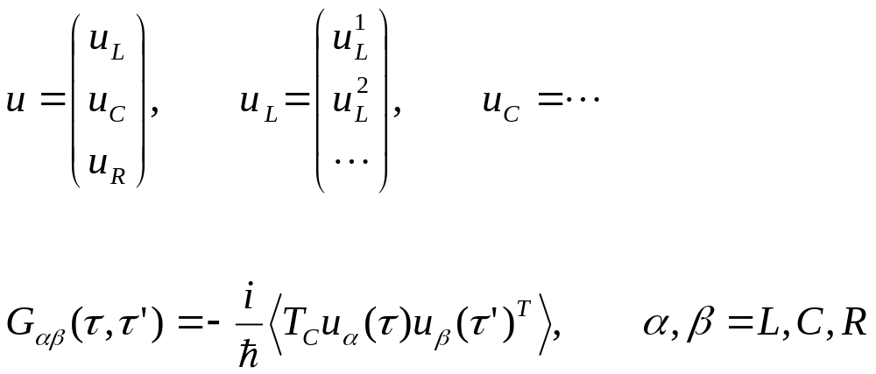
Three regions

Slide 30
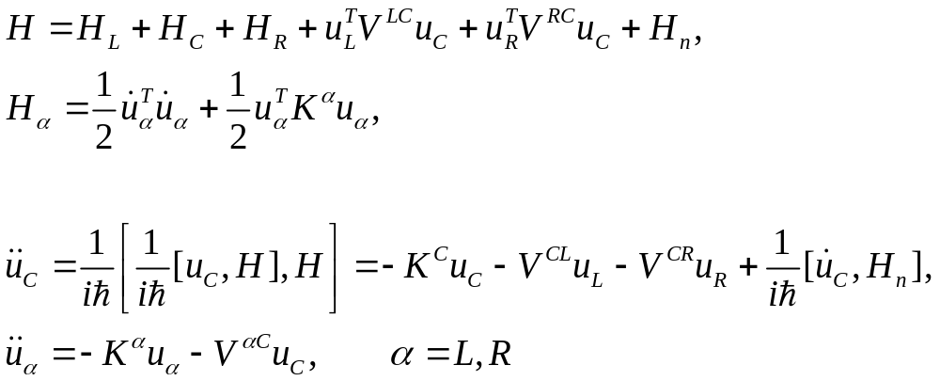
Heisenberg equations of motion in three regions

Slide 31
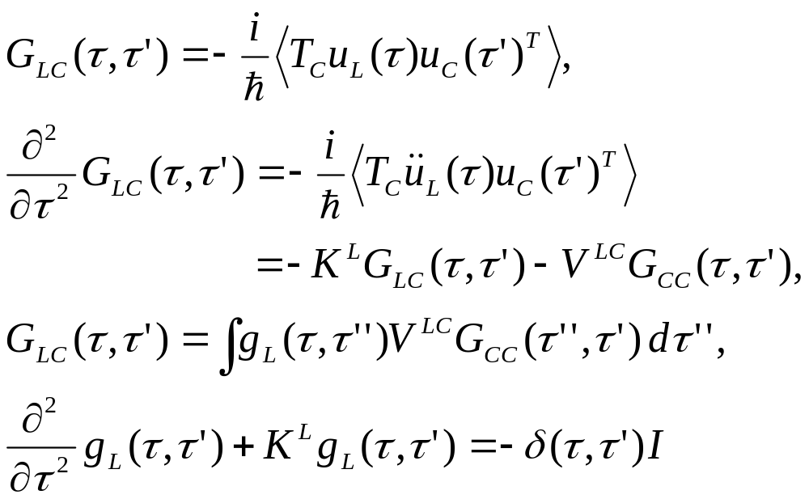
Relation between g and G0
Equation of motion for GLC
Notes:
In obtaining G_{LC}, an arbitrary function satisfying (d/dtau^2 + K^{L}) f = 0 is omitted. Absence of this term is consistent with adiabatic switch-on from Feynman diagrammatic expansion.

Slide 32
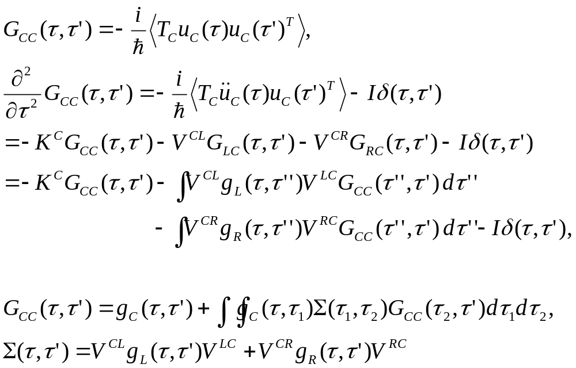
Dyson equation for Gcc
Notes:
In this derivation, we assume H_{n} = 0.

Slide 33
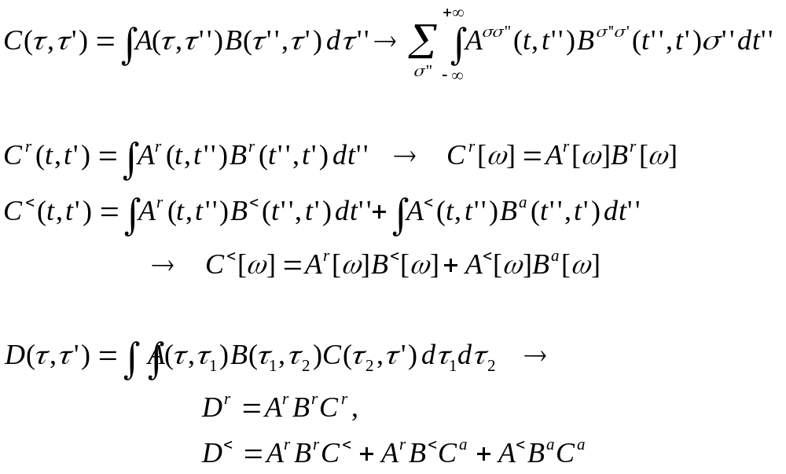
The Langreth theorem
Notes:
Need to use the relation between G⁺⁺, G⁻ ⁻, G⁺⁻, and G⁺⁻ with G^{r} and G<. See Haug & Jauho, page 66.

Slide 34
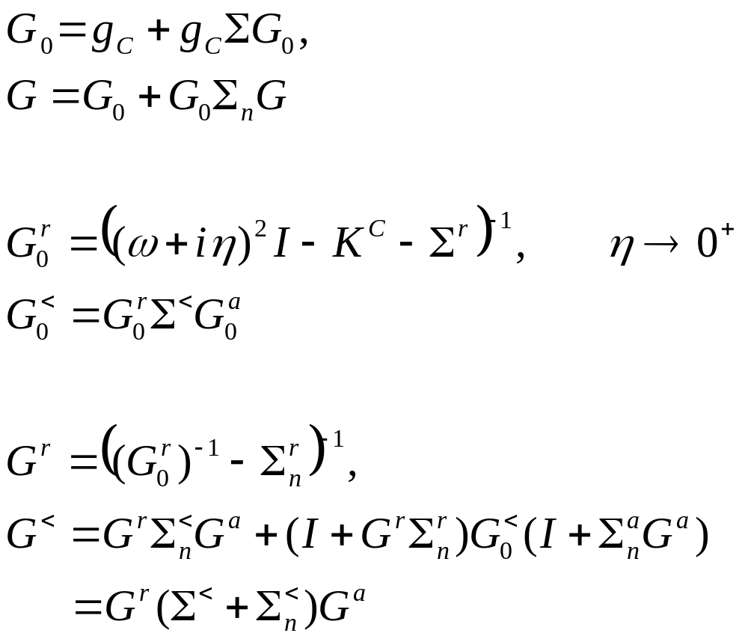
Dyson equations and solution
Notes:
In deriving the last line, we use the fact (g^{r})⁻¹ g< = 0.

Slide 35
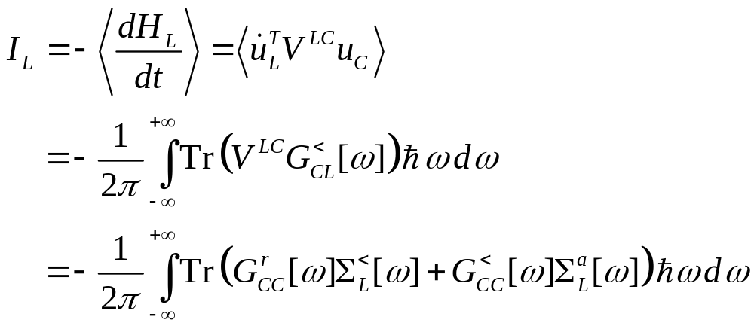
Energy current
Notes:
I_{L} is energy flowing out of the left lead into the center. This expression can be proving to be real, no need to take Re. Above equation works for general nonlinear case.

Slide 36
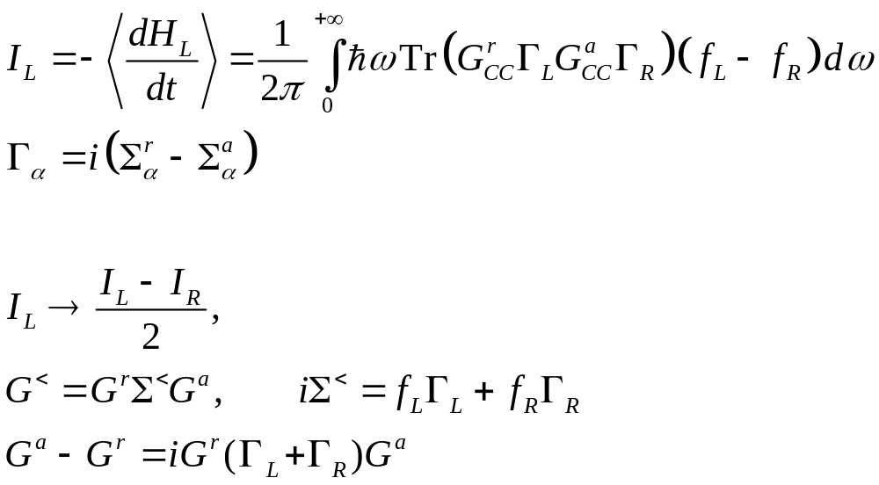
Caroli formula
Notes:
The symmetrization appears necessary to get the Caroli formula. Caroli formula is valid only for ballistic case where H_{n} = 0.

Slide 37
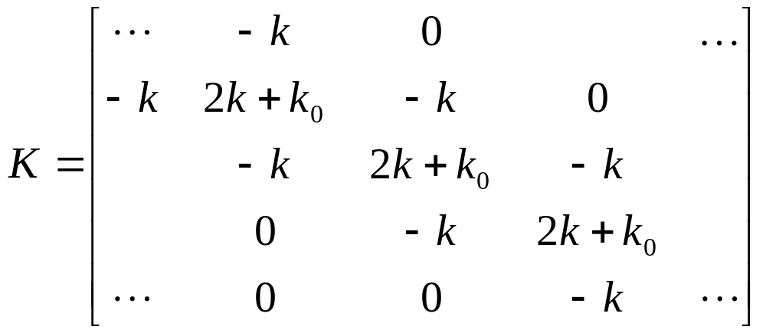
Ballistic transport in a 1D chain
Force constants
Equation of motion
Notes:
The matrix K is infinite in both directions.

Slide 38
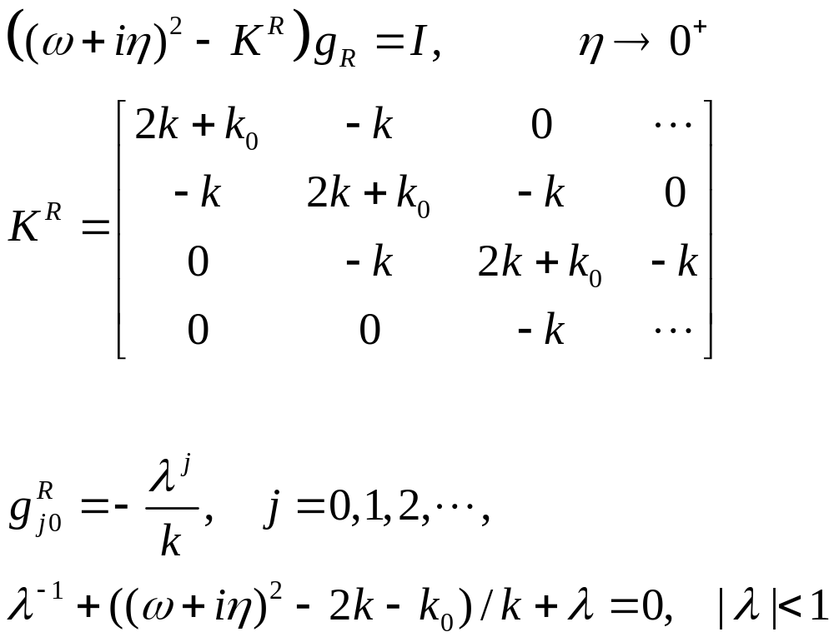
Solution of g
Surface Green’s function
Notes:
K^{R} is semi-finite, V is nonzero only at the corner.

Slide 39
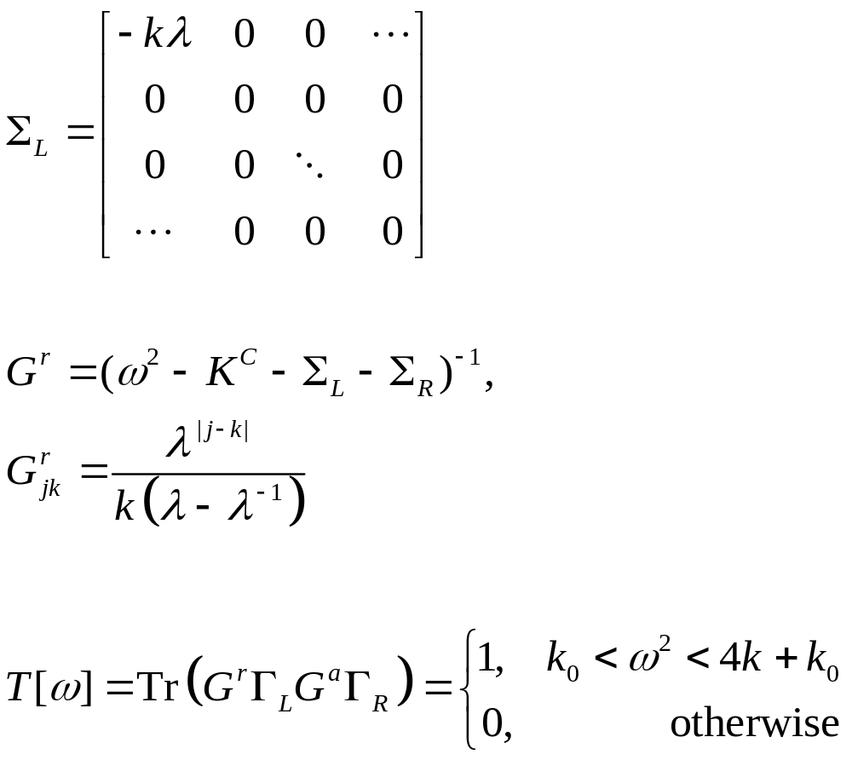
Lead self energy and transmission
T[ω]
1
ω
Notes:
Σ_{R} is nonzero only for the lower right corner.

Slide 40
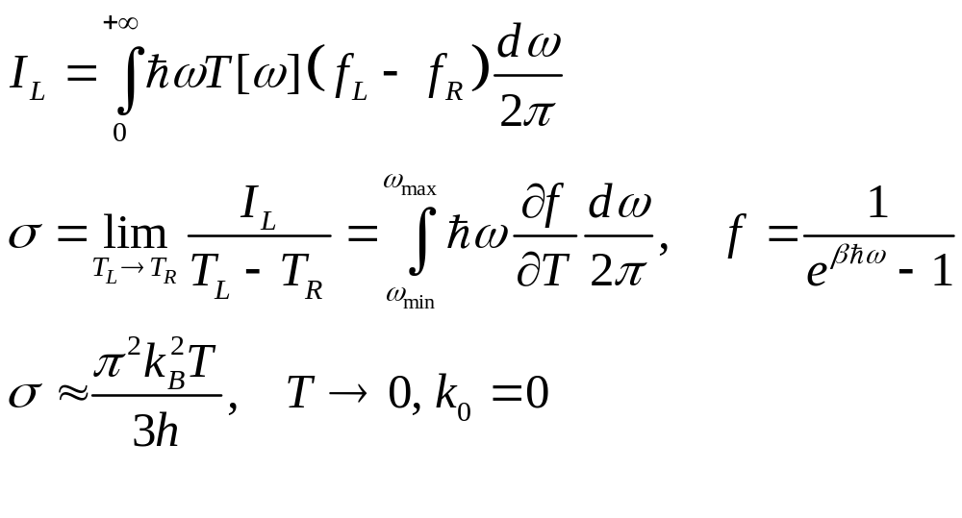
Heat current and conductance
Notes:
The last formula σ is called universal conductance.

Slide 41
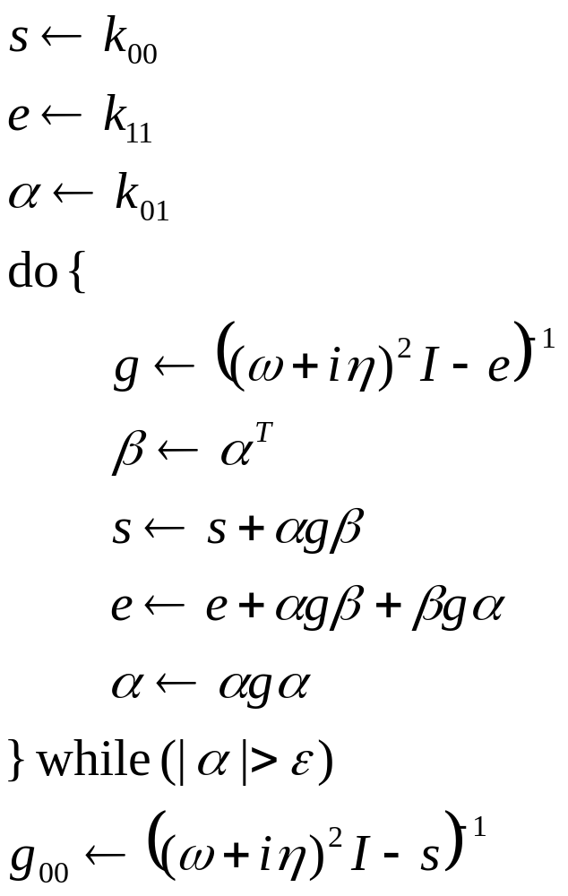
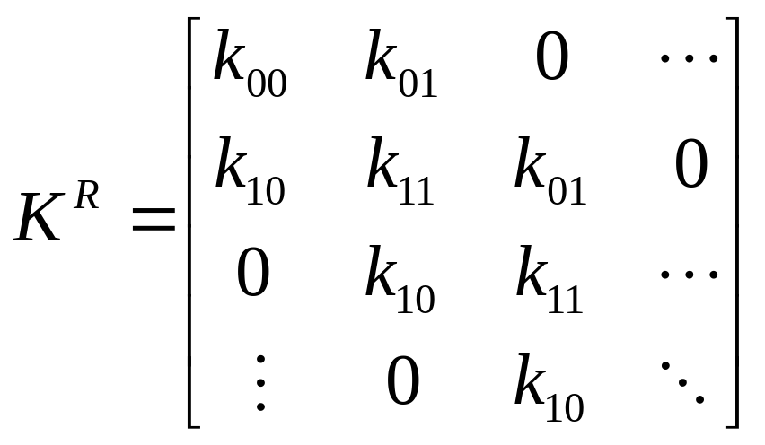
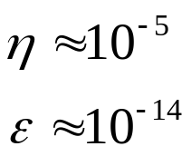
General recursive algorithm for surface Green’s function
Notes:
The algorithm is due to Lopez Sancho et al (1985). Typically, 10 to 20 iterations should be already converged.

Slide 42
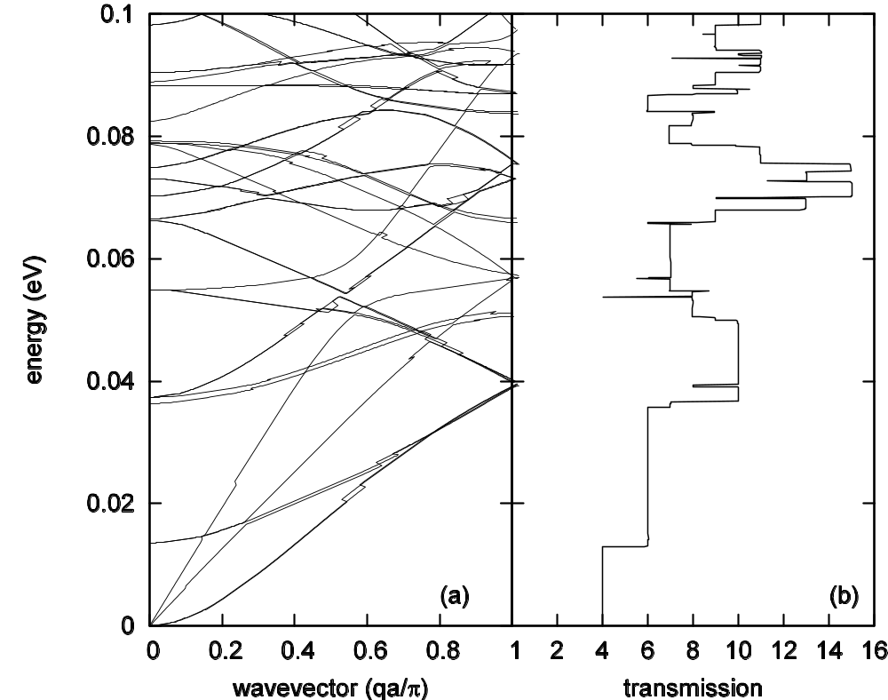
Carbon nanotube (6,0), force field from Gaussian
Dispersion relation
Transmission
Notes:
The force constants were symmetrized using the method of Mingo et al (2008). Calculation was performed by Lü Jingtao.

Slide 43
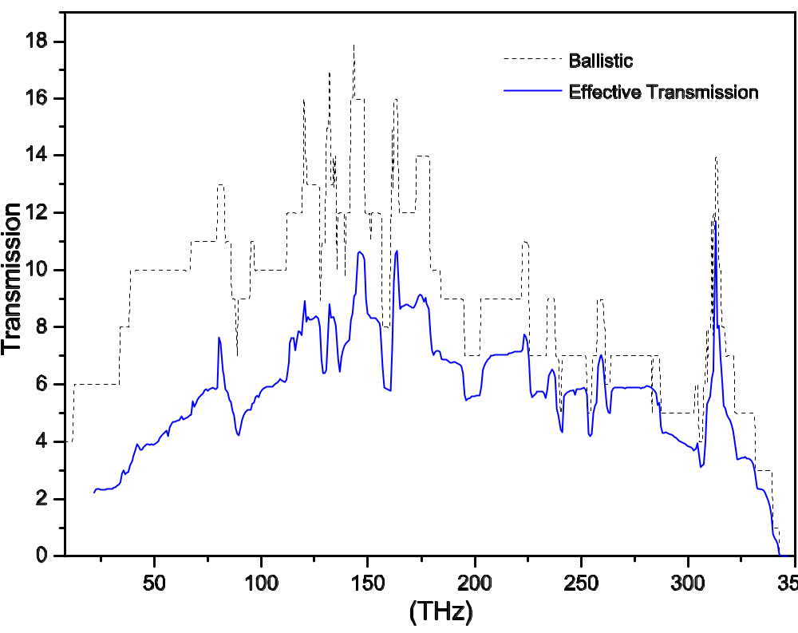
Carbon nanotube, nonlinear effect
The transmissions in a one-unit-cell carbon nanotube junction of (8,0) at 300K. From J-S Wang, J Wang, N Zeng, Phys. Rev. B 74, 033408 (2006).
Notes:
The nonlinear result may be not correct at the low frequency end.

Slide 44
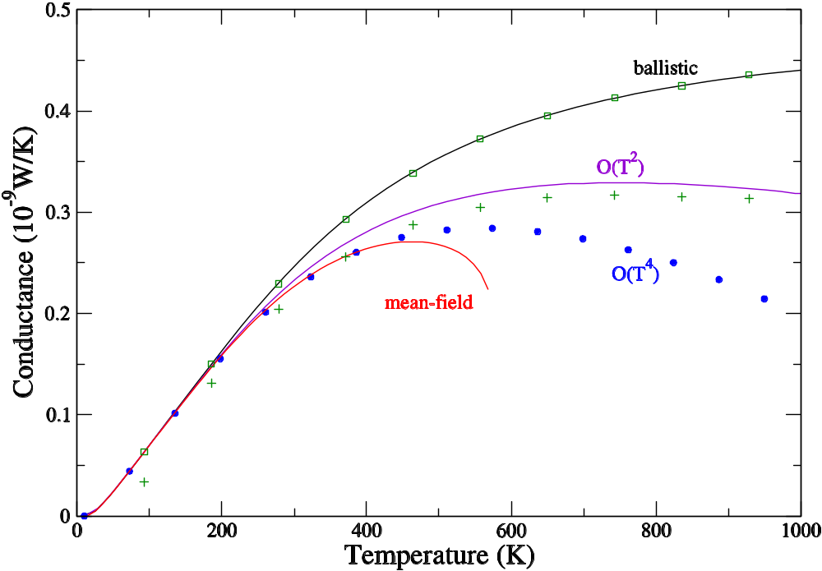
1D chain, nonlinear effect
k_{L}=1.56 k_{C}=1.38, t=1.8 k_{R}=1.44
Three-atom junction with cubic nonlinearity (FPU-α). From J-S Wang, Wang, Zeng, PRB 74, 033408 (2006) & J-S Wang, Wang, Lü, Eur. Phys. J. B, 62, 381 (2008). Squares and pluses are from MD.

Slide 45

Molecular dynamics with quantum bath
Notes:
For more detail, see Phys. Rev. B 80, 224302 (2009).

Slide 46

Average displacement, thermal expansion
One-point Green’s function
Notes:
The idea of calculating the thermal expansion coefficient this way due to Jiang Jinwu.

Slide 47

Thermal expansion
(a) Displacement <u> as a function of position x. (b) as a function of temperature T. Brenner potential is used. From J.-W. Jiang, J.-S. Wang, and B. Li, Phys. Rev. B 80, 205429 (2009).
Left edge is fixed.

Slide 48

Graphene Thermal expansion coefficient
The coefficient of thermal expansion v.s. temperature for graphene sheet with periodic boundary condition in y direction and fixed boundary condition at the x=0 edge.  is onsite strength. From J.-W. Jiang, J.-S. Wang, and B. Li, Phys. Rev. B 80, 205429 (2009).

Slide 49


Transient problems
Notes:
The I_{L} is valid for 1D chain with spring constant k. Eduardo will present a talk on this topic Friday morning.

Slide 50



Dyson equation on contour from 0 to t
Contour C
Notes:
In steady state we use Keldysh contour which is from - to +. But here for transient study, the contour is a finite segment.

Slide 51

Transient thermal current
The time-dependent current when the missing spring is suddenly connected. (a) current flow out of left lead, (b) out of right lead. Dots are what predicted from Landauer formula. T=300K, k =0.625 eV/(Å²u) with a small onsite k₀=0.1k. From E. C. Cuansing and J.-S. Wang, Phys. Rev. B 81, 052302 (2010). See also arXiv:1005.5014.

Slide 52
Summary
The contour ordered Green’s function is the essential ingredient for NEGF
NEGF is most easily applied to ballistic systems, for both steady states and transient time-dependent problems
Nonlinear problems are still hard to work with

Slide 53
References
H. Haug & A.-P. Jauho, “Quantum Kinetics in Transport and …”
J. Rammer, “Quantum Field Theory of Non-equilibrium States”
S. Datta, “Electronic Transport in Mesoscopic Systems”
M. Di Ventra, “Electrical Transport in Nanoscale Systems”
J.-S. Wang, J. Wang, & J. Lü, Europhys B 62, 381 (2008).

Slide 54
Problems for NGS students taken credits
Work out the explicit forms of various Green’s functions (retarded, advanced, lesser, greater, time ordered, etc) for a simple harmonic oscillator, in time domain as well in frequency domain
Consider a 1D chain with a uniform force constant k. The left lead has mass m_{L}, center m_{C}, and right lead m_{R}. Work out the transmission coefficient T[ω] using the Caroli formula.
Work out the detail steps leading to the Caroli formula.

Slide 55
Website
This webpage contains the review article, as well some relevant codes/thesis:
http://staff.science.nus.edu.sg/~phywjs/NEGF/negf.html

Slide 56
Thank you
Notes:
I acknowledge my students/collaborators/group members over the years involved in this field: Wang Jian, Zeng Nan, Lü Jingtao, Eduardo Cuansing, Jiang Jinwu, Jose L. Garcia, Zhang Lifa, Ni Xiaoxi, Leek Meng Lee, Xu Yong, Pawel Keblinski, Baowen Li, Lan Jinghua, Gan Chee Kwan.

Slide 57

nus.edu.sg
Notes:
The National University of Singapore offers a global approach to education and research, with a focus on Asian perspectives and expertise. Its transformative education includes a broad-based curriculum underscored by multi-disciplinary courses and cross-faculty enrichment, as well as special programmes which allow students to realise their potential. Over 30,000 students from 100 countries further enrich the community with their diverse social and cultural perspectives, making campus life vibrant and exciting.
Broad-based curriculum
Focus on multi-disciplinary, global education
IT-intensive environment with state-of-the-art teaching and research facilities
Vibrant learning and living environment
52 Bachelor’s degree programmes
153 Master’s and Doctoral degree, and Graduate Diploma programmes
62 Double Degree, 26 Joint Degree,10 Concurrent Degree and 28 Double Major programmes within NUS, and between NUS and partner universities

