Slide 1
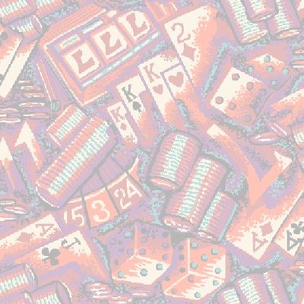
Worm Algorithm for
2D Spin-Glass
Jian-Sheng Wang（王建生）
Dept of Computational Science, NUS

Slide 2
Outline of the Talk
A brief introduction to spin-glasses
Previous algorithms for simulating spin-glasses
The worm algorithm

Slide 3
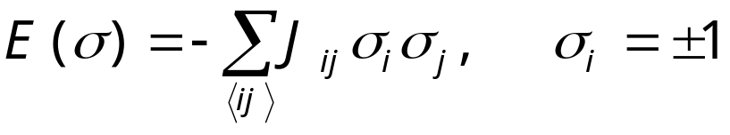
Spin Glass Model
+
-
-
+
-
+
-
-
+
-
+
+
-
-
+
+
+
+
-
+
-
A random interacting Ising model - two types of random, but fixed coupling constants (ferro J_{ij} > 0, anti-ferro J_{ij} < 0). The model was proposed in 1975 by Edwards and Anderson.
-
+
-
+
+
-
+
+
-
-
+
-
-
-
-
+
+
-
-
+
+
+
+
-
+
-
-
-
blue J_{ij}=-J, green J_{ij}=+J
Notes:
See K. Binder and A. P. Young, Rev Mod Phys 58 (1986) 801, for a review.

Slide 4
Spin-Glass, Still a Problem?
2D Ising spin-glass T_{c} = 0
3D Ising spin-glass T_{c} > 0
LowT phase, droplet picture vs replica symmetry breaking picture, still controversial
Relevance to biology, neutral network, optimization, etc

Slide 5
Metropolis Algorithm
(Single-Spin Flip)
Pick a site i at random
Compute ΔE =E(σ’)-E(σ), where σ’ is a new configuration with the spin at site i flipped, σ’_{i} =-σ_{i}
Perform the move if ξ < exp(-ΔE/k_{B}T ), 0<ξ<1 is a random number

Slide 6
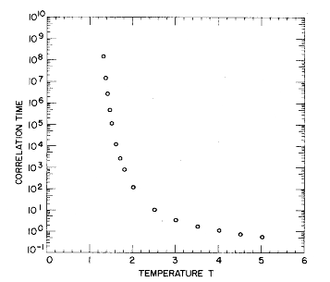
Slow Dynamics in
Spin Glass
Correlation time in single spin flip dynamics for 3D spin glass. τ ∝ |T-T_{c}|⁶.
From Ogielski, Phys Rev B 32 (1985) 7384.

Slide 7
Advanced Algorithms for Spin-Glasses (3D)
Simulated Tempering (Marinari & Parisi, 1992)
Parallel Tempering, also known as replica exchange Monte Carlo (Hukushima & Nemoto, 1996)

Slide 8
Special 2D Algorithms
Replica Monte Carlo, Swendsen & Wang 1986
Cluster algorithm, Liang 1992
Houdayer, 2001

Slide 9
Replica Monte Carlo
A collection of M systems at different temperatures is simulated in parallel, allowing exchange of information among the systems.
β₁
β₂
β₃
. . .
β_{M}
Parallel Tempering: exchange configurations
Notes:
Replica Monte Carlo [R. H. Swendsen and J.-S. Wang, Phys Rev Lett 57 (1986) 2607] is one of the earliest idea that simulates many systems in parallel for efficiency. Hukushima and Nemoto, J Phys Soc Jpn 65 (1996) 1604, proposed parallel tempering or replica exchange.

Slide 10
Moves between Replicas
Consider two neighboring systems, σ¹ and σ², the joint distribution is
P(σ¹,σ²) ∝ exp[-β₁E(σ¹) –β₂E(σ²)]
= exp[-H_{pair}(σ¹, σ²)]
Any valid Monte Carlo move should preserve this distribution

Slide 11
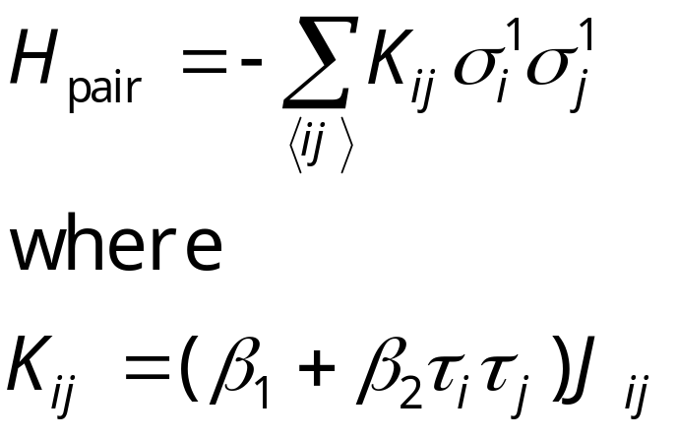
Pair Hamiltonian in Replica Monte Carlo
We define τ_{i}=σ_{i}¹σ_{i}², then H_{pair} can be rewritten as
The H_{pair} again is a spin glass. If β₁≈β₂ and two systems have consistent signs, the interaction is twice as strong; if they have opposite sign, the interaction is 0.

Slide 12
Cluster Flip in
Replica Monte Carlo
Clusters are defined by the values of τ_{i} of the same sign. The effective Hamiltonian for clusters is
H_{cl} = - Σ k_{bc} s_{b}s_{c}
Where k_{bc} is the interaction strength between cluster b and c, k_{bc}= sum over boundary of cluster b and c of K_{ij}.
τ = +1
τ = -1
^{b}
^{c}
Metropolis algorithm is used to flip the clusters, i.e., σ_{i}¹ -> -σ_{i}¹, σ_{i}² -> -σ_{i}² fixing τ for all i in a given cluster.
Notes:
Before the cluster move, s_{b} = +1, for all clusters b. To ensure ergodicity, other single spin flips within a single system has to be used. Swendsen-Wang mapping can be used inside each tau cluster to produce non-interacting clusters as well.

Slide 13
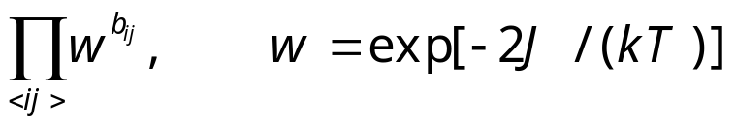
Strings/Domain Walls in 2D Spin-Glass
+
-
-
-
-
The bonds, or strings, or domain walls on the dual lattice uniquely specify the energy of the system, as well as the spin configurations modulo a global spin change.
The weight of the bond configuration is
antiferro
+
+
-
+
-
+
+
-
-
ferro
-
-
+
+
+
+
+
-
+
-
+
+
-
+
+
-
-
+
-
-
-
-
+
+
-
-
+
+
+
+
-
+
-
-
-
bond
b=0 no bond for satisfied interaction, b=1 have bond

Slide 14
Peierls’ Contour
-
-
+
+
+
-
The bonds in Ising model is nothing but the Peierls’ contours separating + spin domains from – spin domains.
-
-
-
+
+
-
+
+
-
-
-
-
+
-
+
+
+
-
+
+
-
-
-
-
+
+
-
-
+
-

Slide 15
Worm Algorithms
Worm algorithms were first proposed for quantum systems and classical ferro-magnetic systems:
  Prokof’ev and Svistunov, PRL 87 (2001) 160601
  Alet and Sørensen, PRE 67, 015701 (2003)

Slide 16
Worm Algorithm for
2D Spin-Glass
Pick a site i₀ at random. Set i = i₀
Pick a nearest neighbor j with equal probability, move it there with probability w^{1-b}_{ij}. If accepted, flip the bond variable b_{ij} (1 to 0, 0 to 1). i = j.
If i = i₀ and winding numbers are even, exit, else go to step 2.
(cond-mat/0506116, to appear in PRE)

Slide 17
The Loop
b=1
b=1
b=0
b=0
i₀
i₀
Erase a bond with probability 1, create a bond with probability w = exp[-2J/(kT)].

Slide 18
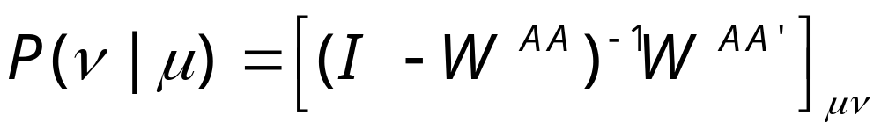
N-fold Way Acceleration
Sample an n-step move with exit probability:
where A is a set of states reachable in n-1 steps of move. A’ is complement of A. W is associated transition matrix.

Slide 19
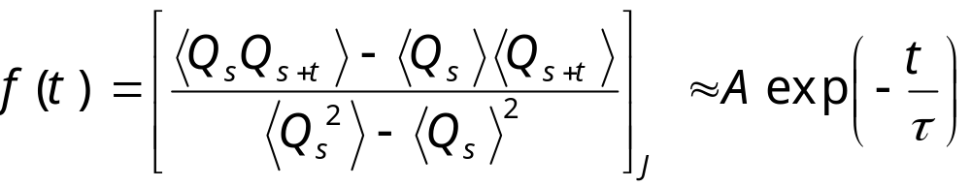
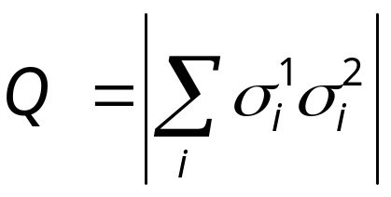
Time-Dependent Correlation Function and Spin-Glass Order Parameter
We define
where
Notes:
Some people define the second term, ∑_{t=1}∞ f(t) as the integrated correlation time. We can call τ_{int} de-correlation time, as it is the number of steps needed to generate effectively independent sample. We can interpret the average < … > as over the history of a Markov chain (which requires the joint distribution of the chain from time s to s+t), or can be estimated from a simulation as average over time, i.e.,
<Q_{s}Q_{s+t}> ≈ (1/N) ∑_{s=1}^{N} Q_{s}Q_{s+t}.
What is τ_{int} for completely uncorrelated sample?

Slide 20
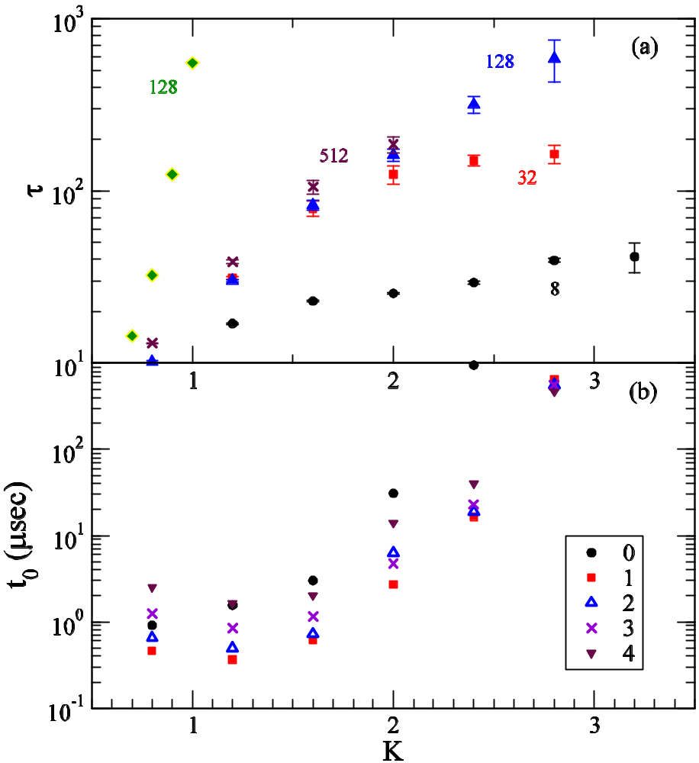
Correlation Times
Exponential relaxation times in units of loop trials of the worm algorithm.
CPU times per loop trial per lattice site (32x32 system). Different symbols correspond to 0 to 4 step N-fold way acceleration.
single spin flip

Slide 21
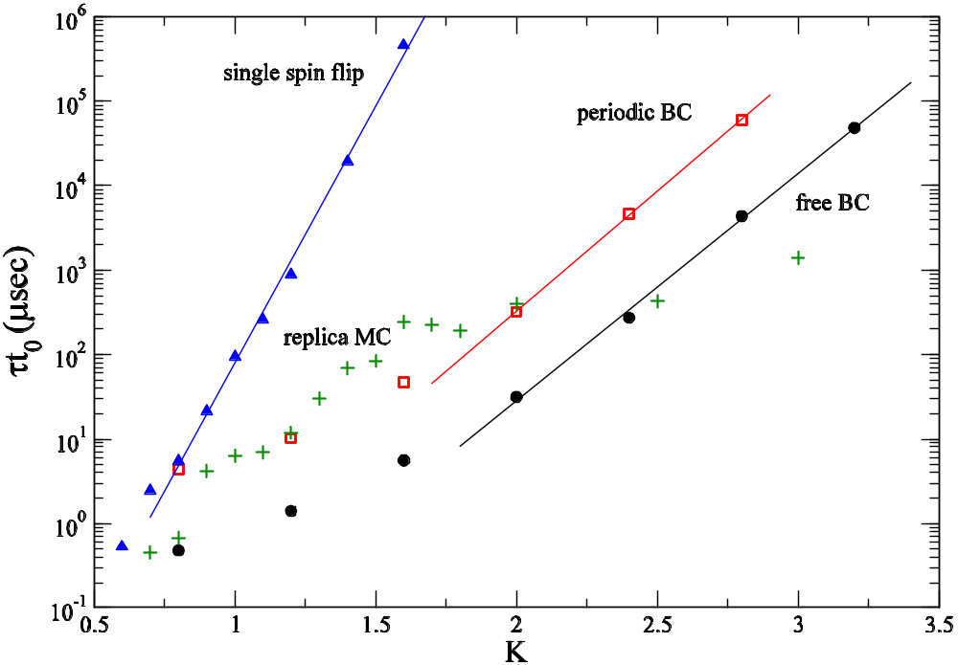
Correlation Times

Slide 22
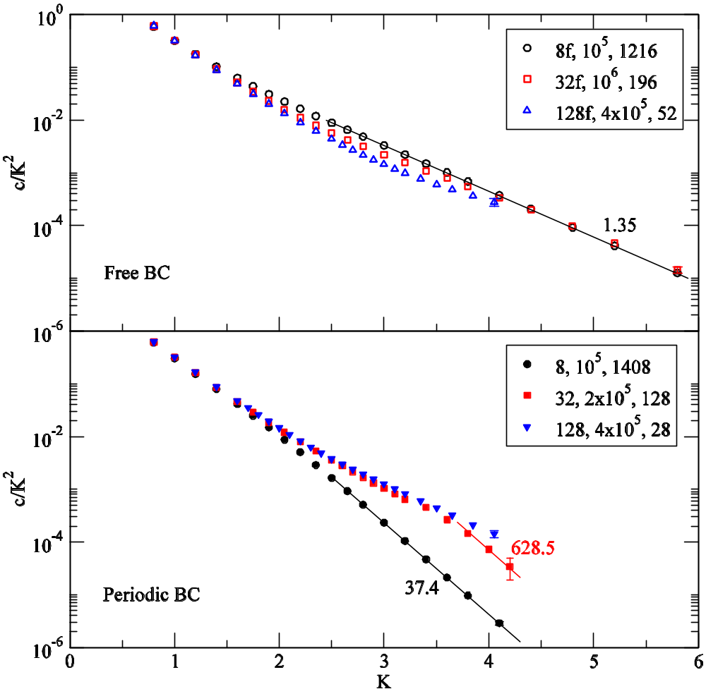
Specific Heat when T -> 0
Free boundary condition: c/K² ≈ exp(-2K).
Periodic BC: c/K² ≈ exp(-2K) in thermodynamic limit ( L -> ∞ first). For finite system it is exp(-4K).
K = J/(kT)

Slide 23
Summary Remarks
Worm algorithm for 2D ±J spin-glass is efficient up to K =J/(kT )≈2
Single system is simulated
Domain wall free energy difference can be calculated in a single run
Slides available at http://web.cz3.nus.edu.sg/~wangjs under talks.

Slide 24
Postdoctorial Research Fellow Position available
Work with J.-S. Wang in areas of computational statistical physics, or nano-thermal transport.
Send CV to wangjs@cz3.nus.edu.sg

