Slide 1

Quantum Monte Carlo Methods
Jian-Sheng Wang
Dept of Computational Science, National University of Singapore

Slide 2
Outline
Introduction to Monte Carlo method
Diffusion Quantum Monte Carlo
Application to Quantum Dots
Quantum to Classical --Trotter-Suzuki formula

Slide 3
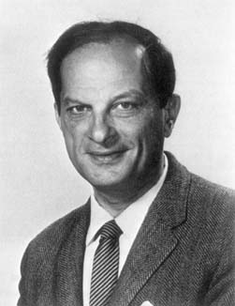
Stanislaw Ulam (1909-1984)
S. Ulam is credited as the inventor of Monte Carlo method in 1940s, which solves mathematical problems using statistical sampling.
Notes:
Stanislaw Ulam, a Polish born mathematician who worked for John von Neumann on the United States’ Manhattan Project during World War II. Ulam is primarily known for designing the hydrogen bomb with Edward Teller in 1951. He invented the Monte Carlo method in 1946 while pondering the probabilities of winning a card game of solitaire.

Slide 4
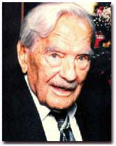
Nicholas Metropolis (1915-1999)
The algorithm by Metropolis (and A Rosenbluth, M Rosenbluth, A Teller and E Teller, 1953) has been cited as among the top 10 algorithms having the "greatest influence on the development and practice of science and engineering in the 20th century."
Notes:
“The code that was to become the famous Monte Carlo method of calculation originated from a synthesis of insights that Metropolis brought to more general applications in collaboration with Stanislaw Ulam in 1949. A team headed by Metropolis, which included Anthony Turkevich from Chicago, carried out the first actual Monte Carlo calculations on the ENIAC in 1948. Metropolis attributes the germ of this statistical method to Enrico Fermi, who had used such ideas some 15 years earlier. The Monte Carlo method, with its seemingly limitless potential for development to all areas of science and economic activities, continues to find new applications.”
From “Physics Today” Oct 2000, Vol 53, No. 10., see also http://www.aip.org/pt/vol-53/iss-10/p100.html.

Slide 5
Markov Chain
Monte Carlo
Generate a sequence of states X₀, X₁, …, X_{n}, such that the limiting distribution is given by P(X)
Move X by the transition probability
W(X -> X’)
Starting from arbitrary P₀(X), we have
P_{n+1}(X) = ∑_{X’} P_{n}(X’) W(X’ -> X)
P_{n}(X) approaches P(X) as n go to ∞

Slide 6
Necessary and sufficient conditions for convergence
Ergodicity
  [W^{n}](X - > X’) > 0
  For all n > n_{max}, all X and X’
Detailed Balance
P(X) W(X -> X’) = P(X’) W(X’ -> X)

Slide 7
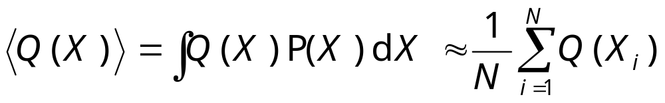
Taking Statistics
After equilibration, we estimate:
It is necessary that we take data for each sample or at uniform interval. It is an error to omit samples (condition on things).

Slide 8
Metropolis Algorithm (1953)
Metropolis algorithm takes
W(X->X’) = T(X->X’) min(1, P(X’)/P(X))
where X ≠ X’, and T is a symmetric stochastic matrix
T(X -> X’) = T(X’ -> X)
Notes:
T is not fixed and is usually zero unless X’ is in a “neighborhood” of X.
Show that detailed balance equation is satisfied.
Peskun has a theorem which says, in some sense, Metropolis rate min(1, …) is most efficient. P Peskun, Biometrika, 60 (1973) 607.

Slide 9
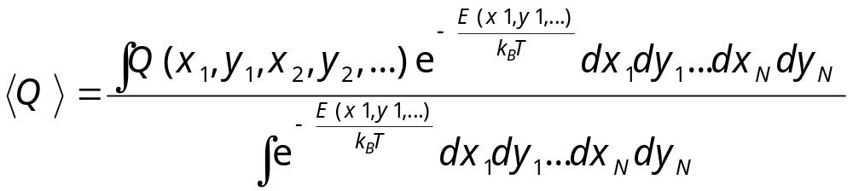
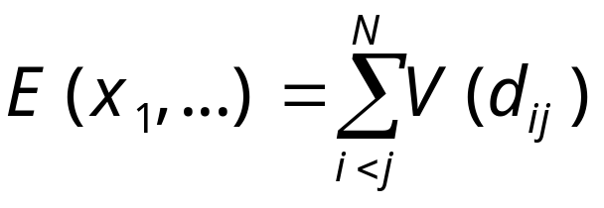
The Statistical Mechanics of Classical Gas/(complex) Fluids/Solids
Compute multi-dimensional integral
where potential energy
Notes:
Using 2D disks as an example.

Slide 10
Advanced MC Techniques
Cluster algorithms
Histogram reweighting
Transition matrix MC
Extended ensemble methods (multi-canonical, replica MC, Wang-Landau method, etc)

Slide 11

2. Quantum Monte Carlo Method

Slide 12
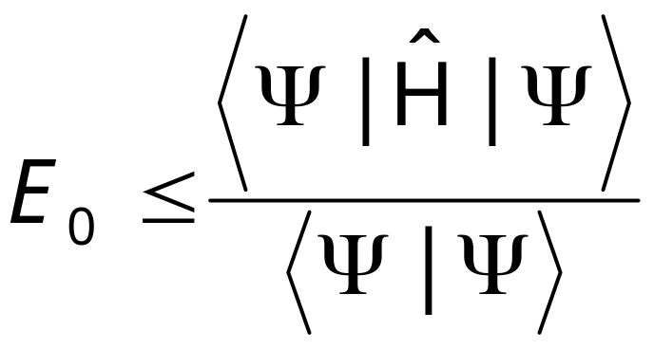
Variational Principle
For any trial wave-function Ψ, the expectation value of the Hamiltonian operator Ĥ provides an upper bound to the ground state energy E₀:
Notes:
See a review article by W. M.C. Foulkes, L. Mitas, R. J. Needs, and G. Rajagopal, Rev. Mod. Phys. 73 (2001) 33, for application in solids.

Slide 13
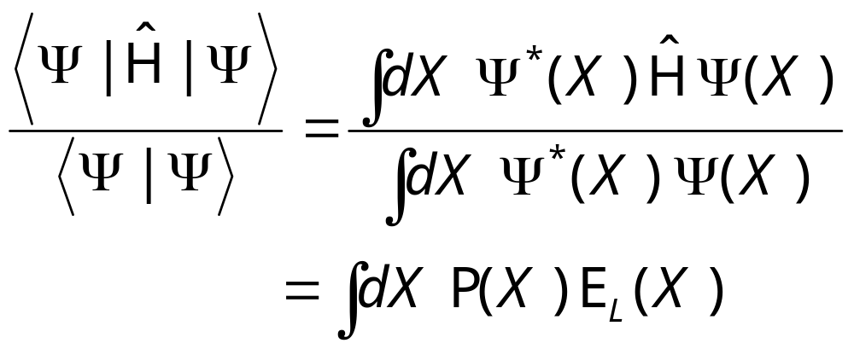
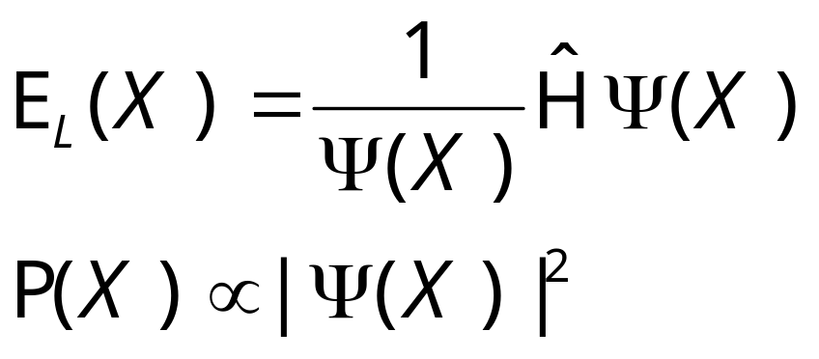
Quantum Expectation by Monte Carlo
where
Notes:
Changing Ψ to minimize <E_{L}> to find E₀. E_{L}(X) is called local energy.

Slide 14
Zero-Variance Principle
The variance of E_{L}(X) approaches zero as Ψ approaches the ground state wave-function Ψ₀.
σ_{E}² = <E_{L}²>-<E_{L}>² ≈ <E₀²>-<E₀>² = 0
Such property can be used to construct better algorithm (see Assaraf & Caffarel, PRL 83 (1999) 4682).
Notes:
See R. Assaraf and M. Caffarel [Phys Rev Lett 83 (1999) 4682] for the use of this principle for better quantum MC algorithm.

Slide 15
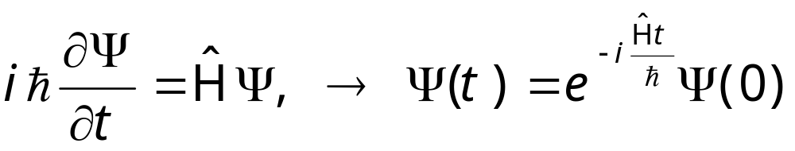
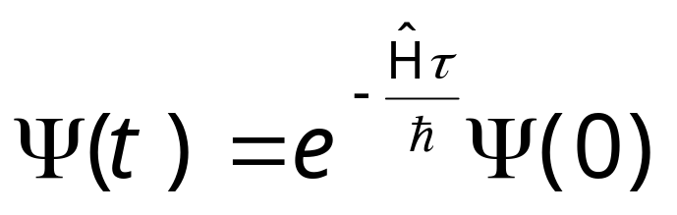
Schrödinger Equation in Imaginary Time
Let τ = it, the evolution becomes
As τ -> ∞, only the ground state survive.
Notes:
This projects out the ground-state as τ goes to infinity. Thus diffusion quantum Monte Carlo only found ground state, so it is a zero temperature algorithm.

Slide 16
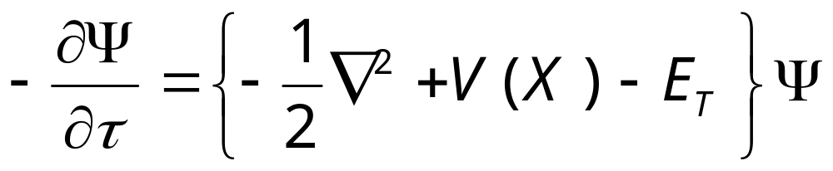
Diffusion Equation with Drift
The Schrödinger equation in imaginary time τ becomes a diffusion equation:
We have let ħ=1, mass m =1 for N identical particles, X is set of all coordinates (may including spins). We also introduce a energy shift E_{T}.
Notes:
We cannot solve the equation by probabilistic means yet, as Ψ can be positive or negative.

Slide 17
Fixed Node/Fixed Phase Approximation
We introduce a non-negative function f, such that
f = Ψ Φ_{T}* ≥ 0
f
f is interpreted as walker density.
Ψ
Φ_{T}
Notes:
f cannot be interpreted as probability, since the normalization condition ∫f(X)dX = constant does not hold. For Bosons, the ground-state wavefunction Ψ is always positive, so we don’t need fixed node approximation. The diffusion quantum Monte Carlo gives the minimum energy consistent with the constraint of fixed node.

Slide 18
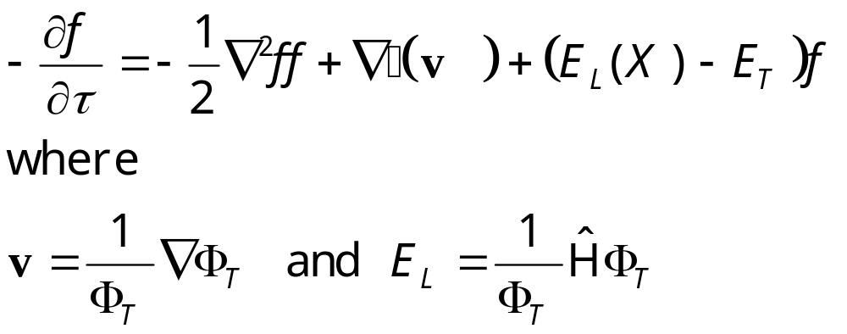
Equation for f
Notes:
This equation is valid for fixed-node approximation only, i.e. Φ_{T} is real.

Slide 19
Monte Carlo Simulation of the Diffusion Equation
If we have only the first term -½∇²f, it is a pure random walk.
If we have first and second term, it describes a diffusion with drift velocity v.
The last term represents birth-death of the walkers.
Notes:
Why don’t we solved it by traditional numerical methods, e.g., finite-difference method?

Slide 20
Walker Space
X
The population of the walkers is proportional to the solution f(X).

Slide 21
Diffusion Quantum Monte Carlo Algorithm
Initialize a population of walkers {X_{i}}
X’ = X + η τ^{½} + v(X) τ
Duplicate X’ to M copies: M = int( ξ + exp[-τ((E_{L}(X)+E_{L}(X’))/2-E_{T}) ] )
Compute statistics
Adjust E_{T} to make average population constant.
Notes:
η is a Gaussian random number with zero mean and unit variance, ξ is a uniformly distributed random number between 0 and 1. A rejection step may be introduce after 3, see Foulkes et al. int( ) is the same of the floor function, i.e., integer part of a number. The theoretical basis of the method is from Green-function solution of the Schrodinger equation.

Slide 22
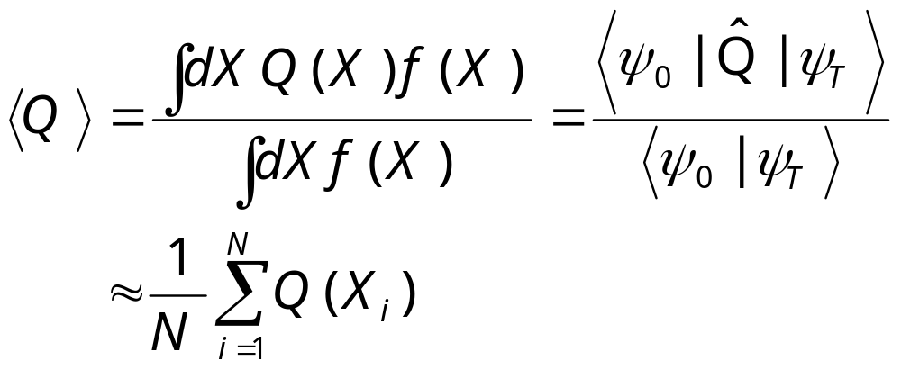
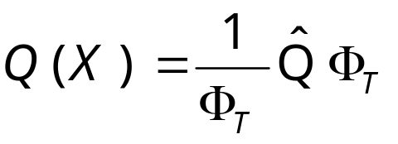
Statistics
The diffusion Quantum Monte Carlo provides estimator for
where

Slide 23
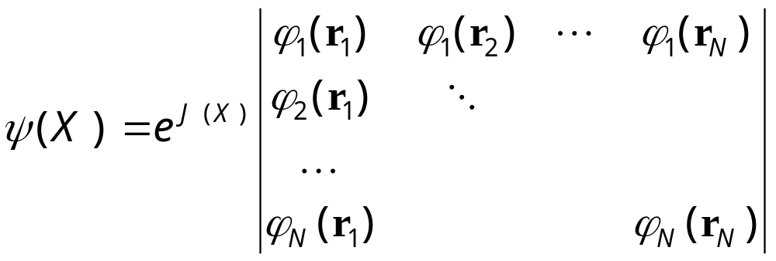
Trial Wave-Function
The common choice for interacting fermions (electrons) is the Slater-Jastrow form:

Slide 24
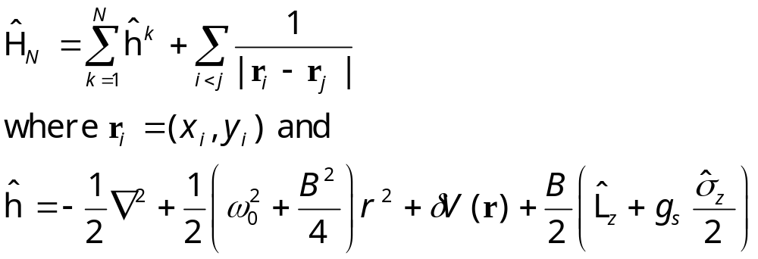
Example: Quantum Dots
2D electron gas with Coulomb interaction in magnetic field
We have used atomic units: ħ=c=m=e=1.
Notes:
A computer implementation for this problem and other supporting programs (Hartree-Fock and exact diagonalisation) is in the tarred and zip file QMC.tar.gz.

Slide 25
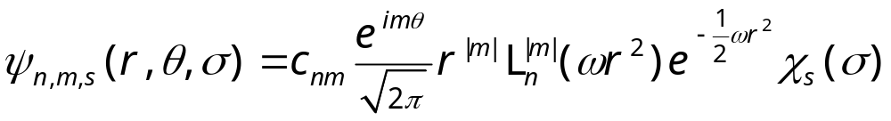
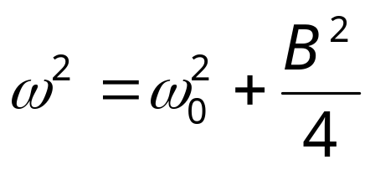
Trial Wave-Function
A Slater determinant of Fock-Darwin solution (J(X)=0):
where
L is Laguerre polynomial
Energy level E_{n,m,s}=(n+2|m|+1)hω + g μ_{B}(m+s)B
Notes:
We set J(X) = 0. L_{n}^{|m|}(ρ) is Laguerre Polynomial. Χ_{s}(σ) is spin part of the wavefunction.

Slide 26
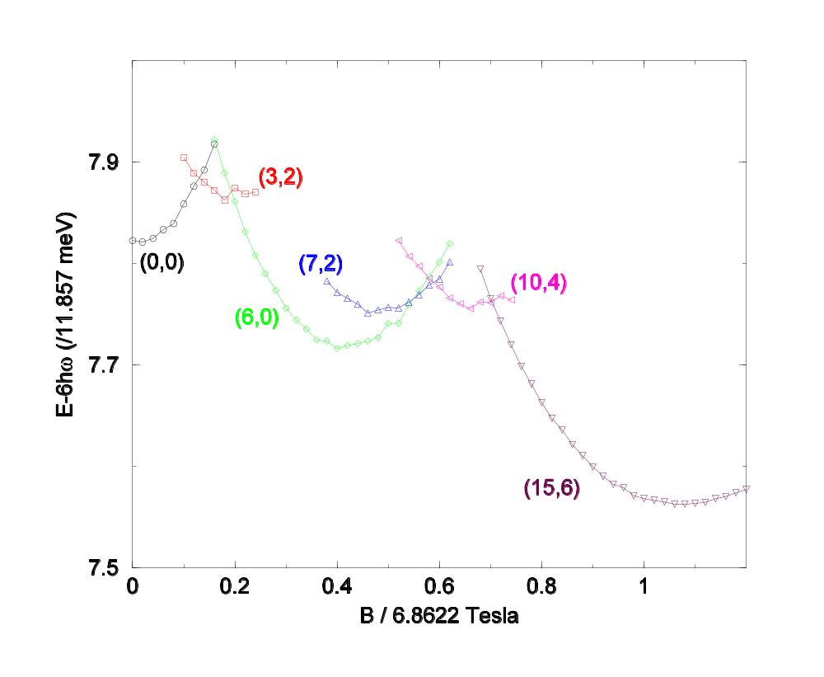
Six-Electrons Ground-state Energy
Using parameters for GaAs.
The (L,S) values are the total orbital angular momentum L and total Pauli spin S.
From J S Wang, A D Güçlü and H Guo, unpublished
Notes:
Results shown are for perfect parabolic confining potential, i.e., δV=0. (L,S) states differ from current-spin DFT calculation of O. Steffens et al, Europhys Lett. 42 (1998) 529, at round B/6.86 = 0.5 to 0.5.

Slide 27
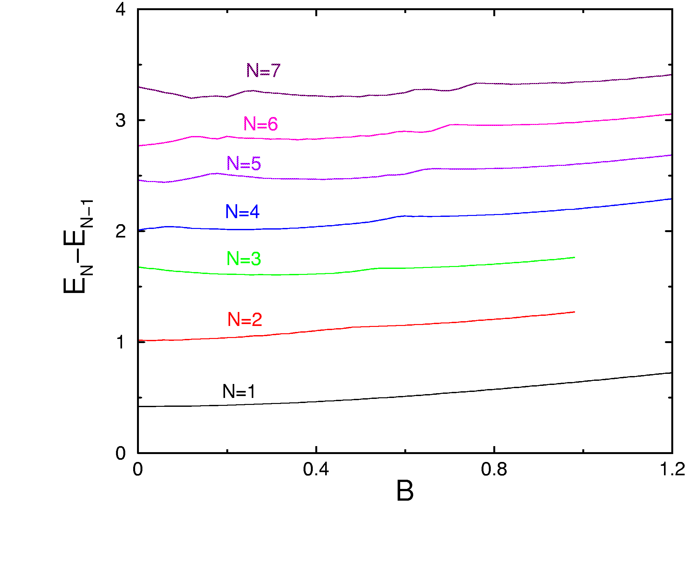
Addition Spectrum E_{N+1}-E_{N}

Slide 28
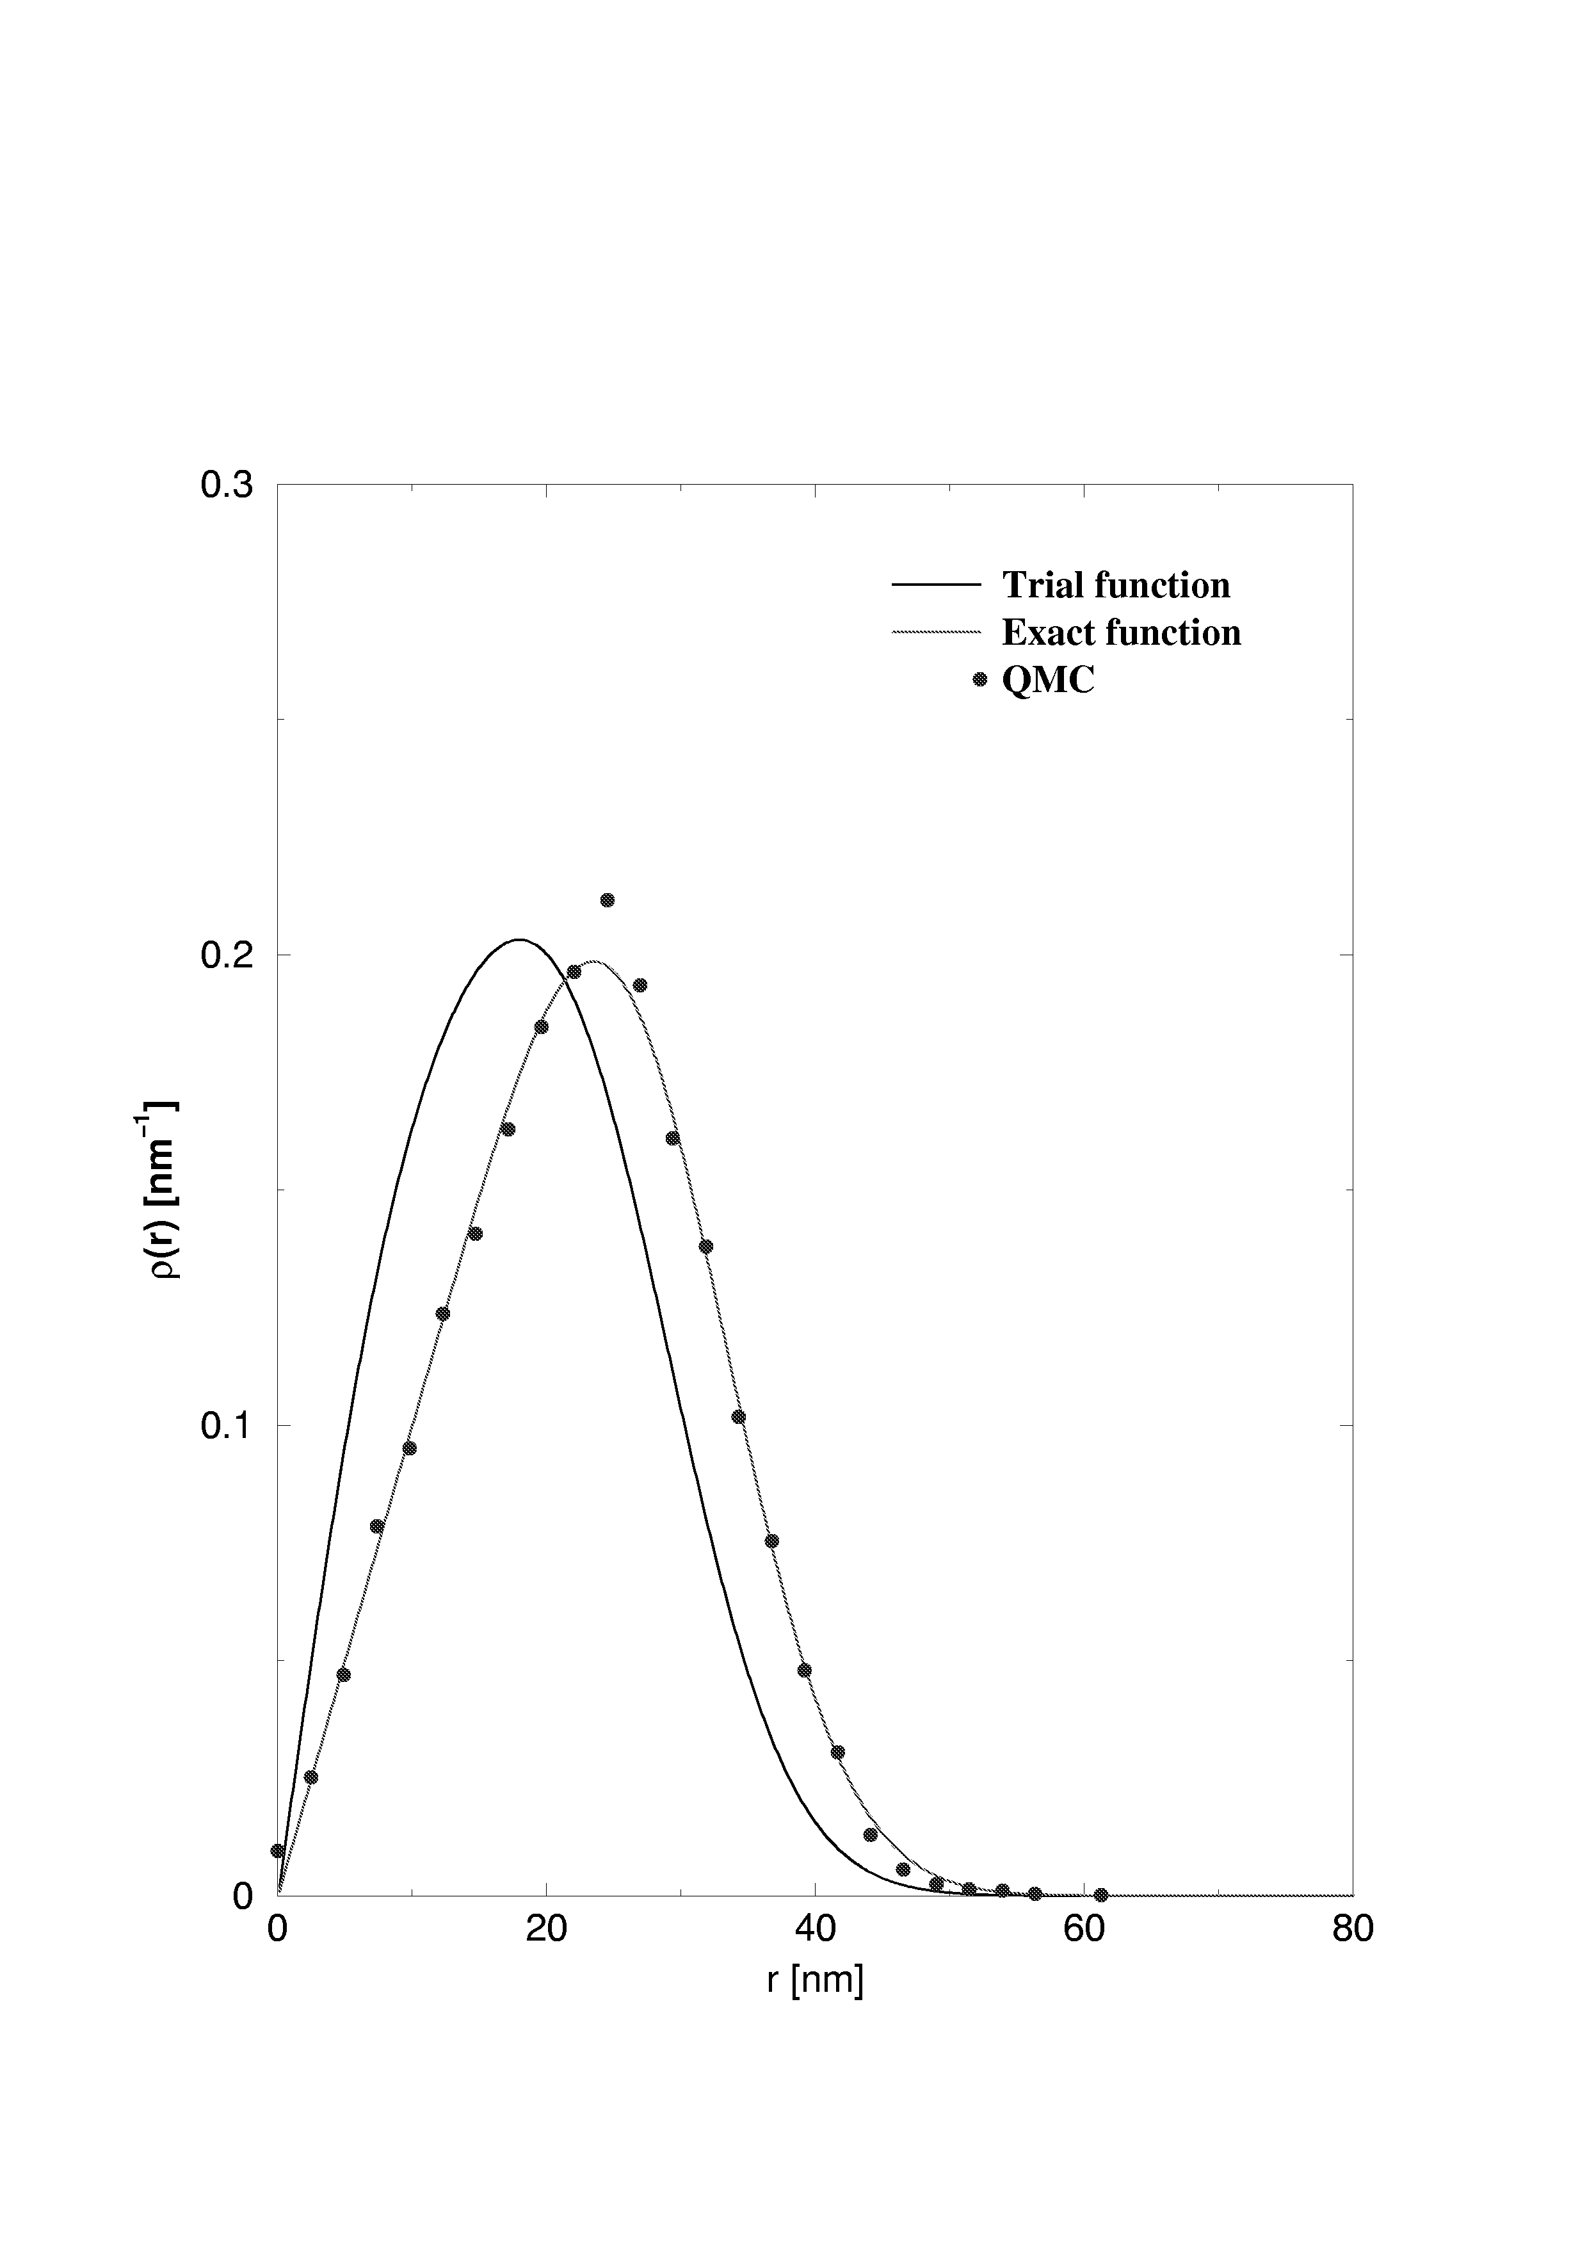
Comparison of Electron Density
Electron charge density from trial wavefunction (Slater determinant of Fock-Darwin solution), exact diagonalisation calculation, and QMC.
N=5 L=6 S=3

Slide 29
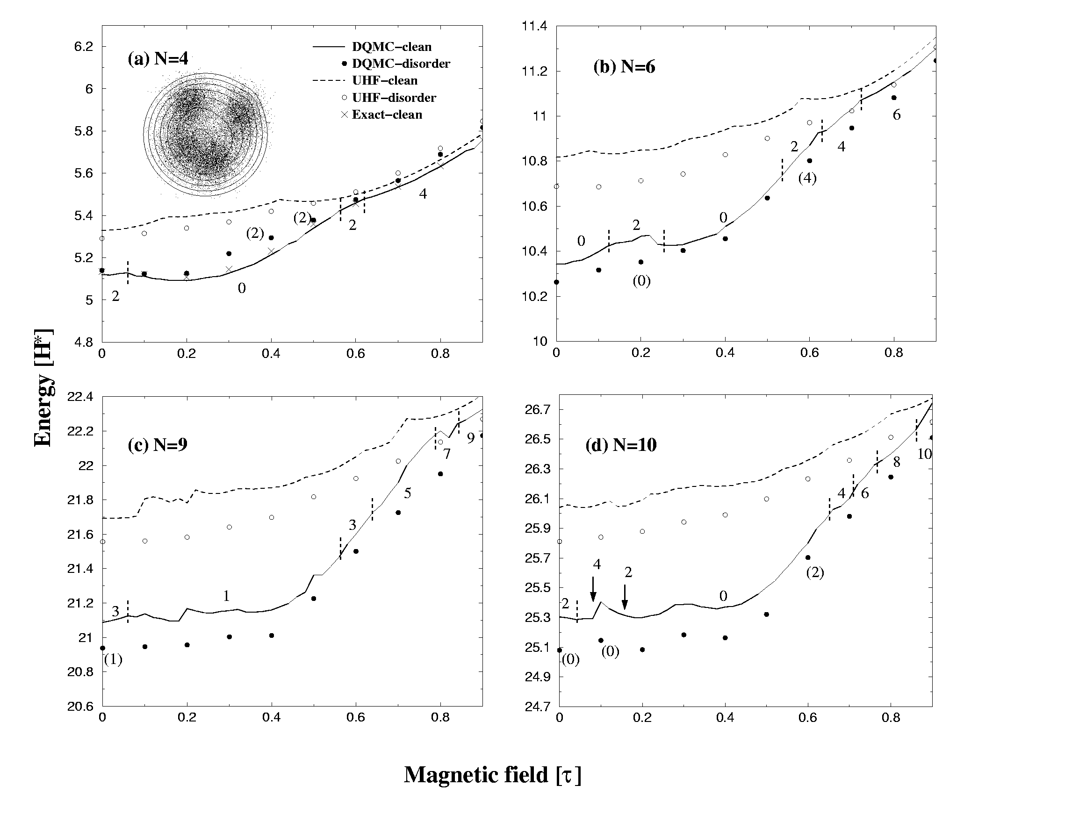
QD - Disordered Potential
Random gaussian peak perturbed quantum dot. From A D Güçlü, J-S Wang, H Guo, PRB 68 (2003) 035304.

Slide 30
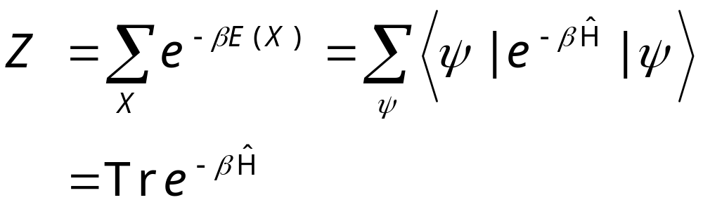
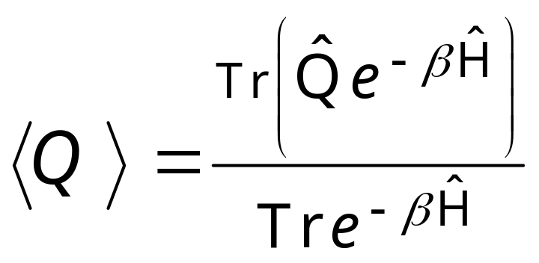
Quantum System at Finite Temperature
Partition function
Expectation value
Notes:
Note that trace Tr is invariant with respect to the set of complete states.

Slide 31
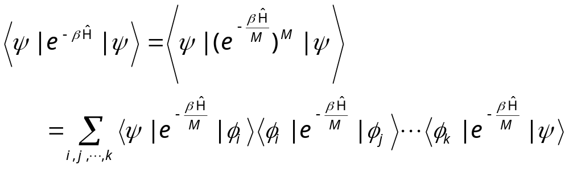
D Dimensional Quantum System to D+1 Dimensional Classical system
Φ_{i} is a complete set of wave-functions
Notes:
We can consider this as β is divided into small interval of length β/M. Each term is a transfer matrix.

Slide 32
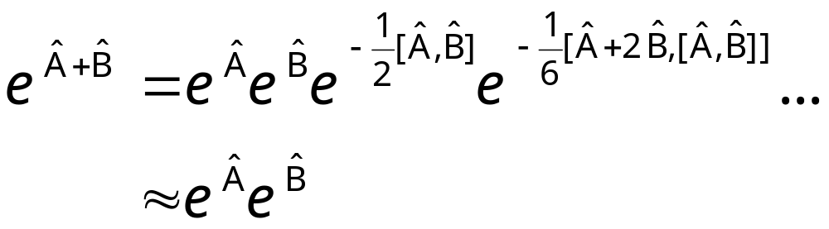
Zassenhaus formula
If the operators Â and Bˆ are order 1/M, the error of the approximation is of order O(1/M²).
Notes:
Actually, the top formula is known as Zassenhaus formula and another similar for exp(A)exp(B) is called Baker-Campbell-Hausdorff formula. The Trotter-Suzuki formula refers to the limit M -> ∞.

Slide 33
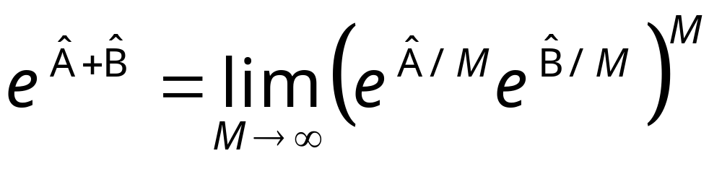
Trotter-Suzuki Formula
where Â and Bˆ are non-commuting operators

Slide 34
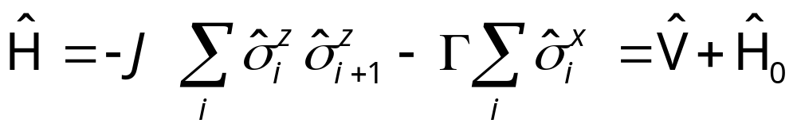
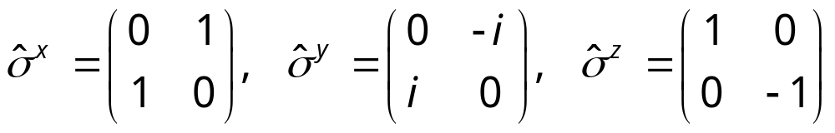
Quantum Ising Chain in Transverse Field
Hamiltonian
where
Pauli matrices at different sites commute.
Notes:
See B. K. Chakrabarti, A. Dutta and P. Sen, “Quantum Ising phase and transitions in transverse Ising models”, Springer, 1996.

Slide 35
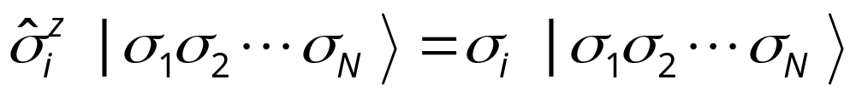
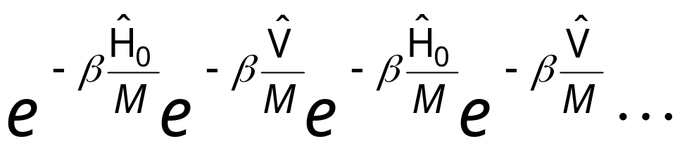
Complete Set of States
We choose the eigenstates of operator σ^{z}:
Insert the complete set in the products:

Slide 36
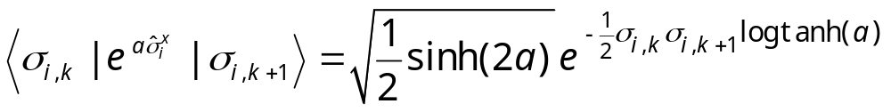
A Typical Term
Trotter or β direction
(i,k)
Space direction

Slide 37
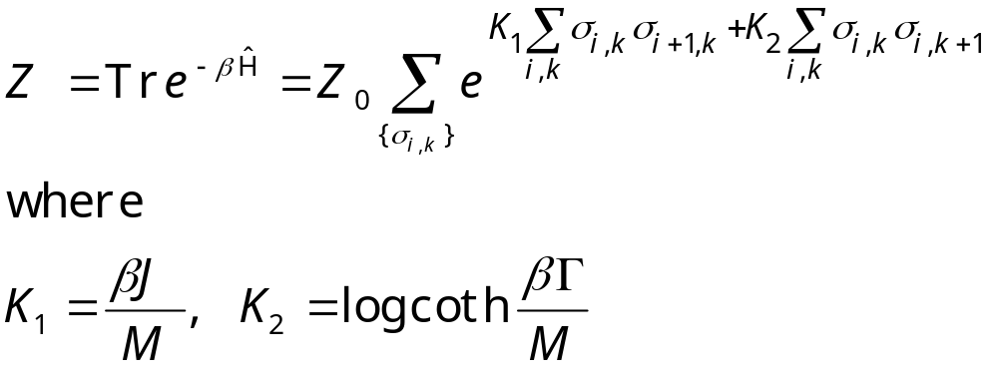
Classical Partition Function
Note that K₁ ∝1/M, K₂ ∝ log M for large M.

Slide 38
Summary
Briefly introduced (classical) MC method
Quantum MC (variational, diffusional, and Trotter-Suzuki)
Application to quantum dot models

