Slide 1
Nonequilibrium Green’s Function Method for Thermal Transport
Jian-Sheng Wang
Notes:
Slides for Xian Symposium, Jian-Sheng Wang, a soft ppt copy is available under the page http://staff.science.nus.edu.sg/~phywjs/Talks/talks.html

Slide 2
Outline of the talk
Introduction
Models
Definition of Green’s functions
Relation to transport (heat current)
Applications
    1D chain and nanotubes
    Transient problem
    Disordered systems

Slide 3
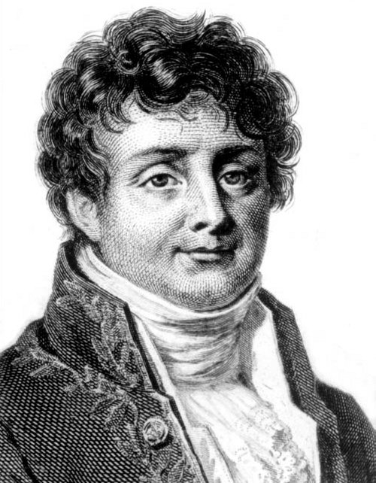
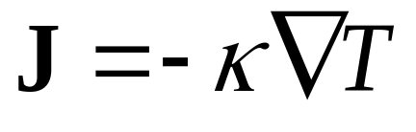
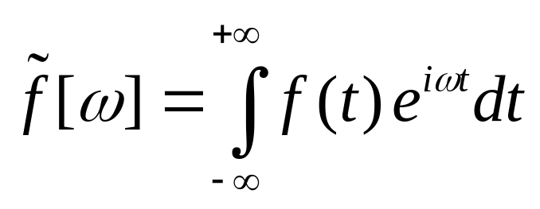
Fourier’s law for heat conduction
Fourier, Jean Baptiste Joseph, Baron (1768-1830)

Slide 4
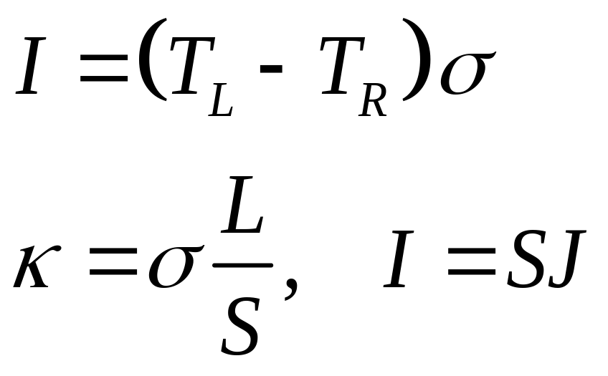
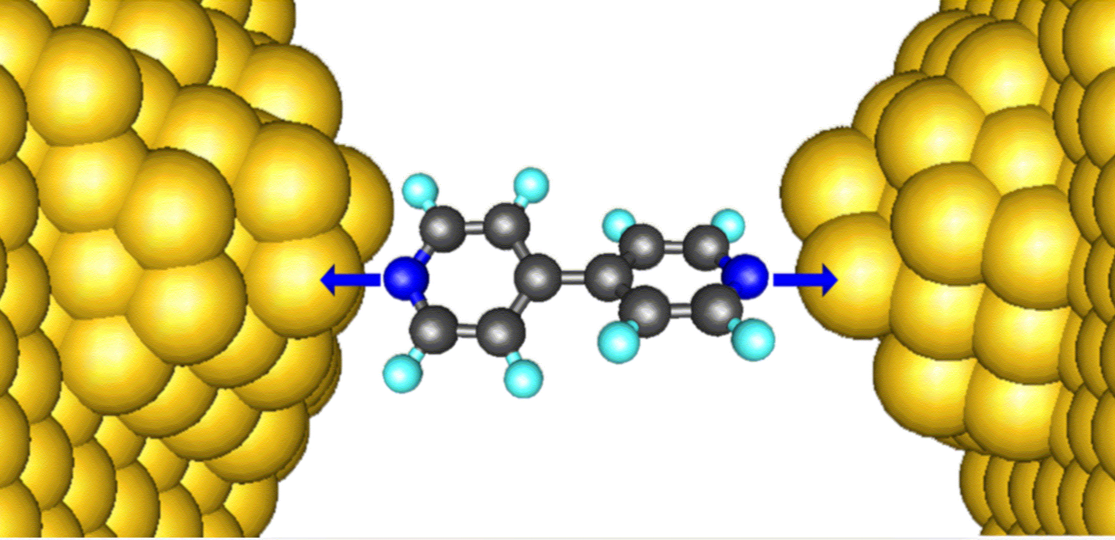
Thermal conductance

Slide 5
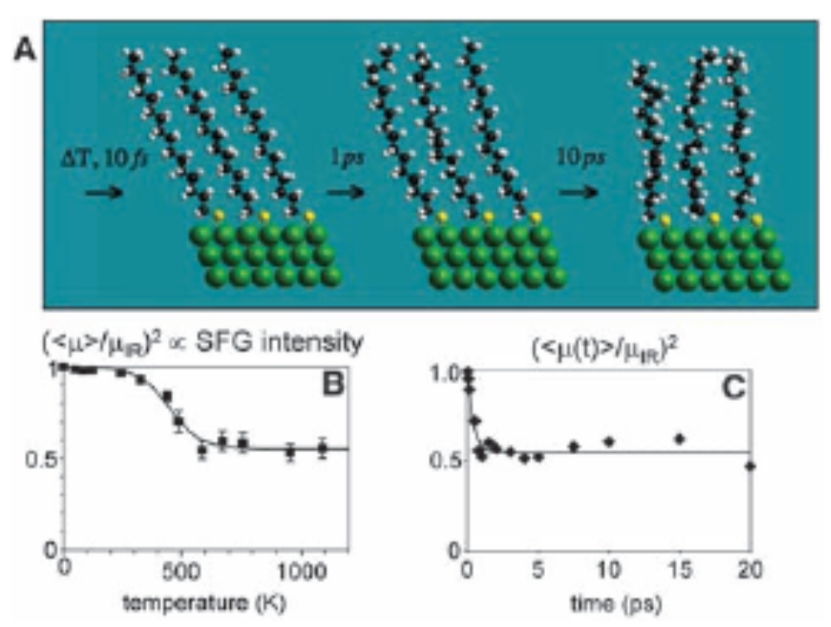
Experimental report of Z Wang et al (2007)
The experimentally measured thermal conductance is 50pW/K for alkane chains at 1000K. From Z Wang et al, Science 317, 787 (2007).

Slide 6
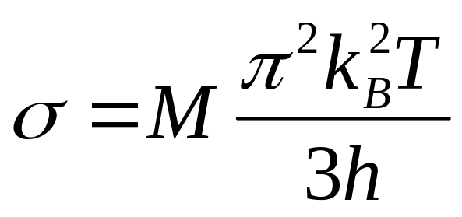
“Universal” thermal conductance in the low temperature limit
Rego & Kirczenow, PRL 81, 232 (1998).
M = 1

Slide 7
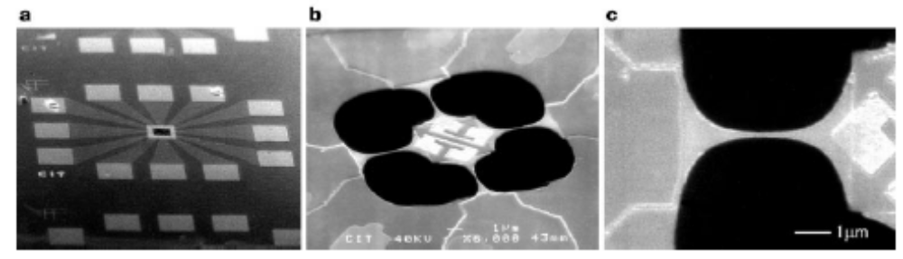
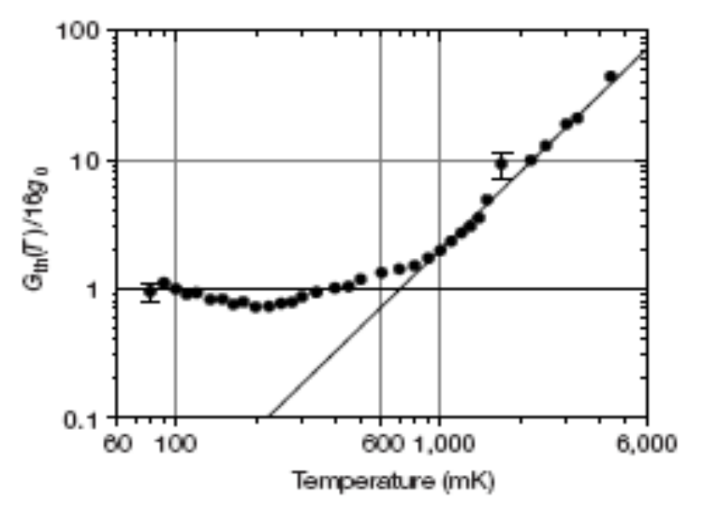
Schwab et al experiments
From K Schwab, E A Henriksen, J M Worlock and M L Roukes, Nature, 404, 974 (2000).

Slide 8
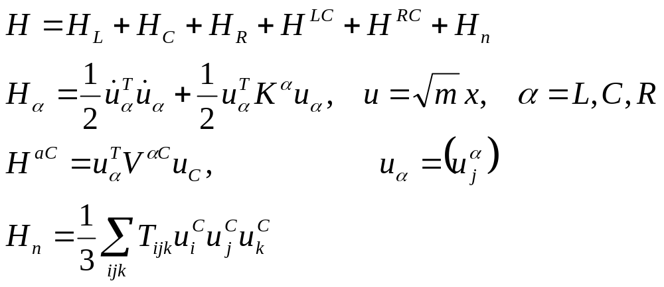
Models
Junction
Left Lead, T_{L}
Right Lead, T_{R}
Notes:
The model in this form is fairly general. Note that x has the dimension of length. Superscript T is for matrix or column vector transpose.

Slide 9
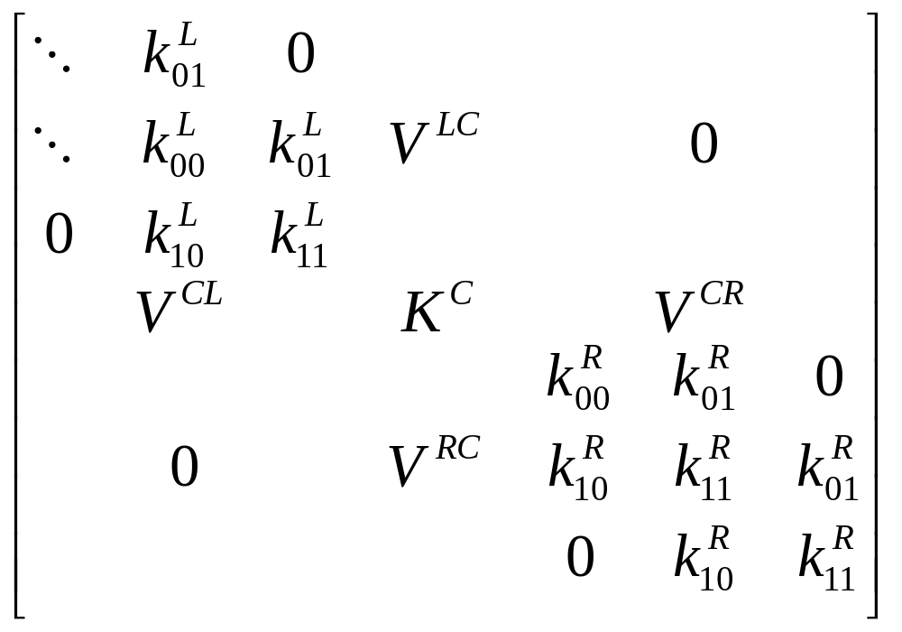
Force constant matrix
K^{R}
Notes:
K is divided into three regions, left, center, right. The force constants K can be computed from a first principles package by taking the second derivatives of the total potential.

Slide 10
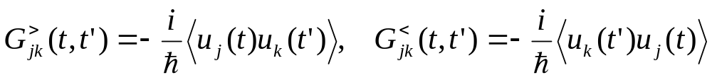
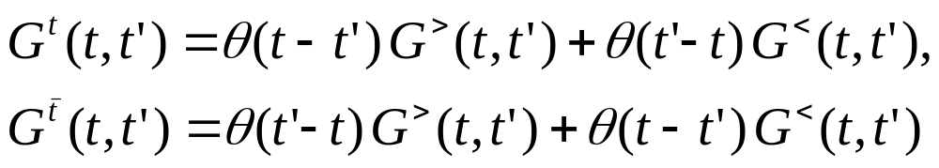
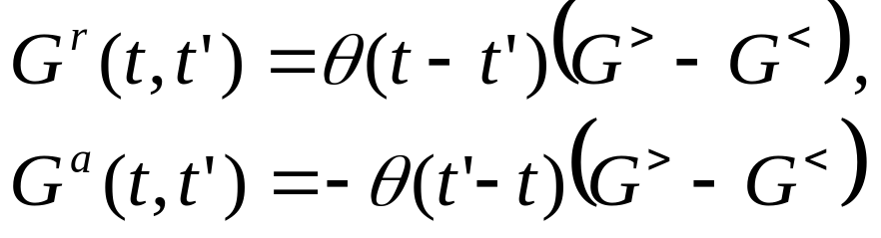
Definitions of Green’s functions
Greater/lesser Green’s function
Time-ordered/anti-time ordered Green’s function
Retarded/advanced Green’s function
Notes:
Other types such as Matsubara Green’s function or canonical (Kubo) correlation are also used. i = sqrt(-1). The average < … > can be equilibrium or with respect to arbitrary density matrix. For classical systems, G< = G>.

Slide 11
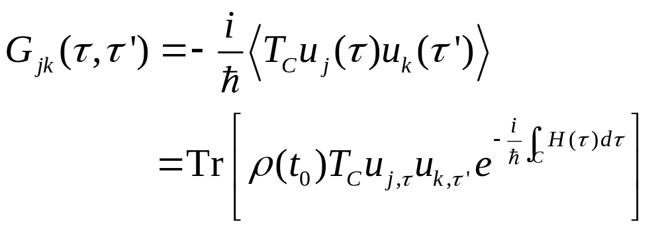
Contour-ordered Green’s function
Contour order: the operators earlier on the contour are to the right.
τ’
τ
t₀

Slide 12
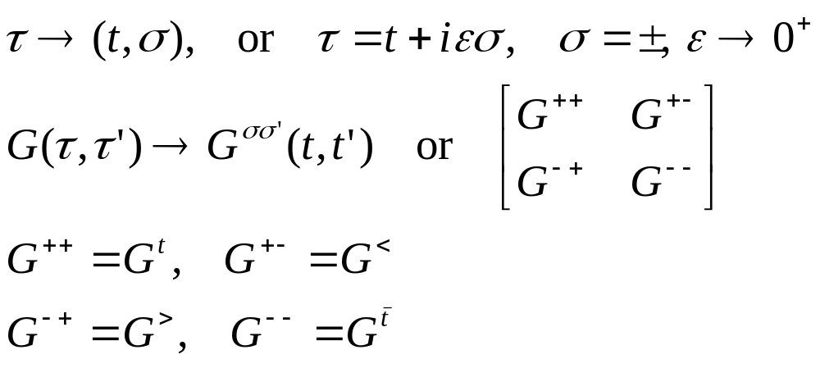
Relation to other Green’s function
τ’
τ
t₀
Notes:
σ = + for the upper branch, and – for the returning lower branch.

Slide 13
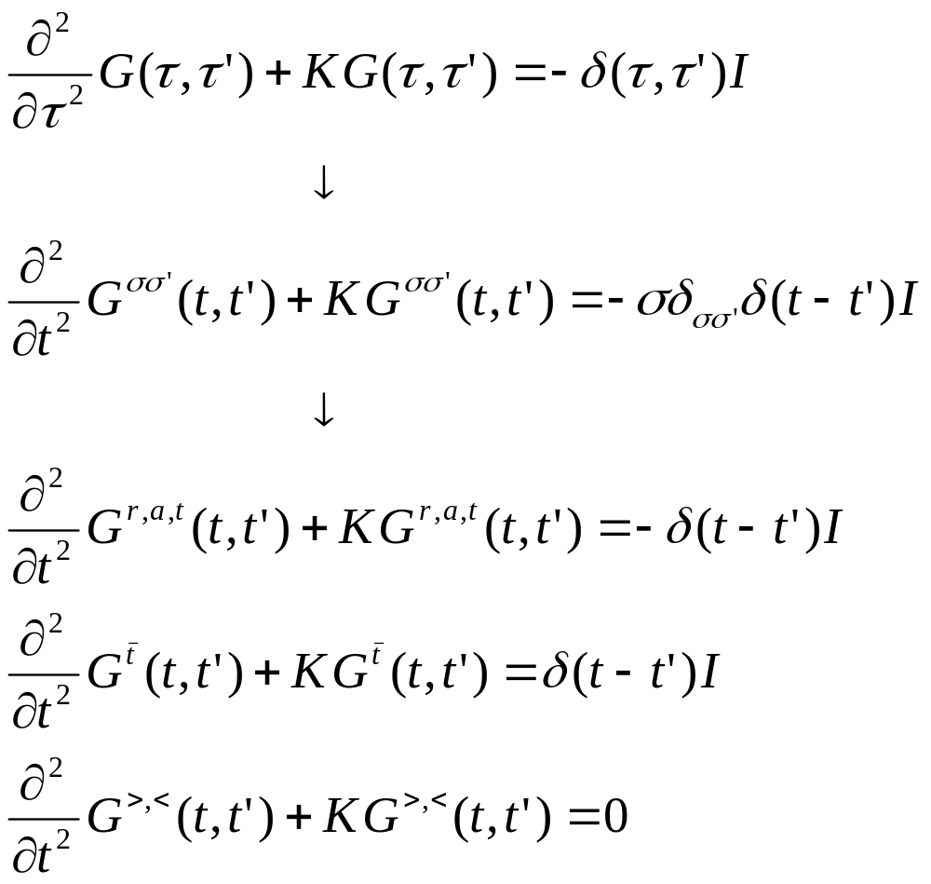
Equations for Green’s functions

Slide 14
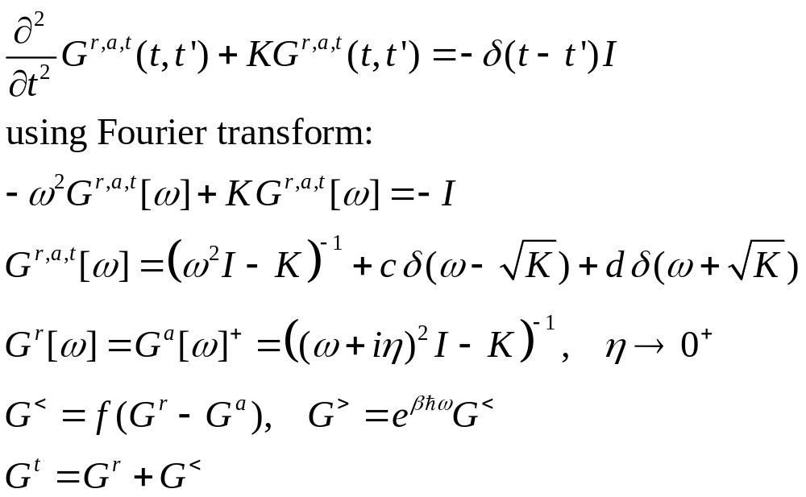
Solution for Green’s functions
c and d can be fixed by initial/boundary condition.
Notes:
Note that if ax = b, x = b/a, but not if a = 0, in that case, x = infinity, thus, the Dirac delta function.

Slide 15
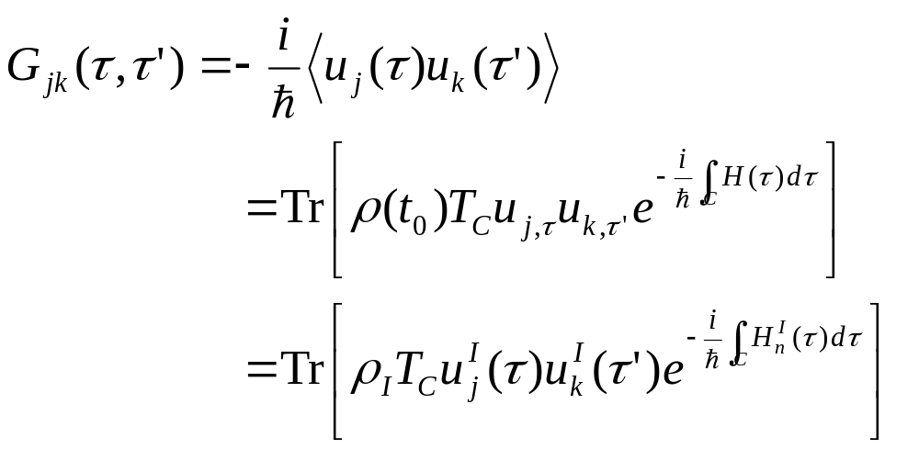
Contour-ordered Green’s function
τ’
τ
t₀
Notes:
Another possible representation of the result is using Feynman path integral formulation.

Slide 16
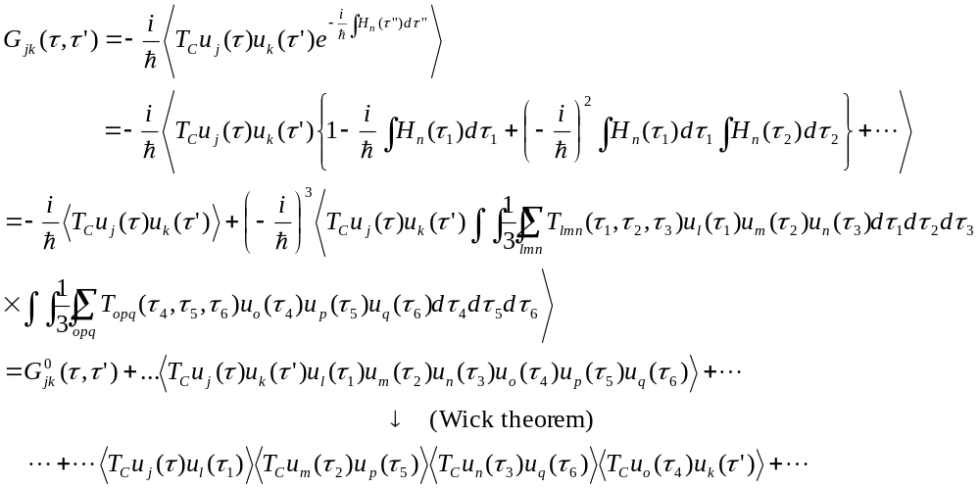
Perturbative expansion of contour ordered Green’s function
Notes:
Every operator is in interaction picture, dropped superscript I for simplicity. The Wick theorem is valid if the expectation < … > is with respect to a quadratic weight. For a proof, see Rammer.

Slide 17
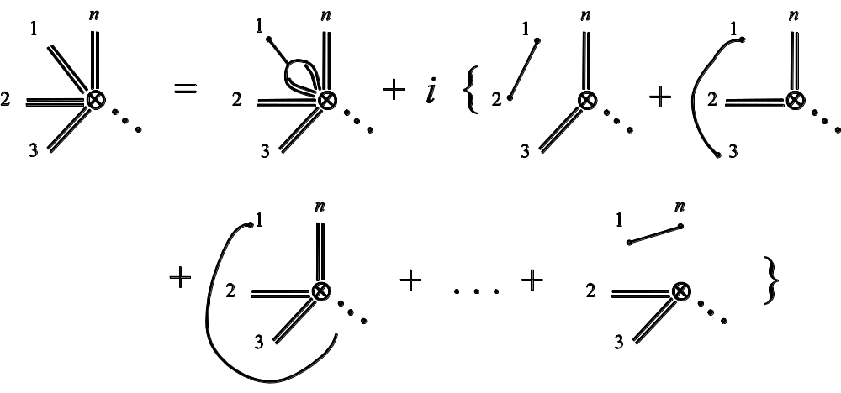
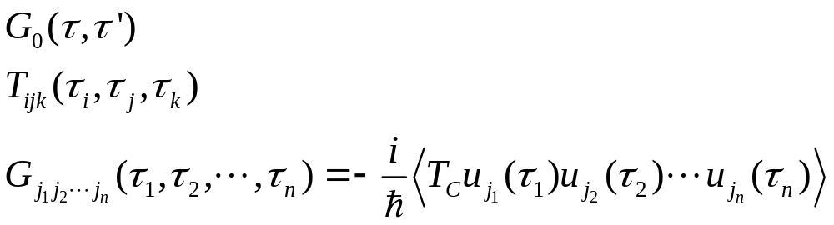
General expansion rule
Single line
3-line vertex
n-double line vertex
Notes:
See our review article or Rammer’s book.

Slide 18
Diagrammatic representation of the expansion
=
+ 2i
+ 2i
+ 2i
=
+

Slide 19
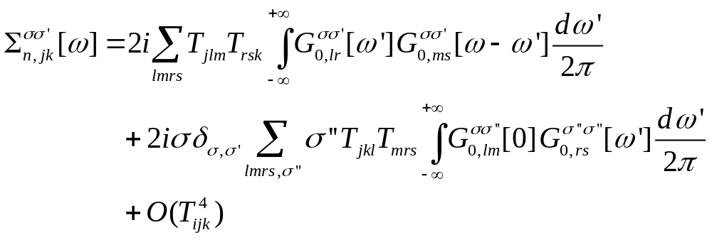
Explicit expression for self-energy
Notes:
See also figure 3 in J.-S. Wang, X. Ni, and J.-W. Jiang, Phys. Rev. B 80, 224302 (2009).

Slide 20
Junction system
Three types of Green’s functions:
  g for isolated systems when leads and centre are decoupled
  G0 for ballistic system
  G for full nonlinear system
Governing Hamiltonians
H_{L}+H_{C}+H_{R} +V +H_{n}
H_{L}+H_{C}+H_{R} +V
G
H_{L}+H_{C}+H_{R}
G₀
Green’s function
g_{α}
t = − ∞
Equilibrium at T_{α}
t = 0
Nonequilibrium steady state established
Notes:
Two adiabatic switch-on’s.

Slide 21
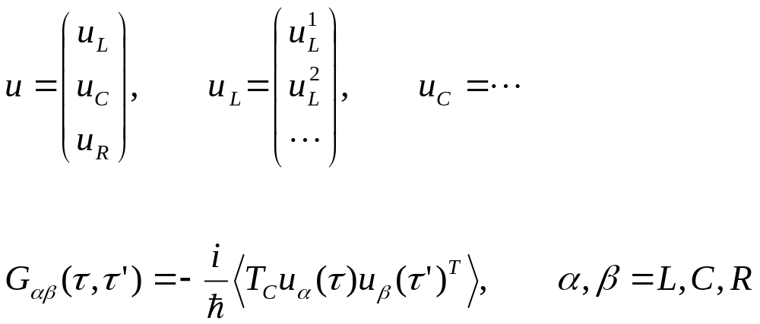
Three regions

Slide 22
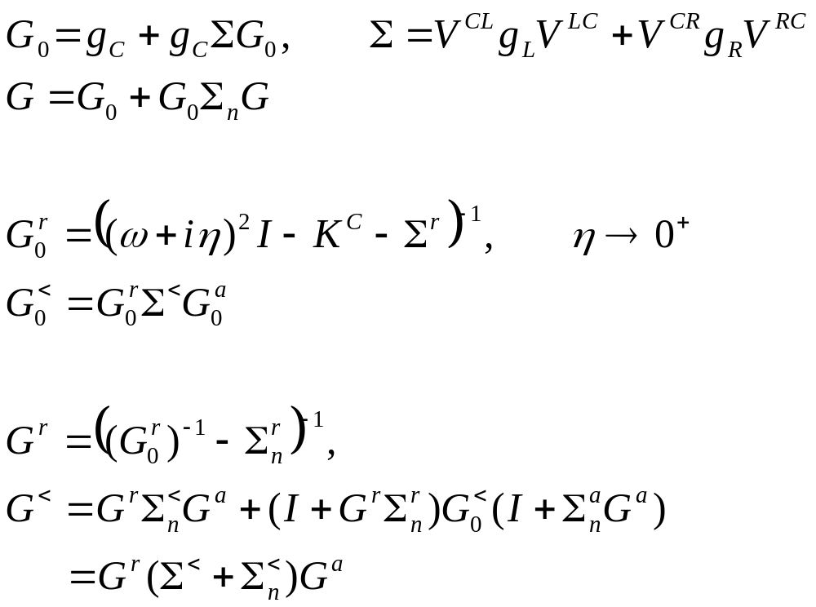
Dyson equations and solution
Notes:
In deriving the last line, we use the fact (g^{r})⁻¹ g< = 0.

Slide 23
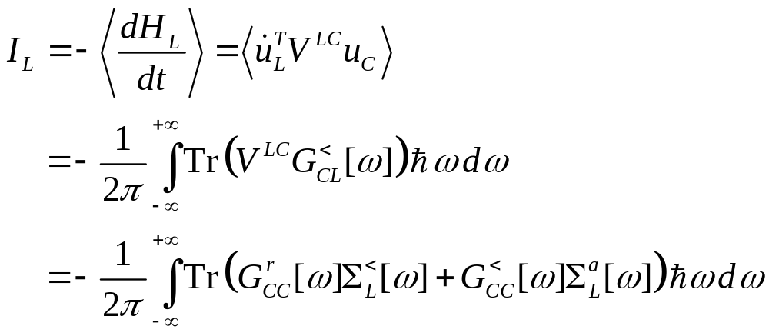
Energy current
Notes:
I_{L} is energy flowing out of the left lead into the center. This expression can be proving to be real, no need to take Re. Above equation works for general nonlinear case.

Slide 24
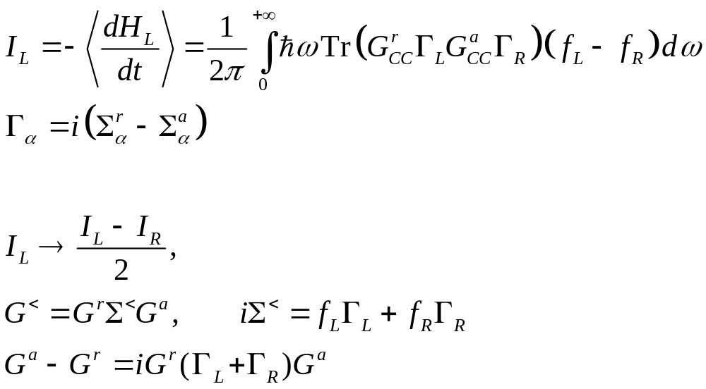
Caroli formula
Notes:
The symmetrization appears necessary to get the Caroli formula. Caroli formula is valid only for ballistic case where H_{n} = 0.

Slide 25
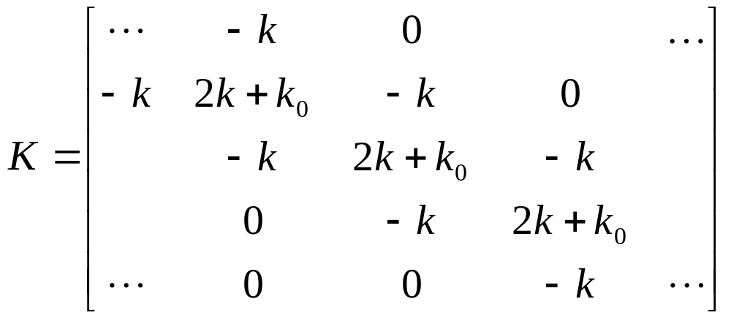
Ballistic transport in a 1D chain
Force constants
Equation of motion
Notes:
The matrix K is infinite in both directions.

Slide 26
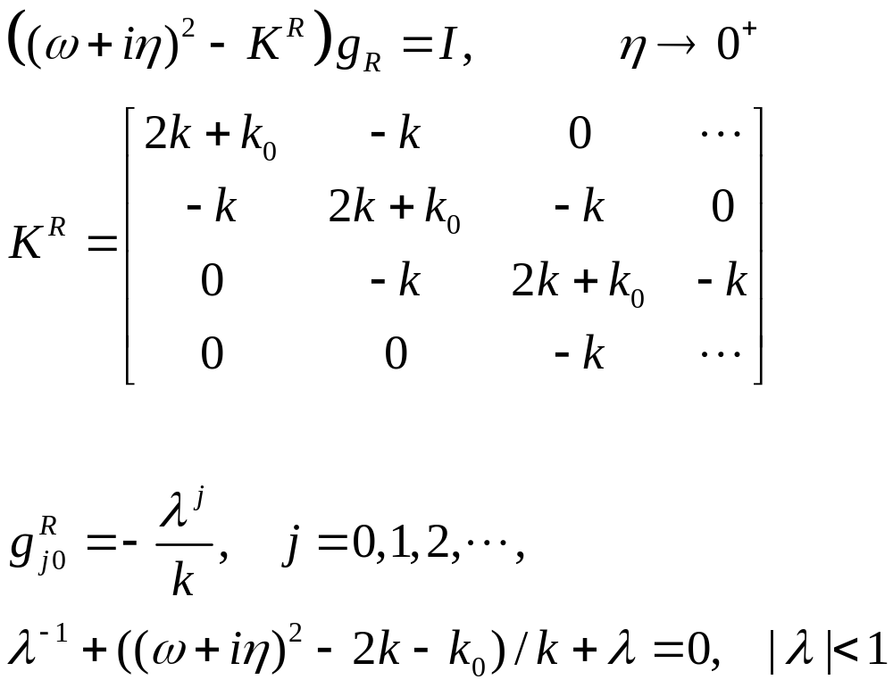
Solution of g
Surface Green’s function
Notes:
K^{R} is semi-finite, V is nonzero only at the corner.

Slide 27
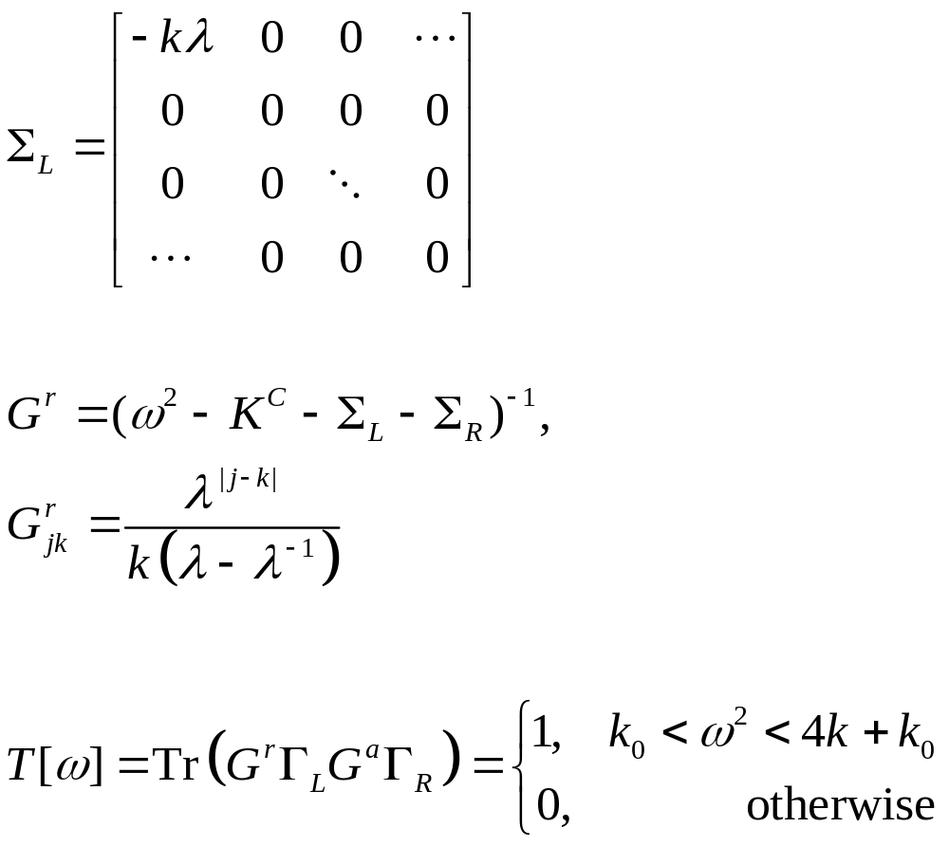
Lead self energy and transmission
T[ω]
1
ω
Notes:
Σ_{R} is nonzero only for the lower right corner.

Slide 28
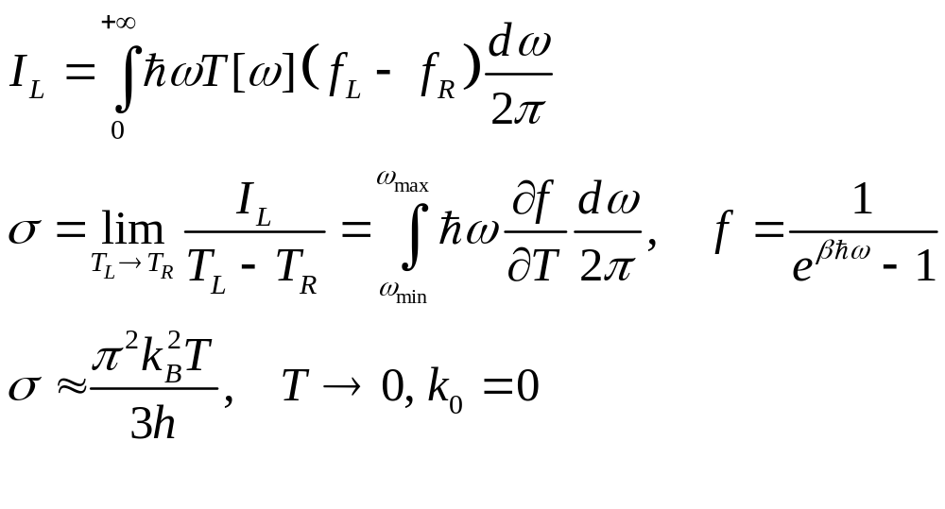
Heat current and conductance, Landauer formula
Notes:
The last formula σ is called universal conductance.

Slide 29
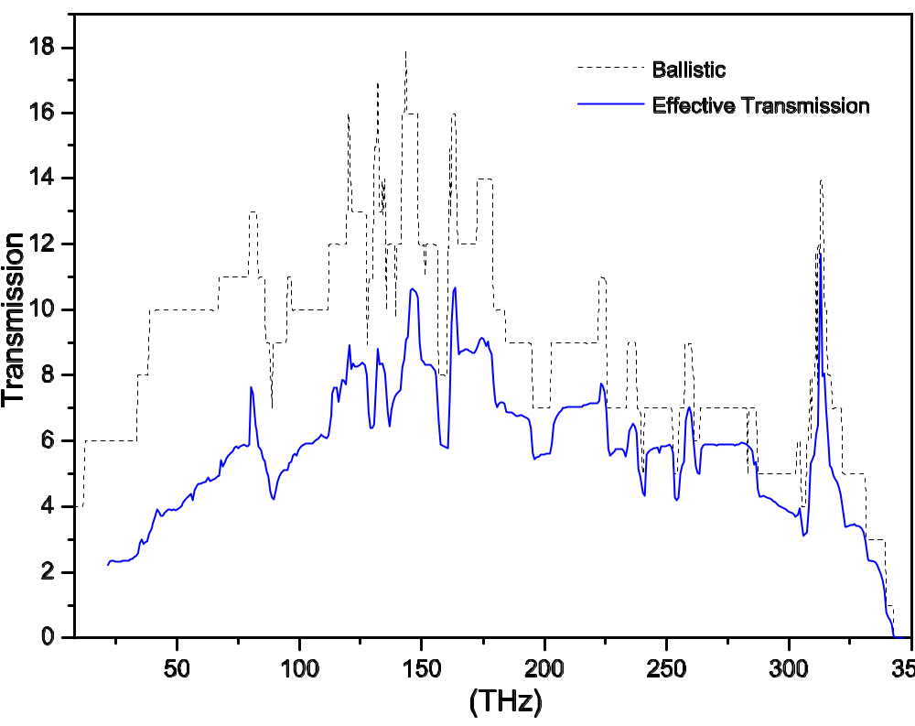
Carbon nanotube, nonlinear effect
The transmissions in a one-unit-cell carbon nanotube junction of (8,0) at 300K. From J-S Wang, J Wang, N Zeng, Phys. Rev. B 74, 033408 (2006).
Notes:
The nonlinear result may be not correct at the low frequency end.

Slide 30
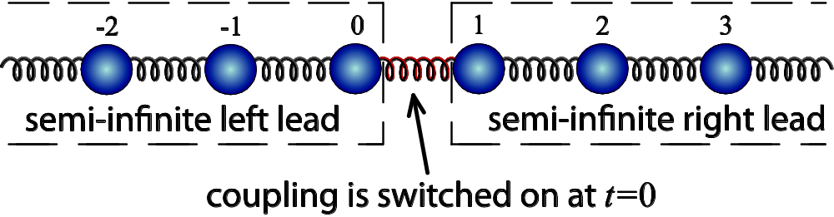
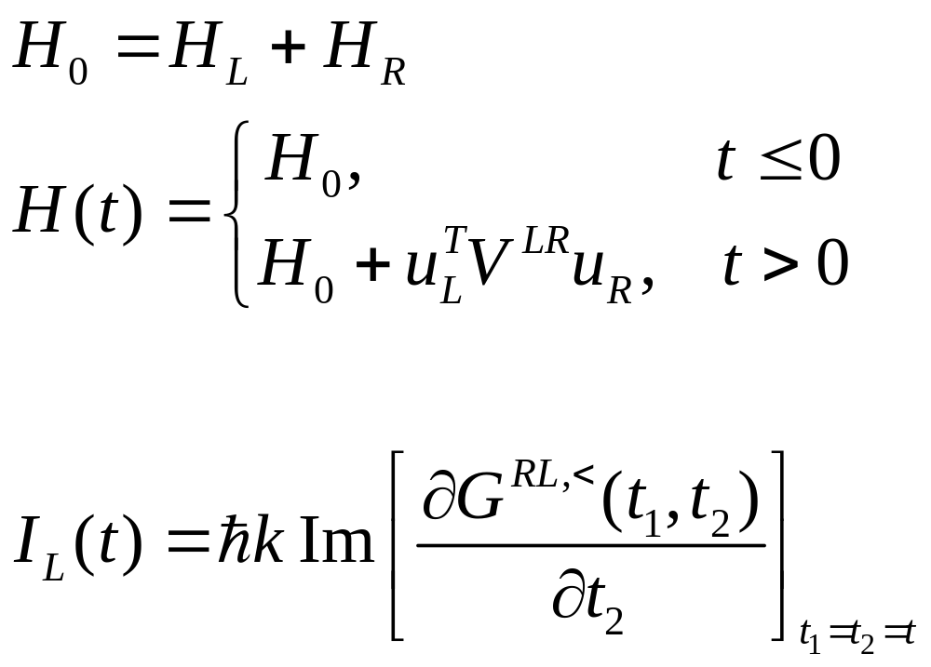
Transient problems
Notes:
The I_{L} is valid for 1D chain with spring constant k.

Slide 31
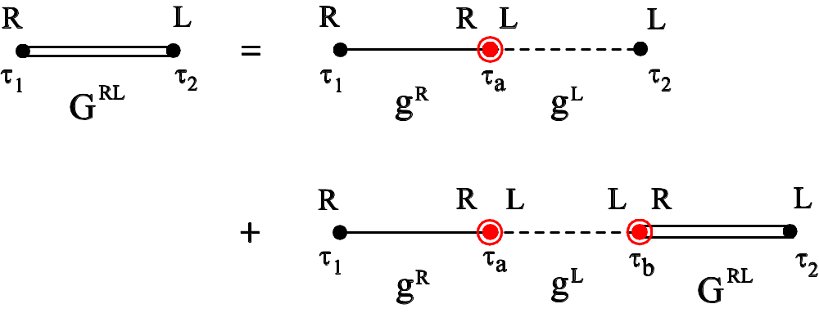
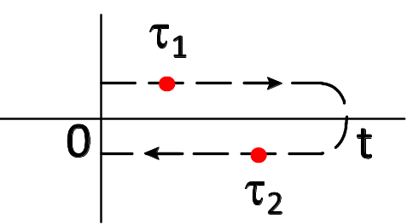
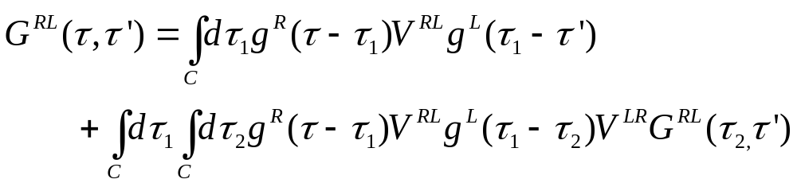
Dyson equation on contour from 0 to t
Contour C
Notes:
In steady state we use Keldysh contour which is from - to +. But here for transient study, the contour is a finite segment.

Slide 32
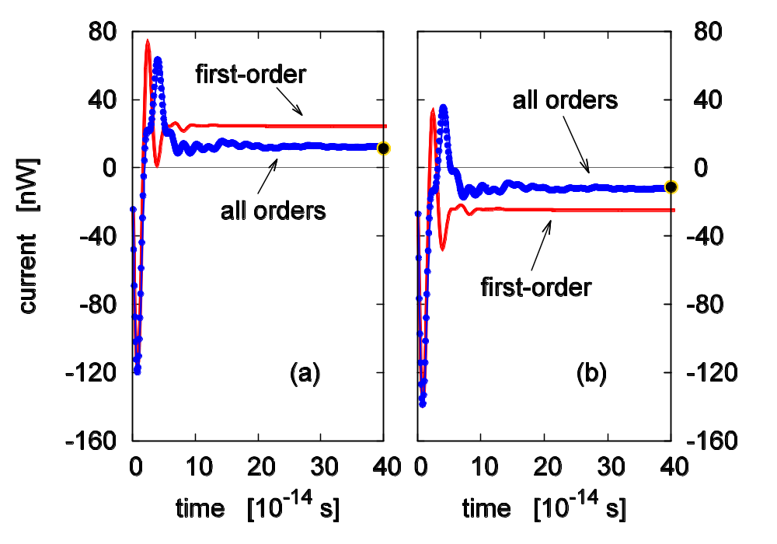
Transient thermal current
The time-dependent current when the missing spring is suddenly connected. (a) current flow out of left lead, (b) out of right lead. Dots are what predicted from Landauer formula. T=300K, k =0.625 eV/(Å²u) with a small onsite k₀=0.1k. From E. C. Cuansing and J.-S. Wang, Phys. Rev. B 81, 052302 (2010). See also PRE 82, 021116 (2010).

Slide 33
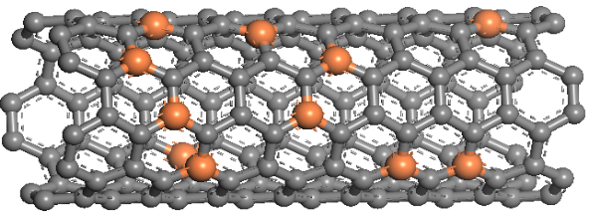

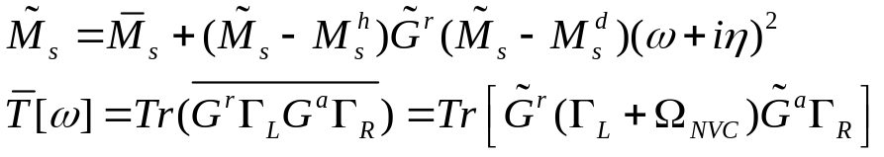
Treatment of mass disorder
Coherent Potential Approximation
Generate a configuration, but treat mass matrix as a variable
Brute Force
Generate configuration randomly, and compute the transmission of each, and average the results.
Constitute two self-consistent equations to solve effective mass
We have the statistically averaged thermal properties
Instead of massive efforts required in brute force calculations, configuration averaging of disordered systems can be efficiently handled in a self-consistent manner by setting up the phonon version of nonequilibrium vertex correction (NVC) theory.

Slide 34
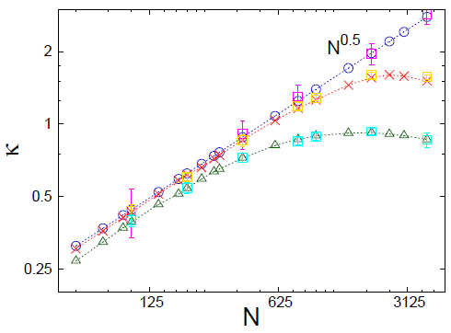
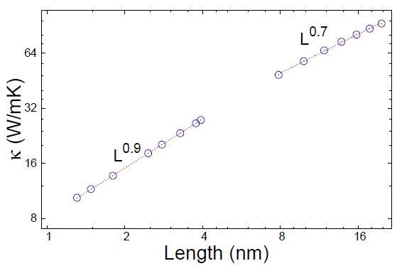
Results for disordered systems
1D chains
nanotubes
Results:
The accuracy of this theory is then tested with Monte Carlo experiments on one-dimensional disordered harmonic chains, the early proposed power law form of thermal conductivity has been recovered and we also indicate the possibility of varying the exponent for larger system size.
Anomalous thermal transport has been shown and also, we observe the transition between different transport regimes due to the scattering of phonons by impurities.
This method of considering mass disorder can also be extended to include force constant disorder.
X. Ni, M. L. Leek, J.-S. Wang, Y. P. Feng, and B. Li, ``Anomalous thermal transport in disordered harmonic chains and carbon nanotubes,'' submitting.

Slide 35
Summary
The contour ordered Green’s function is the essential ingredient for NEGF
NEGF is most easily applied to ballistic systems, for both steady states, transient time-dependent problems, and mass disordered systems
Nonlinear problems are still hard to work with

Slide 36
Thank you
Notes:
I acknowledge my students/collaborators/group members over the years involved in this field: Wang Jian, Zeng Nan, Lü Jingtao, Eduardo Cuansing, Jiang Jinwu, Jose L. Garcia, Zhang Lifa, Ni Xiaoxi, Leek Meng Lee, Xu Yong, Pawel Keblinski, Baowen Li, Lan Jinghua, Gan Chee Kwan.

