Slide 1
Quantum Thermal Transport
Jian-Sheng Wang,
Dept of Physics, NUS

Slide 2
Overview
Diffusive and ballistic thermal transport
Universal thermal conductance
NEGF formulism
Classical MD with quantum bath
Phonon Hall effect

Slide 3
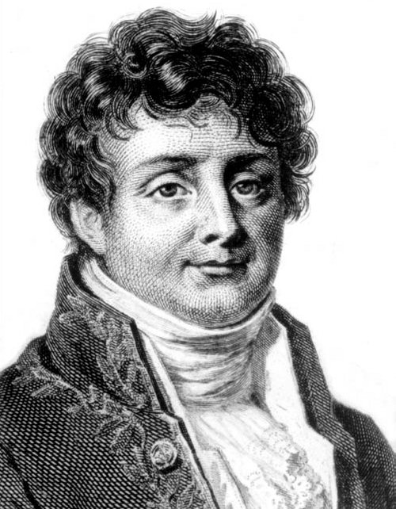
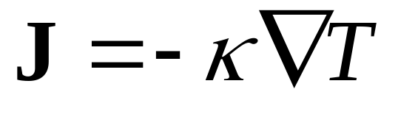
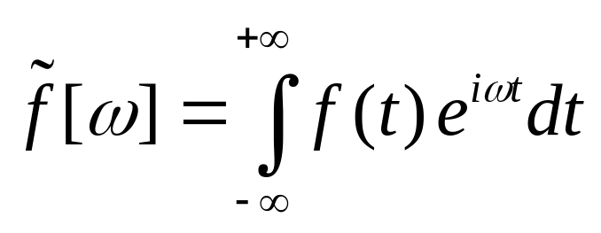
Fourier’s Law
Fourier, Jean Baptiste Joseph, Baron (1768-1830)

Slide 4
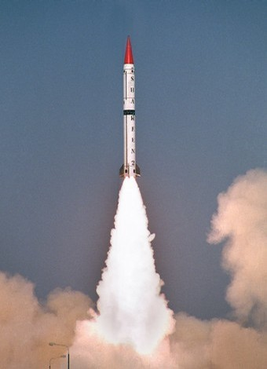


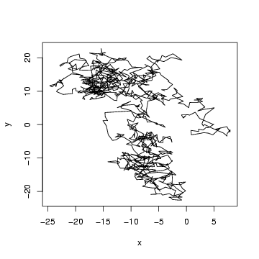

Diffusive Transport vs Ballistic Transport
t

Slide 5
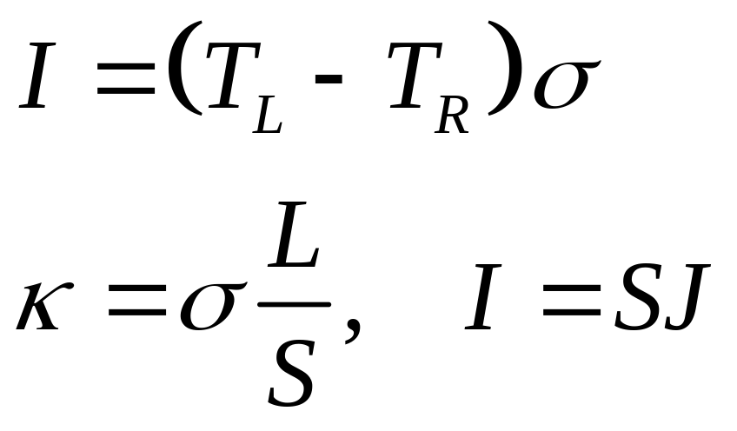
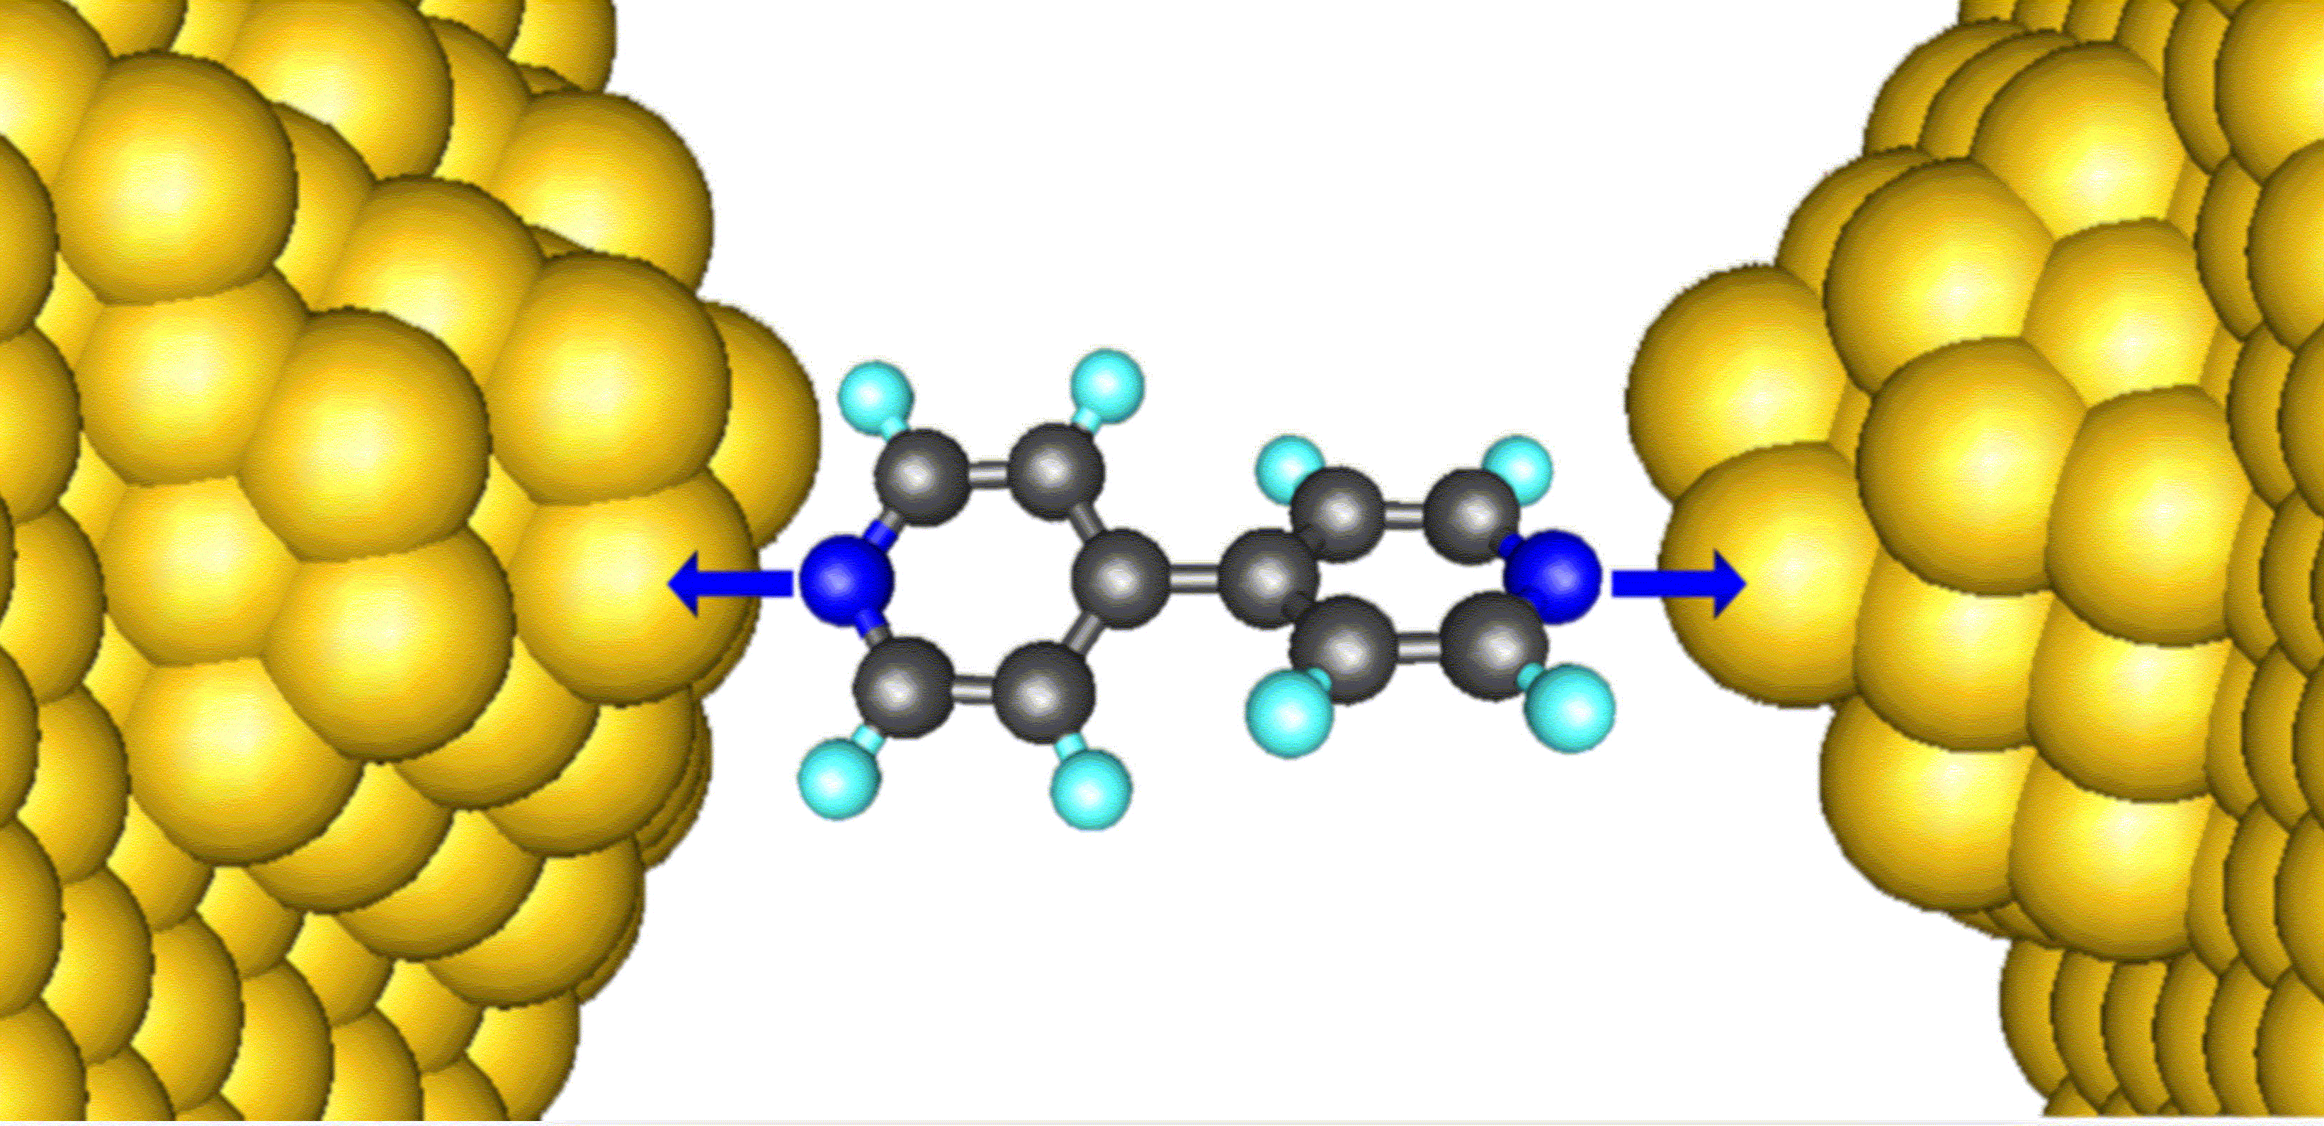
Thermal Conductance

Slide 6
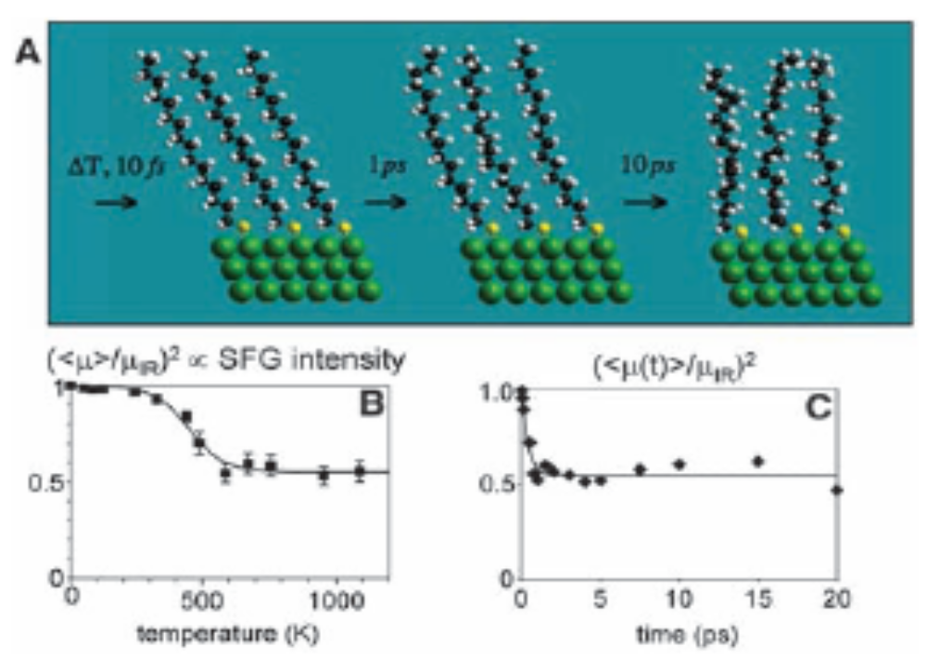
Experimental Report of Z Wang et al (2007)
The experimentally measured thermal conductance is 50pW/K for alkane chains at 1000K, From Z Wang et al, Science 317, 787 (2007).

Slide 7
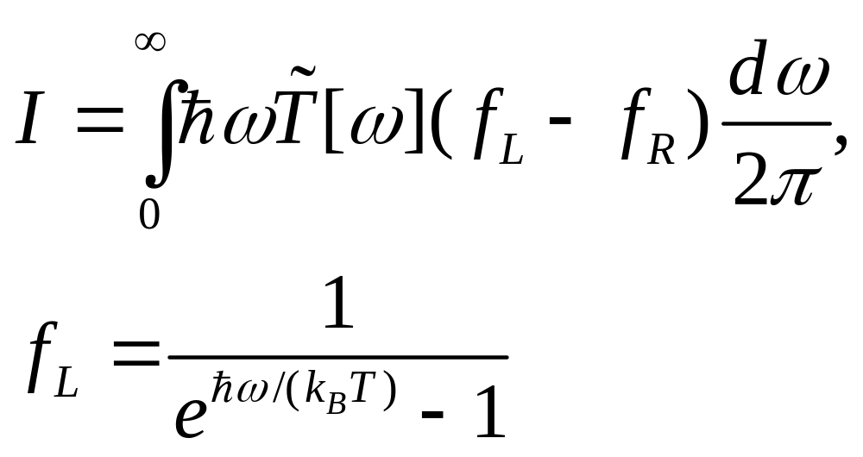
Landauer Formula

Slide 8
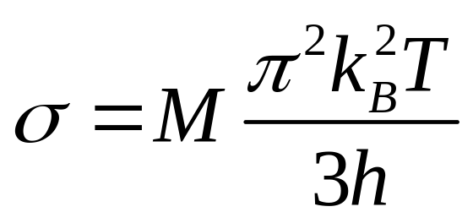
“Universal” Thermal Conductance
Rego & Kirczenow, PRL 81, 232 (1998).
M = 1

Slide 9
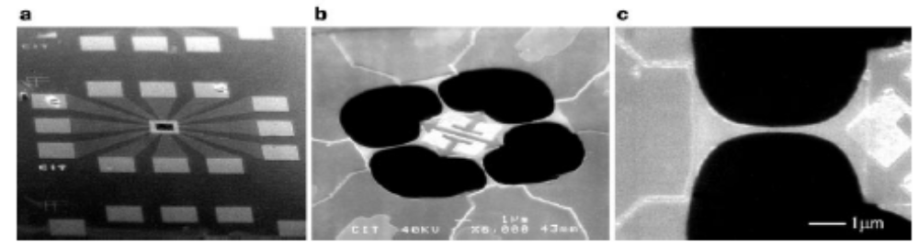
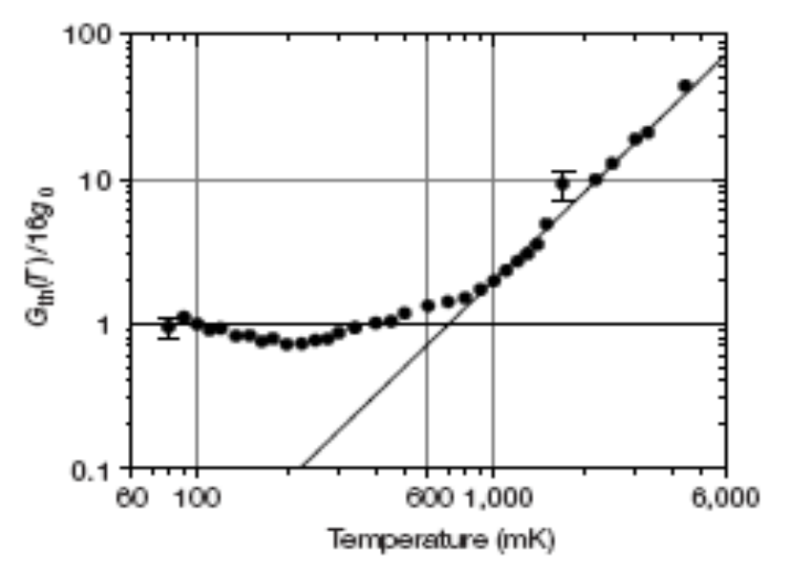
Schwab et al Experiments
From K Schwab, E A Henriksen, J M Worlock and M L Roukes, Nature, 404, 974 (2000).

Slide 10
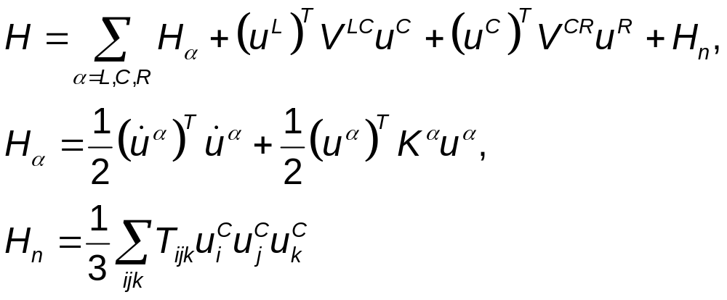
Nonequilibrium Green’s Function Approach
^{T} for matrix transpose
mass m = 1,
ħ = 1
Left Lead, T_{L}
Right Lead, T_{R}
Junction Part

Slide 11
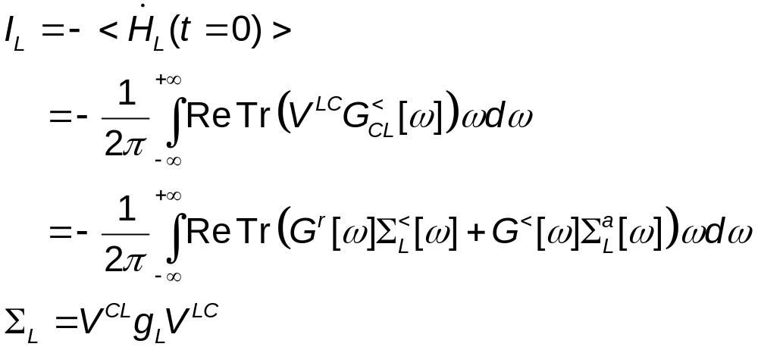
Heat Current
Where G is the Green’s function for the junction part, Σ_{L} is self-energy due to the left lead, and g_{L} is the (surface) Green’s function of the left lead.

Slide 12
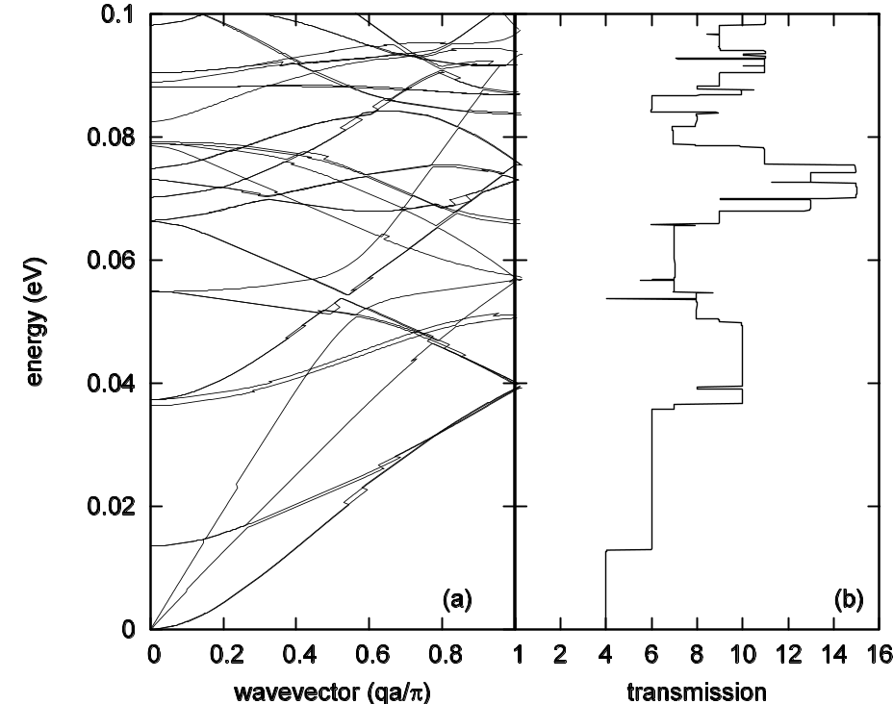
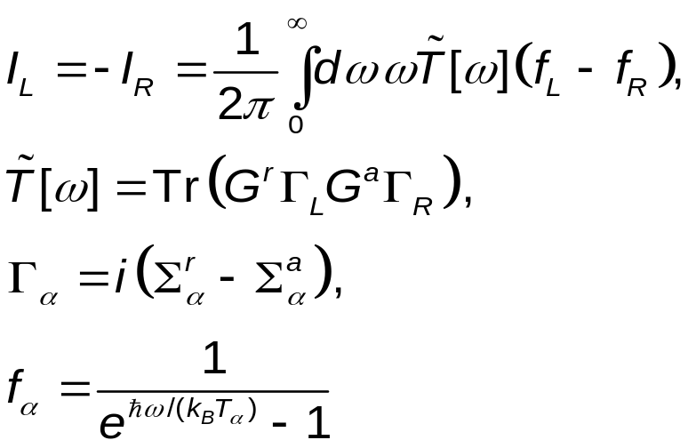
Landauer/Caroli Formula
In systems without nonlinear interaction the heat current formula reduces to that of Laudauer formula:
JSW, Wang, & Lü, Eur. Phys. J. B, 62, 381 (2008).
(6,0) carbon nanotube

Slide 13
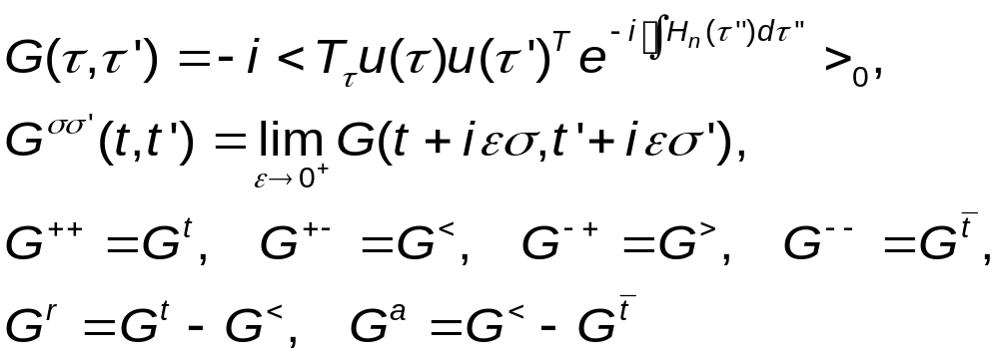
Contour-Ordered Green’s Functions
τ complex plane
See Keldysh, or Meir & Wingreen, or Haug & Jauho

Slide 14
Adiabatic Switch-on of Interactions
Governing Hamiltonians
H_{L}+H_{C}+H_{R} +V +H_{n}
H_{L}+H_{C}+H_{R} +V
G
H_{L}+H_{C}+H_{R}
Green’s functions
G₀
g
t = − ∞
Equilibrium at T_{α}
t = 0
Nonequilibrium steady state established

Slide 15
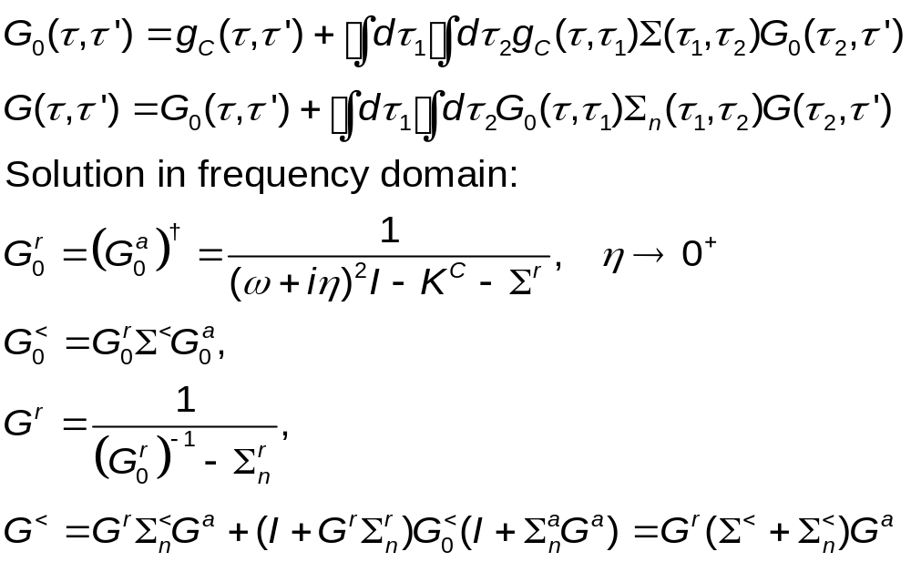
Contour-Ordered Dyson Equations

Slide 16
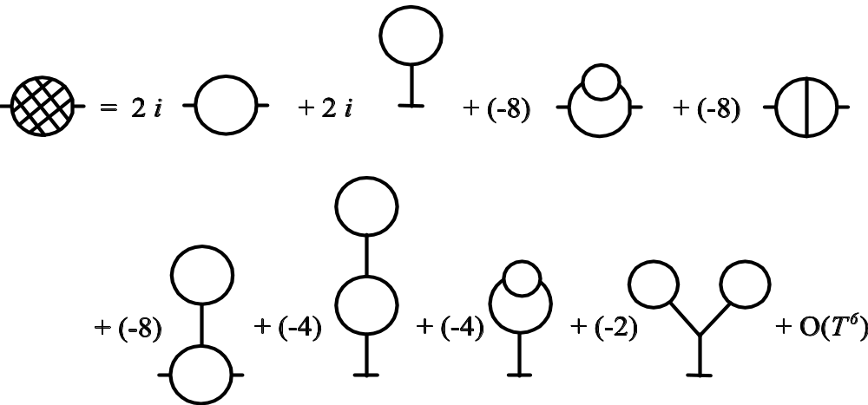
Feynman Diagrams
Each long line corresponds to a propagator G₀; each vertex is associated with the interaction strength T_{ijk}.

Slide 17
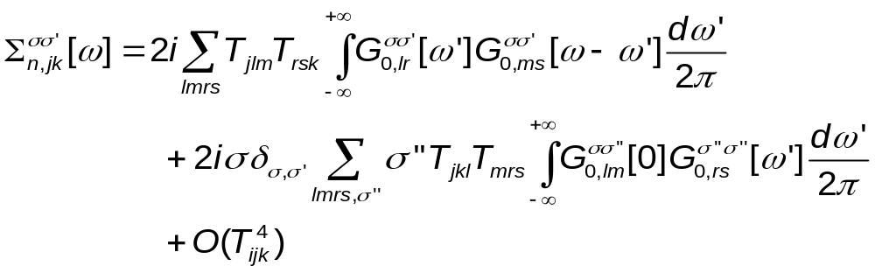
Leading Order Nonlinear Self-Energy
σ = ±1, indices j, k, l, … run over particles

Slide 18
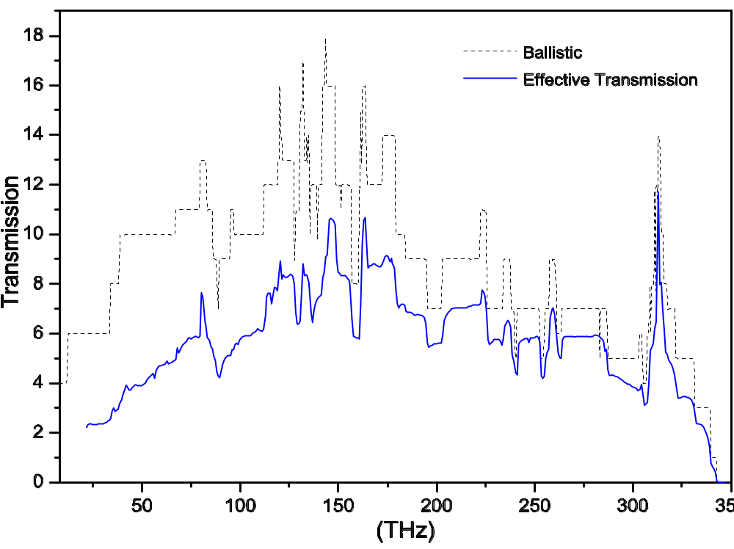
Energy Transmissions
The transmissions in a one-unit-cell carbon nanotube junction of (8,0) at 300 Kelvin. From JSW, J Wang, N Zeng, Phys. Rev. B 74, 033408 (2006).

Slide 19
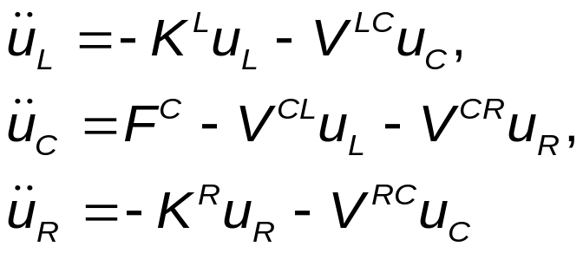
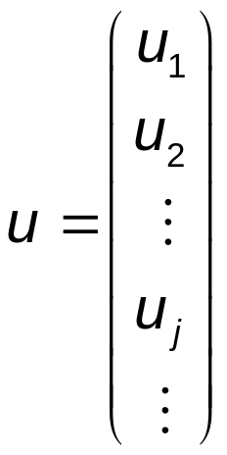
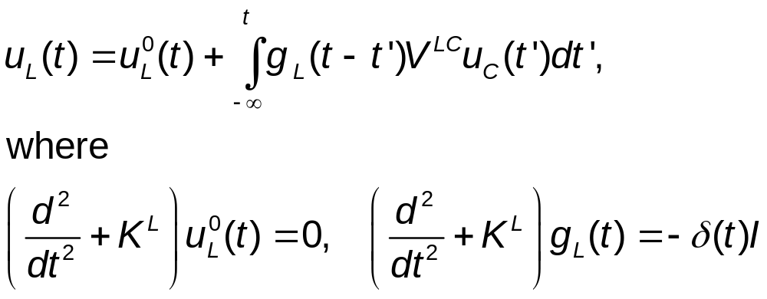
Quantum Heat-Bath & MD
Consider a junction system with left and right harmonic leads at equilibrium temperatures T_{L} & T_{R}, the Heisenberg equations of motion are
The equations for leads can be solved, given

Slide 20
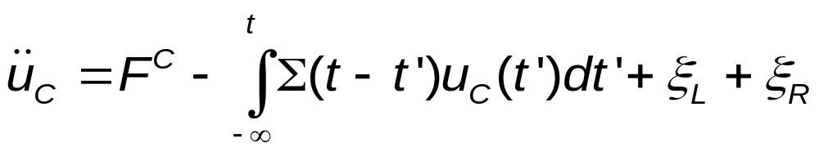
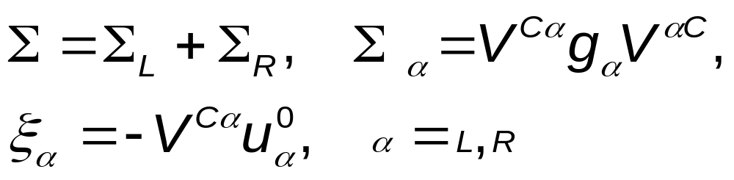
Quantum Langevin Equation for the Center
Eliminating the lead variables, we get
where retarded self-energy and “random noise” terms are given as

Slide 21
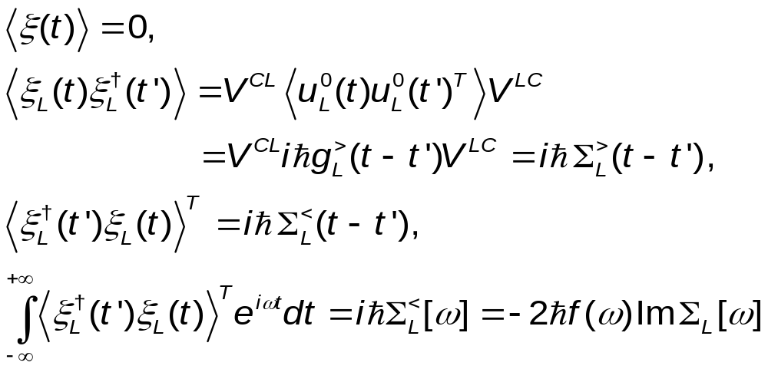
Properties of Quantum Noise
For NEGF notations, see JSW, Wang, & Lü, Eur. Phys. J. B, 62, 381 (2008).

Slide 22
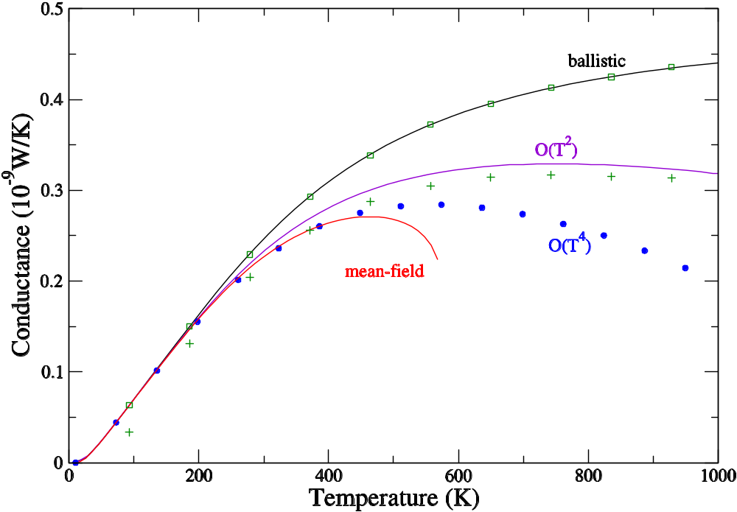
Comparison of QMD with NEGF
Three-atom junction with cubic nonlinearity (FPU-α). From JSW, Wang, Zeng, PRB 74, 033408 (2006) & JSW, Wang, Lü, Eur. Phys. J. B, 62, 381 (2008).
QMD ballistic
QMD nonlinear
k_{L}=1.56 k_{C}=1.38, t=1.8 k_{R}=1.44

Slide 23
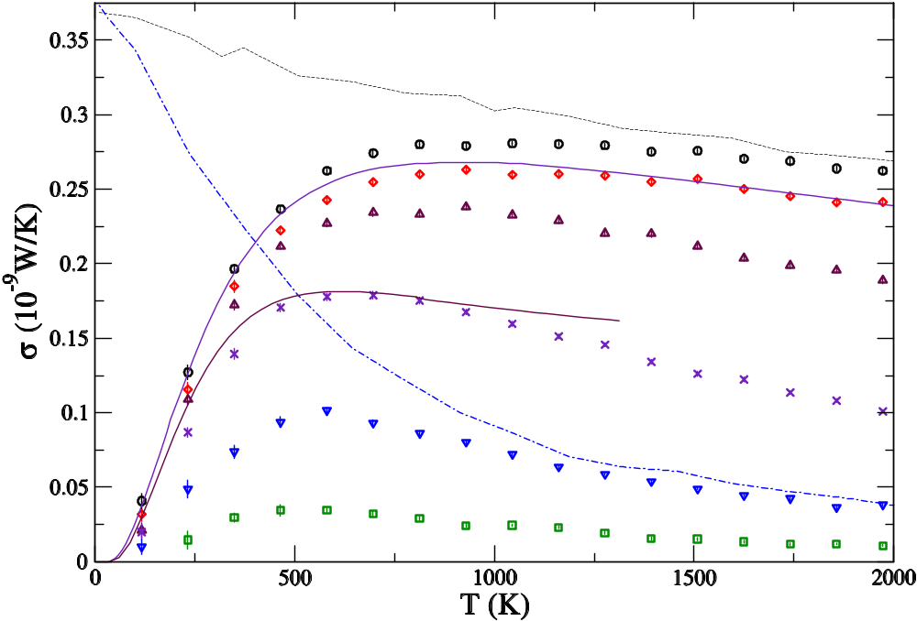
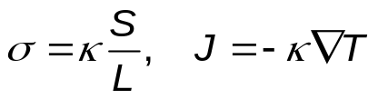
From Ballistic to Diffusive Transport
1D chain with quartic onsite nonlinearity (Φ⁴ model). The numbers indicate the length of the chains. From JSW, PRL 99, 160601 (2007).
Classical, ħ → 0
4
16
NEGF, N=4 & 32
64
256
1024
4096

Slide 24
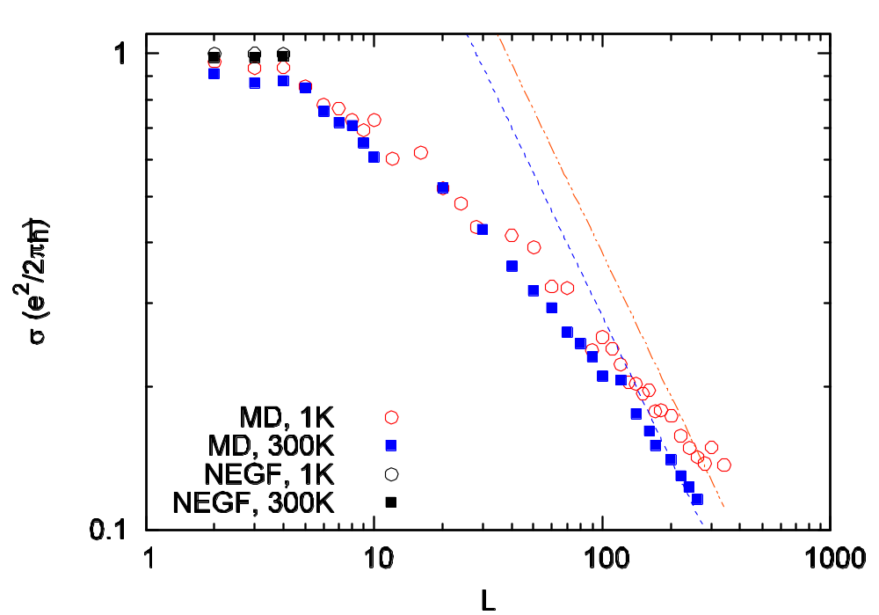
Electronic, Ballistic to Diffusive
Electronic conductance vs center junction size L. Electron-phonon interaction strength is 0.1 eV. From Lü & JSW, J. Phys.: Condens. Matter, 21, 025503 (2009).

Slide 25
Phonon Hall Effect
B
Experiments by C Strohm et al, PRL (2005), also confirmed by AV Inyushkin et al, JETP Lett (2007). Effect is small |T₄ –T₃| ~ 10⁻⁴ Kelvin in a strong magnetic field of few Tesla, performed at low temperature of 5.45 K.
T₄
T₃
Tb₃Ga₅O₁₂
∇T
5 mm

Slide 26
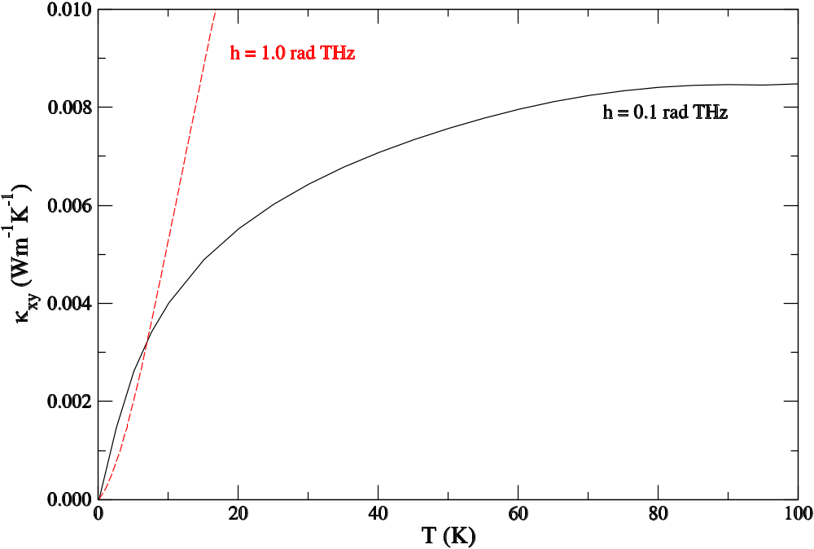
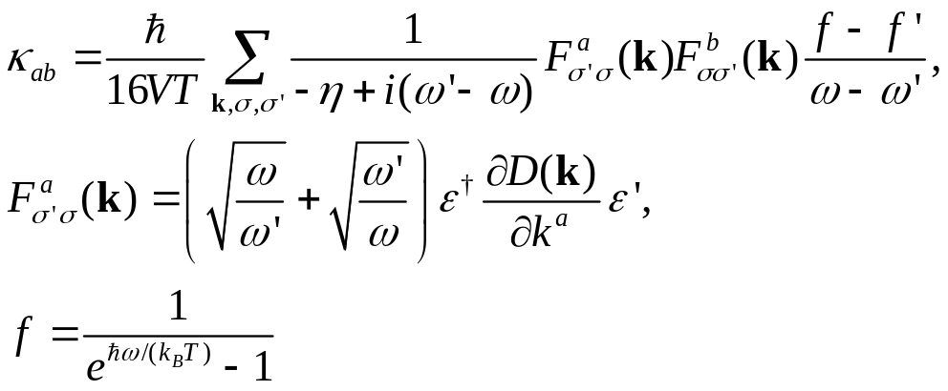
Thermal Hall conductivity, Green-Kubo formula
J S Wang and L Zhang, arXiv:0902.1219

Slide 27
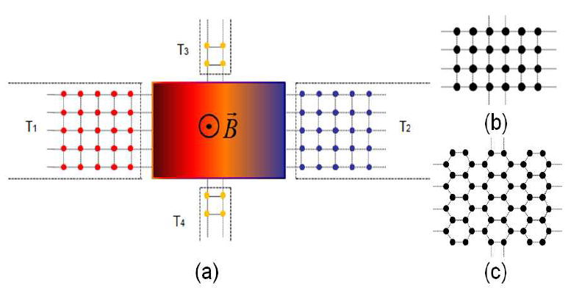
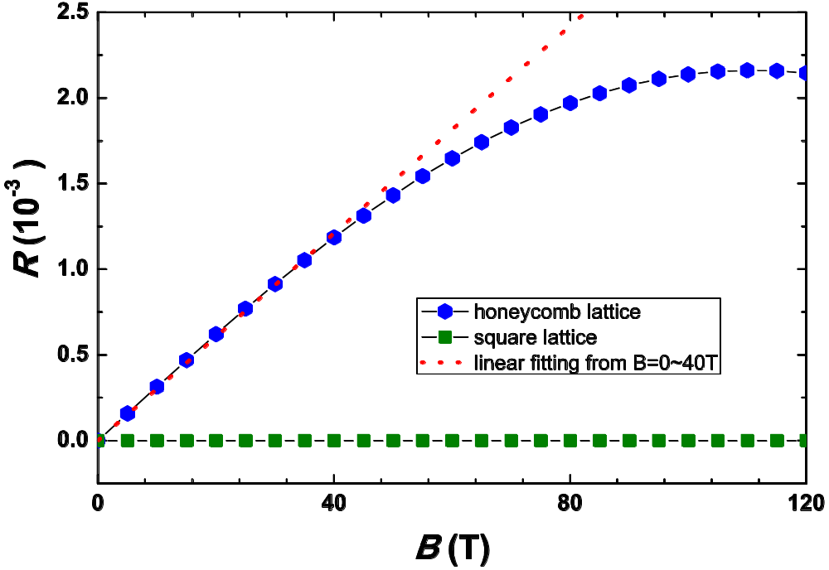
Four-Terminal Junction Structure, NEGF
R=(T₃ -T₄)/(T₁ –T₂).
From L Zhang, J-S Wang, and B Li, arXiv:0902.4839

Slide 28
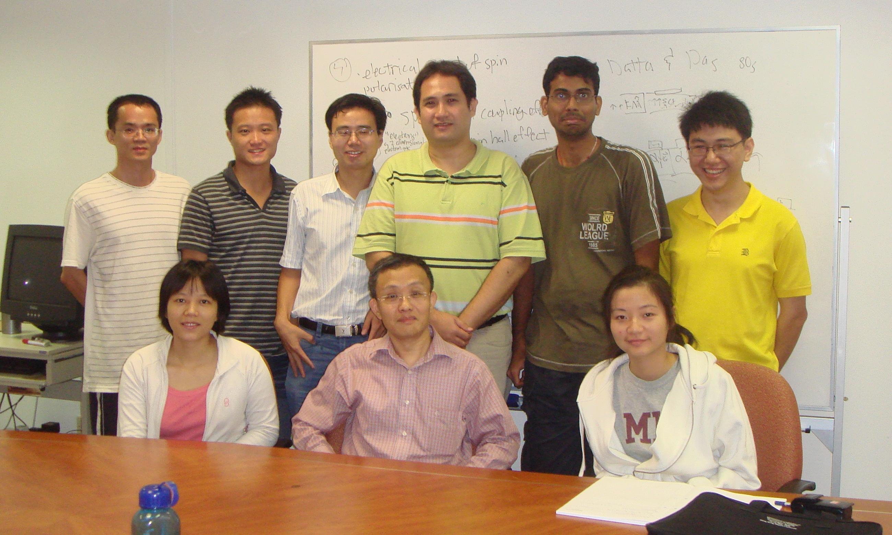
Our Group
From left to right, front: Dr. Lan Jinghua (IHPC), Prof. Wang Jian-Sheng, Ms Ni Xiaoxi, back: Dr. Jiang Jinwu, Mr. Teo Zhan Rui (Honours student), Mr. Zhang Lifa, Dr. Eduardo Chaves Cuansing Jr, Mr. Janakiraman Balachandran, Mr. Siu Zhuo Bin. Sep 2008.

