Slide 1

Monte Carlo Methods
Wang Jian-Sheng
Department of Physics

Slide 2
Outline
The origin of Monte Carlo methods
What Monte Carlo can do for you
Cluster algorithms

Slide 3
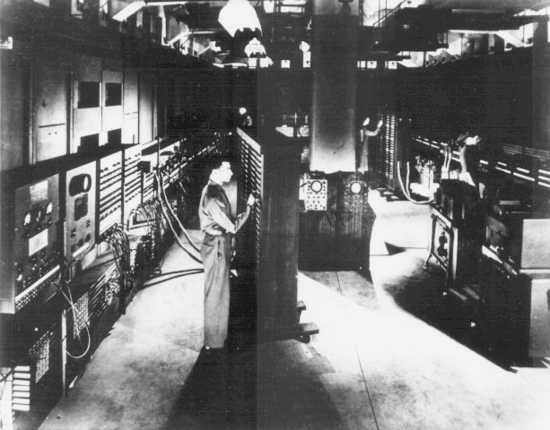
Start of Digital Computer, the ENIAC
Built in 1943-45 at the Moore School of the University of Pennsylvania for the War effort by John Mauchly and J. Presper Eckert, but not delivered to the Army until just after the end of the war, the Electronic Numerical Integrator And Computer (ENIAC) was one of the first general-purpose electronic digital computer.
Notes:
The history of Monte Carlo parallels the history of computer. A team headed by Metropolis carried out the first actual Monte Carlo calculations on the ENIAC computer in 1948. ENIAC was a monster—it contained 17,000 vacuum tubes, weighed 27 tons, consumed 160 kW of power. It can add few thousands of numbers in a second, or few hundred multiplications for a 10 digit number in a second.

Slide 4
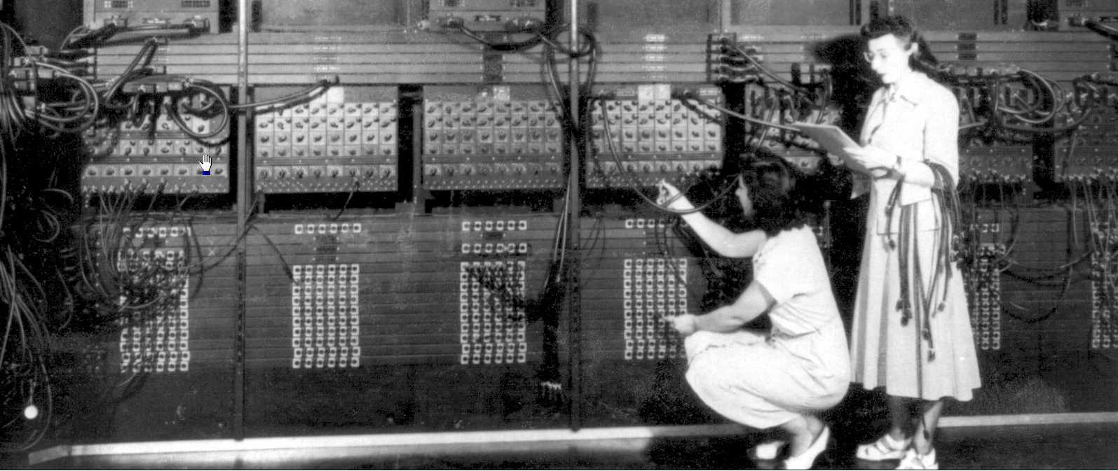
Programming the Computer
Programming in early computers is by wiring the cables and flipping the switches.
Notes:
It is interesting to note that the “early programmers” are mostly women.

Slide 5
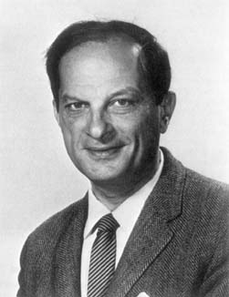
Stanislaw Ulam (1909-1984)
S. Ulam is credited as the inventor of Monte Carlo method in 1940s, which is a method to solve mathematical problems using statistical sampling.
Von Neumann and perhaps also Enrico Fermi contributed to ideas.
Notes:
Stanislaw Ulam, a Polish born mathematician who worked for John von Neumann on the United States’ Manhattan Project during World War II. Ulam is primarily known for designing the hydrogen bomb with Edward Teller in 1951. He invented the Monte Carlo method in 1946 while pondering the probabilities of winning a card game of solitaire.

Slide 6
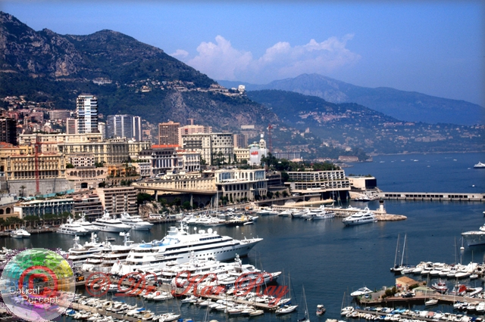
The Name of the Game
Metropolis coined the name “Monte Carlo”, from its gambling Casino.
Monte-Carlo, Monaco
Notes:
Monte Carlo is the capital of city of Monaco. It is tiny (only three kilometers long) and sits on a large rock named Mont Des Mules overlooking the sea. A road separates Monaco from France, and you hardly realize it when you are moving between the two countries. There are about 30,000 residents of Monaco.
Picture from:
http://www.twilightbridge.com/op/gallery/albums/monaco/vew028.jpg
Los Vegas was too late to catch the fame.

Slide 7
The Paper (8800 citations)
THE JOURNAL OF CHEMICAL PHYSICS VOLUME 21, NUMBER 6 JUNE, 1953
Equation of State Calculations by Fast Computing Machines
NICHOLAS METROPOLIS, ARIANNA W. ROSENBLUTH, MARSHALL N. ROSENBLUTH, AND AUGUSTA H. TELLER,
Los Alamos Scientific Laboratory, Los Alamos, New Mexico
AND
EDWARD TELLER, * Department of Physics, University of Chicago, Chicago, Illinois
(Received March 6, 1953)
A general method, suitable for fast computing machines, for investigating such properties as equations of state for substances consisting of interacting individual molecules is described. The method consists of a modified Monte Carlo integration over configuration space. Results for the two-dimensional rigid-sphere system have been obtained on the Los Alamos MANIAC and are presented here. These results are compared to the free volume equation of state and to a four-term virial coefficient expansion.
1087

Slide 8
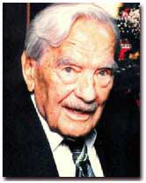
Nicholas Metropolis (1915-1999)
The algorithm by Metropolis (and A Rosenbluth, M Rosenbluth, A Teller and E Teller, 1953) has been cited as among the top 10 algorithms having the "greatest influence on the development and practice of science and engineering in the 20th century."
Notes:
“The code that was to become the famous Monte Carlo method of calculation originated from a synthesis of insights that Metropolis brought to more general applications in collaboration with Stanislaw Ulam in 1949. A team headed by Metropolis, which included Anthony Turkevich from Chicago, carried out the first actual Monte Carlo calculations on the ENIAC in 1948. Metropolis attributes the germ of this statistical method to Enrico Fermi, who had used such ideas some 15 years earlier. The Monte Carlo method, with its seemingly limitless potential for development to all areas of science and economic activities, continues to find new applications.”
From “Physics Today” Oct 2000, Vol 53, No. 10., see also http://www.aip.org/pt/vol-53/iss-10/p100.html.

Slide 9

“Computing in science & engineering,” Jan/Feb 2000.
Metropolis algorithm for Monte Carlo
Simplex method for linear programming
Krylov subspace iteration
Decomposition approach to matrix computation
The Fortran compiler
QR algorithm for eigenvalues
Quick sort
Fast Fourier transform
Integer relation detection
Fast multipole
Notes:
From “Computing in science & engineering” Jan/Feb 2000, a poplar by monthly magazine.

Slide 10
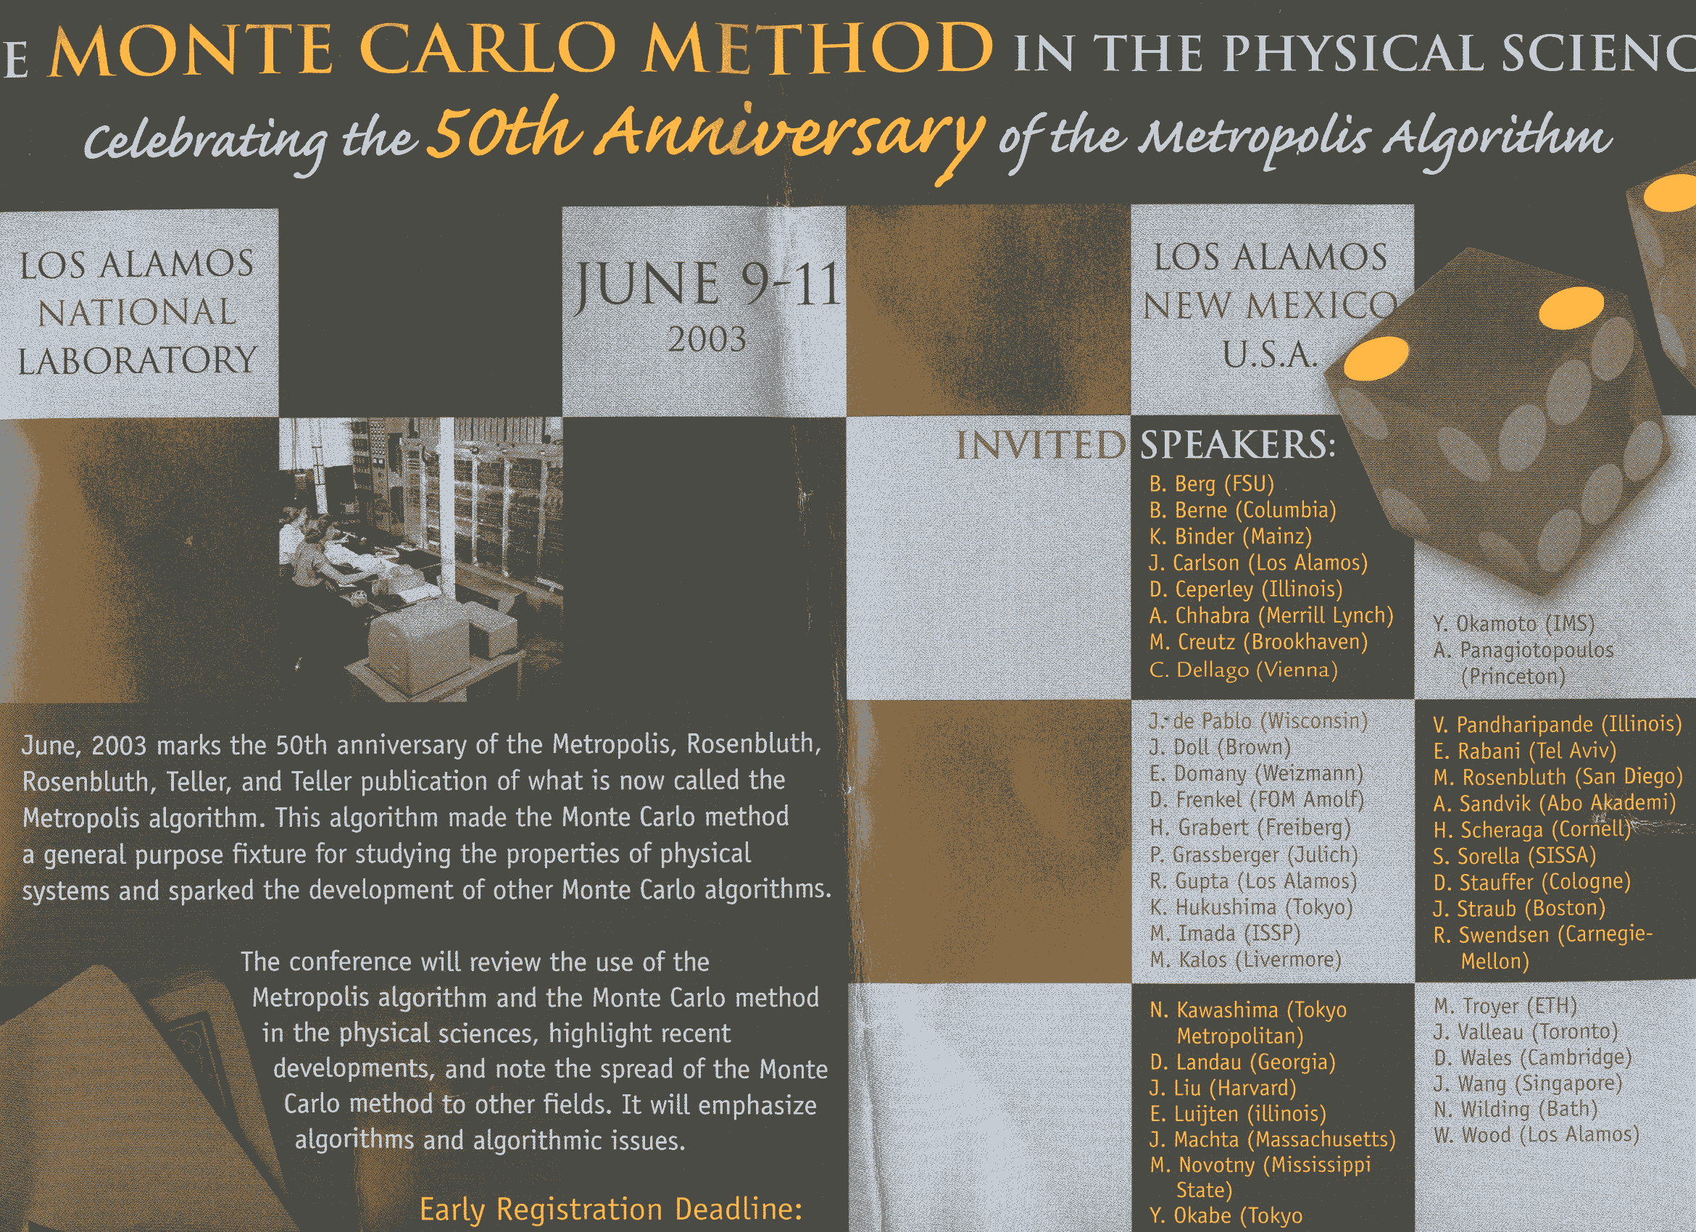
Notes:
One of the originator, Marshall Rosenbluth, attended the conference and gave talk “Genesis of the Monte Carlo Algorithm for Statistical Mechanics”, He died later that year. The proceedings of this conference is dedicated to Rosenbluth and Edward Teller. Teller also died in 2003.

Slide 11
Model Gas/Fluid
A collection of molecules interacts through some potential (hard core is treated), compute the equation of state: pressure P as function of particle density ρ=N/V.
For ideal gas: PV = N k_{B}T
Notes:
P is pressure, V is volume, N is number of molecules or atoms, T is temperature, and k_{B} is Boltzmann constant.

Slide 12
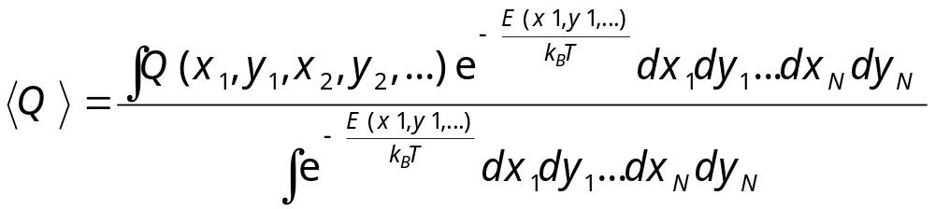
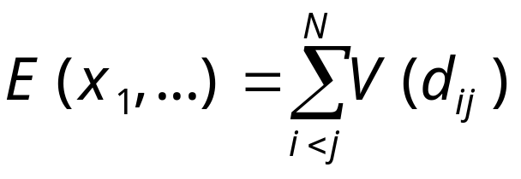
Equilibrium Statistical Mechanics
Compute multi-dimensional integral
where potential energy
Notes:
Using 2D disks as an example. N is usually very large.

Slide 13
Importance Sampling
“…, instead of choosing configurations randomly, …, we choose configuration with a probability exp(-E/k_{B}T) and weight them evenly.”
- from M(RT)² paper
Notes:
Note that P(X) = exp(-E/kT)/Z, the normalization factor Z is not known, but it is not needed in Metropolis algorithm. The authors called this new method modified Monte Carlo, as appose to simple sampling.

Slide 14
The M(RT)²
Move a particle at (x,y) according to
x -> x + (2ξ₁-1)a, y -> y + (2ξ₂-1)a
Compute ΔE = E_{new} – E_{old}
If ΔE ≤ 0 accept the move
If ΔE > 0, accept the move with a small probability exp[-ΔE/(k_{B}T)], i.e., accept if
ξ₃ < exp[-ΔE/(k_{B}T)]
Count the configuration as a sample whether accepted or rejected.
Notes:
M(RT)² standards for Metropolis, Rosenbluth, Rosenbluth, Teller, and Teller.
a is some number, adjusted to have about 50% acceptance rate.
In M(RT)², the acceptance probability is min(1, P(E_{new})/P(E_{old})). What is T(x->y) then?

Slide 15
The Calculation
Number of particles N = 224
Monte Carlo sweep ≈ 60
Each sweep took 3 minutes on MANIAC
Each data point took 5 hours
Notes:
Typical modern calculation takes 10⁶ of sweeps and still hours to days to complete. Number of particles can be 1000 to a million.

Slide 16
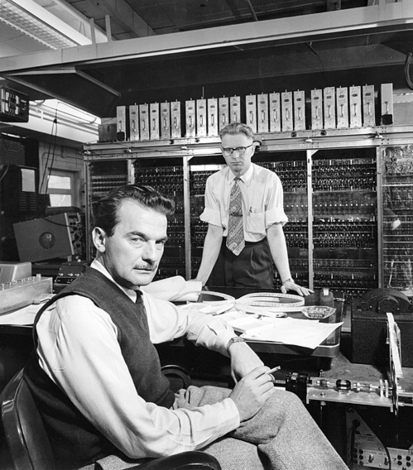
The Man and the Computer
Seated is Nick Metropolis; the background is the MANIAC (Mathematical And Numerical Integrator And Computer) vacuum tube computer, completed in 1952.
Notes:
Mathematical Analyzer Numerator Integrator and Computer--a low-tech name for what was in its time a very high-tech piece of equipment. MANIAC was a computer built at the Los Alamos Scientific Laboratory in the late 1940's and early 1950's. It is one of the earlier stored-program (von Neumann) computer. Input use punched cards. MANIAC sounds crazy, but you don’t need to know what does it mean, only to remember that the last C stands for computer.
Picture from http://www.ominous-valve.com/maniac.html

Slide 17
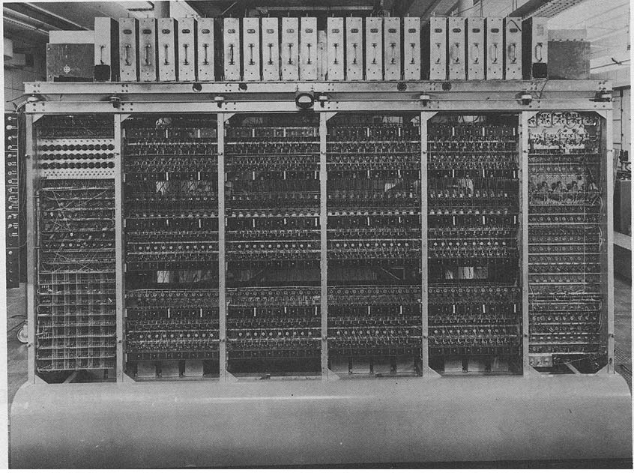
The MANIAC
The MANIAC had a memory of 1K 40-bit words. Multiplication took a milli-second.
Notes:
Some of the projects done on MANIAC: nonlinear dynamics (FPU model by Fermi, Pasta, and Ulam), tumor cell populations and cell multiplication (Hoffman, Metropolis, at al),
Proton scattering (Fermi, Bethe, et al), etc.

Slide 18
Markov Chain
Monte Carlo
Generate a sequence of states X₀, X₁, …, X_{n}, such that the limiting distribution is the given P(X)
Move X by a transition probability
W(X -> X’)
Starting from arbitrary P₀(X), we have
P_{n+1}(X) = ∑_{X’} P_{n}(X’) W(X’ -> X)
P_{n}(X) approaches P(X) as n go to ∞
Notes:
First use of the concept of Markov chain to justify Monte Carlo method appears to be William W. Wood of Los Alamos.
Andrei Andreevich Markov was born June 2, 1856 in Ryazan, Russia

Slide 19
Necessary and sufficient conditions for convergence
Ergodicity
  [W^{n}](X - > X’) > 0
  For all n > n_{max}, all X and X’
Detailed Balance
P(X) W(X -> X’) = P(X’) W(X’ -> X)

Slide 20
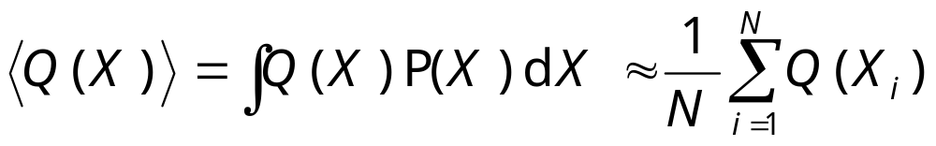
Taking Statistics
After equilibration, we estimate:

Slide 21
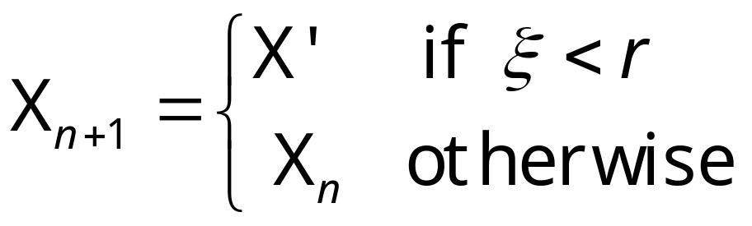
Summary of Metropolis Algorithm
Make a moving proposal according to T(X_{n} -> X’), X_{n} is the current state
Compute the acceptance rate
r = min[1, P(X’)/P(X_{n})]
Set
ξ is a random number between 0 and 1.
Notes:
T(x->x’) = T(x’-> x)

Slide 22
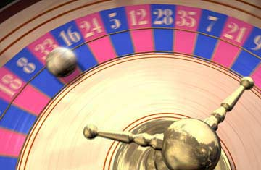
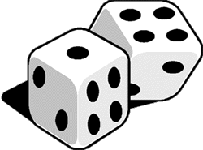
The Roulette, Dice, and Random Numbers
X_{n+1} = (a X_{n} + c) mod m
E.g., m = 2⁶⁴, a = 6364136223846793005, c = 1
Notes:
Roulette picture from
http://www.pierceproductions.net/3D/images/Roulette.JPG
Die picture from
http://blades.netppl.fi/suomi/images/dice.gif

Slide 23
2. What Monte Carlo can do for you

Slide 24
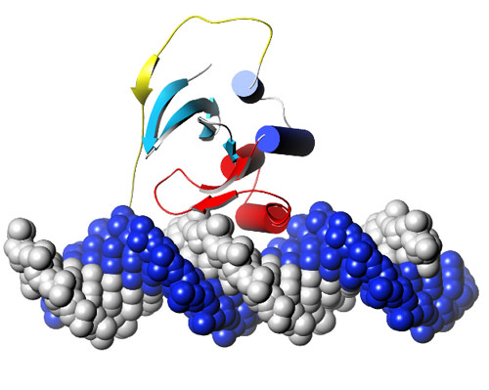
Property of Matter
Solid, liquid, and gas
Macromolecules

Slide 25
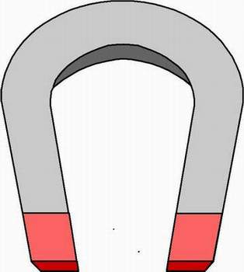
The Ising Model
-
-
+
-
+
-
N S
-
-
-
+
+
-
The energy of configuration σ is
E(σ) = - J ∑_{<ij>} σ_{i} σ_{j}
where i and j run over lattice sites, <ij> denotes nearest neighbors, σ = ±1
+
+
-
-
-
+
+
-
+
+
+
-
+
+
-
-
-
-
+
+
-
-
+
-
σ = {σ₁, σ₂, …, σ_{i}, … }
Notes:
In 1925, physicist W. Lenz asked his student E. Ising to solve a statistical mechanics problem relevant to the magnetic properties of matter. Ising was able to solve it on a one-dimensional lattice. Almost twenty years were passed before L. Onsager found analytic solution to the two-dimensional version of the problem. The three-dimensional Ising model which is most relevant in the physical world has denied any serious attempt. Thus, any information we have is from approximations and numerical simulations.
Ising model and its generalizations are extremely important in our understanding of the properties of matter, especially the phenomena of phase transitions. Ising model is still actively used in various ways to model systems in condensed matter physics. Tc if Fe is very high, about 1000 Kelvin.
Ising model is also a model for gas, known as lattice gas. C N Yang and T D Lee made important contributions to the study of the Ising models as well.

Slide 26
Metropolis Algorithm Applied to Ising Model (Single-Spin Flip)
Pick a site I at random
Compute ΔE=E(σ’)-E(σ), where σ’ is a new configuration with the spin at site I flipped, σ’_{I} = -σ_{Ι}
Perform the move if ξ < exp(-ΔE/kT), 0<ξ<1 is a random number

Slide 27
Characteristics of Commercial Computers
Year | Computer Name | Power (Watts) | Performance (adds/sec) | Memory (kByte) | Price (US dollars)
1951 | UNIVAC I | 124,500 | 1,900 | 48 | $1,000,000
1964 | IBM S360 | 10,000 | 500,000 | 64 | $1,000,000
1965 | PDP-8 | 500 | 330,000 | 4 | $16,000
1976 | Cray-1 | 60,000 | 166,000,000 | 32,768 | $4,000,000
1981 | IBM PC | 150 | 240,000 | 256 | $3,000
1991 | HP 9000 | 500 | 50,000,000 | 16,384 | $7,400
2005 | IBM T42 notebook | 20 | 1,000,000,000 | 512,000 | $1,900
Notes:
From D A Patterson & J L Hennessy, “Computer Organization & Design, the hardware/software interface”, page 40.

Slide 28

3. Swendsen-Wang Algorithm
Notes:
Not only computers are getting faster, there are also important development of algorithms since Metropolis. Perhaps cluster algorithms are one of these important development.

Slide 29
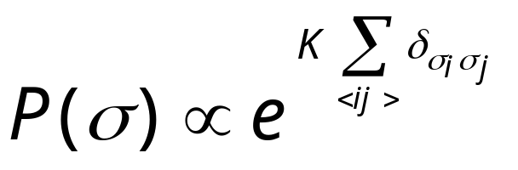
Swendsen-Wang Algorithm
+
-
-
+
-
+
-
An arbitrary Ising configuration according to probability
-
+
-
+
+
-
-
+
+
+
+
-
+
-
-
+
-
+
+
-
+
+
-
-
+
-
-
-
-
+
+
-
-
+
+
+
+
-
+
-
-
-
K = J/(kT)
R H Swendsen and J-S Wang, Phys Rev Lett 58 (1987) 86 (1987); J-S Wang and R H Swendsen, Physica A 167 (1990) 565.
Notes:
For a review, see R. H. Swendsen, J.-S. Wang and A. M. Ferrenberg, in “The Monte Carlo Method in Condensed Matter Physics”, K Binder, ed, Springer 1992. For a complete working program on Swenden-Wang, as well as Sweeny and Gliozzi, see the C program sw-oner-gg.c. The Fortran program sw2d.f was used mainly for timing computers.

Slide 30
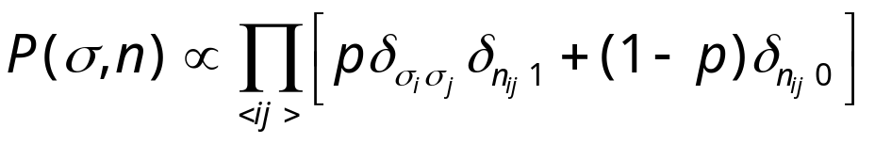
Swendsen-Wang Algorithm
+
-
-
+
-
+
-
-
-
-
-
Put a bond with probability p = 1-e^{-K}, if σ_{i} = σ_{j}
+
+
+
+
+
+
+
-
+
-
-
+
-
+
+
-
+
+
-
-
+
-
-
-
-
+
+
-
-
+
+
+
+
-
+
-
-
-
Notes:
Note that there is a factor of 2 difference between Ising Hamiltonian –JΣσ_{i}σ_{j} and Potts Hamiltonian –JΣδ(σ_{i},σ_{j}). Thus p = 1 –exp(-2J/(kT)) in standard Ising model, but p = 1 – exp(-K) for Potts model.

Slide 31
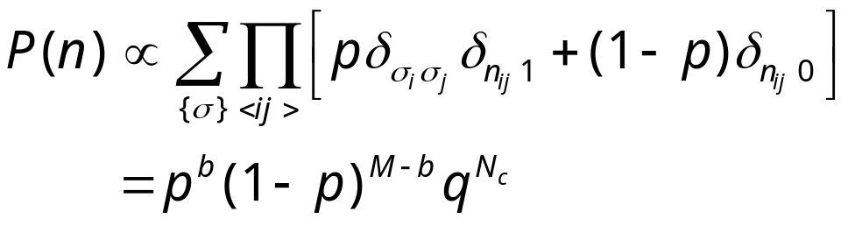
Swendsen-Wang Algorithm
Erase the spins
Fortuin-Kasteleyn mapping, 1969

Slide 32
Swendsen-Wang Algorithm
-
+
-
-
-
-
+
Assign new spin for each cluster at random. Isolated single site is considered a cluster.
-
+
-
-
+
+
+
+
-
-
+
-
-
+
+
+
-
+
+
-
+
+
-
-
-
+
-
-
-
+
+
-
+
-
-
+
+
-
+
+
-
-
Go back to P(σ,n) again.
Notes:
If a magnetic field is present, the probability of new spins will be based on the field energy.

Slide 33
Swendsen-Wang Algorithm
-
+
-
-
-
-
+
Erase bonds to finish one sweep.
-
+
-
-
+
+
+
+
-
-
+
-
-
+
+
+
-
+
+
-
+
+
-
-
-
+
-
-
-
+
+
-
+
-
-
+
+
-
+
+
-
-
Go back to P(σ) again.

Slide 34
Identifying the Clusters
Hoshen-Kompelman algorithm (1976) can be used.
Each sweep takes O(N).

Slide 35
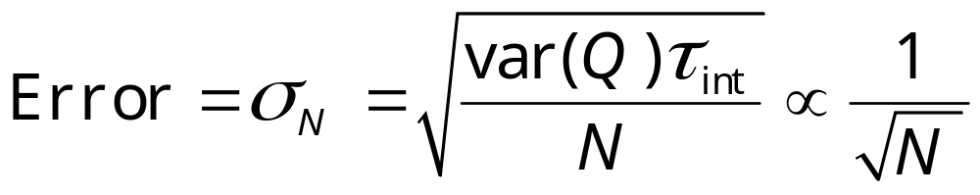
Error Formula
Error estimate in Monte Carlo:
where var(Q) = <Q²>-<Q>² can be estimated by sample variance of Q_{t}.
Notes:
I.e. var(Q) ≈ (1/N) ∑_{t}Q_{t}² - Q_{N}², that is, square average minus the average squared.

Slide 36
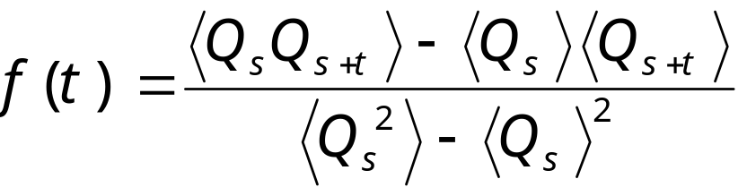
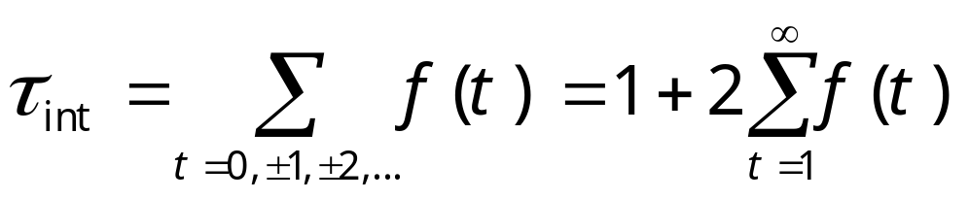
Time-Dependent Correlation Function and Integrated Correlation Time
We define
and
Notes:
Some people define the second term, ∑_{t=1}∞ f(t) as the integrated correlation time. We can call τ_{int} de-correlation time, as it is the number of steps needed to generate effectively independent sample. We can interpret the average < … > as over the history of a Markov chain (which requires the joint distribution of the chain from time s to s+t), or can be estimated from a simulation as average over time, i.e.,
<Q_{s}Q_{s+t}> ≈ (1/N) ∑_{s=1}^{N} Q_{s}Q_{s+t}.
What is τ_{int} for completely uncorrelated sample?

Slide 37
Critical Slowing Down
τ
The correlation time becomes large near T_{c}. For a finite system τ(T_{c}) ∝ L^{z}, with dynamic critical exponent z ≈ 2 for local moves
T_{c}
T
Notes:
The figure is only schematic. z is about 2 for order parameter non-conserving dynamics and 4 for order parameter conserving dynamics. For first-order phase, τ diverges exponentially with size L.

Slide 38
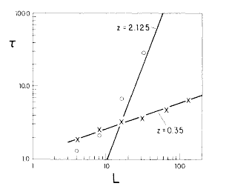
Much Reduced Critical Slowing Down
Comparison of exponential correlation times of the Swendsen-Wang with single-spin flip Metropolis at T_{c} for 2D Ising model
From R H Swendsen and J S Wang, Phys Rev Lett 58 (1987) 86.
τ ∝ L^{z}

Slide 39
4. Replica Monte Carlo/Worm Algorithm
Notes:
For a review of extended ensemble methods, see Y. Iba, Internal J Mod Phys C 12 (2001) 623.

Slide 40
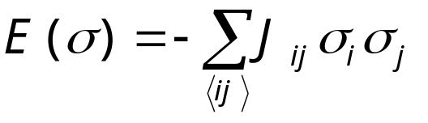
Spin Glass Model
+
-
-
+
-
+
-
-
+
-
+
+
-
-
+
+
+
+
-
+
-
A random interacting Ising model - two types of random, but fixed coupling constants (ferro J_{ij} > 0) and (anti-ferro J_{ij} < 0)
-
+
-
+
+
-
+
+
-
-
+
-
-
-
-
+
+
-
-
+
+
+
+
-
+
-
-
-
Notes:
See K. Binder and A. P. Young, Rev Mod Phys 58 (1986) 801, for a review.

Slide 41
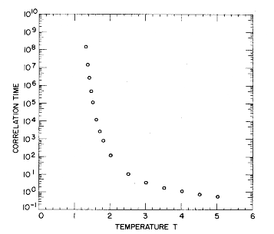
Extremely Slow Dynamics in
Spin Glass
Correlation time in single spin flip dynamics for 3D spin glass. τ ∝ |T-T_{c}|⁶.
From Ogielski, Phys Rev B 32 (1985) 7384.

Slide 42
Replica Monte Carlo
A collection of M systems at different temperatures is simulated in parallel, allowing exchange of information among the systems.
T₁
T₂
T₃
. . .
T_{M}
R H Swendsen and J-S Wang, Phys Rev Lett 57 (1986) 2607; J-S Wang and R H Swendsen, Phys Rev B 38 (1988) 4840; J-S Wang and R H Swendsen, Prog Theor Phys Suppl 157 (2005) 317.
Notes:
Replica Monte Carlo [R. H. Swendsen and J.-S. Wang, Phys Rev Lett 57 (1986) 2607] is one of the earliest idea that simulates many systems in parallel for efficiency.

Slide 43
Move between Replicas
Consider two neighboring systems, σ¹ and σ², the joint distribution is
P(σ¹,σ²) ∝ exp[-β₁E(σ¹) –β₂E(σ²)]
= exp[-H_{pair}(σ¹, σ²)]
Any valid Monte Carlo move should preserve this distribution
β_{j} = 1/(k_{B}T_{j})

Slide 44
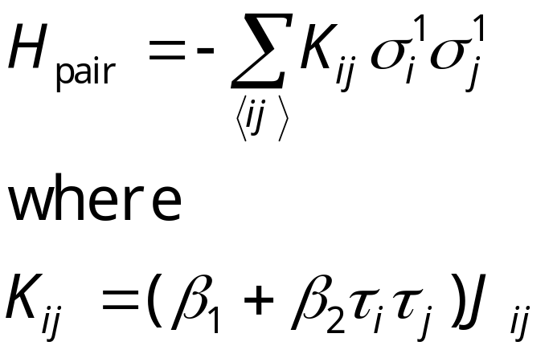
Pair Hamiltonian in Replica Monte Carlo
We define τ_{i}=σ_{i}¹σ_{i}², then H_{pair} can be rewritten as
The H_{pair} again is a spin glass. If β₁≈β₂, and two systems have consistent signs, the interaction is twice as strong; if they have opposite sign, the interaction is 0.

Slide 45
Cluster Flip in Replica Monte Carlo
Clusters are defined by the values of τ_{i} of same sign, The effective Hamiltonian for clusters is
H_{cl} = - Σ k_{bc} s_{b}s_{c}
Where k_{bc} is the interaction strength between cluster b and c, k_{bc}= sum over boundary of cluster b and c of K_{ij}.
τ = +1
τ = -1
^{b}
^{c}
Metropolis algorithm is used to flip the clusters, i.e., σ_{i}¹ -> -σ_{i}¹, σ_{i}² -> -σ_{i}² fixing τ for all i in a given cluster.
Notes:
Before the cluster move, s_{b} = +1, for all clusters b. To ensure ergodicity, other single spin flips within a single system has to be used. Swendsen-Wang mapping can be used inside each tau cluster to produce non-interacting clusters as well.

Slide 46
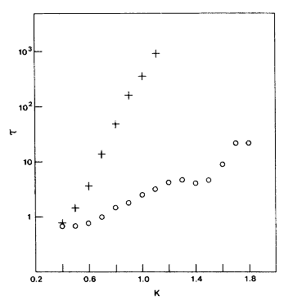
Comparing Correlation Times
Correlation times as a function of inverse temperature β on 2D, ±J Ising spin glass of 32x32 lattice.
From R H Swendsen and J S Wang, Phys Rev Lett 57 (1986) 2607.
Single spin flip
Replica MC
Notes:
The replica Monte Carlo program used for this research is in glassibm.for. It is really a legacy code specially for the IBM 3083 computer that may not compile on modern computers.

Slide 47
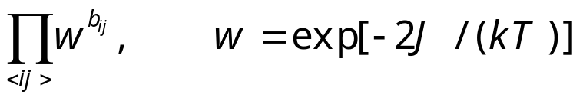
Strings in 2D Spin-Glass
The bonds, or strings, on the dual lattice uniquely specify the energy of the system, as well as the spin configurations modulo a global sign change.
The weight of the bond configuration is
[a low temperature expansion]
+
-
-
-
-
antiferro
+
+
-
+
-
+
+
-
-
ferro
-
-
+
+
+
+
+
-
+
-
+
+
-
+
+
-
-
+
-
-
-
-
+
+
-
-
+
+
+
+
-
+
-
-
-
bond
b=0 no bond for satisfied interaction, b=1 have bond

Slide 48
Constraints on Bonds
An even number of bonds on unfrustrated plaquette
An odd number of bonds on frustrated plaquette
-
+
Blue: ferro
Red: antiferro
+
-
+
-
+
-

Slide 49
Peierls’ Contour
-
-
+
+
+
-
The bonds in ferromagnetic Ising model is nothing but the Peierls’ contours separating + spin domains from – spin domains.
The bonds live on dual lattice.
-
-
-
+
+
-
+
+
-
-
-
-
+
-
+
+
+
-
+
+
-
-
-
-
+
+
-
-
+
-

Slide 50

Worm Algorithm for
2D Spin-Glass
Pick a site i₀ at random. Set i = i₀
Pick a nearest neighbor j with equal probability, move it there with probability w^{1-b}_{ij}. If accepted, flip the bond variable b_{ij} (1 to 0, 0 to 1). i = j.
If i = i₀ and winding numbers are even, exit, else go to step 2.
J-S Wang, Phys Rev E 72 (2005) 036706.

Slide 51
The Loop
b=1
b=1
b=0
b=0
i₀
i₀
Erase a bond with probability 1, create a bond with probability w=exp(-K).

Slide 52
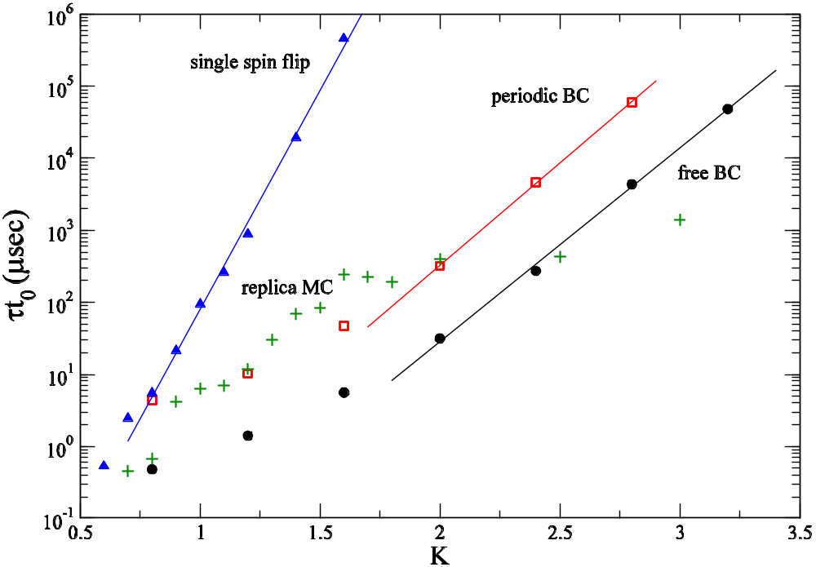
Correlation Times
worm algorithms
L = 128

Slide 53
Conclusion
Monte Carlo methods have broad applications
Cluster algorithms eliminate the difficulty of critical slowing down
Replica Monte Carlo works on frustrated and disordered systems

Slide 54
Thanks

