Slide 1
Thermal Transport in Nanostrucutures
Jian-Sheng Wang
Center for Computational Science and Engineering and Department of Physics, NUS; IHPC & SMA

Slide 2
Outline
Heat transport using classical molecular dynamics
Nonequilibrium Green’s function (NEGF) approach to thermal transport, ballistic and nonlinear
QMD – classical molecular dynamics with quantum baths
Outlook and conclusion

Slide 3
Approaches to Heat Transport
Molecular dynamics√ | Strong nonlinearity | Classical, break down at low temperatures
Green-Kubo formula | Both quantum and classical | Linear response regime, apply to junction?
Boltzmann-Peierls equation | Diffusive transport | Concept of distribution f(t,x,k) valid at nanoscale?
Landauer formula√ | Ballistic transport | T→0, no nonlinear effect
Nonequilibrium Green’s function √ | A first-principle method | Perturbative. A theory valid for all T?

Slide 4
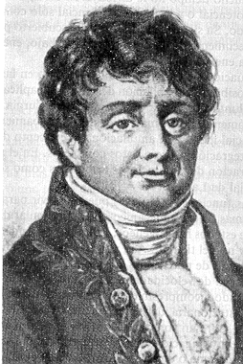
Fourier’s Law of Heat Conduction
Fourier proposed the law of heat conduction in materials as
J = - κ ∇T
where J is heat current density, κ is thermal conductivity, and T is temperature.
Fourier, Jean Baptiste Joseph, Baron (1768 – 1830)

Slide 5
Normal & Anomalous Heat Transport
3D bulk systems obey Fourier’s law (insulating crystal: Peierls’ theory of Umklapp scattering process of phonons; gas: kinetic theory, κ = 1/3 cvl )
In 1D systems, variety of results are obtained and still controversial. See S Lepri et al, Phys Rep 377, 1 (2003); A Dhar, arXiv:0808.3256, for reviews.
T_{L}
T_{H}
J

Slide 6
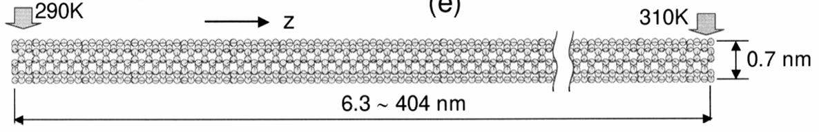
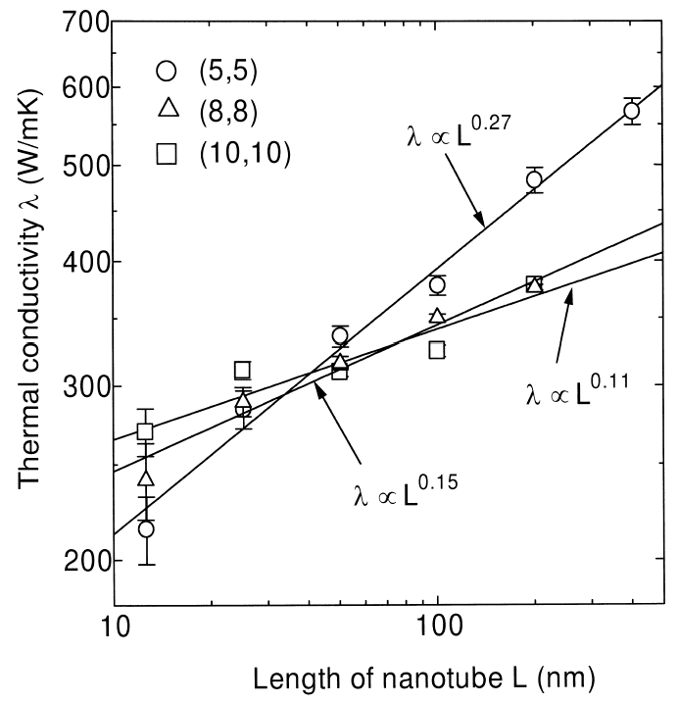
Carbon Nanotubes
Heat conductivity of carbon nanotubes at T = 300K by nonequilibrium molecular dynamics.
From S Maruyama, “Microscale Thermophysics Engineering”, 7, 41 (2003). See also Z Yao at al cond-mat/0402616, G Zhang and B Li, cond-mat/0403393.

Slide 7
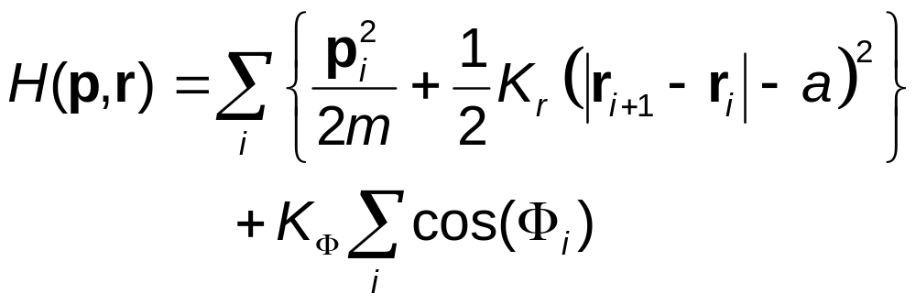
A Chain Model for Heat Conduction
r_{i} = (x_{i},y_{i})
T_{R}
T_{L}
m
Φ_{i}
Transverse degrees of freedom introduced

Slide 8
Nonequilibrium Molecular Dynamics
Nosé-Hoover thermostats at the ends at temperature T_{L} and T_{R}
Compute steady-state heat current: j =(1/N)Σ_{i} d (ε_{i} r_{i})/dt,
where ε_{i} is local energy associated with particle i
Define thermal conductivity κ by <j> = κ (T_{R}-T_{L})/(Na)
N is number of particles, a is lattice spacing.

Slide 9
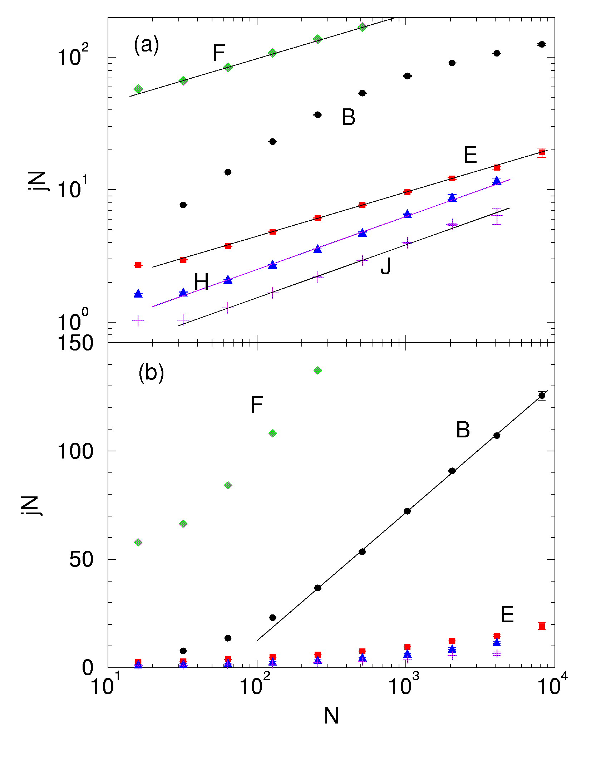
slope=1/3
Conductivity vs size N
Model parameters (K_{Φ}, T_{L}, T_{R}):
Set F (1, 5, 7), B (1, 0.2, 0.4), E (0.3, 0.3, 0.5), H (0, 0.3, 0.5), J (0.05, 0.1, 0.2) ,
m=1, a=2, K_{r}=1.
From J-S Wang & B Li, Phys Rev Lett 92, 074302 (2004).
slope=2/5
ln N

Slide 10
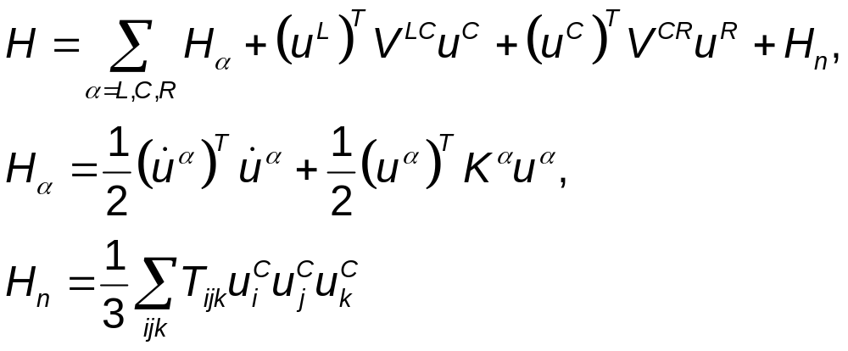
Nonequilibrium Green’s Function Approach
^{T} for matrix transpose
mass m = 1,
ħ = 1
Left Lead, T_{L}
Right Lead, T_{R}
Junction Part

Slide 11
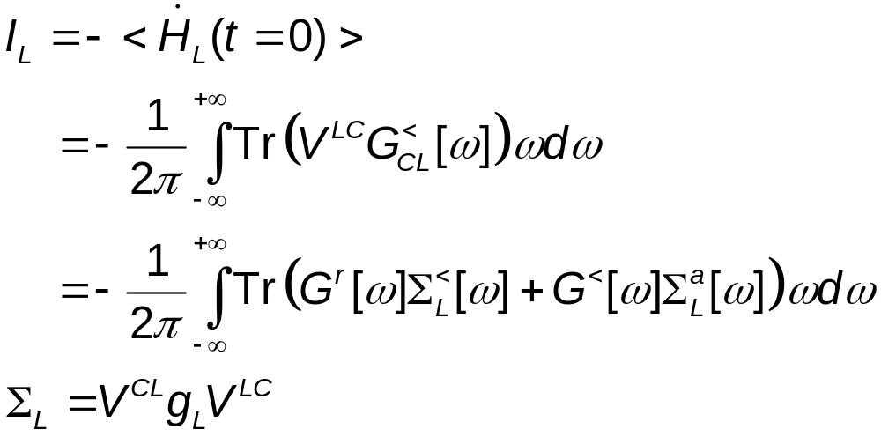
Heat Current
Where G is the Green’s function for the junction part, Σ_{L} is self-energy due to the left lead, and g_{L} is the (surface) Green’s function of the left lead.

Slide 12
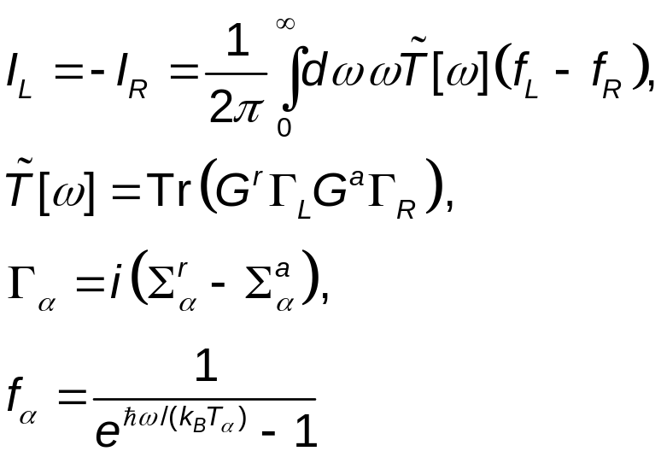
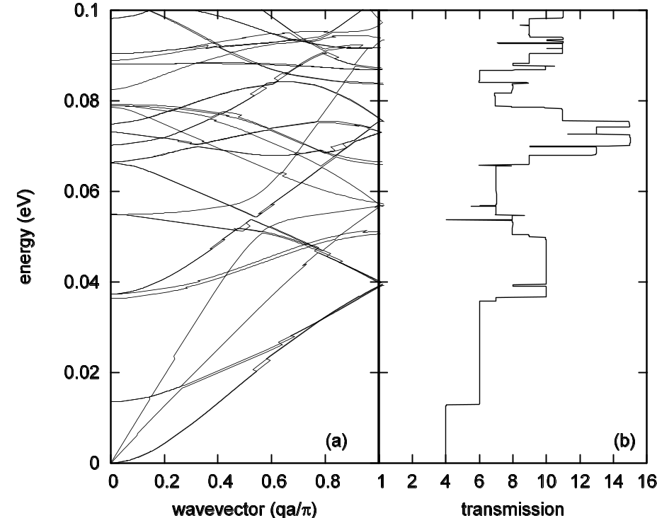
Landauer/Caroli Formula
In systems without nonlinear interaction the heat current formula reduces to that of Laudauer formula:
See, e.g., Mingo & Yang, PRB 68, 245406 (2003); JSW, Wang, & Lü, Eur. Phys. J. B, 62, 381 (2008).

Slide 13
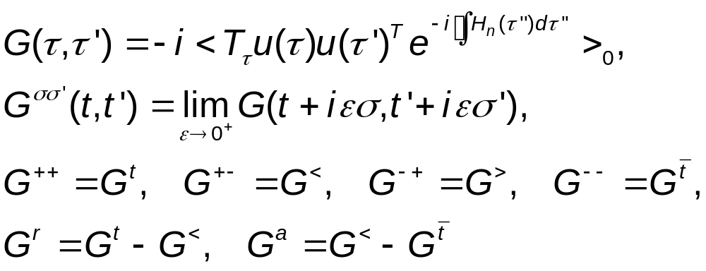
Contour-Ordered Green’s Functions
τ complex plane
See Keldysh, or Meir & Wingreen, or Haug & Jauho

Slide 14
Adiabatic Switch-on of Interactions
Governing Hamiltonians
H_{L}+H_{C}+H_{R} +V +H_{n}
H_{L}+H_{C}+H_{R} +V
G
H_{L}+H_{C}+H_{R}
Green’s functions
G₀
g
t = − ∞
Equilibrium at T_{α}
t = 0
Nonequilibrium steady state established

Slide 15
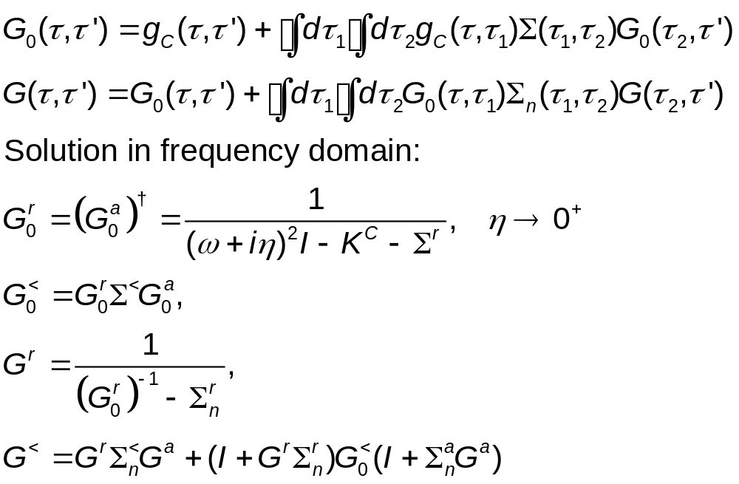
Contour-Ordered Dyson Equations

Slide 16
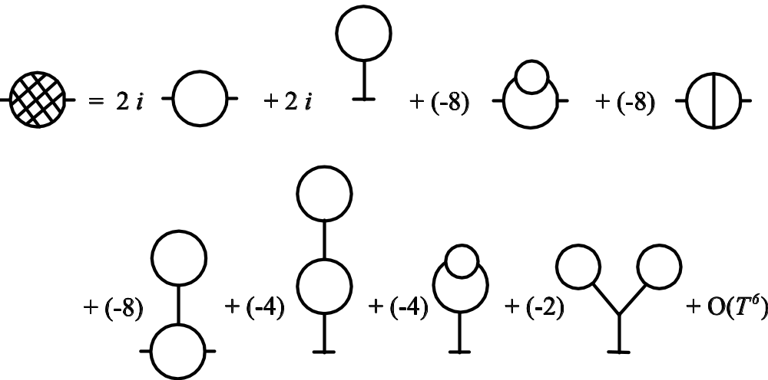
Feynman Diagrams
Each long line corresponds to a propagator G₀; each vertex is associated with the interaction strength T_{ijk}.

Slide 17
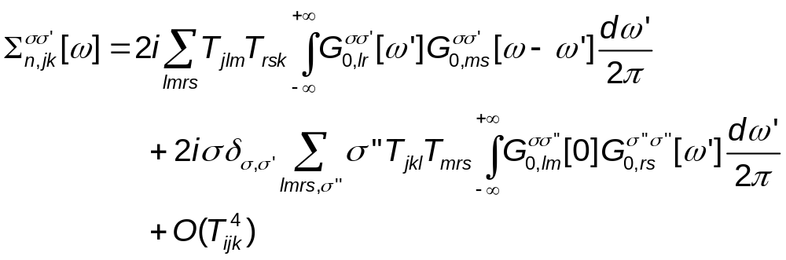
Leading Order Nonlinear Self-Energy
σ = ±1, indices j, k, l, … run over particles

Slide 18
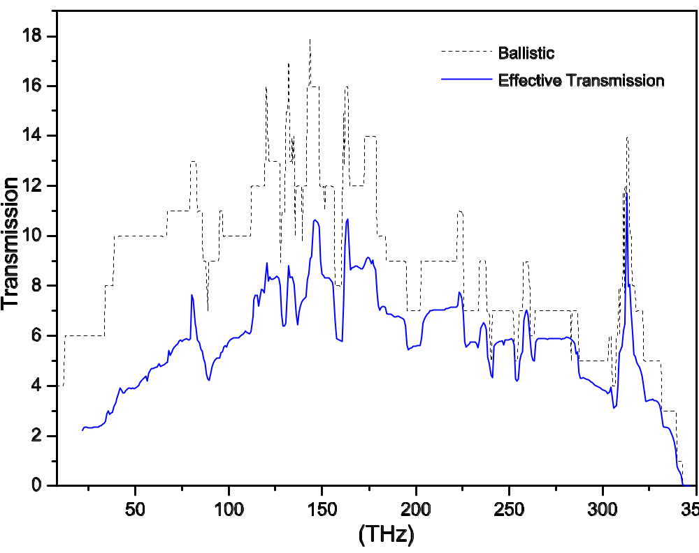
Energy Transmissions
The transmissions in a one-unit-cell carbon nanotube junction of (8,0) at 300 Kelvin. From JSW, J Wang, N Zeng, Phys. Rev. B 74, 033408 (2006).

Slide 19
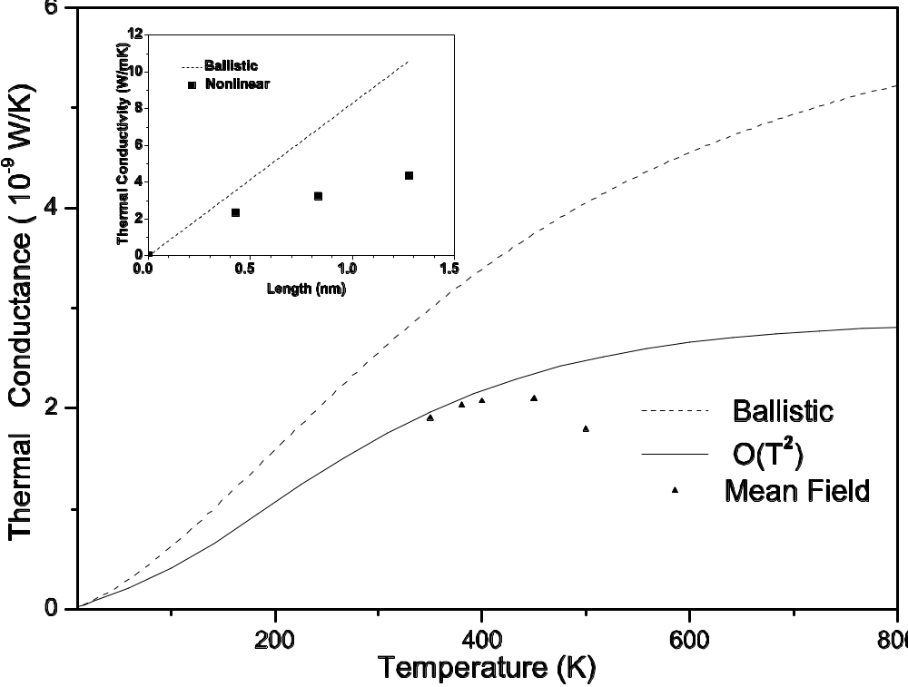
Thermal Conductance of Nanotube Junction
Cond-mat/0605028

Slide 20
Molecular Dynamics
Molecular dynamics (MD) for thermal transport
  Equilibrium ensemble, using Green-Kubo formula
  Non-equilibrium simulation
    Nosé-Hoover heat-bath
    Langevin heat-bath
Disadvantage of classical MD
  Purely classical statistics
    Heat capacity is quantum below Debye temperature of 1000 K
    Ballistic transport for small systems is quantum

Slide 21
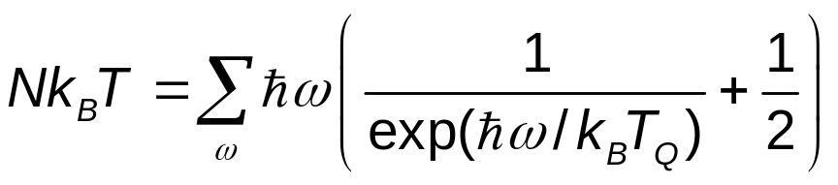
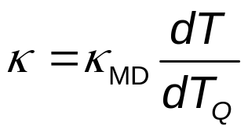
Quantum Corrections
Methods due to Wang, Chan, & Ho, PRB 42, 11276 (1990); Lee, Biswas, Soukoulis, et al, PRB 43, 6573 (1991).
Compute an equivalent “quantum” temperature by
Scale the thermal conductivity by
(1)
(2)

Slide 22
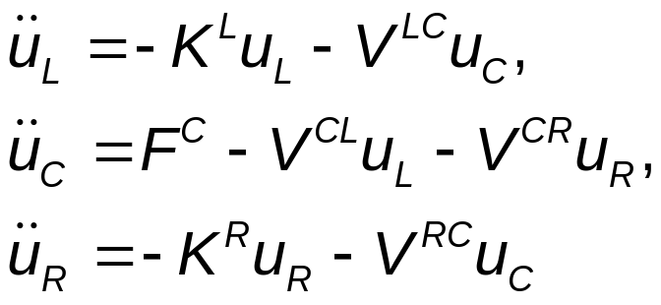
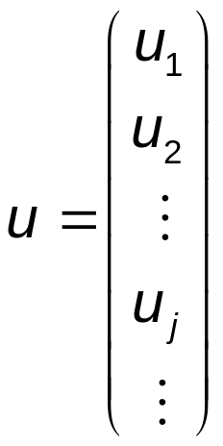
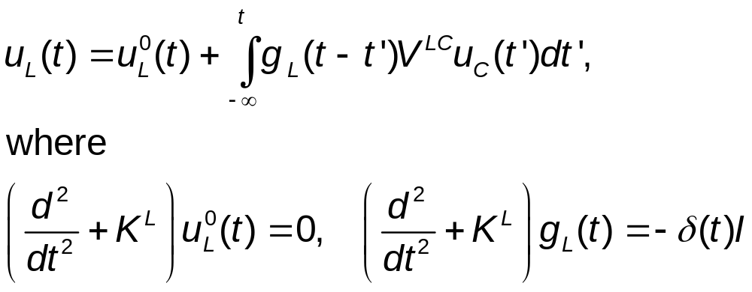
Quantum Heat-Bath & MD
Consider a junction system with left and right harmonic leads at equilibrium temperatures T_{L} & T_{R}, the Heisenberg equations of motion are
The equations for leads can be solved, given
(3)
(4)

Slide 23
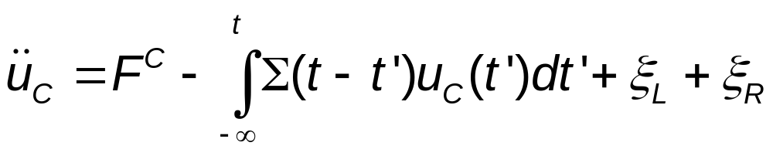
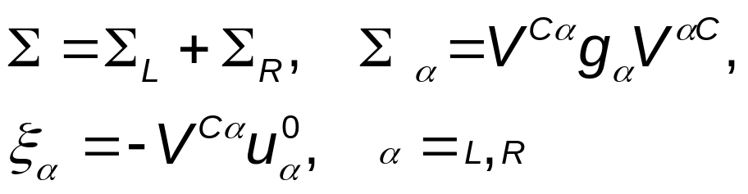
Quantum Langevin Equation for Center
Eliminating the lead variables, we get
where retarded self-energy and “random noise” terms are given as
(5)
(6)

Slide 24
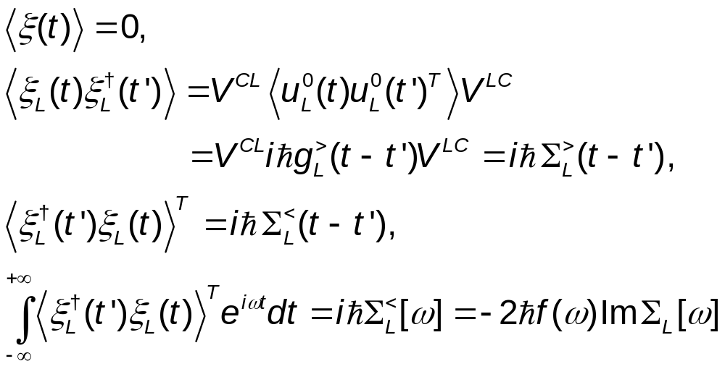
Properties of Quantum Noise
(7)
(8)
(9)
For NEGF notations, see JSW, Wang, & Lü, Eur. Phys. J. B, 62, 381 (2008).

Slide 25
Quasi-Classical Approximation, Schmid (1982)
Replace operators u_{C} & ξ by ordinary numbers
Using the quantum correlation, iħ∑> or iħ∑< or their linear combination, for the correlation matrix of ξ.
Since the approximation ignores the non-commutative nature of ξ, quasi-classical approximation is to assume, ∑> = ∑<.
For linear systems, quasi-classical approximation turns out exact! See, e.g., Dhar & Roy, J. Stat. Phys. 125, 805 (2006).

Slide 26
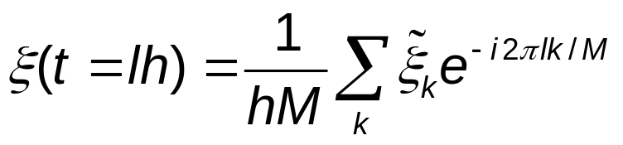
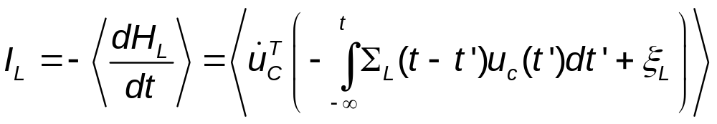
Implementation
Generate noise using fast Fourier transform
Solve the differential equation using velocity Verlet
Perform the integration using a simple rectangular rule
Compute energy current by
(10)
(11)

Slide 27
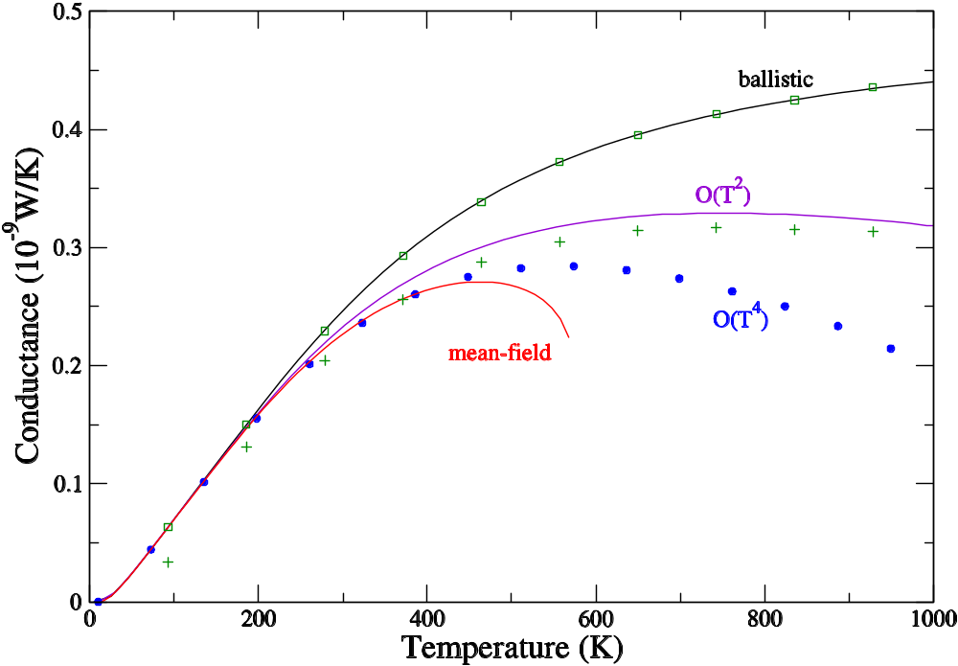
Comparison of QMD with NEGF
Three-atom junction with cubic nonlinearity (FPU-α). From JSW, Wang, Zeng, PRB 74, 033408 (2006) & JSW, Wang, Lü, Eur. Phys. J. B, 62, 381 (2008).
QMD ballistic
QMD nonlinear
k_{L}=1.56 k_{C}=1.38, t=1.8 k_{R}=1.44

Slide 28
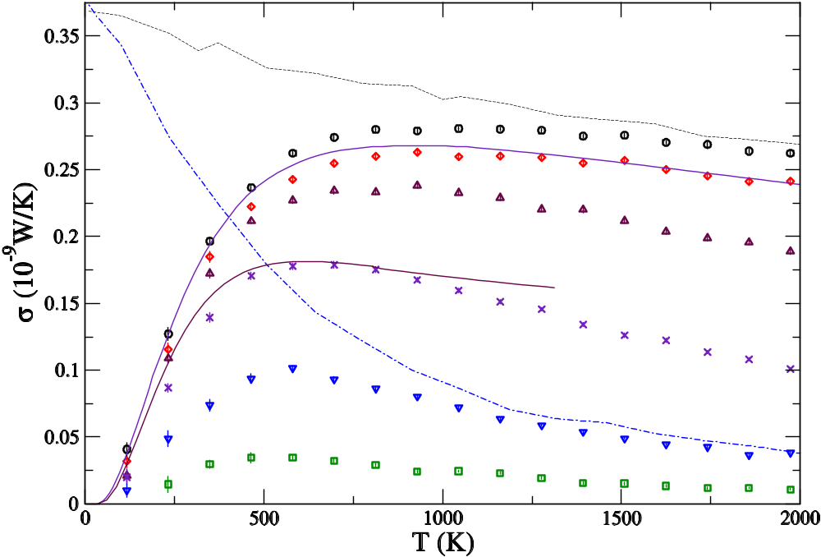
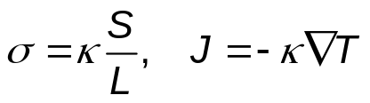
From Ballistic to Diffusive Transport
1D chain with quartic onsite nonlinearity (Φ⁴ model). The numbers indicate the length of the chains. From JSW, PRL 99, 160601 (2007).
Classical, ħ → 0
4
16
NEGF, N=4 & 32
64
256
1024
4096

Slide 29
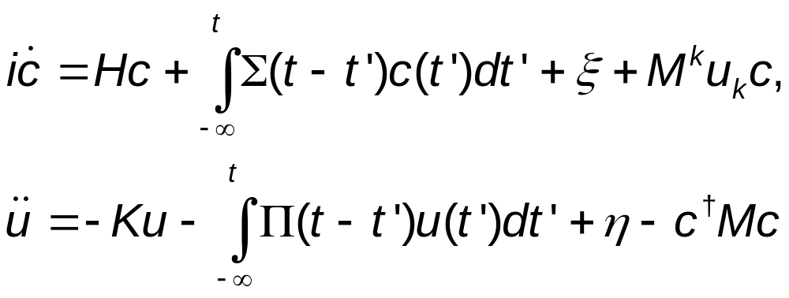
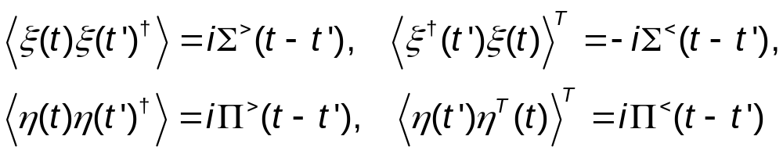
Electron Transport & Phonons
For electrons in the tight-binding form interacting with phonons, the quantum Langevin equations are
(12)
(13)
(14)
(15)

Slide 30
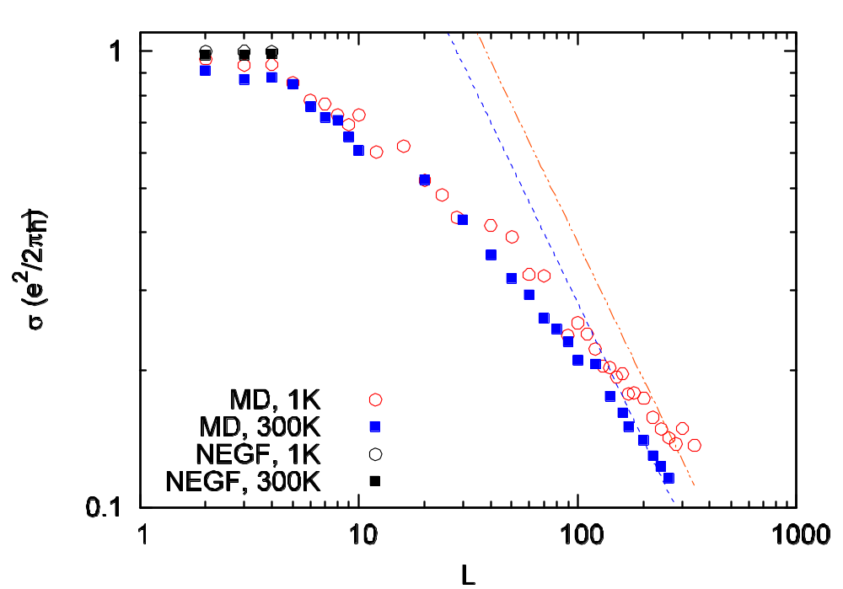
Ballistic to Diffusive
Electronic conductance vs center junction size L. Electron-phonon interaction strength is m=0.1 eV. From Lü & JSW, arXiv:0803.0368.

Slide 31
Conclusion & Outlook
MD is useful for high temperature thermal transport but breaks down below Debye temperatures
NEGF is elegant and efficient for ballistic transport. More work need to be done for nonlinear interactions
QMD for phonons is correct in the ballistic limit and high-temperature classical limit. Much large systems can be simulated (comparing to NEGF)

Slide 32
Collaborators
Baowen Li
Pawel Keblinski
Jian Wang
Jingtao Lü
Nan Zeng
Lifa Zhang
Xiaoxi Ni
Eduardo Cuansing
Jinwu Jiang
Saikong Chin
Chee Kwan Gan
Jinghua Lan
Yong Xu

