Slide 1
Energy, momentum, and angular momentum transfers mediated by photons
Jian-Sheng Wang
Department of Physics,
National University of Singapore

Slide 2
Outline
Radiative (heat & momentum) transfer, experimental background
NEGF theory of energy, momentum, and angular momentum transfer
  N + 1 objects, bath at infinity
  Meir-Wingreen/Landauer formula
  Zero-point motion, when it contributes?
Applications
  Near-field heat transfer between graphene objects
  Angular momentum emission from current-driven benzene molecule
  Nonreciprocity, graphene edge effect

Slide 3
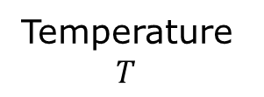
Blackbody radiation
Temperature $T$

Slide 4

Experimental background, blackbody radiation
Poynting vector
Notes:
u is S per unit wavelength.

Slide 5
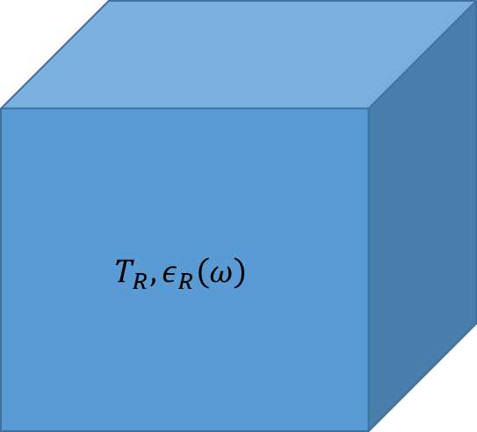
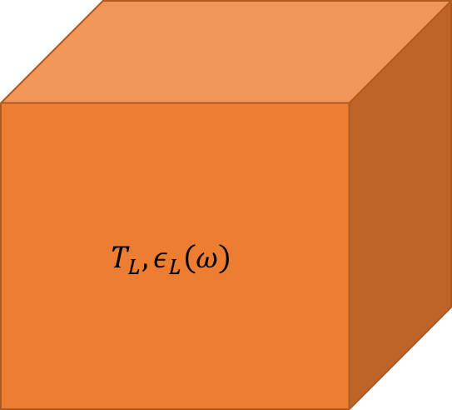

Heat transfer between (grey) bodies
$$T_{L}, ε_{L}\left(ω\right)$$
$$T_{R}, ε_{R}\left(ω\right)$$
Polder & van Hove problem (1971)

Slide 6
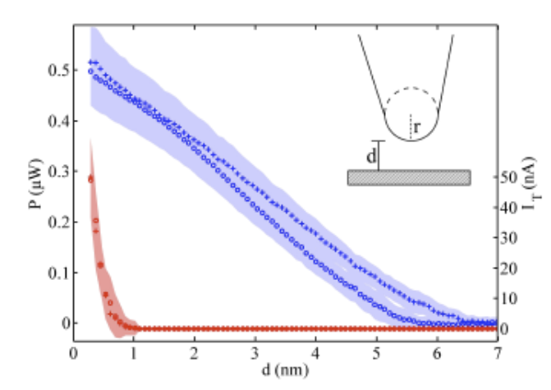
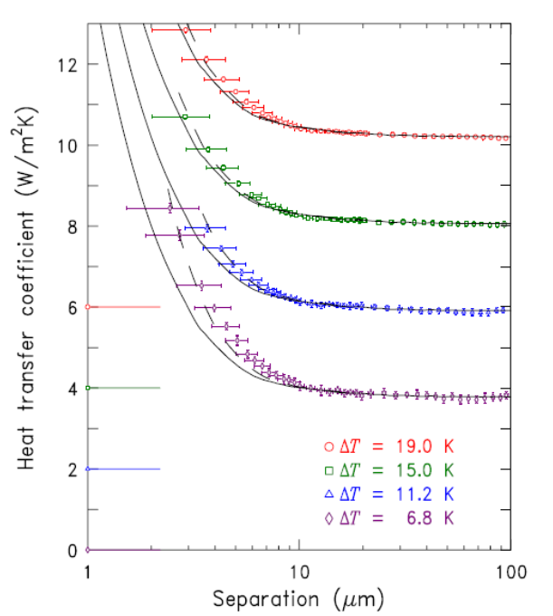
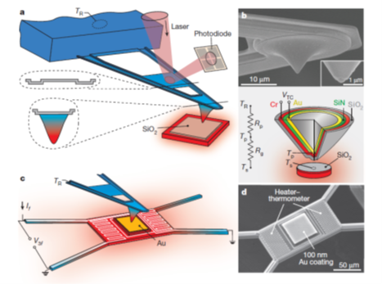
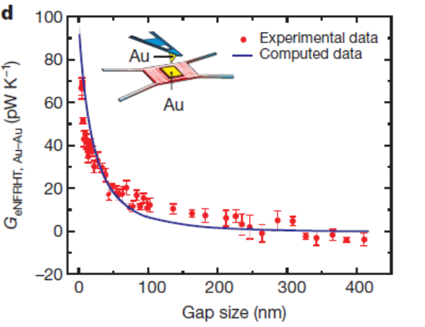
Near-field heat transfer
↑ Kloppstech, et al, Nature Comm (2017).
Ottens, et al PRL (2011).
→ Kim et al, Nature (2015).

Slide 7
(Casimir) force
Casimir force in plate-sphere geometry, from Mohideen and Roy, PRL (1998).

Slide 8
Angular momentum emission
2D semiconductor junction made of WSe₂ that can emit polarized light. From Y. J. Zhang, et al., Science 344, 725 (2014).
Notes:
W: Tungsten, Se: Sellenium. Chalcogen [kaekegen]

Slide 9
Nonequilibrium Green’s function (NEGF) theory
https://phyweb.physics.nus.edu.sg/~phywjs/NEGF/review-2022.pdf

Slide 10

System setup
N+1 or infinity
$$R→∞$$
…
1
Question: what are the energy emitted, force and torque applied to, for each of the object 1 to N+1.
N
2

Slide 11
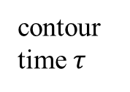


NEGF preliminaries
contour time $τ$
+
−
$$−∞$$
$$t$$

Slide 12
NEGF definitions

Slide 13
Fluctuation-dissipation theorem in thermal equilibrium

Slide 14
Dyson equations

Slide 15
Keldysh equation

Slide 16
ϕ = 0 gauge, fundamental equation for vector potential A

Slide 17
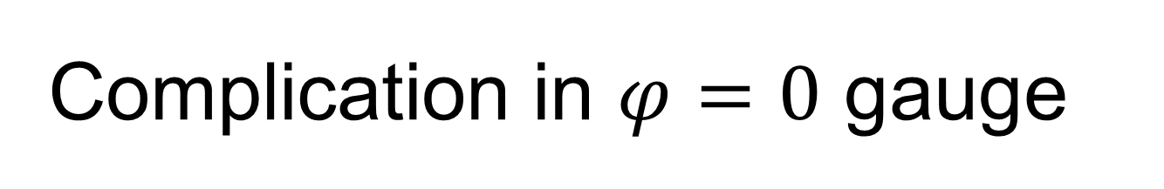
Complication in $φ=0$ gauge
Gauss’s law not reflected in the equation of motion
States need to be selected such that

Slide 18
Poynting theorem, steady state average

Slide 19
Momentum and angular momentum conservation

Slide 20
From surface integral to volume integral
α

Slide 21
A-j correlation function

Slide 22
Hamiltonian, electron-photon system, temporal gauge

Slide 23
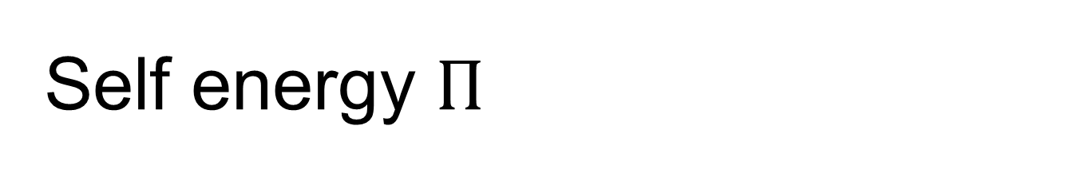
Self energy $Π$
RPA
Aslamazov-Larkin diagram (superconductivity, Coulomb drag)

Slide 24
Operator order: normal or symmetric order?

Slide 25
Meir-Wingreen formula
Notes:
Levi Civita symbol

Slide 26
Bath at infinity
Eckhardt, PRA 29, 1991 (1984)
Krüger, et al, PRB 86, 115423 (2012)

Slide 27
Recover blackbody Planck result
R
0

Slide 28
From Meir-Wingreen to Landauer: local equilibrium approximation
No Landauer form for force and torque!

Slide 29
When zero-point-motion contribution is cancelled?

Slide 30
Emission to infinity

Slide 31
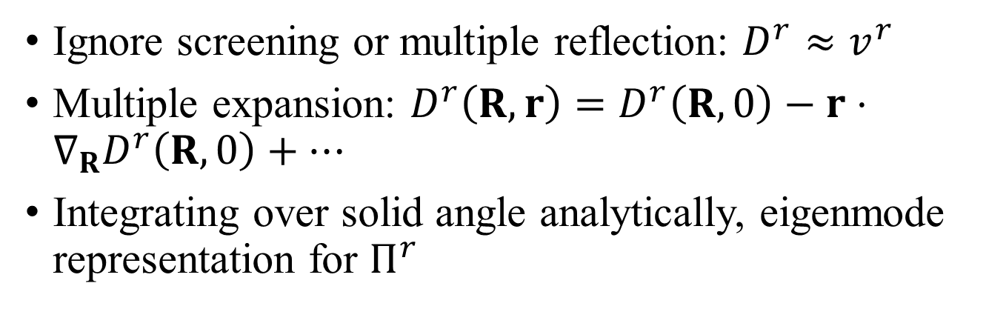
Far field approximations
Ignore screening or multiple reflection: $D^{r}≈v^{r}$
Multiple expansion: $D^{r}\left(R,r\right)=D^{r}\left(R,0\right)−r⋅∇_{R}D^{r}\left(R,0\right)+⋯$
Integrating over solid angle analytically, eigenmode representation for $Π^{r}$
Fermi golden rule

Slide 32
Torque and force on object
Force is zero if system is reciprocal, i.e., if ${\left(Π^{<}\right)}^{T}=Π^{<}$

Slide 33
Applications

Slide 34
Heat transfer between two graphene sheets
↓ First principles QE/BerkeleyGW calculation for the ratio of energy transfer to blackbody value between two graphene sheets at temperatures 300 K and 1000 K, η = 0.05 eV, electron chemical potential at Dirac point. Zhu & Wang, PRB 104, L121409 (2021).
↑ Heat transfer ratio based on electron tight-binding model with nearest neighbor hopping t = 2.8 eV, between 300 K and 1000 K sheets at chemical potential μ = 0.1 eV. Slope ≈ 2.2. Jiang & Wang, PRB 96, 155437 (2017).

Slide 35


Heat transfer between zigzag nanotubes or triangles
Heat transfer from 400K to 300K objects. (a), (b) zigzag carbon nanotubes. (c), (d) nano-triangles. d: gap distance, M: nanotube circumference, L: triangle length. ε: dielectric constant. From Tang, Yap, Ren, and Wang, Phys. Rev. Appl. 11, 031004 (2019).

Slide 36

Angular momentum emission from a benzene molecule
Far field monopole approximation (all atoms are at the origin), ignore screening/multiple scatterings.

Slide 37



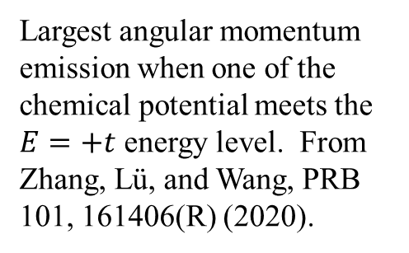
Angular momentum emission resonance effect
E
$E=t$, $\left|l\right|=2$
$$E=−2t, l=0$$
Largest angular momentum emission when one of the chemical potential meets the $E=+t$ energy level. From Zhang, Lü, and Wang, PRB 101, 161406(R) (2020).

Slide 38






Force and torque from the nonequilibrium edge
$$J$$
$$p$$
$$μ_{L}$$
$$μ_{R}$$

Slide 39

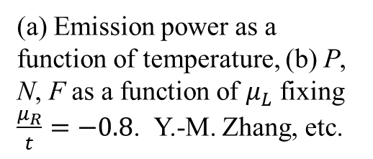
Emission from graphene edge
(a) Emission power as a function of temperature, (b) P, N, F as a function of $μ_{L}$ fixing $\frac{μ_{R}}{t}=−0.8$. Y.-M. Zhang, etc.

Slide 40
I, N, F scan $μ_{R}$vs $μ_{L}$. System size width 700 unit cells, k-point 401. From Zhang, et al, PRB 105, 205421 (2022).

Slide 41
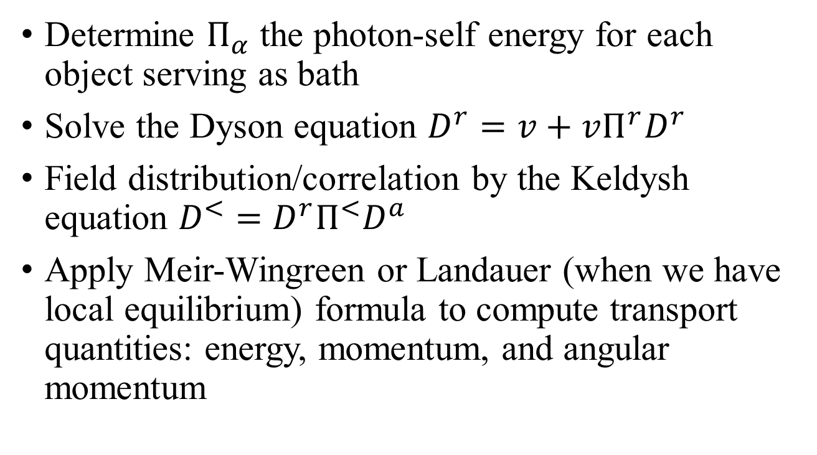
Summary of NEGF approach
Determine $Π_{α}$ the photon-self energy for each object serving as bath
Solve the Dyson equation $D^{r}=v+vΠ^{r}D^{r}$
Field distribution/correlation by the Keldysh equation $D^{<}=D^{r}Π^{<}D^{a}$
Apply Meir-Wingreen or Landauer (when we have local equilibrium) formula to compute transport quantities: energy, momentum, and angular momentum

Slide 42
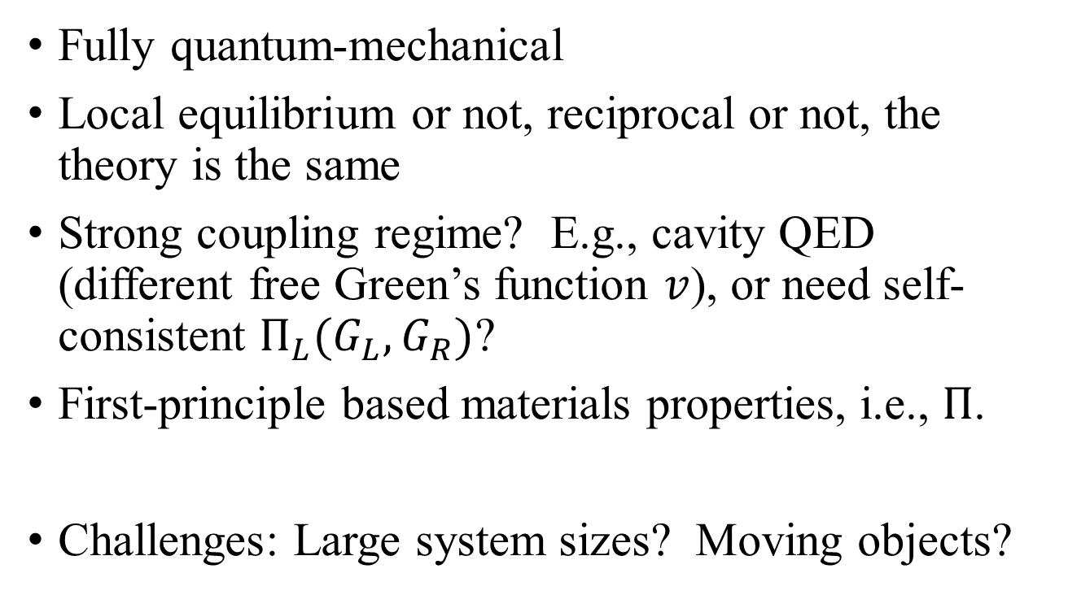
NEGF advantage
Fully quantum-mechanical
Local equilibrium or not, reciprocal or not, the theory is the same
Strong coupling regime? E.g., cavity QED (different free Green’s function $v$), or need self-consistent $Π_{L}(G_{L}, G_{R})$?
First-principle based materials properties, i.e., $Π$.
Challenges: Large system sizes? Moving objects?

Slide 43
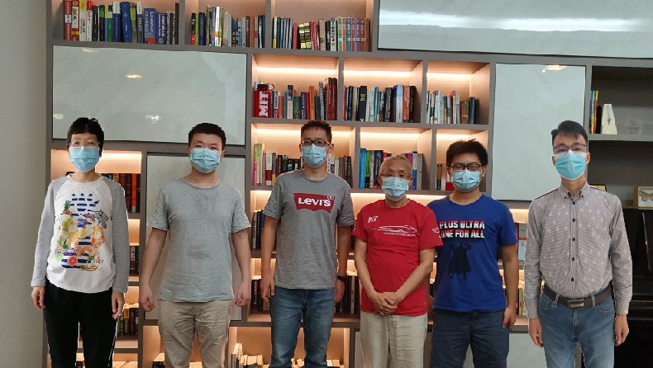
Acknowledgements
left to right: Dr. Zhang Yong-Mei, Dr. Zhu Tao, Dr. Gao Zhibin, Prof. Wang Jian-Sheng, Mr. Sun Kangtai, and Dr. Zhang Zuquan.

