Slide 1
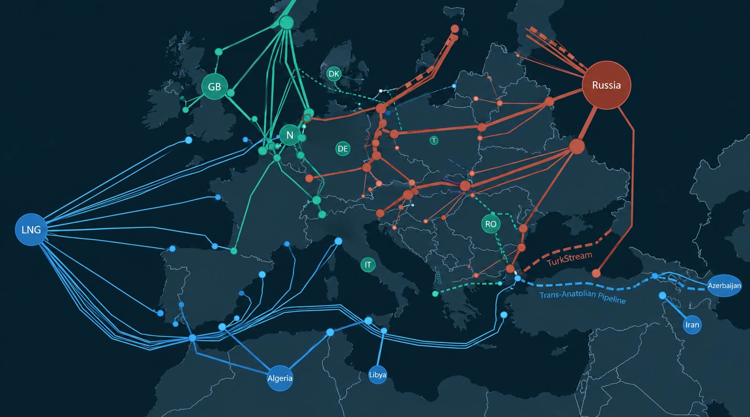
How Europe's gas market reform changed the shape of its vulnerability
Thesis: gas market liberalisation reduced supplier power over volumes but created a new and more deniable channel of leverage, over the marginal price.
Pietro Mischi – Energy and Geopolitics
Notes:
[~40 sec] Europe asks one question about energy security: from whom do we buy, and through which pipeline? In 2021 the pipelines stayed open and the prices still destroyed household budgets and industrial margins. My thesis: liberalisation removed supplier power over volumes but handed over a new lever — the marginal price. Coercion moved from the valve to the price.

Slide 2
Two regimes of price formation
1962–2000s · GRONINGEN MODEL
2003–today · TTF hub
PRICE FIXED BY CONTRACT
PRICE SET AT THE MARGIN
20–25 year contracts; oil-indexed formulas
Take-or-pay: buyer committed to volumes
Interruption = visible, costly, actionable breach
Soviet gas continued to flow during the invasion of Afghanistan in 1979 and martial law in Poland in 1981
EU gas directives 1998 / 2003 / 2009 unbundle supply
TTF launched 2003; hub indexation spreads in the 2010s
The last unit traded prices all the gas
Short-run demand is inelastic → small deficit, large repricing
Sources: Högselius (2013); EU gas directives 98/30/EC, 2003/55/EC, 2009/73/EC
Notes:
[~70 sec] Claim 1: the old order bound both sides. Högselius shows Soviet gas flowed through the worst Cold War moments because breaking a 25-year take-or-pay contract was expensive, visible and legally actionable. Claim 2: liberalisation moved price formation from the contract to the hub. The key property is marginal pricing — the last unit traded sets the price of everything. Ample supply, this disciplines suppliers. Tight supply, and because demand cannot fall in the short run, the whole market reprices.

Slide 3
Winter 2021
No valve was closed
Summer 2021 Rehden, Germany's largest storage site and run by a Gazprom subsidiary, is left almost empty.
Autumn 2021 Gazprom honours its contracts — but offers nothing extra on the spot market. The IEA says Russia could send more.
August 2022 The TTF price touches about €340/MWh.
<€20 → €340
per MWh — before the crisis vs. its peak
No breach, No casus belli, No single act to answer.
Withholding the marginal molecule repriced all the gas: a chokepoint effect without holding the chokepoint (Farrell & Newman 2019).
Notes:
[~60 sec] Act three is the one Europe had not prepared for. In the summer of 2021 the pipelines were open and the contracts were honoured. But Rehden, Germany's largest storage facility, operated by a Gazprom subsidiary, stood almost empty going into winter. Gazprom delivered what it had signed for and not a cubic metre more: no extra spot sales, little extra transit capacity. In the autumn the International Energy Agency said publicly that Russia could have sent more. Nothing on this map was cut – and yet, because the TTF now priced all gas at the margin, withholding the last molecule was enough to move the whole market. By August 2022 the price stood near 340 euros per megawatt-hour, against under 20 before. There was no breach, no casus belli, no single act a government could point to. In Farrell and Newman's terms, a chokepoint effect – exercised by someone who did not own the chokepoint.

Slide 4
Europe's answer
Liquidity cut both ways
The same hub pulled LNG from Asia within months — unthinkable in the Groningen era.
Intent stays unproven
Cold spring, weak wind, post-Covid demand. Conduct consistent with withholding, not proof.
The valve never left
2006 and 2009 show physical coercion survived. What changed was method and deniability.
BRUSSELS, 2022
For the first time, the fix is market design
Binding storage targets (Reg. 2022/1032)
and a cap on the TTF price (Reg. 2022/2578)
— an implicit admission that the market itself had become the vulnerability.
1968 asked: from whom do we buy? 2021 asked: who sets the last price?
The pipeline decides whether gas arrives.
The design of the market decides what it can be made to cost.
Notes:
[~60 sec] How do we know the problem was the market and not the pipes? Look at how Europe finally answered. In 2022, for the first time, Brussels intervened in market design itself: binding storage targets, removing the discretion that let Rehden sit empty, and a cap on the TTF price. That is an institutional admission that the market had become a security vulnerability. History also imposes caveats. The same liquid hub that transmitted the shock also cured it, drawing LNG cargoes from Asia within months. Intent cannot be proven – 2021 also had a cold spring, weak wind and post-Covid demand. And 2006 and 2009 remind us the valve never went away; what changed was method and deniability, not capacity. So the question Europe asked in 1968 – from whom do we buy? – is still necessary, but no longer sufficient. The pipeline decides whether gas arrives; the design of the market decides what it can be made to cost.

