Slide 1


Slide 2
Different Comm. Methods
Unicast
  Point-to-Point Communication(p-2-p)
  Multiple copies are sent.
  communication to a single process is known as unicast.
Broadcast
  One-to-All Communication
  Communication to all processes in the system, as opposed to a subgroup of them, is known as broadcast
Multicast
  One-to-multiple Communication
  multicast communication, in which a message is sent to all the members of the group by a single operation.

Slide 3
Group communication
Group communication is concerned with the delivery of messages to a set of recipients and hence is a multiparty communication paradigm supporting one-to-many communication.
The essential feature of group communication is that a process issues only one multicast operation to send a message to each of a group of processes instead of issuing multiple send operations to individual processes.
In this action, the sender is not aware of the identities of the receivers.
In group communication, the central concept is that of a group with associated group membership, whereby processes may join or leave the group.

Slide 4
key areas of application
reliable distribution of information to potentially large numbers of clients, including in the financial industry, where institutions require accurate and up-to date access to a wide variety of information sources;
support for collaborative applications, where again events must be disseminated to multiple users to preserve a common user view – for example, in multiuser games.
support for a range of fault-tolerance strategies, including the consistent update of replicated data or the implementation of highly available (replicated) servers;
support for system monitoring and management, including for example load balancing strategies.

Slide 5
Group communication
Group communication to provide:
  It enables the implementation to be efficient in its utilization of bandwidth and total transmission time is very less .
  Simultaneous execution of the same operation in a group of workstations
  Software installation in multiple workstations
Who Needs Group Communication?
Highly available servers (client-server)
Database Replication
Multimedia Conferencing
Online Games
Cluster management
…

Slide 6
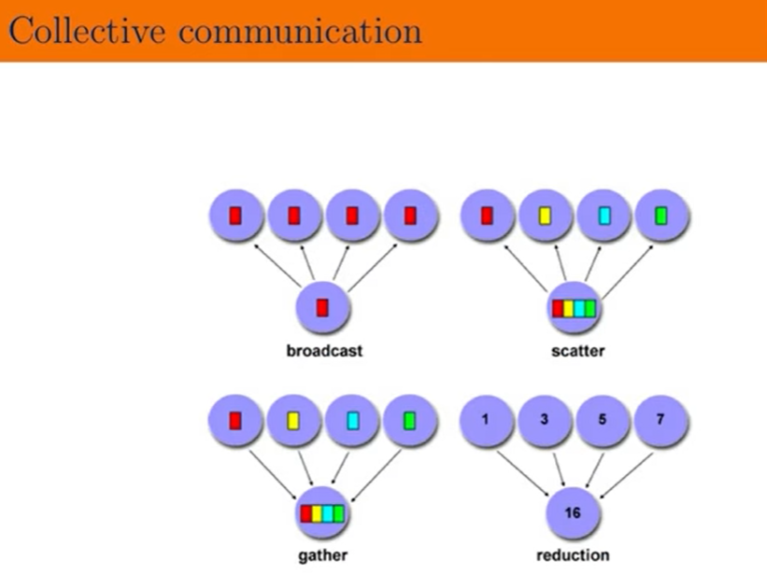

Slide 7
Group Communication Primitives
MPI_Bcast (sendbuf, sendcount, sendtype, rootID, communicator)
  Send the message in "sendbuf" to all processes
MPI_Scatter (sendbuf, sendcount, sendtype, recvbuf, recvcount, recvtype, rootID, communicator)
  Sender rootID distributes (scatters) the message in "sendbuf" among all processes in the communication group

Slide 8
Group Communication Primitives
MPI_Gather (sendbuf, sendcount, sendtype, recvbuf, recvcount, recvtype, rootID, communicator)
  Processor rootID receives messages from all other processors and concatenate the output in the "recvbuf“
MPI_Reduce (sendbuf, recvbuf, count, type, op, rootID, communicator)
  Processor rootID receives messages from all other processors and performs the operation op on the received data. The final outcome is stored in the "recvbuf" variable.

Slide 9
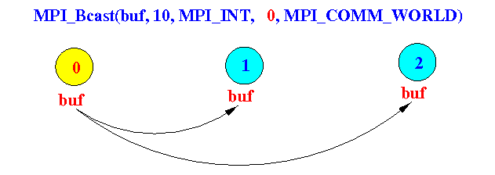
The Broadcast Group Communication Primitive
Broadcasting is sending a message to all members of the group.
Syntax of the MPI_Bcast() call:
MPI_Bcast(void* buffer, int count, MPI_Datatype datatype, int rootID, MPI_Comm comm )
The MPI process "rootID" sends the data in "buffer" to all other members in the communication group "comm"

Slide 10
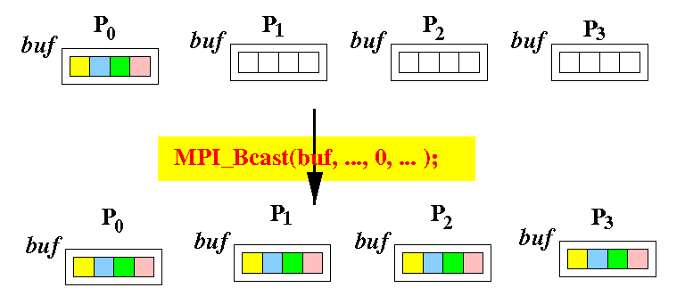
The Broadcast Group Communication Primitive
Psuedo code that describes what happens in a MPI_Bcast():
if ( myID == 0)
{
buffer=10
}
MPI_Bcast( buffer,1, MPI_INT, 0,MPI_COMM_WORLD);

Slide 11
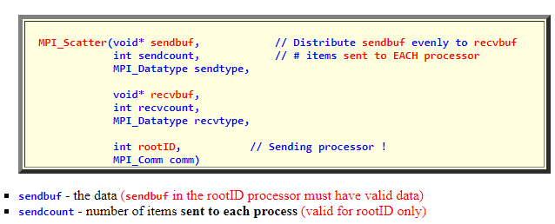
Scatter Group Communication primitive
The MPI_Scatter() is used to split an array into N parts and send one of the parts to each MPI process
Syntax of the MPI_Scatter() call:

Slide 12
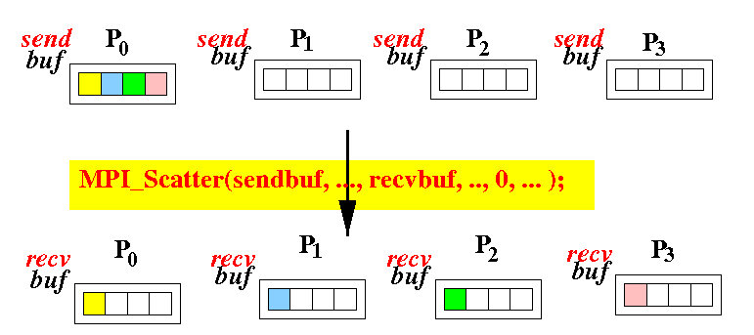
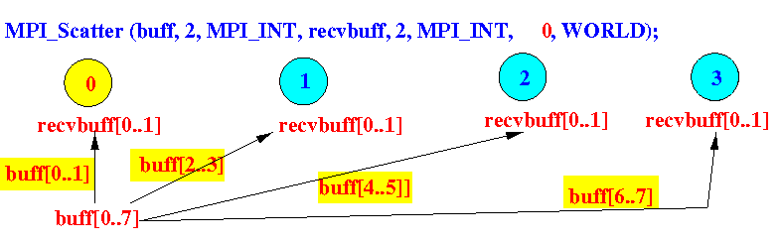
Scatter Group Communication primitive
sendtype - type of data sent (valid for rootID only)
recvbuf - buffer for receiving data
recvcount - number of items to receive
recvtype - type of data received
rootID - id of root processor (who is doing the send operation)
comm - the communicator group

Slide 13
Gather Group Communication primitives
The MPI_Gather() is usually used in conjunction with the MPI_Gather() call.
Syntax of the MPI_Gather() call:
MPI_Gather(void* sendbuf, int sendcount, MPI_Datatype sendtype, void* recvbuf, int recvcount, MPI_Datatype recvtype, int rootID, MPI_Comm comm)
sendbuf - the data (must be valid for ALL processors)
sendcount - number of items that will be sent to the rootID process
sendtype - type of data sent
recvbuf - buffer for receiving data
recvcount - number of items to receive (per processor)

Slide 14
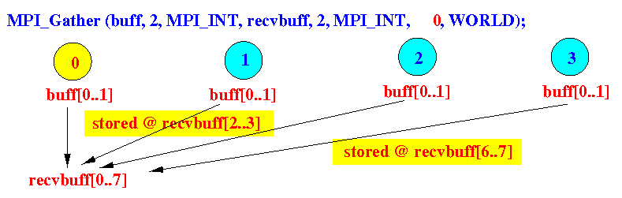
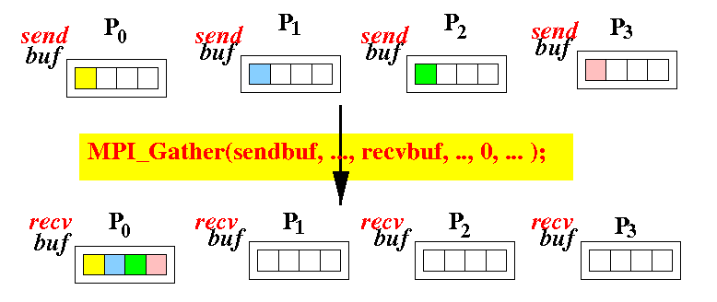
Gather Group Communication primitives

Slide 15
Reduce Group Communication primitives
Often, the data gathered by the MPI_Gather() need to be operated on to produce the final result.
For example, results of the computations could be a part of a sum and the results gathered needs to be added up to produce the final sum.
Syntax of the MPI_Reduce() call:
MPI_Reduce(void* sendbuf, void* recvbuf, int recvcount, MPI_Datatype recvtype, MPI_Op op, int rootID, MPI_Comm comm)

Slide 16
Reduce Group Communication primitives
MPI_Reduce(void* sendbuf, void* recvbuf, int recvcount, MPI_Datatype recvtype, MPI_Op op, int rootID, MPI_Comm comm)
sendbuf - the data (must be valid for ALL processors)
recvbuf - buffer used to receiving data and simultaneously perform the "reducing operation".
recvcount - number of items to receive (per processor)
recvtype - type of data received
op - type of operation used as the "reducing operation"
rootID - id of root processor who is doing the RECEIVE and REDUCE operation
comm - the communicator group

Slide 17
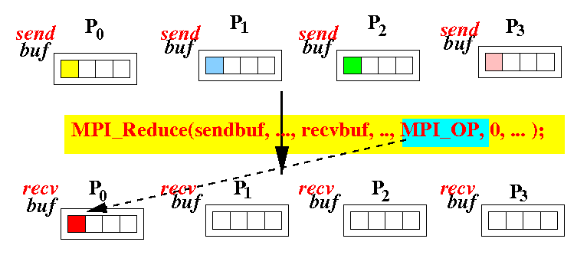
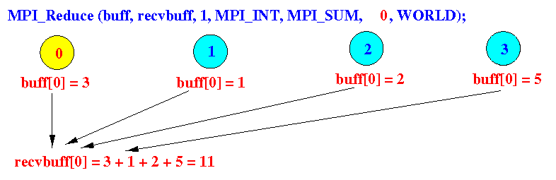

Slide 18
Available Reduction Operations: (directly from MPI)
MPI Reduction Operation | Effect of the Reduction Operation
MPI_MAX | Finds the maximum value
MPI_MIN | Finds the minimum value
MPI_SUM | Computes the sum of all value
MPI_PROD | Computes the product of all value
MPI_LAND | Computes the "logical AND" of all value (0 = false, non-zero = true)
MPI_BAND | Computes the "Bitwise AND" of all value
MPI_LOR | Computes the "logical OR" of all value (0 = false, non-zero = true)
MPI_BOR | Computes the "Bitwise OR" of all value
MPI_LXOR | Computes the "logical XOR" of all value (0 = false, non-zero = true)
MPI_BXOR | Computes the "Bitwise XOR" of all value
MPI_MAXLOC | Find the maximum value and the processor ID that has the value (you need to pass a structure with these 2 elements: (double value, int rank))
MPI_MINLOC | Find the minimum value and the processor ID that has the value (you need to pass a structure with these 2 elements: (double value, int rank))

Slide 19
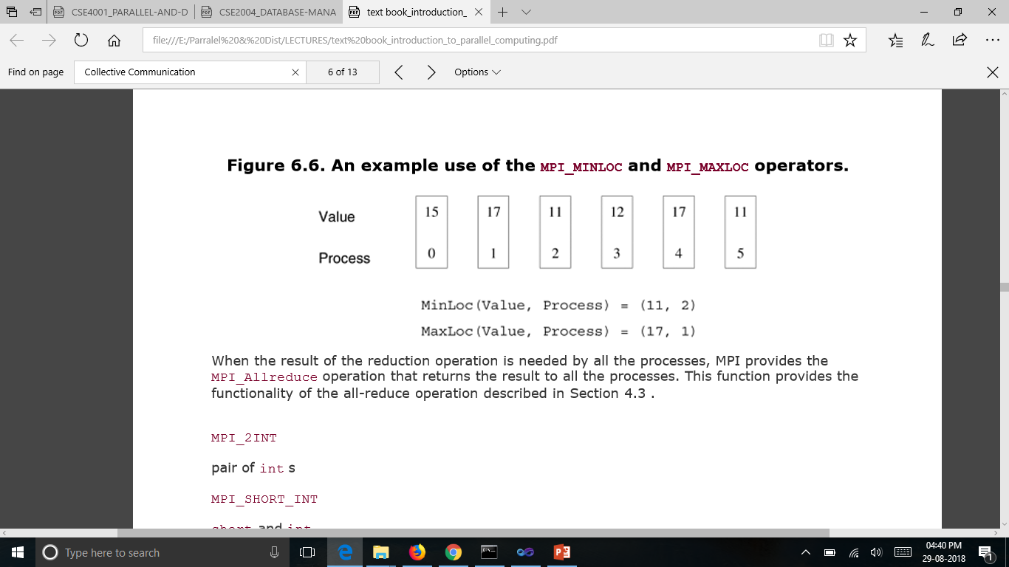

Slide 20
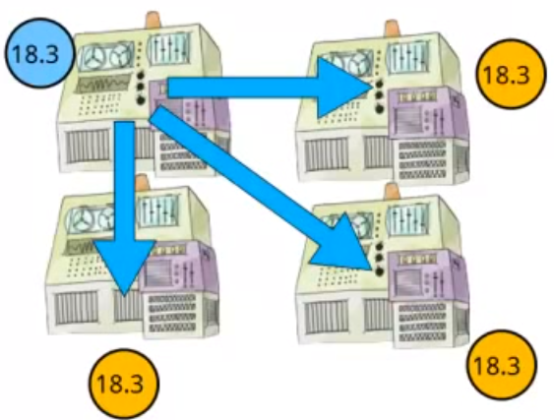
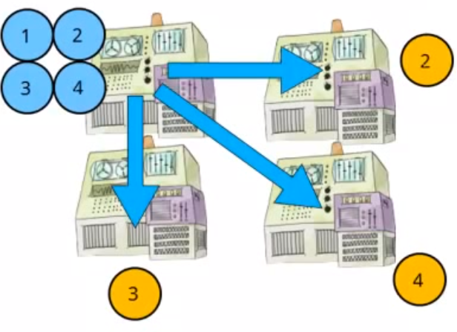
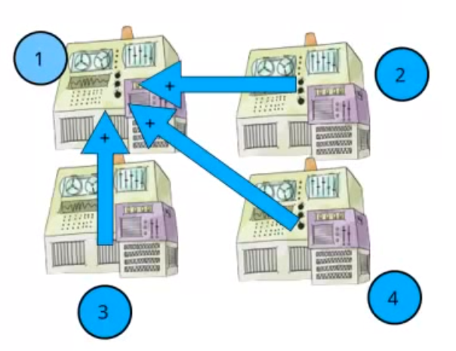
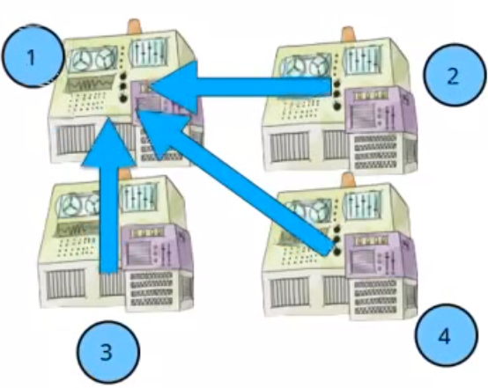
MPI's Group Communication

Slide 21
Coordination in distributed systems
Coordination is needed by distributed systems but hard to achieve:
  Events happen concurrently
  Communication links are not reliable
  Computers can crash
  New nodes can join the systems
  Asynchronous environments
⇒ Need of an efficient way to coordinate a group of processes.

