Slide 1
overview of MPI

Slide 2
Why Message Passing
A parallel computation consists of a number of processes, each working on some local data. Each process has purely local variables, and there is no mechanism for any process to directly access the memory of another.
Sharing of data between processes takes place by message passing, that is, by explicitly sending and receiving data between processes.
Message passing is the basis of most inter-process communication in distributed systems.
6

Slide 3
MESSAGE PASSING
Message passing is a paradiagram of communication where messages are sent from a sender to one or more recipient.
Message passing is used widely on parallel computers with distributed memory and on clusters of servers.
OR
Message passing refers to mean of communication between:
Different threads within a process.
Different processes running on same node.
Different processes running on different node.

Slide 4
Message Passing Interface - MPI
What is the message passing model?
An application passes messages among processes
in order to perform a task.
This model works out quite well in practice for parallel applications
Notes:
Master slave example. Merge sort example.
Portable to all major parallel architectures

Slide 5
Message Passing Interface - MPI
The goal of the Message Passing Interface is to establish a portable, efficient, and flexible standard for message passing
It is a message passing library standard based on the consensus of the MPI Forum.
It becomes the "industry standard" for writing message passing programs on HPC platforms.
It addresses the message-passing parallel programming model: data is moved from the address space of one process to that of another process

Slide 6
History
1982-1992 – Parallel computing developers uses no. of incompatible tools for writing programs
April 1992 – Workshop on standards for message passing - features essential to a standard message passing interface were discussed
Nov 1992: Working group meets in Minneapolis with MPI draft proposal
Nov 1993: Supercomputing 93 conference - draft MPI standard presented
May 1994: Final version of MPI-1.0 released
  MPI-1.1 (Jun 1995), MPI-1.2 (Jul 1997), MPI-1.3 (May 2008).
1998: MPI-2 picked up where the first MPI specification left off, and addressed topics which went far beyond the MPI-1 specification.
  MPI-2.1 (Sep 2008), MPI-2.2 (Sep 2009)
Sep 2012: The MPI-3.0 standard was approved.
  MPI-3.1 (Jun 2015)
Current: The MPI-4.0 standard is available

Slide 7
Why MPI is simple?
Many parallel programs can be written using just these six functions, only two of which are non-trivial;
    MPI_INIT
    MPI_FINALIZE
    MPI_COMM_SIZE
    MPI_COMM_RANK
    MPI_SEND
    MPI_RECV

Slide 8
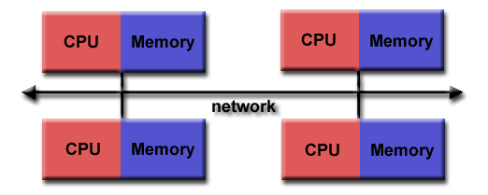
Programming Model:
Originally, MPI was designed for distributed memory architectures (1980 – 1990’s)

Slide 9
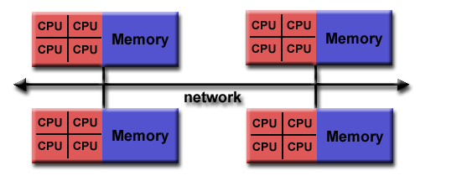
Shared memory SMPs were combined over networks creating hybrid distributed memory / shared memory systems
MPI implementors adapted their libraries to handle both types of underlying memory architectures seamlessly.
Today, MPI runs on virtually any hardware platform:
  Distributed Memory, Shared Memory, Hybrid

Slide 10
MPI’s design for the message passing model
Communications such as this which involve one sender and receiver are known as point-to-point communications.
Collective communications - There are many cases where processes may need to communicate with everyone
For example, when a master process needs to broadcast information to all of its worker processes
Mixtures of point-to-point and collective communications can be used to create highly complex parallel programs.

Slide 11
MPI’s design for the message passing model
Communicator - A communicator defines a group of processes that have the ability to communicate with one another.
In this group of processes, each is assigned a unique rank, and they explicitly communicate with one another by their ranks.
A process may send a message to another process by providing the rank of the process and a unique tag to identify the message.
The receiver can then post a receive for a message with a given tag and then handle the data accordingly.

Slide 12
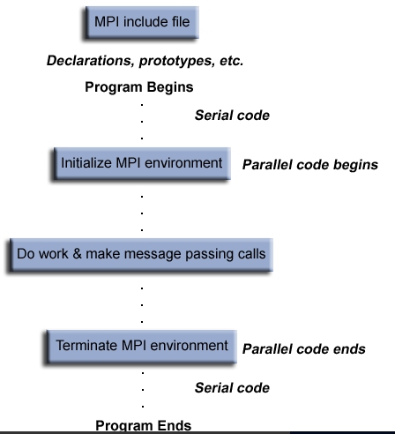
MPI Program Structure

Slide 13
A Minimal MPI Program (C)
#include "mpi.h"
#include <stdio.h>
int main( int argc, char *argv[] )
{
MPI_Init( &argc, &argv );
printf( "Hello, world!\n" );
MPI_Finalize();
return 0;
}

Slide 14
Finding Out About the Environment
Two important questions that arise early in a parallel program are:
  How many processes are participating in this computation?
  Which one am I?
MPI provides functions to answer these questions:
  MPI_Comm_size reports the number of processes.
  MPI_Comm_rank reports the rank, a number between 0 and size-1, identifying the calling process

Slide 15
Better Hello (C)
#include "mpi.h"
#include <stdio.h>
int main( int argc, char *argv[] )
{
int rank, size;
MPI_Init( &argc, &argv );
MPI_Comm_rank( MPI_COMM_WORLD, &rank );
MPI_Comm_size( MPI_COMM_WORLD, &size );
printf( "I am %d of %d\n", rank, size );
MPI_Finalize();
return 0;
}

Slide 16
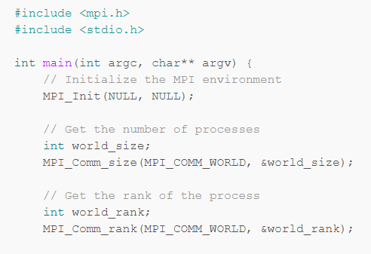
Example Program

Slide 17
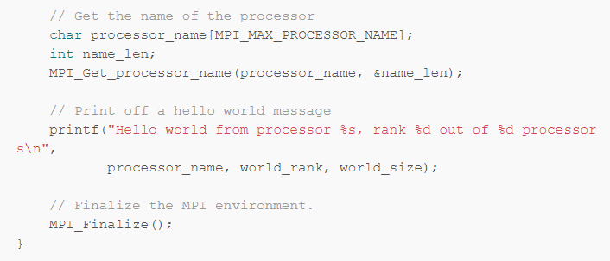
Example Program

Slide 18
Basic MPI types
MPI datatype C datatype
MPI_CHAR signed char
MPI_SIGNED_CHAR signed char
MPI_UNSIGNED_CHAR unsigned char
MPI_SHORT signed short
MPI_UNSIGNED_SHORT unsigned short
MPI_INT signed int
MPI_UNSIGNED unsigned int
MPI_LONG signed long
MPI_UNSIGNED_LONG unsigned long
MPI_FLOAT float
MPI_DOUBLE double
MPI_LONG_DOUBLE long double

Slide 19
MPI Send and Receive operations
Sending and receiving are the two foundational concepts of MPI.
Almost every single function in MPI can be implemented with basic send and receive calls.
MPI’s send and receive calls operation:
Process A decides a message needs to be sent to process B.
Process A then packs up all of its necessary data into a buffer (envelope)
Communication device is responsible for routing the message
The location of the message is defined by the process’s rank
Process B has to acknowledge the receipt of the message
If process A might have to send many different types messages to B, MPI allows senders and receivers to use specify message IDs known as tags

Slide 20
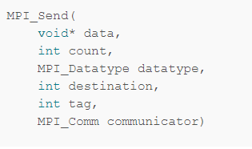
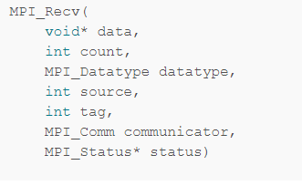
Prototypes for the MPI sending and receiving functions

Slide 21
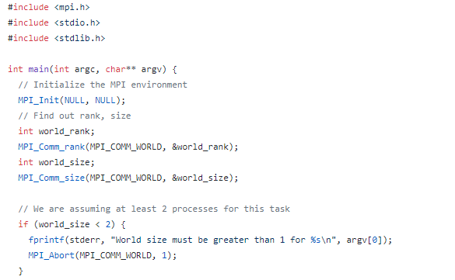
Example: 2

Slide 22
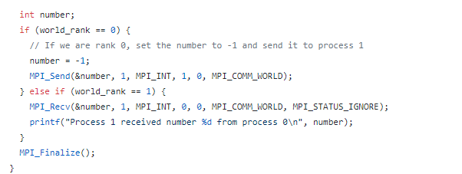
Example 2 Continuation…

Slide 23
Features of MPI
Supports both point to point communication and collective communication
Provides support for the design of safe, modular parallel software libraries
General or derived datatypes
Provides a rich set of collective communication routines
Blocking and nonblocking versions of the routines are provided
Buffering is available
Message ordering

Slide 24
MPI vs OpenMP

Slide 25
MPI | OpenMP
Available from different vendor and can be compiled in desired platform. One can use any of MPI API i.e MPICH, OpenMPI or other | OpenMP are hooked with compiler but have specific implementation. User is at liberty with changing compiler but not with OpenMP implementation
MPI target both distributed as well shared memory system | OpenMP target only shared memory system
Based on both process and thread based approach | Only thread based parallelism
Overhead for creating process is one time | Depending on implementation, threads can be created and joined for particular task which add overhead
There are overheads associated with transferring message from one process to another | No such overheads, as thread can share variables
Process in MPI has private variable only, no shared variable | In OpenMP , threads have both private as well shared variable
Data racing is not there if not using any thread in process | Data racing is inherent in OpenMP model

