Slide 1
Loop work sharing construct & Scheduling clauses

Slide 2
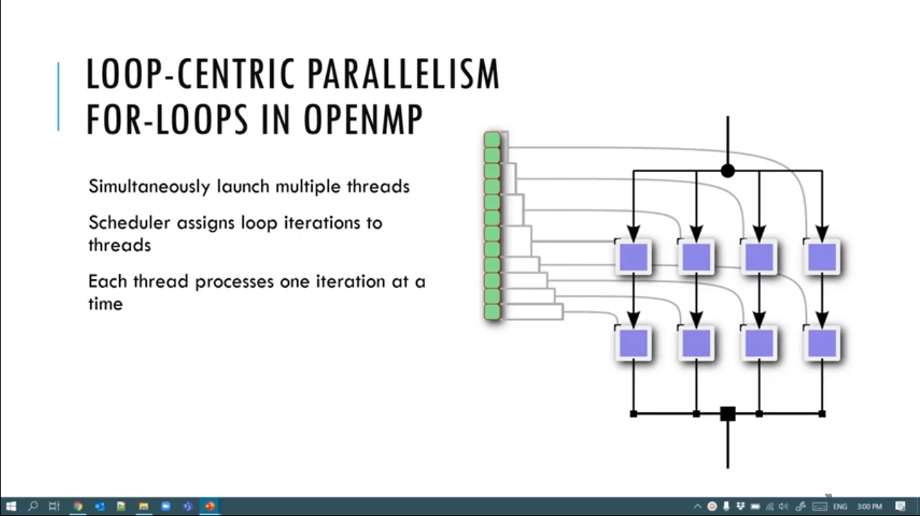

Slide 3
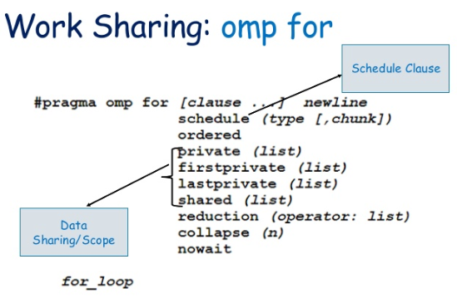

Slide 4
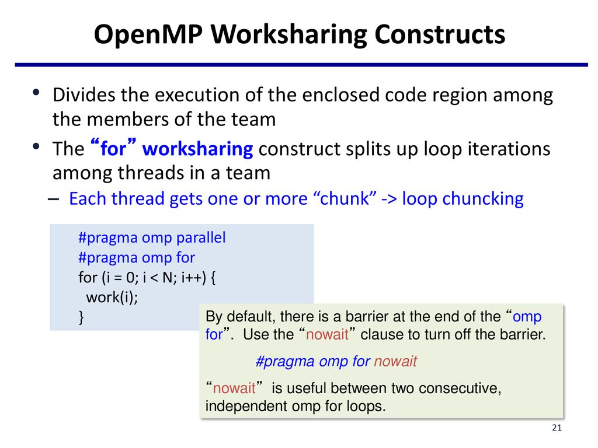

Slide 5
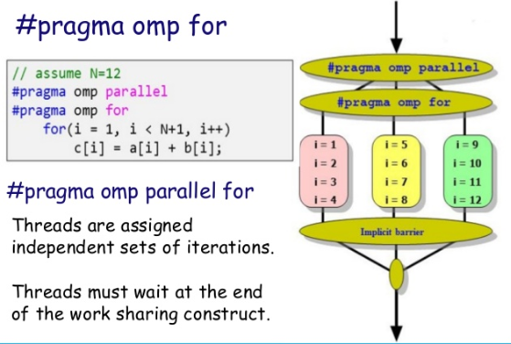

Slide 6
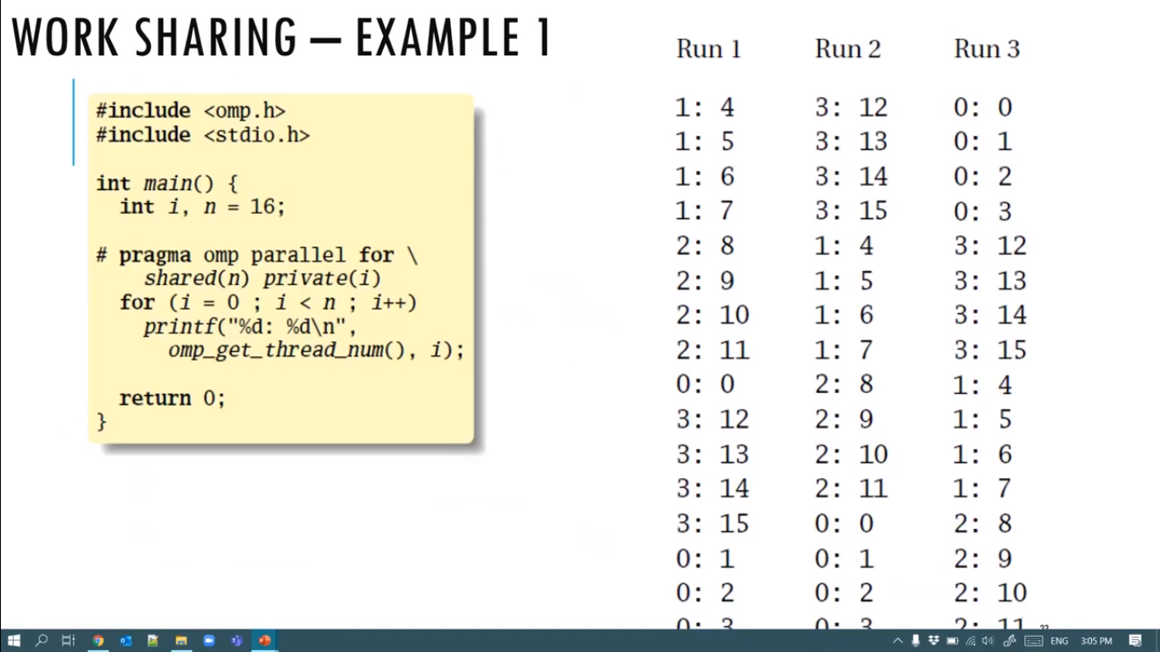

Slide 7
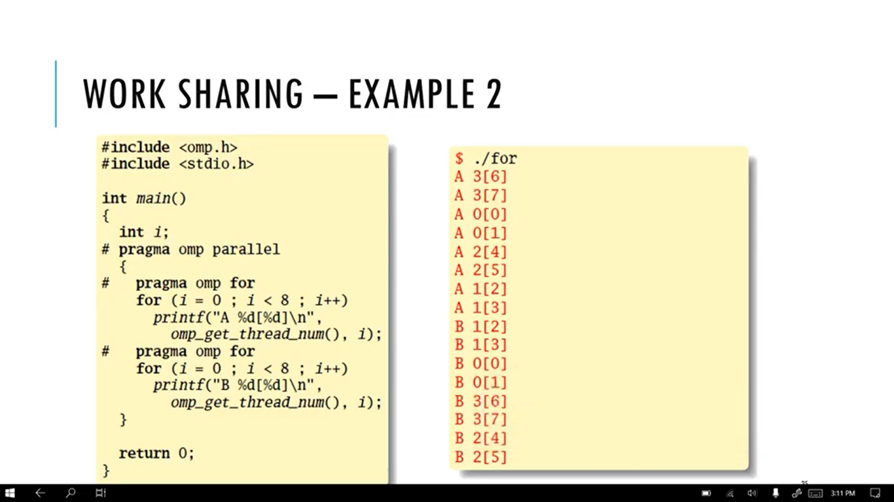

Slide 8
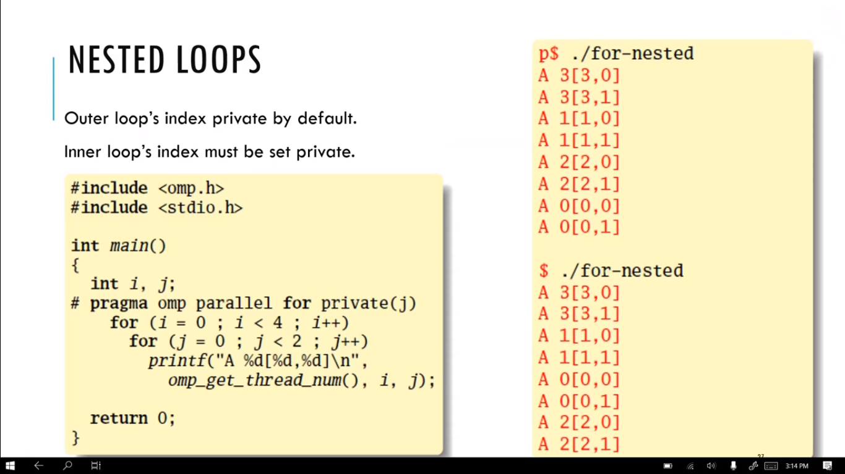

Slide 9
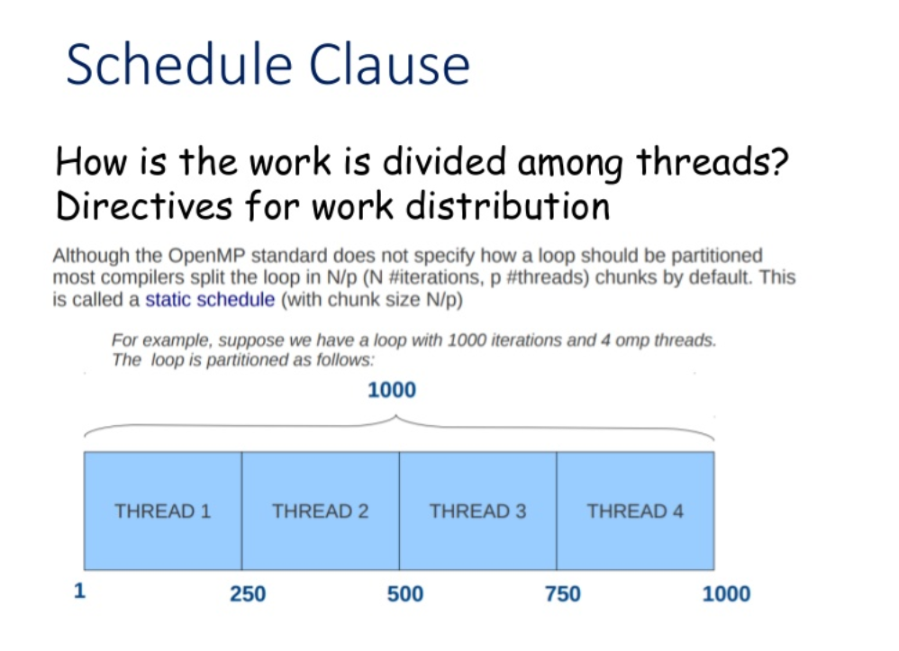

Slide 10
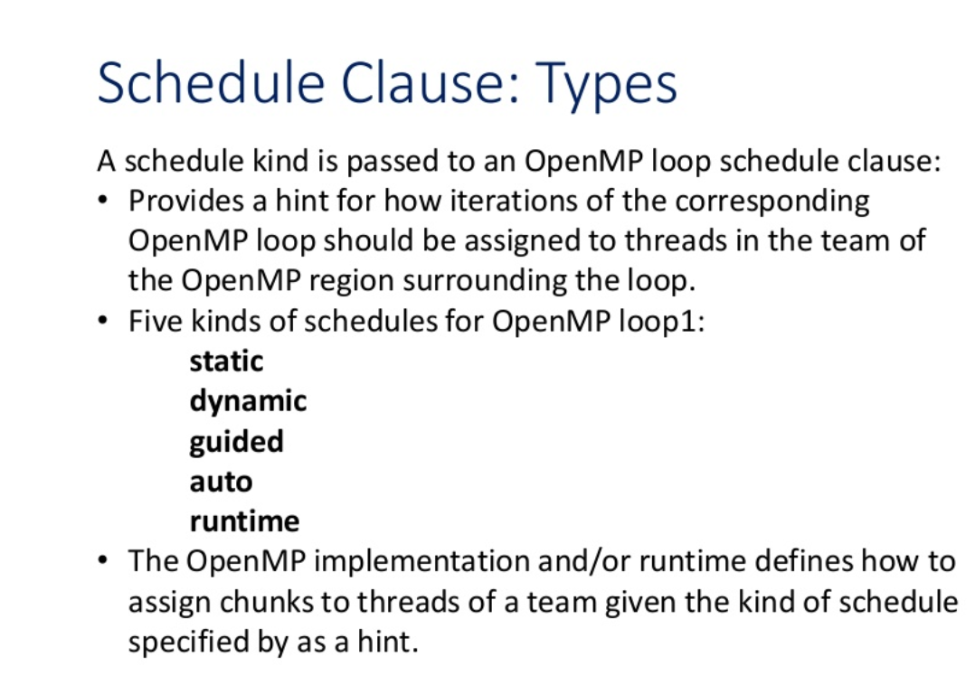

Slide 11
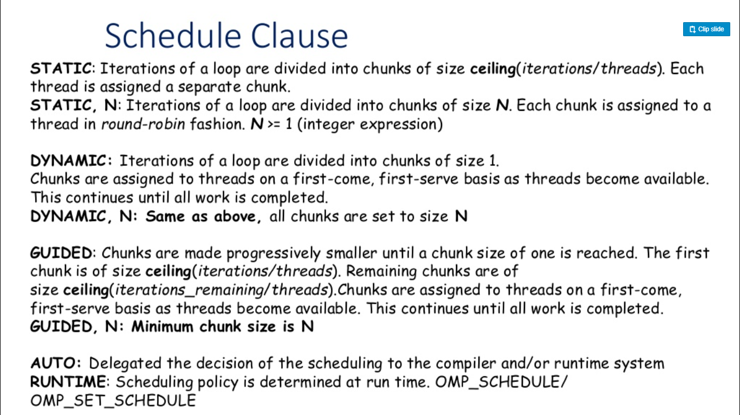

Slide 12
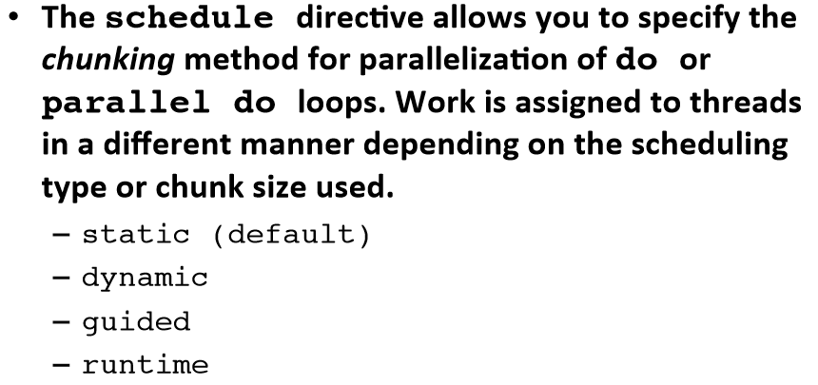
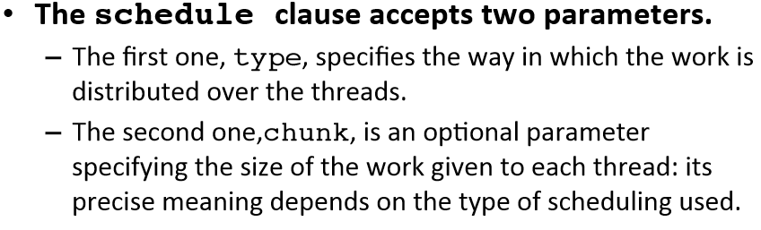

Slide 13
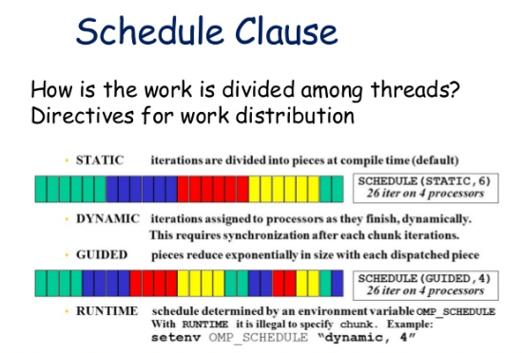

Slide 14
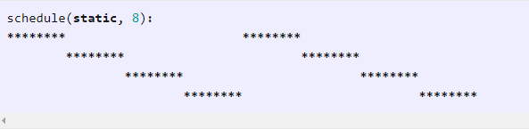
Static
The schedule(static, chunk-size) clause of the loop construct specifies that the for loop has the static scheduling type. OpenMP divides the iterations into chunks of size chunk-size and it distributes the chunks to threads in a circular order.
When no chunk-size is specified, OpenMP divides iterations into chunks that are approximately equal in size and it distributes at most one chunk to each thread.

Slide 15
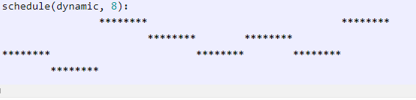
Dynamic
The schedule(dynamic, chunk-size) clause of the loop construct specifies that the for loop has the dynamic scheduling type. OpenMP divides the iterations into chunks of size chunk-size. Each thread executes a chunk of iterations and then requests another chunk until there are no more chunks available.
There is no particular order in which the chunks are distributed to the threads. The order changes each time when we execute the for loop.
If we do not specify chunk-size, it defaults to one.

Slide 16
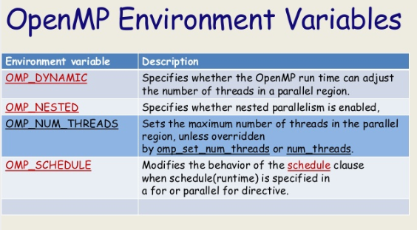

Slide 17
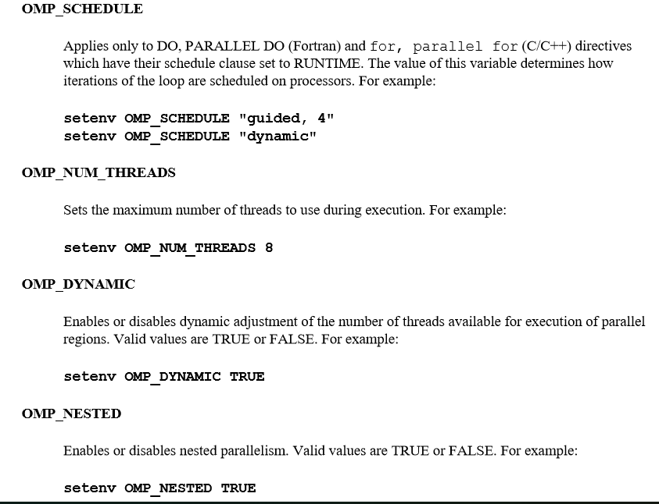

Slide 18
Example
#include <stdio.h>
#include <omp.h>
#define SIZE 10
int main (int argc, char *argv[]) {
float u[SIZE], v[SIZE], dp,dpp;
int i, j, tid;
dpp=0.0;
for(i=0;i<SIZE;i++){
u[i]=1.0*(i+1);
v[i]=1.0*(i+2);
}
printf("\n values of u and v:\n");
for (i=0;i<SIZE;i++){
printf(" u[%d]= %.1f\t v[%d]= %.1f\n",i,u[i],i,v[i]);
}
#pragma omp parallel shared(u,v,dp,dpp) private (tid,i)
{
tid=omp_get_thread_num();
#pragma omp for schedule(dynamic,2)
for(i=0;i<SIZE;i++){
dpp+=u[i]*v[i];
printf("thread: %d\n", tid);
}
dp=dpp;
}
printf("\n dot product is %f\n",dp);
}

