Slide 1
#define MAX 999
int main()
{
int count = 0;
#pragma omp parallel num_threads(MAX)
{
count++;
}
printf_s("Number of threads: %d\n", count);
}

Slide 2
Synchronization Constructs

Slide 3
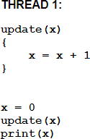
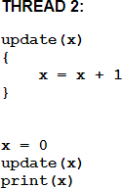
Synchronization Constructs
Consider a simple example where two threads are both trying to update variable x at the same time:

Slide 4
Synchronization Constructs
One possible execution sequence:
  Thread 1 initializes x to 0 and calls update(x)
  Thread 1 adds 1 to x. x now equals 1
  Thread 2 initializes x to 0 and calls update(x) x now equals 0
  Thread 1 prints x, which is equal to 0 instead of 1
  Thread 2 adds 1 to x. x now equals 1.
  Thread 2 prints x as 1.
To avoid a situation like this, the updating of x must be synchronized between the two threads to ensure that the correct result is produced.
OpenMP provides a variety of Synchronization Constructs that control how the execution of each thread proceeds relative to other team threads

Slide 5
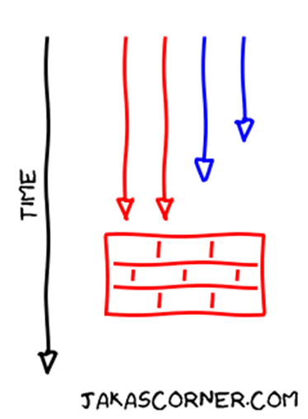
Barrier Directive
The BARRIER directive synchronizes all threads in the team.
When a BARRIER directive is reached, a thread will wait at that point until all other threads have reached that barrier.
All threads then resume executing in parallel the code that follows the barrier
#pragma omp barrier newline
All threads in a team must execute the BARRIER region
At the end of a parallel region the team of threads is dissolved and only the master thread continues. Therefore, there is an implicit barrier at the end of a parallel region .

Slide 6
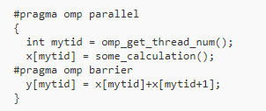
Example 1

Slide 7
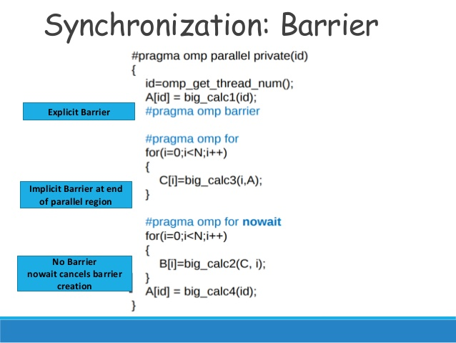

Slide 8
MASTER Directive
The MASTER directive specifies a region that is to be executed only by the master thread of the team.
All other threads on the team skip this section of code
There is no implied barrier associated with this directive
#pragma omp master newline structured_block

Slide 9
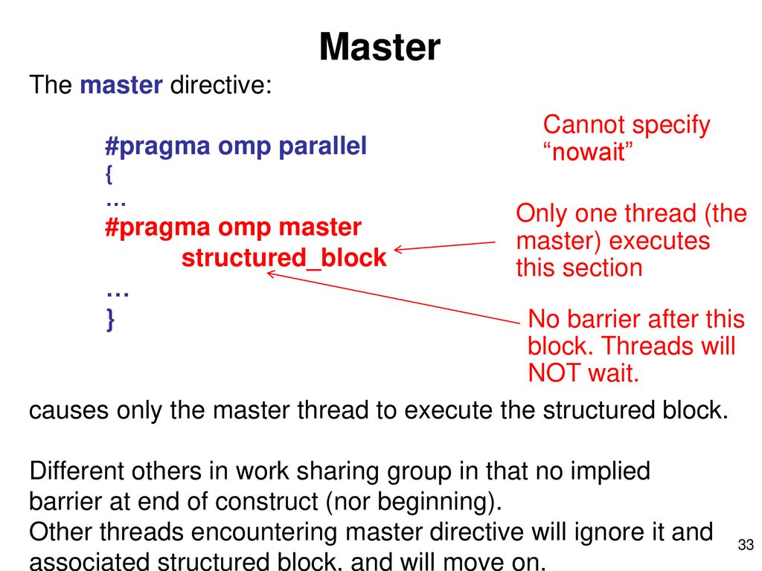

Slide 10
int main( )
{
int a[5], i;
#pragma omp parallel
{
#pragma omp for
for (i = 0; i < 4; i++)
a[i] = i * i;
#pragma omp master
for (i = 0; i < 4; i++)
printf("a[%d] = %d\n", i, a[i]);
#pragma omp for
for (i = 0; i < 4; i++)
a[i] += i;
}
}

Slide 11
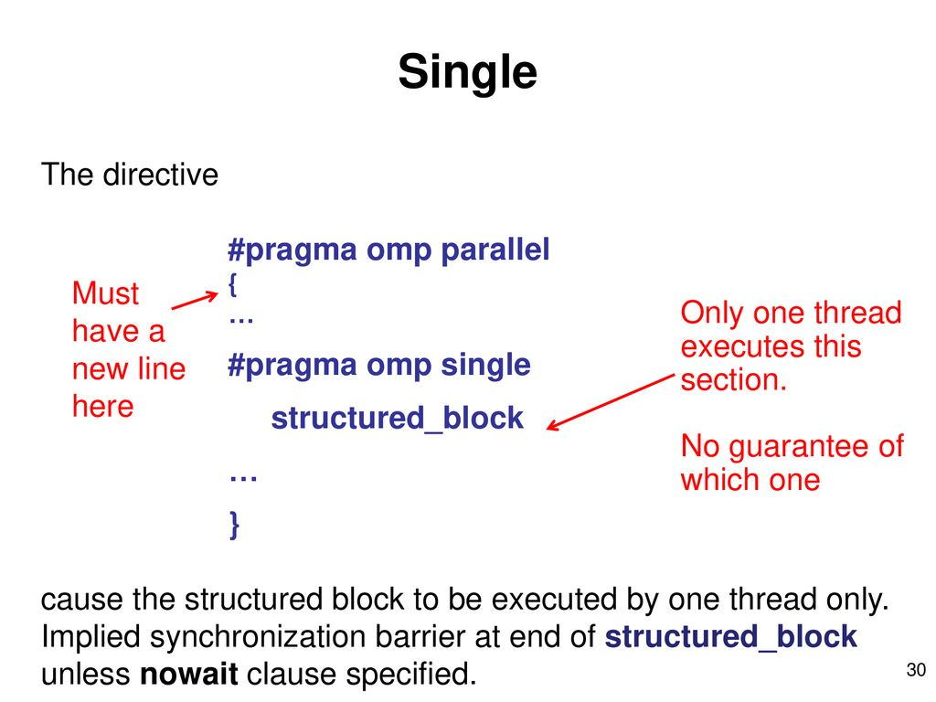

Slide 12
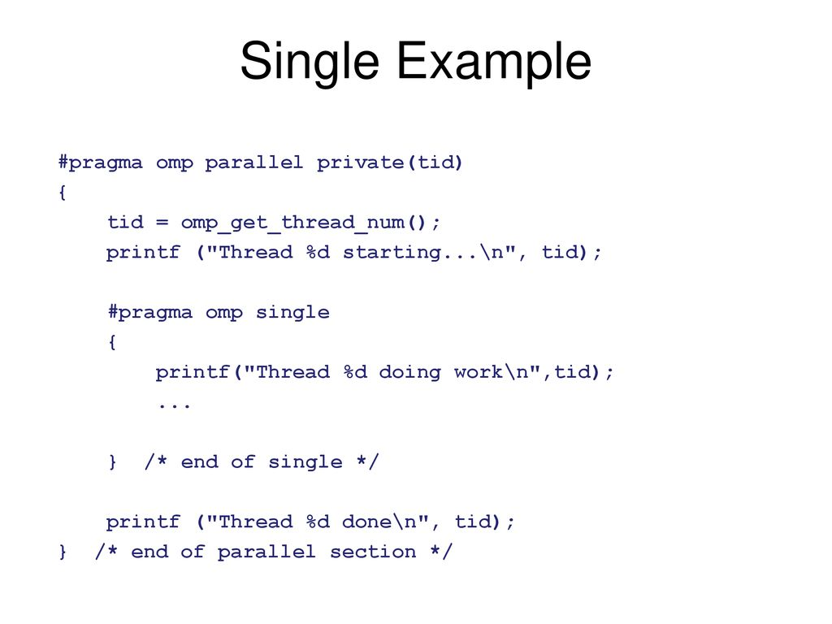

Slide 13
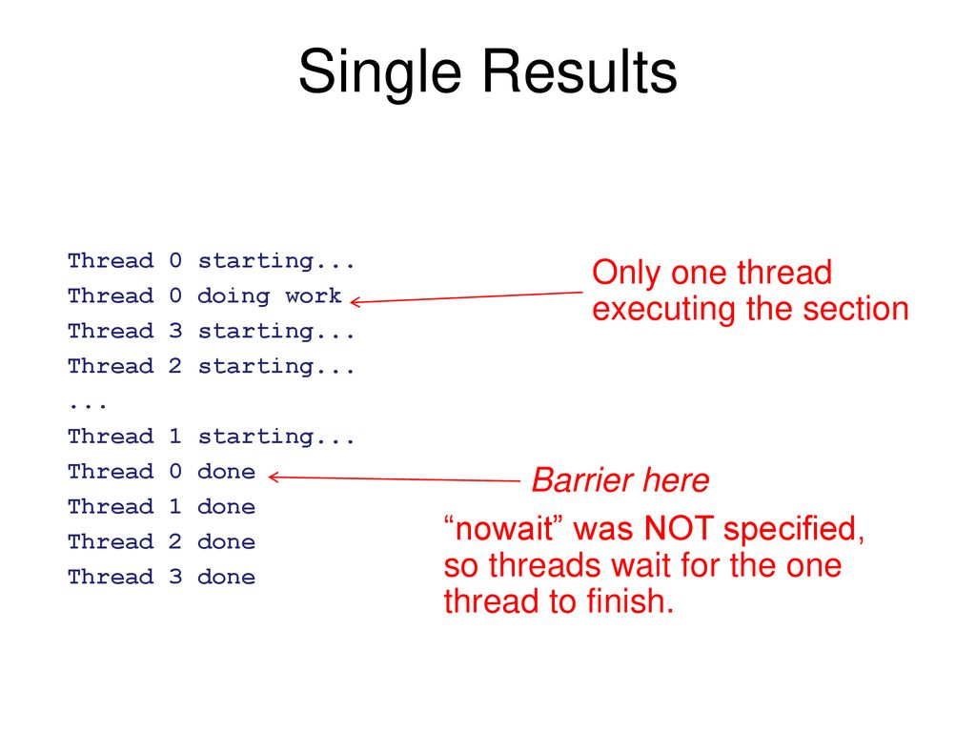

Slide 14
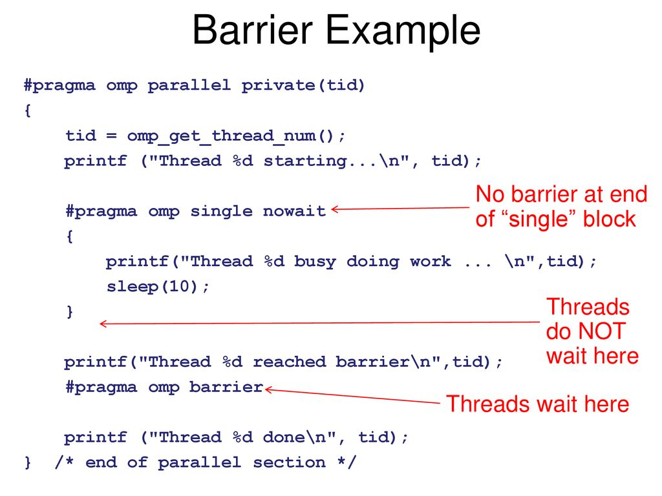

Slide 15
int main( )
{
int tid;
#pragma omp parallel private(tid)
{
tid=omp_get_thread_num();
printf("Thread %d starting\n", tid);
#pragma omp single nowait
{
printf("Thread %d doing work\n", tid);
sleep(10);
}
printf("Thread %d reached barrier\n", tid);
#pragma omp barrier
printf("Thread %d done\n", tid);
}
}

Slide 16
Quiz
#include <stdio.h>
#include <omp.h>
void main()
{
int i,j;
omp_set_num_threads(100);
#pragma omp parallel
{
i=omp_get_num_threads();
j=omp_get_max_threads();
if(2==omp_get_thread_num())
{
printf("num threds\n%d\n%d",i,j);
}
}
}

Slide 17
Critical Directive
The CRITICAL directive specifies a region of code that must be executed by only one thread at a time
#pragma omp critical [ name ] newline
structured_block
If a thread is currently executing inside a CRITICAL region and another thread reaches that CRITICAL region and attempts to execute it, it will block until the first thread exits that CRITICAL region

Slide 18
Critical Directive
The optional name enables multiple different CRITICAL regions to exist:
  Names act as global identifiers.
  Different CRITICAL regions with the same name are treated as the same
region.
  All CRITICAL sections which are unnamed, are treated as the same section

Slide 19
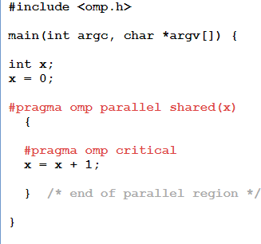
Critical Directive example

Slide 20
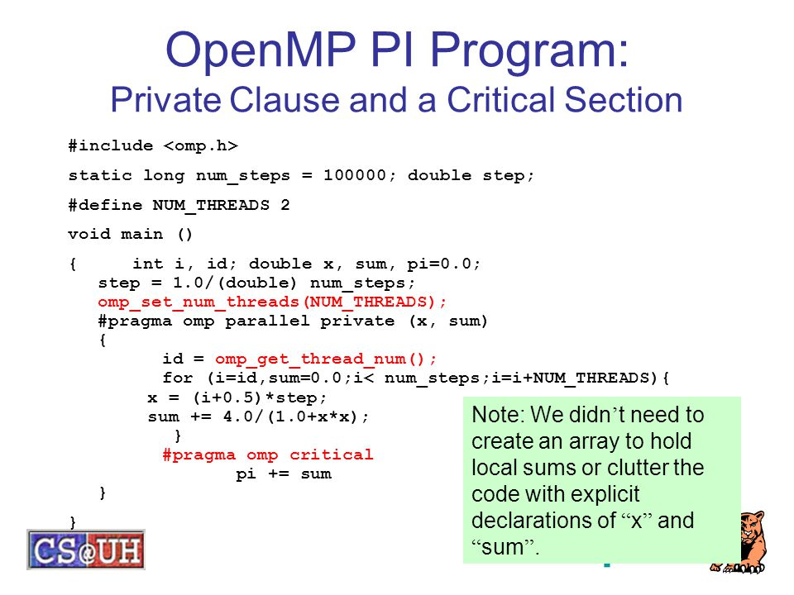

Slide 21
Atomic Directive
The omp atomic directive allows access of a specific memory location atomically instead of exposing the location to the possibility of multiple, simultaneously writing threads.
It ensures that race conditions are avoided through direct control of concurrent threads that might read or write to or from the particular memory location.
#pragma omp atomic newline
read write update
statement_expression
Permits better optimization

Slide 22
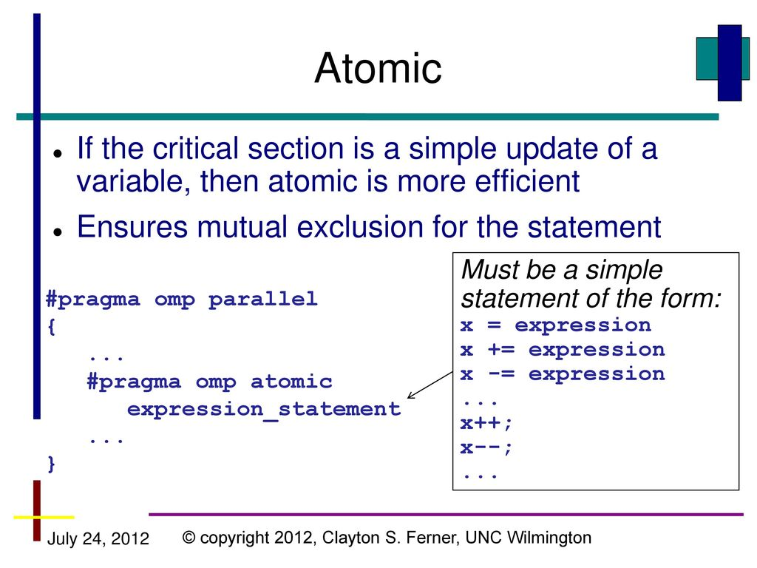

Slide 23
#include <stdio.h>
#include <omp.h>
#define MAX 10
int main()
{
int count = 0;
#pragma omp parallel num_threads(MAX)
{
#pragma omp atomic
count++;
}
printf("Number of threads: %d\n", count);
}

Slide 24
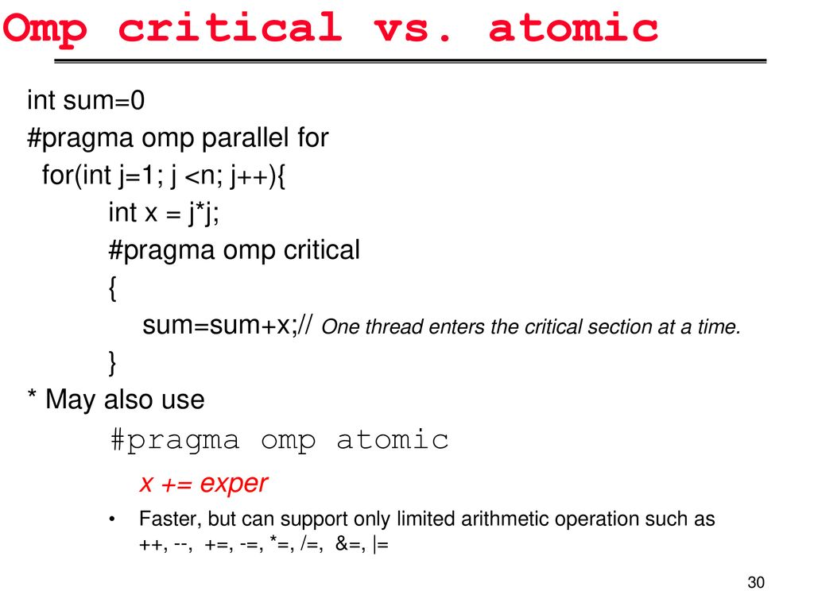

Slide 25
Ordered Directive
It specifies that iterations of the enclosed loop will be executed in the same order as if they were executed on a serial processor
Threads will need to wait before executing their chunk of iterations if previous iterations haven't completed yet
Used within a DO / for loop with an ORDERED clause
#pragma omp for ordered [clauses...] (loop region)
#pragma omp ordered newline structured_block
(endo of loop region)

Slide 26
#include <stdio.h>
#include <omp.h>
int main( )
{
int i;
#pragma omp parallel
{
#pragma omp for ordered
for (i = 0 ; i < 5 ; i++)
test(i);
}
}
void test(int iter)
{
#pragma omp ordered
printf("test() iteration %d\n", iter);
}

