Slide 1

Tech Mentorship Unit 3
Data Types & Arithmetic Operators

Slide 2
01
Intro to Data Types

Slide 3
What are Data Types?
Data Types in programming are like different "kinds" of information that a computer can understand and work with.
Data Types help your computer understand and organize this information properly.
Notes:
Make sure students know that Data Types are a way of representing Data like numbers

Slide 4
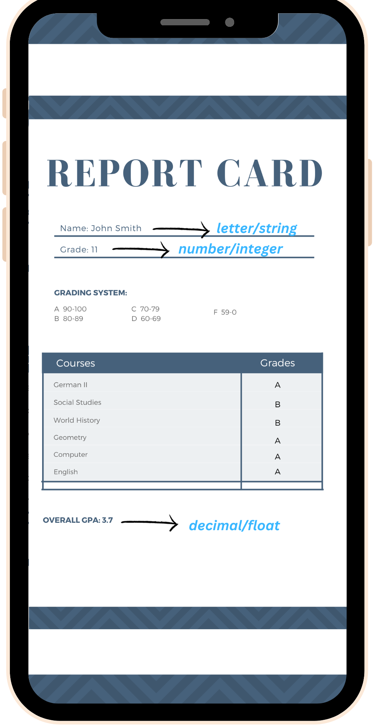
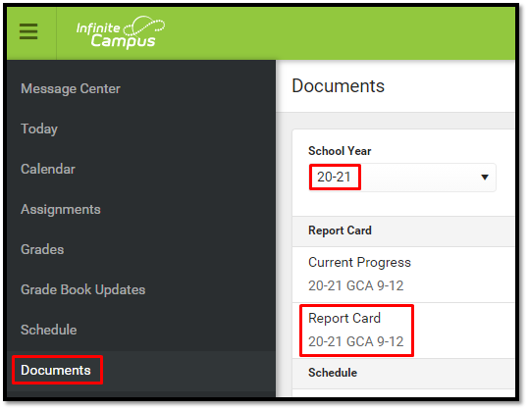
Why do we need them?
We have to store names, grades, GPAs, and many more informations according to their data types

Slide 5
What is each group?
1.) 12
2.) 7.8
3.) 7.0
4.) -7
5.) -4.3
Label each group with either: Whole Number or Decimal
Whole Number
Decimal
Decimal
Whole Number
Decimal
Notes:
Make sure students can label which are Whole Numbers and Which are Decimals
As well, make sure student know that 7.0 IS a decimal because there is a .0 (point zero)

Slide 6
The Groups Identified Were Data Types!
Integer
Float
Is a data type to represent whole numbers, like 12 & 7?
Is a data type to represent decimals, like 7.8, 7.0, & -4.3?
Notes:
Make sure students can identify the difference between Integer & Float

Slide 7
Identify Data Type
01
37
04
13
02
4.0
05
15
03
7.6
06
5.1
Integer
Integer
Float
Integer
Float
Float
Notes:
Go through activity with students and make sure they can identify the which are Integers & Floats

Slide 8
Identify Data Type for these Variables
01
a = 10
04
d = 45
02
b = 9.0
05
e = 1500
03
c = 19.6
06
f = 50.01
Integer
Integer
Float
Integer
Float
Float
Notes:
Go through activity with students and make sure they can identify the which are Integers & Floats

Slide 9
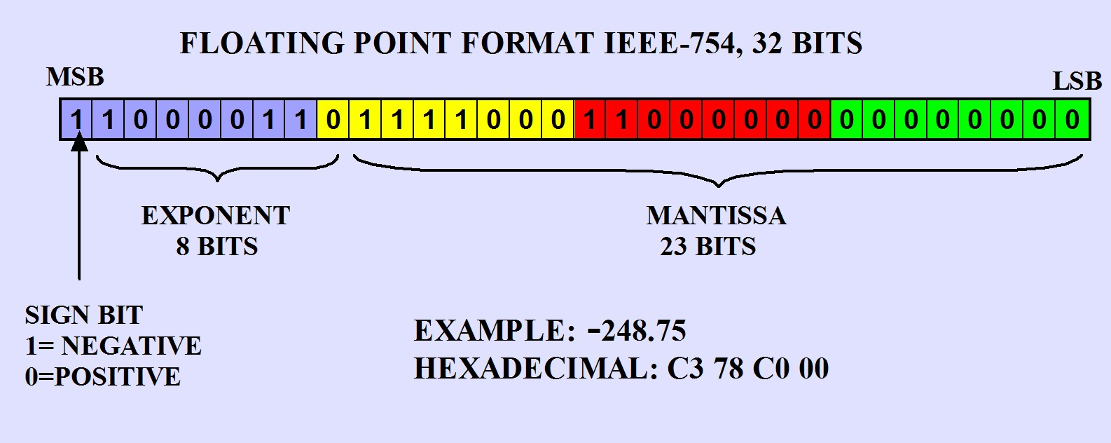
Limitations of a Floating Point number
https://www.puntoflotante.net/FLOATING-POINT-FORMAT-IEEE-754.htm
Floating points in Python can only store 64 bits = (8 bytes * 8 bits per byte) of information
Python follows the IEEE 754 standard (64-bit)
Notes:
Go through activity with students and make sure they can identify the which are Integers & Floats

Slide 10
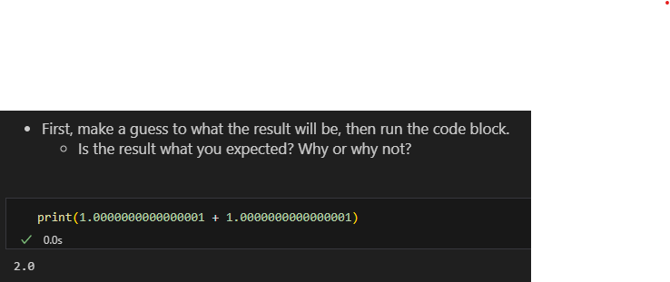
Limitations of a Floating Point number
Notes:
Go through activity with students and make sure they can identify the which are Integers & Floats

Slide 11
02
Arithmetic Operators

Slide 12
Beginner Operators
Addition
Subtraction
Multiplication
Plus Symbol
“ + ”
Minus Symbol
“ - ”
Asterisk Symbol
“ * ”
Division
Exponential
Forward Slash
“ / ”
2 Asterisk Symbol “ ** ”
Notes:
Make sure students know the symbols for each operation

Slide 13
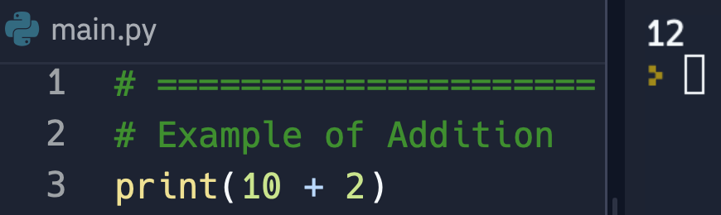
Addition Example
Notes:
Have students predict what the program will out

Slide 14
Addition Example: Answer
Notes:
Have discussion with students about any confusion

Slide 15
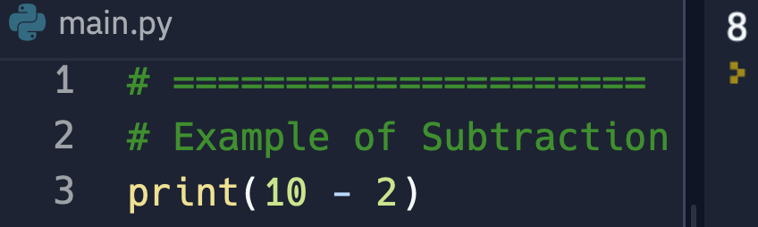
Subtraction Example:
Notes:
Have students predict what the program will out

Slide 16
Subtraction Example: Answer
Notes:
Have discussion with students about any confusion

Slide 17
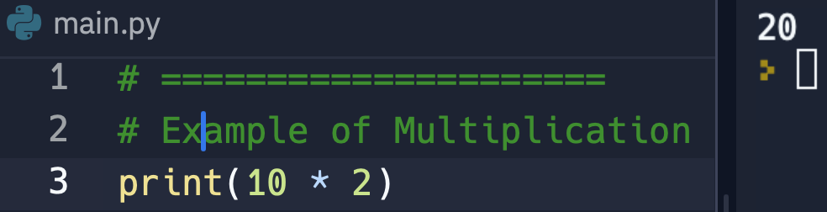
Multiplication Example:
Notes:
Have students predict what the program will out

Slide 18
Multiplication Example: Answer
Notes:
Have discussion with students about any confusion

Slide 19
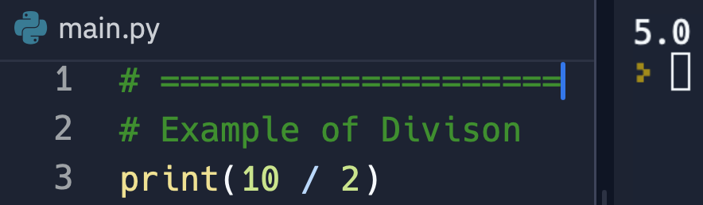
Division Example:
Notes:
Have students predict what the program will out
If students are stuck follow the steps below:
Ask the students to predict what the data type of “10 / 2” will be
Give them the options of Integer & Float
And have a discussion about it with students

Slide 20
Division Example: Answer
Note: Normal Division ALWAYS gives a Float as an Answer
Notes:
Have discussion with students about any confusion

Slide 21
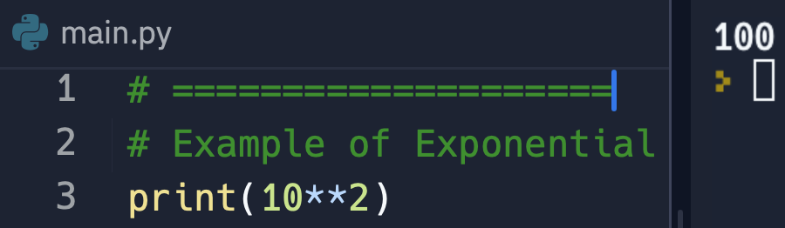
Exponential Example:
Notes:
Have students predict what the program will out

Slide 22
Exponential Example: Answer
Notes:
Have discussion with students about any confusion

Slide 23
Practice & Review
Write a program that print out the answers to these math questions.
20 Plus 3
30 Minus 5
10 Times 4
9 Divided by 3
3 to the 4th Power
Notes:
Make sure students are NOT doing print(23) as the answer for the first question or any of the other questions

Slide 24
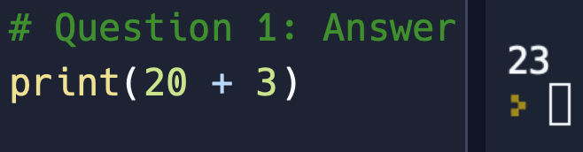
Question 1: Answer
Notes:
Have discussion with students about any confusion

Slide 25
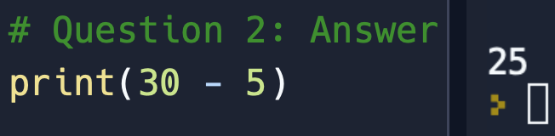
Question 2: Answer
Notes:
Have discussion with students about any confusion

Slide 26
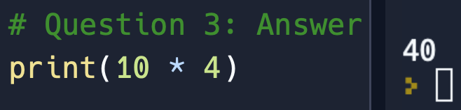
Question 3: Answer
Notes:
Have discussion with students about any confusion

Slide 27
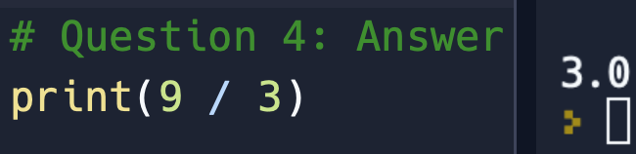
Question 4: Answer
Notes:
Have discussion with students about any confusion

Slide 28
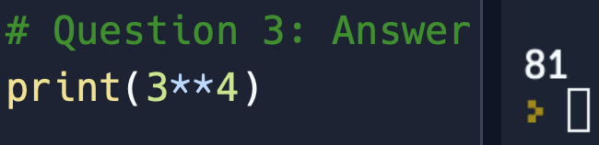
Question 5: Answer
Notes:
Have discussion with students about any confusion

Slide 29
Wait!
There are some more Arithmetic Operators in Python

Slide 30
What is Floor Division
Floor Division
Symbol “//”
Definition:
Floor division divides two numbers but rounds down to the nearest whole number.
Notes:
Make sure students understand that Floor division is just normal division with the decimal cut off

Slide 31
How do you do Floor Division?
9 // 2
9 / 2
4.5
4
Here’s our Question
First, let’s use normal division
What’s 4.5 rounded down to a Whole Number ?
Amazing!
You got it!
9 / 2 = 4.5
4.5 rounds down to 4
9 // 2 = 4
Notes:
Introduce how we are going to solve 9 // 2 as a class
Explain to students we are changing 9 // 2 to 9 / 2 in order to solve the problem
Have students answer what 9 / 2 is before moving on
Explain to students that we take 9 / 2 = 4.5 and we need to round it down
Have students answer what 4.5 is rounded down before moving on
Congratulate students because the answer is 24
Then click to reveal that 9 // 2 = 4

Slide 32
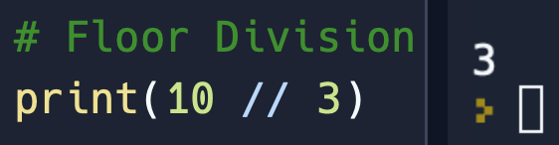
Floor Division Example:
Notes:
Ask students what the answer is
They should say 3
If they are stuck follow these steps
Ask students what 10 normal division 3 is
They should say 3.333333

Slide 33
Floor Division Example: Answer
Notes:
Have discussion with students if any of them are confused

Slide 34
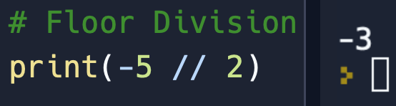
Floor Division Example:
Notes:
Ask students what the answer is
They should say -3
If they are stuck ask them what -5 normal division 2 is
They should say -2.5
Then ask students what is -2.5 rounded down to the nearest whole number
They Should say -3
Then congratulate them and click to the next slide

Slide 35
Floor Division Example: Answer
Notes:
Have discussion with students if any of them are confused

Slide 36
Python Artmethic
Operators
Modular
Symbol “%”
Definition:
Modular division, also known as remainder operator calculates the remainder of division

Slide 37
How do you do Modular Division?
Our Module Question is: 10 % 4
10 // 4
4 * 2
10 - 8
2
Take the floor division of the Modular Question
Multiply the denominator by the floor division answer.
Take the numerator and subtract it from our previous answer
Amazing! You now have the correct answer!
10 // 4 = 2
4 * 2 = 8
10 - 8 = 2
10 % 4 = 2
Notes:
Introduce how we are going to solve 10 % 4 as a class
Explain to students we are changing 10 % 4 to 10 // 4
Have students answer what 10 // 4 is before moving on
Explain to students that we take the denominator of 10 % 4 which is 4 and then multiple by 2 which we got from the answer of 10 // 2
Have students answer what 4 * 2 is before moving on
Explain to students that we now take the numerator of 10 % 4 which is 10 and subtract 8 from it which we got from the last question of 4 * 2 = 8
Have students answer what 10 - 8 is before moving on
Congratulate students because the answer is 2
Then click to reveal that 10 % 4 = 2

Slide 38
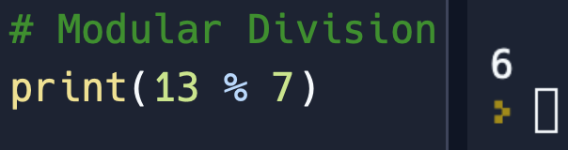
Modular Division Example:
Notes:
USE WHITE BOARD TO KEEP TRACK OF INFORMATION WITH STUDENTS
Ask students what the answer to the code on screen is
They should say 6
If they are stuck walk through these steps
Ask them what is 13 floor division 7
They should say 1
Then ask them what is 7 times 1
They should say 7
Then ask students what is 13 - 7
They should say 6
Then congratulate them because 13 modular 7 is 6
Then click to next slide to show them

Slide 39
Modular Division Example: Answer
Notes:
Have discussion with students if any of them are confused

Slide 40
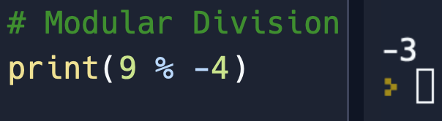
Modular Division Example:
Notes:
USE WHITE BOARD TO KEEP TRACK OF INFORMATION WITH STUDENTS
Ask students what the answer to the code on screen is
They should say -3
If they are stuck walk through these steps
Ask them what is 9 floor division -4
They should say 3
Then ask them what is 4 times 3
They should say 12
Then ask students what is 9 - 12
They should say -3
Then congratulate them because 9 modular -4 is -3

Slide 41
Modular Division Example: Answer
Notes:
Have discussion with students if any of them are confused

Slide 42
Floor Division Vs. Modular Division
Floor Division
Modular
Symbol “//”
Symbol “%”
Definition:
Definition:
Floor division divides two numbers but rounds down to the nearest whole number.
Modular division, also known as remainder operator calculates the remainder of division

Slide 43
Review: Data Types & Arithmetic Operators
01
What does an Integer mean?
02
What does a Float mean?
03
What division type could I use to always round down to a whole number?
04
What division type will give the remainder?
Notes:
Answers:
Any Whole Number
Any Decimal Number
Floor Division
Modular Division or Remainder Division

