Slide 1


Slide 2

str = “Strings”
index, slice, methods

Slide 3

str = “Strings”
index, slice, methods

Slide 4
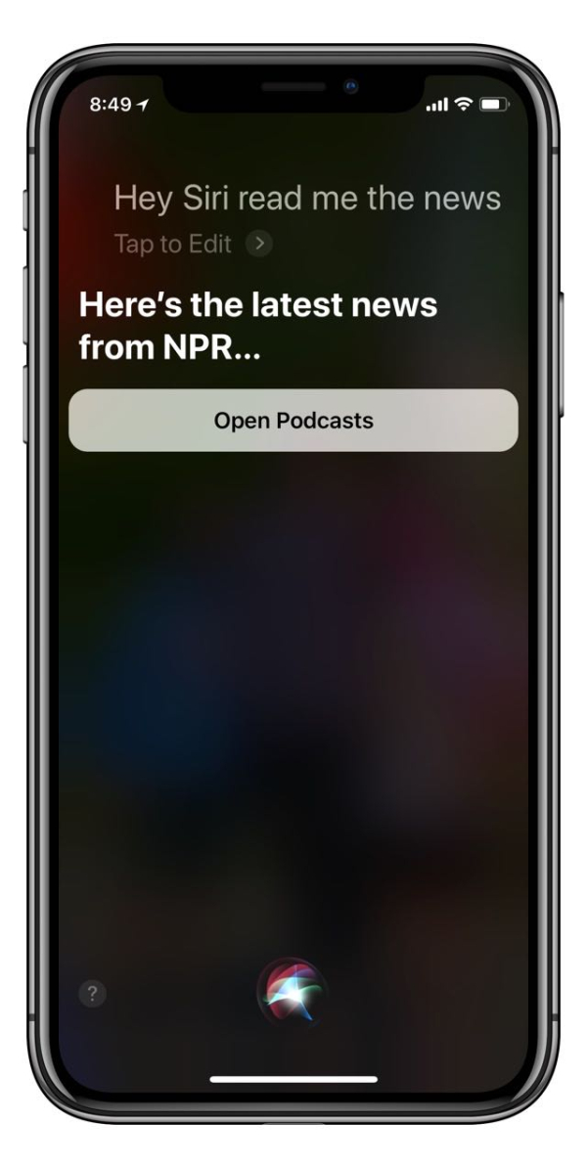
Terminology
String
An ordered series of characters or symbols
Strings are the basis for computer science challenges like natural language processing (NLP) and computational genetics
ex. Siri, ChatGPT, DigitizeMyDocs (Ryan’s old team)

Slide 5

Terminology
Index
A number (key), which provides access to a value within a string (lock).
Indices (plural)
In computing, indices usually start at 0. ‘0th index’

Slide 6


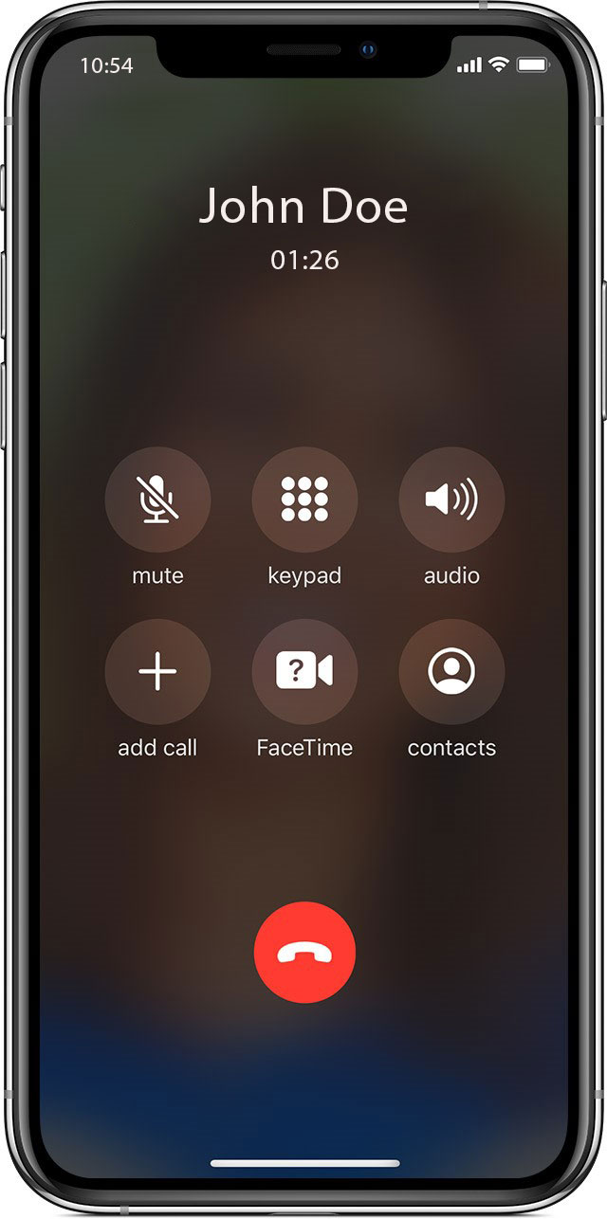
Real Life Indices
Addresses[123 Street St] =
Library[123-4-56-789012-3] =
Phones[515-123-4567] =

Slide 7
string[ index ]

Slide 8
Individual String Facts
The len() function tells us the number of characters in a string
The in keyword tells us if one string can fit inside the other
len(‘MyString’)
=> 8
‘s’ in ‘string’
=> True
‘z’ in ‘string’
=> False

Slide 9

Terminology
Keyword
Words that are reserved solely for the purpose of special programming syntax within a certain language. Keywords cannot be used as identifiers like variable names.
ex. in = ‘not allowed’

Slide 10
secretString Exercise

Slide 11



N O I C E job

Slide 12
What if I only want a certain part of a string?

Slide 13
Terminology
Substring
A string that exists within another string
ex. ‘Sand’ - ‘and’
ex. ‘Something’ - ‘some’, ‘thing’
ex. ‘Noice’ - ‘no’, ‘ice’

Slide 14
Exercise 3
Use index accessors to print out the substring “Some” from the larger string “Something”

Slide 15


N O I C E Job

Slide 16
What if there’s an easier way?

Slide 17
Introducing Slices
Remember math class? Domains? Ranges?
x is defined on domain [0,3]…
Python kind of has its own version of this called slices.

Slide 18
string[ start : stop ]

Slide 19
Exercise 3b
Use slices to print out the substring “Some” from the larger string “Something”

Slide 20


N O I C E job

Slide 21
Translating Slice Syntax
“Everything from 0 to 4 except 4”
‘Something’[0:4]
‘Some’

Slide 22
Slices Save Time
Imagine writing this except with a string from 0 to 100
a = ‘Something’[0] # ‘S’
b = ‘Something’[1] # ‘o’
c = ‘Something’[2] # ‘m’
d = ‘Something’[3] # ‘e’

Slide 23
More Slice Stuff
What happens if we leave out parts of the domain?
What happens if we use negative numbers?
‘Something’[:4]
‘Something’[0:]
‘Something’[0:-1]
‘Something’[-1:-4]

Slide 24
Negative Indices Explained
Negative indices are really just regular indices with an implied length expression
ex = “NoIce”
ex[0:-1]
ex[0:len(ex) – 1]
ex[0:5 – 1]
ex[0:4]

Slide 25
Negative Indices Explained
Negative indices are really just regular indices with an implied expression with the string length
ex = “NoIce”
ex[-3:]
ex[len(ex) – 3:]
ex[5 - 3:]
ex[2:]

Slide 26
Programming Terminology
Expression
Code that can go on the right side of the assignment operator (‘=‘)
Sometimes you can inline an expression into other syntax, which can remove the need for an extra variable
example[0:len(example) – 1]

Slide 27


N O I C E job

Slide 28
String Methods

Slide 29
String Methods
All strings have functions called methods that can be accessed by using the dot operator (‘.’). These methods allow us to handle strings in complex ways.

Slide 30
Terminology
Method
Methods are functions that exist as properties on certain variables, data, or objects in a programming language.

Slide 31
String.method(parameters)

Slide 32
Exercise 5
Capitalize your firstName
Make your firstName all uppercase
Make your firstName all lowercase
‘NoIce’ to ‘Noice’ in one line
firstName.capitalize()
firstName.upper()
firstName.lower()
‘NoIce’.lower().capitalize()

Slide 33



N O I C E job

Slide 34
Terminology
Chaining
Sequential access of properties or methods originating from the same variable, data, or object. This programming pattern can be more readable sometimes.
myVariable
.filter(unwanted)
.sum()
‘NoIce’
.lower()
.capitalize()

Slide 35

Terminology
Immutable
Once a string is initialized or returned from a method, the string is considered constant and immutable. Directly changing strings is forbidden in Python.
noIce = ‘NoIce’
noIce[2] = ‘i’ # …???
‘NoIce’ # memory – ‘NoIce’
.lower() # ‘noice’
.capitalize() # ‘Noice’

Slide 36
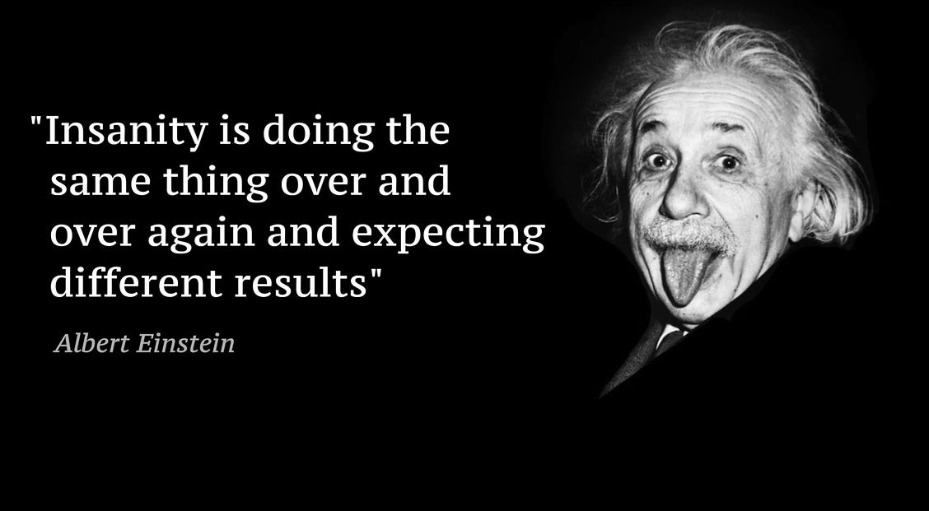
Terminology
Idempotent
no matter how many times you execute something, you always get the same result for the same input
This concept will become very important in mathematics, computer science, and especially in software engineering (i.e. API development).

Slide 37
Terminology
always getting
the same
Idempotent
- Literally everyone maintaining production software
no matter how many times you execute something, you always get the same result for the same input
This concept will become very important in mathematics, computer science, and especially in software engineering (i.e. API development).

Slide 38
Split
string.split(delimiter)
method breaks apart the string anywhere that the delimiter is present and returns the resulting substrings in a list
‘Make like a banana and split!’.split(‘banana’)
=> [‘Make like a ’, ‘ and split!’]

Slide 39
Terminology
Delimiter
A character, symbol, or substring that indicates the beginning or end of data units within a larger sequence.
Important to understand for data manipulation with formats like .csv files.

Slide 40
Join
delimiter.join(subStrings)
takes a list of substrings and glues them together using a delimiter
‘banana’.join([‘Make like a ’, ‘ and split!’])
=> ‘Make like a banana and split!’

Slide 41
Replace
string.replace(search, replacement)
replaces all instances of
<search> with <replacement>
in the original string
‘Make like a banana and split!’
.replace(’banana’, ‘pear’)
=> ‘Make like a pear and split!’

Slide 42



N O I C E job

Slide 43






Slide 44



