Slide 1
Tech Mentorship Unit 13
For Loops

Slide 2
01
Sequential Traversal
(sometimes referred to as iterating or enumerating)

Slide 3
What is Sequential Traversal?
Remember!
The order could be almost anything!
- Start to end
- End to start
When iterating or enumerating, consider:
- Every other element
- Every n^{th} element
Looking at an entire data structure in some order (or sequence).

Slide 4
02
Iterables

Slide 5
What is an iterable?
Tuple
t = (“pi”, 5, 1, 5)
Almost anything with a key-value pair.
String
str = “pi515”
List
l = [“pi”, 5, 1, 5]
Set
s = {0, 1, 2, 3, 4, 5, 6, 7, 8, 9}
Caveat!
Most iterables use indexing to define order.
Dictionary
d = dict({‘a’: 1, ‘b’: 2})

Slide 6
In what order does each traverse?
List
l = [“pi”, 5, 1, 5]
Set
s = {0, 1, 2, 3, 4, 5, 6, 7, 8, 9}
0 1 2 3
No order. Random traversal!
Tuple
t = (“pi”, 5, 1, 5)
Dictionary
d = dict({‘a’: 1, ‘b’: 2})
0 1 2 3
a b
Ordered in Python 3.7+.
Unordered in prior versions.
String
str = “pi515”
01234

Slide 7
03
For Loop Syntax

Slide 8
For Loop Syntax
for iterator_var in sequence: # do something

Slide 9
04
Core Examples

Slide 10
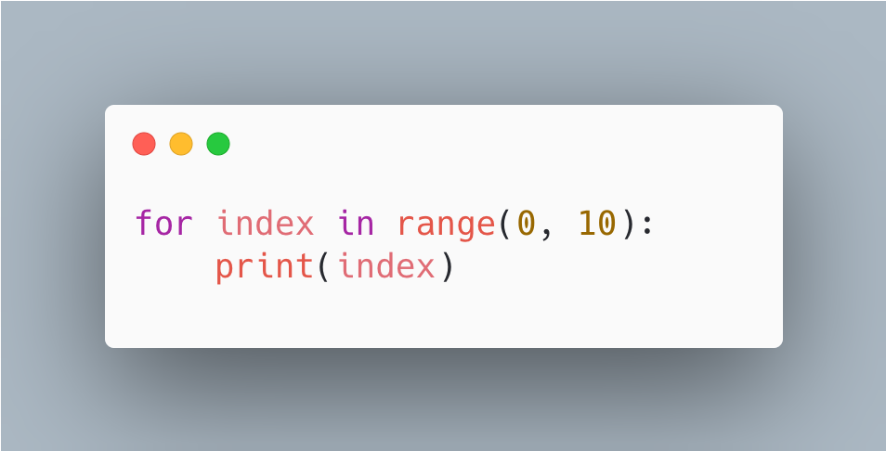
Example 1
Output
0
1
2
3
4
5
6
7
8
9

Slide 11
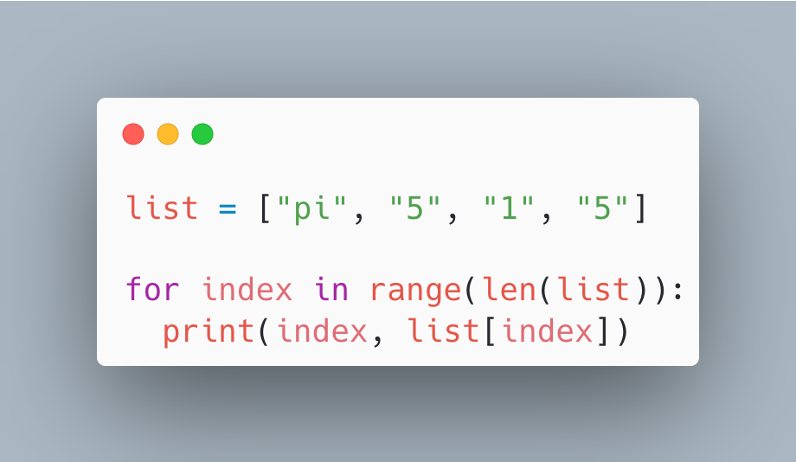
Example 2
Output
0 pi
1 5
2 1
3 5

Slide 12
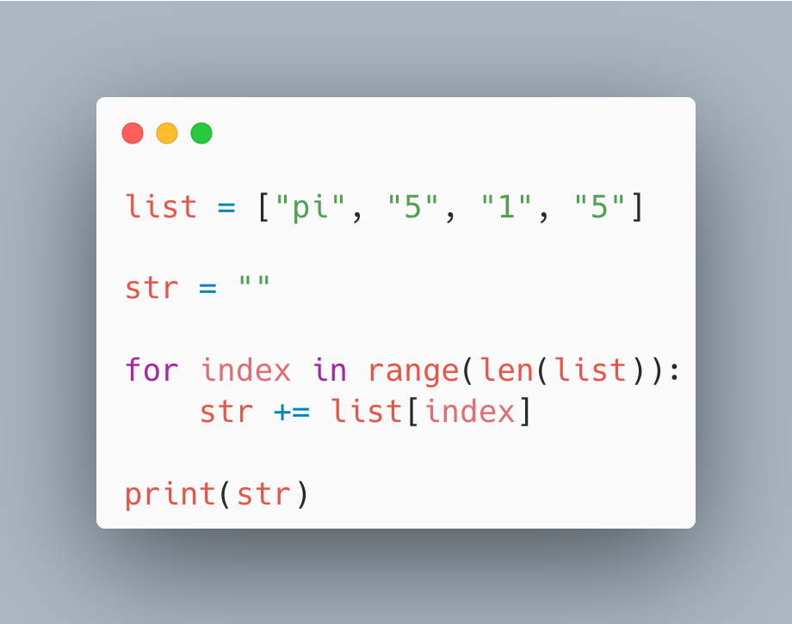
Example 3
Output
pi515

Slide 13
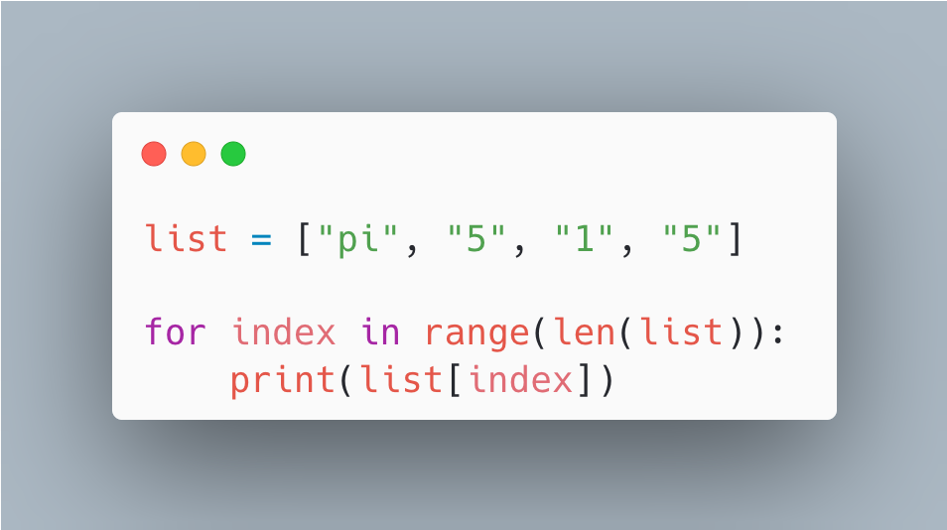
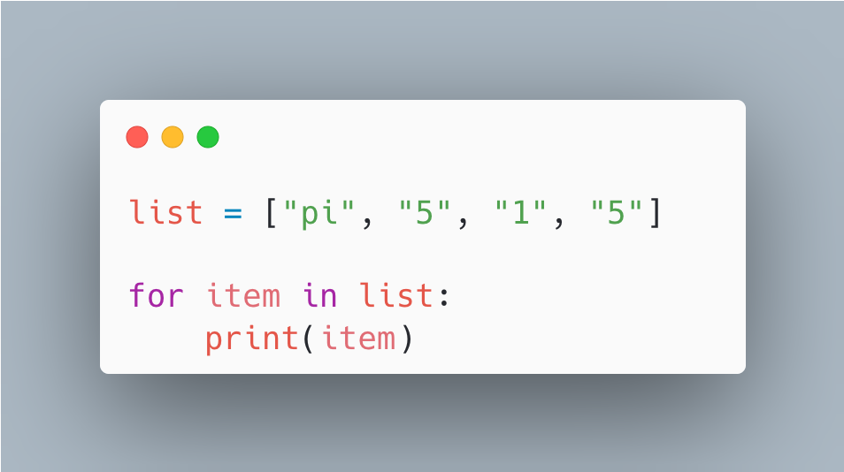
Example 4 (short hand)
Output
pi515
Output
pi515

Slide 14
05
The `continue` Statement

Slide 15
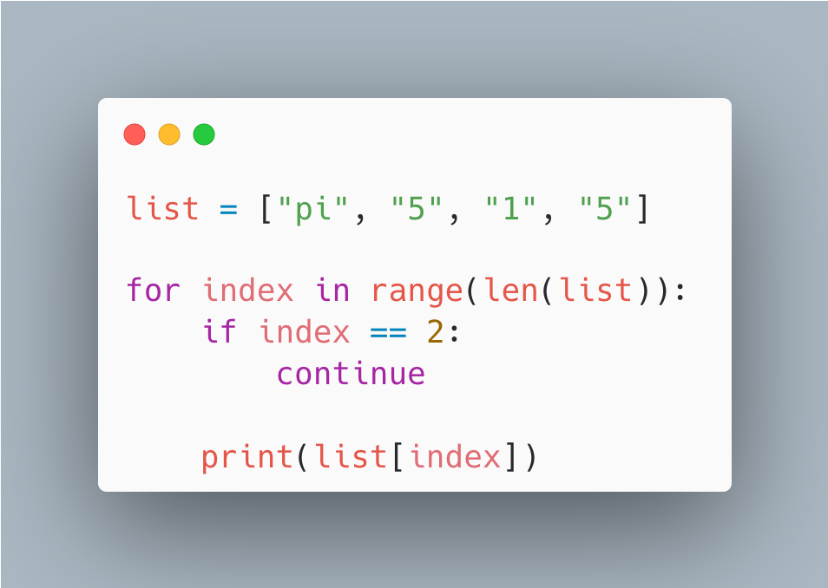
How do we skip over elements?
We use the `continue` statement!
Output
pi
5
5

Slide 16
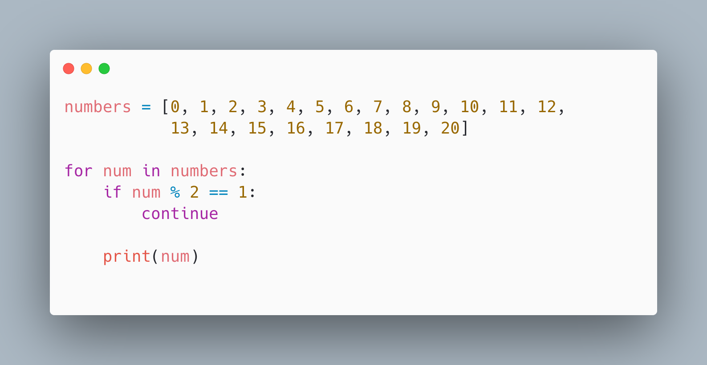
Example 5
Output
0
2
4
6
8
10
12
…

Slide 17
06
The `break` Statement

Slide 18
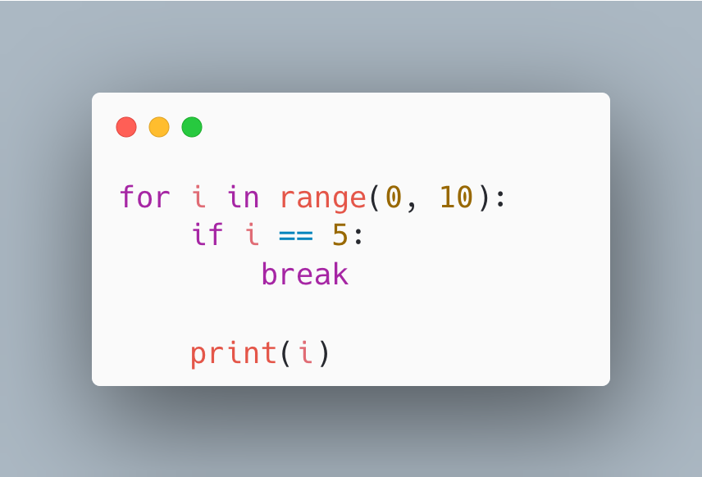
How do we stop iterating?
We use the `break` statement!
Output
0
1
2
3
4

Slide 19
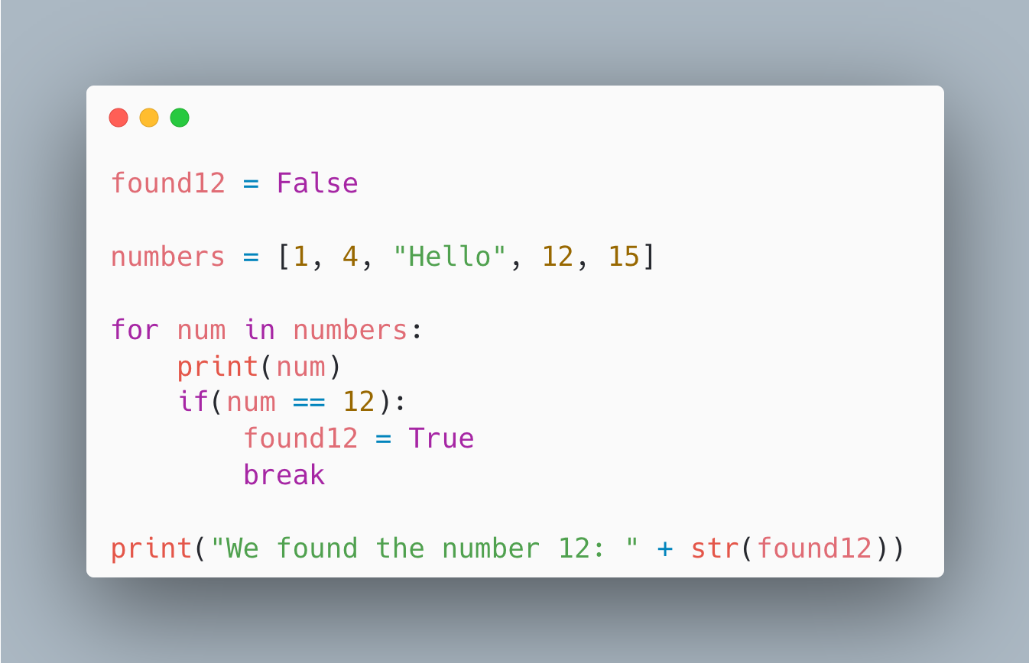
Example 6
Output
1
4
Hello
12
We found the number 12: True

Slide 20
07
Flipped Classroom: Nested For Loops

Slide 21
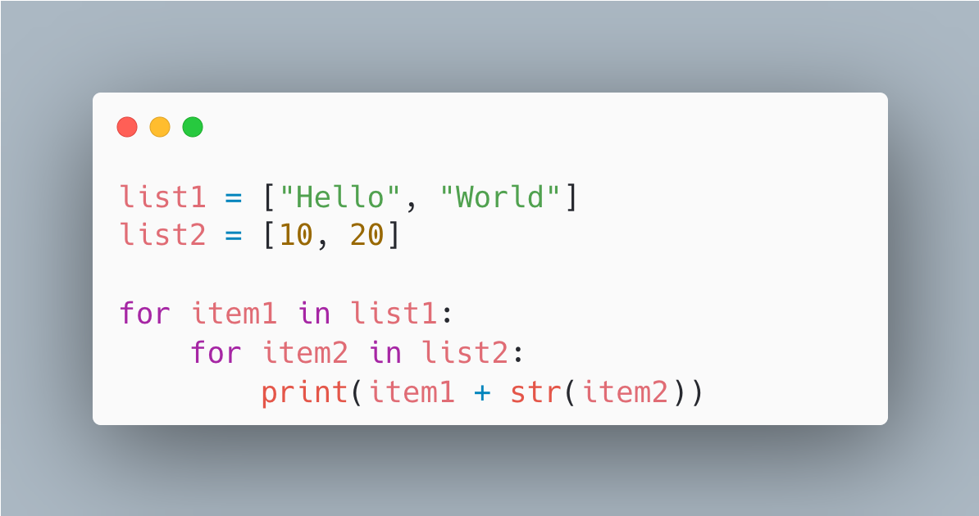
Problem 1
Task
Using two lists and a nested for loop, generate the project-environment names using the two lists.
Problem
A business analyst would like to dynamically generate
project-environment names for different projects.
Ex.
webapp-devl
webapp-qual
webapp-prod
server-devl
server-qual
server-prod
Hint
Try out this code.
The analyst would like to manage both the list of projects and environments in two lists.

Slide 22
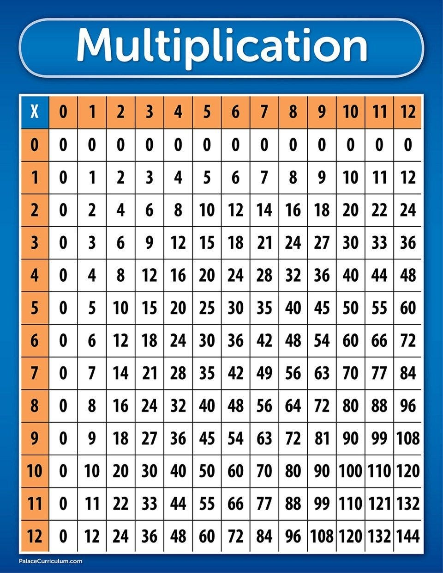
Problem 2
Problem
Your younger sibling is learning their multiplication table, however the internet is down and you can’t search for one online!
Task
Write a python program to print out a 10x10 multiplication table.
Hint
Use two ranges.

Slide 23
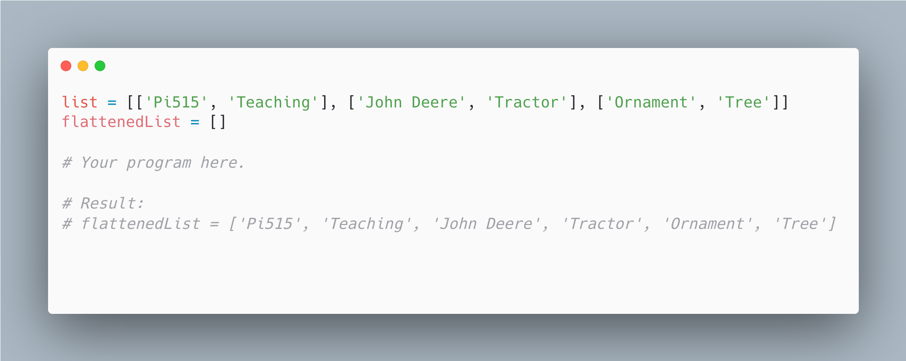
Problem 3
Task
Write a python program that takes a `list` and transforms it into the `flattenedList` shown in the code snippet below.
Problem
Oh no! You have a list made up of lists, and your engineering manager asked you to consolidate all the strings into a single list to flatten the structure.

