Slide 1

Tech Mentorship Unit 7
If-Elif-Else Statements & Scope
©Pi515

Slide 2
01
If Statements

Slide 3
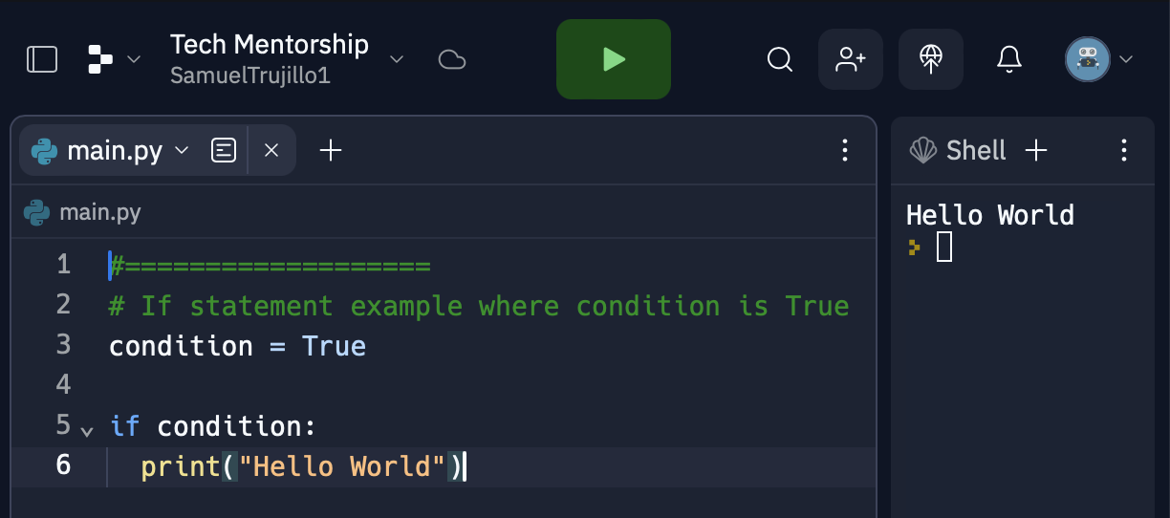
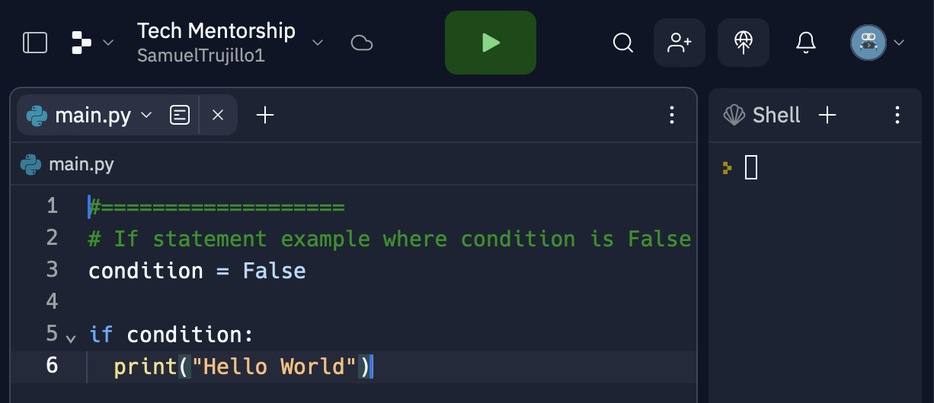
What is an If Statement
If statement is a way to make decisions in your program based on certain conditions. It allows your program to perform different actions depending on whether a specific condition is true or false.
Notes:
Ask Student to notice what is the difference between the output of both programs
Students should say how the Left program prints out “Hello World” while the Right one does not
As well make sure students notice how the “Hello World” was only outputted if the condition was True

Slide 4
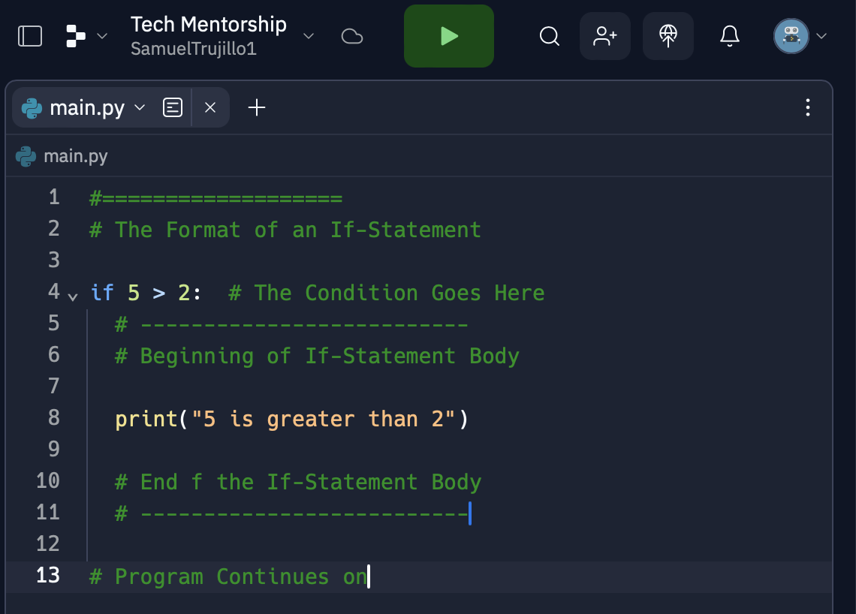
If Statement Format
There is a Condition for every If-Statement which determines whether or not the body will run
The body of the If-Statement is represented by code which is intended with the Tab key
Notes:
Make sure the students know there is a condition & body of an If-Statement that will determine how the If-Statement will run
Then Explain about how once the program is done the program will move onward

Slide 5
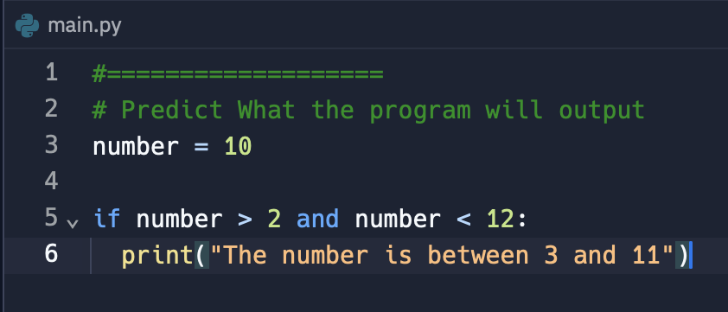
If Statement Example Pt.1
Notes:
Ask Students to predict what the program will output
Have students explain their reasoning
Ask Students if they see a relationship between If-Statements and Booleans/Comparison Operators/Logical Operators from the previous lesson111

Slide 6
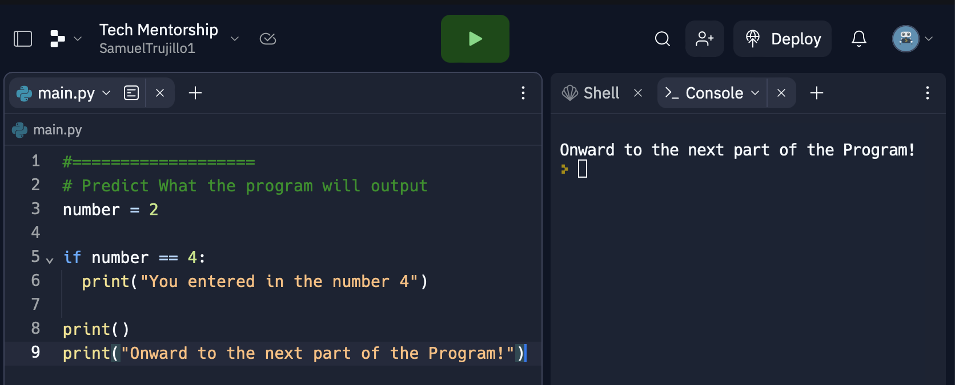
If Statement Example Pt.2
Notes:
Ask Students to predict what the program will output
Have students explain their reasoning
Ask the students to predict whether the “Onward Message” will appear even though the if statement is False
After Showing Answer students should notice that the program continues one with the code that is not in the body of the If-Statement

Slide 7
02
Else Statements

Slide 8
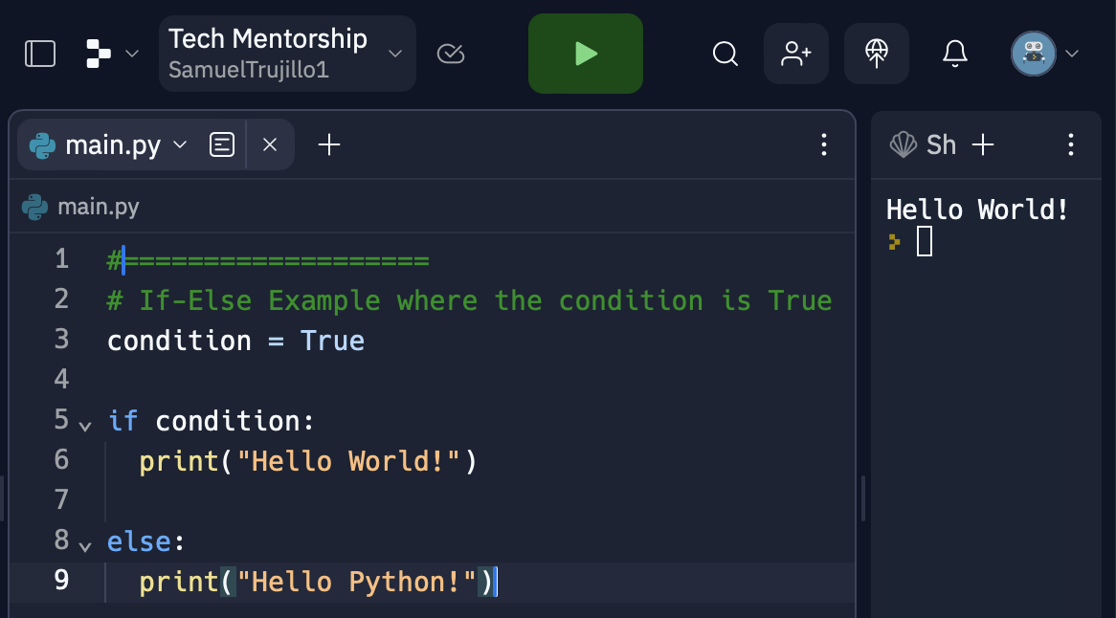
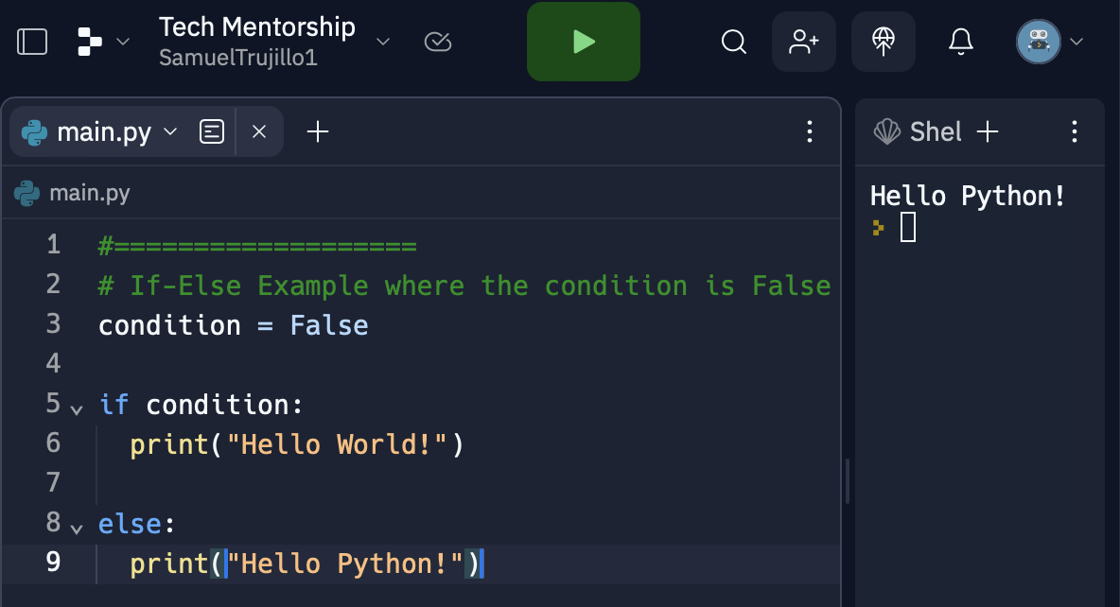
What is an Else Statement
An "else" statement is used in conjunction with an "if" statement to provide an alternative set of instructions to execute when the condition of the "if" statement is not met.
Notes:
Ask Student to notice what is the difference between the output of both programs
Students should notice how the output was different depending on if the condition was True or False

Slide 9
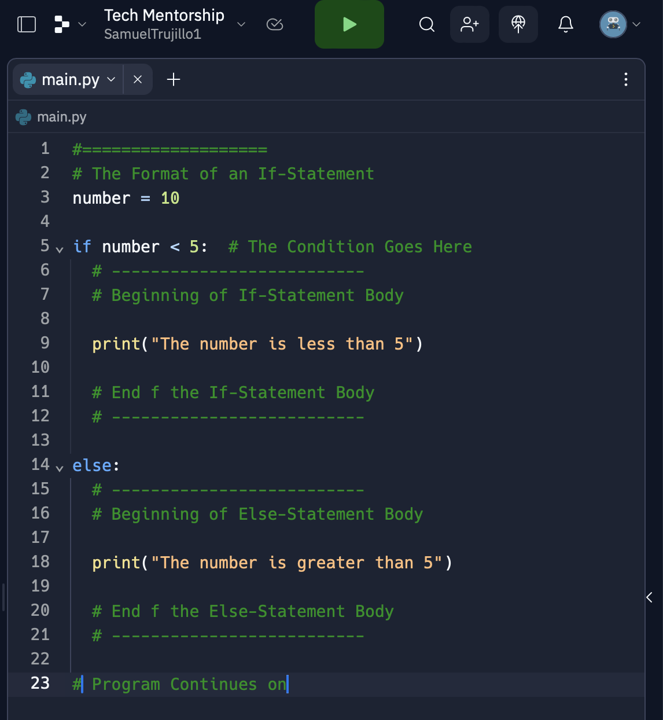
Else Statement Format
An "else" statement in Python functions similarly to an "if" statement but has its own body of code that is executed when the "if" condition is not satisfied. If the "if" condition is false, the code within the "else" block is executed.
Notes:
Make sure the students know there is a condition & body of an If-Statement that will determine how the If-Statement will run
Then Explain about how once the program is done the program will move onward

Slide 10
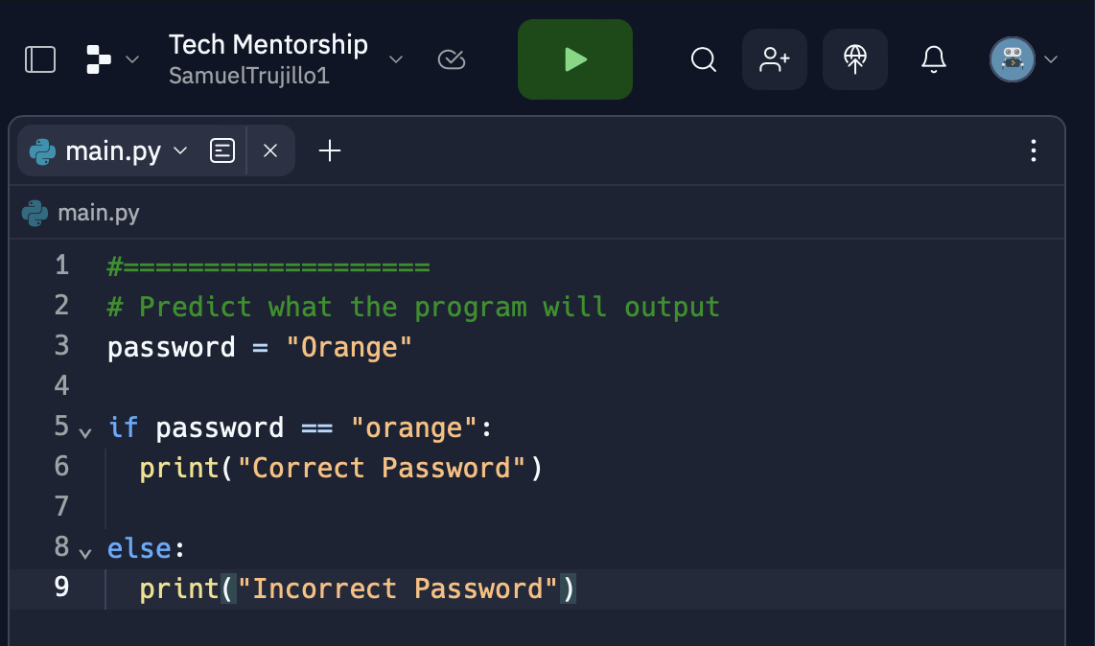
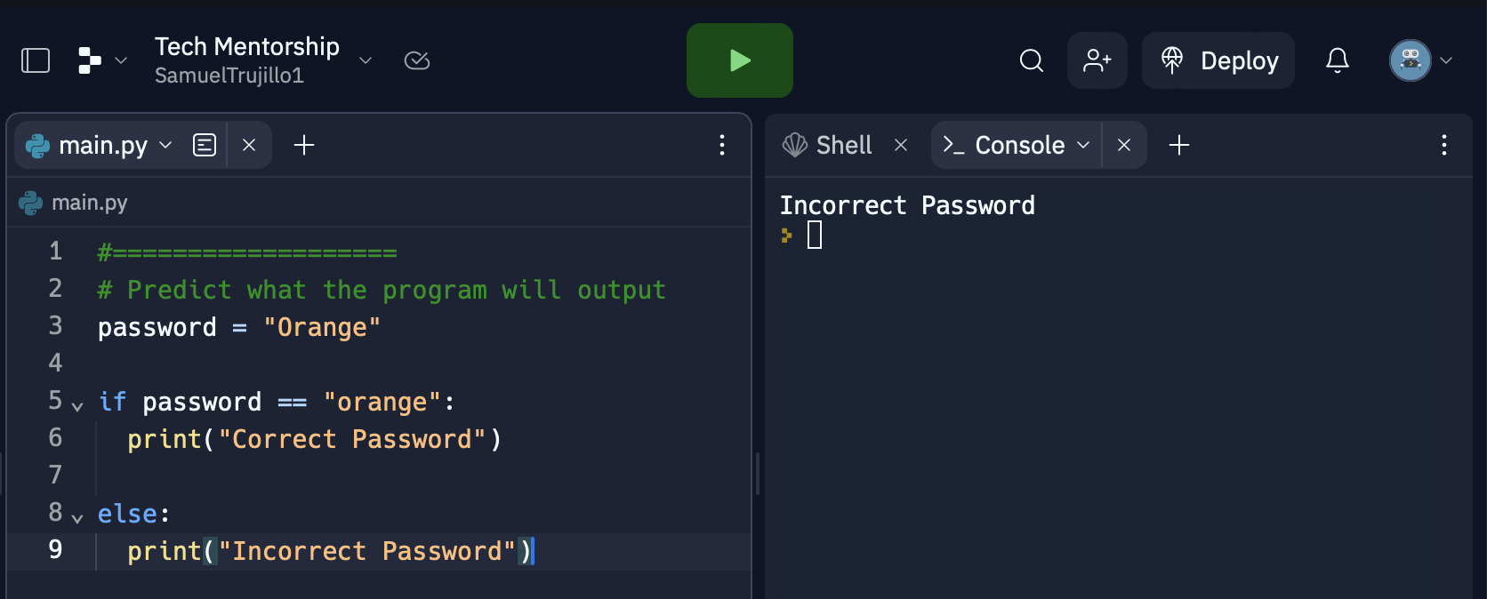
Else Statement Example Pt.1
Notes:
Before Asking students to predict
Point out to students that we are comparing Strings in our If-Else Statement
Ask students to predict what they think the program will output
Make sure students realize that the password was incorrect because in the variable password it have “Orange” with a capital O, but the correct password is “orange” with a lowercase letter and that capitalization is crucial when comparing strings

Slide 11
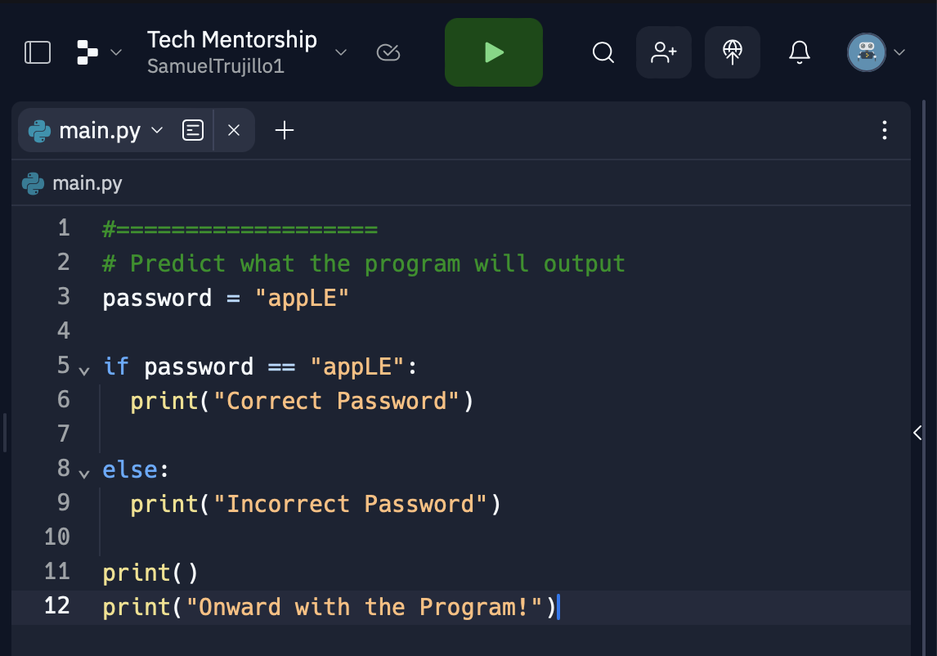
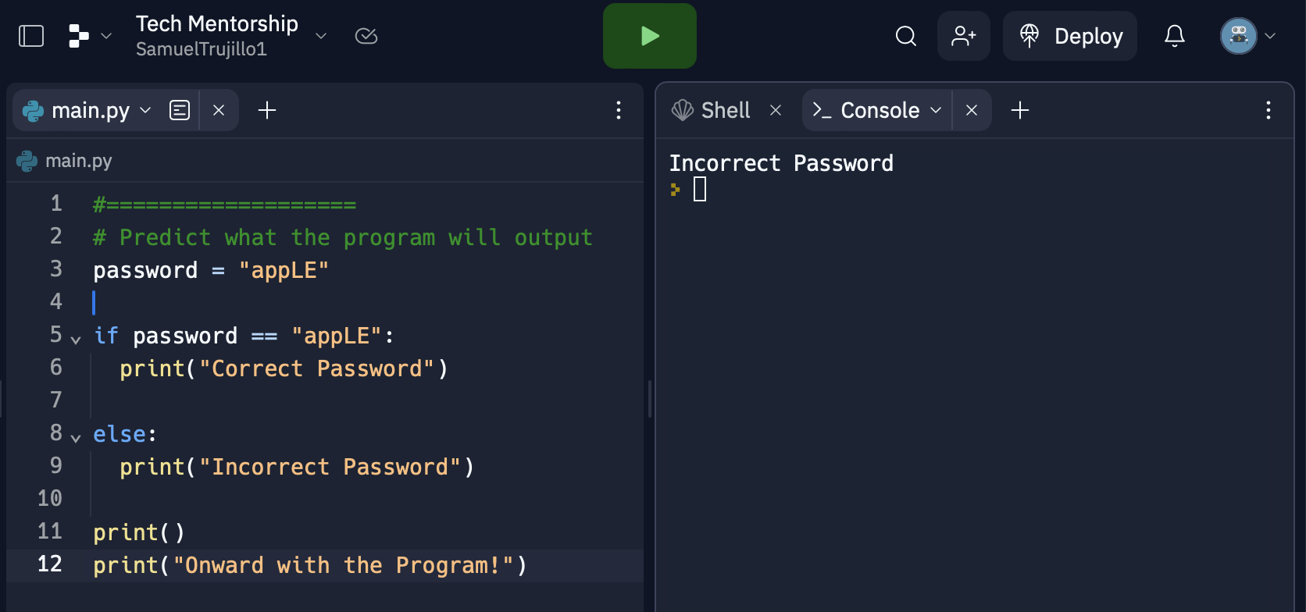
Else Statement Example Pt.2
Notes:
Ask Students to predict what the program will output
Have students explain their reasoning
Ask the students to predict whether the “Onward Message” will appear

Slide 12
03
Elif Statements

Slide 13
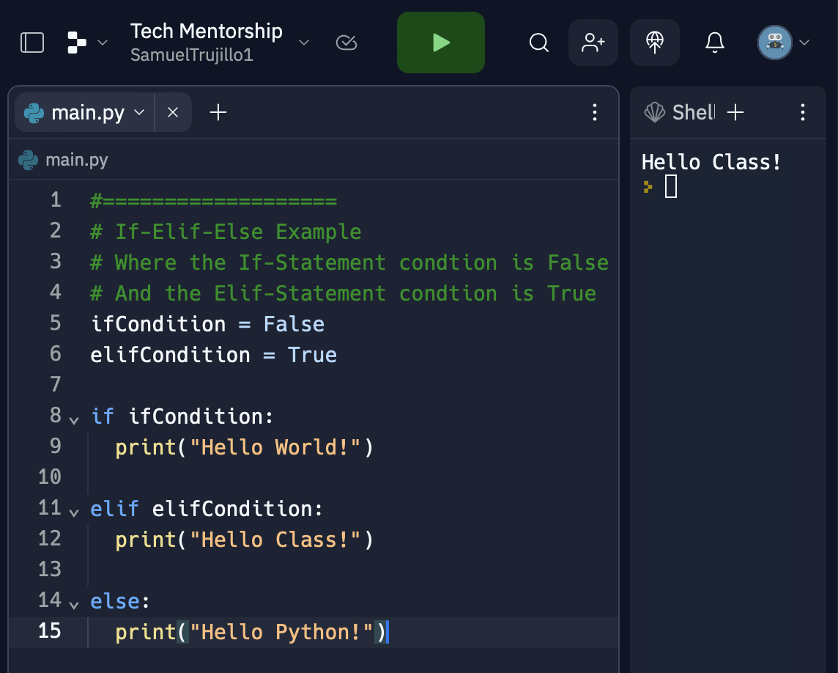
What is an Elif Statement
An "elif" statement allows us to make decisions in our code based on certain conditions. The "elif" statement comes after an "if" statement and before an optional "else" statement.
Notes:
Walk Students through the program and show them how the Elif-Statement block is run when the If-statement is False AND the Elif-Statement is True

Slide 14
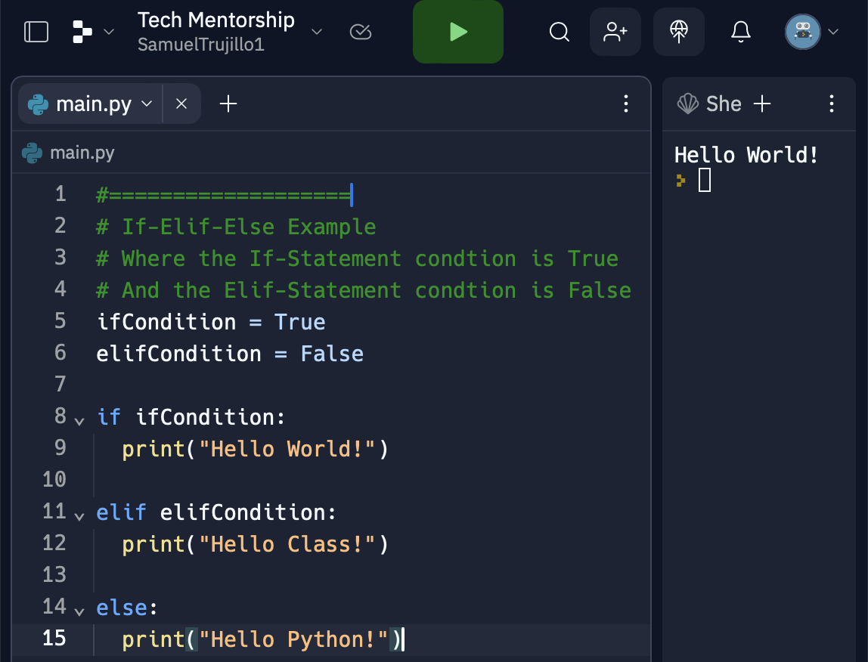
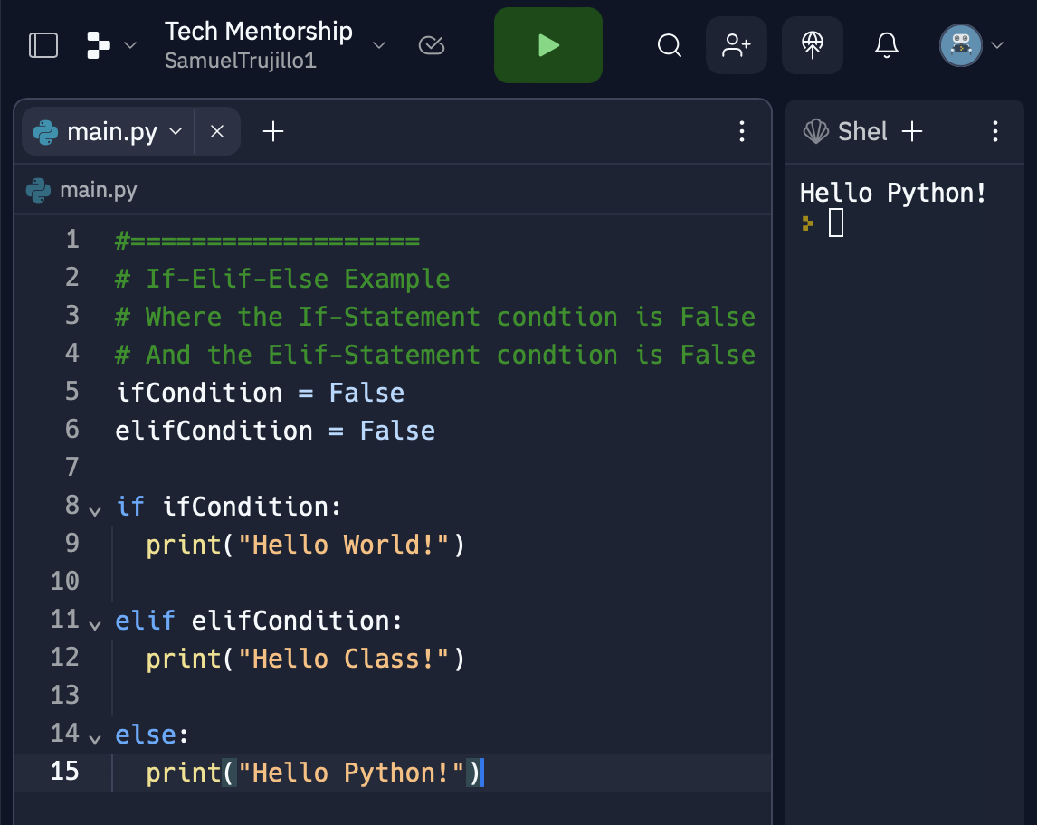
How are Elif-Statements Different
Notes:
Continue walking students through the examples from the previous slide
Make sure that students know that If-Elif-Else Statements all work together and that when one condition is False it moves down the Path

Slide 15
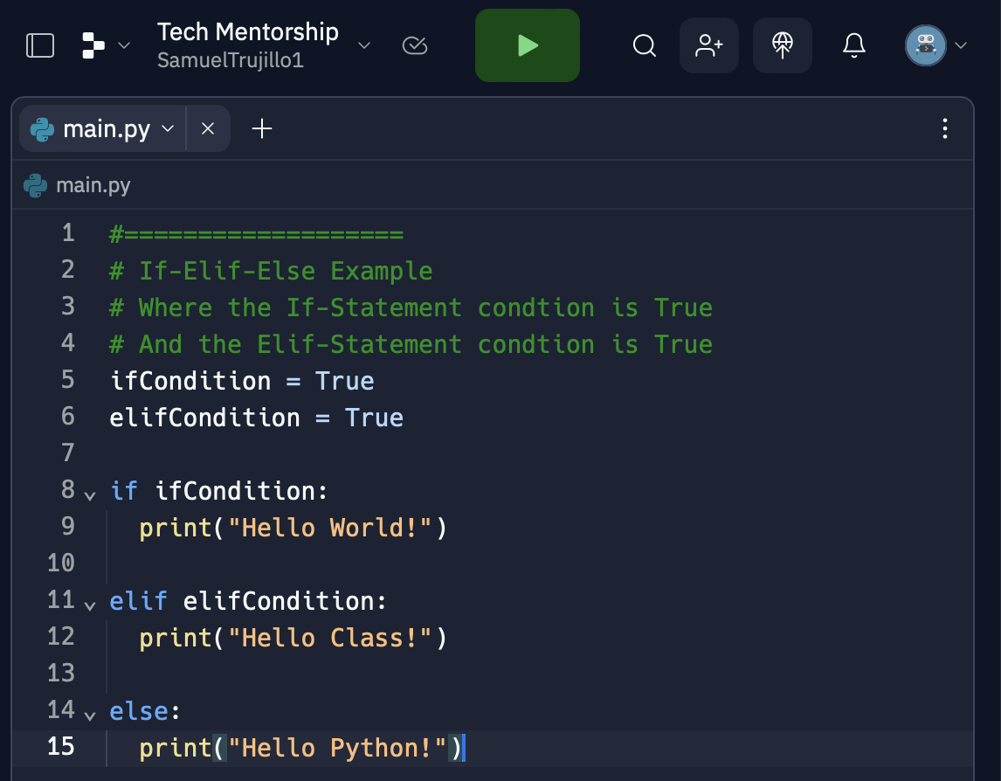
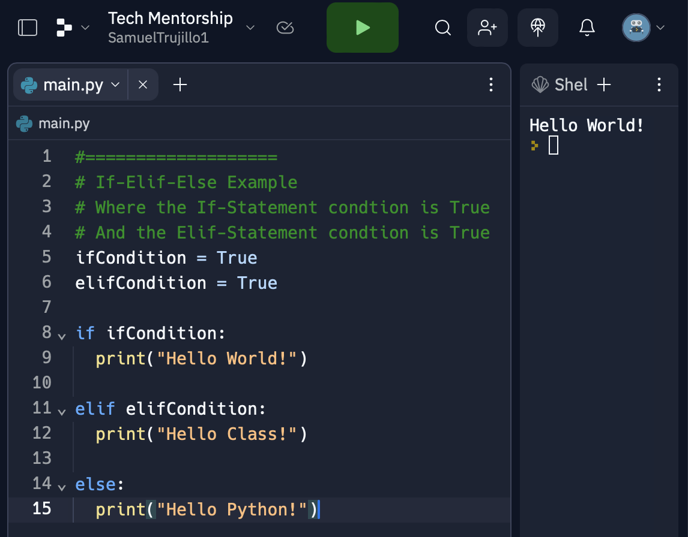
What Happens Here?
What happens when the If-Statement condition AND the Elif-Statement condition is True?
Notes:
Have students predict what the program will output
If there are stuck give them the options of: “An Error”, it will print “Hello World!”, it will print “Hello Class!”, it will print “Hello Python!”
Show students that the print “Hello World!” is outputted because it was the first in line to be True
Make Sure students have a solid understand that one output can come from every If-Elif-Else Statement
Also make sure they know that the first condition to be true is the one that is outputted

Slide 16
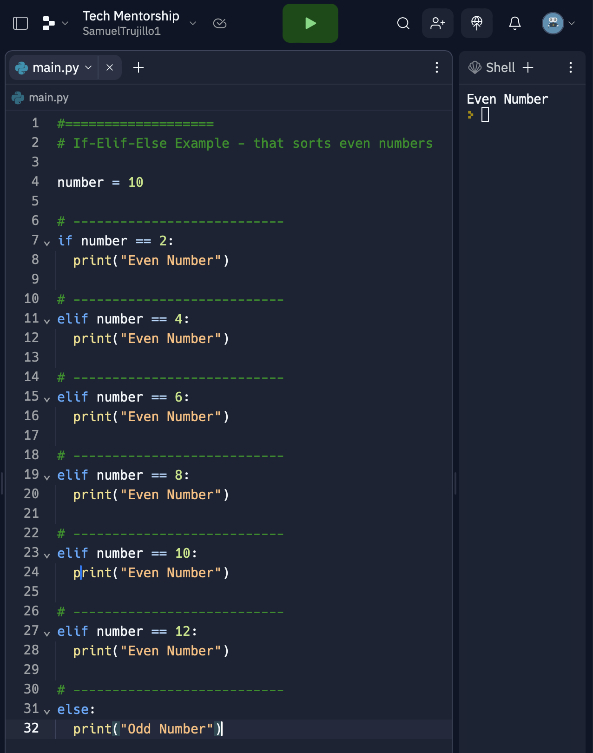
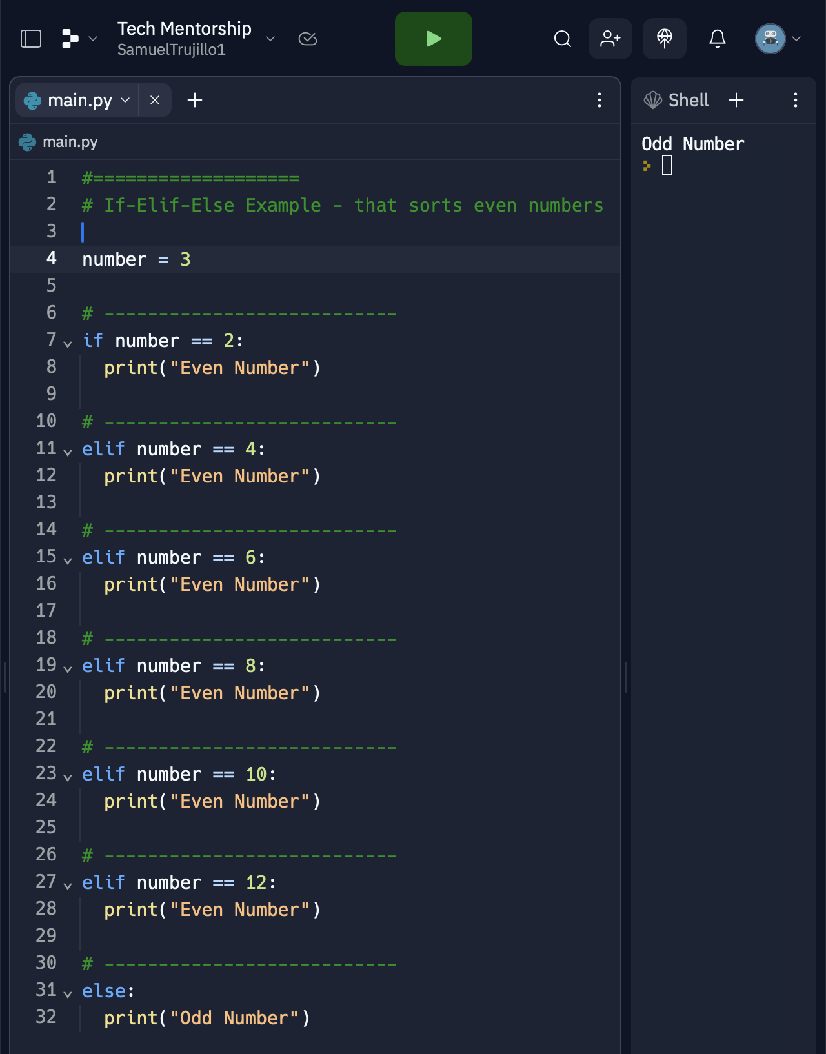
How Many Elif-Statements can I have?
Notes:
Tell Students that they can have infinite many Elif statements in their If-Elif-Else Statement
As well, show them how for both programs that there is only ever one bock within the If-Elif-Else statement is run
As well, please tell them this is a terrible way of knowing if a number is even and it's only for educational purposes

Slide 17
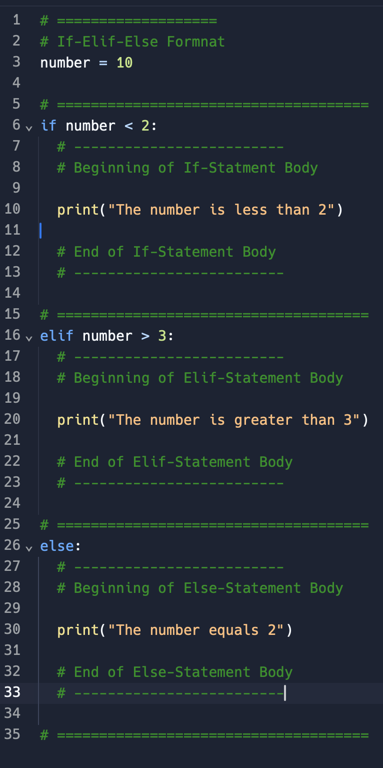
Elif Statement Format
The "elif" statement is used when we want to check multiple conditions, one after the other, in a structured way. And its purpose is to provide an alternative condition to be checked if the condition in the "if" statement is false.
Notes:
Make sure the students know there is a condition & body of an If-Statement that will determine how the If-Statement will run
Then Explain about how once the program is done the program will move onward

Slide 18
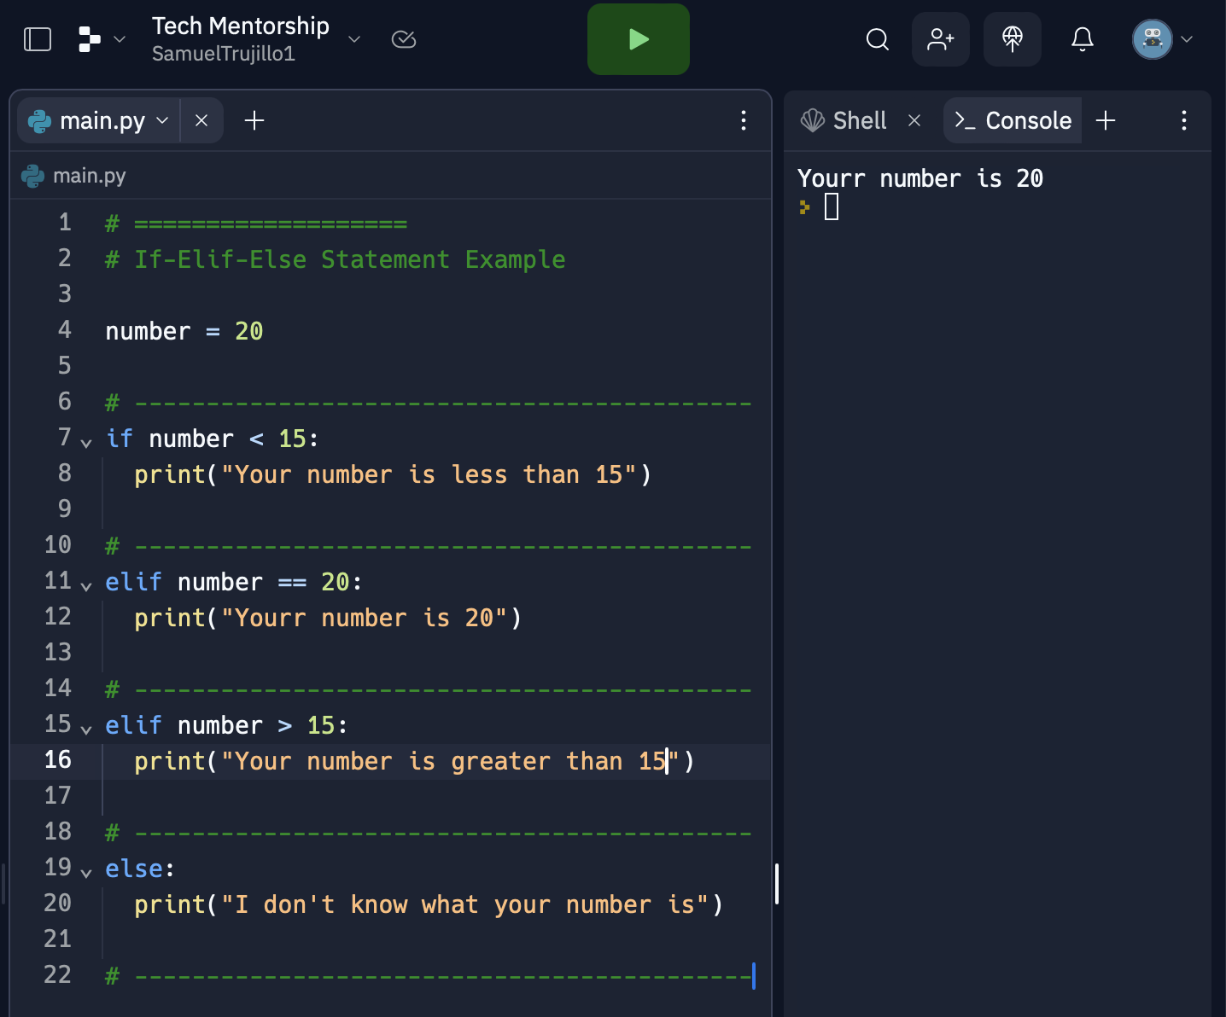
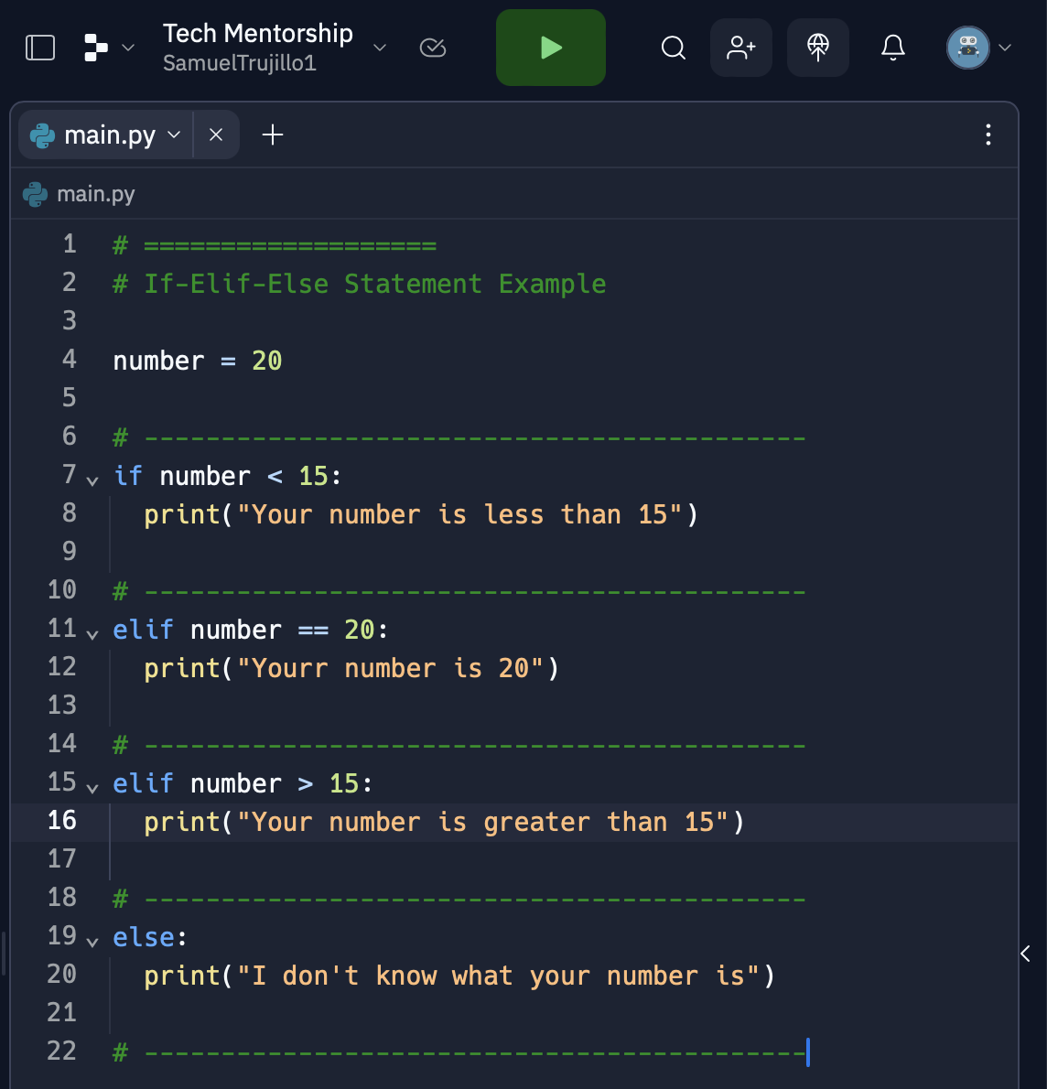
Elif Statement Example Pt.1
Notes:
Make sure they notice that there are multiple Elif-Statements
Have Students predict what the program will print out
Have students explain their reasonings

Slide 19
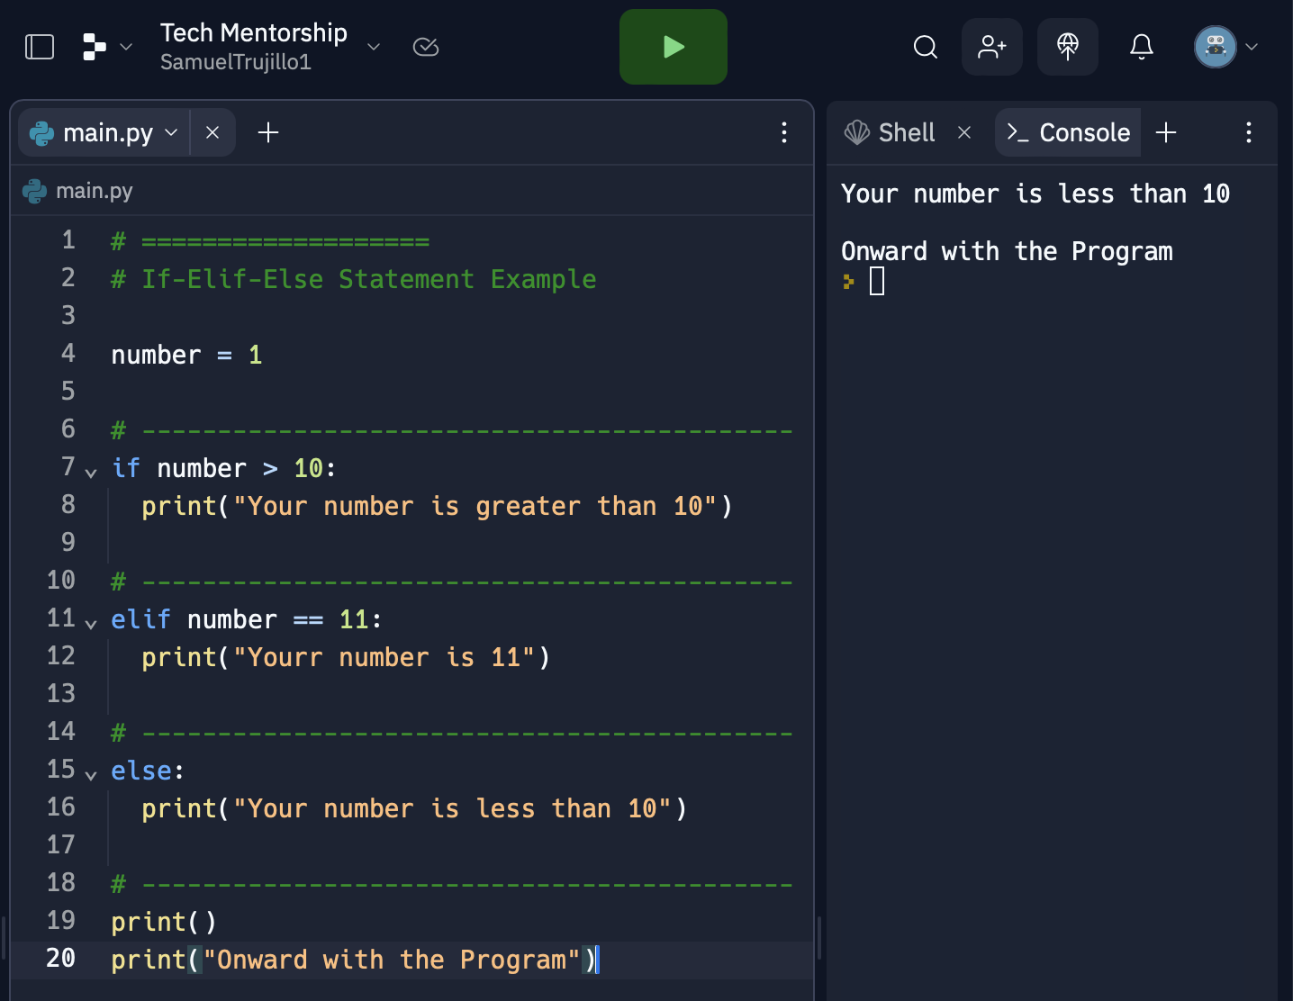
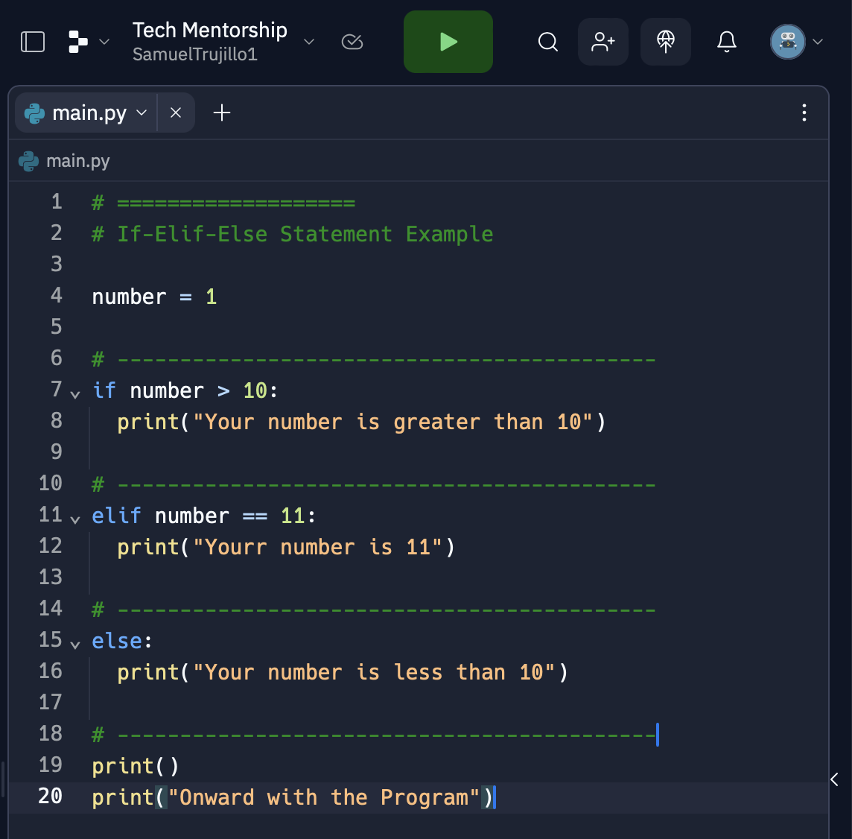
If Statement Example Pt.2
Notes:
Ask Students to predict what the program will output
Have students explain their reasoning
Ask the students to predict whether the “Onward Message” will appear

Slide 20
05
Practice & Review If-Elif-Else

Slide 21
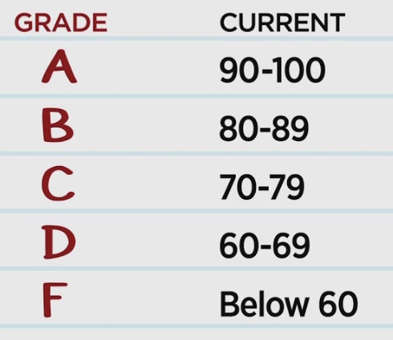
Create a Program! Pt.1
Create a program that uses If-Elif-Else statements to convert a grade percent into a letter grade and the scale is below
A: 100 - 90
B: 89 - 80
C: 79 - 70
D: 69 - 60
F: 60 and Below
Note: You can also not have a grader higher than 100 or any negative grades

Slide 22
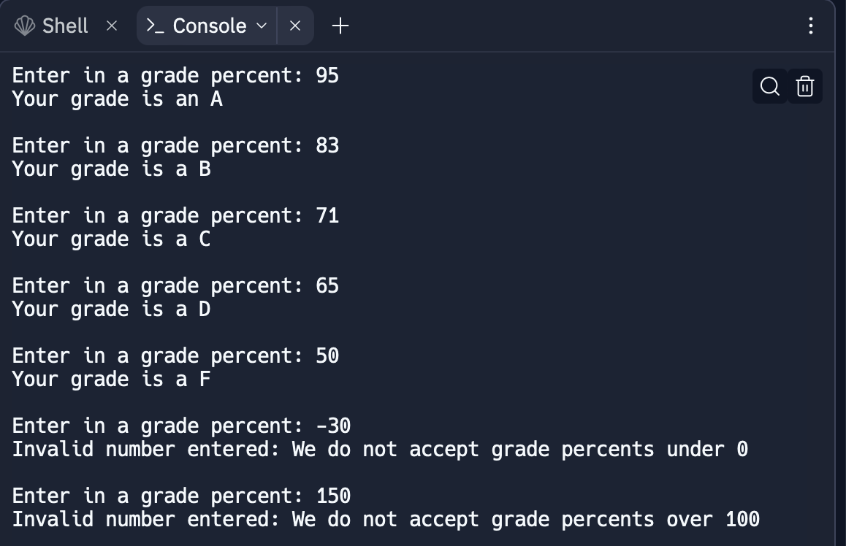
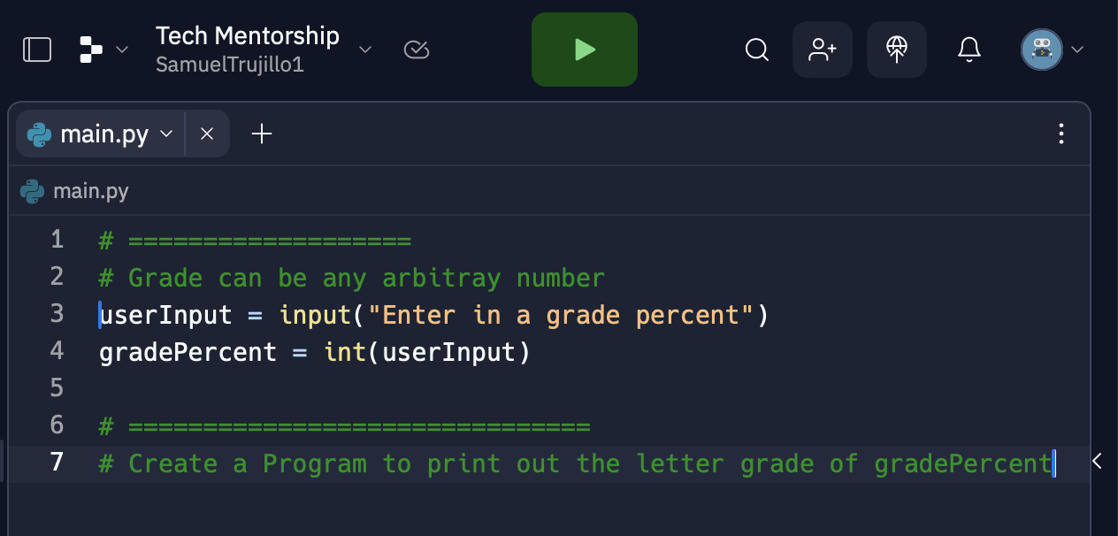
Create a Program! Pt.1
Starter Code for Replit
Here is what your end product Program should output

Slide 23
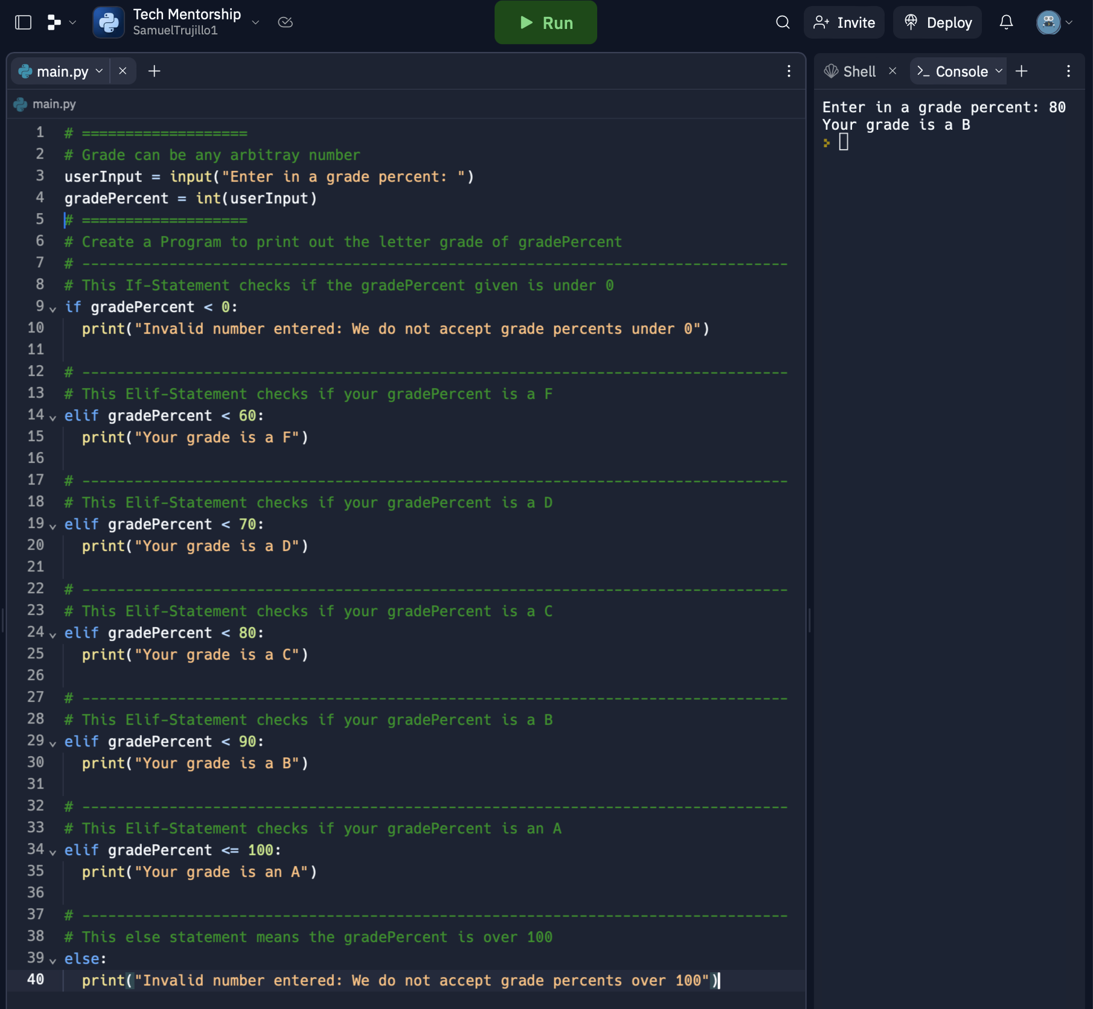
Example Answer
Note: This is not the only way to solve to solve the prompt

