Slide 1
Tech Mentorship Unit 19
Object Oriented Programming

Slide 2
01
Classes

Slide 3
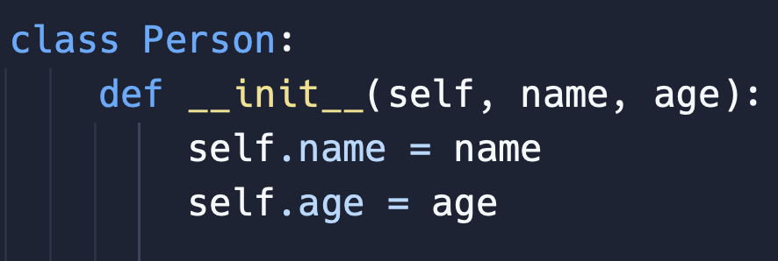
What are Classes?
A class is like a blueprint that defines the structure and behavior of objects.
Notes:
Explain to students that we are creating a class that will be a blueprint for for a Person
As well, tell the students that the name of Name of the class is “Person”
Ask students to point out what are some of Characteristics that we have for our person class
If they are stuck ask them What are in side of the parentheses of the function
They should say that we have characteristics of a Person for their Name & Age

Slide 4
Class Name
Rules
Numbers
Variables are unable to start with a number
Ex: 1option = 10
Variables should AlWAYS start with a Capital letter
Spaces
There cannot be spaces between numbers/words
Ex: option 1 = 10
Notes:
Explain to students that If a class is to start without a Capital Letter there will be no Syntax Error
However, it is commonly accepted to ALWAYS start a variable with a Capital Letter because it will let programmers know that they are working with Classes
As well, that other than the Capital First letter that Class Naming is the same as Variable naming using either Camel Casing or Snake casing

Slide 5
What are Attributes?
Attributes are variables that are associated with a class.
Notes:
Explain to students that the characteristics they just spoke about are know as Attributes
Ask students what they think the self could mean?
They are not expected to know the answer yet but have a discussion

Slide 6
What about the self?
“self” is a special variable that refers to the current instance of a class. And is a required parameter
Notes:
Explain that in other words as them name sounds self refers to in this case the Person class
Point to self.name to the students
Then tell them what is says is use the name is attached to this instance of the class which is the name given when created
As well make sure students are aware if they want to access an attribute they must self.[Attribute Name]

Slide 7

What was that Function?
Notes:
What allowed us to output “Hello World”?

Slide 8
It was a Constructor!
A constructor is a special method that is automatically called when you create an instance of a class. Its purpose is to initialize the attributes of the object and set up its initial state. the constructor method is named __init__.
Notes:
Explain to students that in other words the Constructor is what creates the Person Class

Slide 9
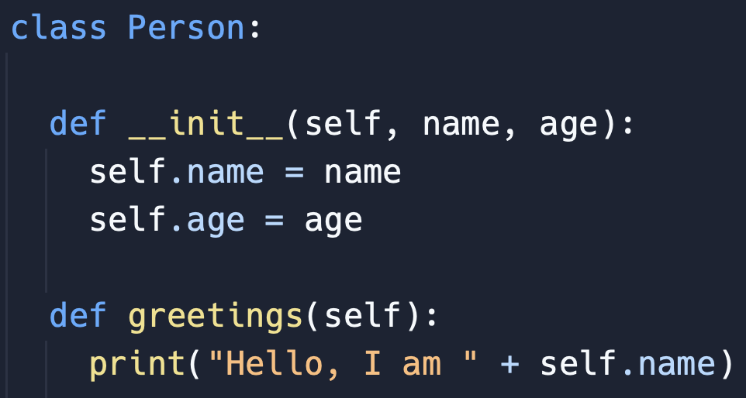
But, what is a Method?
Methods are functions that are associated with a class.
Notes:
Ask students what another word for greetings.
The goal is to guide students into saying that greeting is an ACTION which a Person can do
Then Tell students that Methods are the Actions a Person can do
While Attributes are the Characteristics a Person has

Slide 10
Let’s Practice

Slide 11
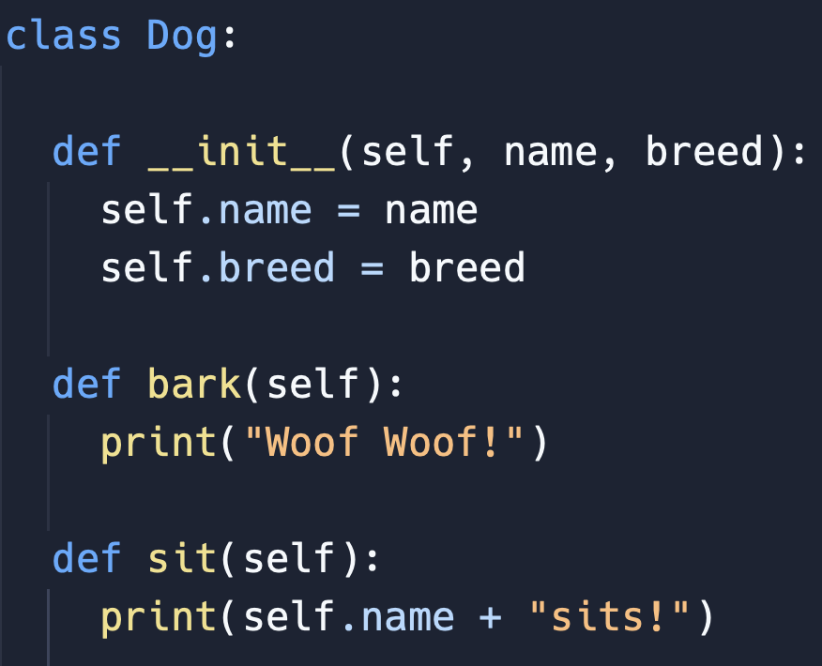
Class Constructor
Identify
The Constructor
Notes:
Ask students where the Constructor Method is
If students are stuck ask them where the __init__() Method is
Make sure they all understand that the Constructor Method is the always the method called __init__()

Slide 12
Class Attributes
Identify
The Attributes
Notes:
Ask students what the attributes are of the Dog Class
If they are stuck ask them to point out the Constructor Method
Then ask them what the parameters of the Constructor Method are
They should say: “Self”, “Name”, “Breed”
Is “Self a characteristic of a Dog?
They should say No
Then ask is “name” a characteristic of a Dog?
They should say Yes, because it describes the dog as in their name
Then ask is “breed” a characteristic of a Dog?
They should say Yes, because a breed describes a Dog
Then state to the students that we figured out that the “name” and “breed” parameters are characteristics of a dog
Then ask What is another name for a characteristic that we spoke about earlier
They should say Attributes
Then restate that “name” and breed” are the attributes of the Class Dog

Slide 13
Class Methods
Identify
The Methods
Notes:
Ask the students to identify the Methods of the Dog Class
If students are stuck ask them to work through process elimination
Is def __init__() an action a Dog can do?
They Should say no
Is def bark() an action a Dog can do?
They should say yes
Is def sit() an action a Dog can do?
They should say yes
Then repeat to students that we have figured out that “bark” and “sit” are both actions a dog can do
Then ask students what is another term for action that we have discussed about today
They should say Methods
Then tell students that the “bark” and “sit” are both methods because they are actions which a Dog can do

Slide 14
One More Practice

Slide 15
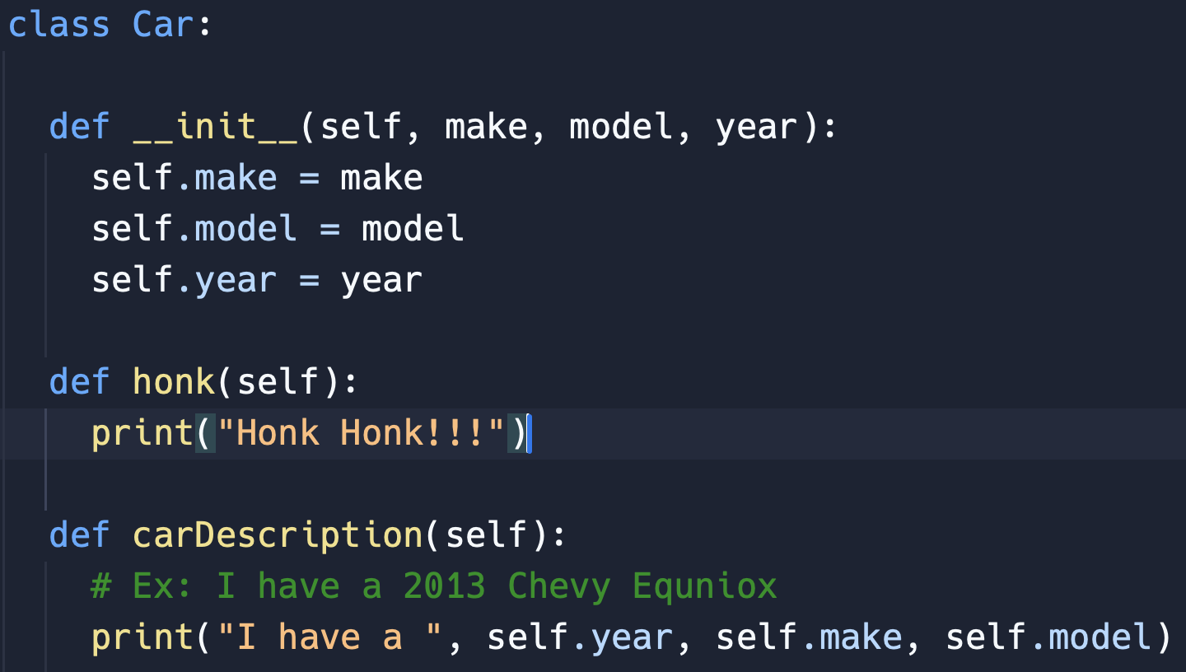
Class Constructor
Identify
The Constructor
Notes:
Ask students where the Constructor Method is
If students are stuck ask them where the __init__() Method is
Make sure they all understand that the Constructor Method is the always the method called __init__()

Slide 16
Class Attributes
Identify
The Attributes
Notes:
Ask students what the attributes are of the Dog Class
If they are stuck ask them to point out the Constructor Method
Then ask them what the parameters of the Constructor Method are
They should say: “self”, “make”, “model”, “year”
Is “self” a characteristic of a Car?
They should say No
Then ask is “make” a characteristic of a Car?
They should say Yes, because it describes the car
Then ask is “model” a characteristic of a Car?
They should say Yes, because it describes a Car
Then ask is “year” a characteristic of a Car?
They should say Yes, because it describes a Car
Then state to the students that we figured out that the “make”, “model”, and “year” parameters are characteristics of a Car
Then ask What is another name for a characteristic that we spoke about earlier
They should say Attributes
Then restate that “make”, “model”, and “breed” are the attributes of the Car Class

Slide 17
Class Methods
Identify
The Methods
Notes:
Ask the students to identify the Methods of the Car Class
If students are stuck ask them to work through process elimination
Is def __init__() an action a Car can do?
They Should say no
Is def honk() an action a Car can do?
They should say yes
Is def carDescription() an action a Car can do?
They should say yes, but if there is confusion explain to students although cars cannot talk they do all this have descriptions of themselves
Then repeat to students that we have figured out that “honk” and “carDescription” are both actions a Car can do
Then ask students what is another term for action that we have discussed about today
They should say Methods
Then tell students that the “honk” and “carDescription” are both methods because they are actions which a Dog can do

Slide 18
Class Vocabulary
1.) Classes
2.) Attributes
3.) Methods
4.) Constructor
What is each Vocab word?
Blueprint
Characteristics of a Class
Actions of a Class
Creator of a Class
Notes:
Walk through each Vocab word with the students and make sure the class has a solid understanding of what each word means

Slide 19
02
Objects

Slide 20
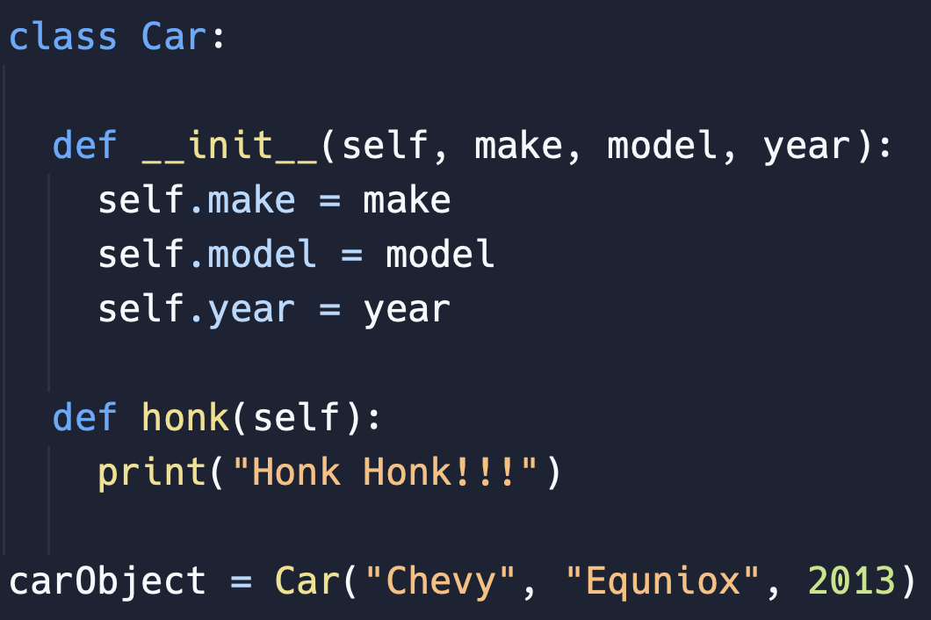
What are Objects?
Objects are class after they have been created
Notes:
Explain to students that the bottom line is an Object because it is taking the class above and turning it an “physical” object in the program

Slide 21
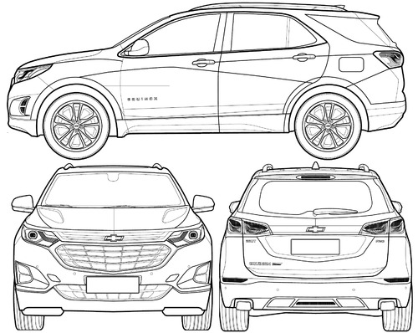
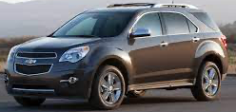
What's the Difference?
Blueprint
Actual Car
Notes:
Tell Students before we discuss the difference between Classes & Objects
Have a class discussion about what is The difference between the Blueprint of a Car on the Left versus the Actual Car on the Right
We are not look for any specific responses but just that they understand that the blueprint is how the Car is suppose to be created and the actual Car is the product of the blueprint
After they have grasped the difference between the Blueprint Car and actual Car
Ask them could the blueprint of a Car lead to the creation of a House
They should say No
Have a discuss with the class why not
Again we are not looking for a specific response but just for the class to understand the blueprint can only create the Object described on the blueprint

Slide 22
Classes Vs. Objects
Classes
Objects
Are the Blueprints
Are the creations from a class (Blueprints)

Slide 23
Objects in Python
How do I create an Object with a Class?
Notes:
Ask students what the name of class is in the code above?
They should say Car
Then tell students that last line is taking the Car class and turning it into and Object and saving it into the carObject variable
Also let them know it also known as a “Class Instance”
Ask Students if the Car(“Chevy”, “Equniox”, 2013) format looks familiar at all
They should say yes, that it looks like a Function call
Also point out to students that the parameters of the Constructor and being filled out when the Class Instance Occurs
As well, make sure students notice that we do not give an argument to the self parameter
Then tell them the format of turning an Class into an Object is the same as a Function Call

Slide 24
Let’s Practice

Slide 25
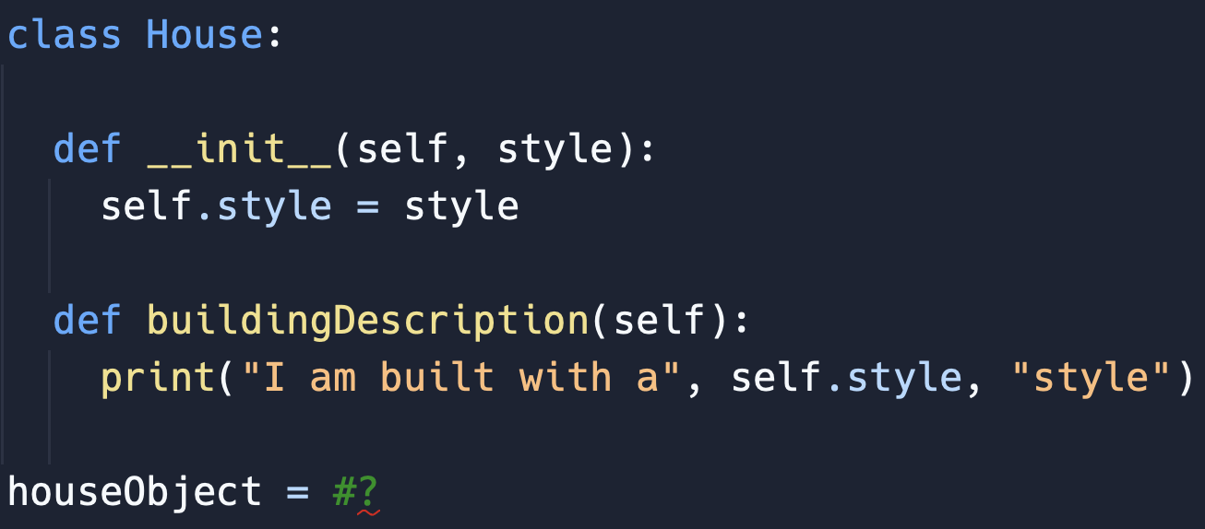
Fill in the Blank
How do I initialize the Class?
Notes:
Ask students what should go into the blank spot at the bottom of the code so I can turn my Class into an Object
If they are stuck as them what is the name of the class
They should say “House”
Then Ask what the parameters of the Constructor are
They should say “self”, and “style”
Then Ask do we give an argument to the “self” parameter?
They should say no, because it is NOT an Attribute of the Class
Then Ask do we give an argument to the “style” parameter?
They should say yes, because it is an Attribute of the Class
Now state to the students that we know the name of Class is “House” and the Parameters which need Arguments is “style”
Then Ask students how do you make a Function Call
Lead them to saying we need the name of the function
Then parentheses
Followed by the arguments
Then tell the students to switch function name to the class name and that is Class Instance
Then show them the answer is House(“Medival”)

Slide 26
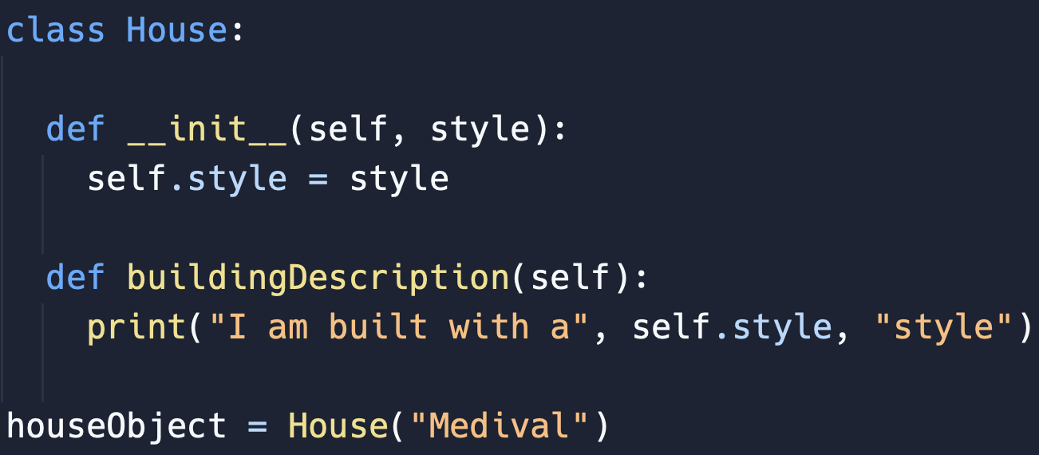
Fill in the Blank: Answer
Notes:
Point out the students that they figured out the Class Instance Call
As well make sure students are aware that the arguments could have been different, but for this example that is what they were chosen as
Have a discussion with the class about any confusion

Slide 27
One More Practice

Slide 28
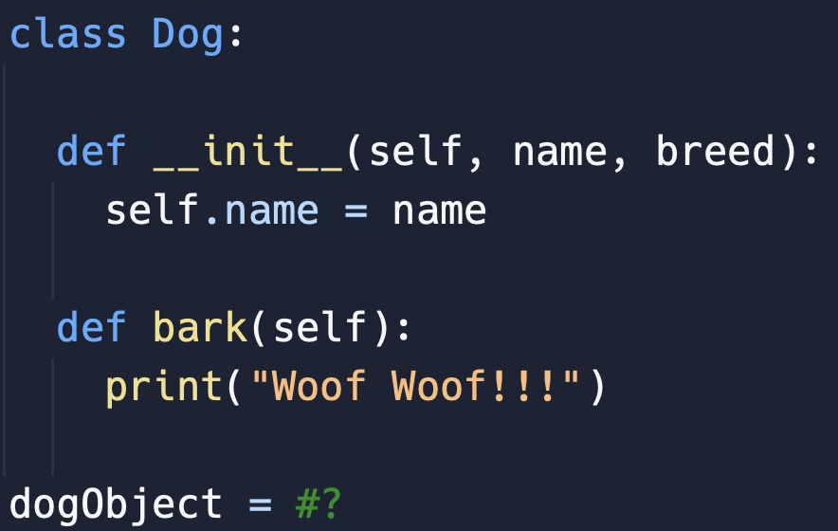
Fill in the Blank
How do I initialize the Class?
Notes:
Ask students what should go into the blank spot at the bottom of the code so I can turn my Class into an Object
If they are stuck as them what is the name of the class
They should say “Dog”
Then Ask what the parameters of the Constructor are
They should say “self”, “name”, and “breed”
Then Ask do we give an argument to the “self” parameter?
They should say no, because it is NOT an Attribute of the Class
Then Ask do we give an argument to the “name” parameter?
They should say yes, because it is an Attribute of the Class
Then Ask do we give an argument to the “breed” parameter?
They should say yes, because it is an Attribute of the Class
Now state to the students that we know the name of Class is “House” and the Parameters which need Arguments “name”, and “breed”
Then Ask students how do you make a Function Call
Lead them to saying we need the name of the function
Then parentheses
Followed by the arguments
Then tell the students to switch function name to the class name and that is Class Instance
Then show them the answer is House(“Medieval”)

Slide 29
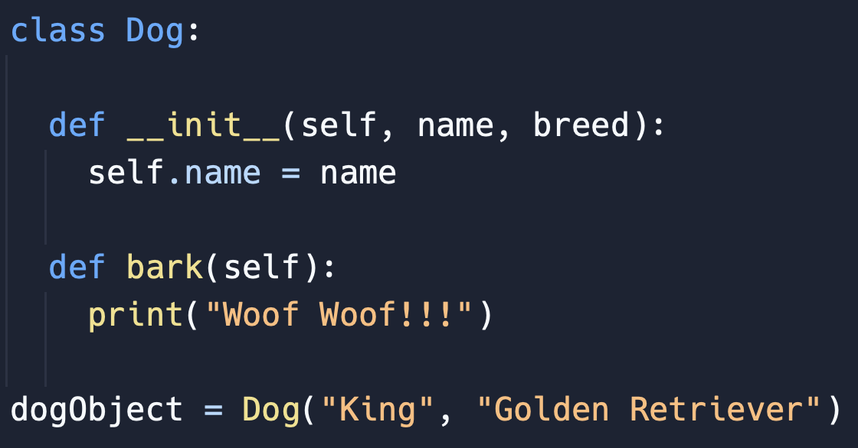
Fill in the Blank: Answer
Notes:
Point out the students that they figured out the Class Instance Call
As well make sure students are aware that the arguments could have been different, but for this example that is what they were chosen as
Have a discussion with the class about any confusion

Slide 30
Class Instance Review
To Initialize a class you need the Class Name followed by parentheses and in the parentheses to need the necessary Arguments
Notes:
Explain to students that the bottom line is an Object because it is taking the class above and turning it an “physical” object in the program

Slide 31
03
Objects Acessing Methods

Slide 32
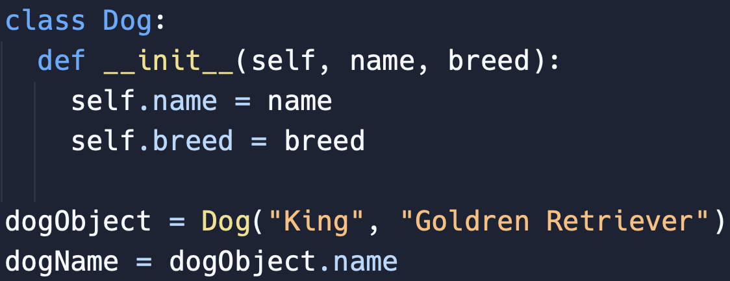
Objects using Class Methods
The Object does have access to the Objects respective Class Attributes
Notes:
Explain to students that once you have created an Object from the instance of a Class you can access the Class Attributes using the variable the object is saved to
Then point to the bottom line of the code and tell them that you use the Object Variable name put a period “.” then the name of the attribute

Slide 33
Let’s Practice

Slide 34
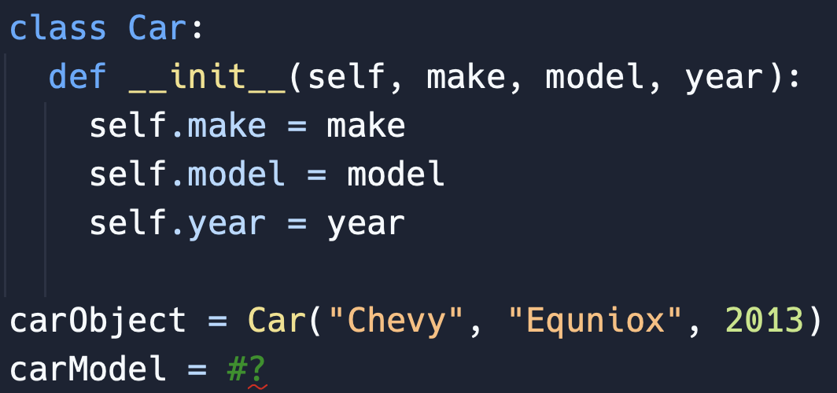
Method Access
How do I access the model Attribute?
Notes:
USE WHITEBOARD TO KEEP TRACK OF INFORMATION WITH STUDENTS
Ask the students to figure out how to access the model attribute
If students are stuck ask them what is the name of the variable that hold the car Object
They should say the carObject variable hold the instance of the Car Class
Then ask the students what is the name of the attribute we want to access
They should say model
Then ask students what symbol goes in between the the carObject Variable and the model attribute, from the pervious slide
If they are stuck tell them it is the period symbol “.”
Now tell them to put that all together to get the answer
carObject.model is how we can access the model attribute

Slide 35
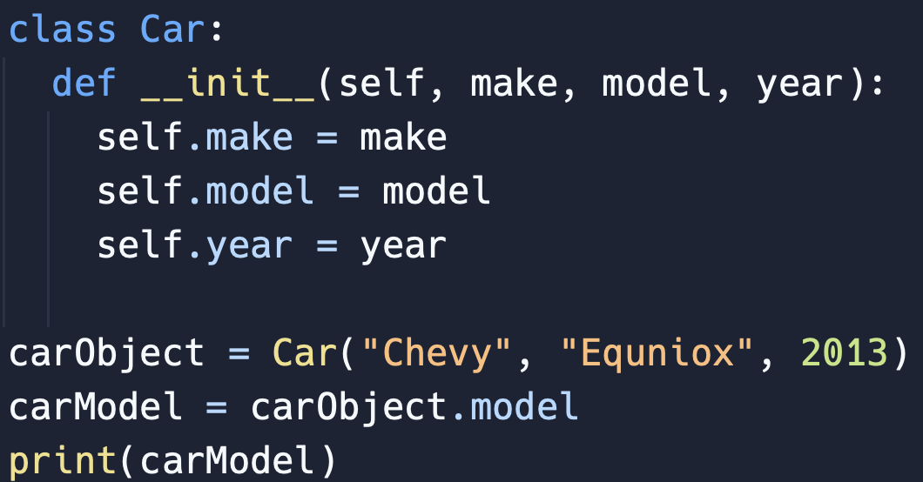
Method Access: Answer
Predict Output
Notes:
Have students predict what the carModel variable will print out
They should say “Equniox”

Slide 36
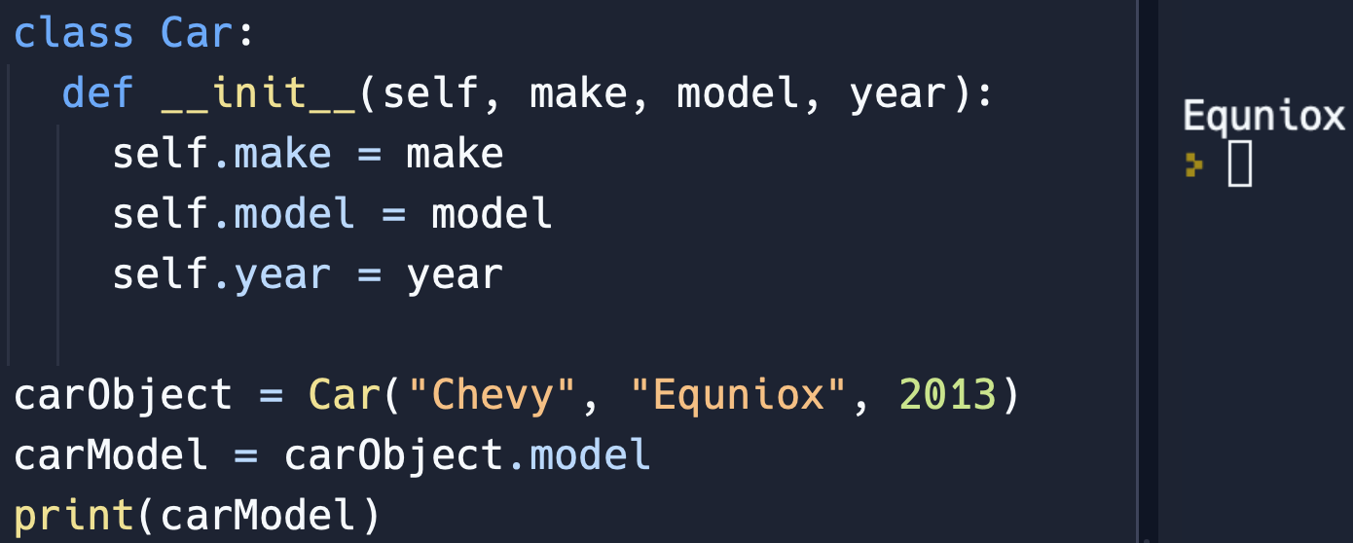
Output: Answer
Notes:
Have a discussion with the class about any confusions they may have

Slide 37
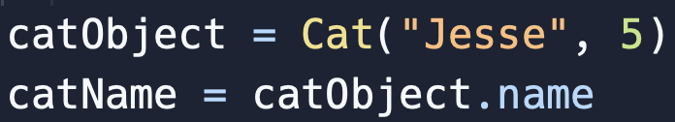
Object Method Access Review
To access a class Attribute of an object saved in a variable, you use the object variable name, followed by a period (.), and then the name of the class Attribute.
Notes:
Explain to students that the bottom line is an Object because it is taking the class above and turning it an “physical” object in the program

Slide 38
04
Objects Acessing Methods

Slide 39
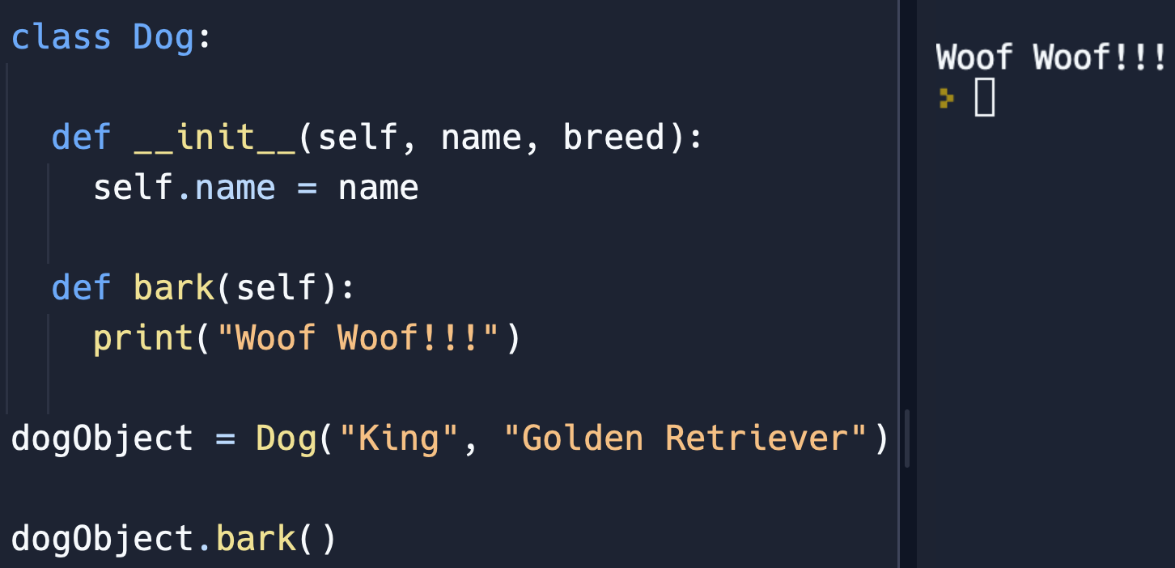
Objects using Class Methods
The Object does have access to the Objects respective Class Methods
Notes:
Explain to students that once you have created an Object from the instance of a Class you can access the Class Methods using the variable the object is saved to
Then point to the bottom line of the code and tell them that you use the Object Variable name put a period “.” then the name of the method

Slide 40
Let’s Practice

Slide 41
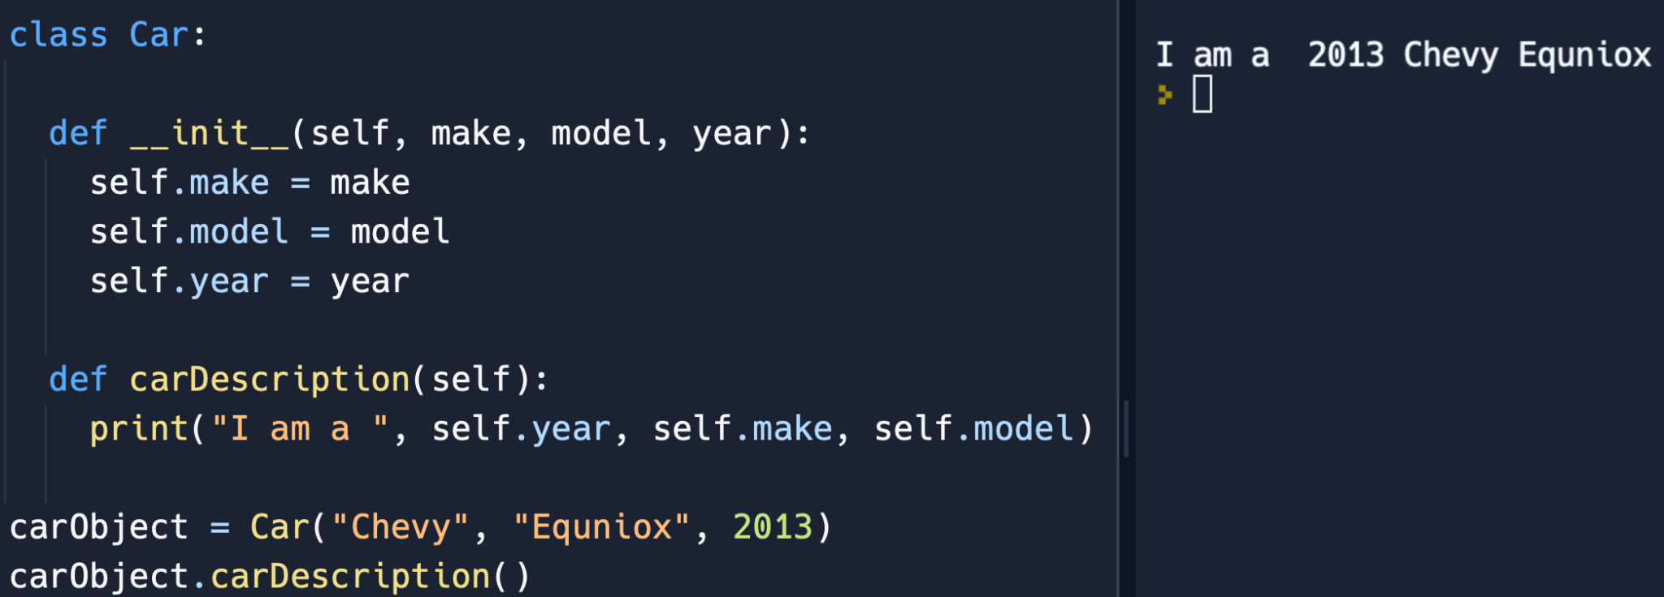
Method Access
How do I use the carDescription Method?
Notes:
Ask the students to figure out how to access the carDescription Method by using the carObject variable which has a Car Class instance saved in it
If students are stuck ask them what is the name of the variable with the Object saved into it
They should say carObject
Then ask what comes after carObject
They should say a period “.”
If they don’t tell them to use a period “.”
Then ask students what comes after the period
They should say the Method
If they don’t skip this questions and ask the next one
What is the name of the method we are trying to use
They should say the carDescription Method
Tell the class that is what comes after the period the name of the Method we want to use
Then ask what comes after the method name
They should say parentheses “( ) “
If they don’t tell them to use parentheses
Then ask the students what the parameters of carDescription are
They should say self
Then ask the class does do we give the self parameter an argument?
They should say no
Then tell the class then there are no parameters which need arguments for the carDescription Method
Then tell the class to add the information together to create
carObject.carDescription()
Then move to the next slide

Slide 42
Method Access: Answer
Predict Output
Notes:
Have a discussion with the class if there is any confusion on how we accessed the carDescrption Method
After ask the class to predict the output of the program
If students are stuck ask them to look at the carDescription Method
Ask the students what is in the body of the print statement
They should say a print statement
After that ask them what Attributes are being used in the print statement
They should say year, make, and model
Then ask students what the year attribute equal?
If they are confused ask them to look at the Car Instance and what argument is filled in for the year parameter
They should say 2013
Then ask students what the make attribute equal?
If they are confused ask them to look at the Car Instance and what argument is filled in for the make parameter
They should say “Equniox”
Then ask students what the model attribute equal?
If they are confused ask them to look at the Car Instance and what argument is filled in for the model parameter
They should say “Chevy”
Then tell students to put all together in the print statement
Have them fill in self.year, self.make, and self.model with the arguments just spoken about
Then show the answer on the next slide

Slide 43
Output: Answer
Notes:
Have a discussion with the class about any confusions they may have

Slide 44
One More Practice

Slide 45
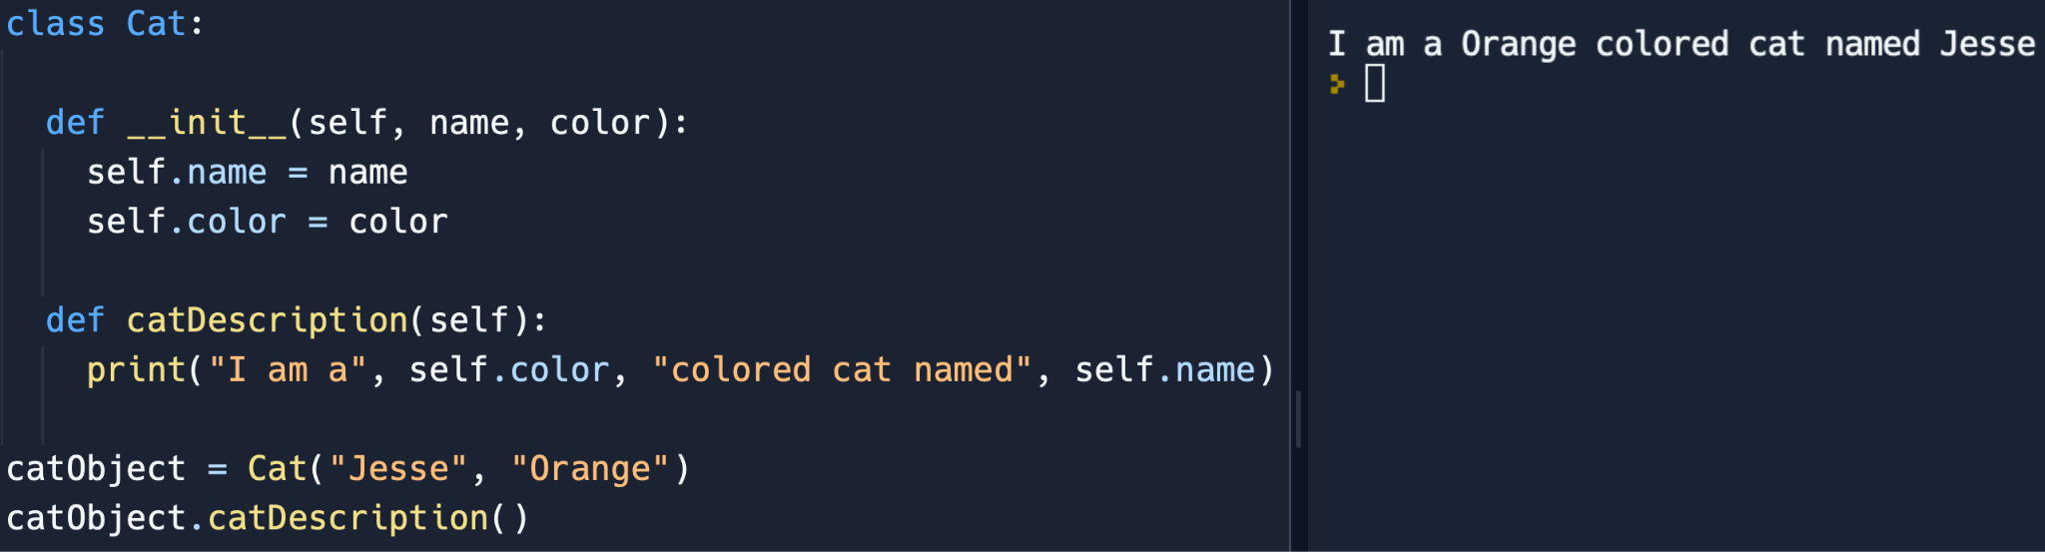
Method Access
How do I use the catDescription Method?
Notes:
Ask the students to figure out how to access the catDescription Method by using the catObject variable which has a Cat Class instance saved in it
If students are stuck ask them what is the name of the variable with the Object saved into it
They should say catObject
Then ask what comes after catObject
They should say a period “.”
If they don’t tell them to use a period “.”
Then ask students what comes after the period
They should say the Method
If they don’t skip this questions and ask the next one
What is the name of the method we are trying to use
They should say the catDescription Method
Tell the class that is what comes after the period the name of the Method we want to use
Then ask what comes after the method name
They should say parentheses “( ) “
If they don’t tell them to use parentheses
Then ask the students what the parameters of catDescription are
They should say “self”
Then ask the class does do we give the “self” parameter an argument?
They should say no
Then tell the class then there are no parameters which need arguments for the carDescription Method
Then tell the class to add the information together to create
catObject.catDescription()
Then move to the next slide

Slide 46
Method Access: Answer
Predict Output
Notes:
Have a discussion with the class if there is any confusion on how we accessed the catDescrption Method
After ask the class to predict the output of the program
If students are stuck ask them to look at the catDescription Method
Ask the students what is in the body of the print statement
They should say a print statement
After that ask them what Attributes are being used in the print statement
They should say self.color and self.name
Then ask students what the year attribute equal?
If they are confused ask them to look at the Cat Instance and what argument is filled in for the color parameter
They should say “Orange”
Then ask students what the name attribute equal?
If they are confused ask them to look at the Car Instance and what argument is filled in for the name parameter
They should say “Jesse”
Then tell students to put all together in the print statement
Have them fill in self.color and self.name with the arguments just spoken about
Then show the answer on the next slide

Slide 47
Output: Answer
Notes:
Have a discussion with the class about any confusions they may have

Slide 48
Object Method Access Review
To access a class method of an object saved in a variable, you use the object variable name, followed by a period (.), and then the name of the class method. After that, you need to include parentheses with any necessary arguments inside them.
Notes:
Explain to students that the bottom line is an Object because it is taking the class above and turning it an “physical” object in the program

Slide 49
05
Object Oriented Programming

Slide 50
What is Object Oriented Programming (OOP)
Object-Oriented Programming (OOP) is a way of organizing and designing code to make it more manageable and easier to work with.
Which uses Class & Objects throughout the Program
Notes:
Explain to students that the bottom line is an Object because it is taking the class above and turning it an “physical” object in the program

Slide 51
Why use OOP?
Modularity
Abstraction
OOP allows programmers to break down complex problems into smaller, self-contained modules (objects).
OOP provides the ability to create abstract ideas of real-world objects. Abstraction allows programmers to focus on essential features while hiding unnecessary details.

Slide 52
04
List Challenge Activity

Slide 53
Create a Program (Help)
Notes:
Ask the Students to describe what the grocery list is
We are look for answers like [a bunch of item, order, and changeable]

