Slide 1
OBJECTIVE:
To know number of delays based on time period for each origin country.

Slide 2
What?
To group data based on time of scheduled departure.
To know the number of flights delayed in daytime(6 am to 6 pm) and night time based on origin country(from where flight took off).

Slide 3
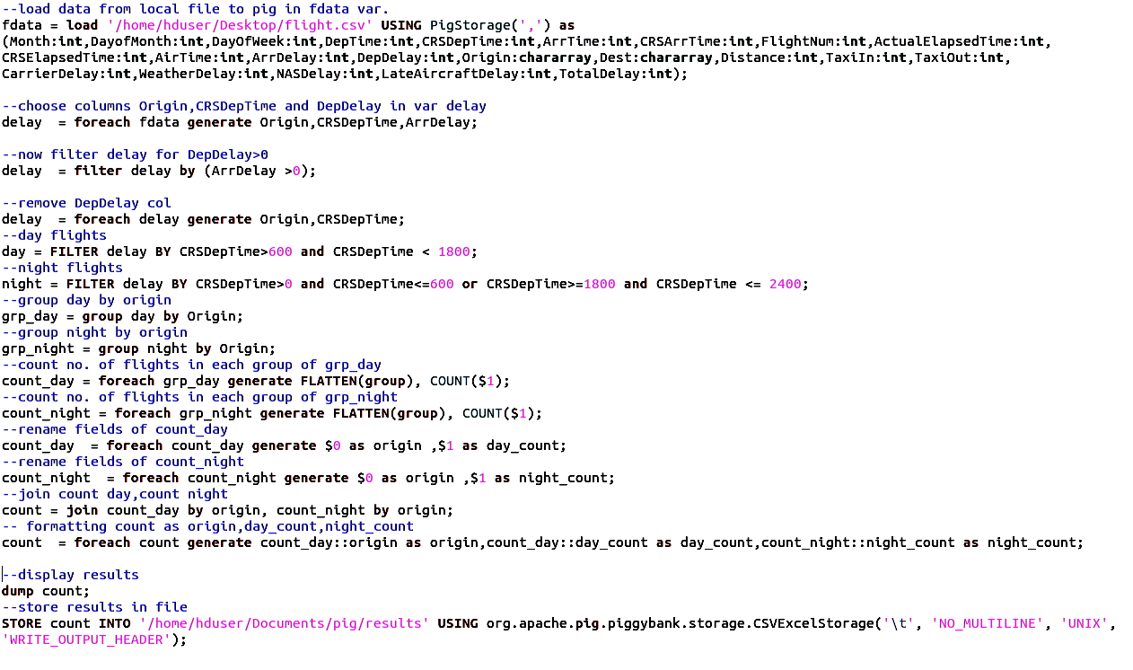
HOW?

Slide 4
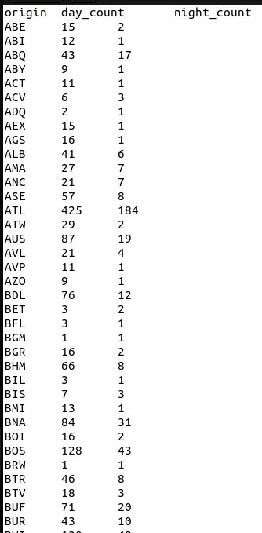
The Results:

Slide 5
Something Interesting?
flights from INDIA :
No. of delays in daytime are 69.
And During Nights are 23.

Slide 6
OBJECTIVE:
To know the number of flights delayed on each day of month

Slide 7
What?
To group the data based on day of month.
Count the number of delays for each day.

Slide 8
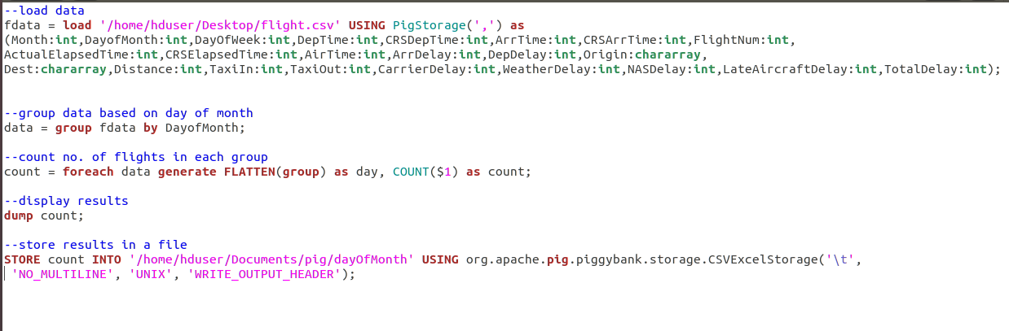
HOW?

Slide 9
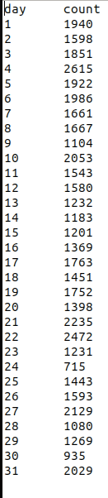
RESULTS:

Slide 10
Something Interesting?
Much more delays were recorded on 31st as compared to 30th .

