Slide 1

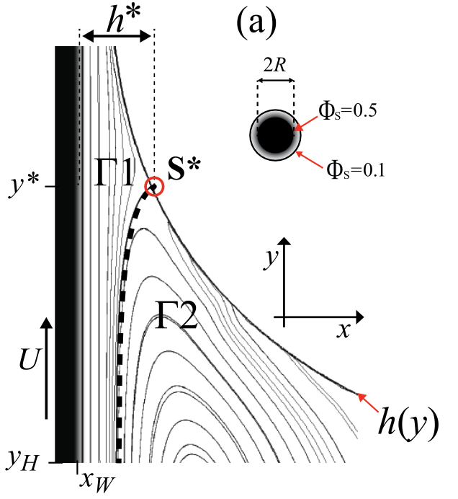
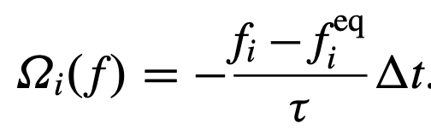
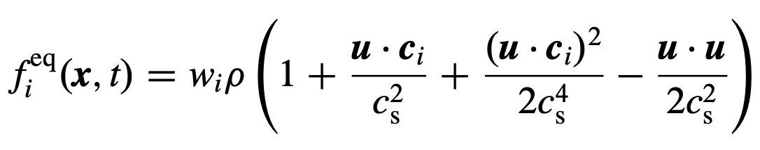

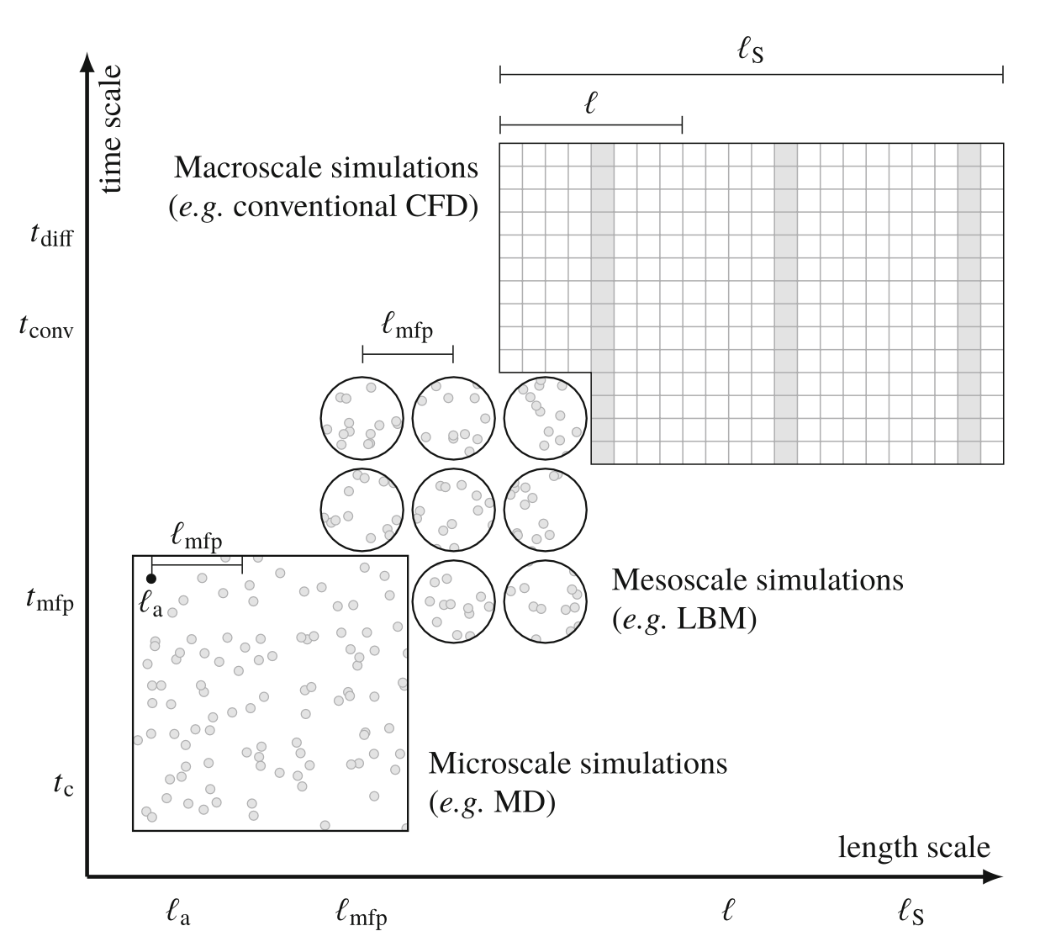
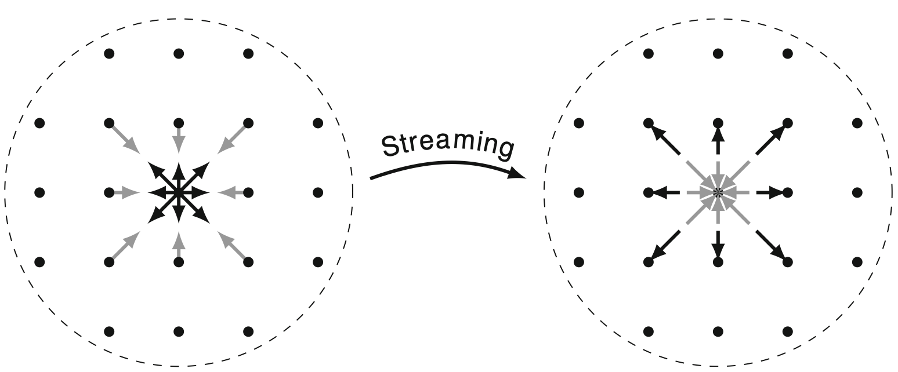
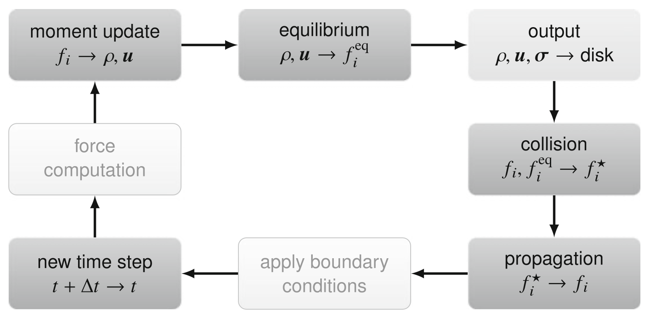
LATTICE BOLTMANN METHOD FOR THE HYDRODYNAMICS OF COLLOIDAL ASSEMBLY IN DIP COATING
Department of Physics, Virginia Tech
Author: Maxwell Tetteh Bessey
INTRODUCTION
GOVERNING EQUATION FOR LBM
OBSERVED STRIPE PATTERNS
The hydrodynamics of colloidal assembly in dip coating has been investigated analytically and numerically using the Lattice Boltzmann Method. Both the analytical result and numerical simulation agreed on the strip pattern formation of the colloids in dip coating, which agrees with experimental results.
LATTICE BOLTZMANN METHOD
A
B
Thanks! Nadir Cihan Kaplan and Danielle Lucero
Carlos E. Colosqui, Jeffrey F. Morris, and Howard A. Stone. “Hydrodynamically Driven Colloidal Assem- bly in Dip Coating”. In: Phys. Rev. Lett. 110 (18 Apr. 2013), p. 188302. doi: 10.1103/PhysRevLett. 110.188302. url: https://link.aps.org/doi/10.1103/PhysRevLett.110.188302
Kruger, T. (2016). Lattice boltzmann method: Principles and practice; Timm Kruger ... et al (1st ed., Vol. 1). SPRINGER.
DEPARTMENT OF PHYSICS
MAILTO: MTTBESSEY@VT.EDU

