Slide 1
LLM Odyssey: A Game-Based Platform for Teaching LLM Engineering Concepts
Priyamvada Tripathi
Tufts Institute for Artificial Intelligence
Tufts University
Work in Progress, Innovative Practice · FIE 2026, Paphos, Cyprus
Notes:
12 minutes. One idea per slide. Token Forge is the reference implementation. Games 2–13 are playable prototypes. Do not claim a measured learning gain. Live site and repository are on the closing slide.

Slide 2
CS graduates get little hands-on
LLM engineering practice.
Practitioners name four competencies that programs do not consistently develop.
Prompt engineering
Retrieval-augmented generation
Fine-tuning
Production deployment
Bommasani et al., 2022. Huyen, Designing Machine Learning Systems, 2022.
Notes:
The gap is practice, not the absence of ML theory. These four competencies frame the curriculum. Do not claim Odyssey has already closed the gap.

Slide 3
Many existing tools focus on individual concepts.
LLM Odyssey integrates them into a scaffolded learning pathway.
What exists
What Odyssey adds
OpenAI Playground
Progressive difficulty
Hugging Face Spaces
Pedagogical scaffolding
Lectures and textbook examples
A path from tokenization to a design brief
Notes:
Odyssey does not replace Playground or Spaces. It sequences decisions from a single mechanism to a constrained design.

Slide 4
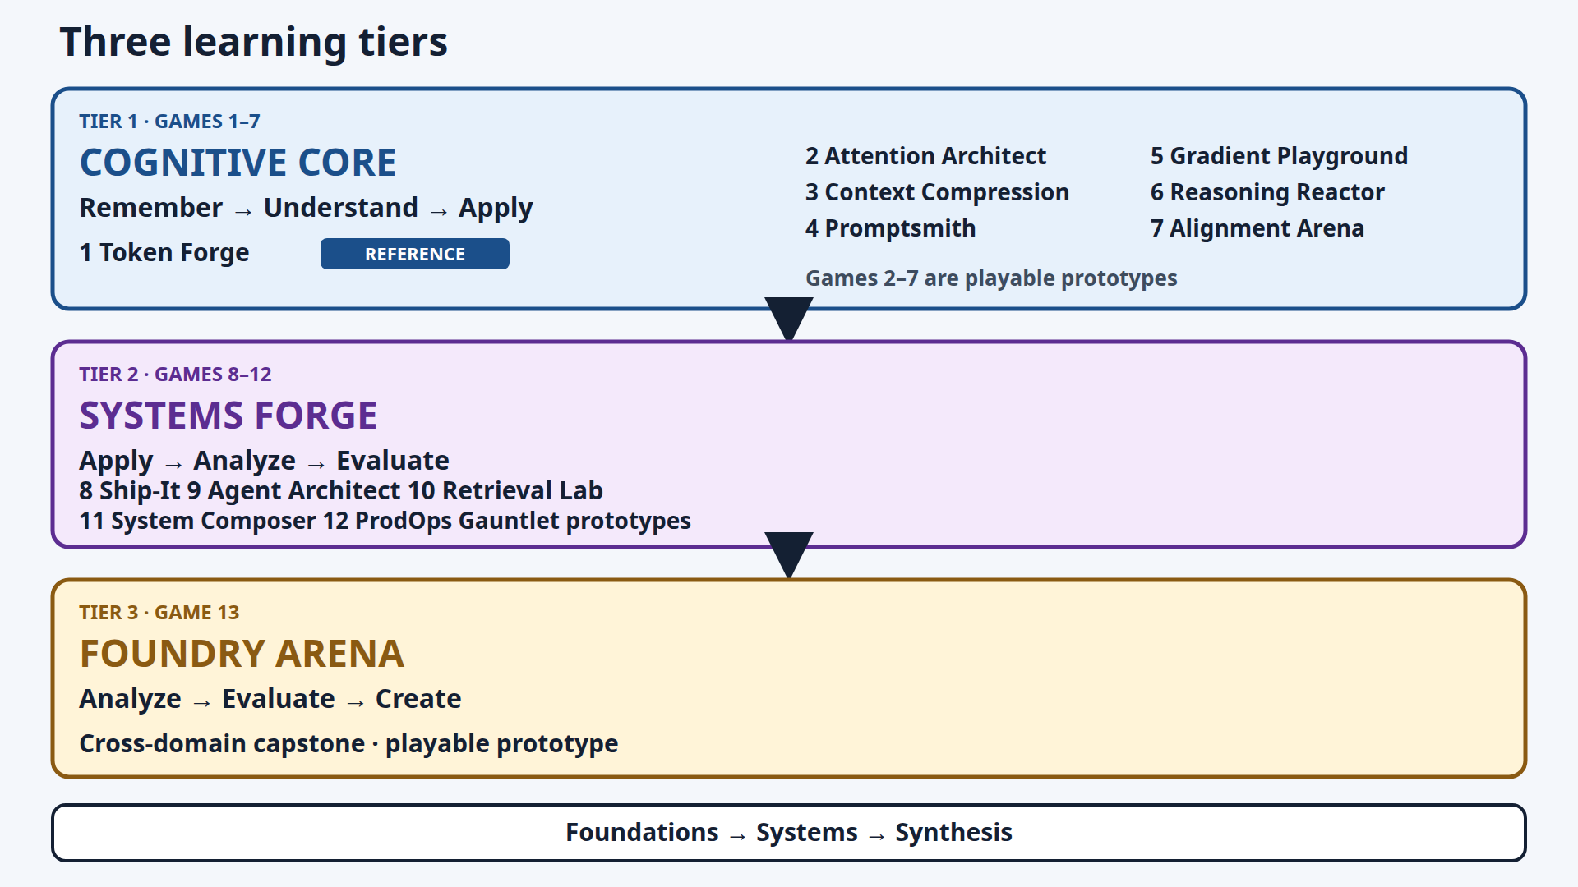
13 games move from foundations to systems to synthesis
Later tiers open at a 70% instructional mastery benchmark. That is not a completion threshold and not professional expertise.
Notes:
Token Forge is the reference implementation. Games 2–13 are playable prototypes. Later tiers open after enough games meet the 70% instructional mastery benchmark. Systems Forge opens after 4 Cognitive Core games. Foundry Arena opens after 3 Systems Forge games. Say: Foundations, then systems, then synthesis.

Slide 5
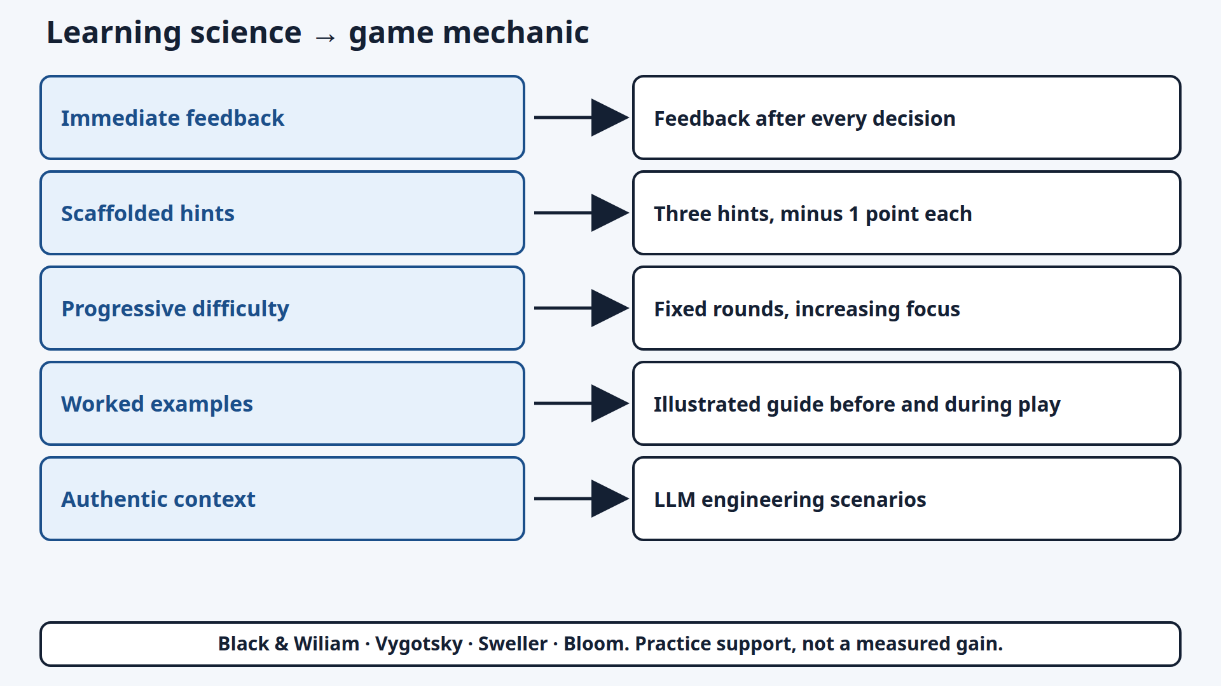
Learning-science principles become game mechanics
Notes:
Five strategies: immediate feedback, scaffolded hints, progressive difficulty, worked examples, authentic context. Sources on the diagram: Black and Wiliam, Vygotsky, Sweller, Bloom. A hint costs one point. The design supports practice. It is not a measured learning gain.

Slide 6
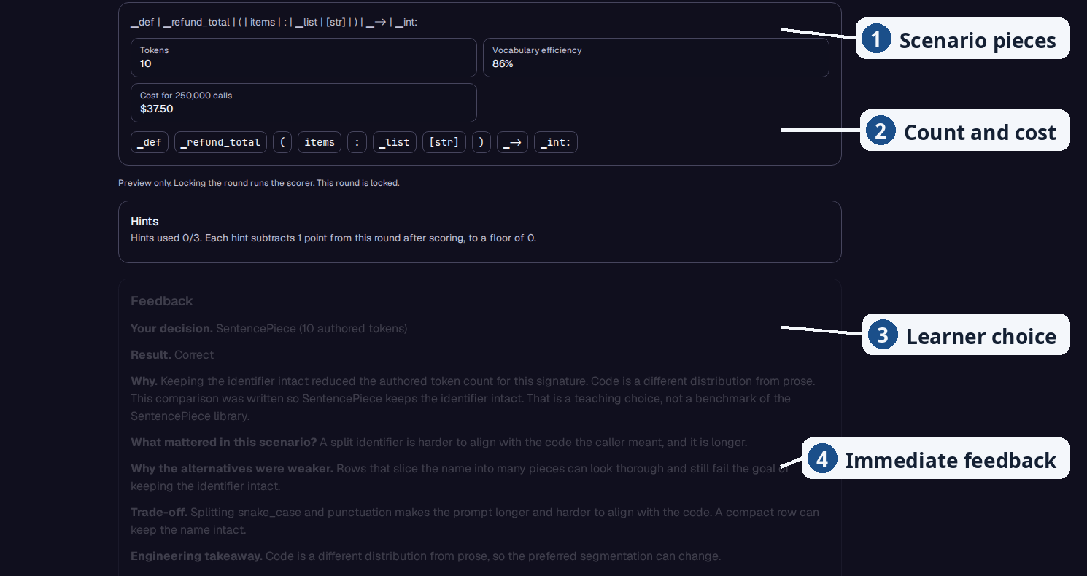
Students make an engineering decision — and immediately see why it mattered
Notes:
Token Forge, one decision, then the reason. Reference implementation. The round uses the shipped signature def refund_total(items: list[str]) -> int:. SentencePiece is selected. The pieces are authored examples. Token count, efficiency, and the exercise cost are arithmetic on those pieces, not a live commercial tokenizer. Callouts: scenario pieces, count and cost, learner choice, immediate feedback. Round score is 10 of 10 with no hint penalty. Research mode is off by default. No paid model API is required.

Slide 7
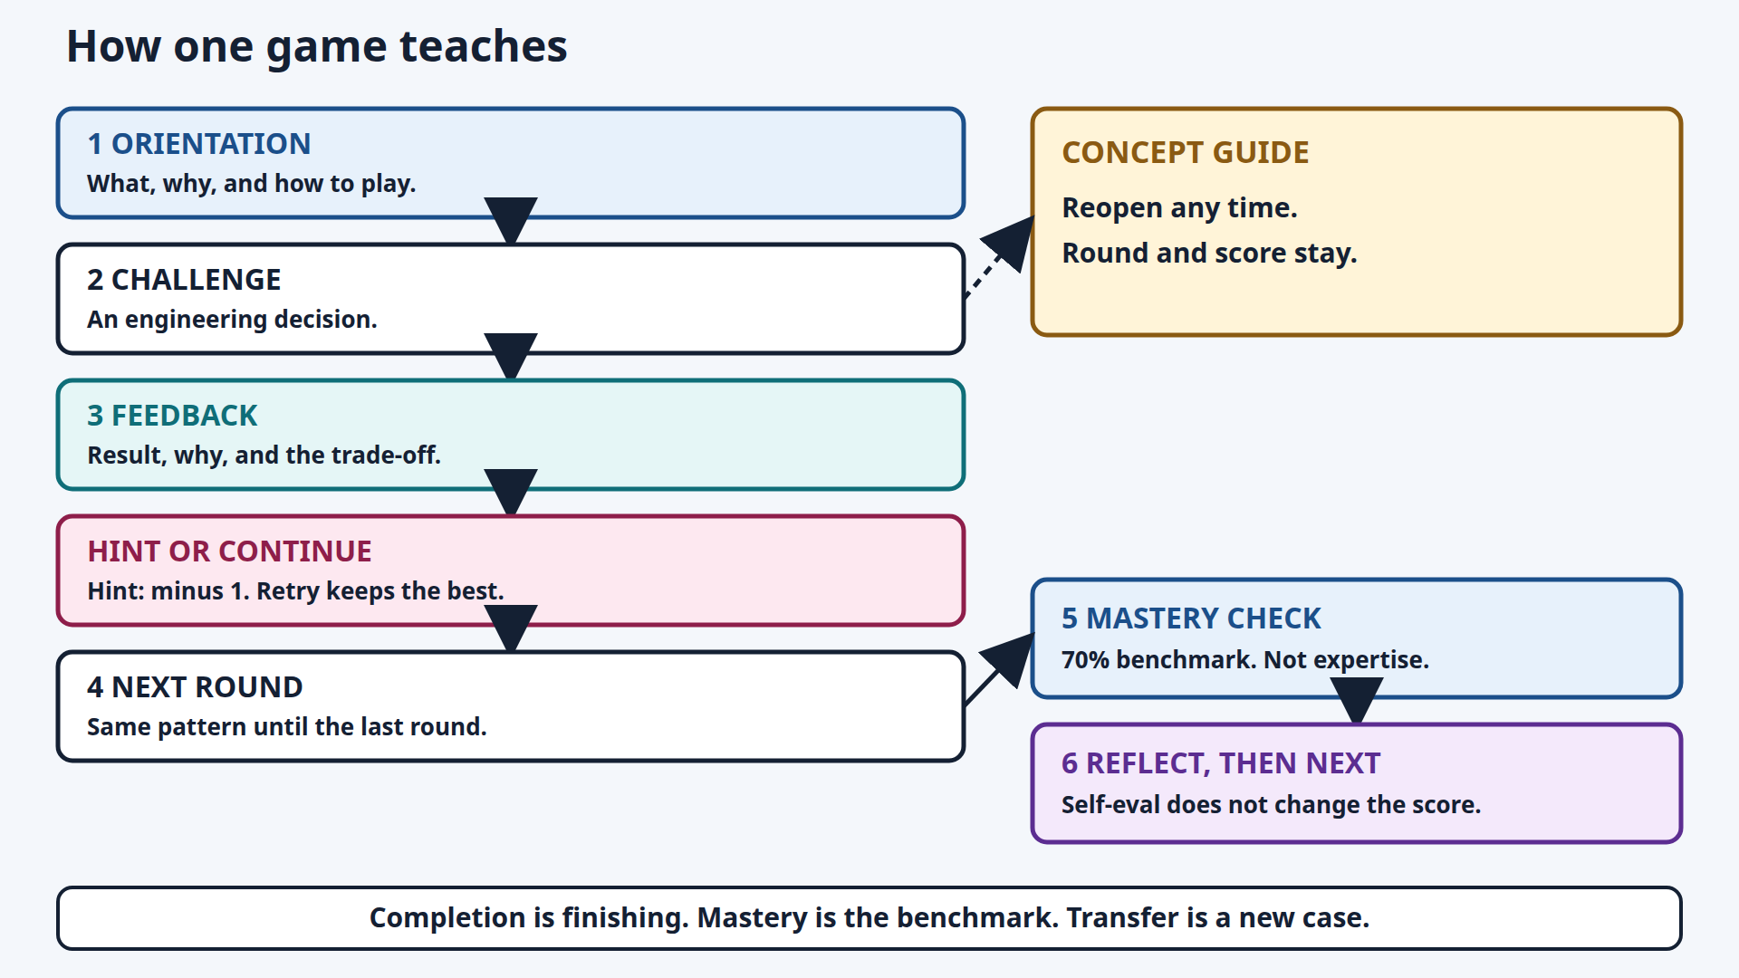
Each game follows the same scaffolded learning cycle
Notes:
Orientation, decision, feedback, hint or continue, next round. The concept guide reopens without resetting the round or the score. Mastery check is the 70% instructional mastery benchmark, not expertise. Self-evaluation does not change the score. Transfer is explaining a new case.

Slide 8
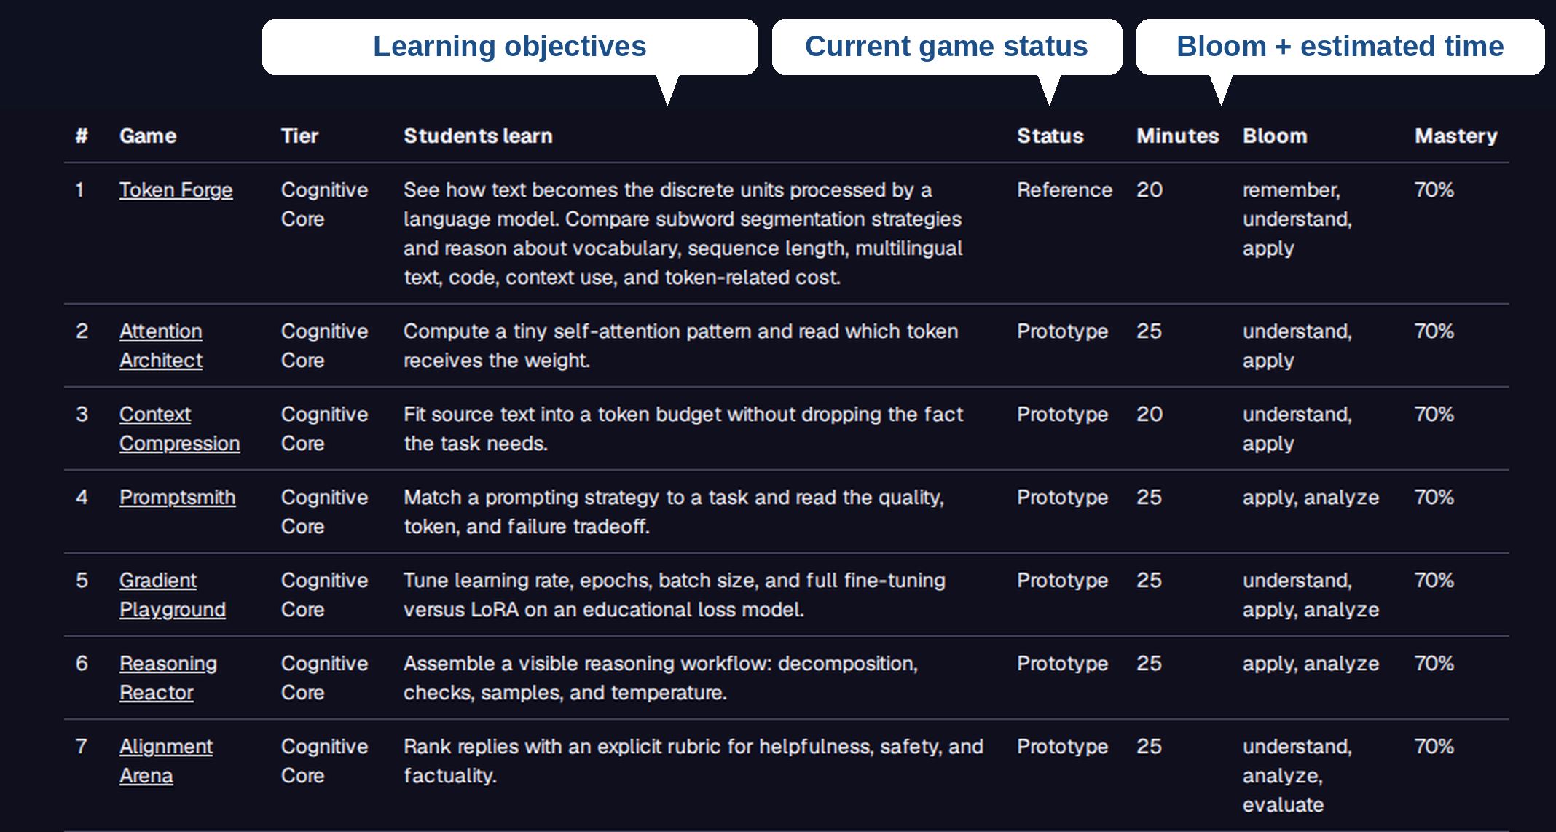
Educators can inspect the instructional design before assigning a game
Notes:
The crop shows what students learn, status, minutes, and Bloom. Token Forge is Reference. The other games shown are playable prototypes. The 70% column is the instructional mastery benchmark, not a completion threshold and not professional expertise. A game title opens the student view. No account and no paid model API are required. Research mode is off unless an educator turns it on.

Slide 9
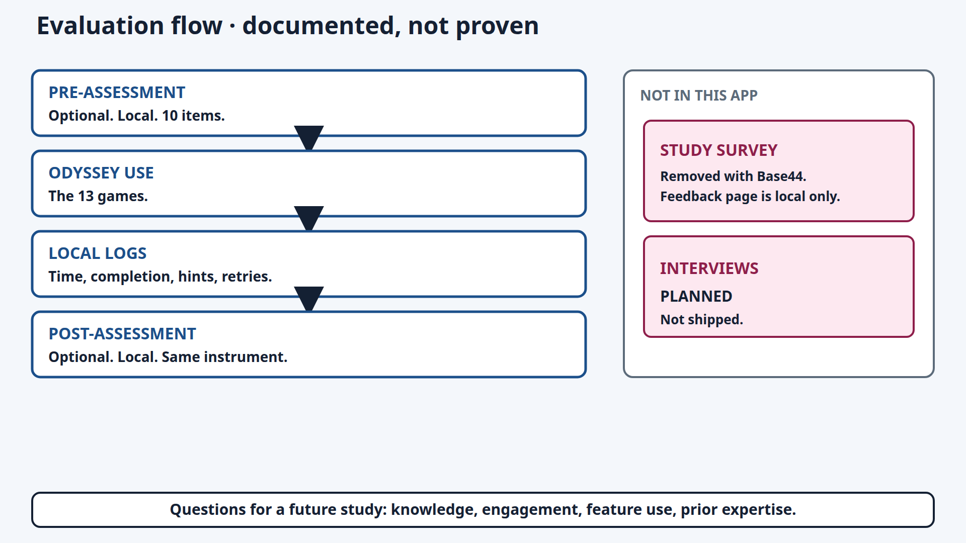
The next question is empirical: does Odyssey improve learning?
Learning effectiveness has not yet been established.
Notes:
This is a documented protocol for a future study. Learning effectiveness is not established. Pre and post are optional local 10-item checks. Logs stay in the browser unless research mode is turned on. Research mode is off by default. The study survey from the original prototype is not in this app. Interviews are planned and not shipped. If asked about faculty review: two reviewers gave feasibility and face-validity feedback during Winter 2026, while the author was at Durham College. That review is not proof of learning. Durham College is not the current affiliation.

Slide 10
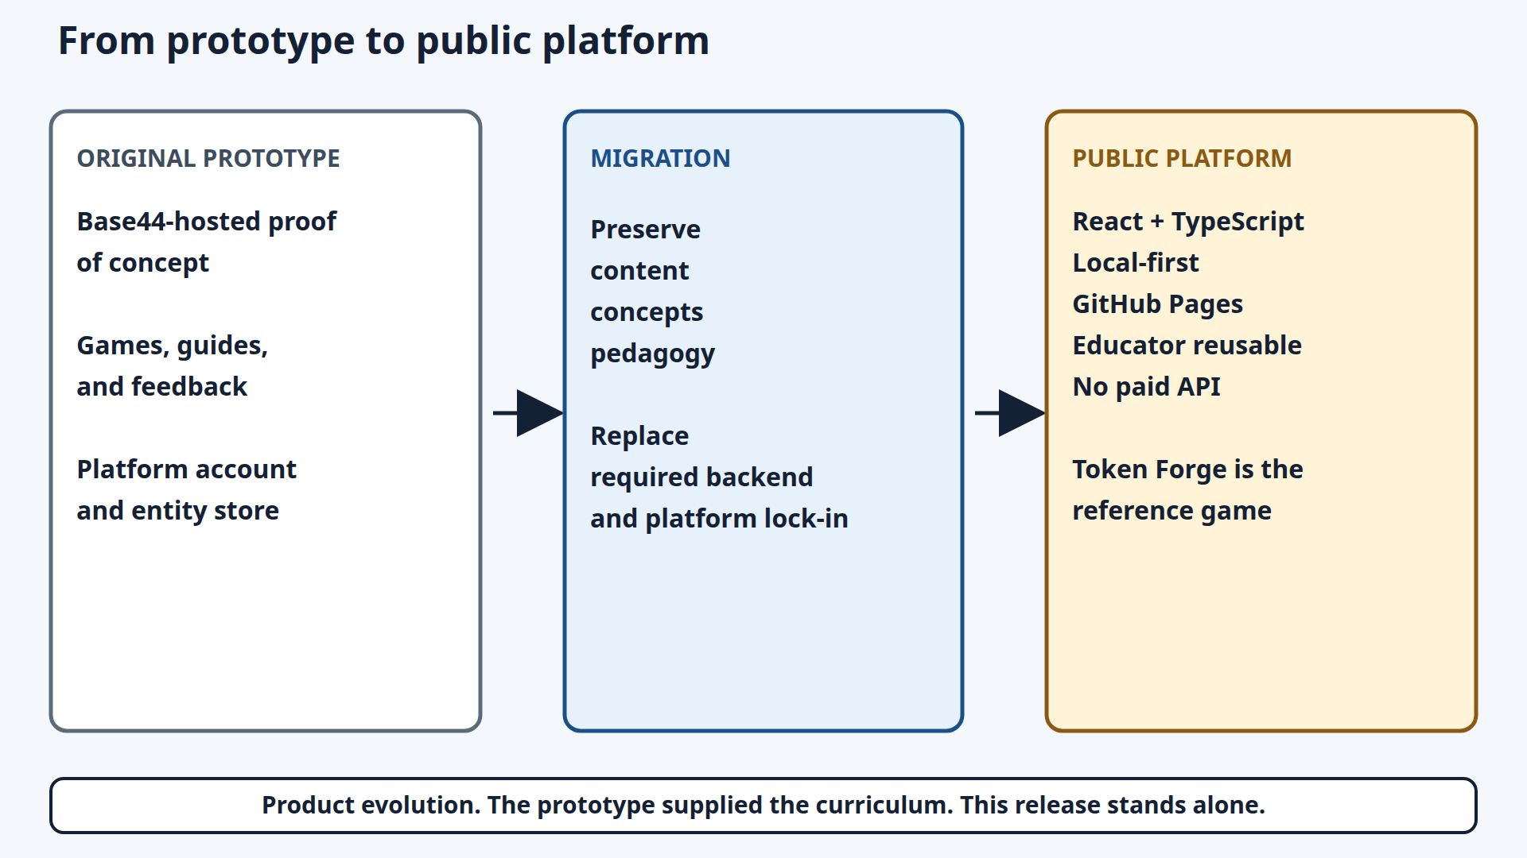
From working prototype to reusable open-source teaching platform
https://piaattufts.github.io/llmodyssey/
https://github.com/piaattufts/llmodyssey
Notes:
Stop the talk on this slide. The prototype supplied the curriculum. This release is React and TypeScript, local-first, on GitHub Pages, with no paid API. Token Forge uses authored, precomputed educational segmentations. No archived Base44 screenshots are in the repository. Contact: pia.tripathi@tufts.edu. Remaining slides are backup.

Slide 11
Backup · Earlier deployment performance targets
< 16 ms
< 100 ms
60 fps
0
interaction response
page load
animations
availability incidents
Game logic runs in the browser, so play does not wait on a server round trip.
From an earlier deployment report. Not a new benchmark of this public release, and not a learning result.
Notes:
Only if asked about speed. Do not present these numbers as evidence that students learned.

Slide 12
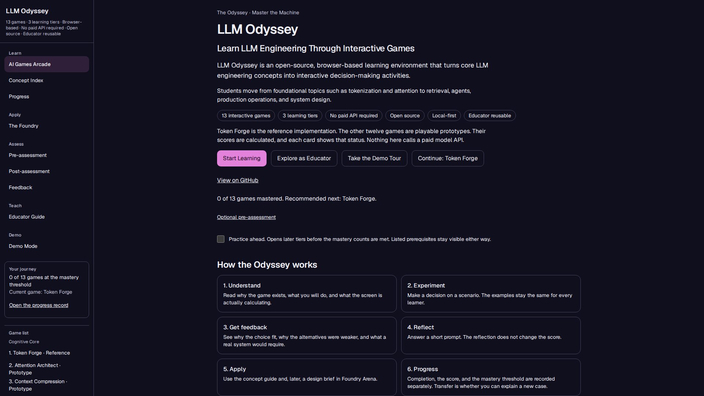
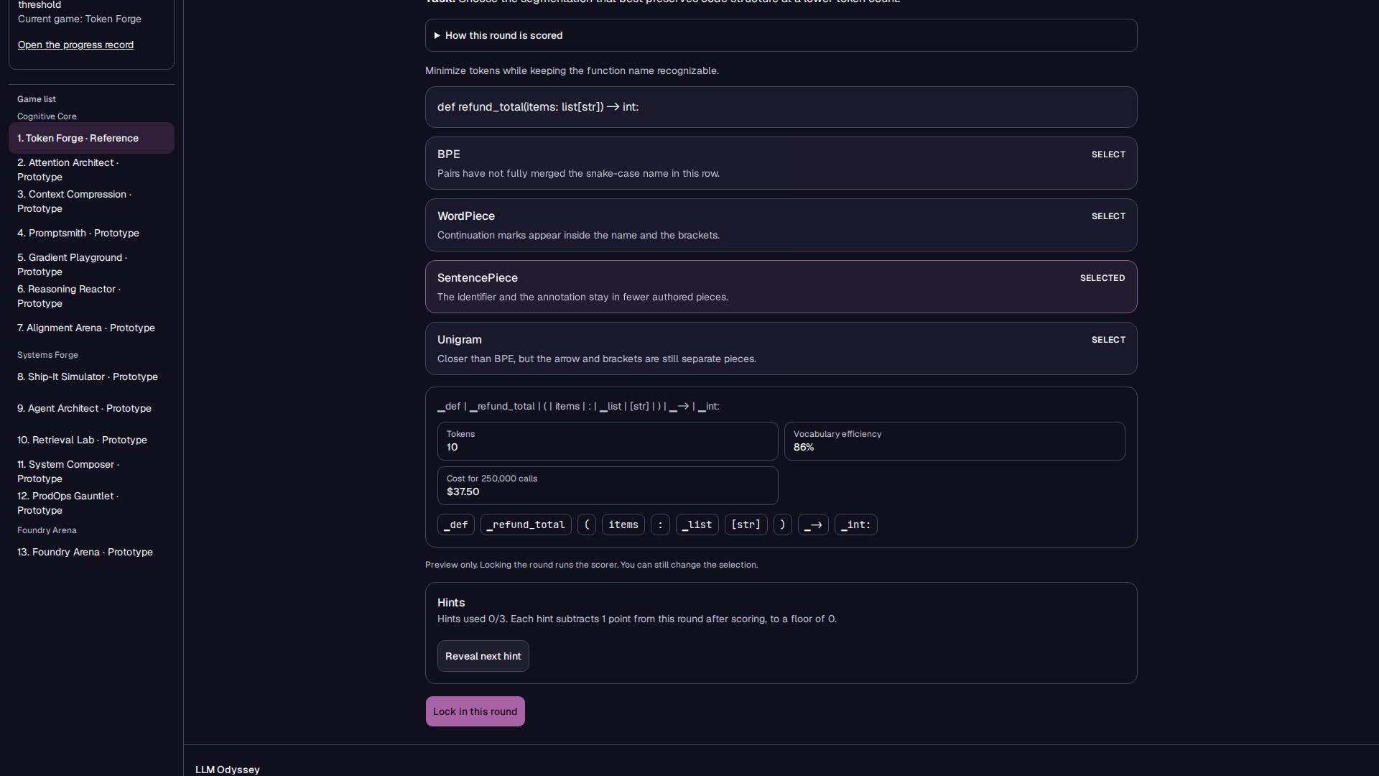
Backup · Current open-source app
Homepage
Token Forge, reference game
13 games · 3 tiers · no paid API required for core gameplay
Notes:
Homepage states 13 games, 3 tiers, and no paid API. Gameplay shows the shipped Python signature and four authored rows. These are the current app, not the original prototype.

Slide 13
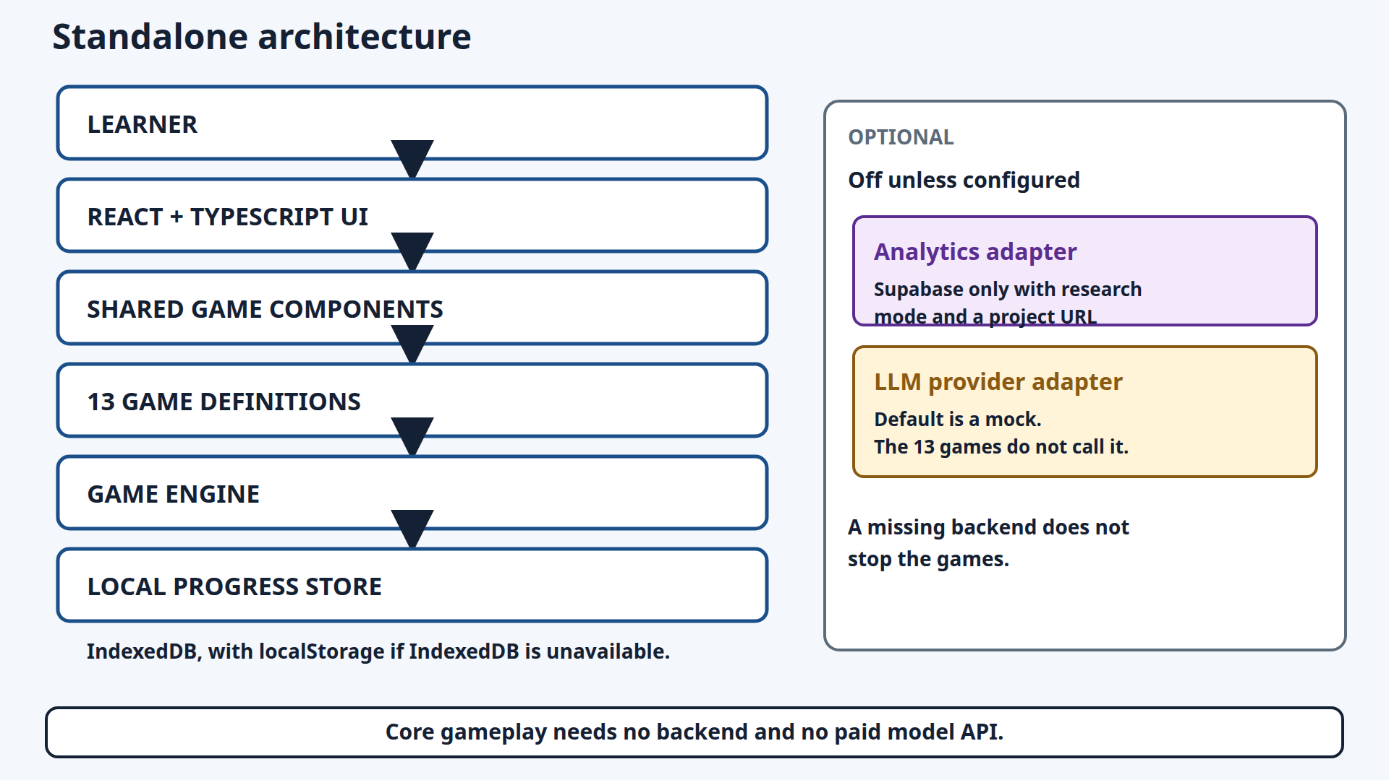
Backup · Core gameplay needs no backend and no paid model API
Notes:
Research mode is off by default. The analytics adapter is unused unless research mode and a project URL are set. The model adapter defaults to a mock. The 13 games do not call it. Token Forge uses authored, precomputed educational segmentations.

Slide 14
Backup · Faculty feasibility feedback, not a learning result
Two faculty reviewers, Winter 2026.
The author was then at Durham College. That is not the current affiliation.
They confirmed the platform runs.
They named adaptive difficulty as the next priority.
This is face-validity feedback. It is not evidence of learning effectiveness.
Notes:
Use only if asked. N=2. Do not generalize to student learning gains. Current affiliation is Tufts.

Slide 15
Backup · Product history, without unlabeled prototype screenshots
Original Base44 screenshots are not in this package. The current app is the public platform.
Notes:
Do not show an unlabeled historical screenshot. No original Base44 captures were archived. The prototype supplied the curriculum. This release stands alone.

