Slide 1
LLM Odyssey
A game-based platform for teaching
LLM engineering concepts
Priyamvada Tripathi
Tufts Institute for Artificial Intelligence
Tufts University
Work in Progress, Innovative Practice
FIE 2026, Paphos, Cyprus
Notes:
12 minutes. One idea per slide. Token Forge is the reference implementation. Games 2–13 are playable prototypes. Do not claim a measured learning gain. Live site: https://piaattufts.github.io/llmodyssey/ Code: https://github.com/piaattufts/llmodyssey

Slide 2
CS graduates get little hands-on
LLM engineering practice.
Practitioners name four competencies that programs do not consistently develop.
Prompt engineering
Retrieval-augmented generation
Fine-tuning
Production deployment
Bommasani et al., 2022. Huyen, Designing Machine Learning Systems, 2022.
Notes:
The gap is practice, not the absence of ML theory. These four competencies are the ones the work-in-progress paper uses to frame the curriculum. Do not claim Odyssey has already closed the gap.

Slide 3
Tools are fragmented.
Odyssey is one scaffolded pathway.
What exists
What Odyssey adds
OpenAI Playground
Progressive difficulty
Hugging Face Spaces
Pedagogical scaffolding
Lectures and textbook examples
A path from tokenization to a design brief
Notes:
Name the fragmentation, then the pathway. Odyssey does not replace Playground or Spaces. It sequences decisions from a single mechanism to a constrained design.

Slide 4
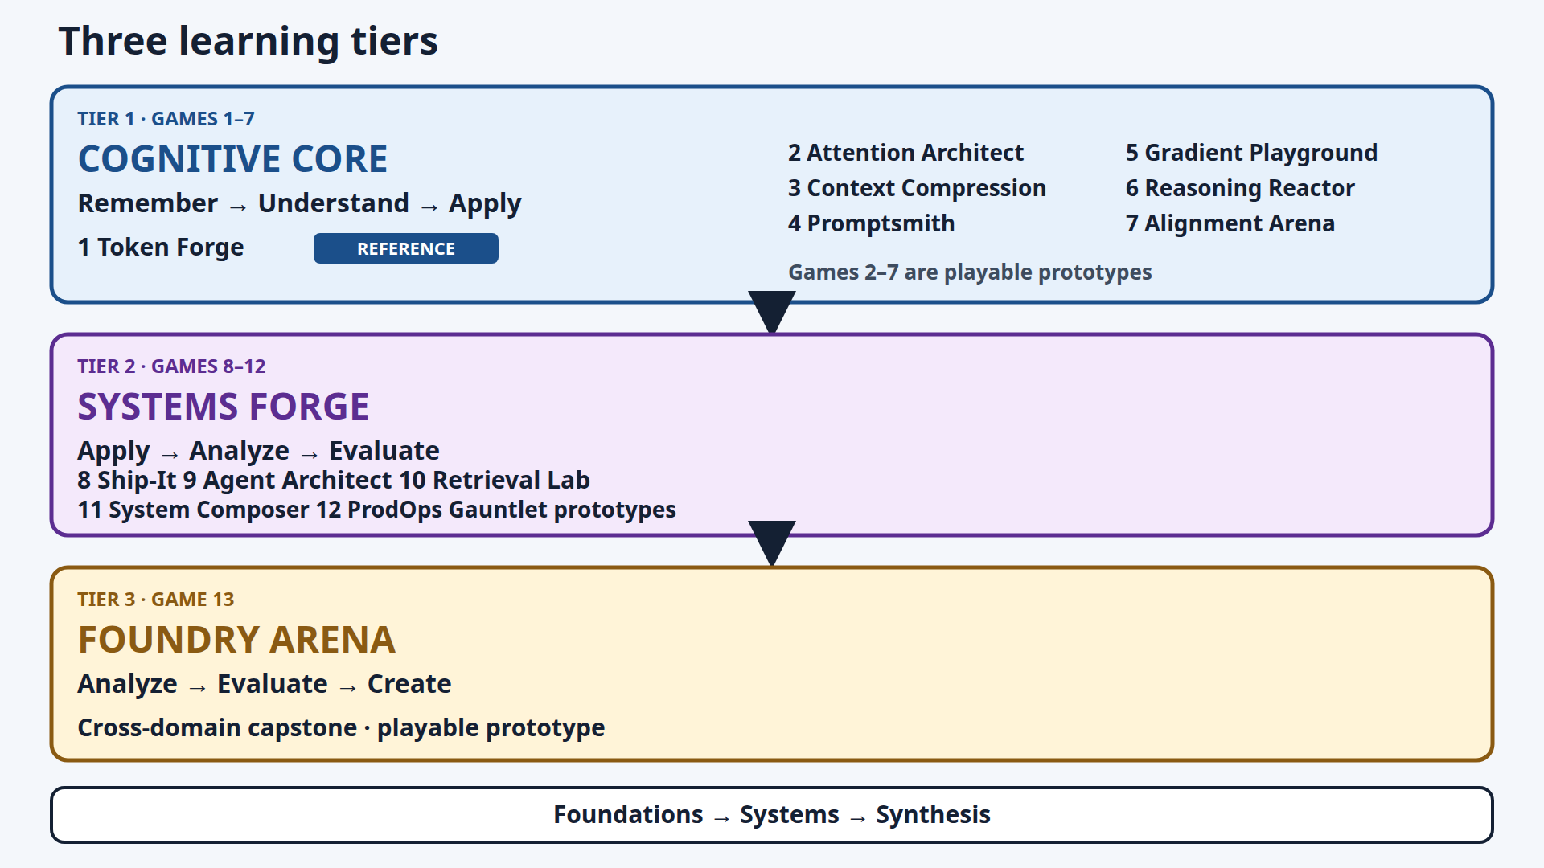
Notes:
Token Forge is the reference implementation. Games 2–13 are playable prototypes. Later tiers open after enough games meet the 70% instructional mastery benchmark. That benchmark is not a completion percentage and not professional expertise. Systems Forge opens after 4 Cognitive Core games. Foundry Arena opens after 3 Systems Forge games. Say: Foundations, then systems, then synthesis.

Slide 5
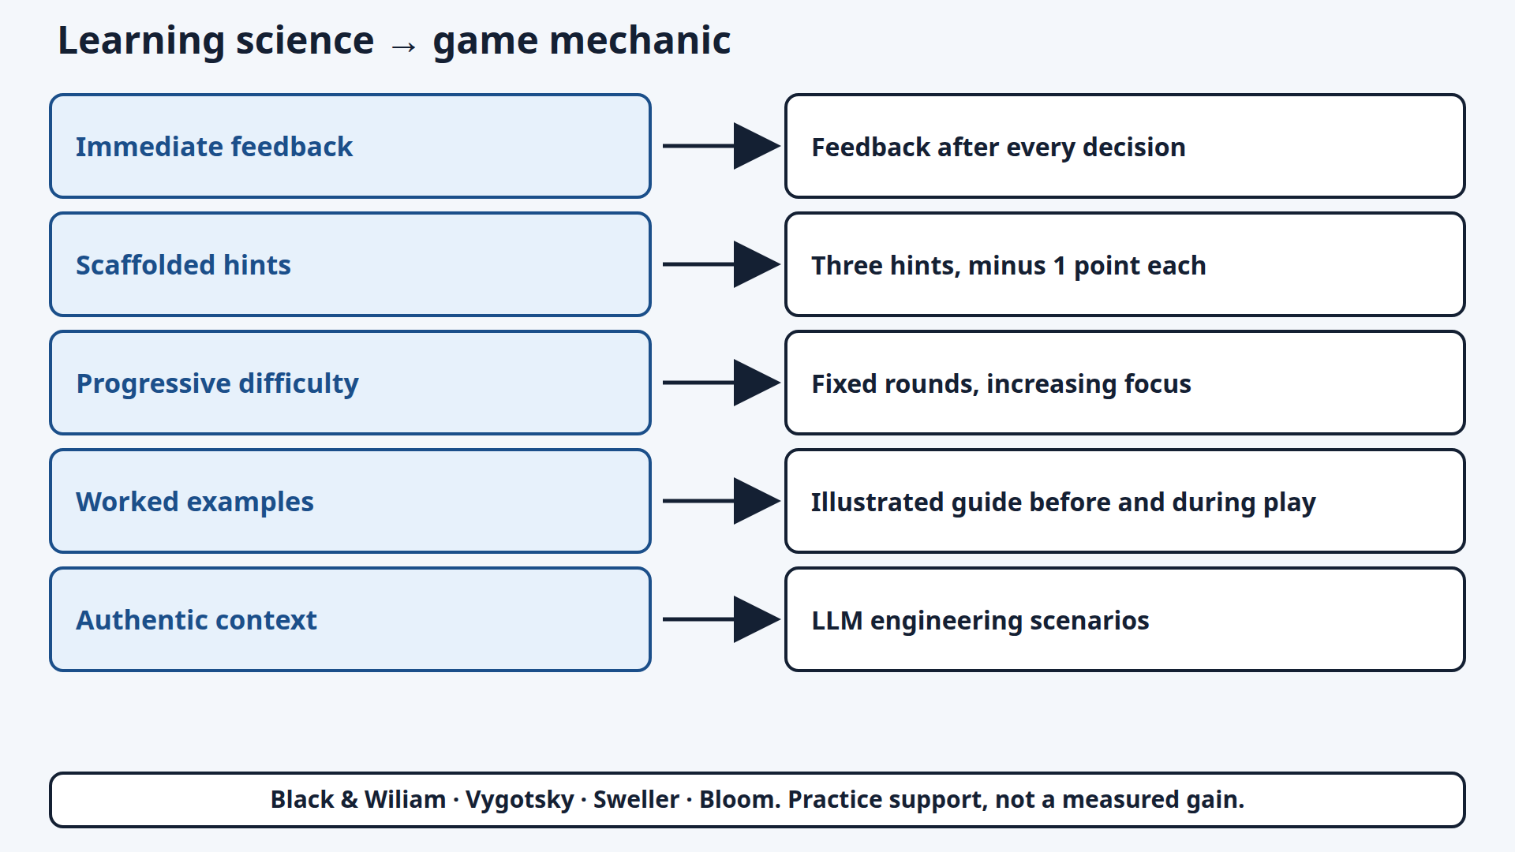
Notes:
Five strategies: immediate feedback, scaffolded hints, progressive difficulty, worked examples, authentic context. Sources on the diagram: Black and Wiliam, Vygotsky, Sweller, Bloom. A hint costs one point. The design supports practice. It is not a measured learning gain.

Slide 6
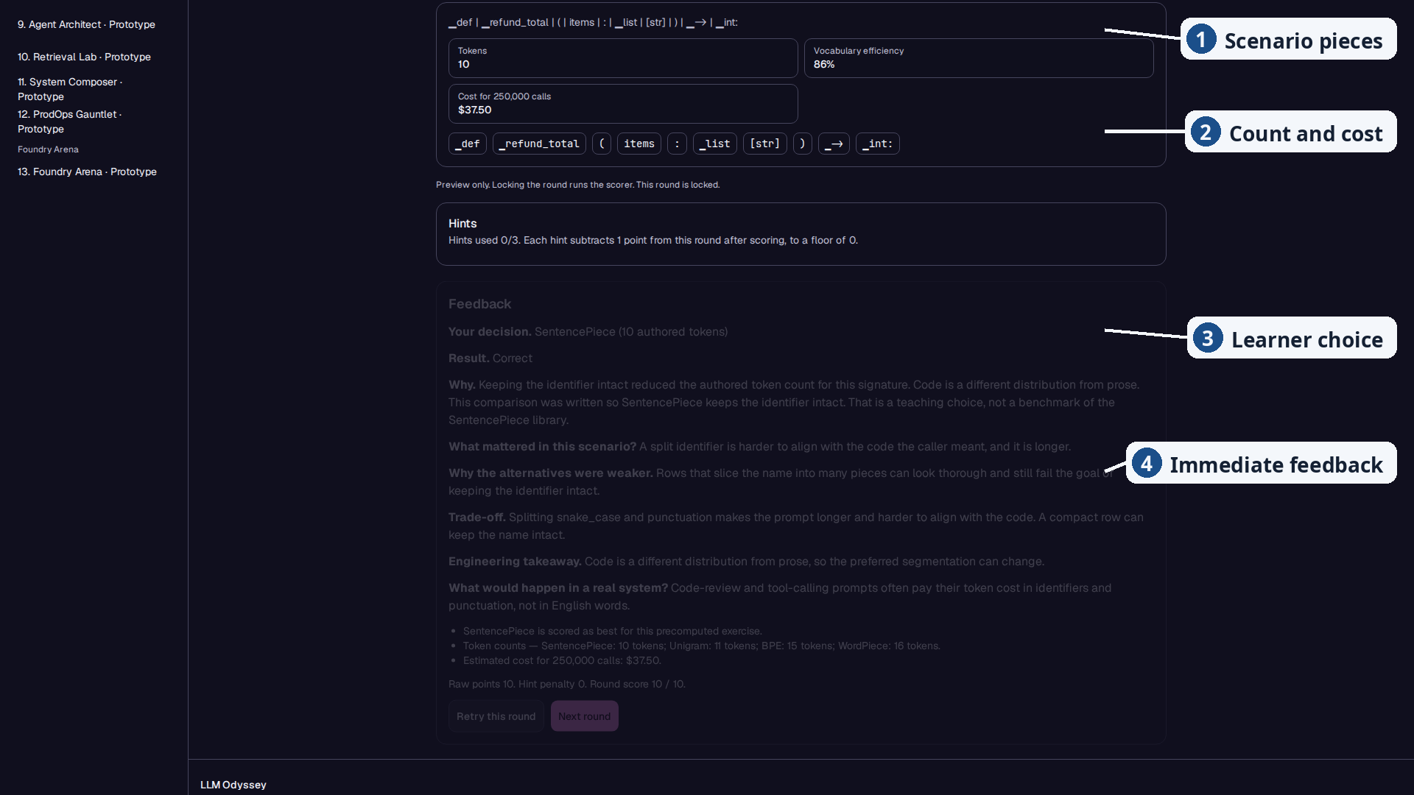
Notes:
Say: Token Forge, one decision, then the reason. Reference implementation. The round uses the shipped signature def refund_total(items: list[str]) -> int:. Do not say import numpy. SentencePiece is selected. The pieces are authored examples. Token count, efficiency, and the exercise cost are arithmetic on those pieces, not a live commercial tokenizer. Callouts, top to bottom: scenario pieces, count and cost, learner choice, immediate feedback. Round score is 10 of 10 with no hint penalty.

Slide 7
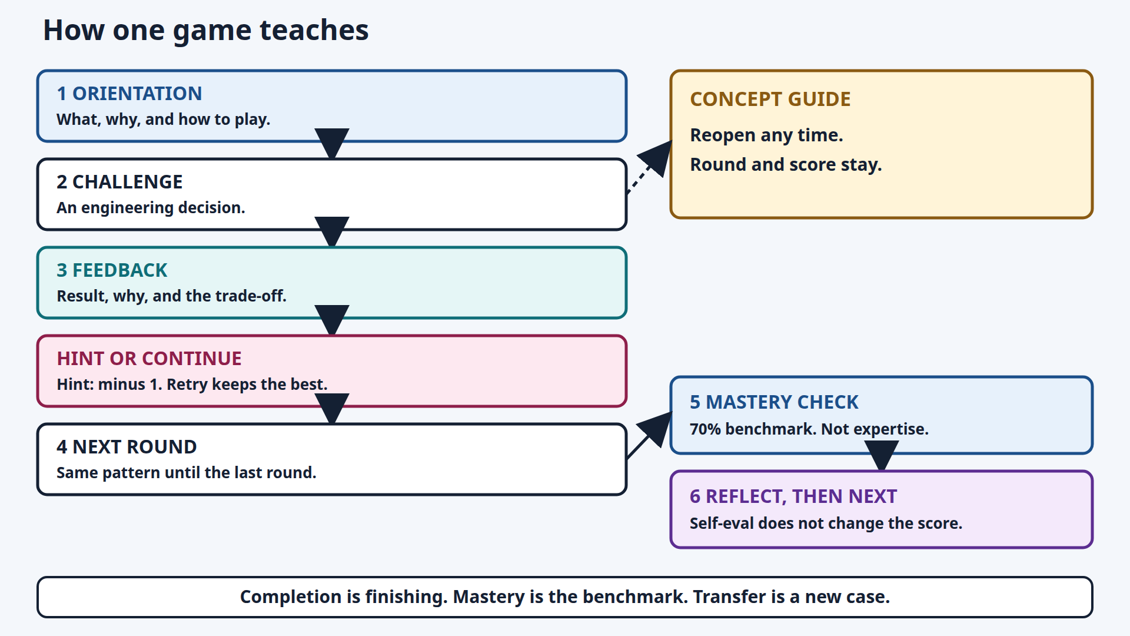
Notes:
Orientation, decision, feedback, hint or continue, next round. The concept guide reopens without resetting the round or the score. Mastery check is the 70% instructional mastery benchmark, not expertise. Self-evaluation does not change the score. Transfer is explaining a new case.

Slide 8
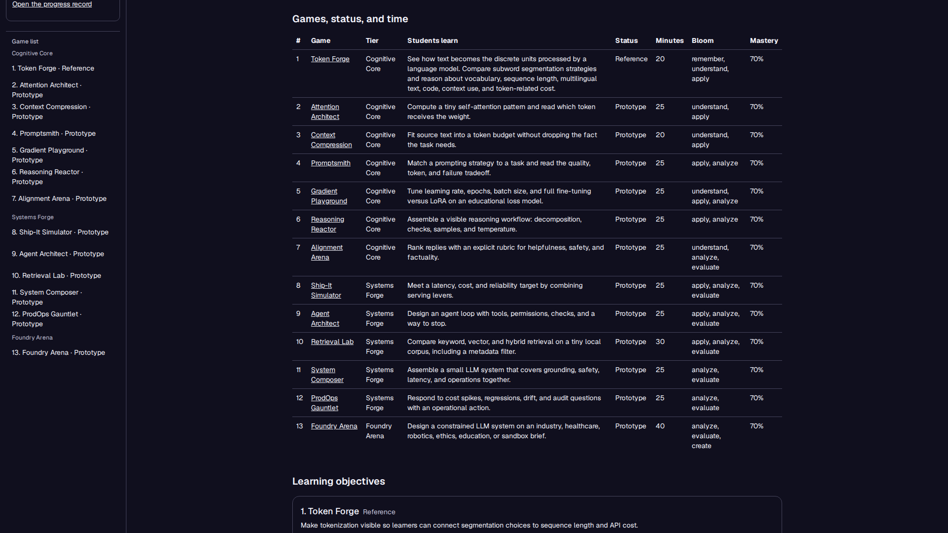
Notes:
Say: Educators can assign from the guide. The table shows the game, tier, what students learn, status, minutes, Bloom level, and the 70% mastery column. Token Forge is Reference. The other twelve are Prototype. There is no button named Preview as Student. A game title opens the student view. No account and no paid model API are required.

Slide 9
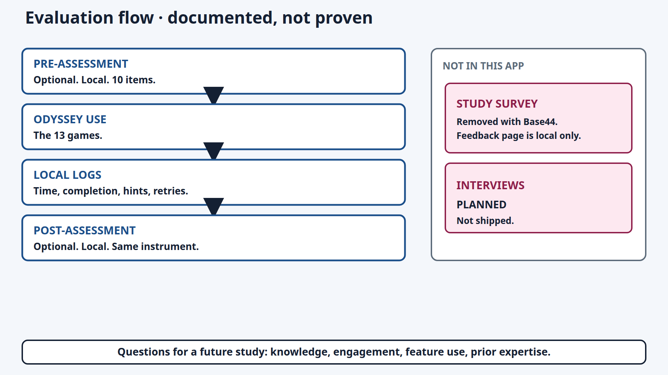
Notes:
This is a documented protocol for a future study. Learning effectiveness is not established. Pre and post are optional local 10-item checks. Logs stay in the browser unless research mode is turned on. The study survey from the original prototype is not in this app. Interviews are planned and not shipped. If asked about faculty review: two reviewers gave feasibility and face-validity feedback during Winter 2026, while the author was at Durham College. That review is not proof of learning. Durham College is not the current affiliation.

Slide 10
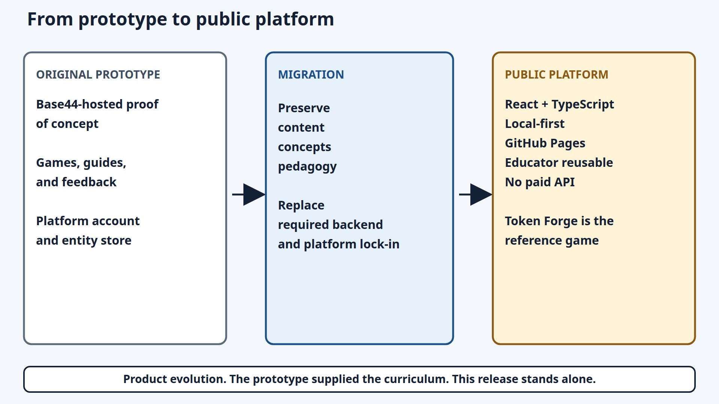
https://piaattufts.github.io/llmodyssey/
https://github.com/piaattufts/llmodyssey
Notes:
Stop the talk on this slide. Product evolution: the prototype supplied the curriculum. This release is React and TypeScript, local-first, on GitHub Pages, with no paid API. No archived Base44 screenshots are in the repository. Contact: pia.tripathi@tufts.edu. Remaining slides are backup.

Slide 11
Backup · Reported deployment targets
< 16 ms
< 100 ms
60 fps
0
interaction response
page load
animations
availability incidents
Game logic runs in the browser, so play does not wait on a server round trip.
From the work-in-progress deployment report. Not a new benchmark of this public release, and not a learning result.
Notes:
Only if asked about speed. Do not present these numbers as evidence that students learned.

Slide 12
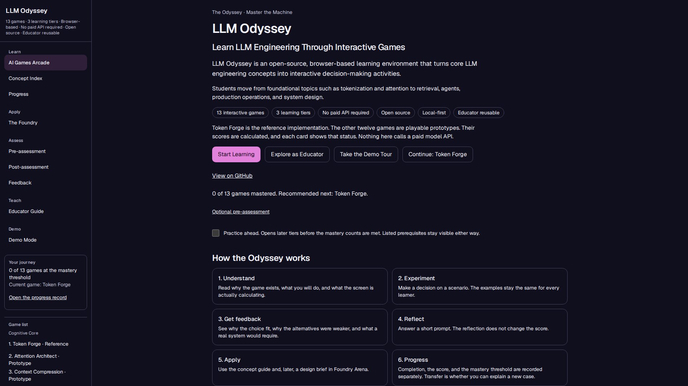
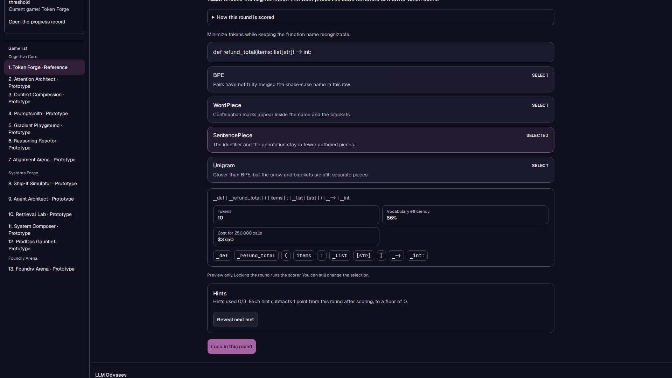
Backup · Homepage and a Token Forge round
Homepage
Reference game, before feedback
Notes:
Homepage states 13 games, 3 tiers, and no paid API. Gameplay shows the shipped Python signature and four authored rows.

Slide 13
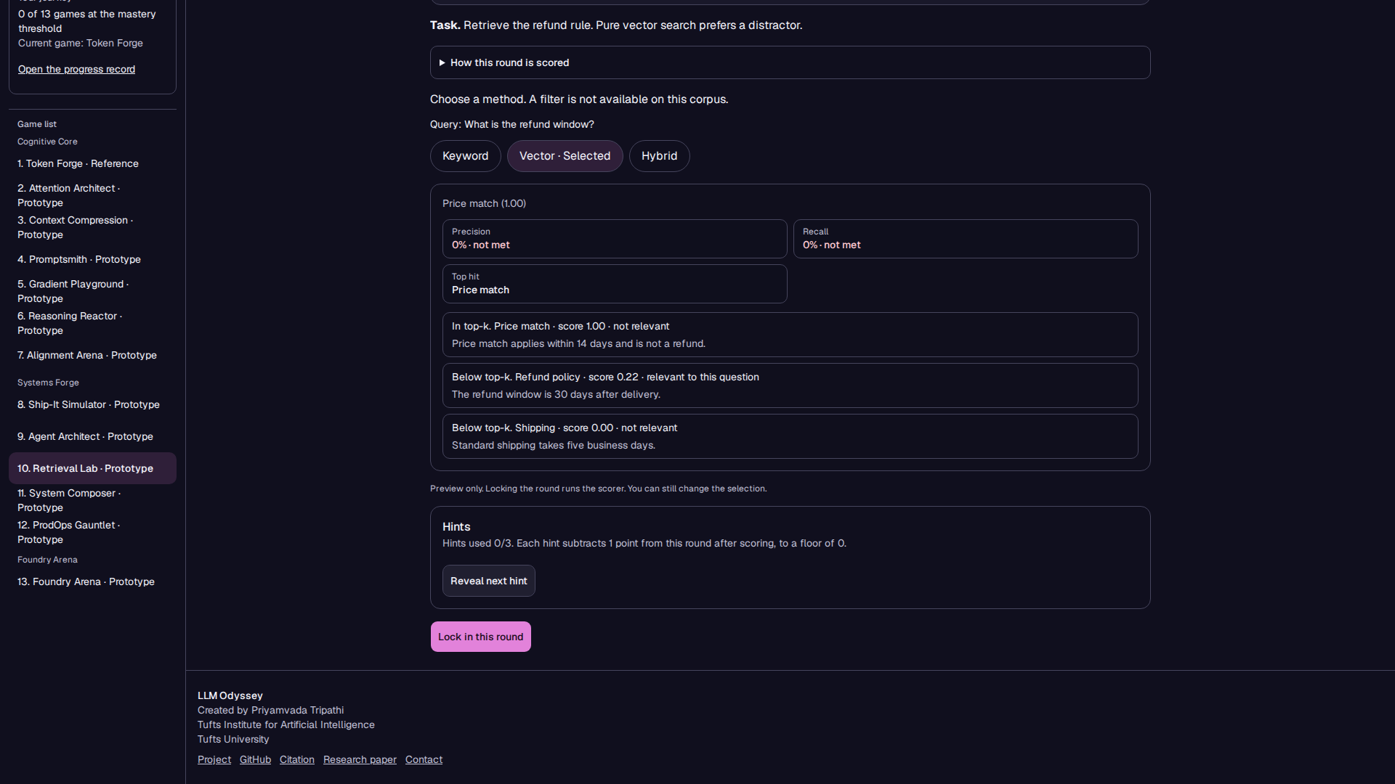
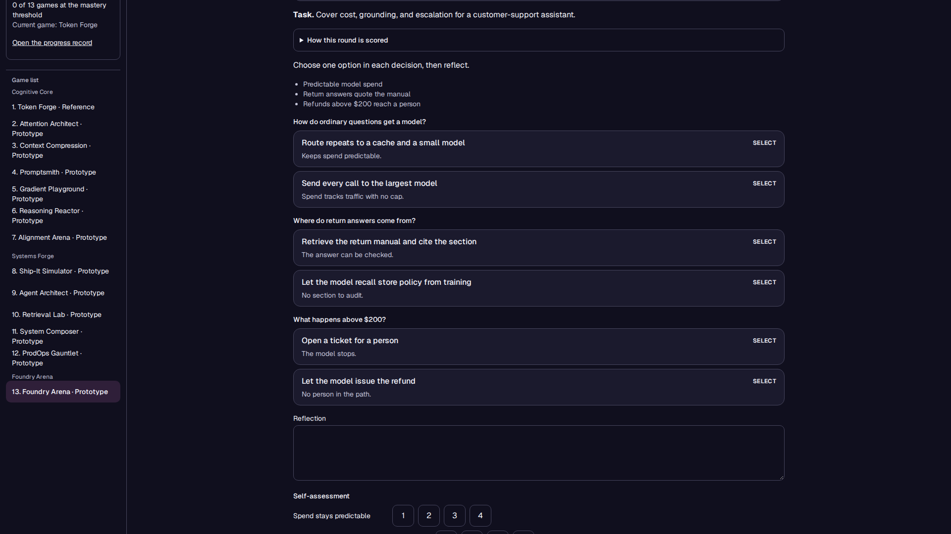
Backup · A prototype game and the capstone
Retrieval Lab, playable prototype
Foundry Arena, playable prototype
Notes:
Retrieval Lab ranks authored chunks. Foundry is a design brief with more than one defensible answer.

Slide 14
Notes:
Same diagram as the closing slide, without the URL bar, if you need the footer sentence: Product evolution. The prototype supplied the curriculum. This release stands alone. No original Base44 screenshots were archived, so none are shown.

Slide 15
Backup · Feasibility feedback, not a learning result
Two faculty reviewers, Winter 2026.
The author was then at Durham College. That is not the current affiliation.
They confirmed the platform runs.
They named adaptive difficulty as the next priority.
This is face-validity feedback. It is not evidence of learning effectiveness.
Notes:
Use only if asked. N=2. Do not generalize to student learning gains. Current affiliation is Tufts.

