Slide 1
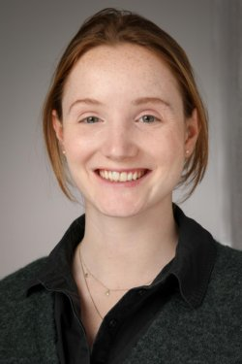












Pia Hildebrandt Software-Development

Slide 2

Pia Hildebrandt Software-Development

Slide 3

Pia Hildebrandt Software-Development

Slide 4

Pia Hildebrandt Software-Development

Slide 5

Projekt 1 anskn dlkajlkfjda jöl afds tech: html, CSS

Slide 6
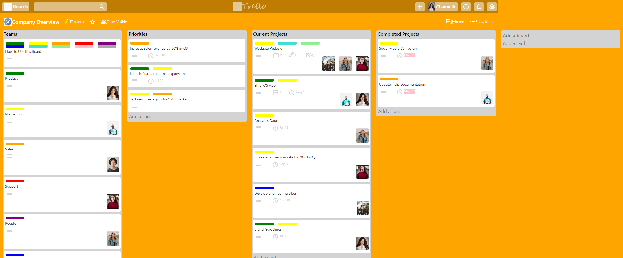
Projekt 2 anskn dlkajlkfjda jöl afds tech: html, CSS

