Slide 1
Do LLM answers change patients' decisions?
Three ways the LLM writes the same answer
Clinical Only
facts only
Direct Empathy
facts, warm and empathic, in one step
Two-Stage
first the facts, then a warm rewrite without new facts
Same LLM (MedGemma 27B), same sources (Insel patient information, guidelines) – only the instruction differs.
Until now
New
– Is the answer clear and empathic?
– Does the answer make patients more or less certain about their therapy decision?
– Would doctors give this answer to a patient?
empathicLLM patient study · lab meeting 28.10.2026
1
Notes:
Pitch in one sentence: we already compare three ways of writing; the new part is that we measure whether the answer changes how certain patients are about their therapy decision, not only whether it sounds empathic.

Slide 2
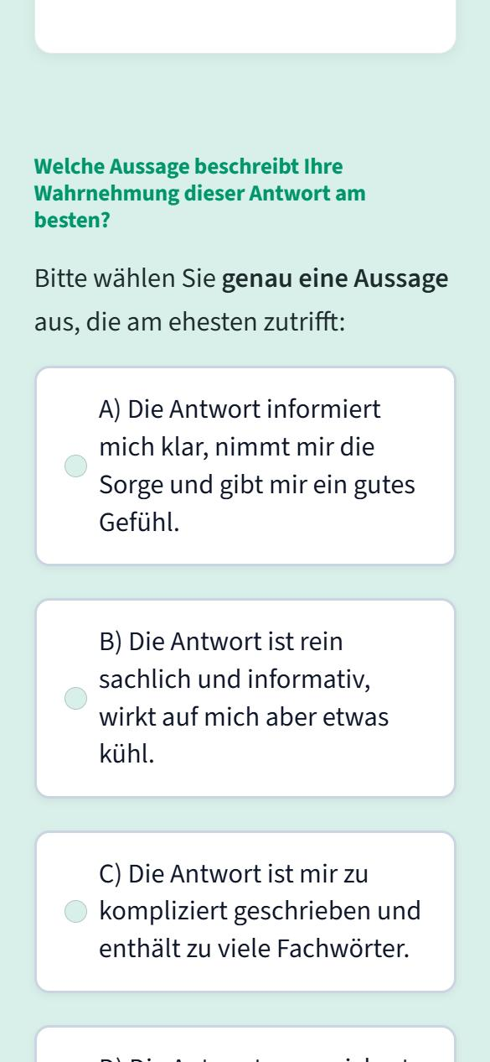
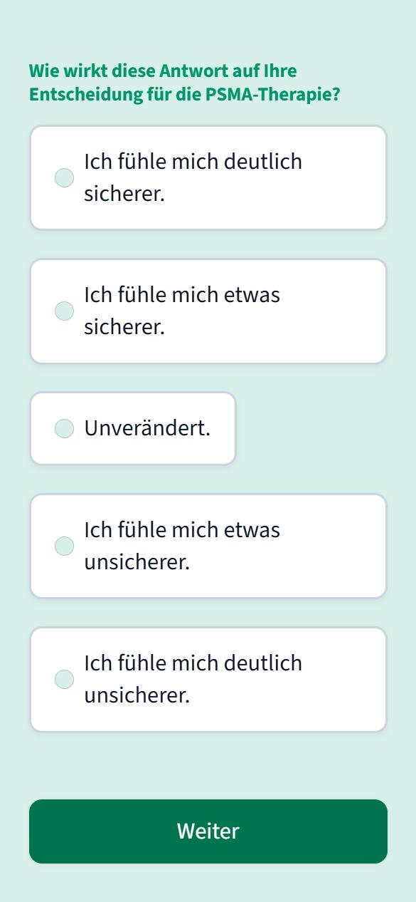
What participants answer
After each of 10 answers
Patients: more certain … less certain about the PSMA therapy (+2 to −2)
Doctors: would you give this answer to a patient – as is / with changes / no
Before and after (patients)
SURE test: 4 yes/no questions on decisional conflict
Main comparison
Do Two-Stage answers make patients more certain than Clinical Only answers?
1 Rating of the answer (A–D)
2 New: effect on the decision
empathicLLM patient study · lab meeting 28.10.2026
2
Notes:
Per answer two questions; the second one is new. Certainty rather than for/against, because many patients are already in therapy. SURE = validated 4-item screening test for decisional conflict (Légaré et al. 2010). Doctors get their own second question.

Slide 3
Plan and what I need
Plan
Questions for you
until 6 Nov medical check of the 60 answers
9–13 Nov test run with colleagues
16 Nov study start
Realistic: 20–30 patients → report as a pilot study; patients and doctors analysed together as a pre-planned extra analysis
1. Is this the decision outcome you had in mind?
2. May we inform the ethics committee about the added decision questions?
3. Who is the second doctor for the medical check?
empathicLLM patient study · lab meeting 28.10.2026
3
Notes:
No new answers and no new medical check are needed: the decision question is added to the same 60 answers. Dosimetry was dropped as an example because it is hardly done at Insel.

